Slide 1



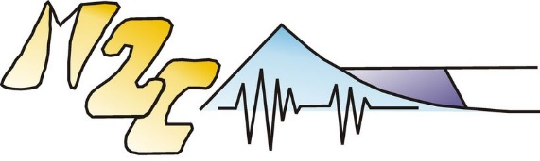
Link between molards and permafrost degradation: an experimental study
Meven Philippe*¹, Liza Jabbour², Maxime Leguen³, Susan J. Conway¹, Marianne Font-Ertlen⁴, Costanza Morino⁵
¹Laboratoire de Planétologie et Géodynamique, CNRS UMR 6112, Université de Nantes, France
²Université Paris 1 Panthéon-Sorbonne, 12 Place du Panthéon, 75231 Paris
³Université Caen Normandie (UNICAEN), 14000 Caen, France
⁴Université Caen Normandie (UNICAEN), CNRS UMR 6143 M2C, 14000 Caen, France
⁵Laboratoire Environnements Dynamiques et Territoires de la Montagne, CNRS UMR 5204, Université Savoie-Mont Blanc, Le Bourget-du-Lac, France
*Corresponding author: philippe.meven@gmail.com
Meven PHILIPPE – vEGU2021 session CR5.4

Slide 2
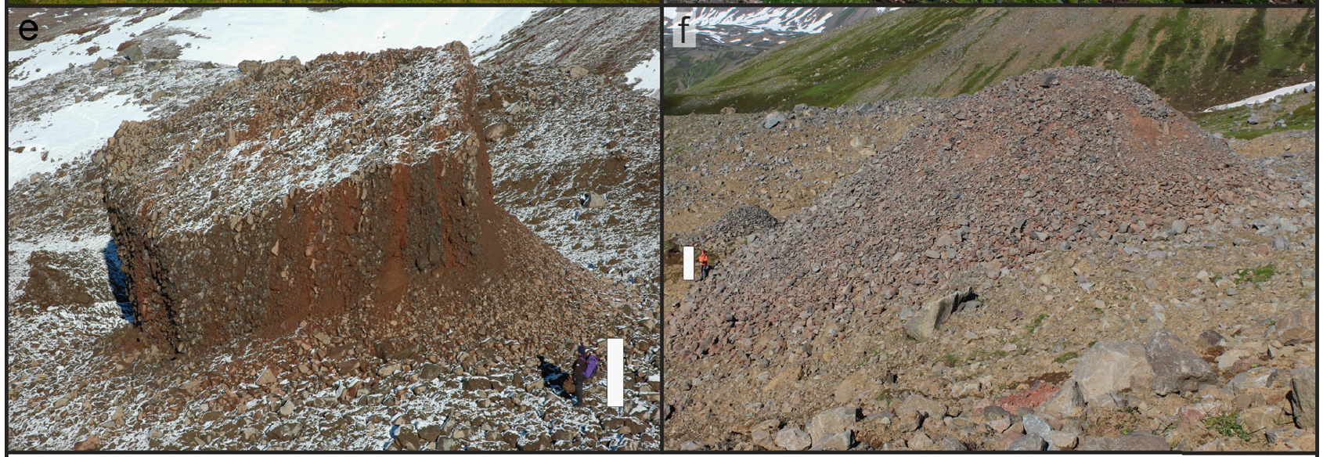
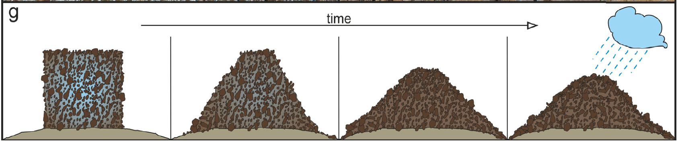
Background
Method
Preliminary results
Future work
a
Molards are defined as:
Cones of loose debris found in landslide deposits in periglacial areas (~ 50 cm to 15 m high), potentially underwater in case of coastal landslides
Remnants of ice-cemented blocks of sediment that moved within a landslide and degraded
They imply involvement of both ice-cemented and non ice-cemented material in the landslide → presence of discontinuous permafrost at the detachment zone
b
Figure 1: evolution from (a) an initial ice-cemented block of sediment to (b) a molard (from Morino et al., 2019).
Figure 2: schematic diagram of the degradation from an initial ice-cemented block of sediment to a molard (from Morino et al., 2019).
Meven PHILIPPE – vEGU2021 session CR5.4
1

Slide 3
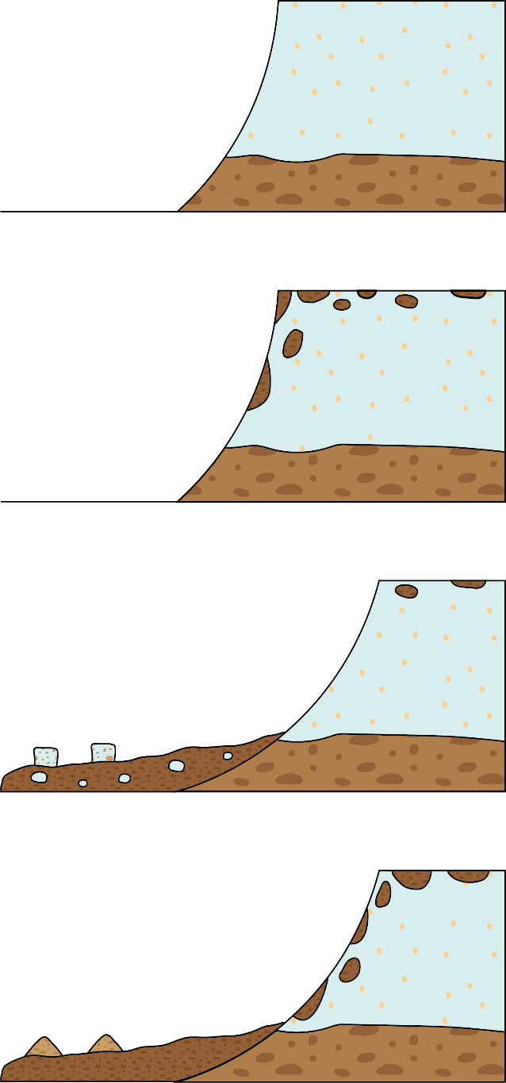
Background
Method
Preliminary results
Future work
a
Increasing temperatures can cause permafrost degradation…
…which in turn causes slope instability → threat for local populations
  Identify zones of discontinuous permafrost can allow us to:
    Protect populations from future natural hazards
    Better understand state & evolution of permafrost
MAAT < 0°C
b
MAAT > 0°C
time
c
MAAT > 0°C
d
Figure 3: a. cliff constituted of ice saturated permafrost ground (MAAT: Mean Annual Air Temperature); b. formation of patches of discontinuous permafrost as temperature increases; c. landslide involving discontinuous permafrost, leaving ice-cemented blocks in the deposits; d. formation of new patches of discontinuous permafrost, degradation from ice-cemented blocks to molards in the landslide deposits.
MAAT > 0°C
Meven PHILIPPE – vEGU2021 session CR5.4
2

Slide 4
Background
Method
Preliminary results
Future work
Increasing temperatures can cause permafrost degradation…
…which in turn causes slope instability → threat for local populations
  Identify zones of discontinuous permafrost can allow us to:
    Protect populations from future natural hazards
    Better understand state & evolution of permafrost
  Molards are markers of these zones of discontinuous permafrost, so we have to better understand these morphologies
Analogue experiments
allow a controlled and systematic study of the process
What is the range of properties (ice content, grain size…) that allows molard formation?
What are the sub-processes at work during degradation?
How can molards be distinguished from other similar landforms (e.g. hummocks or ice-cored moraines)?
Meven PHILIPPE – vEGU2021 session CR5.4
3

Slide 5
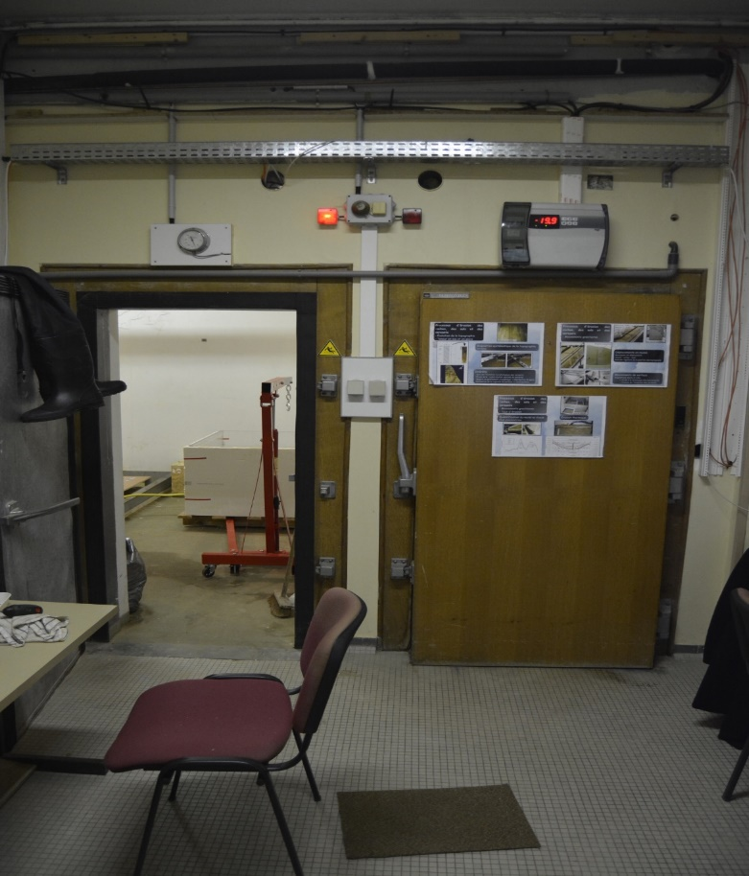
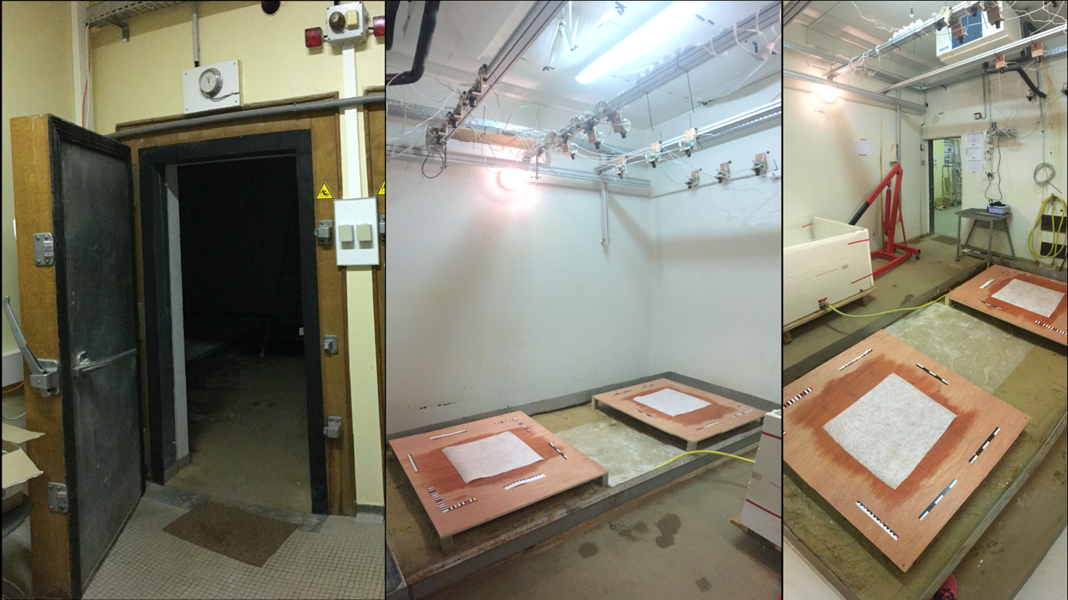
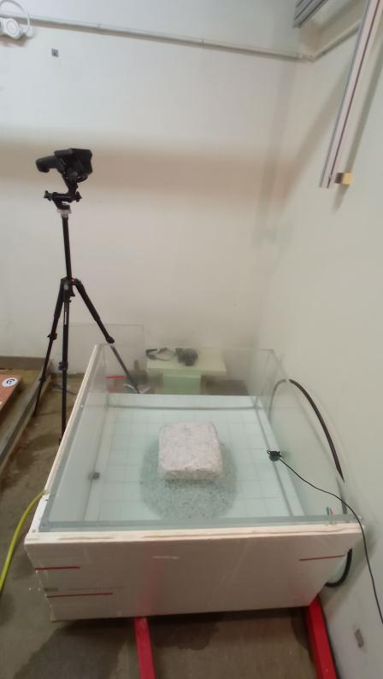
Background
Method
Preliminary results
Future work
We work in two cold rooms at the M2C in Caen (France), that allow near-field-scale simulations
thawing room
freezing room
geotextile sheets
water tank
drainage boards
Figure 4: a. the two cold rooms entrances; b. the interior of the thawing room with the two drainage boards (for aerial experiments); c. the water tank (for submerged experiments).
Meven PHILIPPE – vEGU2021 session CR5.4
4

Slide 6
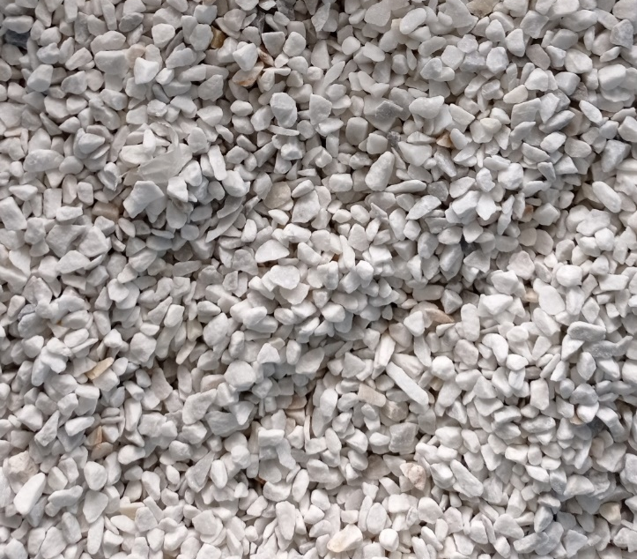
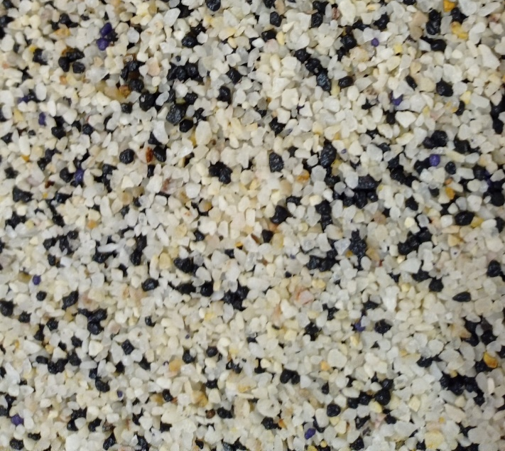
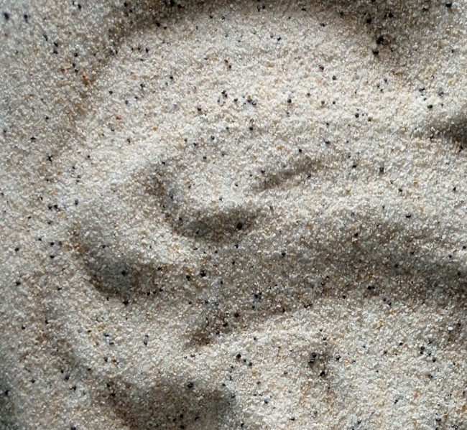
Background
Method
Preliminary results
Future work
We work in two cold rooms at the M2C in Caen (France), that allow near-field-scale simulations
Experimental protocol:
    Fill 30-cm cubic moulds with sediment - 3 grain sizes:
      Gravel (4-8 mm)
      Coarse sand (2-4 mm)
      Fine sand (< 1.2 mm)
1
Meven PHILIPPE – vEGU2021 session CR5.4
5

Slide 7
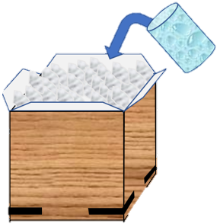
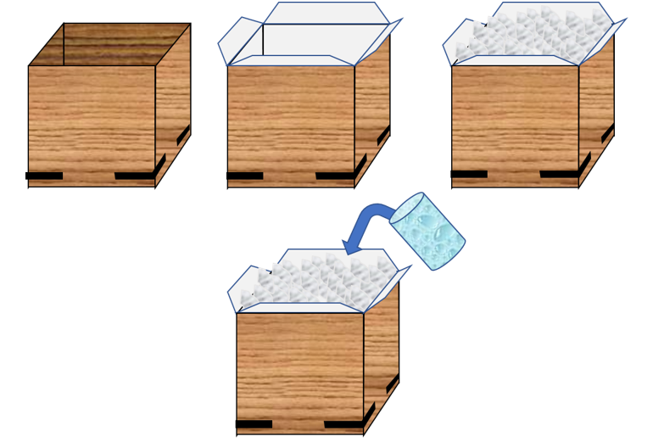
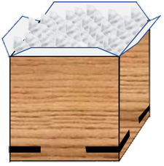



Background
Method
Preliminary results
Future work
We work in two cold rooms at the M2C in Caen (France), that allow near-field-scale simulations
Experimental protocol:
    Fill 30-cm cubic moulds with sediment - 3 grain sizes:
      Gravel (4-8 mm)
      Coarse sand (2-4 mm)
      Fine sand (< 1.2 mm)
    Add the calculated amount of water (20 to 30 wt% depending on the sediment used)
    Freeze the mixes at – 20°C
    Remove from mould and thaw at ambient temperature, aerial or submerged
    If submerged, additional variations:
      water level (block fully or partially submerged)
      addition of flow in water
1
2
3
4
1
2
3
30 cm
Figure 5: schematic diagram of the block-making process (credits: M. Leguen).
Meven PHILIPPE – vEGU2021 session CR5.4
6

Slide 8
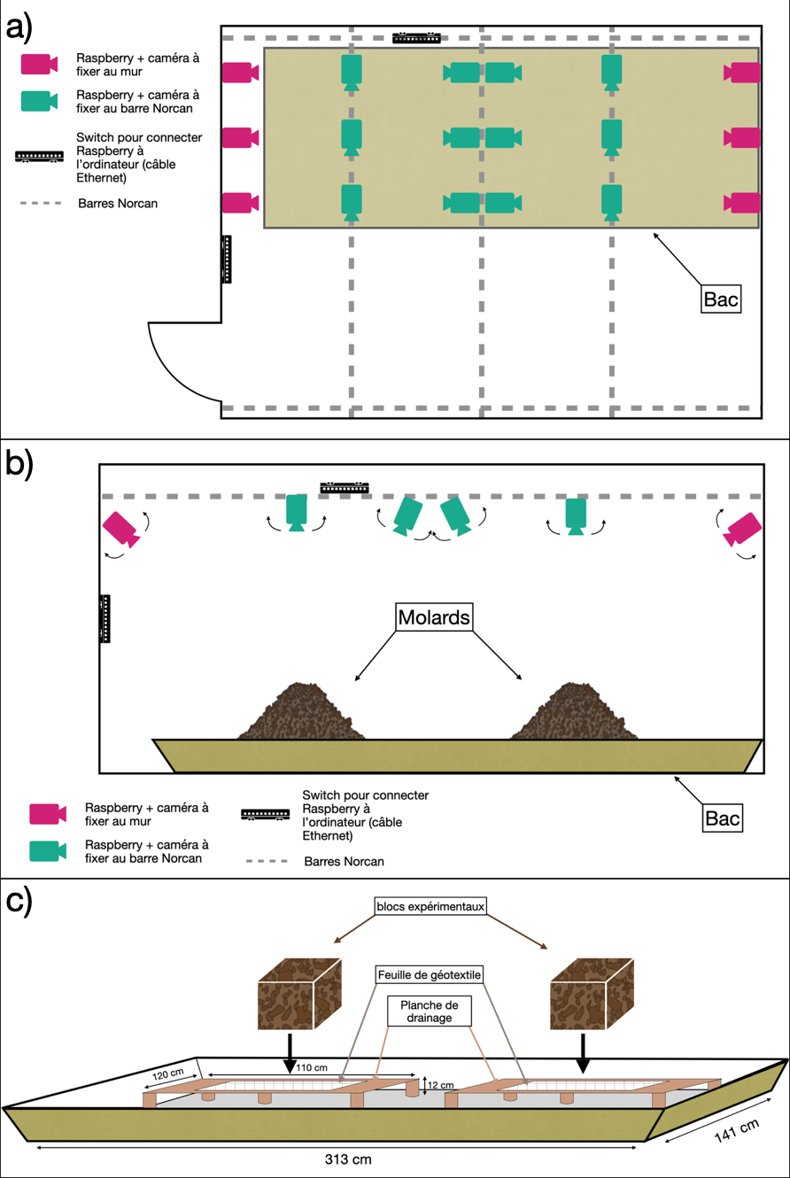
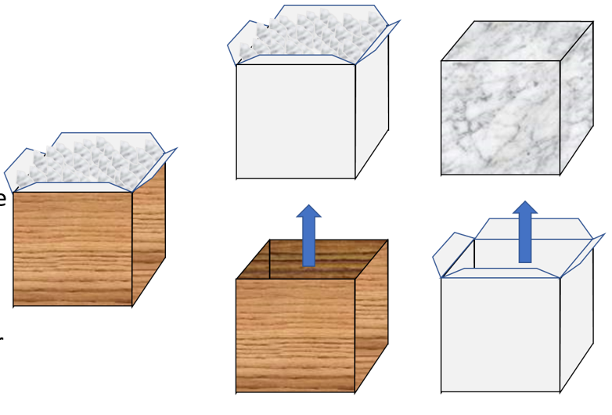
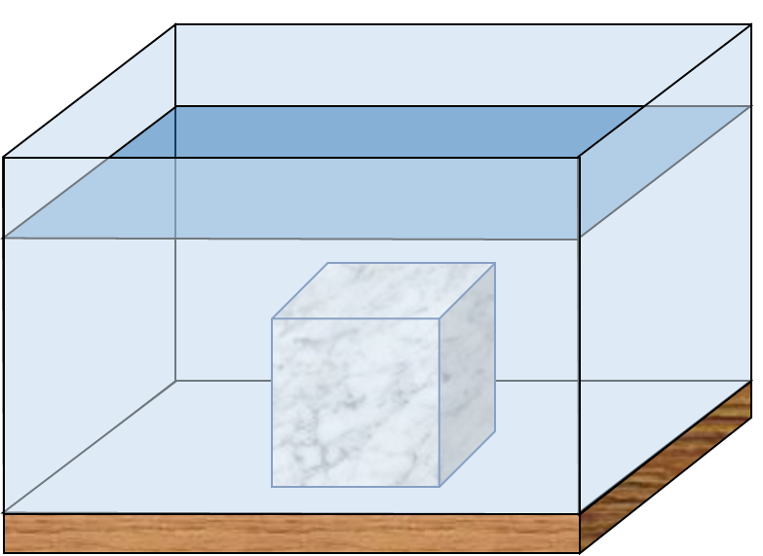
Background
Method
Preliminary results
Future work
4
a
geotextile sheets
drainage boards
b
100 cm
100 cm
64 cm
Figure 6: schematic diagram of the experiments start-up configuration for a. the aerial experiments, and b. the submerged experiments. In a. geotextile sheets prevent the leaching of fine sediment. Credits: M. Leguen and L. Jabbour.
Meven PHILIPPE – vEGU2021 session CR5.4
7

Slide 9
Background
Method
Preliminary results
Future work
Degradation is observed visually, and several sets of data are acquired:
  time-lapse pictures – every 10 s (submerged) or 30 min (aerial)
  thermal data from a thermal camera
  sets of photographs to perform photogrammetry (aerial = automated system; submerged = handheld camera)
  air temperature and humidity (every 30 min)
Figure 7: schematic diagram of the experimental setup, top view. The aerial experiments are made on drainage boards (top of the schematic) and the submerged ones in a water tank (bottom).
Legend
time-lapse cameras
drainage boards
thermal cameras
experimental blocks
handheld camera
supporting trails
automated cameras
air temperature & humidity sensor
water tank
Meven PHILIPPE – vEGU2021 session CR5.4
8

Slide 10
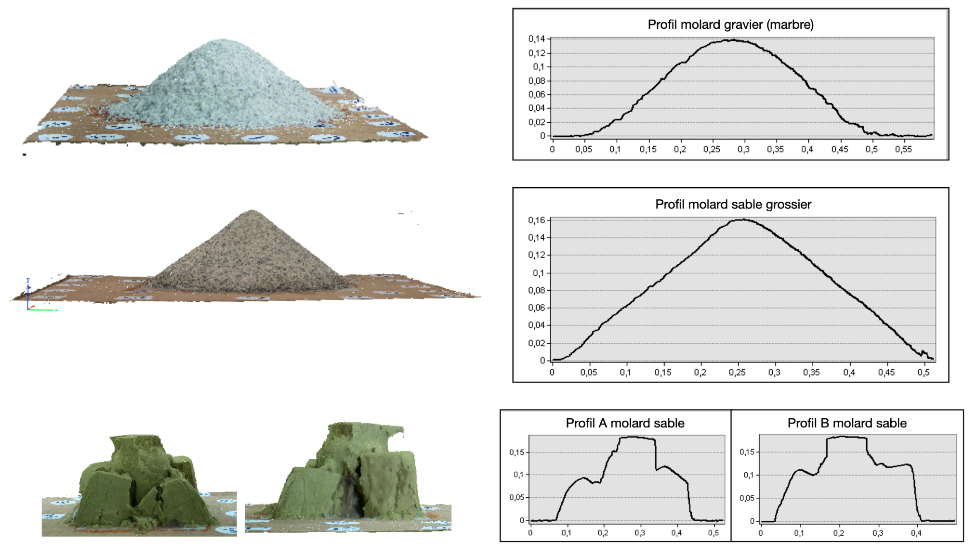
Background
Method
Preliminary results
Future work
Aerial
gravel
a
coarse sand
b
fine sand
c
Figure 8: 3D models and cross-cutting profiles for an experiment with a. gravel, b. coarse sand, c. fine sand. Credits: L. Jabbour.
Meven PHILIPPE – vEGU2021 session CR5.4
9

Slide 11
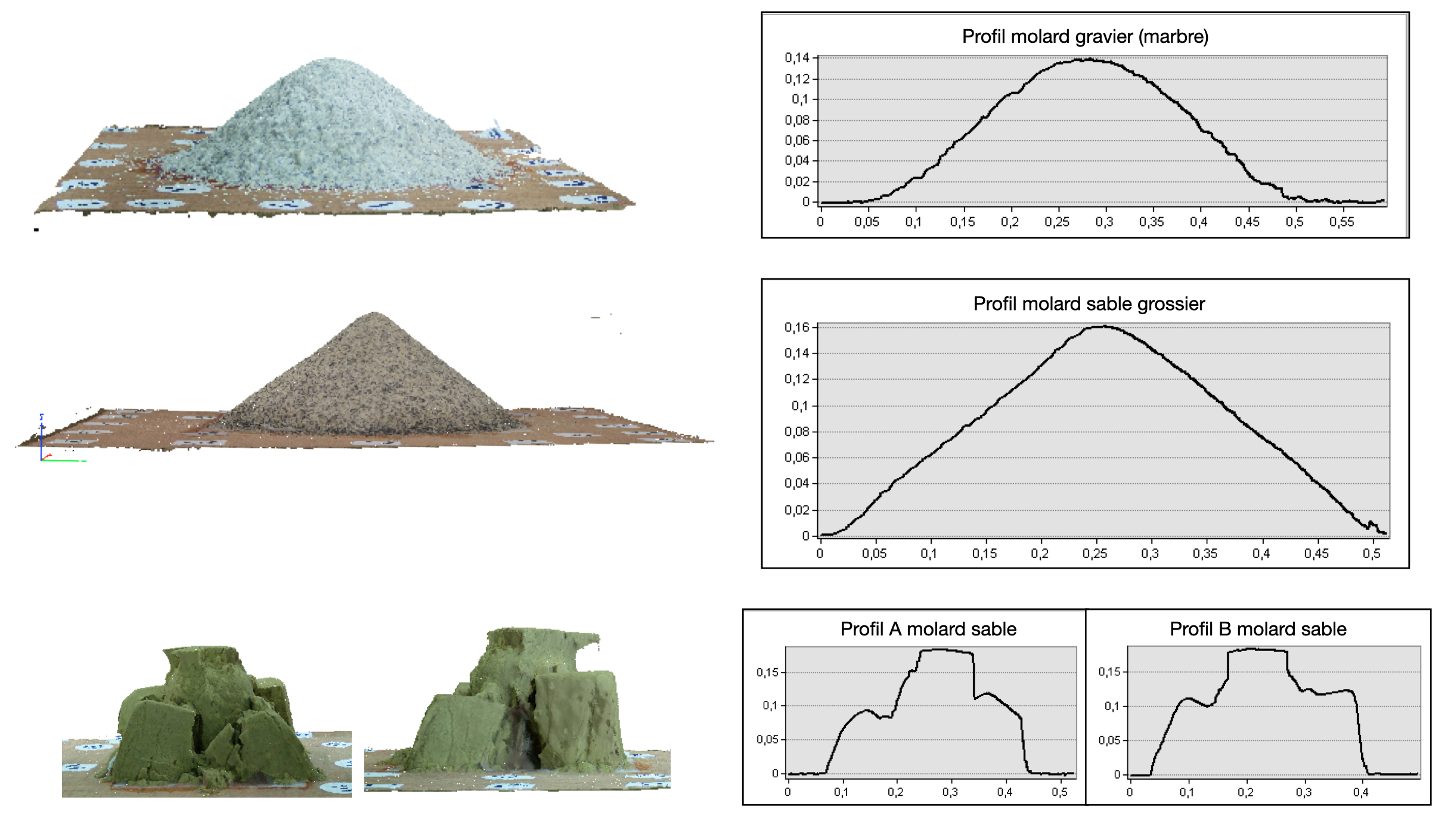
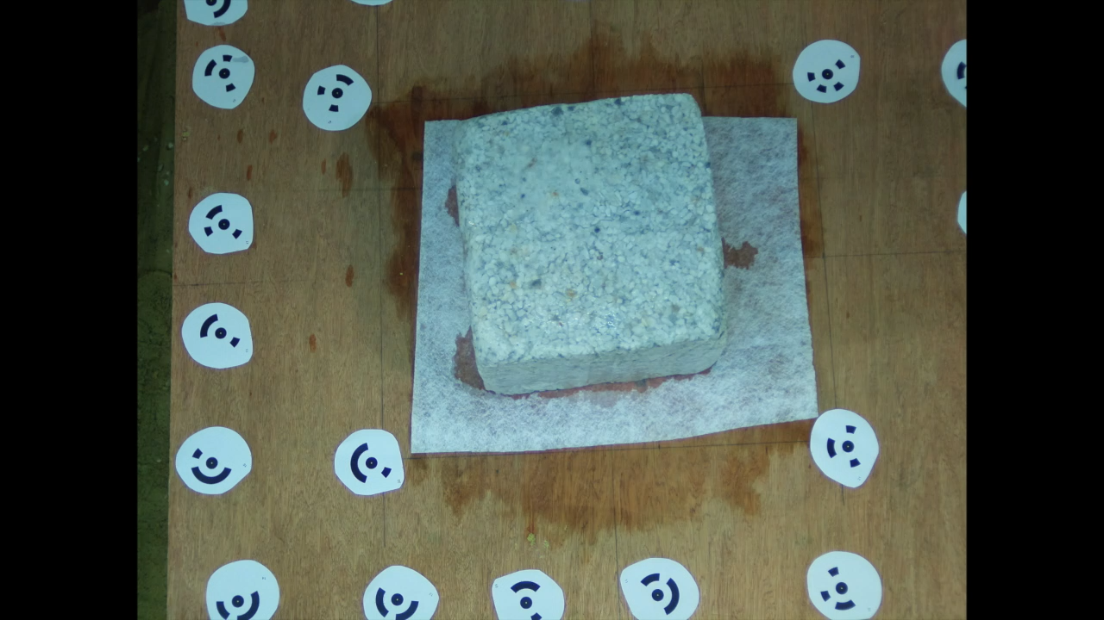
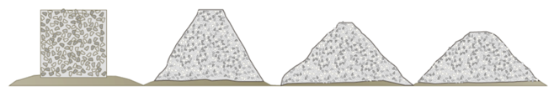
Background
Method
Preliminary results
Future work
Aerial
gravel
b
Time
a
Figure 9: a. time-lapse video and b. schematic diagram of morphological evolution of an experiment with gravel. Credits: L. Jabbour.
Meven PHILIPPE – vEGU2021 session CR5.4
10

Slide 12
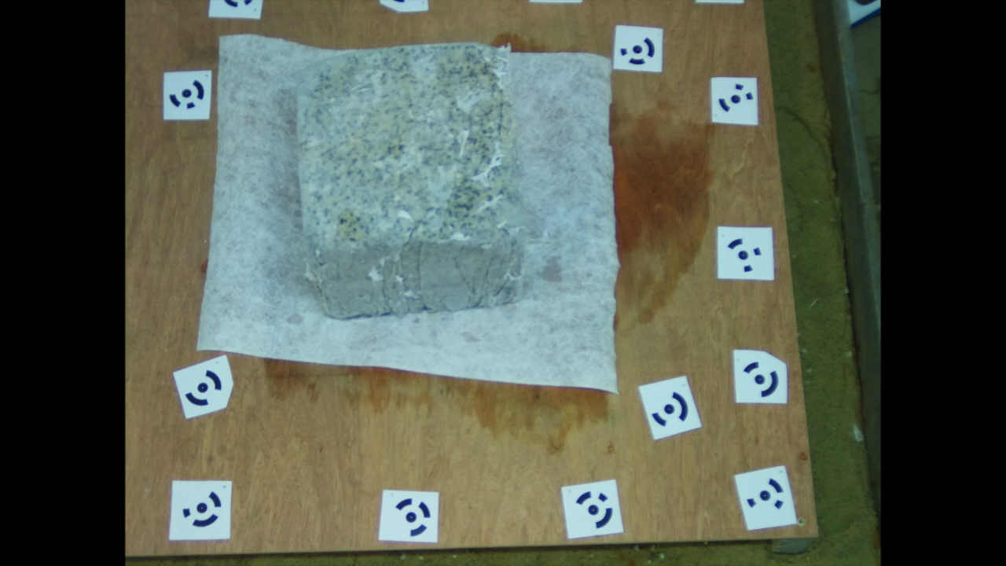
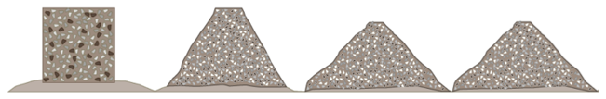
Background
Method
Preliminary results
Future work
Aerial
coarse sand
b
Time
a
Figure 10: a. time-lapse and b. schematic diagram of morphological evolution of an experiment with coarse sand. Credits: L. Jabbour.
Meven PHILIPPE – vEGU2021 session CR5.4
11

Slide 13
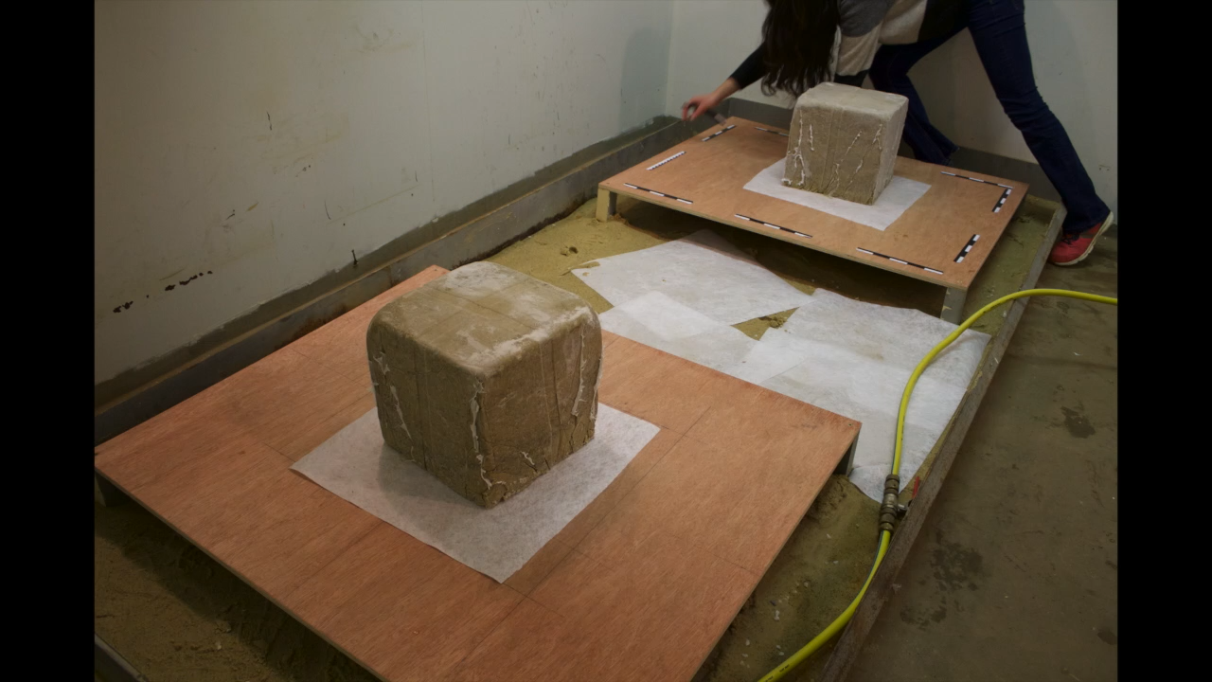
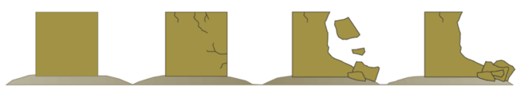
Background
Method
Preliminary results
Future work
Aerial
fine sand
b
Time
a
Figure 11: a. time-lapse and b. schematic diagram of morphological evolution of an experiment with fine sand. Credits: L. Jabbour.
Meven PHILIPPE – vEGU2021 session CR5.4
12

Slide 14
Background
Method
Preliminary results
Future work
Aerial
conical shape
rounded top
gravel
conical shape
sharp top
coarse sand
fine sand
no conical shape
Credits: L. Jabbour
Meven PHILIPPE – vEGU2021 session CR5.4
13

Slide 15
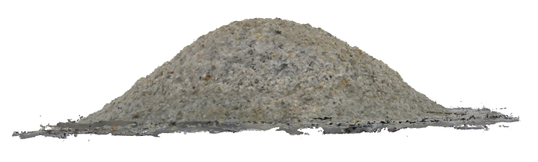
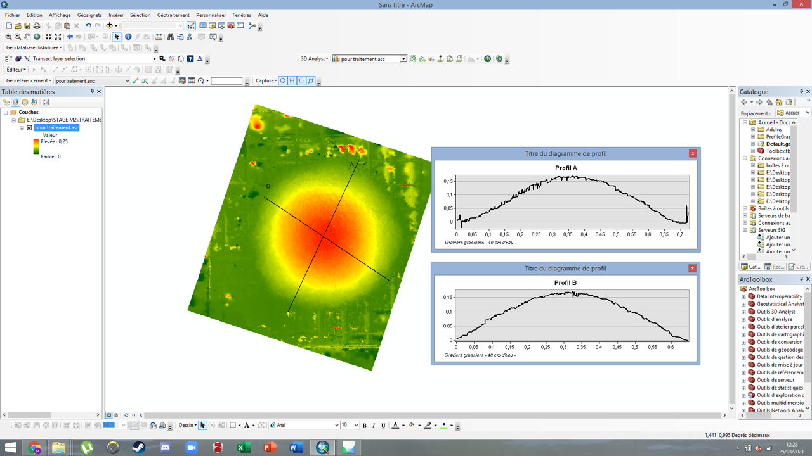
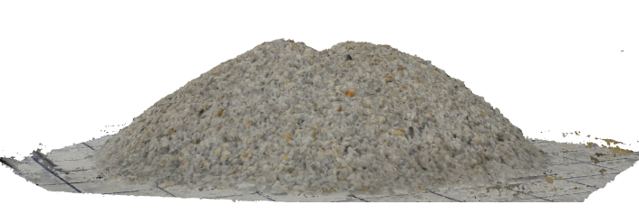
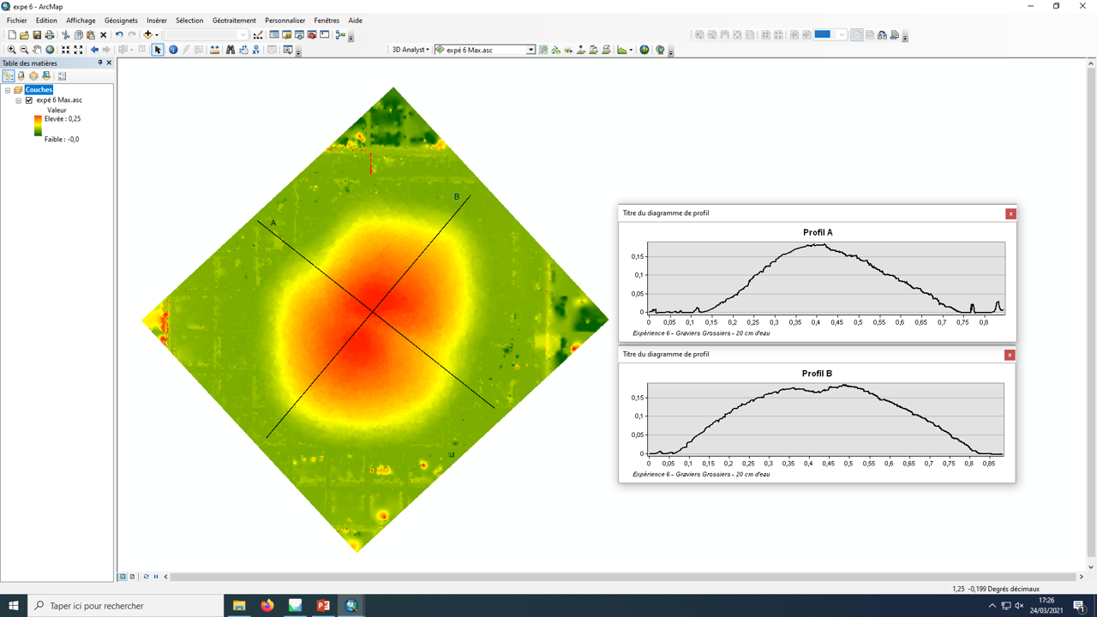
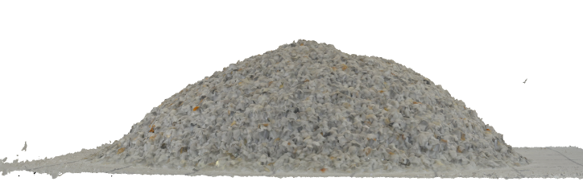
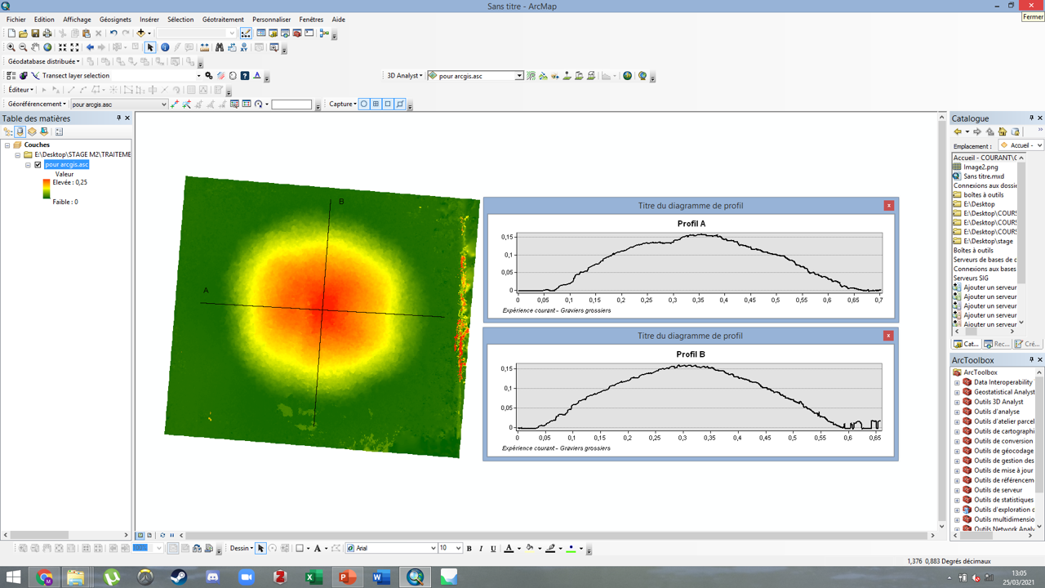
Background
Method
Preliminary results
Future work
Submerged
fully submerged
a
partially submerged
b
partially submerged + current
c
Figure 12: 3D models and cross-cutting profiles for an experiment with a block a. fully submerged, b. partially submerged, c. partially submerged and subject to current. Credits: M. Leguen.
Meven PHILIPPE – vEGU2021 session CR5.4
14

Slide 16
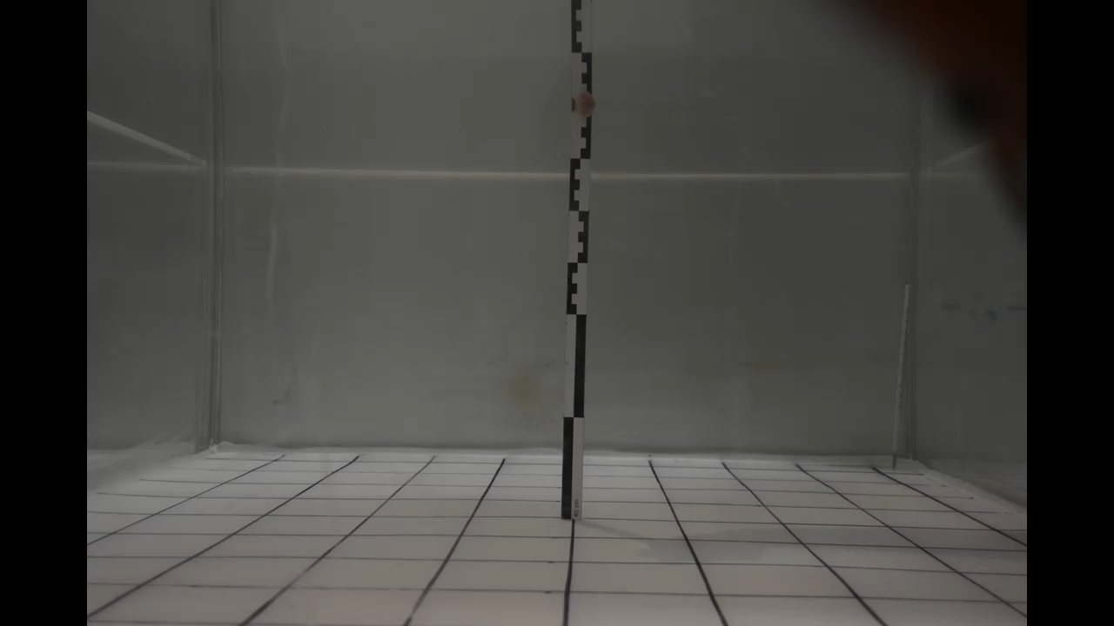
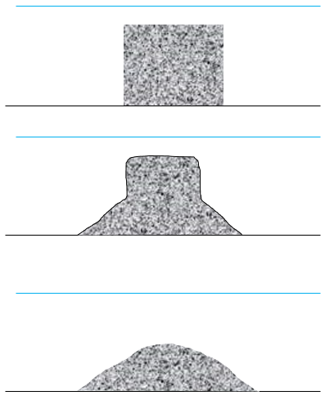
Background
Method
Preliminary results
Future work
Submerged
fully submerged
b
a
Time
Figure 13: a. time-lapse and b. schematic diagram of morphological evolution of an experiment with a block fully submerged. Credits: M. Leguen.
Meven PHILIPPE – vEGU2021 session CR5.4
15

Slide 17
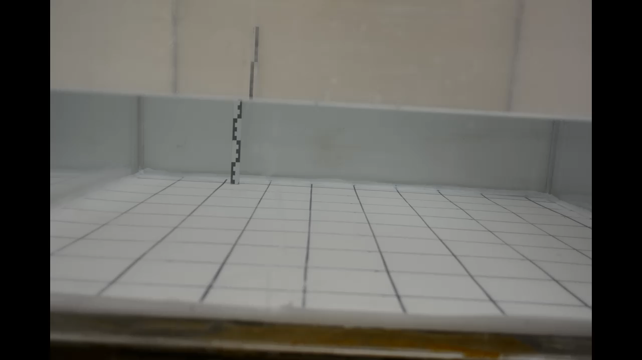
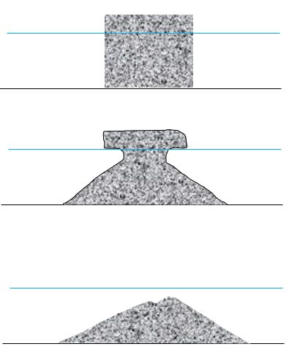
Background
Method
Preliminary results
Future work
Submerged
partially submerged
b
a
Time
Figure 14: a. time-lapse and b. schematic diagram of morphological evolution of an experiment with a block partially submerged. Credits: M. Leguen.
Meven PHILIPPE – vEGU2021 session CR5.4
16

Slide 18
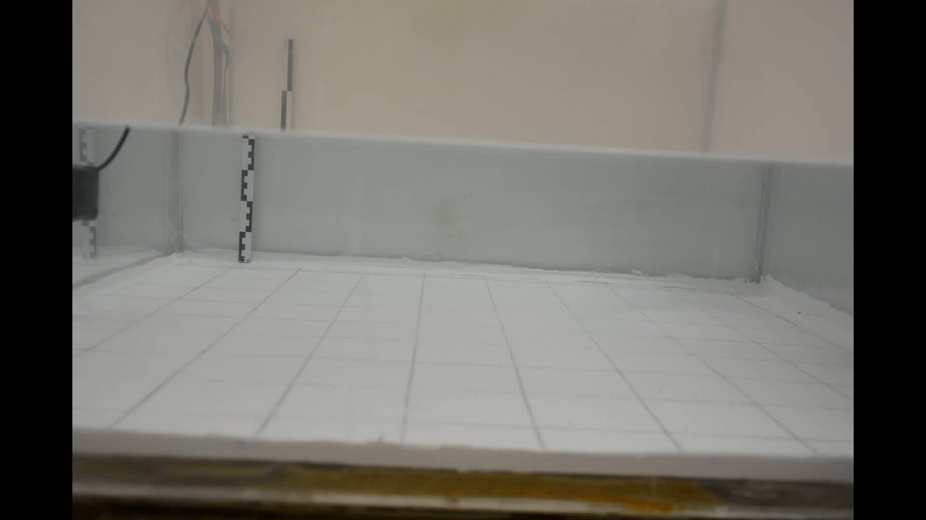
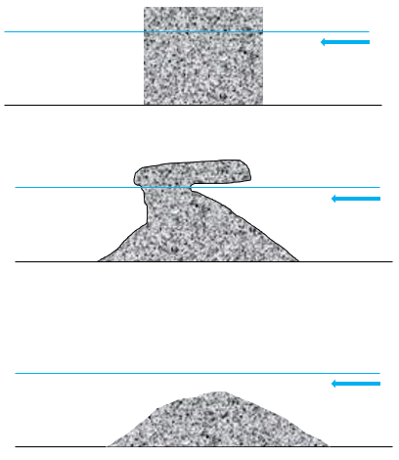
Background
Method
Preliminary results
Future work
Submerged
partially submerged + current
b
a
Time
Figure 15: a. time-lapse and b. schematic diagram of morphological evolution of an experiment with a block partially submerged and subject to an unidirectional current. Credits: M. Leguen.
Meven PHILIPPE – vEGU2021 session CR5.4
17

Slide 19
Background
Method
Preliminary results
Future work
Submerged
conical shape
single peak
rounded top
fully submerged
partially submerged
double peak
peaks at similar heights
partially submerged + current
double peak
one peak takes over the other
Credits: M. Leguen
Meven PHILIPPE – vEGU2021 session CR5.4
18

Slide 20
Background
Method
Preliminary results
Future work
Preliminary observations
Aerial:
  fine sediment does not favour molard formation without additional processes (rain, wind, etc) – absorbed water likely cements the grains
fine sand
Meven PHILIPPE – vEGU2021 session CR5.4
19

Slide 21
Background
Method
Preliminary results
Future work
Preliminary observations
Aerial:
  fine sediment does not favour molard formation without additional processes (rain, wind, etc) – absorbed water likely cements the grains
  grain size of the sediment affects the shape of molards not especially in terms of angle of repose, but more in terms of roundness of the top
gravel
coarse sand
Meven PHILIPPE – vEGU2021 session CR5.4
20

Slide 22
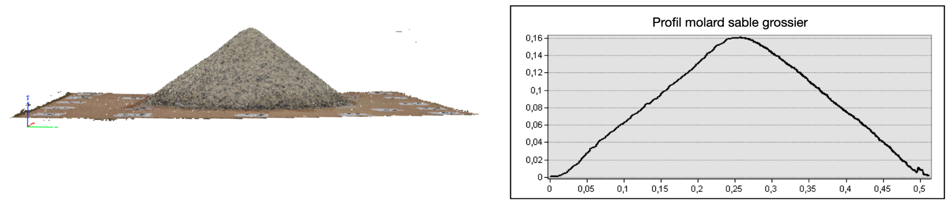
Background
Method
Preliminary results
Future work
Preliminary observations
Aerial:
  fine sediment does not favour molard formation without additional processes (rain, wind, etc) – absorbed water likely cements the grains
  grain size of the sediment affects the shape of molards not especially in terms of angle of repose, but more in terms of roundness of the top
Submerged:
  submerged molards seem to be generally rounder - the weight of the water column plays a role; the buoyancy/friction effects on falling grains, and the shear stress effects on rolling grains
aerial
slope > 31°
submerged
slope < 25°
Meven PHILIPPE – vEGU2021 session CR5.4
21

Slide 23
Background
Method
Preliminary results
Future work
Preliminary observations
Aerial:
  fine sediment does not favour molard formation without additional processes (rain, wind, etc) – absorbed water likely cements the grains
  grain size of the sediment affects the shape of molards not especially in terms of angle of repose, but more in terms of roundness of the top
Submerged:
  submerged molards seem to be generally rounder - the weight of the water column plays a role; the buoyancy/friction effects on falling grains, and the shear stress effects on rolling grains
  submerged molards show more varied morphologies, depending on the conditions (e.g. water flow, partial submersion), compared to the aerial molards
fully submerged
partially submerged
partially submerged + current
Meven PHILIPPE – vEGU2021 session CR5.4
22

Slide 24
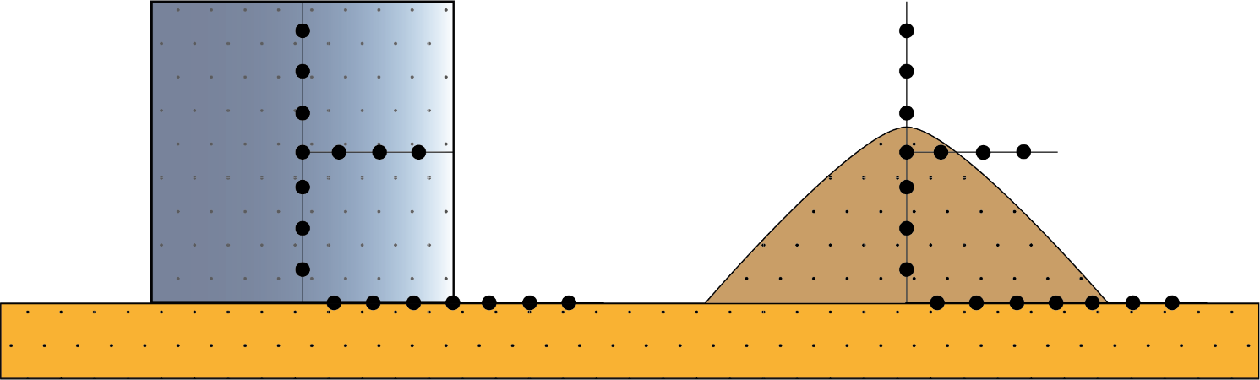
Background
Method
Preliminary results
Future work
Finish the processing and analyse of acquired data (3D models, time lapse photographs, thermal data)
Study the internal temperature evolution of the models
temperature sensors
Figure 16: schematic diagram of an experiment monitoring the internal temperature of a model, from the state of an initial block to a molard.
Meven PHILIPPE – vEGU2021 session CR5.4
23

Slide 25
Background
Method
Preliminary results
Future work
Finish the processing and analyse of acquired data (3D models, time lapse photographs, thermal data)
Study the internal temperature evolution of the models
Calibrate a numerical model
numerical model calibration
final shape
air temperature & humidity
internal temperature evolution
grain size
ice content
degradation processes
exploration of a parameter space impractical for the laboratory (e.g. bigger scales)
Meven PHILIPPE – vEGU2021 session CR5.4
24

Slide 26
Background
Method
Preliminary results
Future work
labwork
remote sensing study
Finish the processing and analyse of acquired data (3D models, time lapse photographs, thermal data)
Study the internal temperature evolution of the models
Calibrate a numerical model
Help to define recognition criteria for molards in the field & on remote sensing imagery
compositional properties (e.g. grain size of the sediment)
morphological properties (e.g. global shape)
landscape-scale properties (e.g. spatial distribution in landslide deposits)
distinguish molards from similar morphologies (e.g. hummocks, ice-cored moraines)
Meven PHILIPPE – vEGU2021 session CR5.4
25

Slide 27



References
- Allen, S.K. et al. (2009). Exploring steep bedrock permafrost and its relationship with recent slope failures in the Southern Alps of New Zealand. Permafrost Periglac. Process., 20: 345-356.
- Brideau, M. et al. (2009). Preliminary description and slope stability analyses of the 2008 Little Salmon Lake and 2007 Mt. Steele landslides, Yukon. Yukon Explor. Geol., 119–134.
- Dramis, F. et al. (1995). Mountain permafrost and slope instability in the Italian Alps: The Val Pola Landslide. Permafrost Periglac. Process., 6: 73-81.
- Fischer, L. et al. (2006). Geology, glacier retreat and permafrost degradation as controlling factors of slope instabilities in a high-mountain rock wall: the Monte Rosa east face. Natural Hazards and Earth System Sciences, 6(5):761 -772.
- Gómez, A. et al. (2003). Talus instability in a recent deglaciation area and its relationship to buried ice and snow cover evolution (Picacho del Veleta, Sierra Nevada, Spain). Geogr. Ann., 85 A (2): 165–182.
- Haeberli, W. et al. (2017). Increasing risks related to landslides from degrading permafrost into new lakes in de-glaciating mountain range. Geomorphology, Volume 293, Part B, Pages 405-417.
- Harris, C. et al. (2003). Warming permafrost in European mountains. Global and Planetary Change, Volume 39, Issues 3–4, Pages 215-225.
- Kellerer-Pirklbauer, A. et al. (2012). Climate change and rock fall events in high mountain areas: numerous and extensive rock falls in 2007 at Mittlerer Burgstall, Central Austria. Geogr. Ann., Ser. A94 (1), 59–78.
- Krautblatter, M. et al. (2013). Why permafrost rocks become unstable: a rock–ice‐mechanical model in time and space. Earth Surf. Process. Landforms, 38: 876-887.
- Lyle, R. et al. (2003). Landslides on ice-rich slopes - a geohazard in a changing climate. 6th Canadian Geohazards Conference.
- Milana, J.P. (2016). Molards and their relation to landslides involving permafrost failure. Permafr. Periglac. Process. 27, 271–284.
- Morino, C. et al. (2019). Molards as an indicator of permafrost degradation and landslide processes. Earth and Planetary Science Letters, Volume 516, Pages 136-147.
- Sæmundsson, Þ. et al. (2018). The triggering factors of the Móafellshyrna debris slide in northern Iceland: intense precipitation, earthquake activity and thawing of mountain permafrost. Sci. Total Environ. 621, 1163–1175.
- Wei, M. et al. (2006). Slope instability phenomena in permafrost regions of Qinghai-Tibet Plateau, China. Landslides 3, 260–264.
Meven PHILIPPE – vEGU2021 session CR5.4
26

