Slide 1


Examination and Enhancement of solar radiation pressure model for BDS-3 satellites
Jie Li, Yongqiang Yuan, Shi Huang, Chengbo Liu, Jiaqing Lou, and Xingxing Li
School of Geodesy and Geomatics, Wuhan University
2021.4.27

Slide 2

Overview
We focus on the SRP models of BDS-3 satellites to improve BDS-3 precise orbit determination(POD) performance.
Analysis of the ECOM model and ECOM2 model
Enhancement of ECOM and ECOM2 model
Performance of a priori Box-Wing (BW) models using different geometrical and optical coefficients
Background
Method
Result
Summary
Navigation: Click buttons for more information

Slide 3
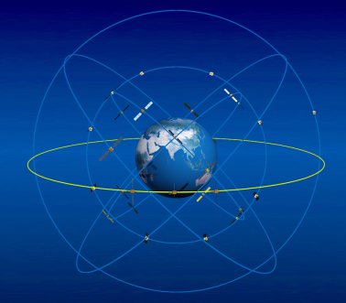
Background
BDS-3
BDS-3 has been completed in June 2020.
BDS-3 constellation:
3 Geostationary Earth Orbit (GEO) satellites
3 Inclined Geosynchronous Orbit (IGSO) satellites
24 Medium Earth Orbit (MEO) satellites (two manufacturers as follow)
Fig 1 BDS-3 satellites constellation from http://www.csno-tarc.cn
CAST: satellites developed by China Academy of Space Technology
with one satellite structure
SECM: satellites developed by Shanghai Engineering Center for Microsatellites with two structures, namely SECM-A and SECM-B respectively

Slide 4
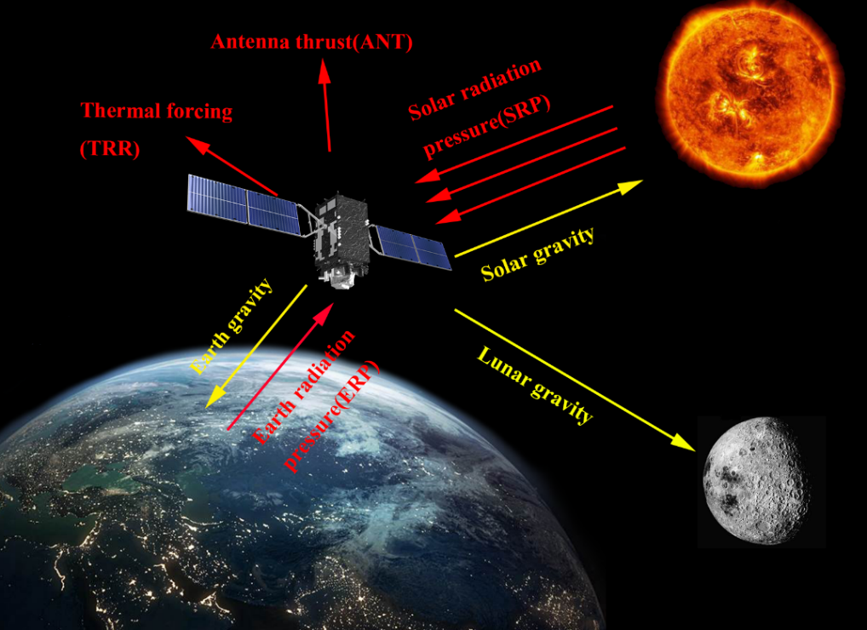
Background
SRP
SRP is the main non-conservative orbit perturbation for BDS-3 satellites.
Main SRP models:
Empirical SRP models
correct effects of SRP by adjusting a few parameters in a simple empirical acceleration formula without knowledge of physical principles.
e.g. ECOM model; ECOM2 model
Analytical SRP models
rebuild SRP acceleration by physics, these models need a good knowledge of the satellite metadata, and nominal attitude.
e.g. Adjustable Box-Wing model (ABW model)
Semi-empirical SRP models
improve a priori models from the long arc adjustment of model properties, compensate the lack of accurate dimensions and optical properties for satellites.
e.g. a priori box-wing model
Fig 2 main orbit perturbations for satellites

Slide 5
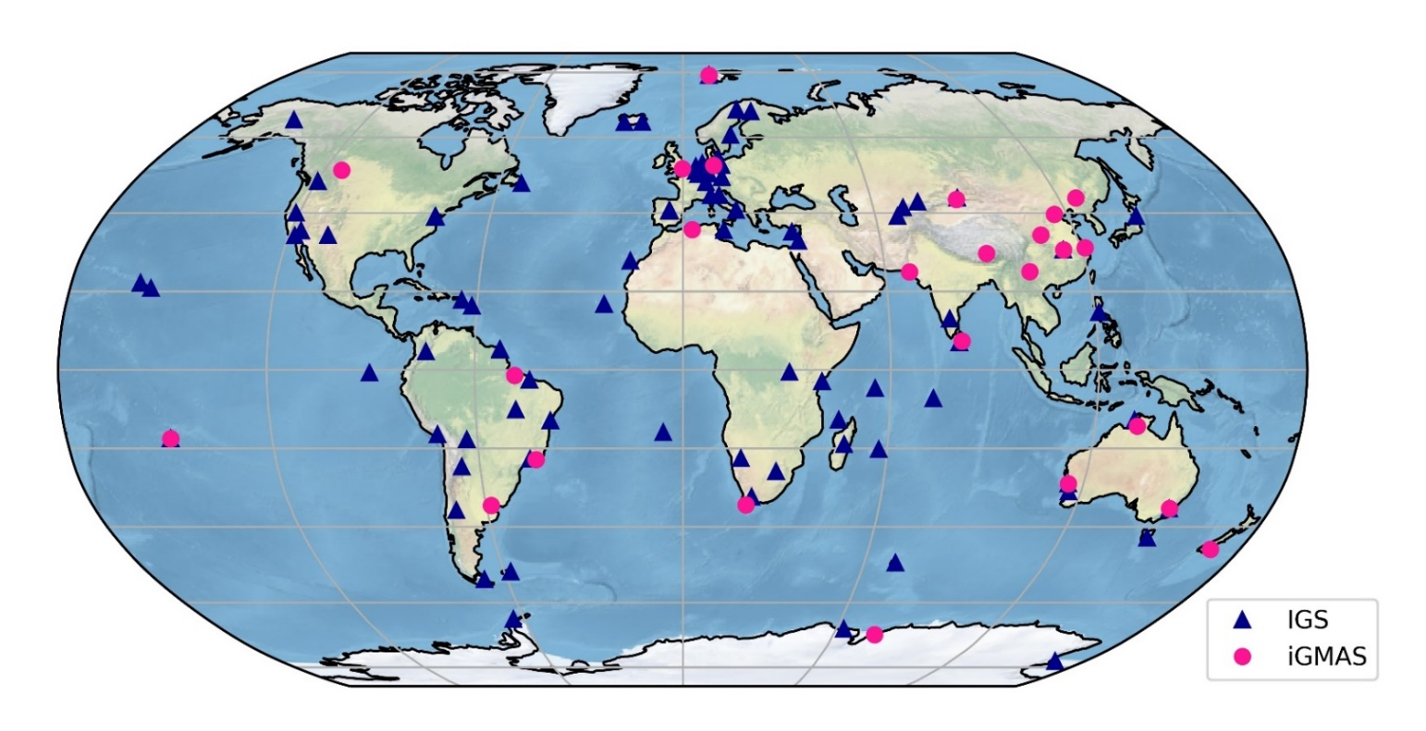
Method
Strategy
SRP models used in this study:
ECOM: ECOM model with 5 parameters
ECOM2
BW: the a priori box-wing in combination with five-parameter ECOM model
The distribution of stations is as follow:
138 MEGX stations (blue)
26 iGMAS stations (pink)
Fig 3 The distribution of stations

Slide 6
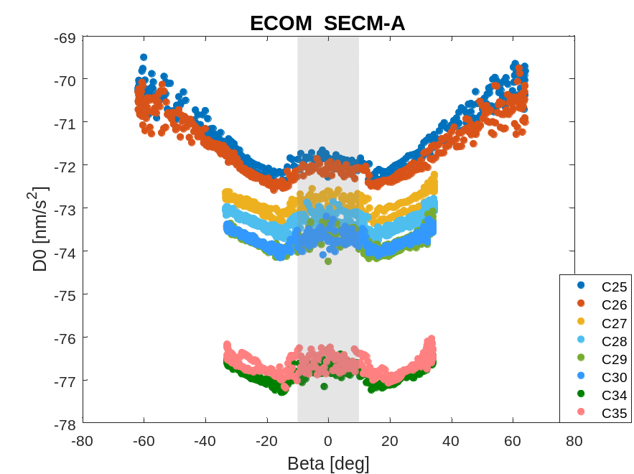
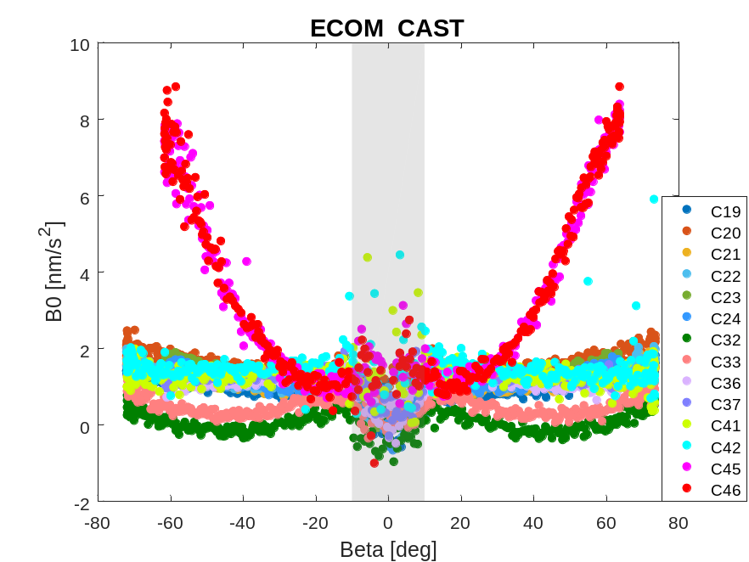
ECOM model
Parameter analysis
Fig 4 ECOM D0 estimates of SECM-A.
Fig 5 ECOM B0 estimates of CAST.
D0 estimates of C34 and C35 satellites are not consistent with other SECM-A satellites. The masses of these two satellites from metadata are larger than their actual masses;
The variation tendency of B0 estimates for C45 and C46 satellites is obviously different from other CAST satellites. These two satellites are likely to have a new structure.

Slide 7
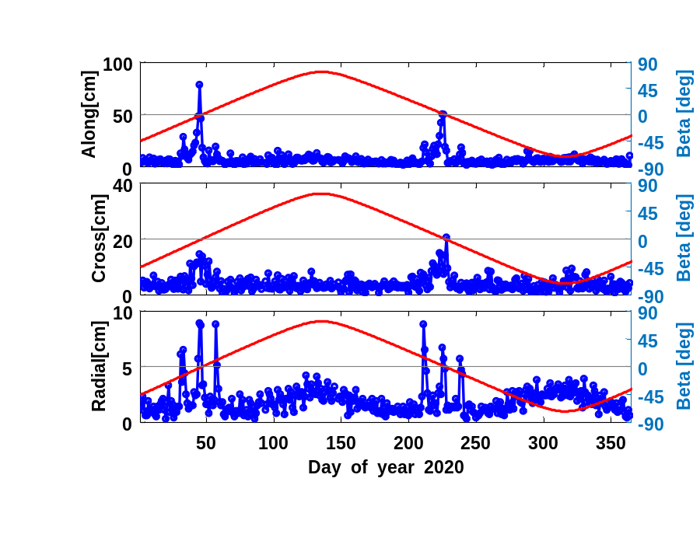
ECOM model
POD results
24h obit overlaps
Table 1 Orbit overlapping results for MEO (CAST and SECM respectively, without results in the eclipse season)、IGSO and GEO satellites in 2020
 | Along [cm] | Cross [cm] | Radial [cm] | 1D RMS [cm]
CAST | 6.71 | 4.27 | 1.99 | 4.73
SECM | 6.01 | 3.81 | 1.61 | 4.21
IGSO | 17.32 | 12.16 | 4.83 | 12.53
GEO | 337.86 | 35.92 | 18.36 | 196.45
Fig 6 Overlapping results for C20 in 2020
The average 1D RMS values of the MEO (without results in the eclipse season)、IGSO、GEO satellites are about 5 cm、13 cm and 197 cm, respectively;
The overlapping results have an obvious reduction when the satellites enter the eclipse season.

Slide 8
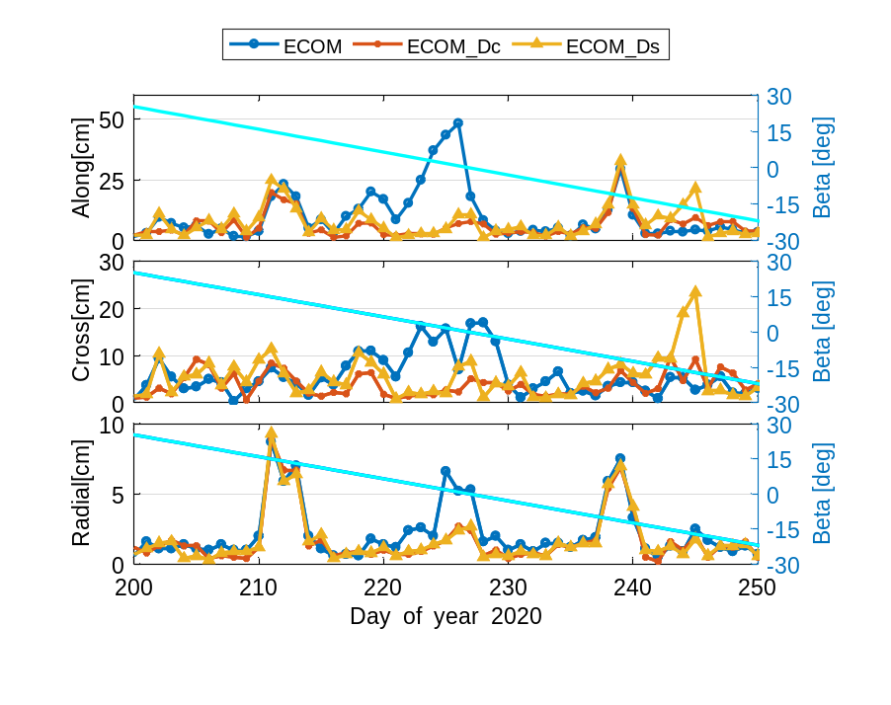
ECOM model
Enhanced ECOM
Add parameters into ECOM model (higher harmonic terms in D direction)
The improvements of 1D RMS values achieve 61.51% for MEO satellites in eclipse season using ECOM_Dc model and 51.75% using ECOM_Ds;
1D RMS values of GEO satellites are improved 41.75% by employing ECOM_Dc, and 40.98% by ECOM_Ds in all period.
Fig 7 overlapping results for C20 in eclipse season.
ECOM_Dc: ECOM model added with the parameter Dc
ECOM_Ds: ECOM model added with the parameter Ds

Slide 9
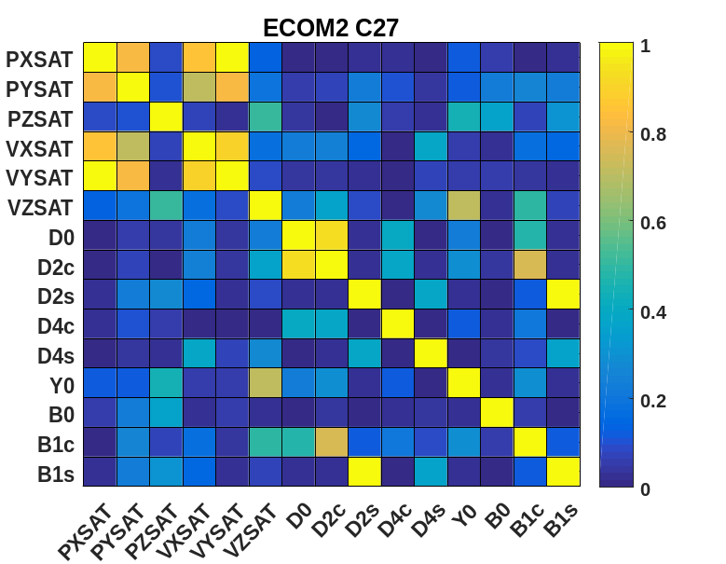
ECOM2 model
POD results
24h obit overlaps
Correlation analysis of SRP parameters
Table 2 Orbit overlapping results for MEO (CAST and SECM respectively, without results in the eclipse season)、IGSO and GEO satellites in 2020
 | Along [cm] | Cross [cm] | Radial [cm] | 1D RMS [cm]
CAST | 6.51 | 4.97 | 2.29 | 4.91
SECM | 6.24 | 4.44 | 2.45 | 4.64
IGSO | 16.56 | 12.39 | 6.42 | 12.51
GEO | 359.84 | 30.95 | 18.33 | 208.79
Fig 8 Correlation coefficients of SRP parameters.
D0 estimates show a strong correlation with D2c estimates for satellites in slot-A and slot-B .

Slide 10
ECOM2 model
Enhanced ECOM2
Remove parameter D2c in ECOM2 model (8ECOM2)
Table 3 Orbit overlapping results for MEO satellites.
 | Model | Along [cm] | Cross [cm] | Radial [cm] | 1D RMS [cm]
CAST Slot-B | ECOM2 | 7.23 | 4.88 | 3.23 | 5.37
 | 8ECOM2 | 6.85 | 4.28 | 2.14 | 4.82
CAST Slot-C | ECOM2 | 8.25 | 8.21 | 2.49 | 6.87
 | 8ECOM2 | 7.92 | 6.40 | 2.03 | 6.00
SECM Slot-A | ECOM2 | 5.75 | 3.95 | 1.74 | 4.15
 | 8ECOM2 | 5.65 | 3.70 | 1.59 | 4.01
SECM Slot-C | ECOM2 | 7.78 | 5.99 | 3.04 | 5.94
 | 8ECOM2 | 7.52 | 4.71 | 1.93 | 5.24
8ECOM2 model perform better than ECOM2 model;
The improvements of 1D RMS values achieve about 10% except for SECM satellites in slot-C.

Slide 11
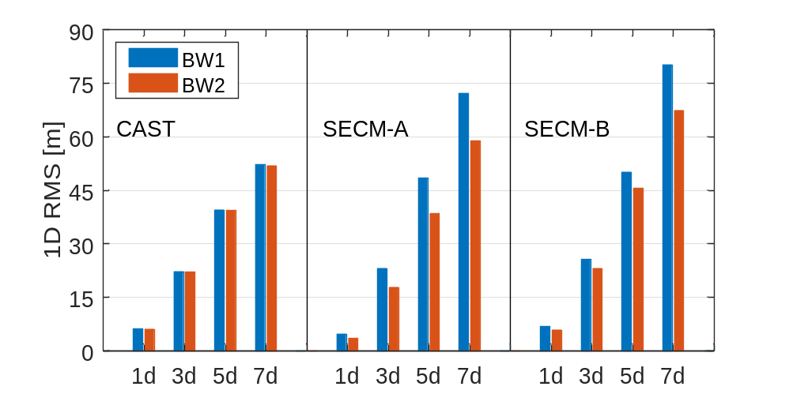
BW model
POD results
Prediction
SLR validation
Table 4 SLR residuals of satellite orbits while adopting ECOM, BW1 and BW2 model.
SLR | Model | #NP | Mean [cm] | STD [cm]
C20 | ECOM | 651 | 4.61 | 4.05
 | BW1 | 651 | 3.35 | 3.66
 | BW2 | 651 | 3.13 | 3.66
C29 | ECOM | 439 | -4.64 | 4.41
 | BW1 | 439 | -3.02 | 2.70
 | BW2 | 439 | -1.36 | 2.74
Fig 9 RMS values of orbit prediction using different optical coefficients and different arc lengths.
BW2 model shows a superior performance in orbit prediction especially for SECM satellites;
Both STD values and mean biases of SLR residuals reduce when BW models are applied.
BW1: BW model with the geometrical and optical properties from BDS-3 metadata
BW2: BW model with more detailed geometrical and optical coefficients

Slide 12
Summary
The masses of C34 and C35 satellites from metadata are likely to be larger than their actual masses; a new structure exists for C45 and C46 satellites;
Adding higher harmonic terms in D direction into ECOM model can obviously improve overlapping results in the eclipse season;
Removing parameter D2c in ECOM2 model make POD performance better;
By applying the detailed geometrical and optical coefficients, smaller STD values and mean biases of SLR residuals can achieve with the a priori BW model.

Slide 13
Thanks！

