Slide 1



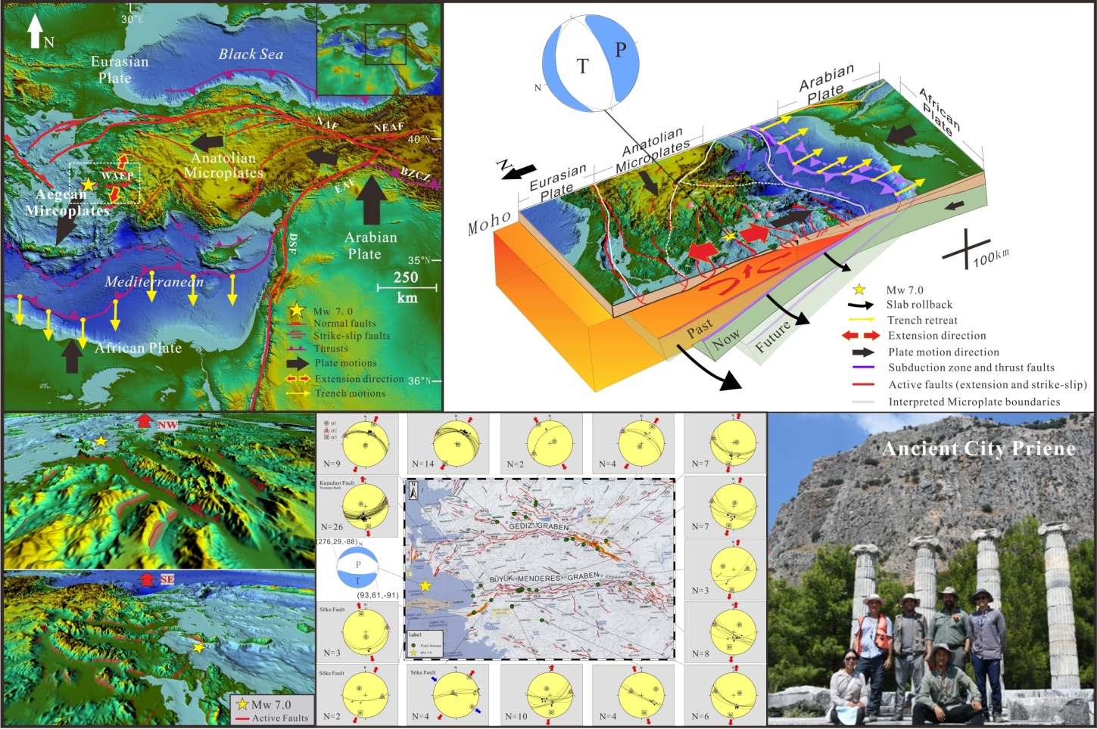



Unusual Mw 7.0 Extensional Aegean Earthquake Related to African Slab Rollback and Formation of Plate Boundary in Anatolia
Introduction
The earthquake mechanism is a hot topic, but not enough attention are paid to the upper crust earthquake of subduction zone.
The Mw 7.0 earthquake caused 119 people died, 1053 people injured, and hundreds of buildings were destroyed! We interpret this event as the result of slab subduction and roll back.
Probably a divergent plate boundary is forming today.
Interpretation
Aegean and Anatolian upper crust being pulled apart by north–south extensional stresses resulting from slab rollback, where the African plate is subducting northwards beneath Eurasia. The slab is sinking by gravitational forces, causing it to retreat southwards. Since the retreating African slab is coupled with the overriding plate, it tears the upper plate apart as it retreats, breaking it into numerous small plates with frequent earthquakes along their boundaries.
Jiannan Meng^{1,2}, Ozan Sinoplu¹,Zhipeng Zhou¹,
Bulent Tokay³, Timothy Kusky^{1,2,3}*,
Erdin Bozkurt³ ，Lu Wang¹
1.Center for Global Tectonics, School of Earth Sciences, China University of Geosciences, Wuhan 430074, China.
2.Three Gorges Research Center for Geohazards, China University of Geosciences, Wuhan 430074, China.
3.Department of Geological Engineering, Middle East Technical University, Ankara, Turkey. *email: tkusky@gmail.com

