Slide 1
The influence of intraseasonal soil moisture-atmosphere feedbacks on the West African monsoon circulation
Joshua Talib
jostal@ceh.ac.uk
Christopher Taylor, Cornelia Klien, Bethan Harris, Seonaid Anderson,
Semeena Shamsudheen (UKCEH)

Slide 2
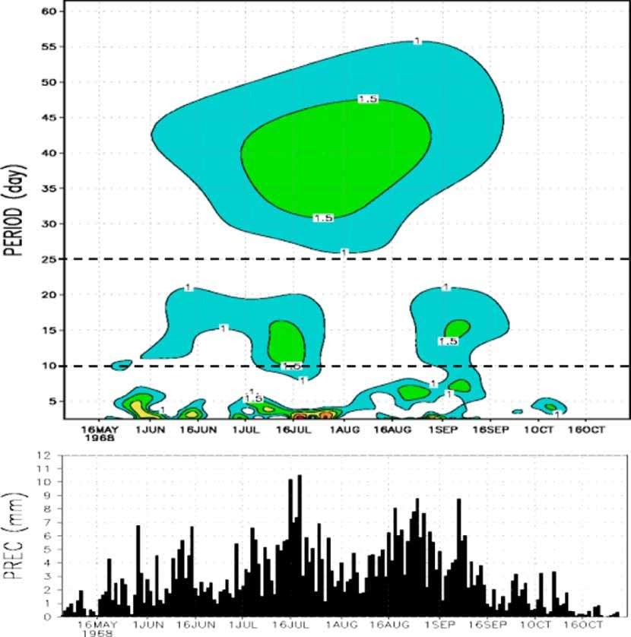
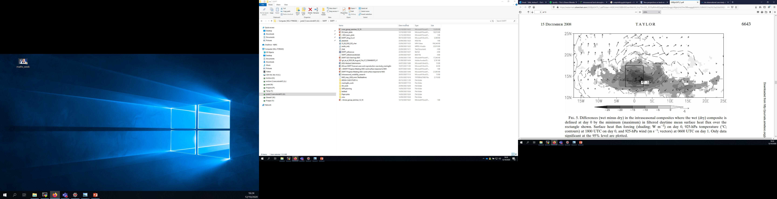
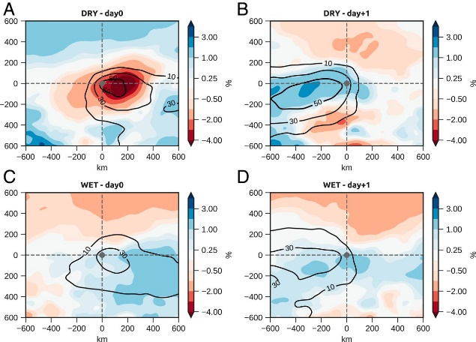
Introduction and Motivation:
Land-atmosphere feedbacks across West Africa
Rainfall variability across West Africa (Janicot et al., 2010) has been to shown to promote land-atmosphere feedbacks.
  Taylor et al., 2008: Land-atmosphere feedbacks control characteristics of the Sahel mode.
  Klein et al., 2021: Soil moisture conditions affect storm intensification.
However, the impact of intraseasonal land-atmosphere feedbacks is yet to be explored?
In this study we use various satellite observations and ERA5 reanalysis to investigate intraseasonal land-atmosphere feedbacks.
Taylor, 2008
Janicot et al., 2010
Klein et al., 2021

Slide 3
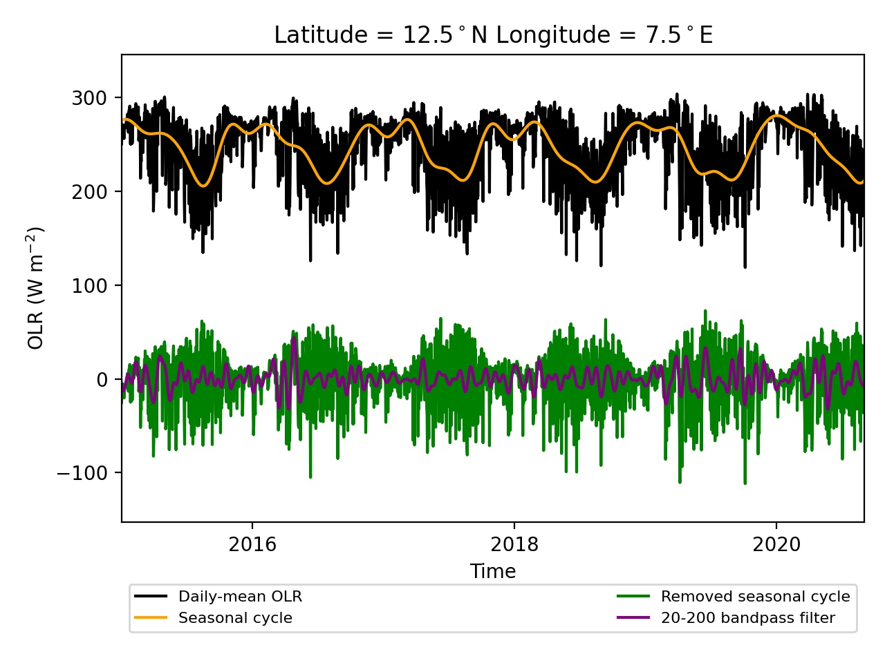
Methodology:
Detecting intraseasonal variability using OLR data
Take OLR readings across West/Central Africa (JJAS 1979-2020).
Remove seasonal cycle using Fourier Transform.
Apply a 20-200 day bandpass filter.
Example of computing 20-200 day filtered OLR data.

Slide 4
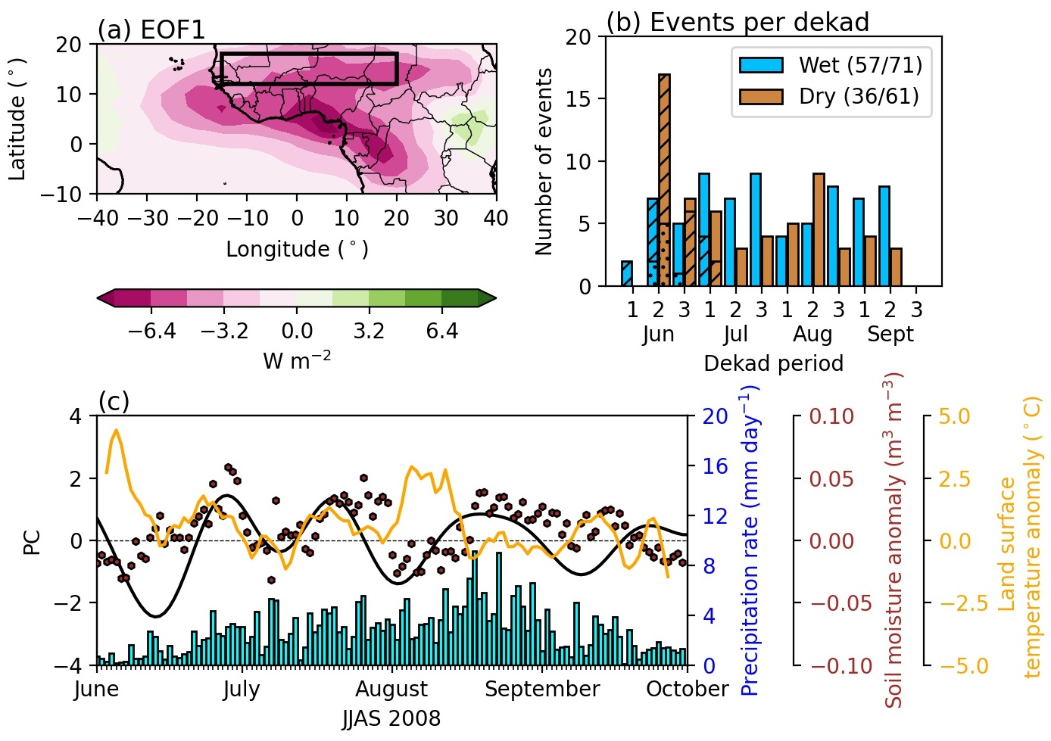
Methodology:
Detecting intraseasonal variability using OLR data
Take OLR readings across West/Central Africa (JJAS 1979-2020).
Remove seasonal cycle using Fourier Transform.
Apply a 20-200 day bandpass filter.
Produce EOF of filtered OLR.
EOF1 of 20-200 day filtered OLR data.

Slide 5
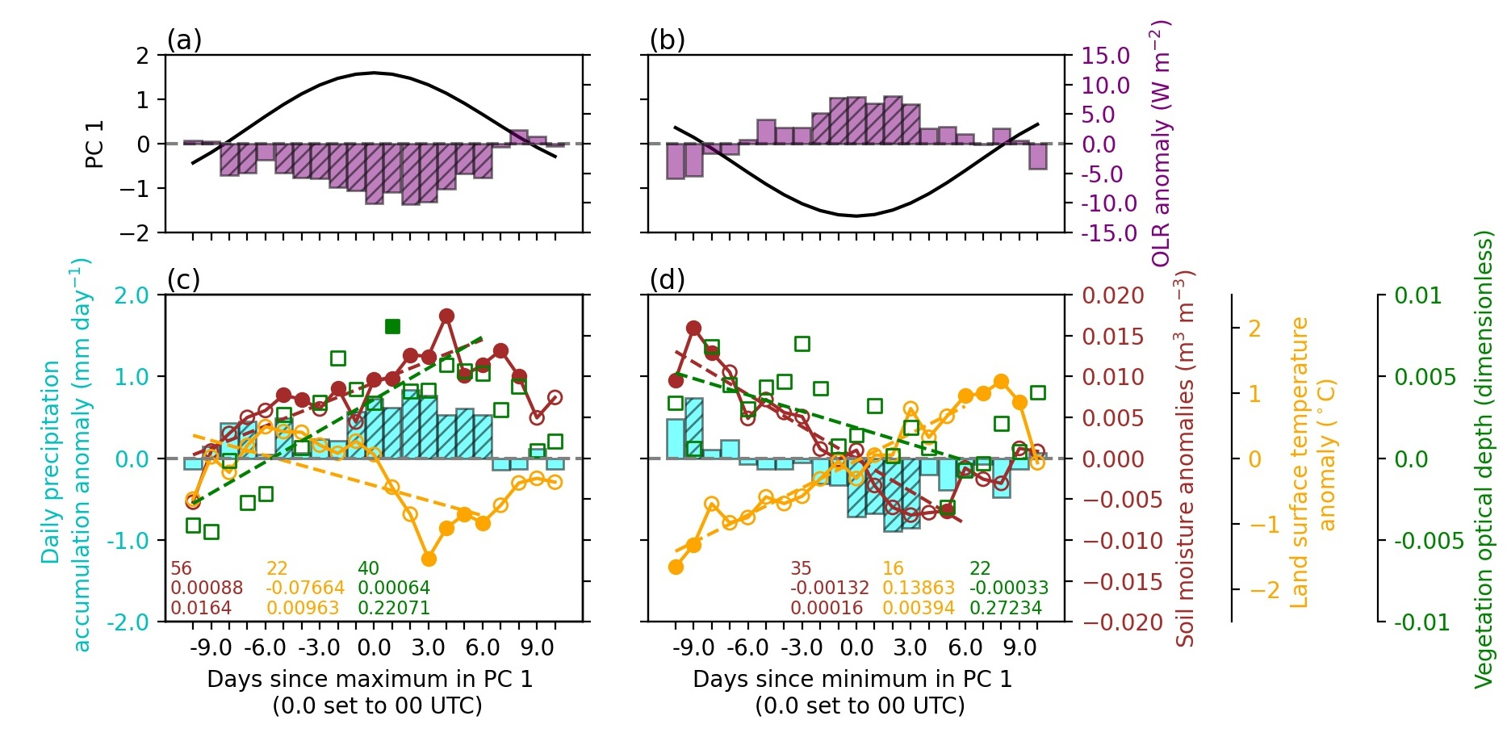
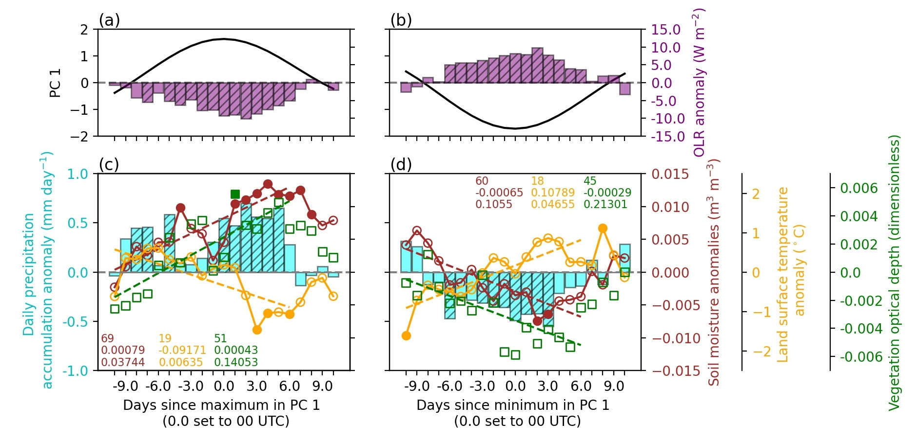
Methodology:
Identifying intraseasonal dry and wet spells
Take OLR readings across West/Central Africa (JJAS 1979-2020).
Remove seasonal cycle using Fourier Transform.
Apply a 20-200 day bandpass filter.
Produce EOF of filtered OLR.
Compute a composite of +/- 1 standard deviation events of the EOF1 principal component time series lasting for >= 3 days.
Events are only included if they occur after monsoon onset, which is defined using Janicot et al., 2003 methodology.
57 wet and 36 dry intraseasonal events are identified.
Number of events in each composite. Lined and dotted hatching denotes events associated with monsoon onset and pre-monsoon respectively.
Sahel-averaged OLR anomalies during (top) wet and (bottom) dry intraseasonal events.
High index – Low OLR – High rainfall.
Low index – High OLR – Low rainfall.

Slide 6
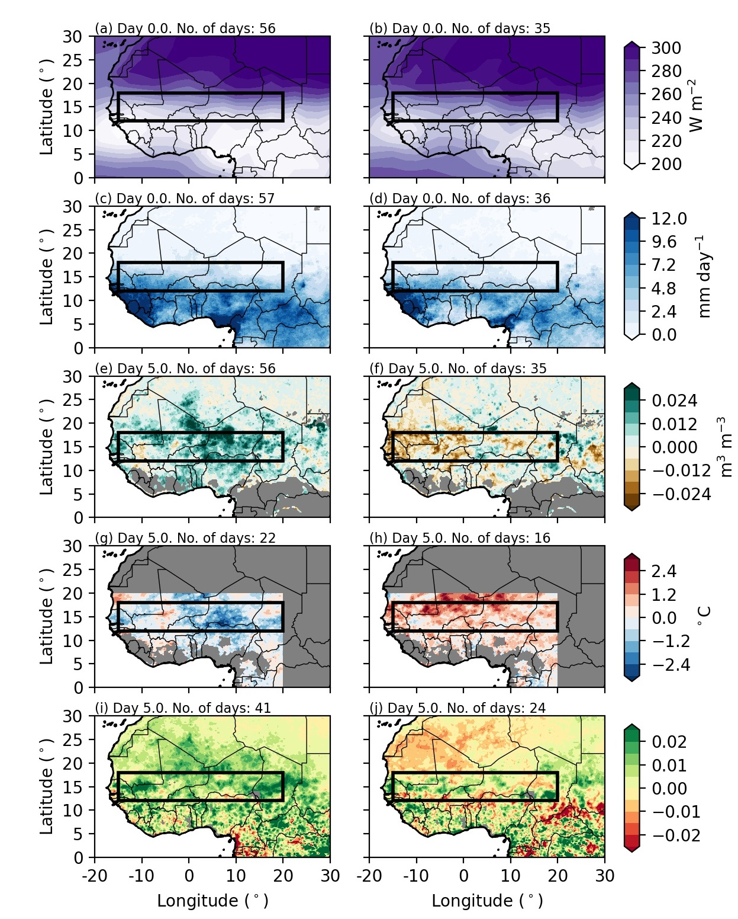

Results:
Land surface response to intraseasonal events.
Satellite observations are used to identify a surface response. Observations used include:
  ESA CCI soil moisture.
  SEVIRI land surface temperatures.
  Microwave radiation-derived vegetation optical depth.
Composite-mean soil moisture during day 5.0 of dry intraseasonal event.
During an intraseasonal dry event, the Sahel surface dries and warms. There is also evidence of decreased vegetation.
The surface drying and warming is indicative of increased surface sensible heat flux and decreased latent heat flux.
The opposite of these processes is observed during a wet intraseasonal event (not shown).
Sahel-averaged (brown) soil moisture, (yellow) LST and (green) VOD plus (cyan) precipitation and (purple) OLR anomaly during a dry intraseasonal event.

Slide 7

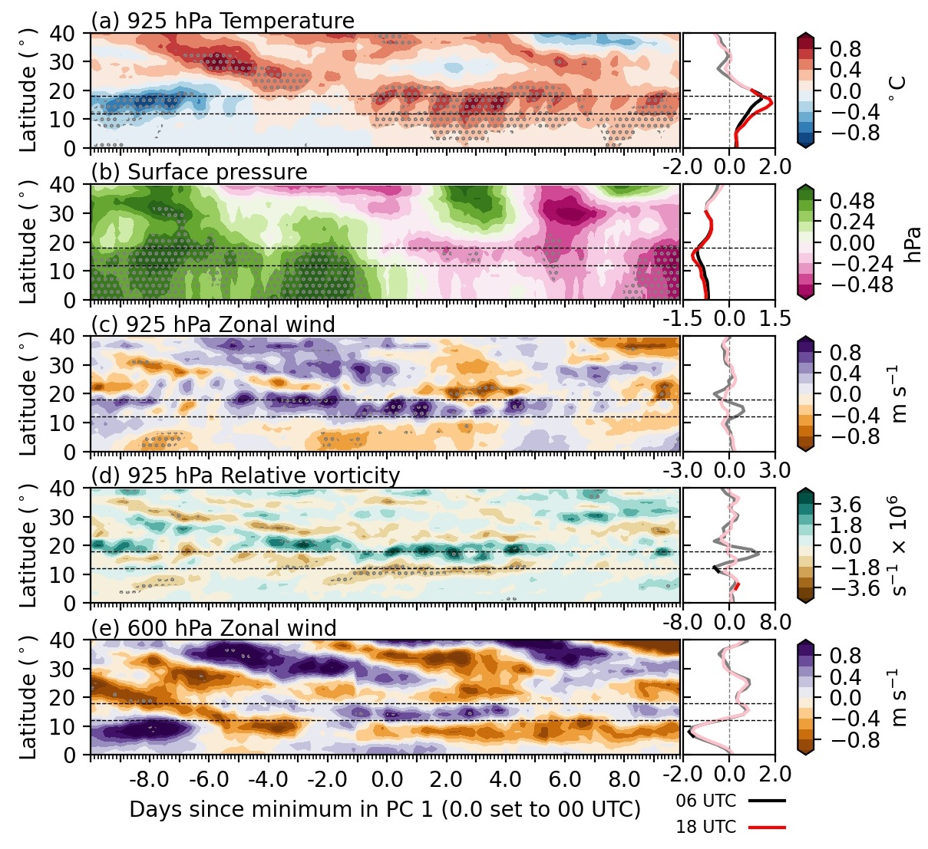
Results:
Land-atmosphere feedback associated with surface response.
Using ERA5 reanalysis, we identify that the surface response to intraseasonal variability impacts the dynamics of the West African monsoon.
An intraseasonal dry event promotes (a) low-level atmospheric heating, (b) a negative surface pressure tendency, and (d) increased vorticity across the Sahel.
Surface warming across the Sahel also promotes (e) an intensification and southward shift of the African Easterly Jet.
The combined effect of enhanced low-level monsoon westerlies and an intensified AEJ, increases low-tropospheric shear across Southern West Africa.
Hoevmullers (-15-20°E) during
an intraseasonal dry event.

Slide 8
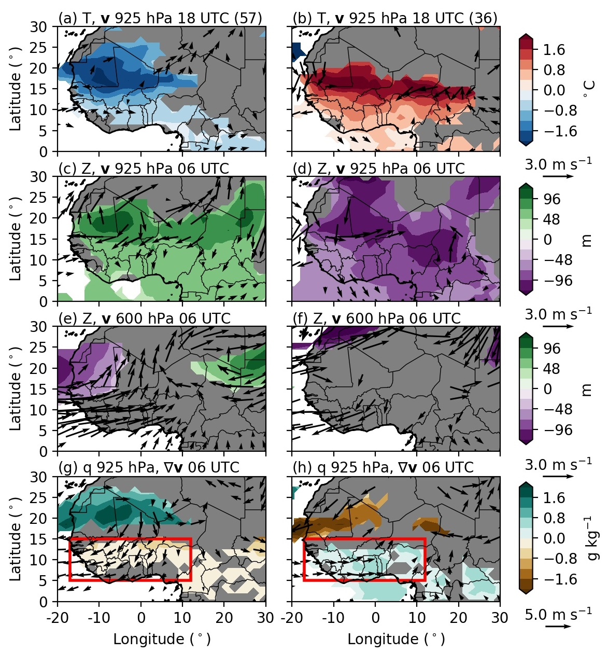
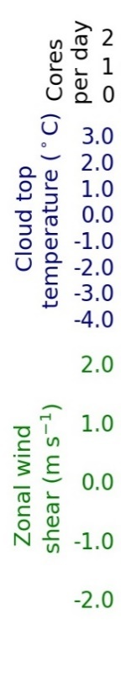

Results:
Convective storm response to intraseasonal land-atmosphere feedbacks.
Dry intraseasonal events are associated with enhanced low-troposphere shear and humidity across Southern West Africa.
Using 1800 UTC Meteosat thermal infrared brightness temperatures, we analyse changes in deep convection characteristics.
During a dry intraseasonal event, the minimum cloud top temperature associated with each convective storm decreases (blue), indicative of storm intensification, whilst total cloud cover reduces (grey).
Analysis of atmospheric changes at 12 UTC illustrates that both humidity (black) and shear (green) changes play a role in storm intensification.
Changes in low-level (filled) q and (arrows) shear during a dry intraseasonal event.
Zonal-mean changes in 18 UTC (blue) convective storm cloud top temperature, (grey) total cloud cover below -40°C, 12 UTC (purple) surface CAPE, (green) low-level shear, and (green) low-level shear.

Slide 9



Conclusions and future work
Conclusions:
Surprisingly, even with heterogeneous daily precipitation variations across West Africa, the surface responds to intraseasonal variability.
The surface response feeds back onto the atmosphere affecting the dynamics of the West African monsoon and characteristics of deep convection.
Future work:
Does the surface response affect monsoon onset?
Emma Barton UKCEH – Can understanding the surface response to intraseasonal variability improve subseasonal forecasts?
Bethan Harris UKCEH - Produce a global assessment of intraseasonal variability of land-atmosphere feedbacks.
Get in contact:
jostal@ceh.ac.uk
@joshtalib
@joshtalib
jostal@ceh.ac.uk

