Slide 1
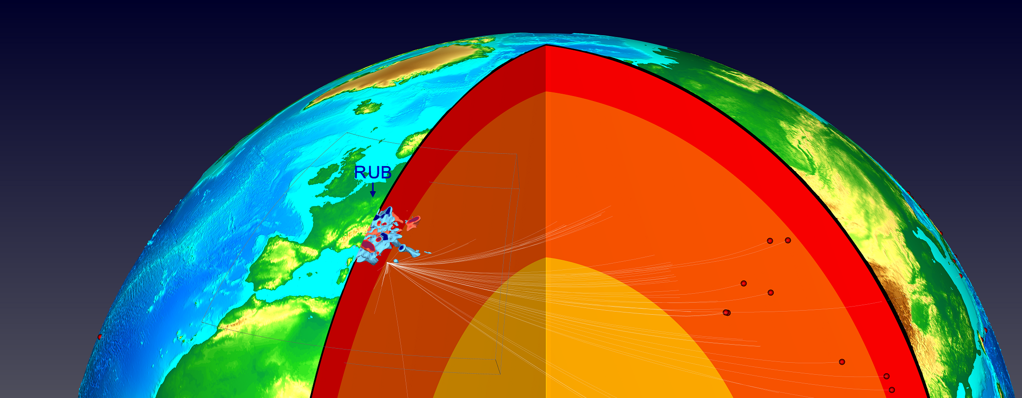




P-wave traveltime tomography of the Alpine upper mantle using AlpArray seismic network data
Marcel Paffrath, Wolfgang Friederich and the AlpArray Working Group

Slide 2
Please use presentation mode for animations and slide transitions!

Slide 3
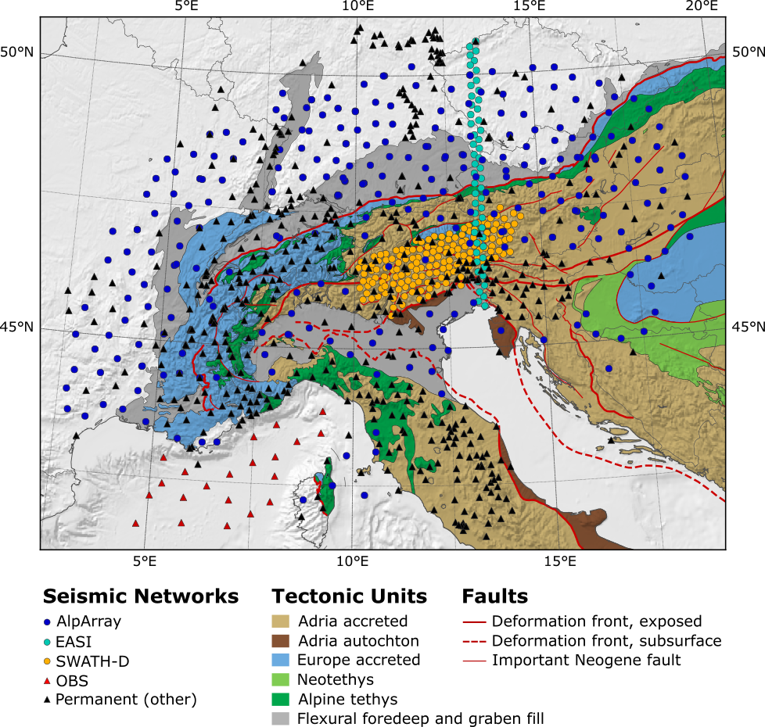
The AlpArray Seismic Network
Multinational, multidisciplinary research initiative on the Alps and neighboring mountain belts
Over 600 seismological broadband stations (permanent networks + temporary stations)
Measuring period of over 3 years
AlpArray Seismic network + complementary experiments + surrounding stations (5° radius around 46°N 11°E)
Paffrath et al. 2021 (in review.), Tectonic map compiled by M. Handy

Slide 4
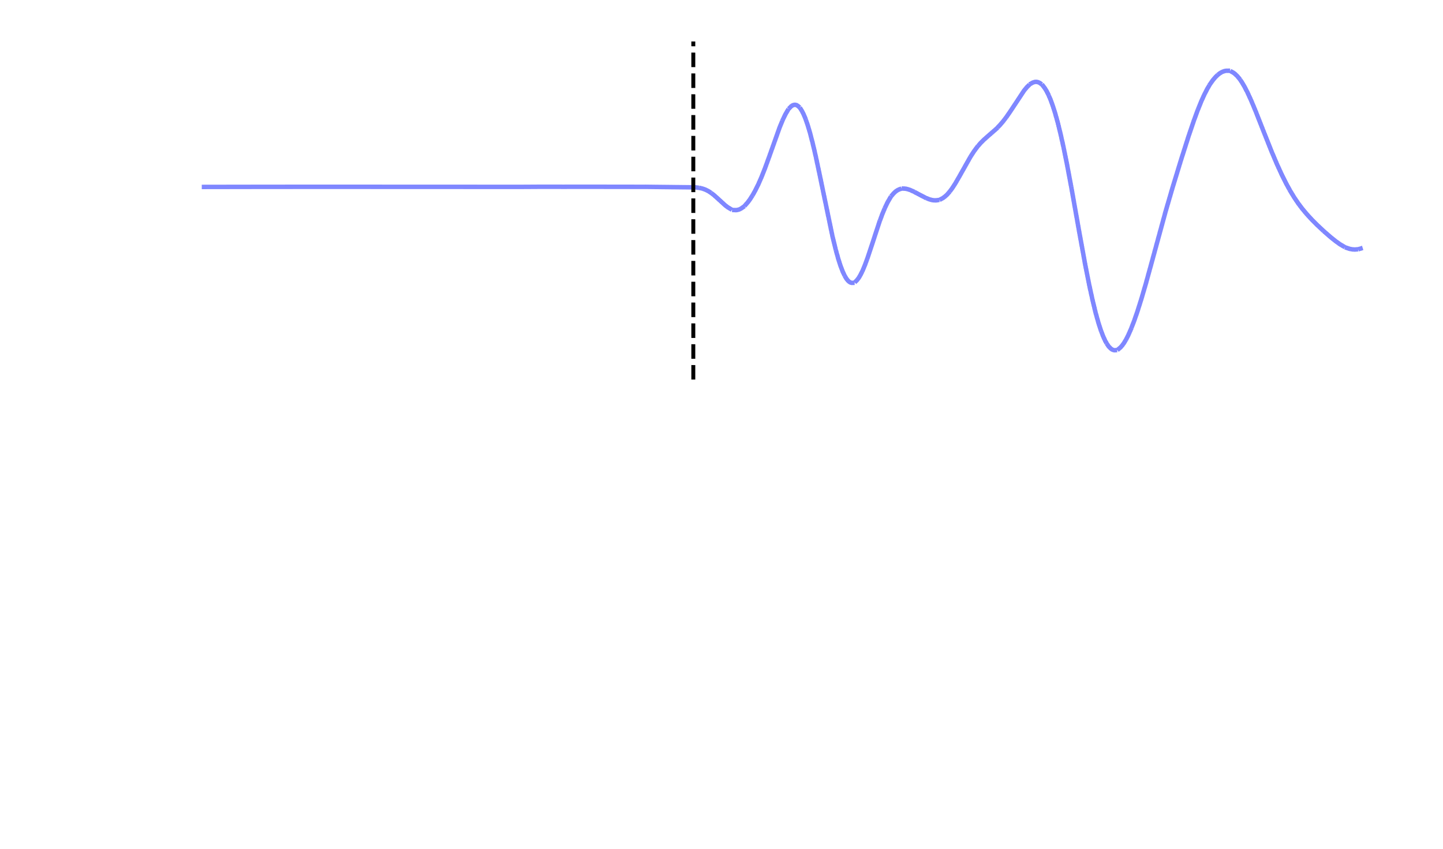
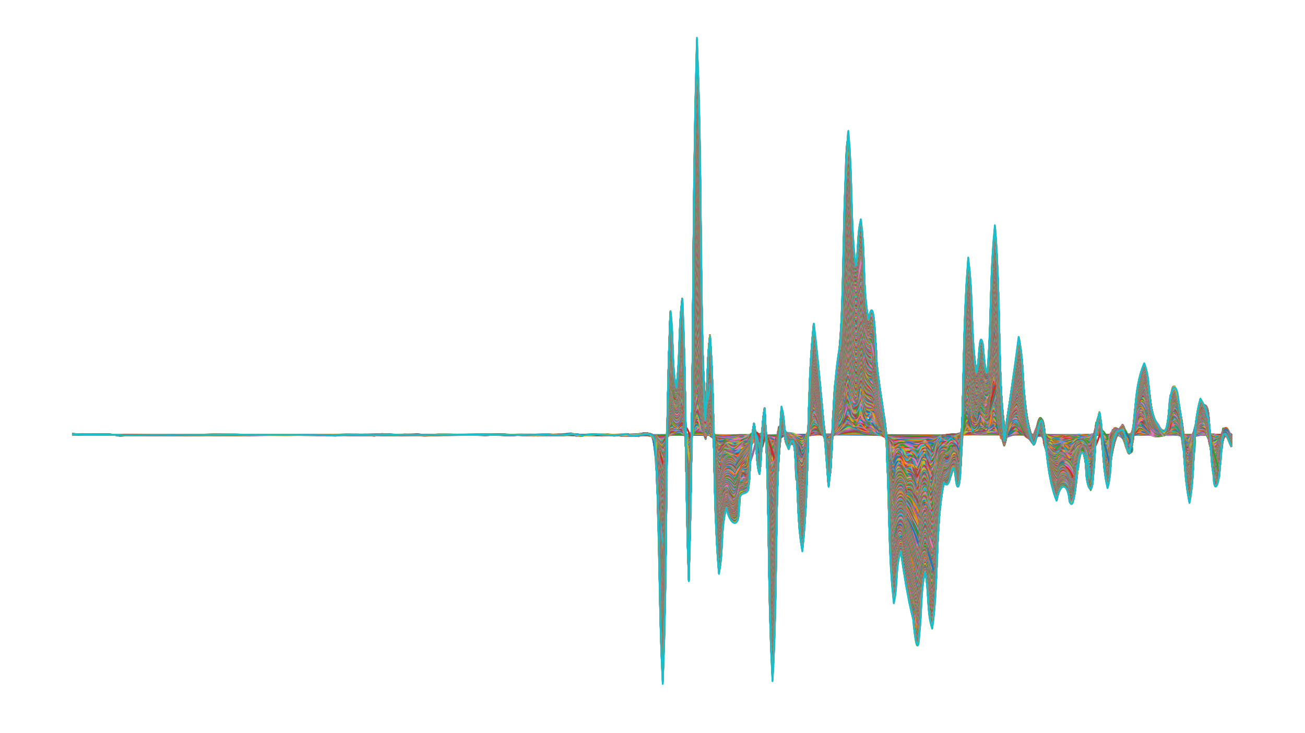
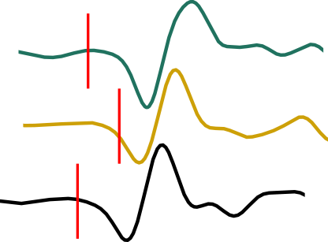
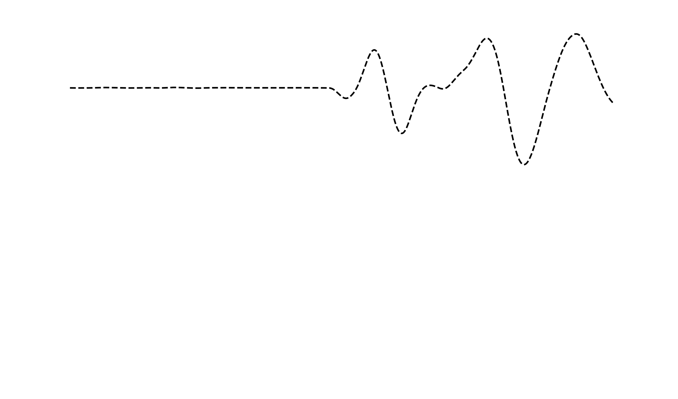
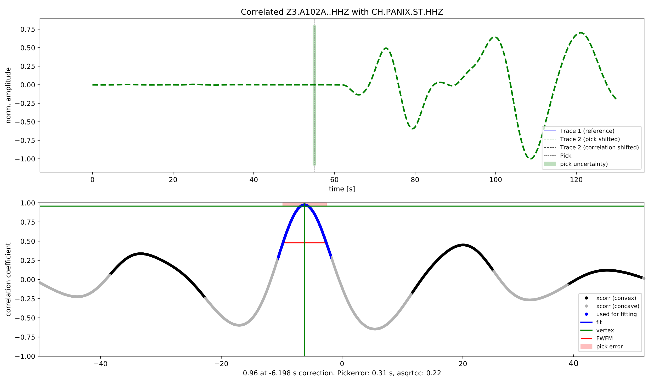
P-Wave Traveltime Picking
Filter & pick
Stack traces
correlate
Automatic picking based on Kurtosis (higher-order statistics) and AIC for reference times (Kueperkoch et al. 2010)
Beamforming/stacking using cross-correlation on reference trace
Filter & pick reference trace
Correlation of stacked trace with all stations for final onset
Calculation of uncertainty based on cross-correlation coefficient and width of cross-correlation function
Δt
Δt

Slide 5
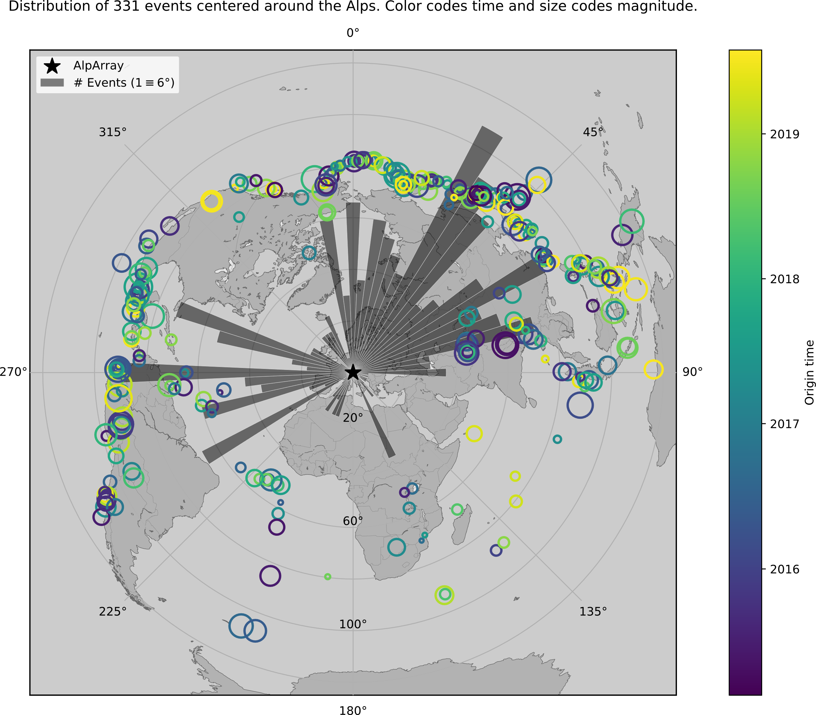
Event Database
HF
Azimuthal Distribution of 331 events of main dataset (370 events) used for inversion. Color codes origin time. Size codes magnitude.
Mantle Phases (between ~35° and 135° distance)
Absolute traveltimes for use in full-waveform inversion, relative travel times for traveltime tomography
Two Datasets:
HF (up to 0.5 Hz) / LF (up to 0.1 Hz)
> 170.000 picks from 370 events (HF)
> 255.000 picks from 421 events (LF)
Strongly uneven azimuthal distribution (histogram) with most events coming from NE, W
Main dataset
Paffrath et al. 2021 (in review)

Slide 6
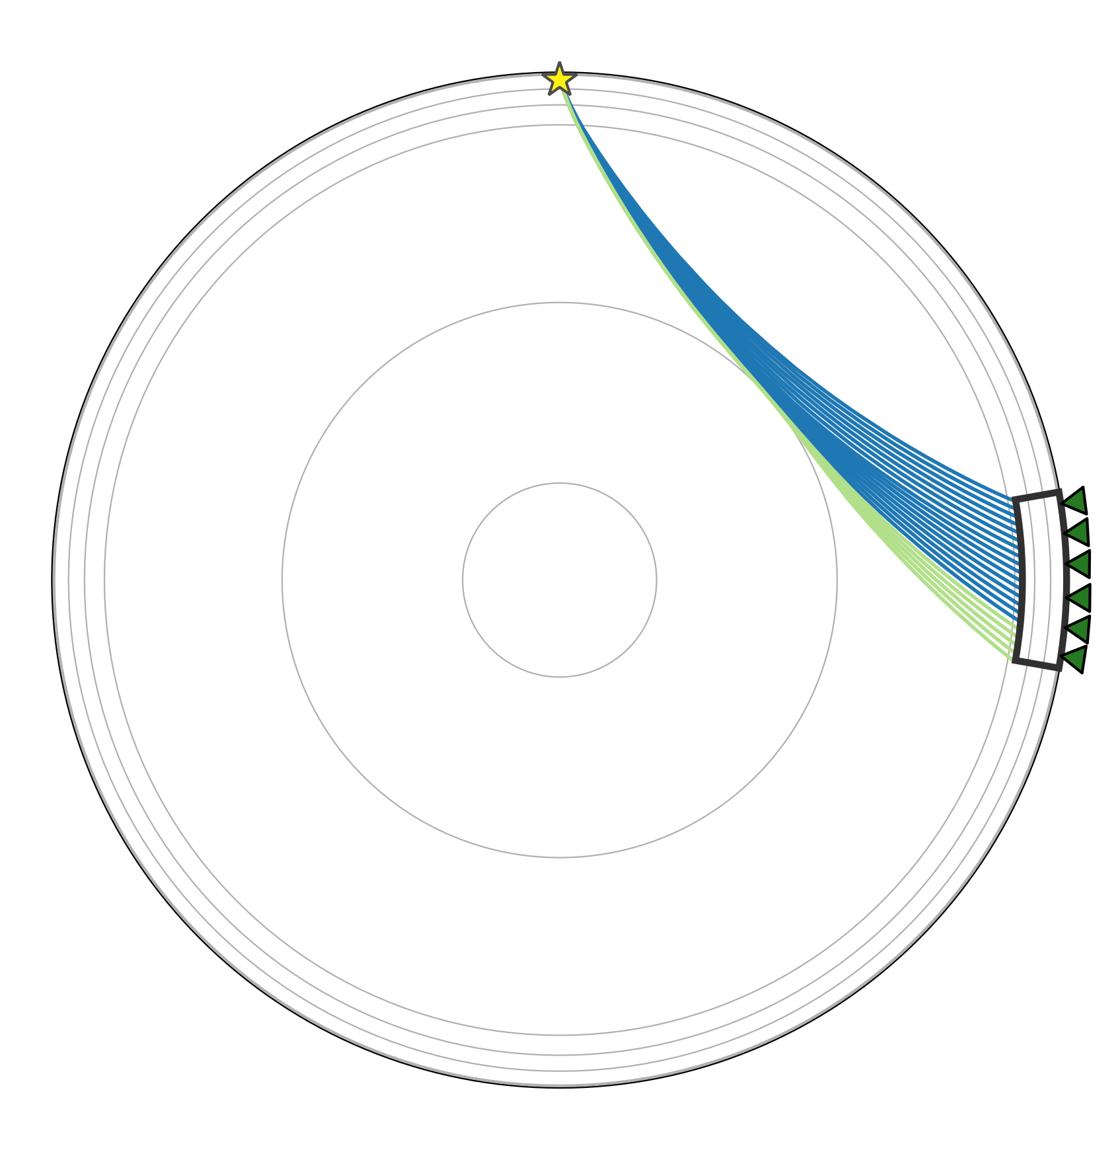
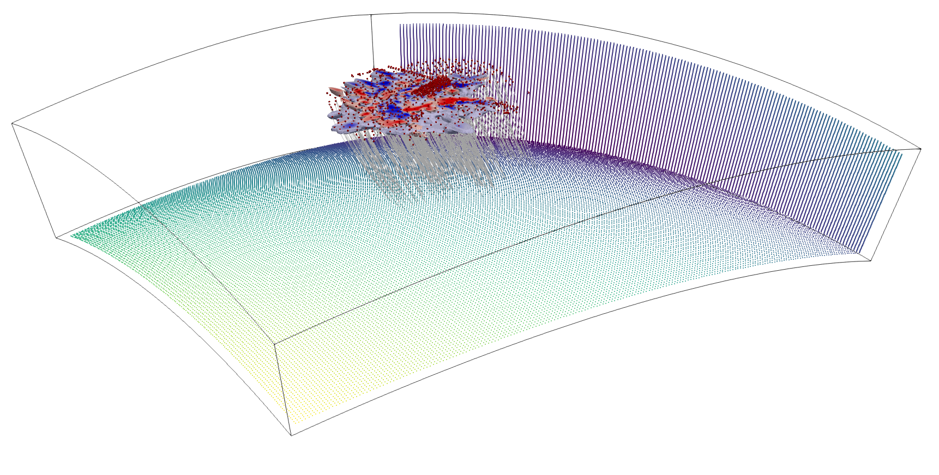
Hybrid method
Global (1D)
Reduce computational costs assuming a spherically symmetric global earth (1D) and only account for regional heterogeneities in a 3D box
1D calculation to grid boundaries of regional box using Tau-P (ObsPy)
Inside box: Fast Marching Method (Rawlinson et al. 2004)
FMTOMO inversion code, subspace inversion method (Rawlinson et al. 2004)
We directly include a precise 3D crustal model as part of the teleseismic inversion model
    Nonlinearity of the iterative inversion
    Interpretation of crust + mantle in one model
We allow small velocity changes to be made where the resolution of the crustal model is low
Regional (3D)
CRUSTAL MODEL

Slide 7
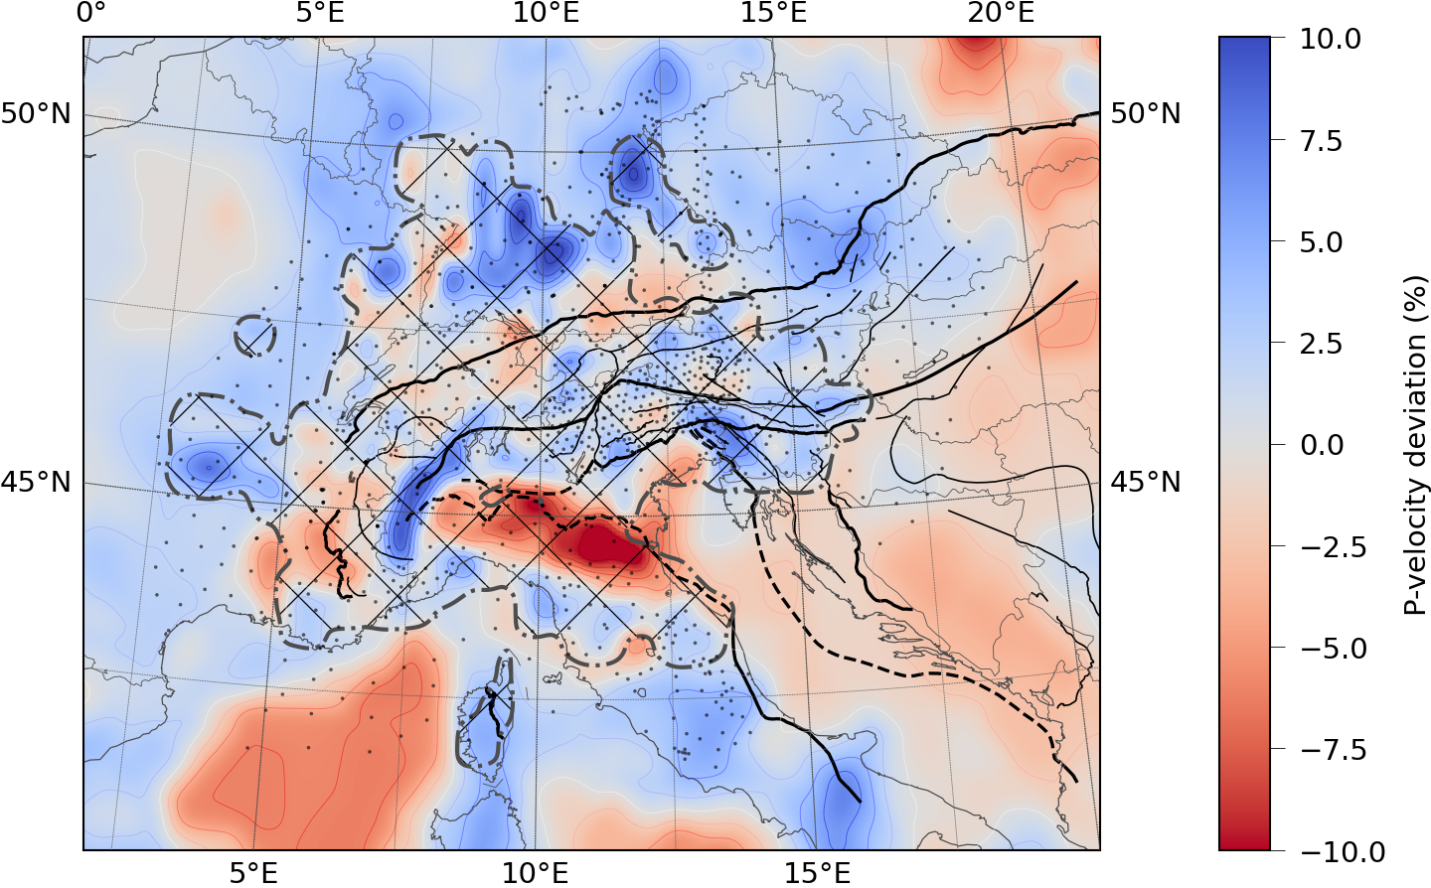
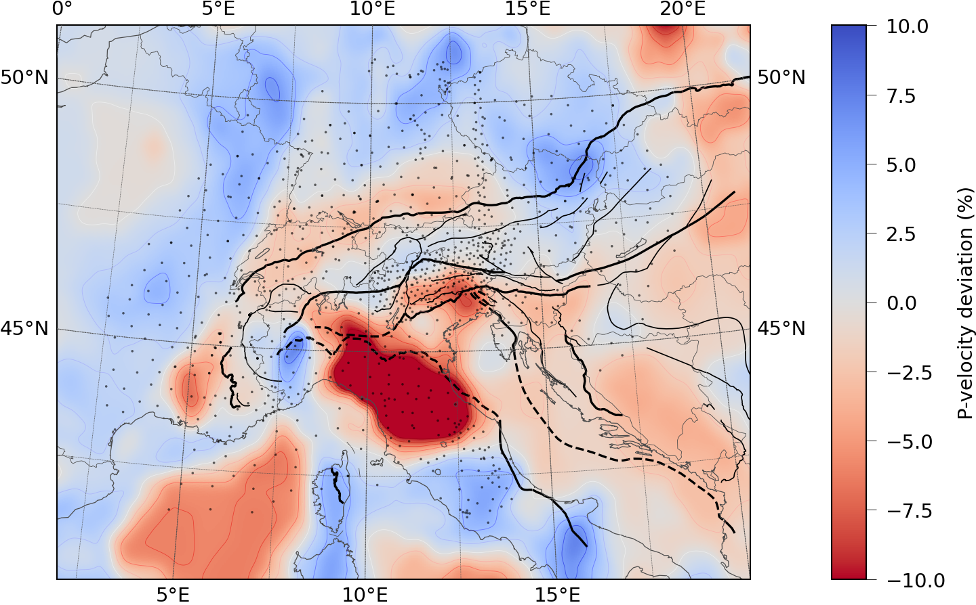
Integration of crustal model
Slice through crustal model at 15km depth
“Background”: EuCrust07 (Tesauro et al. 2008)
    Layered model containing upper, lower crustal boundaries (Moho) + average v_{p} velocities + sediment thickness
    Improve Moho information in the Alpine region using Spada et al. (2013) Moho map
  Replace generic model with 3D tomographic model by Diehl et al. (2009) if the resolution information is sufficient
  Smoothing of the model to fit on the inversion grid (25x25x15 km)
EuCrust-07 model (Tesauro)
Diehl model
Ivrea
Po-plain
Boundary (smooth)
Paffrath et al. 2021 (in prep.)

Slide 8

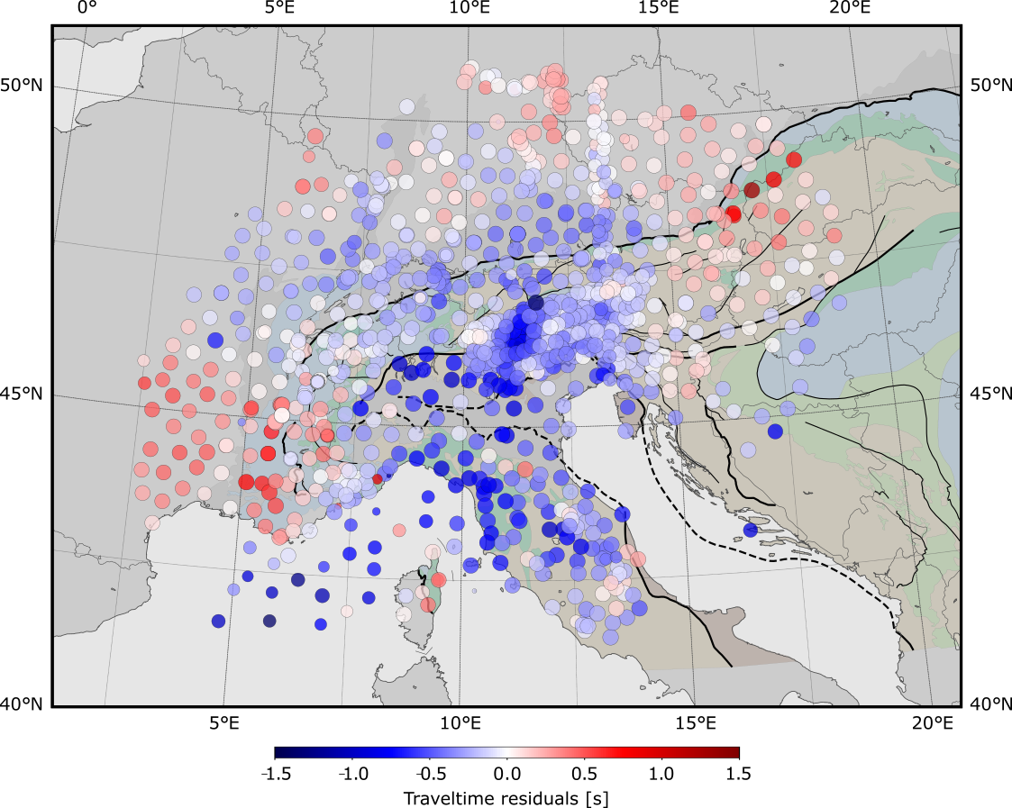
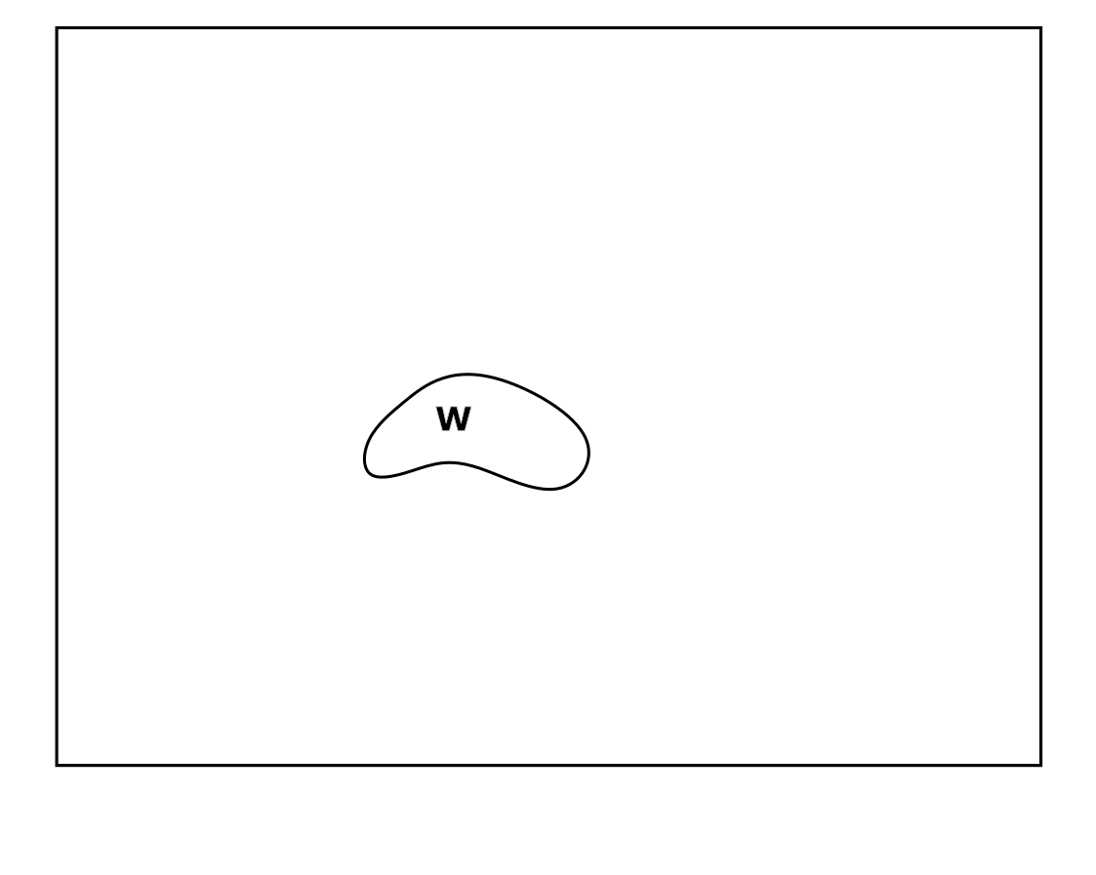

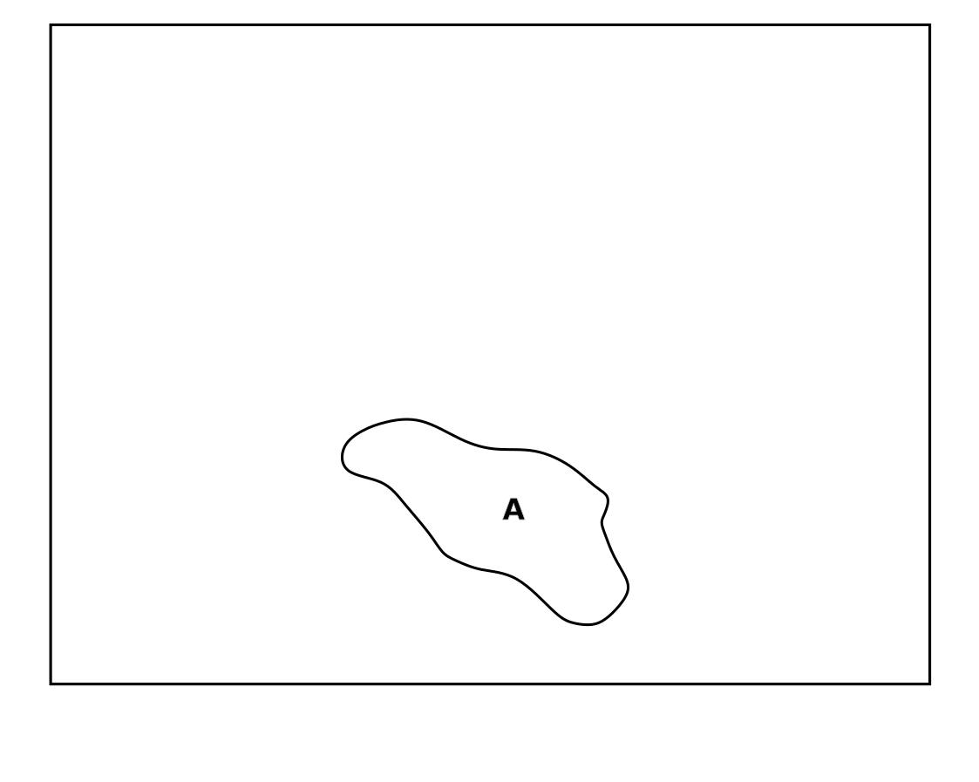
Stacked traveltime residuals (HF)
Stacked and demeaned traveltime residuals relative to 1D earth model for all 370 events, corrected for crustal influence
Trace of western Alpine high-velocity anomaly (W)
High-velocity anomaly in the central Alps (C)
Eastern Alpine anomaly (E) separated from (C) by (possible) slab gap
Strong high velocity zone below Apennines extending to the southern borders of the array (A)
Paffrath et al. 2021 (in review)

Slide 9
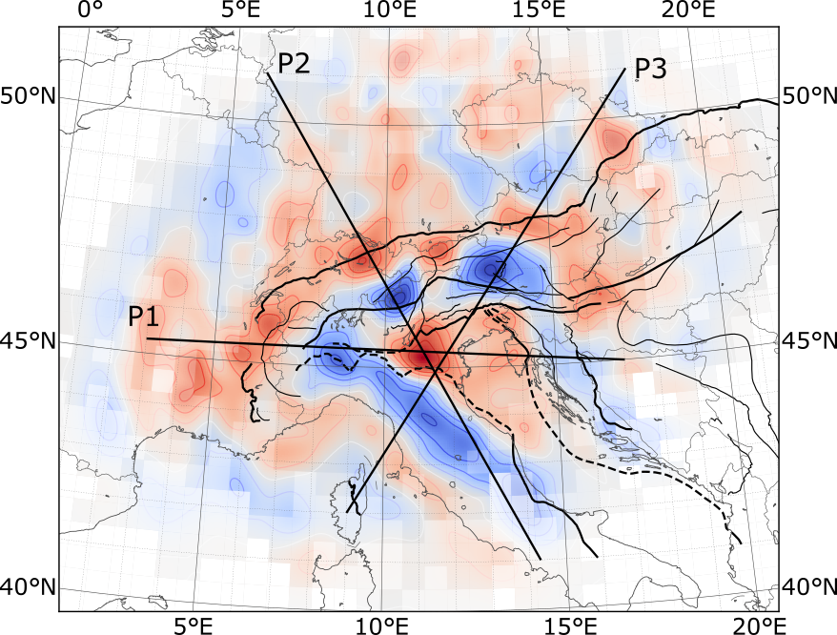
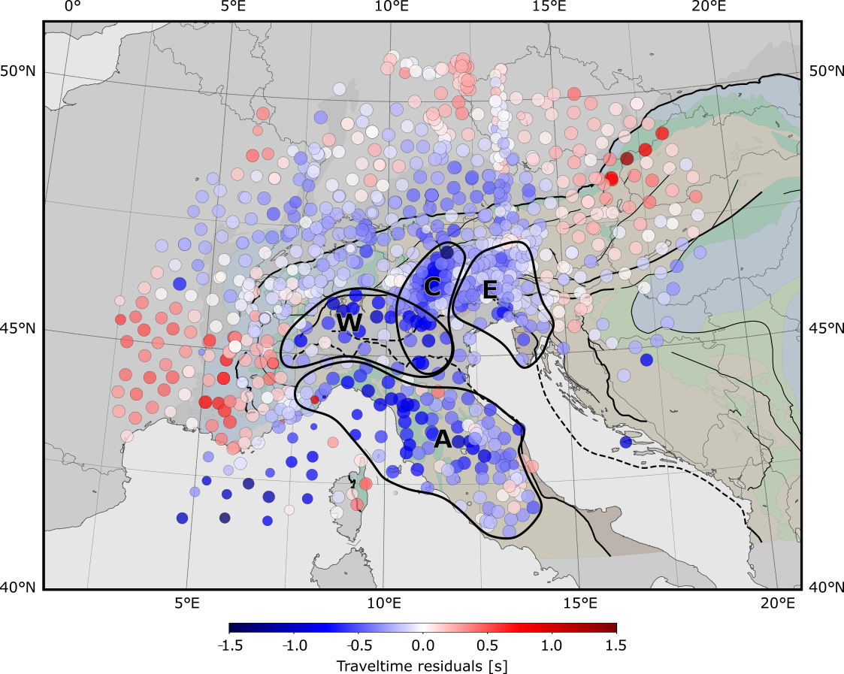
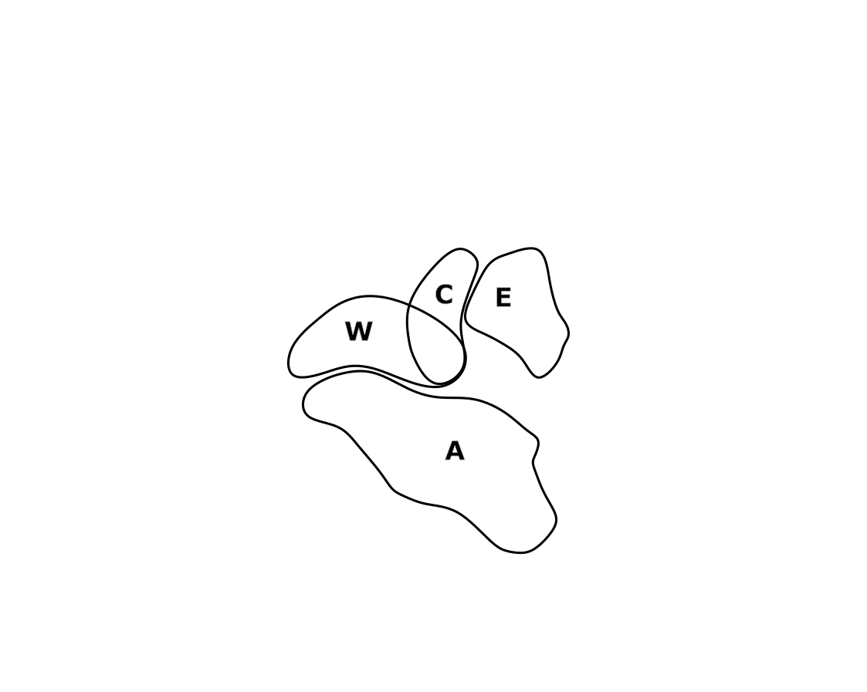
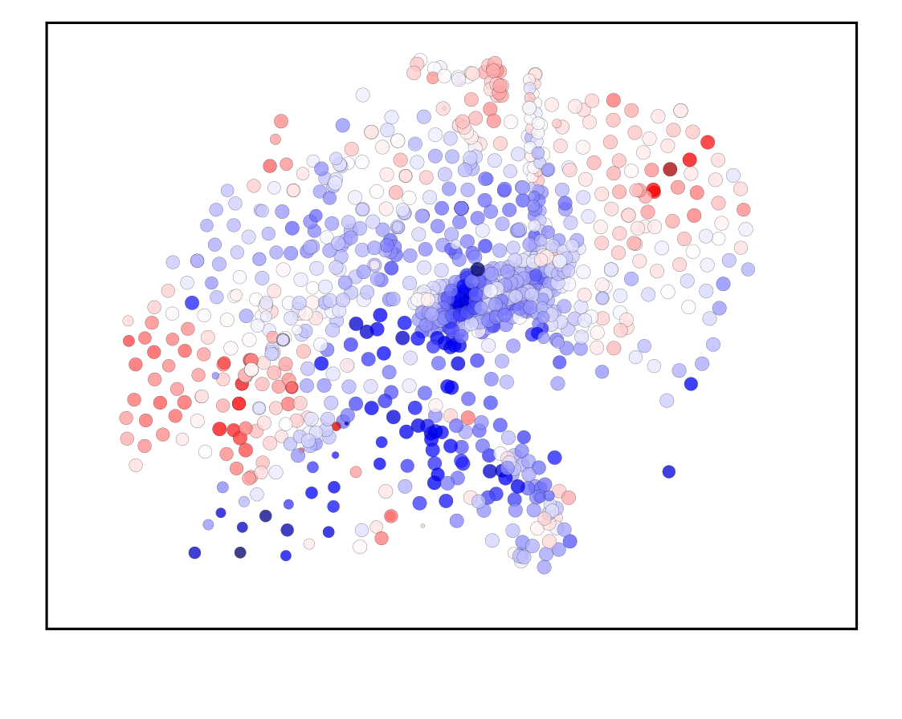
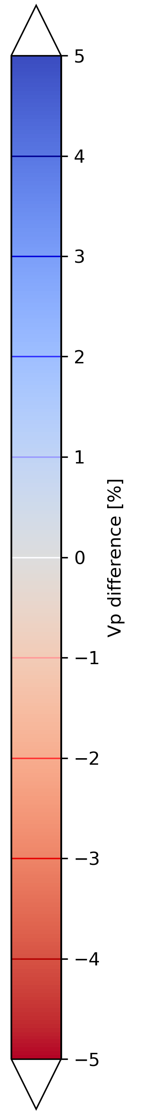
Model results – Horizontal Slice
Relation between traveltime residuals at the surface and velocity perturbation in the resulting model
Horizontal Slice at 180 km depth through the inversion result
Three profiles
    8: Western Alps through Apennines
    B: Through the central Alpine anomaly (B of Lippitsch et al. 2003)
    12: Through the eastern Alps and perpendicular to Apennines
Paffrath et al. 2021 (in review)

Slide 10
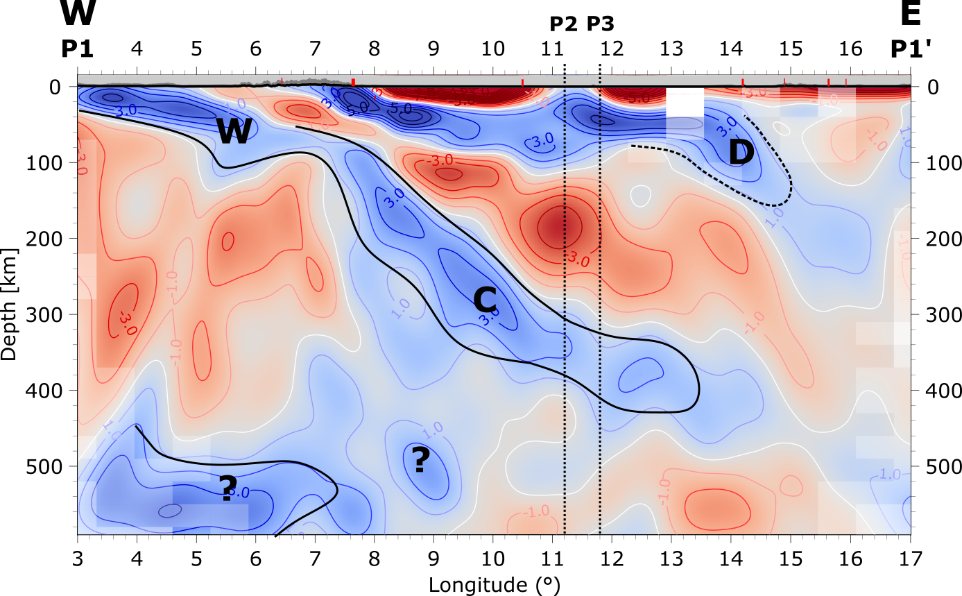
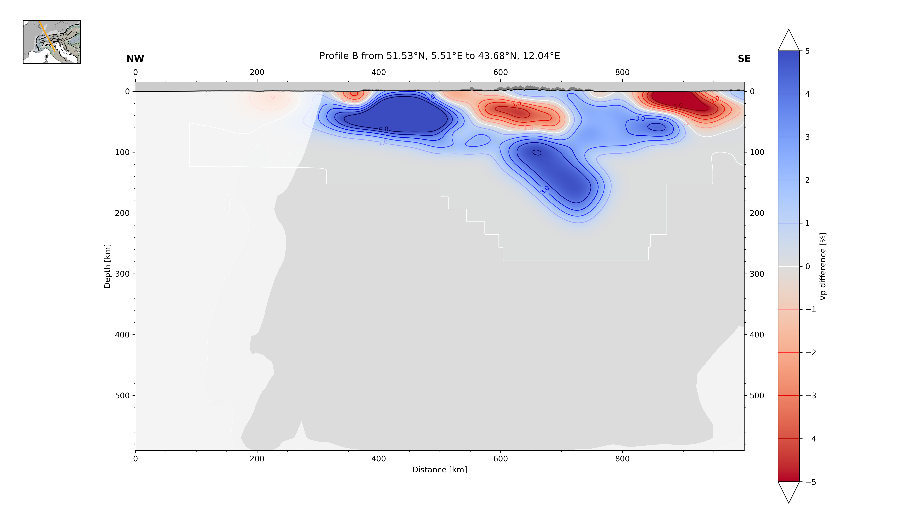
Model results – Section 1
Slice through southern part of western Alpine slab and central Alpine slab
Dinaric slab can be seen in the east
Central Alpine slab sliced parallel to strike
Connected to western Alpine slab, sliced along dipping direction
Upwelling asthenosphere
Dinaric slab
European slab from western and central Alps
Alpine Tethys relicts?
Paffrath et al. (in prep.)

Slide 11
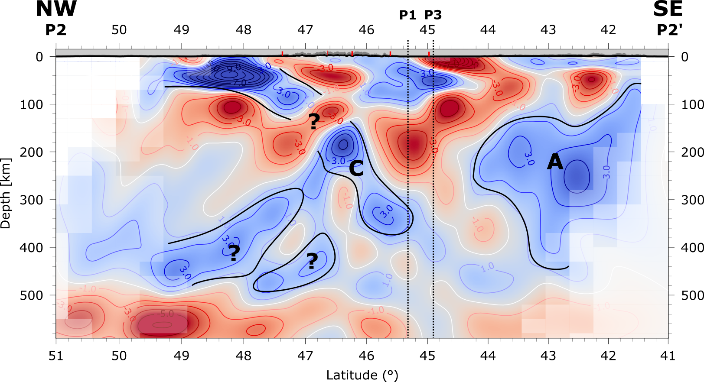
Model results – Section 2
Upwelling asthenosphere
Adriatic slab (Apennines)
Central Alpine slab, mostly derived from European plate, but still close to Adria
Paffrath et al. (in prep.)

Slide 12
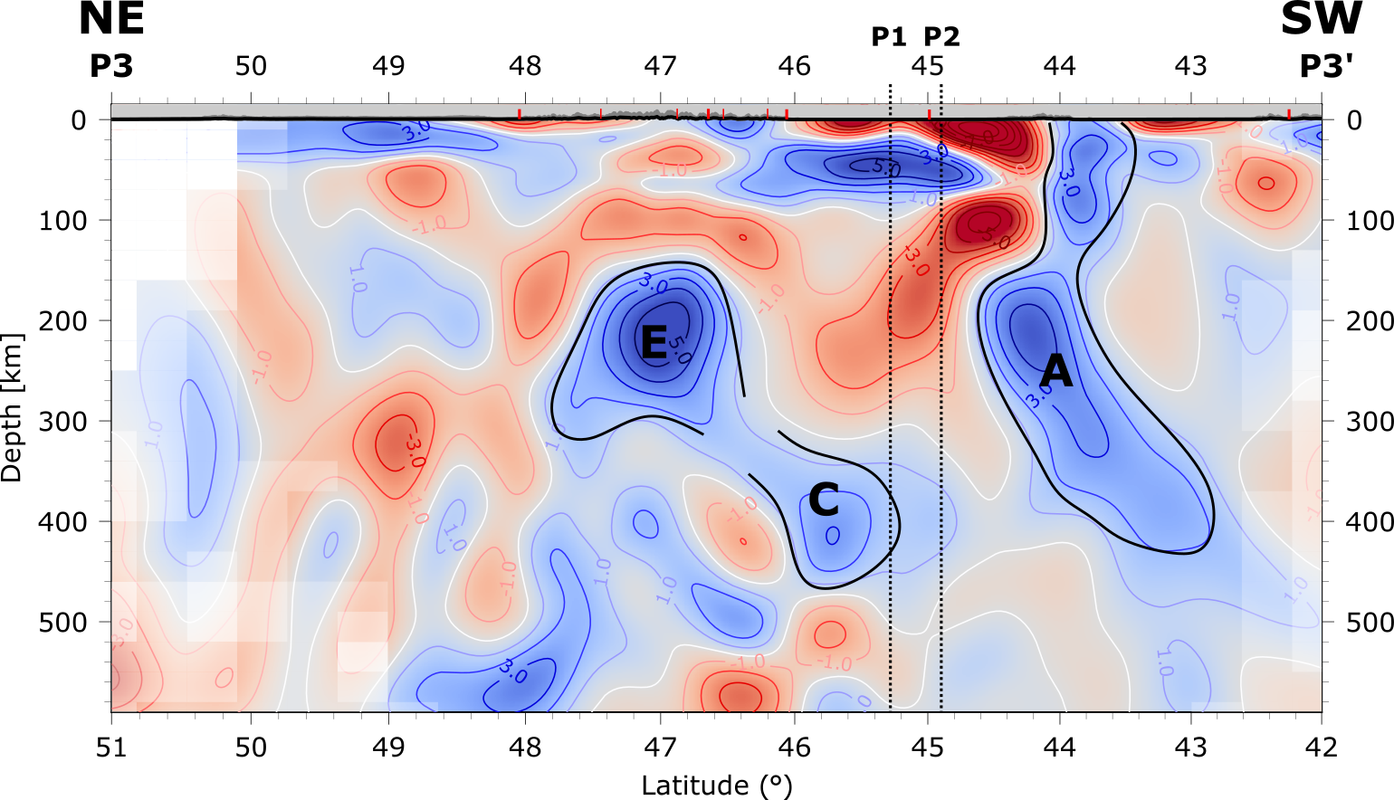
Model results – Section 3
Delaminated lithosphere
Upwelling asthenosphere
Overturned part
Detached European slab
Alpine Tethys relicts ?
Adriatic slab (Apennines)
Central Alpine slab
Paffrath et al. (in prep.)

Slide 13
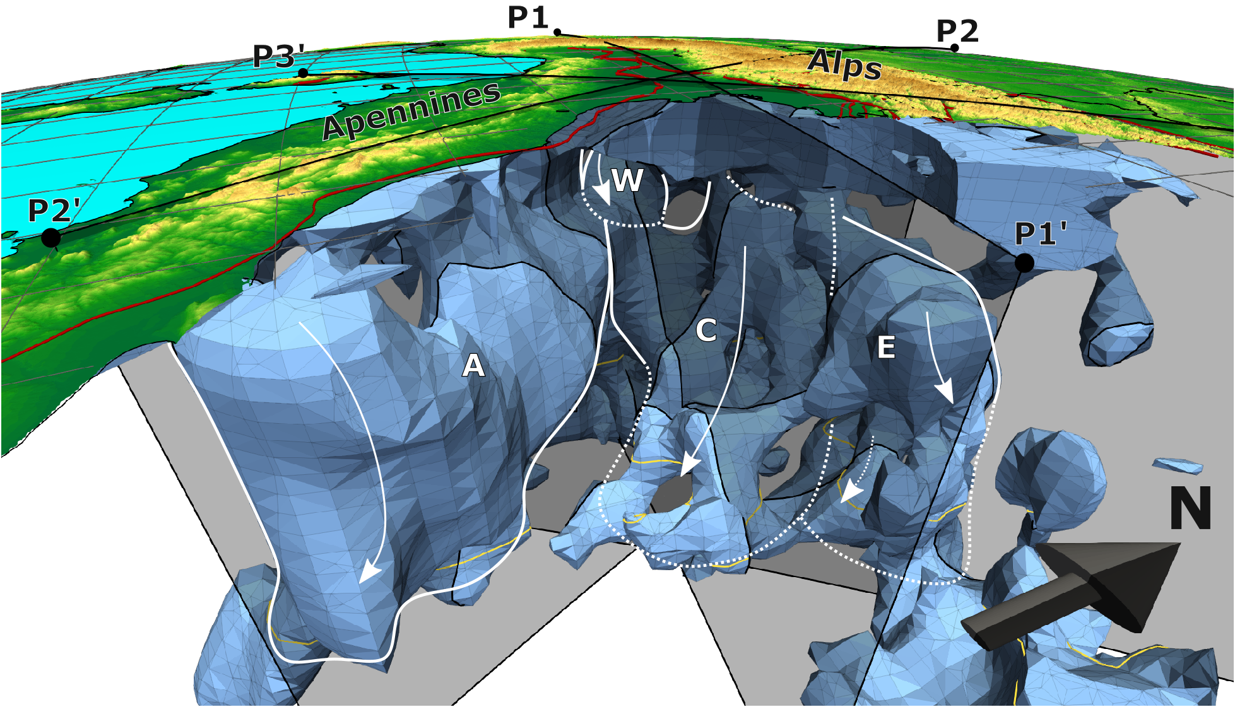

Model results – 3D view
Iso-surfaces at 1.25% P-wave velocity increase (Paffrath et al., in prep.)

Slide 14
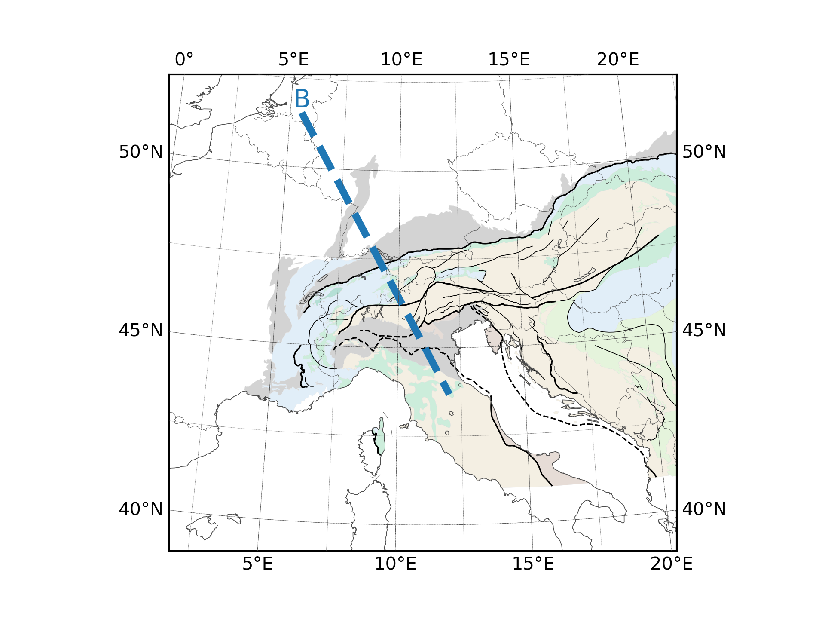
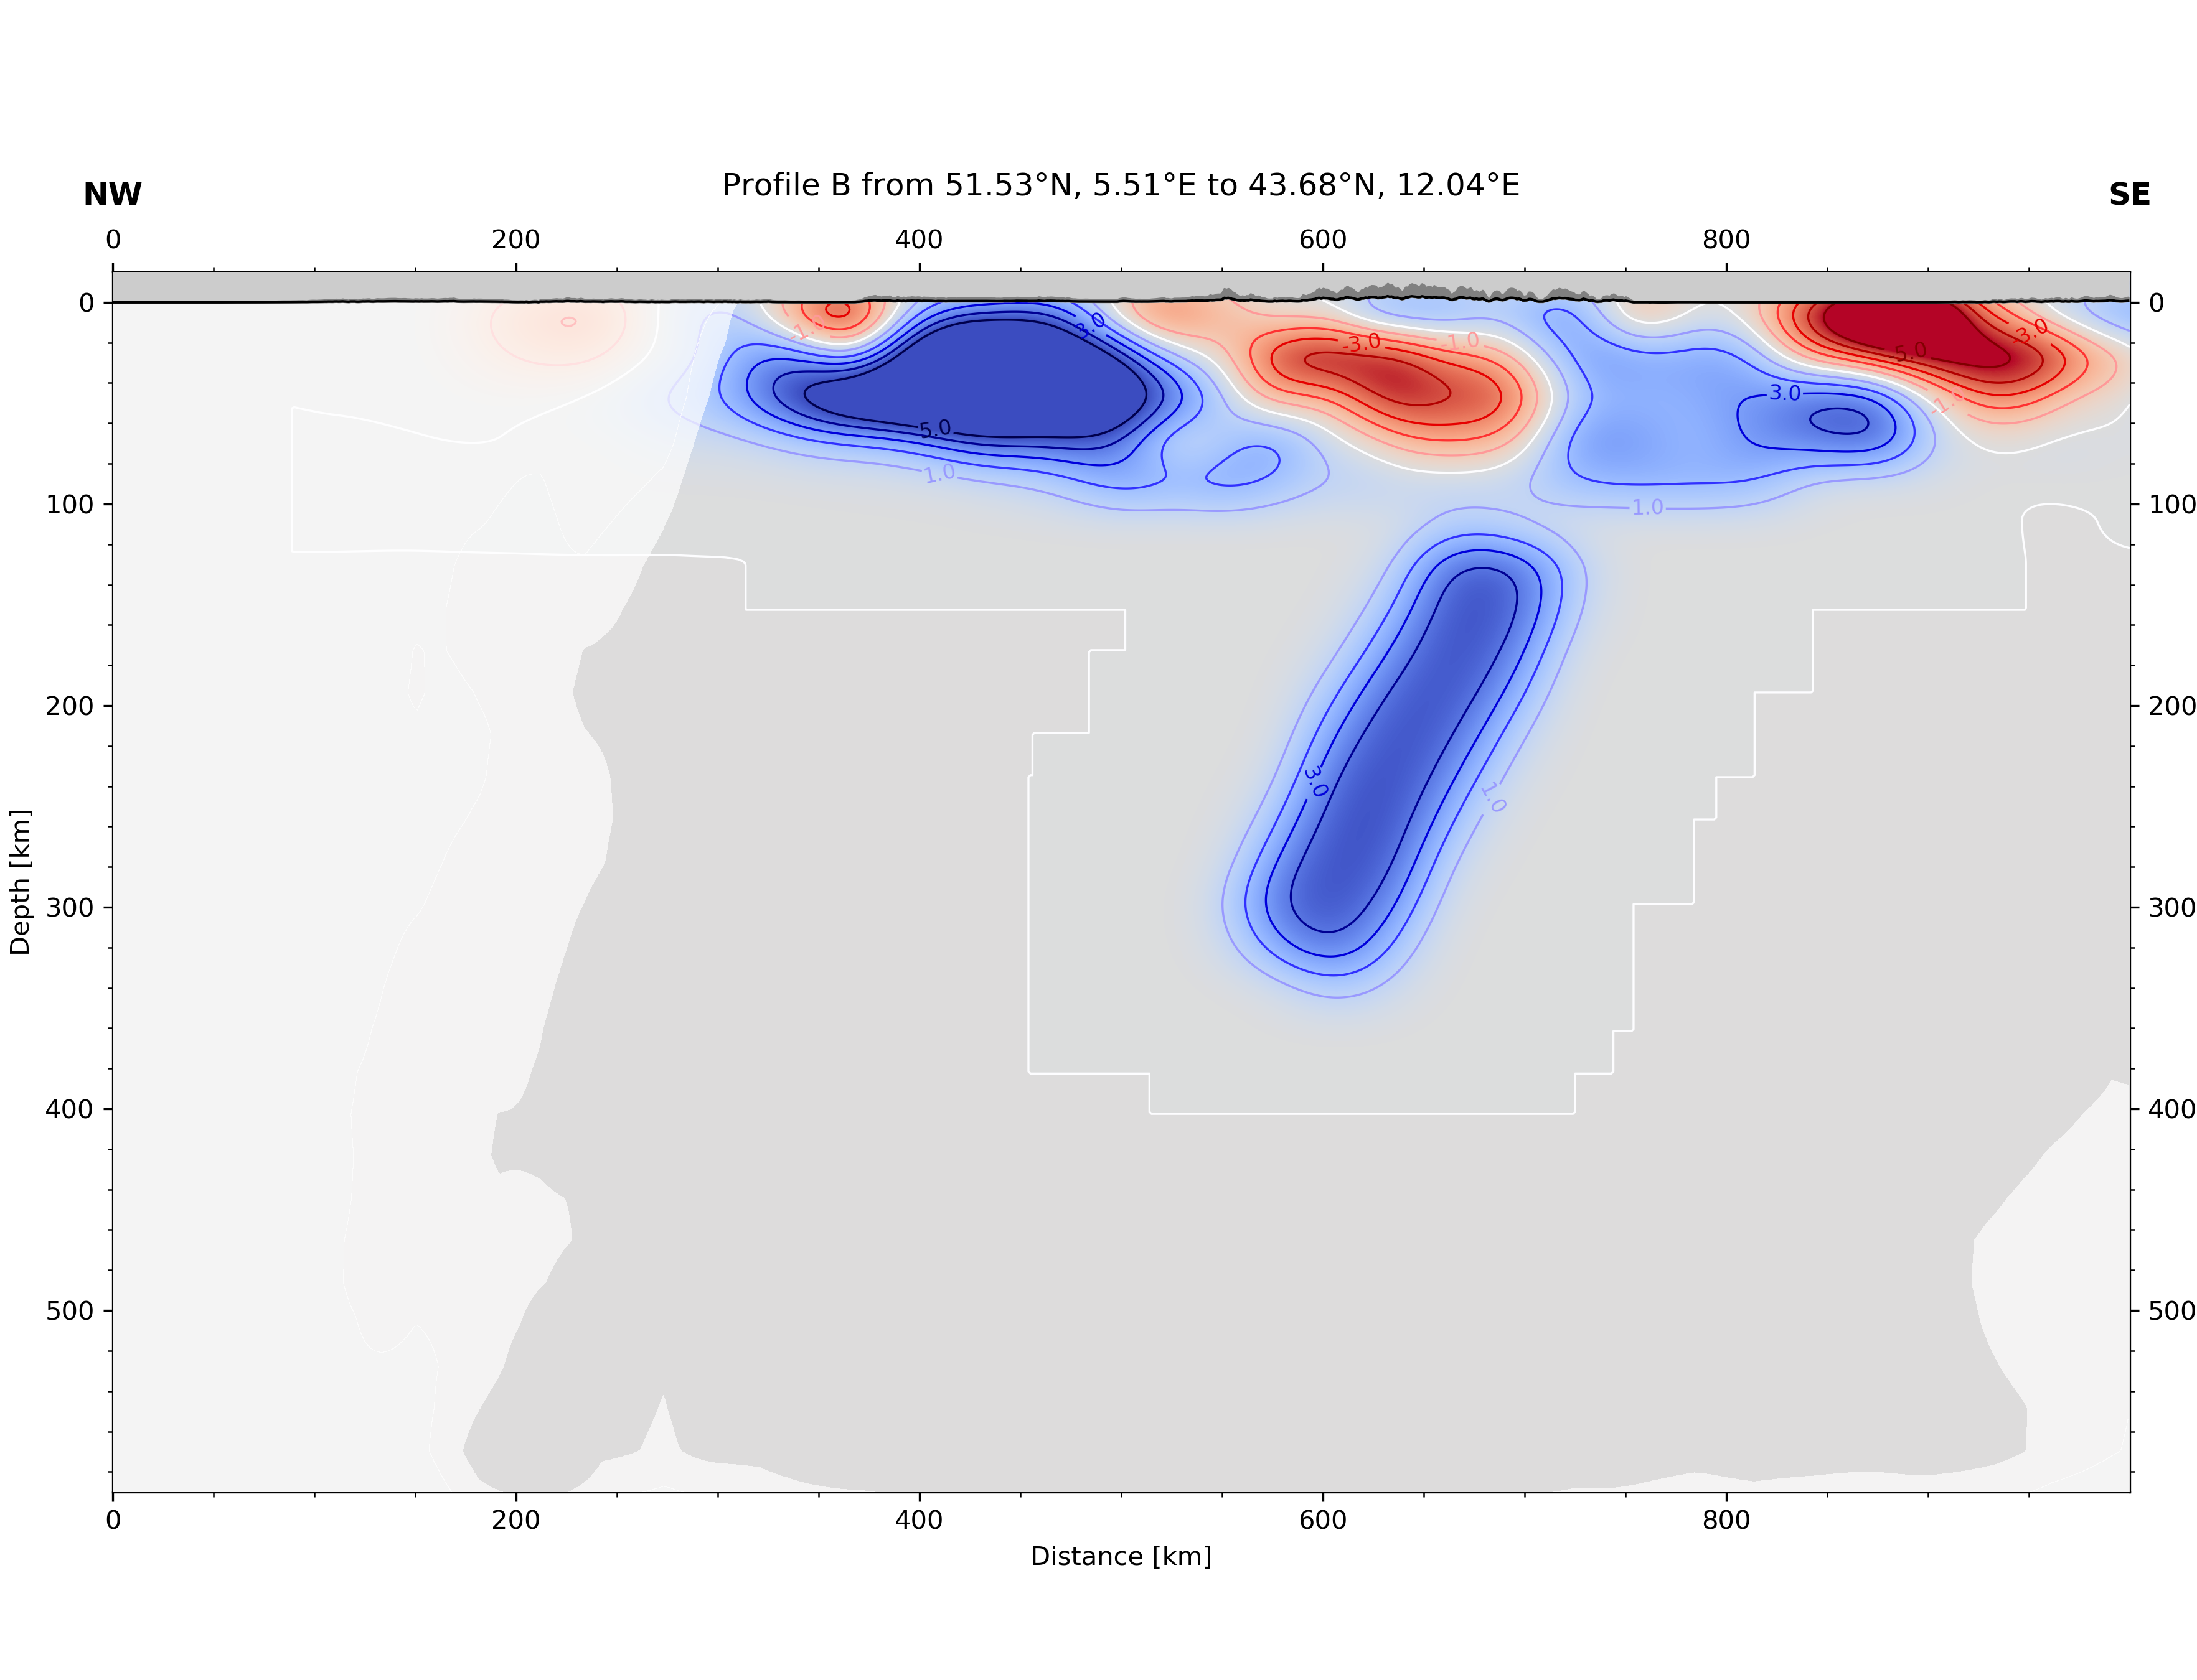

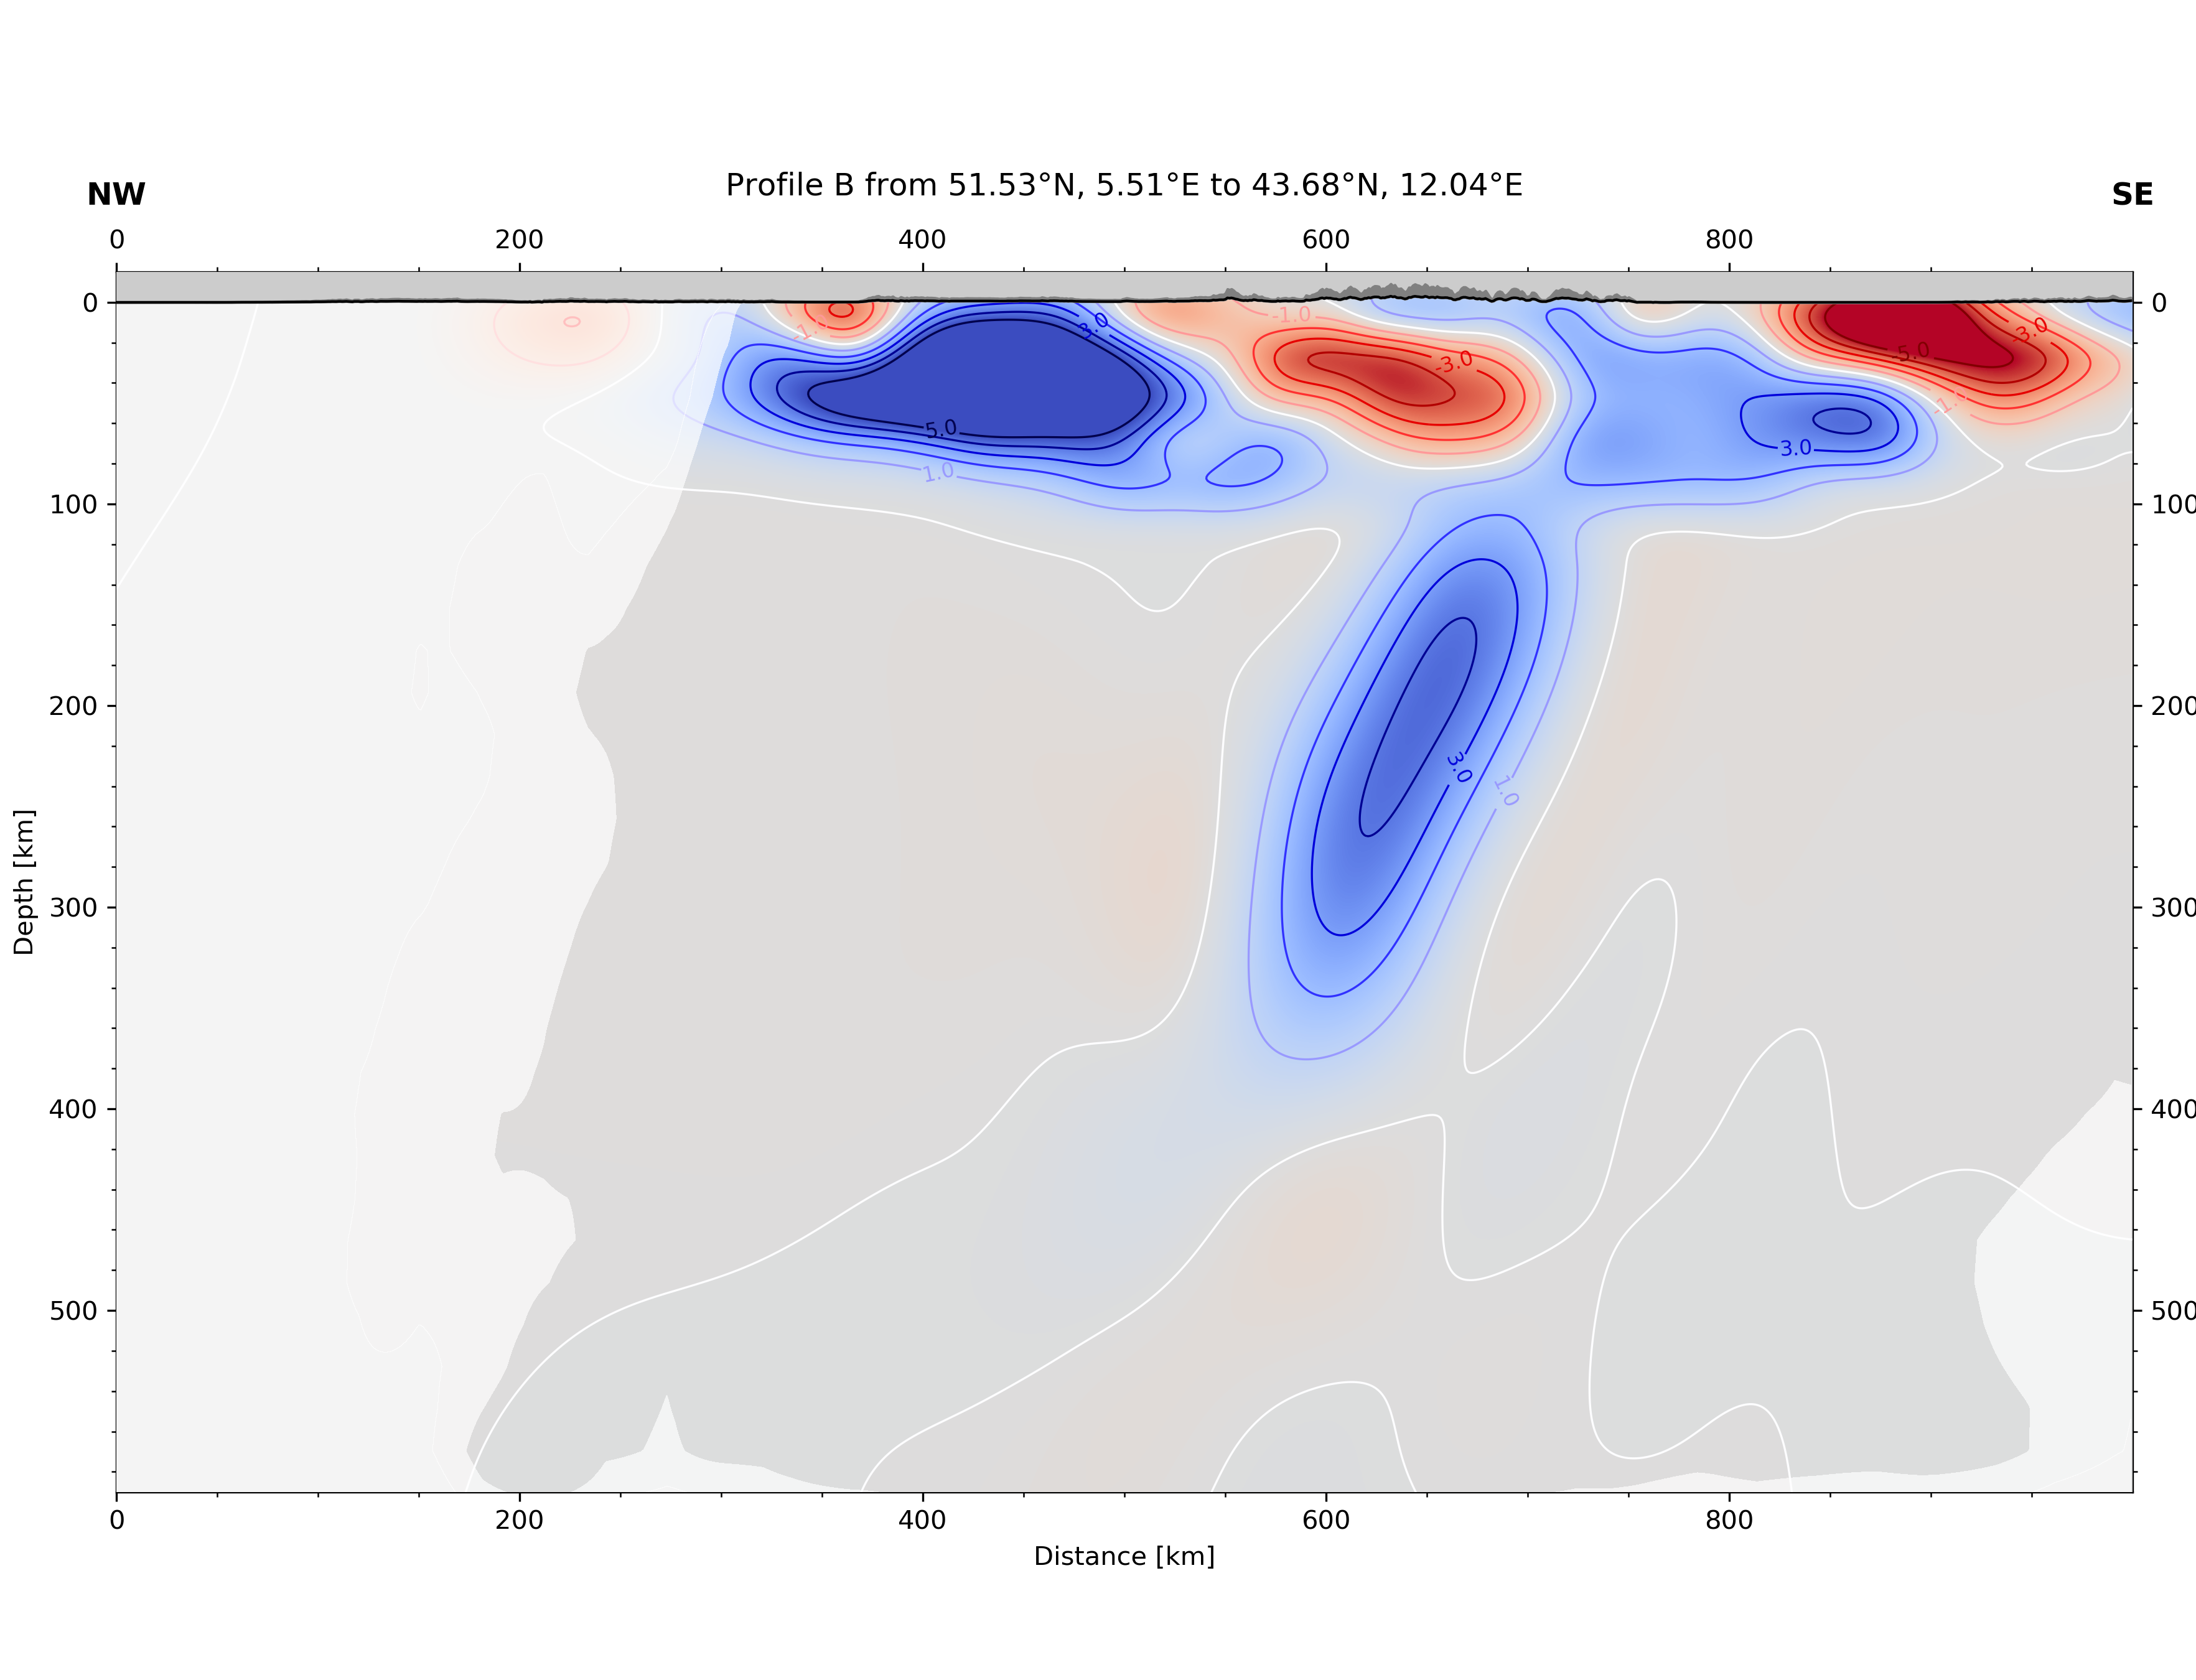
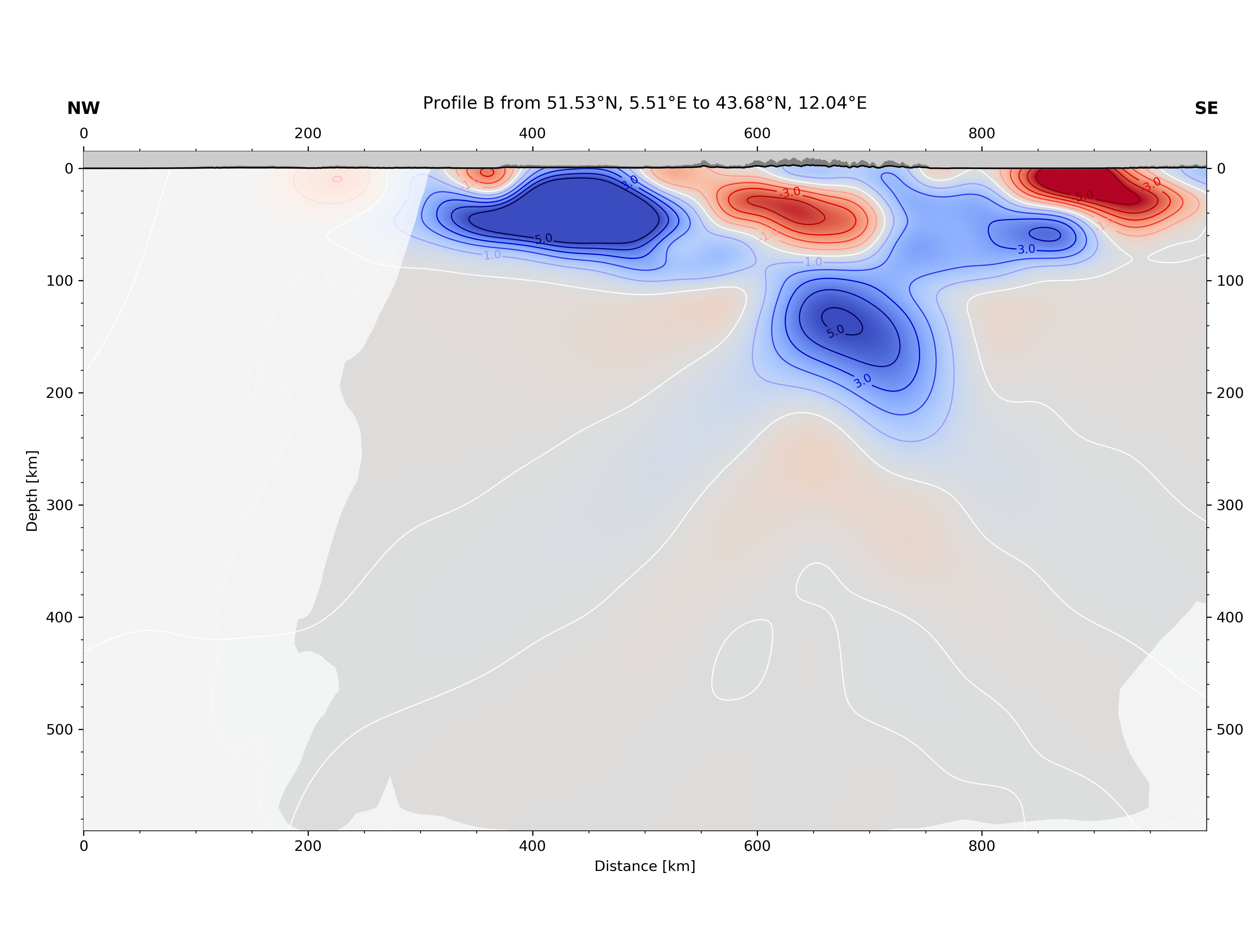
Resolution Analysis
Lippitsch (2003) Profile B, reversed slab orientation test
Dedicated resolution tests for different features
Always simulate through crustal model using actual source/receiver configurations and uncertainties
Add noise to synthetic data
Synthetic tests:
Assume different slab geometries/orientation
Dipping direction resolved, however smearing possible, mostly in depth increasing apparent dip angle
Crustal model (T. Diehl 2009)
Crustal model (T. Diehl 2009)
Input slab
Input slab
Crustal model (T. Diehl 2009)
Crustal model (T. Diehl 2009)
smearing
smearing
Resolved slab
Resolved slab
*least events coming from NW not most

Slide 15
Summary & Outlook
Traveltime Tomography:
High resolution P-wave tomography of the upper mantle in the Alps with an integrated crustal model from over 170.000 relative P-wave onsets
Publish results
Full Waveform Inversion:
Use traveltime tomography results as starting model for Full Waveform Inversion
Forward hybrid solver: injecting global wavefield calculated using AxiSEM (Nissen-Meyer et al 2016) or Gemini (Friederich 1995) into Stacey boundary conditions of Specfem3D (Komatitsch 2002)
    EGU talk by Thomas Möller: A hybrid method to calculate teleseismic body waves in a regional 3D model using GEMINI and SPECFEM (EGU21-14565)
Inversion: Analysis of Sensitivity and Kernel Inversion ASKI (Schumacher et al. 2015)

Slide 16
References
AlpArray Seismic Network (2015): AlpArray Seismic Network (AASN) temporary component. AlpArray Working Group. Other/Seismic Network. doi:10.12686/alparray/z3_2015, http://www.alparray.ethz.ch/
Amante, C. and B.W. Eakins, 2009. ETOPO1 1 Arc-Minute Global Relief Model: Procedures, Data Sources and Analysis. NOAA Technical Memorandum NESDIS NGDC-24. National Geophysical Data Center, NOAA. doi:10.7289/V5C8276M
T. Diehl, S. Husen, E. Kissling, N. Deichmann, High-resolution 3-D P-wave model of the Alpine crust, Geophysical Journal International, Volume 179, Issue 2, November 2009, Pages 1133–1147, https://doi.org/10.1111/j.1365-246X.2009.04331.x
Wolfgang Friederich, Jörg Dalkolmo; Complete synthetic seismograms for a spherically symmetric earth by a numerical computation of the Green's function in the frequency domain, Geophysical Journal International, Volume 122, Issue 2, 1 September 1995, Pages 537–550, https://doi.org/10.1111/j.1365-246X.1995.tb07012.x
Hosseini, K. and Sigloch, K.: ObspyDMT: a Python toolbox for retrieving and processing large seismological data sets, Solid Earth, 8, 1047-1070, https://doi.org/10.5194/se-8-1047-2017, 2017
Komatitsch, D.; Tromp, J. (2002a), Spectral-element simulations of global seismic wave propagation-I. Validation, Geophysical Journal International, 149 (2) , 390-412, doi: http://doi.org/10.1046/j.1365-246X.2002.01653.x, url: http://doi.wiley.com/10.1046/j.1365-246X.2002.01653.x
L. Krischer, T. Megies, R. Barsch, M. Beyreuther, T. Lecocq, C. Caudron, J. Wassermann (2015)
L. Küperkoch, T. Meier, J. Lee, W. Friederich, EGELADOS Working Group, Automated determination of P-phase arrival times at regional and local distances using higher order statistics, Geophysical Journal International, Volume 181, Issue 2, May 2010, Pages 1159–1170, https://doi.org/10.1111/j.1365-246X.2010.04570.x
Lippitsch, R., Kissling, E., and Ansorge, J. ( 2003), Upper mantle structure beneath the Alpine orogen from high‐resolution teleseismic tomography, J. Geophys. Res., 108, 2376, doi:10.1029/2002JB002016, B8.
Nissen-Meyer, T.; Fournier, A.; van Driel, M.; Stähler, S.;Hempel, S.;Hosseini, K.; Ampuero, J.-P.; Chaljub, E.; Colombi, A.; Dahlen, F.A.; Komatitsch, D.;Nolet, G.; Tromp, J. (2016), AxiSEM v1.3 [software], Computational Infrastructure for Geodynamics, doi: http://doi.org/NoDOI, url: https://geodynamics.org/cig/software/axisem/
ObsPy: a bridge for seismology into the scientific Python ecosystem, Computational Science & Discovery, 8(1), 014003, DOI: 10.1088/1749-4699/8/1/014003
N. Rawlinson, M. Sambridge, Wave front evolution in strongly heterogeneous layered media using the fast marching method, Geophysical Journal International, Volume 156, Issue 3, March 2004, Pages 631–647, https://doi.org/10.1111/j.1365-246X.2004.02153.x
F. Schumacher, W. Friederich and S. Lamara, A flexible, extendable, modular and computationally efficient approach to scattering-integral-based seismic full waveform inversion, Geophysical Journal International 2016, 204 (2): 1100-1119
http://dx.doi.org/10.1093/gji/ggv505
M. Spada, I. Bianchi, E. Kissling, N. Piana Agostinetti, S. Wiemer, Combining controlled-source seismology and receiver function information to derive 3-D Moho topography for Italy, Geophysical Journal International, Volume 194, Issue 2, August 2013, Pages 1050–1068, https://doi.org/10.1093/gji/ggt148
Tesauro, M., Kaban, M. K., and Cloetingh, S. A. P. L. (2008), EuCRUST‐07: A new reference model for the European crust, Geophys. Res. Lett., 35, L05313, doi:10.1029/2007GL032244.
Trabant, C., A. R. Hutko, M. Bahavar, R. Karstens, T. Ahern, and R. Aster (2012), Data Products at the IRIS DMC: Stepping Stones for Research and Other Applications, Seismological Research Letters, 83(5), 846–854, https://doi.org/10.1785/0220120032.
Zhao, L., et al. ( 2016), Continuity of the Alpine slab unraveled by high‐resolution P wave tomography, J. Geophys. Res. Solid Earth, 121, 8720– 8737, doi:10.1002/2016JB013310.

