Slide 1


A diffusive description of Vertical Mixing in the Benthic Biolayer.
Ahmed Monofy, Fulvio Boano, Stanley B. Grant, and Megan A. Rippy

Slide 2

Mixing process in the benthic biolayer
The benthic biolayer is the upper layer of sediment where much of the microbial biomass, nutrient and pollutent processing, is concentrated.
Turbulent mixing in the benthic biolayer:
Turbulent pumping (dispersive mixing).
Turbulence penetration.
Bedform Pumping.
Bedform turnover.
Water
2~5 cm
Sediment

Slide 3

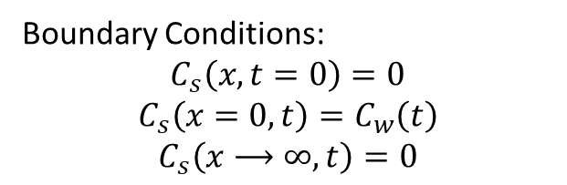
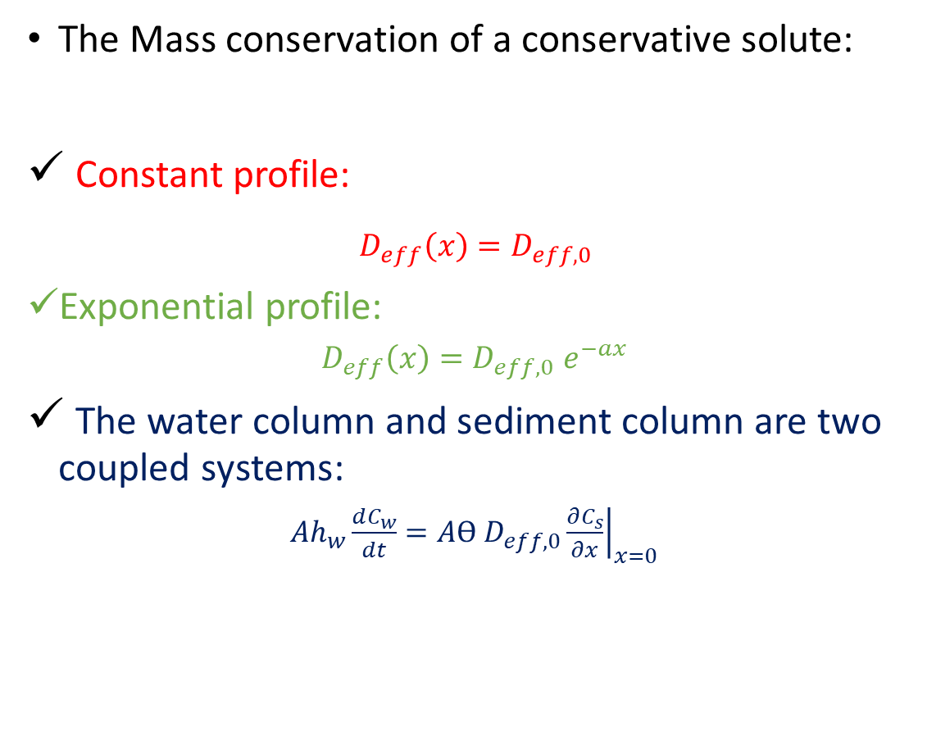
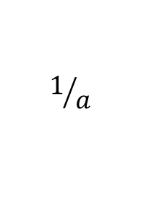

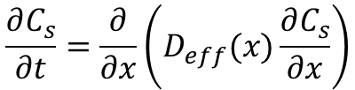

The diffusivity Model (To model the mixing process)
The Mass conservation of a conservative solute:
Constant profile:
$D_{eff}\left(x\right)=D_{eff,0}$
Exponential profile:
$D_{eff}\left(x\right)=D_{eff,0}{ e}^{−ax}$
The water column and sediment column are two coupled systems:
$Ah_{w}\frac{dC_{w}}{dt}=Aϴ D_{eff,0}{\left.\frac{∂C_{s}}{∂x}\right|}_{x=0}$
Water
$$\frac{∂C_{s}}{∂t}=\frac{∂}{∂x}\left(D_{eff}(x)\frac{∂C_{s}}{∂x}\right)$$
$$C_{w}$$
$$D_{eff,0}$$
x
$$1/a$$
$$C_{s}$$
Sediment
Boundary Conditions:
$$C_{s}\left(x,t=0\right)=0$$
$$C_{s}\left(x=0,t\right)=C_{w}\left(t\right)$$
$$C_{s}\left(x⟶∞,t\right)=0$$
ϴ: Sediment porosity, $A$: bed area,${ h}_{w}$: Water column height

Slide 4
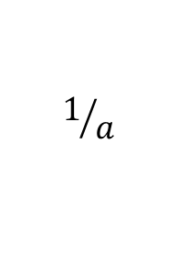




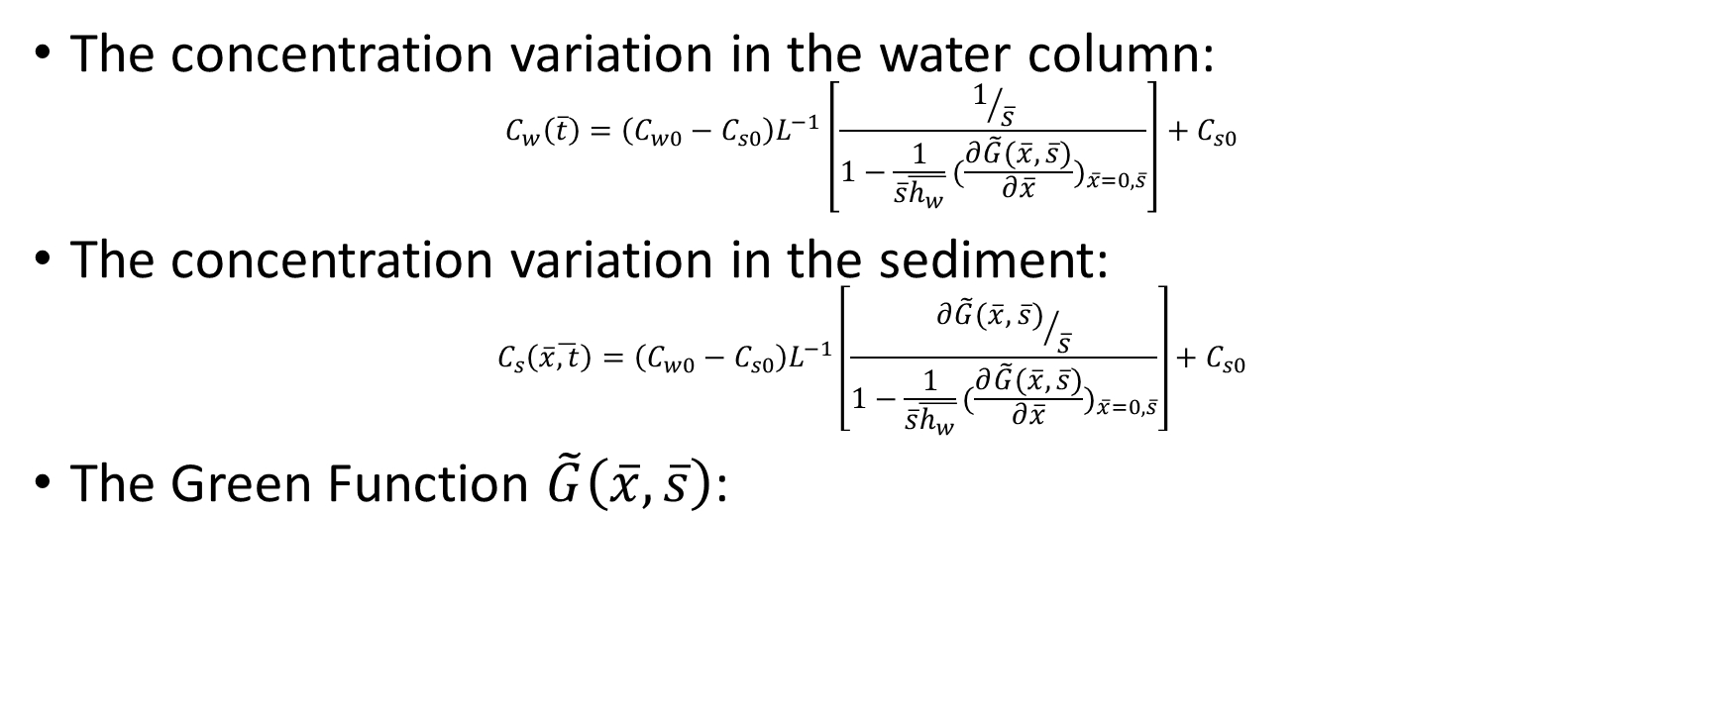

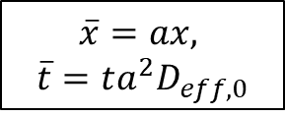

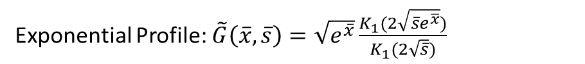

The diffusivity Model (To model the mixing process)
The concentration variation in the water column:
$$C_{w}\left(\overline{t}\right)=\left(C_{w0}−C_{s0}\right)L^{−1}\left[\frac{1/{\overline{s}}}{1−\frac{1}{\overline{s}\overline{h_{w}}}{(\frac{∂\tilde{G}(\overline{x},\overline{s})}{∂\overline{x}})}_{\overline{x}=0,\overline{s}}}\right]+C_{s0}$$
The concentration variation in the sediment:
$$C_{s}\left(\overline{x}\overline{,t}\right)=\left(C_{w0}−C_{s0}\right)L^{−1}\left[\frac{{∂\tilde{G}(\overline{x},\overline{s})}/{\overline{s}}}{1−\frac{1}{\overline{s}\overline{h_{w}}}{(\frac{∂\tilde{G}(\overline{x},\overline{s})}{∂\overline{x}})}_{\overline{x}=0,\overline{s}}}\right]+C_{s0}$$
The Green Function $\tilde{G}\left(\overline{x},\overline{s}\right)$:
$$\overline{x}=ax,$$
$$\overline{t}=ta^{2}D_{eff,0}$$
Water
$$h_{w}$$
$$C_{w}\left(\overline{t}\right)$$
$$C_{w0}$$
$$D_{eff,0}$$
x
$$1/a$$
Constant Profile:${\tilde{G}\left(\overline{x},\overline{s}\right)=e}^{−\overline{x}\sqrt{\overline{s}}}$
$$C_{s}\left(\overline{x},\overline{t}\right)$$
$$C_{s0}$$
Exponential Profile: $\tilde{G}\left(\overline{x},\overline{s}\right)=\sqrt{e^{\overline{x}}}\frac{K_{1}(2\sqrt{\overline{s}e^{\overline{x}}})}{K_{1}(2\sqrt{\overline{s}})}$
Sediment

Slide 5
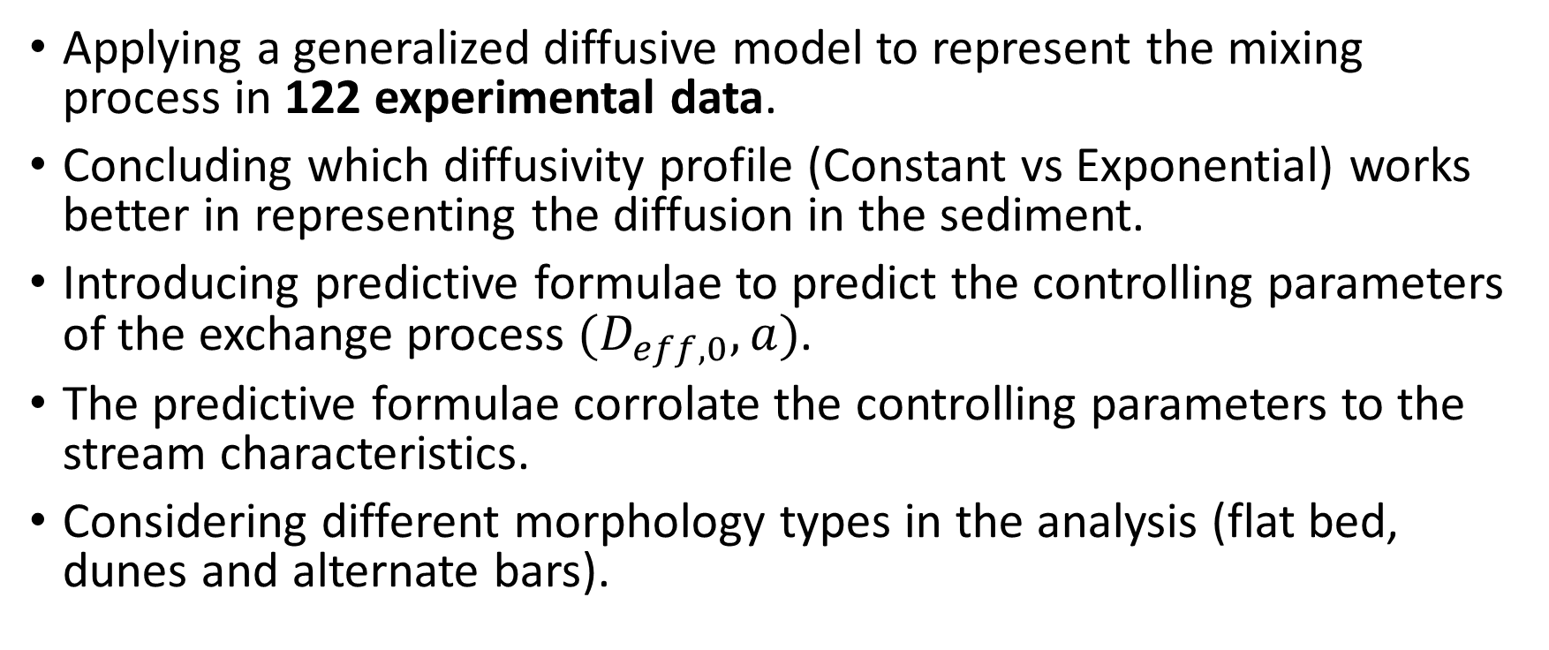
Plan
Applying a generalized diffusive model to represent the mixing process in 122 experimental data.
Concluding which diffusivity profile (Constant vs Exponential) works better in representing the diffusion in the sediment.
Introducing predictive formulae to predict the controlling parameters of the exchange process $(D_{eff,0}, a)$.
The predictive formulae corrolate the controlling parameters to the stream characteristics.
Considering different morphology types in the analysis (flat bed, dunes and alternate bars).

Slide 6
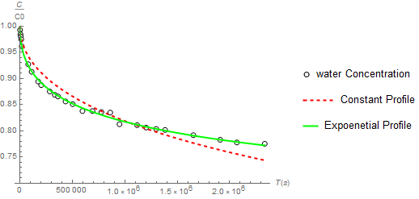
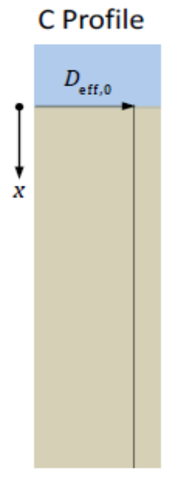
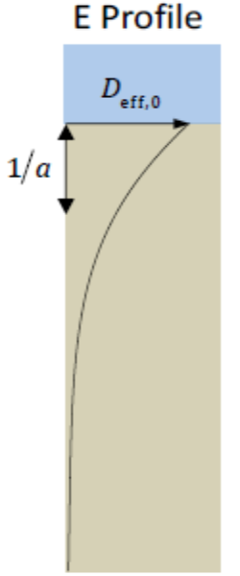

Constant Profile vs Exponential profile
The diffusivity model is applied on 122 experiments, in literature, with different morphology types (flatbed, dunes and alternate bars).
Exponential diffusivity profile produces a better fitting, especially in terms of the modified Akaike Information Criterion (AICc).
AICc
Data Points
Constant profile
R² >98%
Exponential profile
RMSE
Exp#17 in Elliot and Brooks, 1997

Slide 7


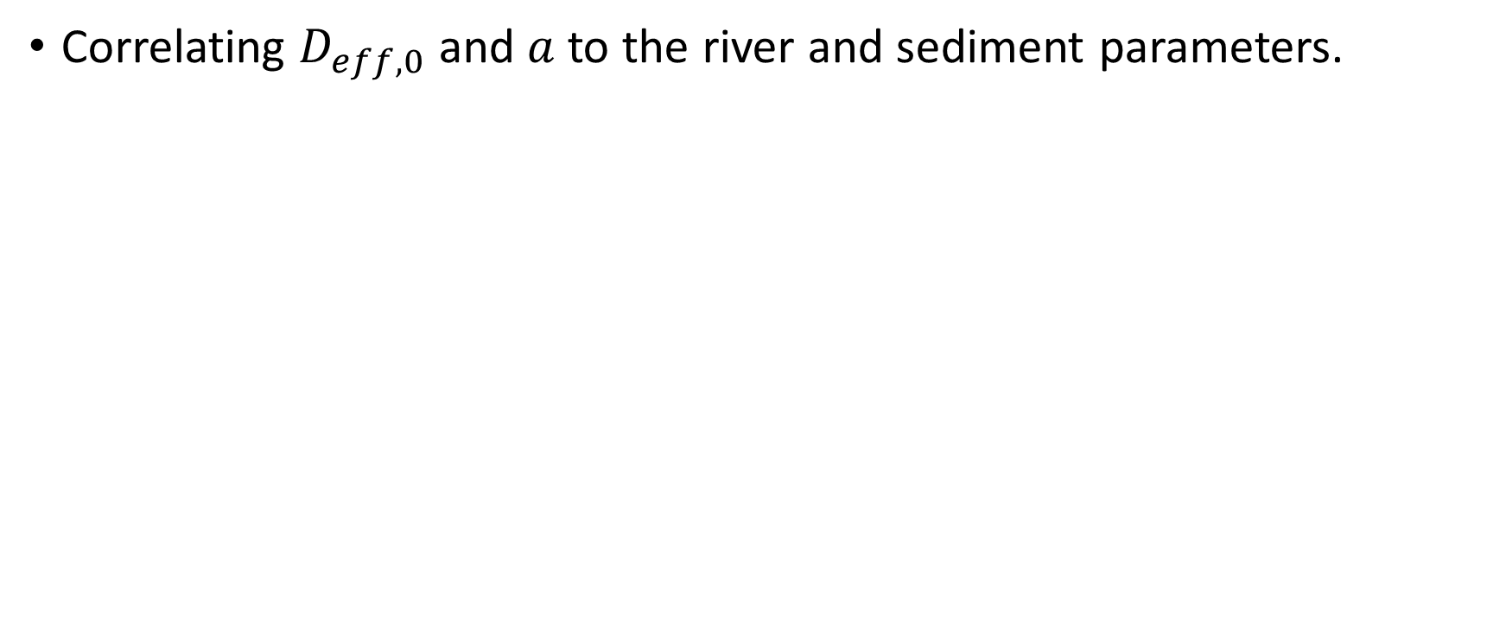

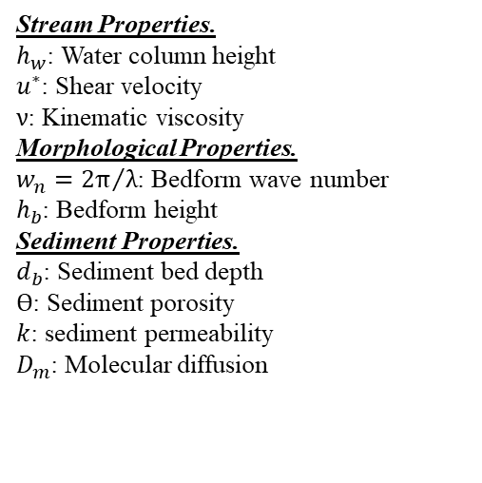



Predicting Exponential profile parameters
Correlating $D_{eff,0}$ and $a$ to the river and sediment parameters.
Stream Properties.
$h_{w}$: Water column height
$u^{∗}$: Shear velocity
$ν$: Kinematic viscosity
Morphological Properties.
$w_{n}={2π}/λ$: Bedform wave number
$h_{b}$: Bedform height
Sediment Properties.
$d_{b}$: Sediment bed depth
$ϴ$: Sediment porosity
$k$: sediment permeability
$D_{m}$: Molecular diffusion
$$h_{w}$$
$$u^{∗}$$
$$h_{b}$$
$$ν$$
$$λ$$
$$d_{b}$$
$ϴ$, $k$, $D_{m}$

Slide 8
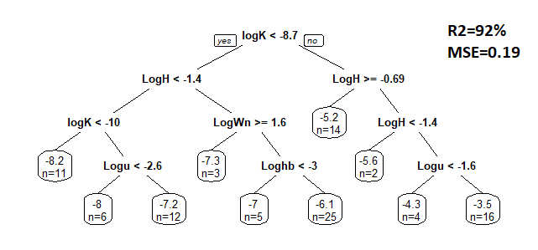



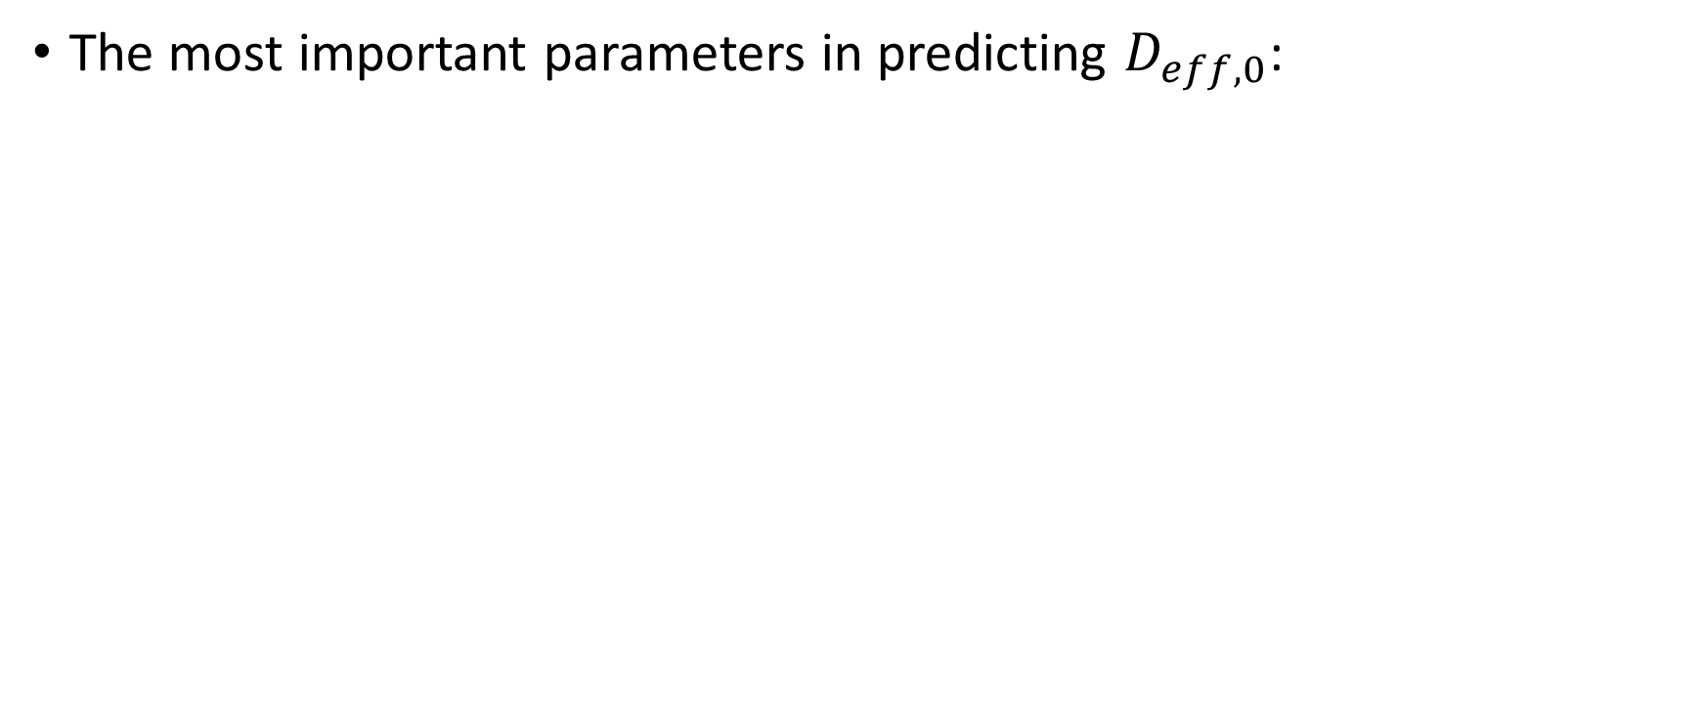







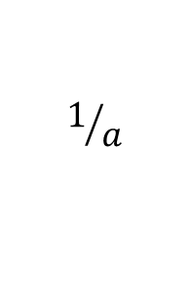

Predicting Exponential profile parameters
The most important parameters in predicting $D_{eff,0}$:
$$D_{eff,0}=f(k,h_{w},w_{n},h_{b},u^{∗})$$
Water
Sediment permeability ($k$)
R²=92%
MSE=0.19
$$C_{w}$$
Water column height ($h_{w}$)
Water column height ($h_{w}$)
$$D_{eff,0}$$
x
$$1/a$$
sediment permeability ($k$)
Wave number ($w_{n}$)
Water column height ($h_{w}$)
$$C_{s}$$
Shear velocity ($u^{∗}$)
Bedform height ($h_{b}$)
Shear velocity ($u^{∗}$)
Sediment

Slide 9
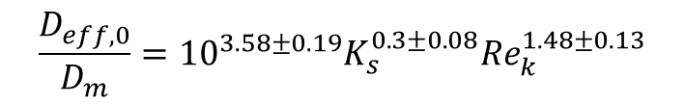
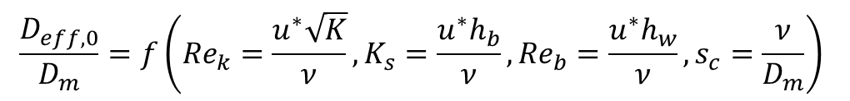
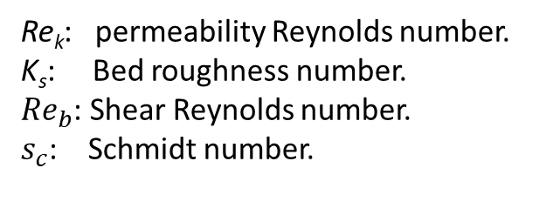
Predicting Exponential profile parameters
Predicting formula, using MLR:
The most parsimonious Model: $D_{eff,0}=f(k,h_{b},u^{∗})$
$$\frac{D_{eff,0}}{D_{m}}=f\left({Re}_{k}=\frac{u^{∗}\sqrt{K}}{ν},K_{s}=\frac{u^{∗}h_{b}}{ν},{Re}_{b}=\frac{u^{∗}h_{w}}{ν}, s_{c}=\frac{ν}{D_{m}}\right)$$
$$\frac{D_{eff,0}}{D_{m}}={10}^{3.58±0.19}K_{s}^{0.3±0.08}{Re}_{k}^{1.48±0.13}$$
Re_{k}: permeability Reynolds number.
K_{s}: Bed roughness number.
${Re}_{b}$: Shear Reynolds number.
$s_{c}$: Schmidt number.

Slide 10


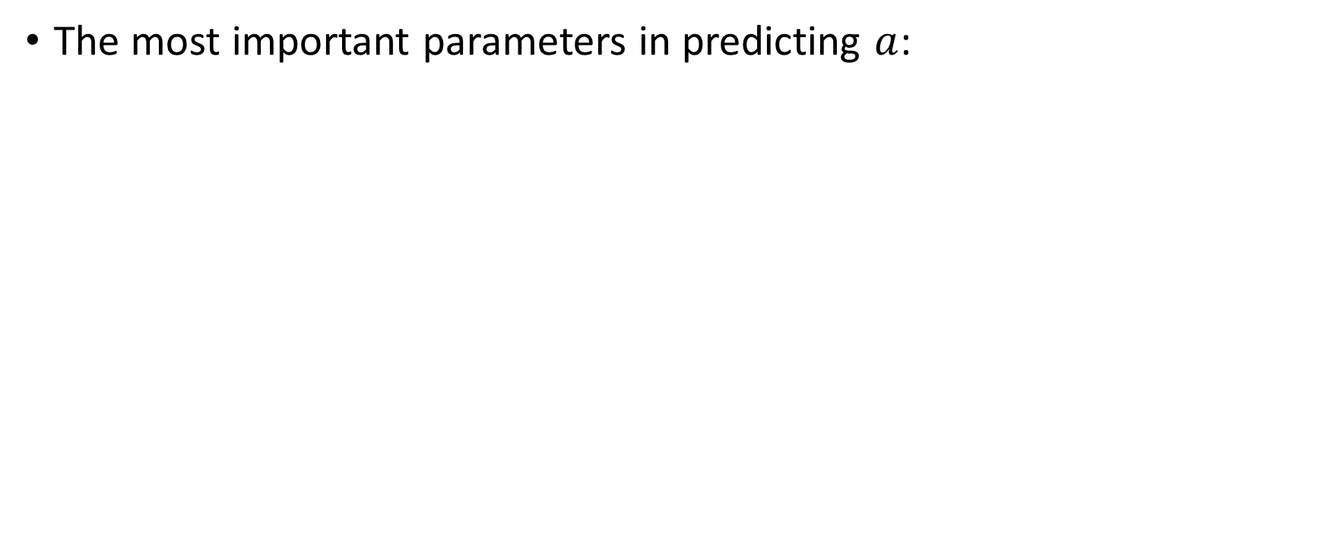








Predicting Exponential profile parameters
The most important parameters in predicting $a$:
$$a=f(h_{w},d_{b},w_{n},h_{b},u^{∗}, ϴ)$$
R²=94%
MSE=0.03
Water
Water column height ($h_{w}$)
$$C_{w}$$
Bed depth ($d_{b}$)
Shear velocity ($u^{∗}$)
$$D_{eff,0}$$
Wave number ($w_{n}$)
Bedform height ($h_{b}$)
Porosity ($ϴ$)
Porosity ($ϴ$)
x
$$1/a$$
Water column height ($h_{w}$)
($h_{w}$)
$$C_{s}$$
Water column height ($h_{w}$)
Sediment

Slide 11
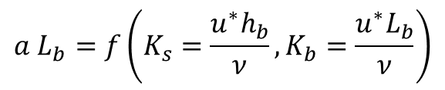
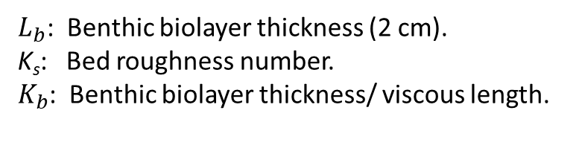
Predicting Exponential profile parameters
Predicting formula, using MLR:
The most parsimonious Model: $a=f(h_{b},u^{∗})$
$$a L_{b}=f\left(K_{s}=\frac{u^{∗}h_{b}}{ν},K_{b}=\frac{u^{∗}L_{b}}{ν}\right)$$
$$a L_{b}={10}^{−0.006±0.06}K_{s}^{−0.2±0.02}$$
$L_{b}$: Benthic biolayer thickness (2 cm).
K_{s}: Bed roughness number.
$K_{b}$: Benthic biolayer thickness/ viscous length.

Slide 12
Predicting Exponential profile parameters

Slide 13
Conclusions
This predictive framework can help in understanding and estimating the mixing process between the water column and sediment in streams.
The effective diffusion at the sediment-water interface is not dependent on the morphology and is mainly controlled by water column and sediment characteristics.
The solute penetration depth is dependent on the bed morphology:
The deepest penetration of the solute is observed in alternate bars.
In dunes, the solute penetration is deeper than in a Flat bed.

Slide 14
Limitations
This model is applied only to laboratory experiments with conservative solutes and steady flow.
The morphologies in the experiments that were considered in this study are stationary.

Slide 15
Model derivation
For Model derivations and equations, please check these published papers:
https://doi.org/10.1029/2019WR026822
https://doi.org/10.1029/2020WR027967

Slide 16
References
Chandler, I. D., Guymer, I., Pearson, J. M., & Van Egmond, R. (2016). Vertical variation of mixing within porous sediment beds below turbulent flows. Water resources research, 52(5), 3493-3509.
Elliott, A. H., & Brooks, N. H. (1997). Transfer of nonsorbing solutes to a streambed with bed forms: Laboratory experiments. Water Resources Research, 33(1), 137-151.
Grant, S. B., Gomez‐Velez, J. D., Ghisalberti, M., Guymer, I., Boano, F., Roche, K., & Harvey, J. (2020). A one‐dimensional model for turbulent mixing in the benthic biolayer of stream and coastal sediments. Water Resources Research, e2019WR026822.
Grant, S. B., Monofy, A., Boano, F., Gomez‐Velez, J. D., Guymer, I., Harvey, J., & Ghisalberti, M. (2020). Unifying advective and diffusive descriptions of bedform pumping in the benthic biolayer of streams. Water Resources Research, 56(11), e2020WR027967.
Richardson, C. P., & Parr, A. D. (1988). Modified Fickian model for solute uptake by runoff. Journal of environmental engineering, 114(4), 792-809.
Ren, J., & Packman, A. I. (2004). Stream-subsurface exchange of zinc in the presence of silica and kaolinite colloids. Environmental science & technology, 38(24), 6571-6581.
Rehg, K. J., Packman, A. I., & Ren, J. (2005). Effects of suspended sediment characteristics and bed sediment transport on streambed clogging. Hydrological Processes: An International Journal, 19(2), 413-427.
Lai, J. L., Lo, S. L., & Lin, C. F. (1994). Effects of hydraulic and medium characteristics on solute transfer to surface runoff. Water Science and Technology, 30(7), 145.
Packman, A. I., Brooks, N. H., & Morgan, J. J. (2000). Kaolinite exchange between a stream and streambed: Laboratory experiments and validation of a colloid transport model. Water Resources Research, 36(8), 2363-2372.
Packman, A. I., & MacKay, J. S. (2003). Interplay of stream‐subsurface exchange, clay particle deposition, and streambed evolution. Water Resources Research, 39(4).
Packman, A. I., Salehin, M., & Zaramella, M. (2004). Hyporheic exchange with gravel beds: Basic hydrodynamic interactions and bedform-induced advective flows. Journal of Hydraulic Engineering, 130(7), 647-656.

Slide 17
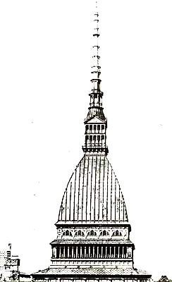
TH NK You

