Slide 1

ICOS Carbon Portal as example of a FAIR community data repository supporting scientific workflows
Alex Vermeulen , Margareta Hellström , Oleg Mirzov , Ute Karstens ,
Claudio D'Onofrio , and Harry Lankreijer

Slide 2
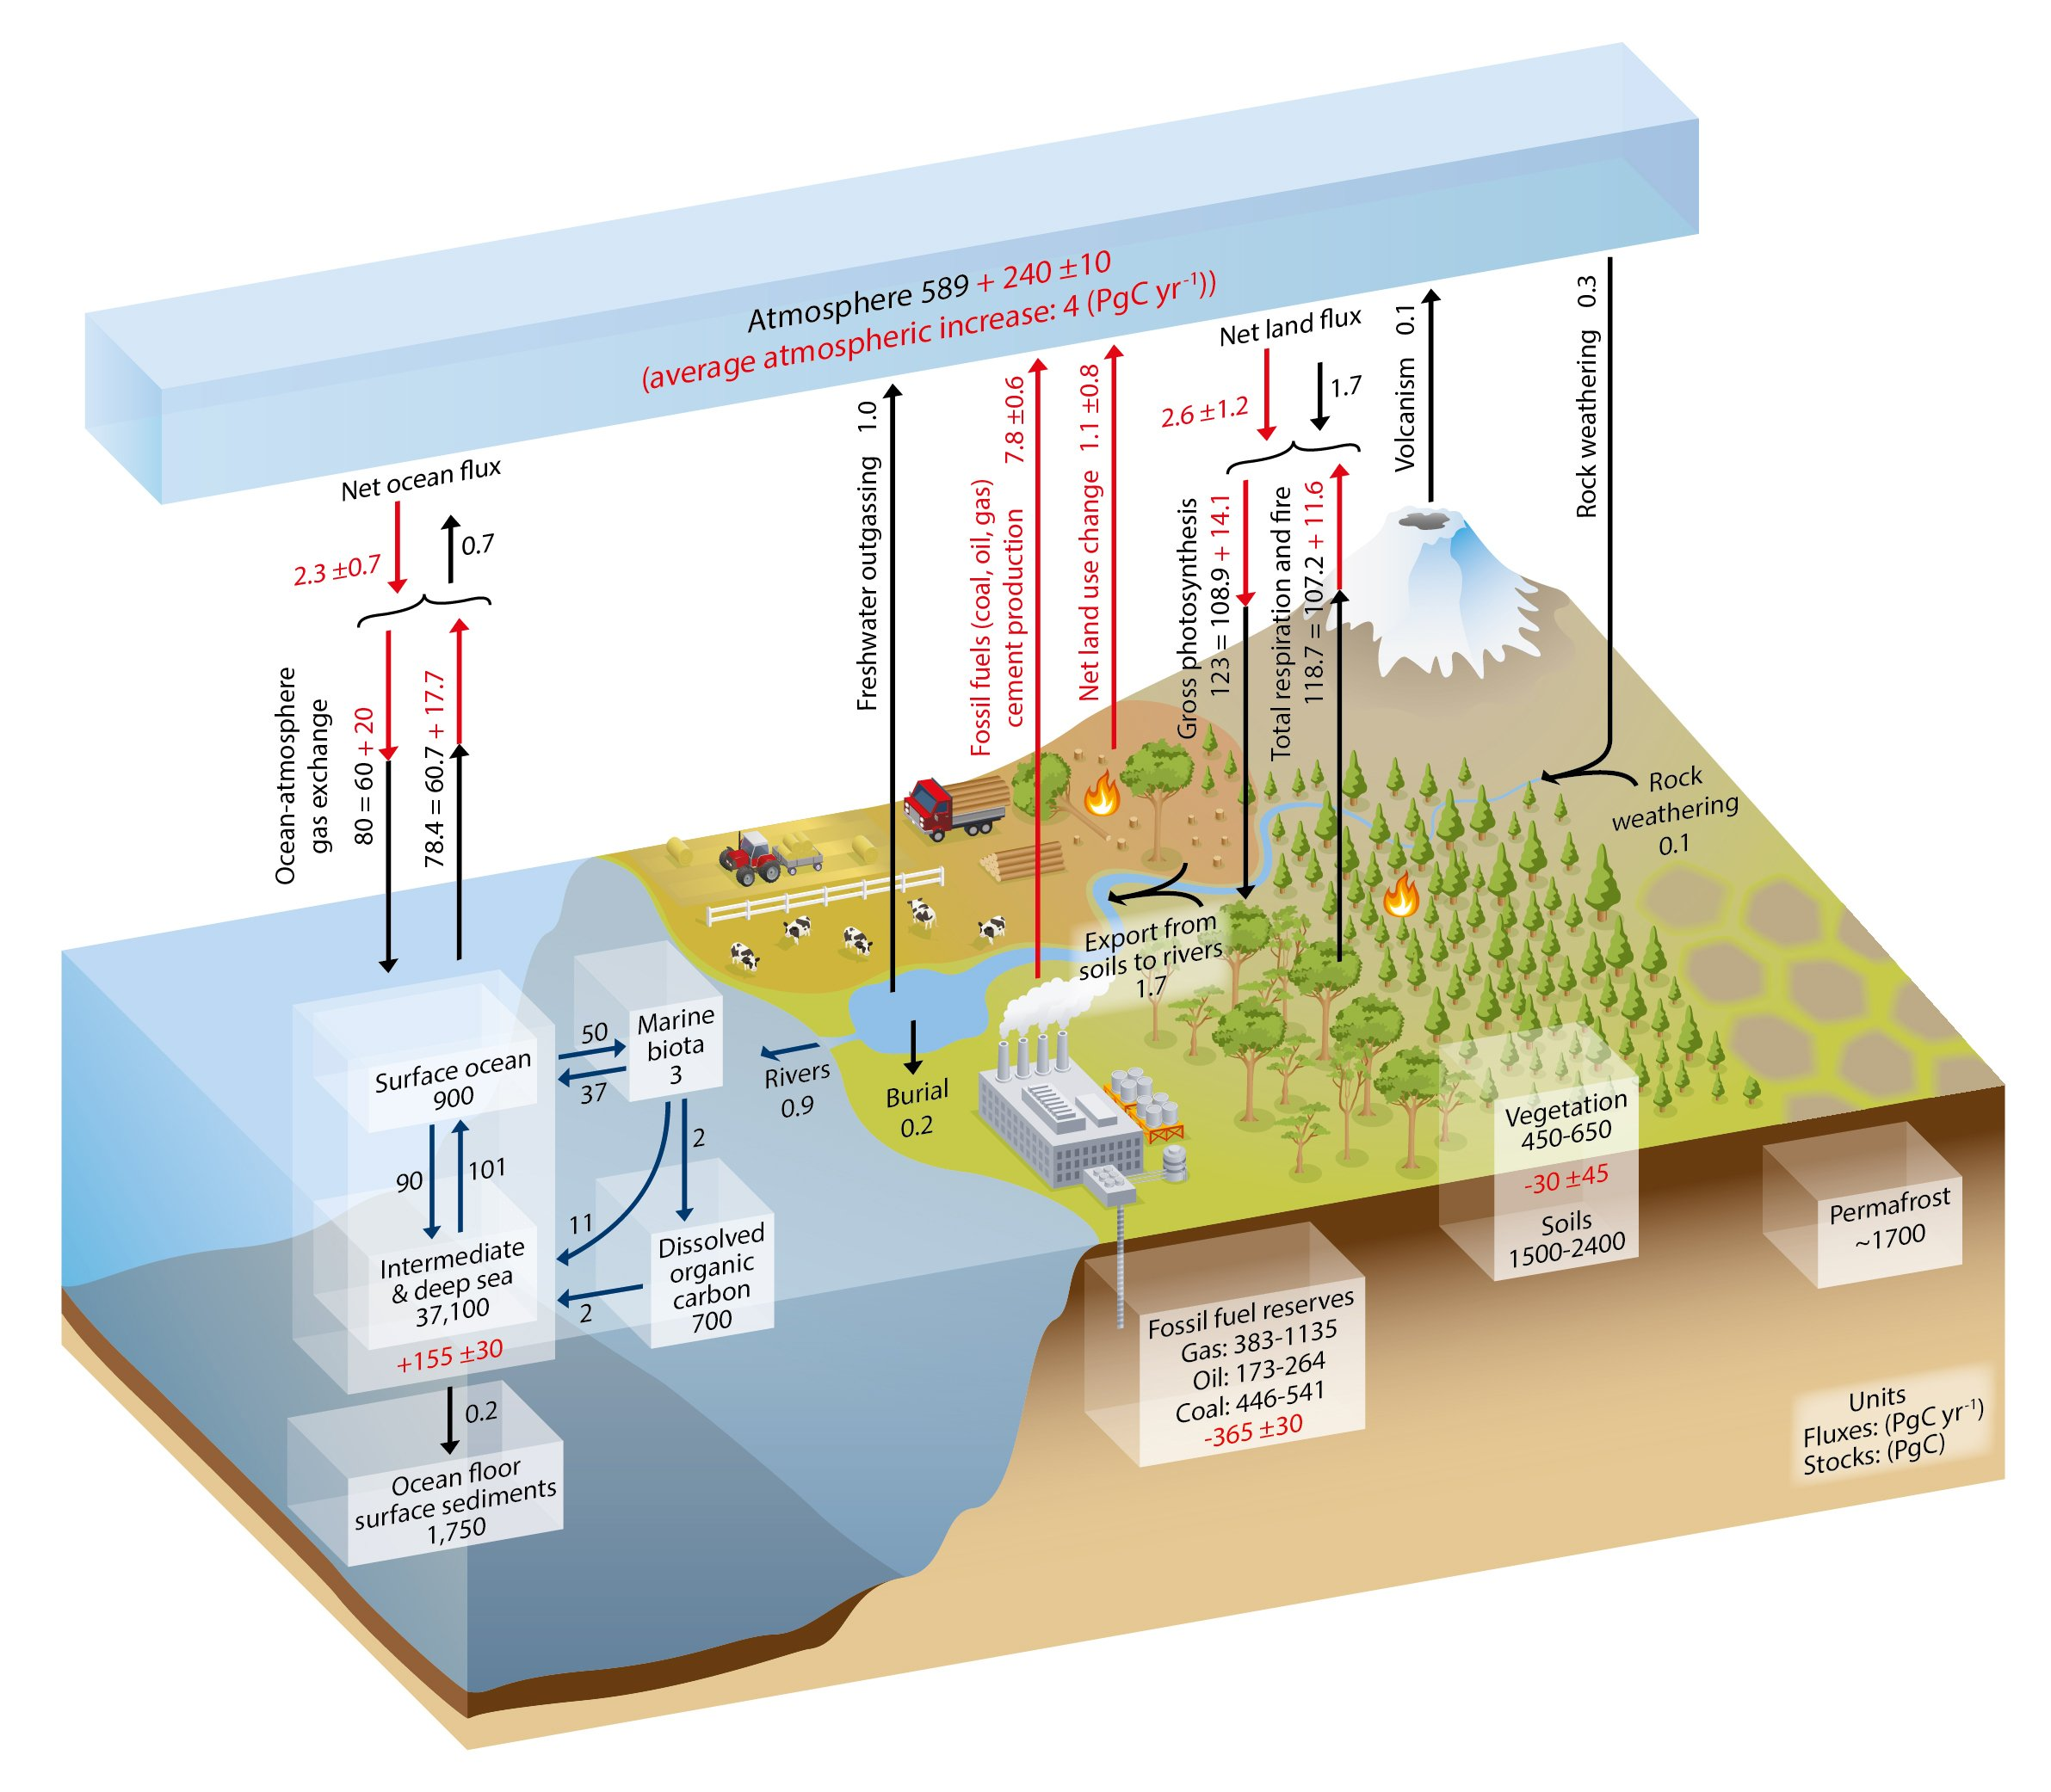
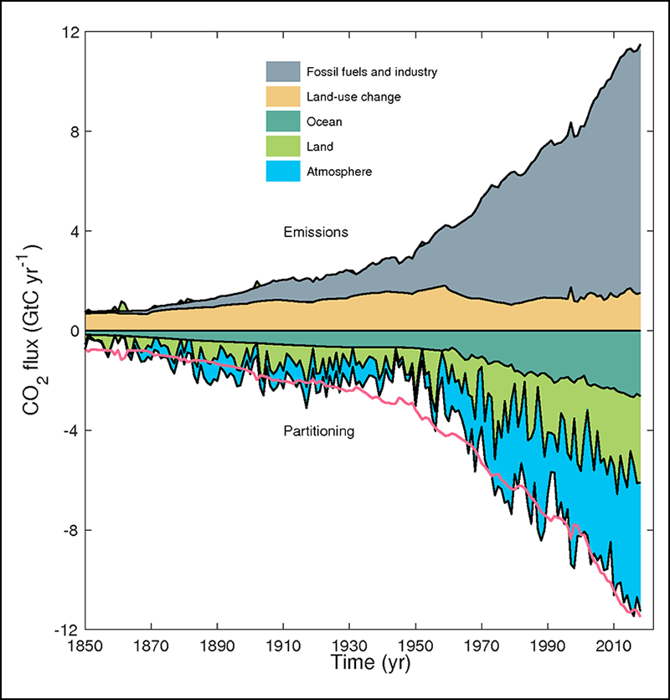
Climate and the carbon cycle
Credit: IPCC, 2018
Credit: Friedlingstein et al., 2019, https://doi.org/10.5194/essd-11-1783-2019, CC BY 4.0

Slide 3
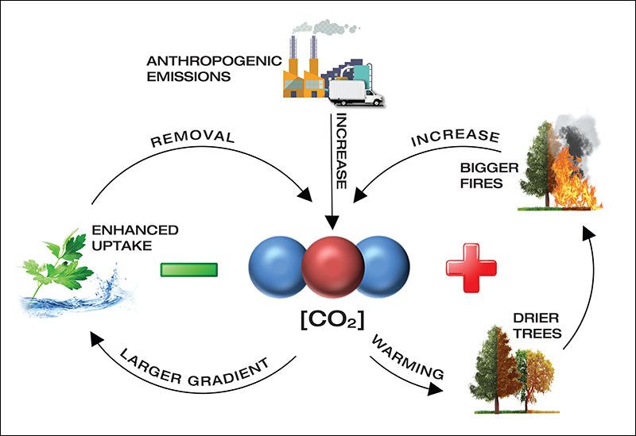
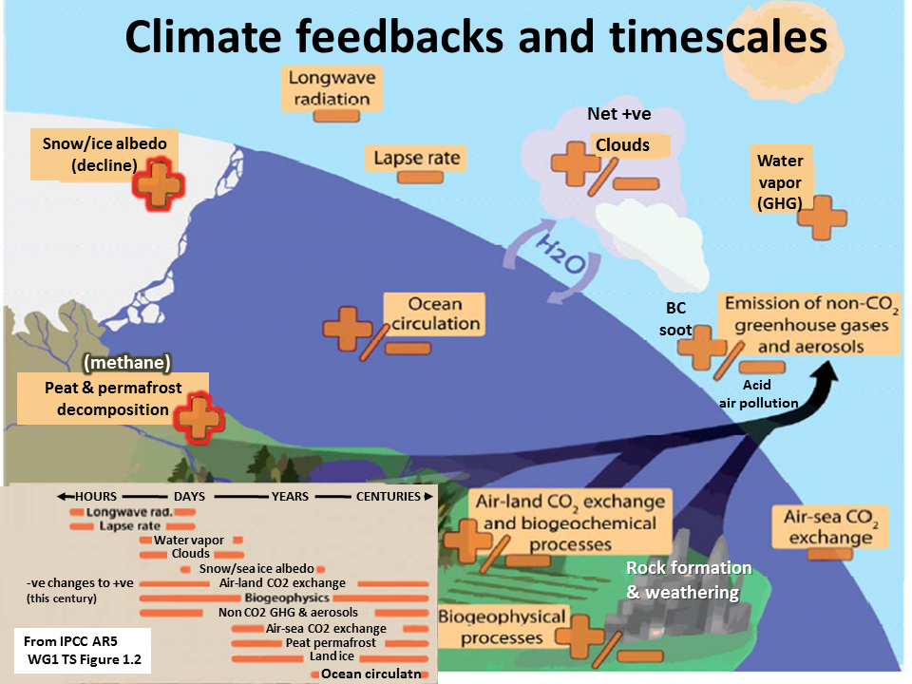
Feedbacks & timescales
Credit: Kaushik, Hingle et al, 2020
Credit: http://www.onlyzerocarbon.org/arctic_feedback.html

Slide 4
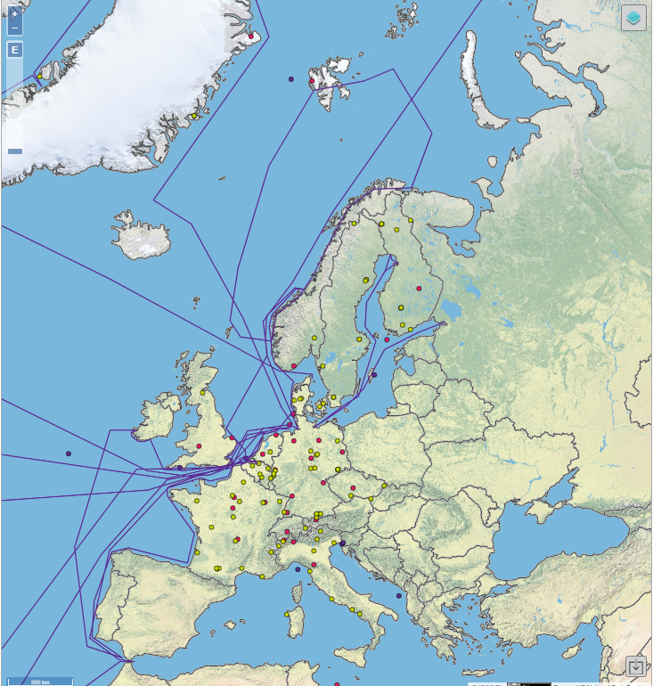
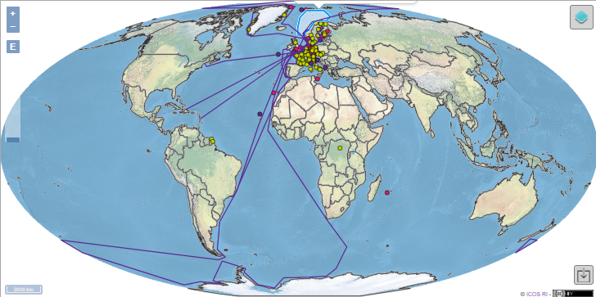
ICOS – all about reliable data
ICOS = Integrated Carbon Observation System
Landmark ESFRI European research Infrastructure
Informs:
  Scientists (IPCC, UNFCCC)
  Policy makers
  General public
Generate long-term high quality standardized observation data of greenhouse gas concentrations and exchange fluxes
Transparent – open data (CC4BY)
From raw to elaborated data products
Clear data lifecycle
Catalyser of biogeochemical science
Improve knowledge and inform on
  Anthropogenic and natural fluxes
  Detect climate feedbacks
  Emission trends
Timely (NRT) factual information, beyond debate!
3 domains: Atmosphere, Ecosystem and Ocean
>100 institutes, thousands of scientists
Globally connected to WMO GAW, SOCAT, Fluxnet, COPERNICUS, GEO

Slide 5
ICOS in a few numbers
>500 000 downloads/yr
300
user accounts
>400 000
Data objects
>7 000 citations/yr
3
domains
148
stations
60 000
unique users

Slide 6
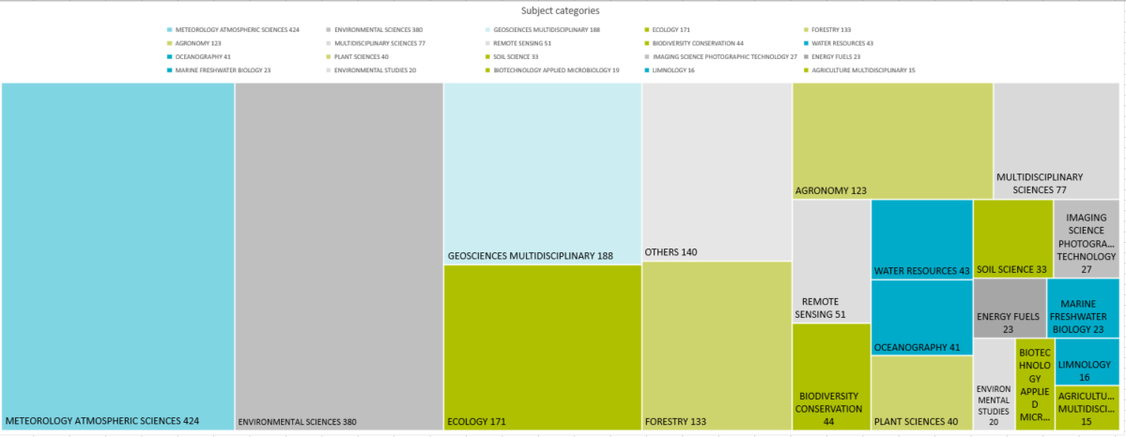
Articles using ICOS data are found in 58 categories of Web of Science.
Meteorology and Atmospheric sciences (37% of all)
Environmental sciences (34%).
ICOS data is widely used

Slide 7

ICOS Network and data Flow
Diverse user communities, including data producers and other portals
User 1
User 2
User 3
Finalized and elaborated
data products
ICOS Carbon Portal
External metadata
registry & catalogue
services
Data ingestion
PID and DOI minting
Metadata services
Data discovery & access
Usage tracking
Data visualisation
Long term archiving
Repository administration
Preservation planning
User community support
Ecosystem Thematic
Centre
Oceanic Thematic Centre
Atmospheric Thematic Centre
Calibration
Labs
Standardized processing, quality assurance & control
ICOS
repository
(data, metadata)
High performance and throughput computing
services
Measurement stations
(National networks)
Sensor data

Slide 8
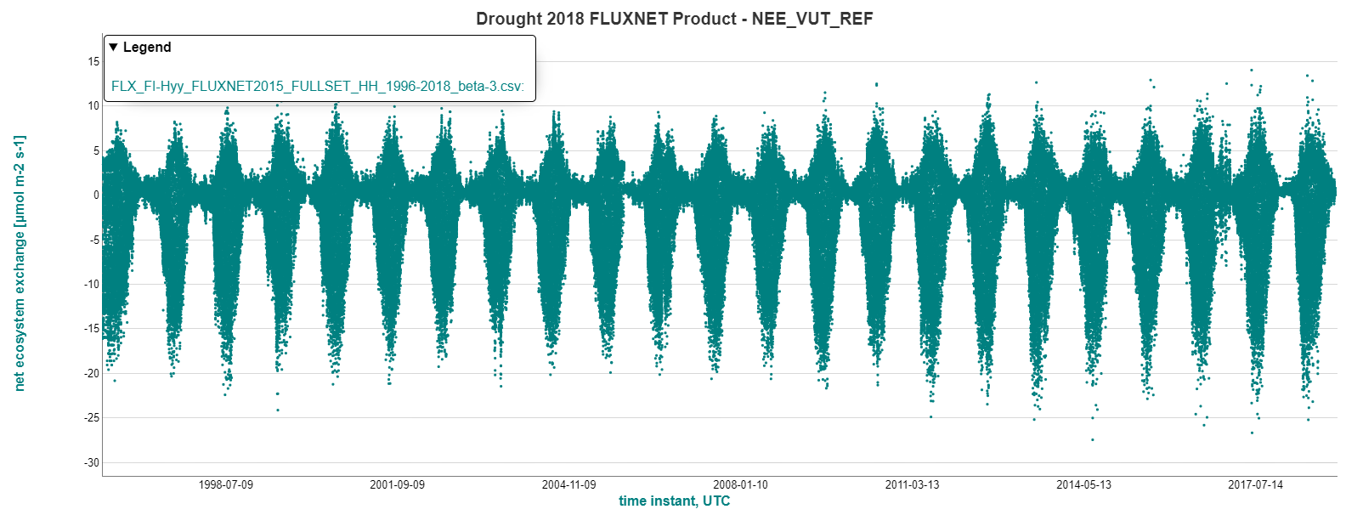
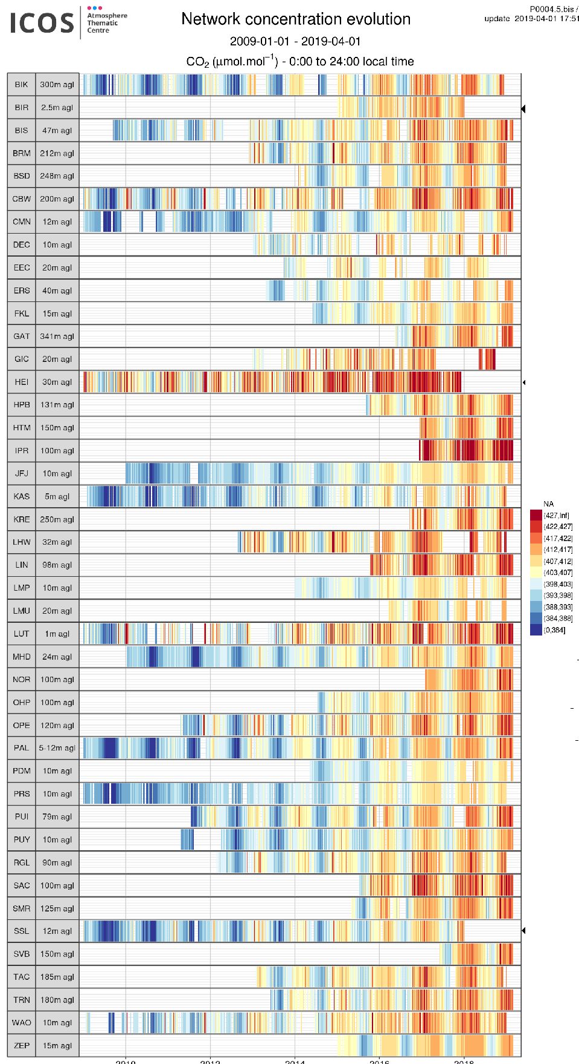
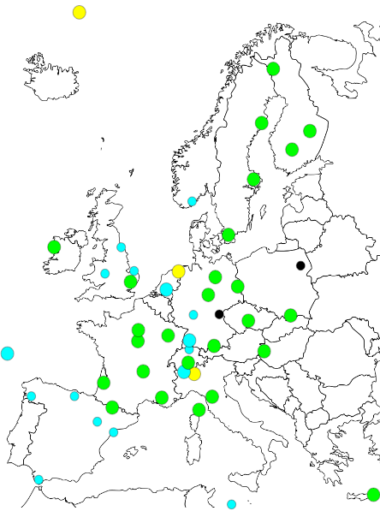

Timely high quality long term time series + Near Real Time data
Facilitating science
Example: Drought science initiative
Special issue Phil. Trans. Roy. Soc., 17 articles
Full release data in November 2019
- 48 stations Ecosystem
- 48 stations Atmosphere
Data goes back to 1979
Now: Warm Winter 2020 initiative/COVID response
Near Real Time
Atmosphere+Ocean report NRT e.g. to COPERNICUS

Slide 9
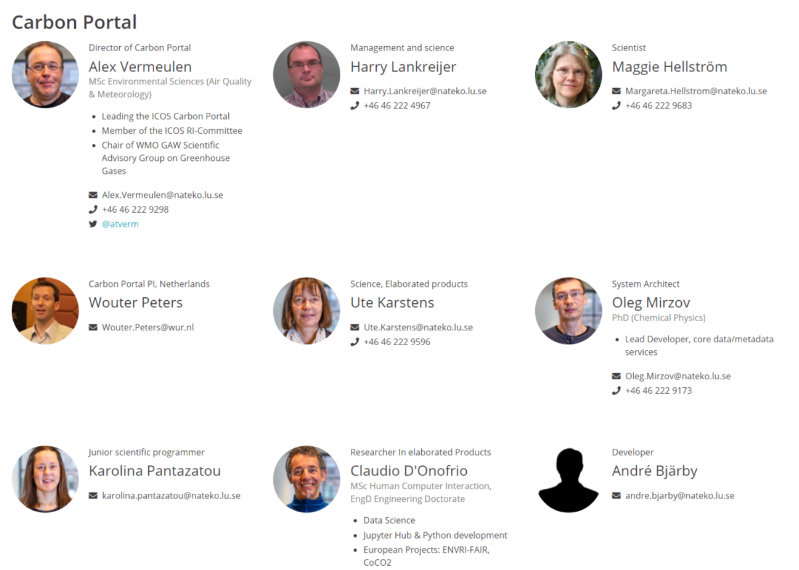
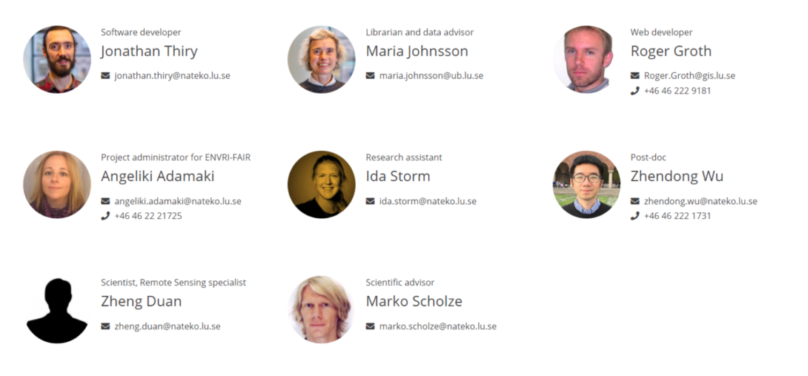
ICOS Carbon Portal

Slide 10
Value chain should preserve the metadata
Observations
Publishing (CP)
Processing (TC)
Acquisition (stations)
Products
For science, policy and public (CP/Portals)
Jupyter/Cloud (CP)
Modelling (community)
Metadata, provenance
Metadata, provenance
Metadata, provenance
Metadata, provenance

Slide 11
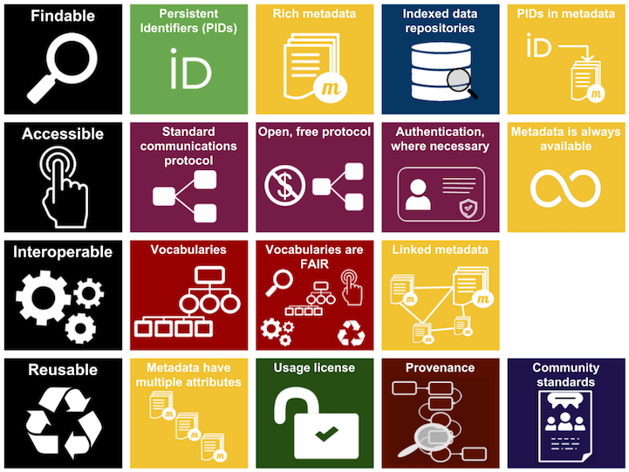
FAIRNESS at CP
Machines first
PIDs for all data
Linked open data
Open SPARQL endpoint
Rich metadata
Simplified PROV-O
Standard https protocol for data and metadata access
Secure authenticated uploads and metadata update
Own community vocabularies, mapping to global standards
Evaluation ICOS, 2020: 10 out of 13 FAIR principles completely fulfilled, 3 partially.

Slide 12
Simplified relations of the rich metadata model
Data
Publishing
Station
attributes
People
attributes
Instruments
attributes
Data
Processing
attributes
Organisation
attributes
Observations
attributes

Slide 13
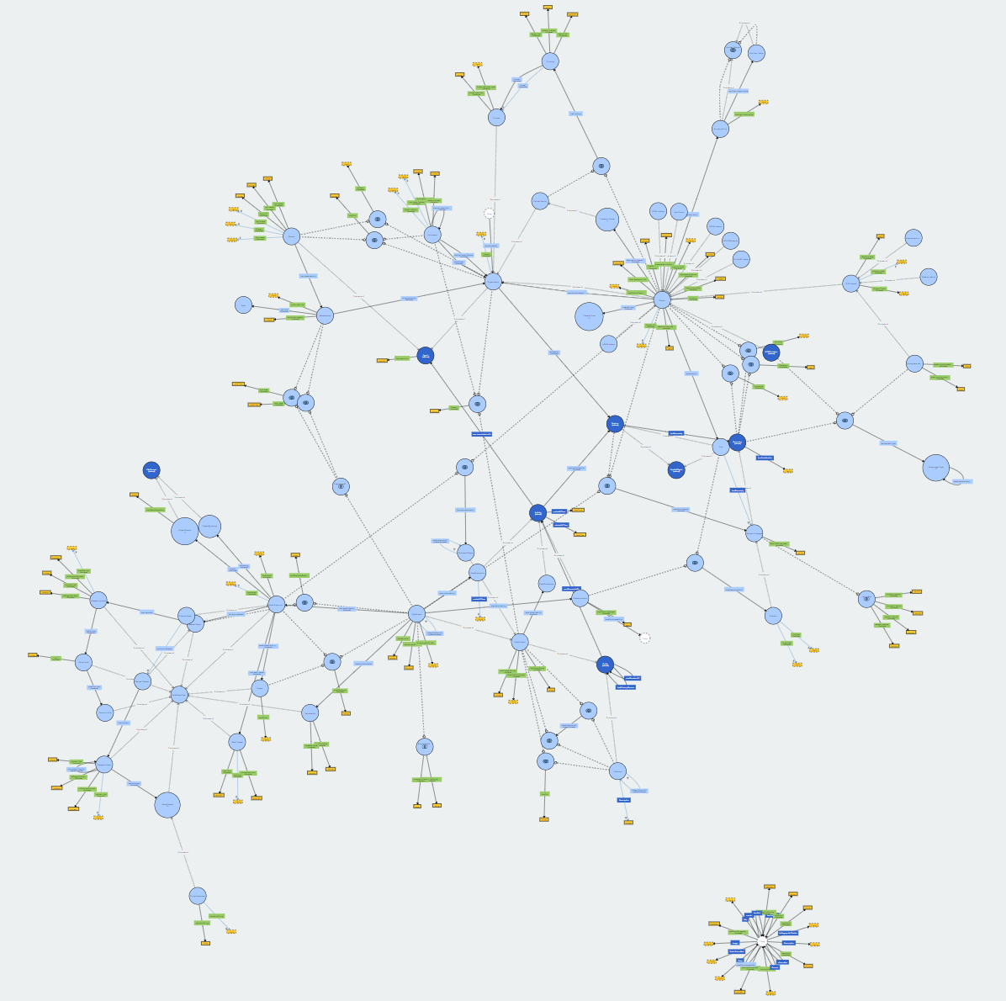
All relations form a complex graph/tree
Common metadata model for the three domains
Daily update of metadata from Thematic Centres
Roles determine citation string for all ICOS data
Dynamic landing pages for stations and data, instruments under construction
Dynamic generation of citation string
http://www.visualdataweb.de/webvowl/#iri=http://meta.icos-cp.eu/ontologies/cpmeta/

Slide 14
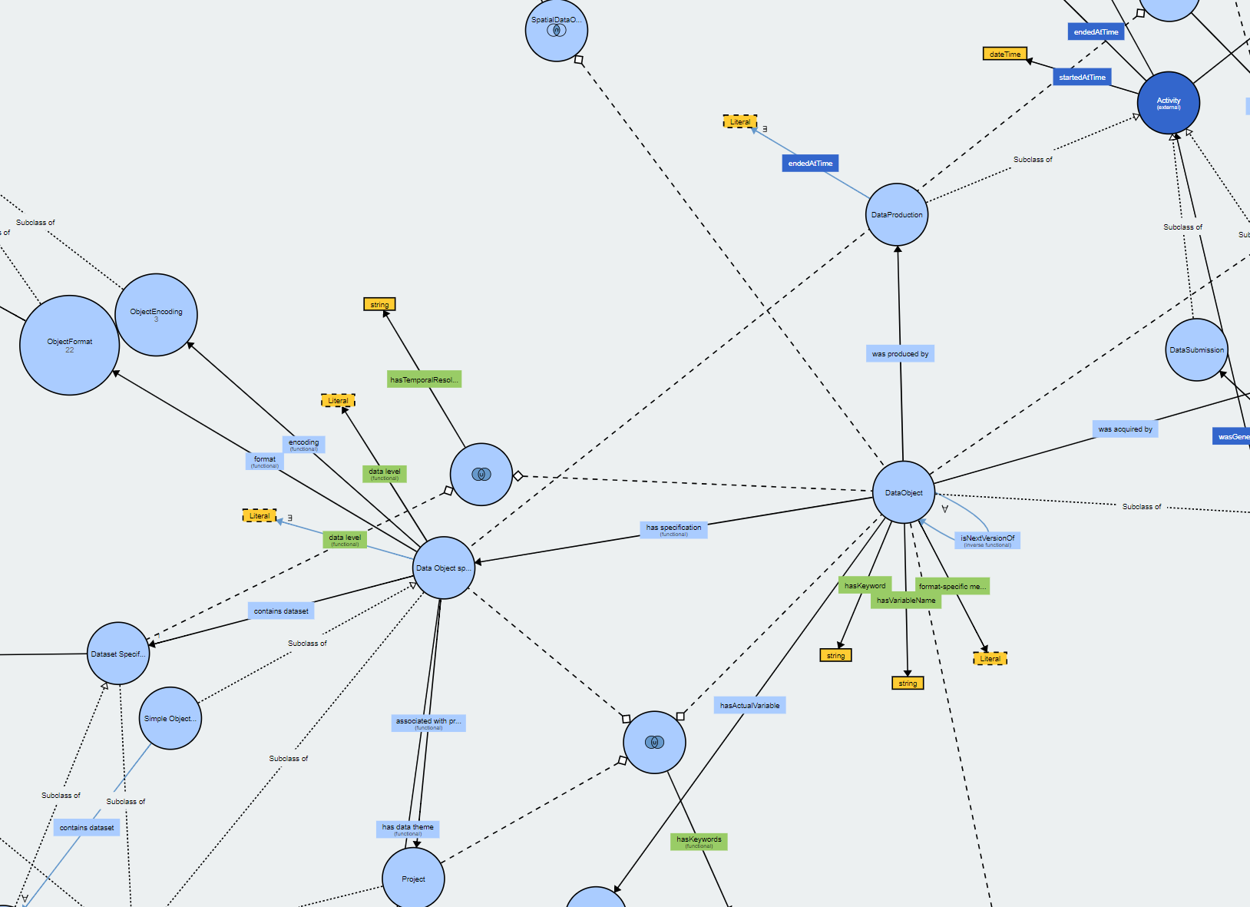
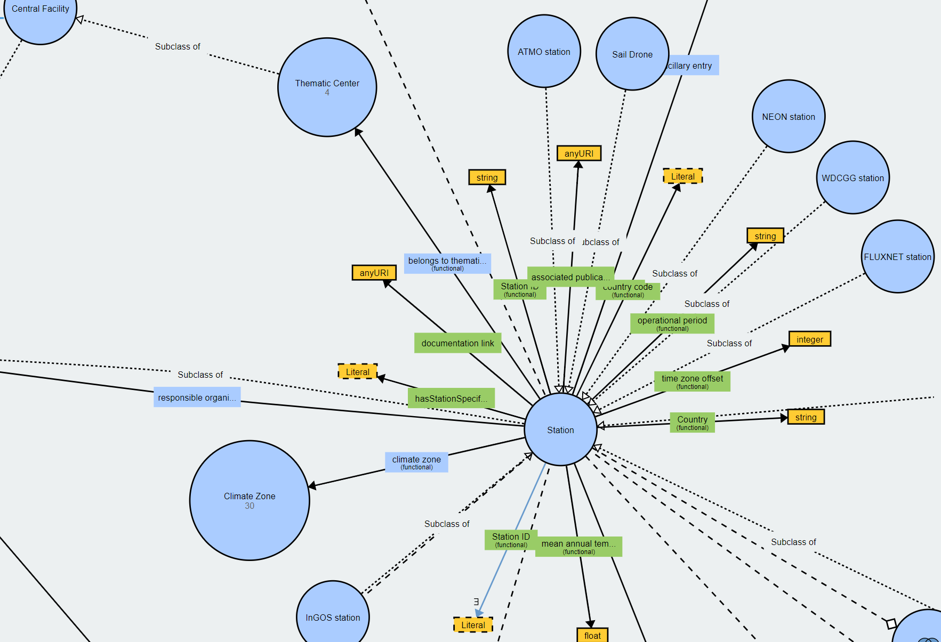

Slide 15

ICOS Carbon Portal, system elements
All services fully scalable and portable, ready for cloud (dockerized)
Open software, shared through GITHUB, GPL licence
Data objects in trusted long term repository (B2SAFE, 2 replicates)
Semantic web (WEB 3.0), linked open data
  Metadata based on ontology, all elements have (linked) URIs
  nonSQL, RDF database
  Open SPARQL endpoint
  Versioned meta data store: roll-back, time dependent queries
Persistent identifiers, linking to data object and metadata: DOI and/or Handle system
  PID based on SHA256 checksum of data object: Data Integrity control
  Maximum granularity of Data Objects
Support for versioning, collections for DOI
Machine actionable through standard http(s) protocol, RESTful API in backend and frontend
NGiNX proxy redirects to services (https://service.domain.eu), domain completely configurable and stylable
Can be deployed as single portal backend with multiple frontends or as set of federated portals using one or more interoperable metadata stores (example: SITES Swedish national infrastructure at https://data.fieldsites.se/portal/ )

Slide 16
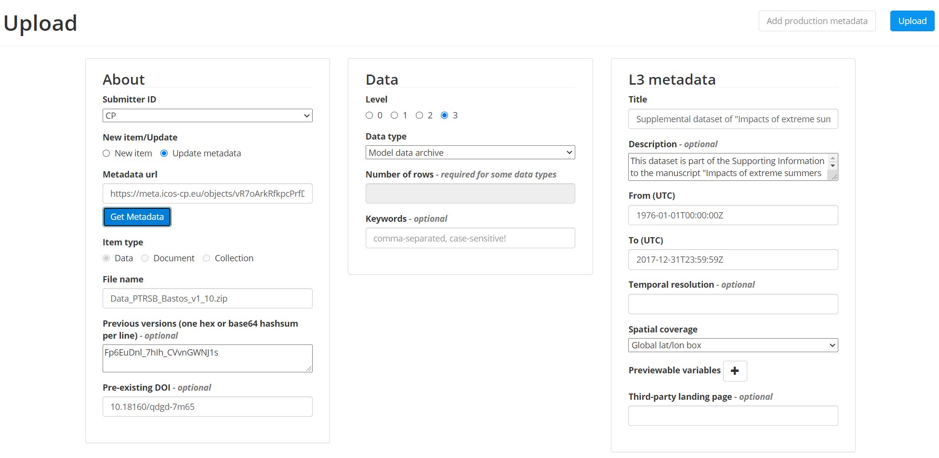
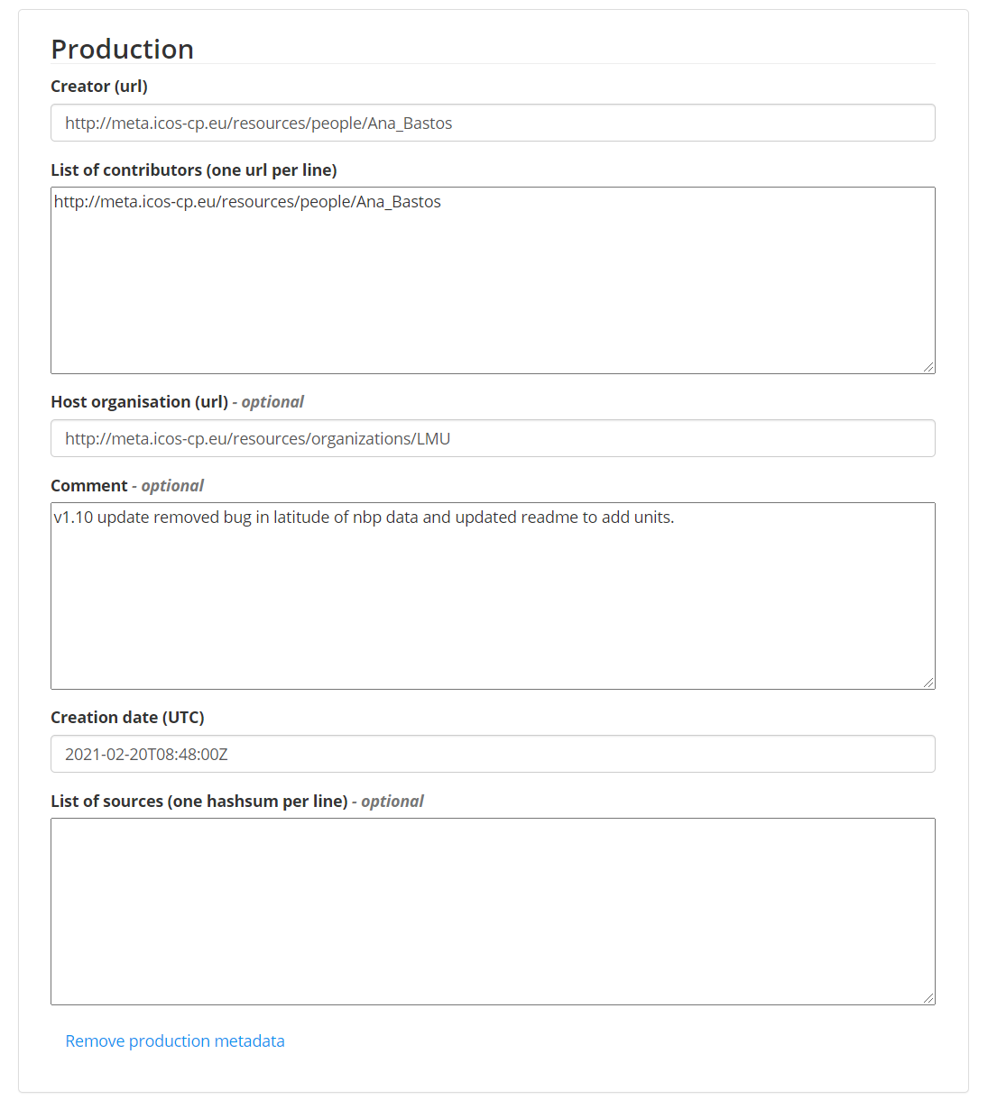
Ingestion, (meta)data upload/update
Authentication required
Two-step process, metadata package first
Data streamed to trusted repo on the fly
Only completed when hashes ok
Data linked to ontology through data object type

Slide 17
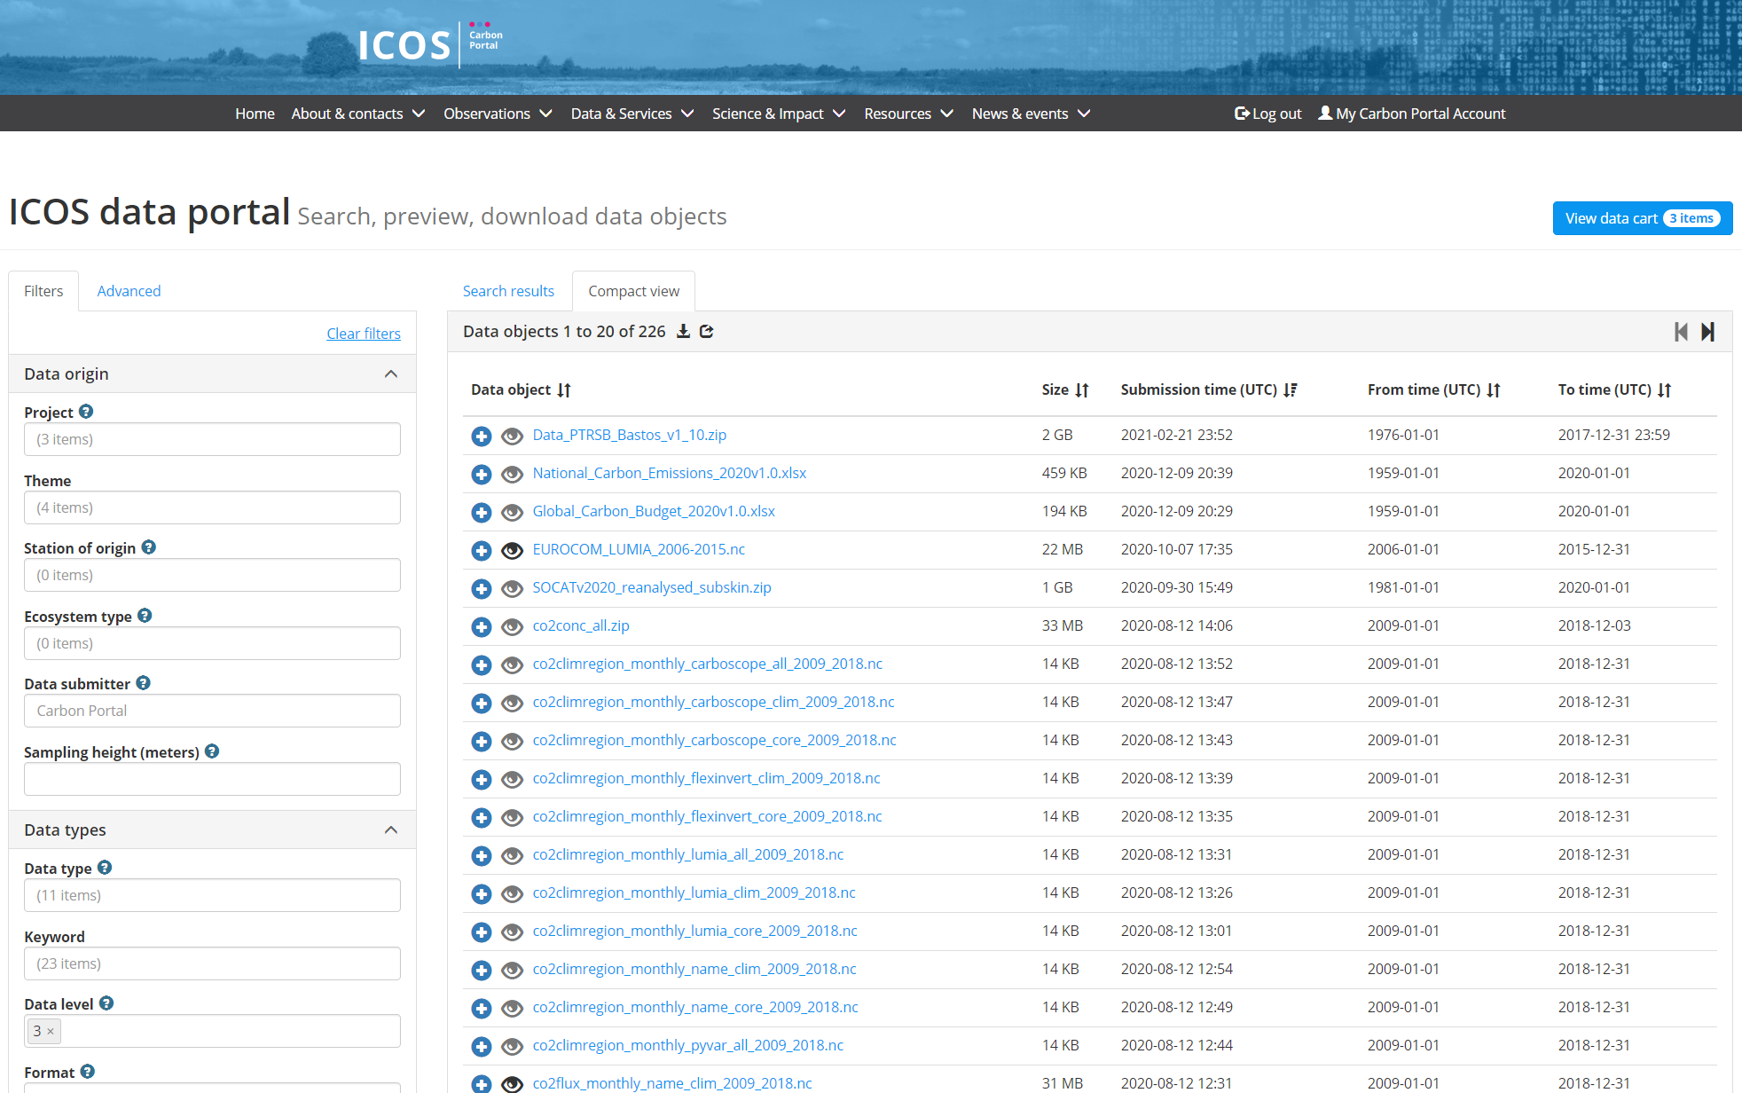
Faceted search data portal, data basket, download

Slide 18
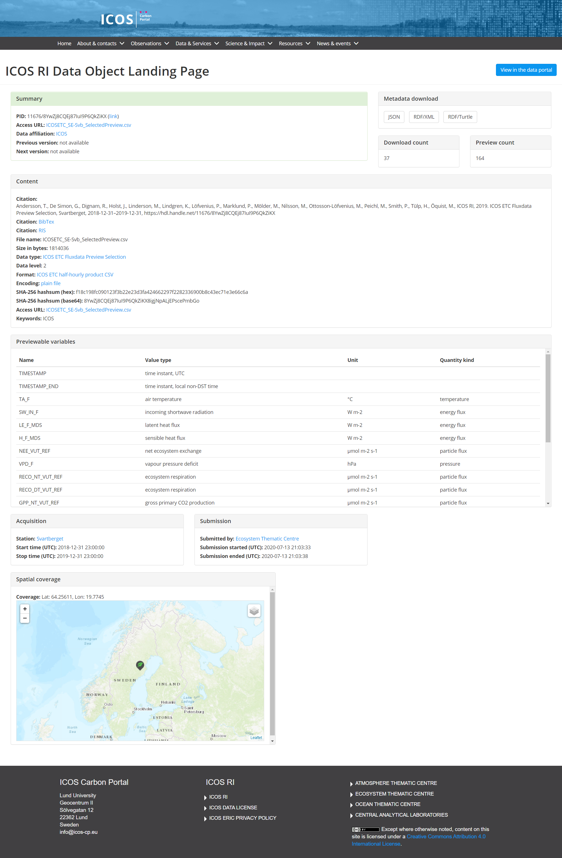

Slide 19
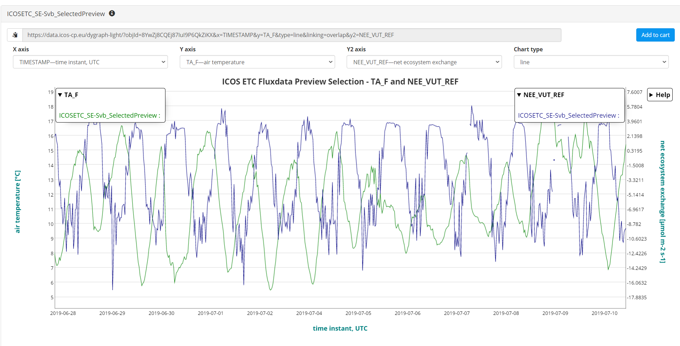
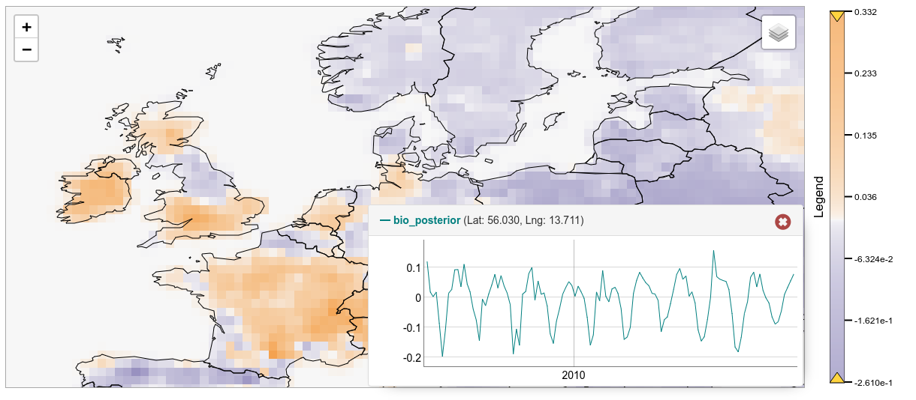
Preview of data
https://data.icos-cp.eu/dygraph-light/?objId=8YwZj8CQEj87IuI9P6QkZiKX&x=TIMESTAMP&y=TA_F&type=line&linking=overlap&y2=NEE_VUT_REF

Slide 20
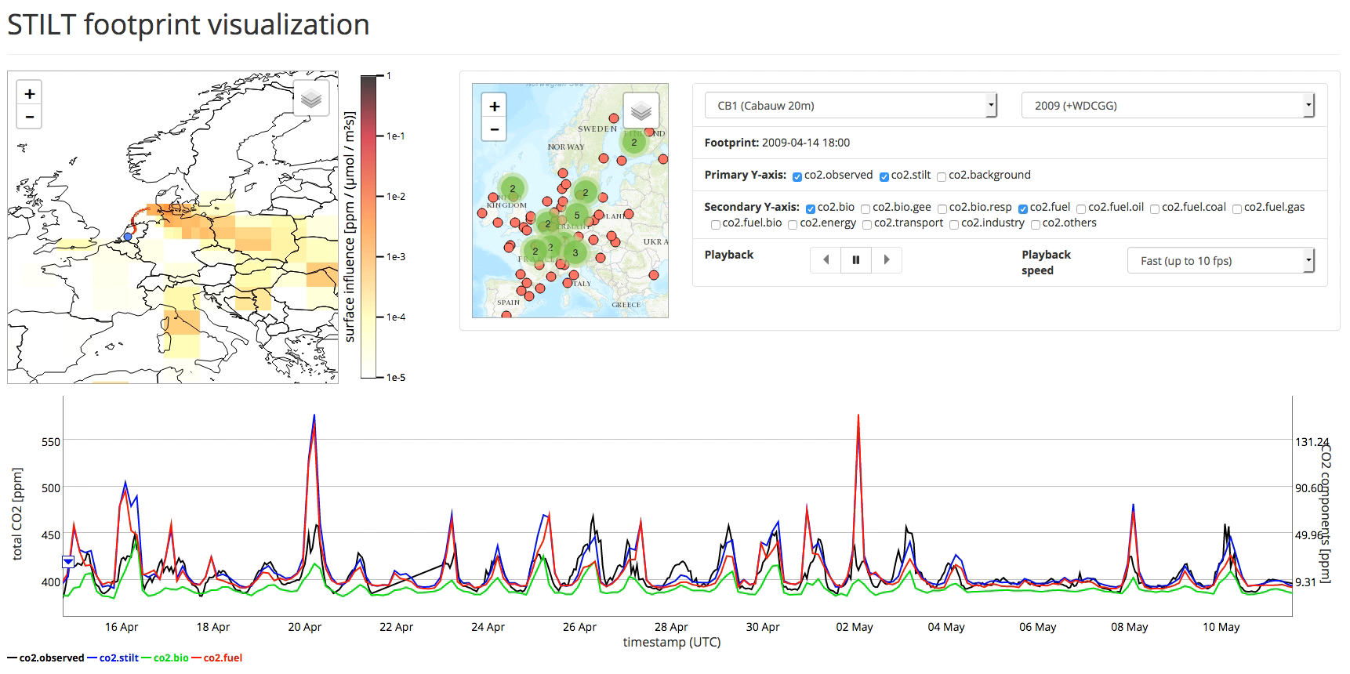
Start exploring yourself at
https://stilt.icos-cp.eu/viewer/ for visualization of all available results
https://stilt.icos-cp.eu/worker/ for starting on-demand computations

Slide 21
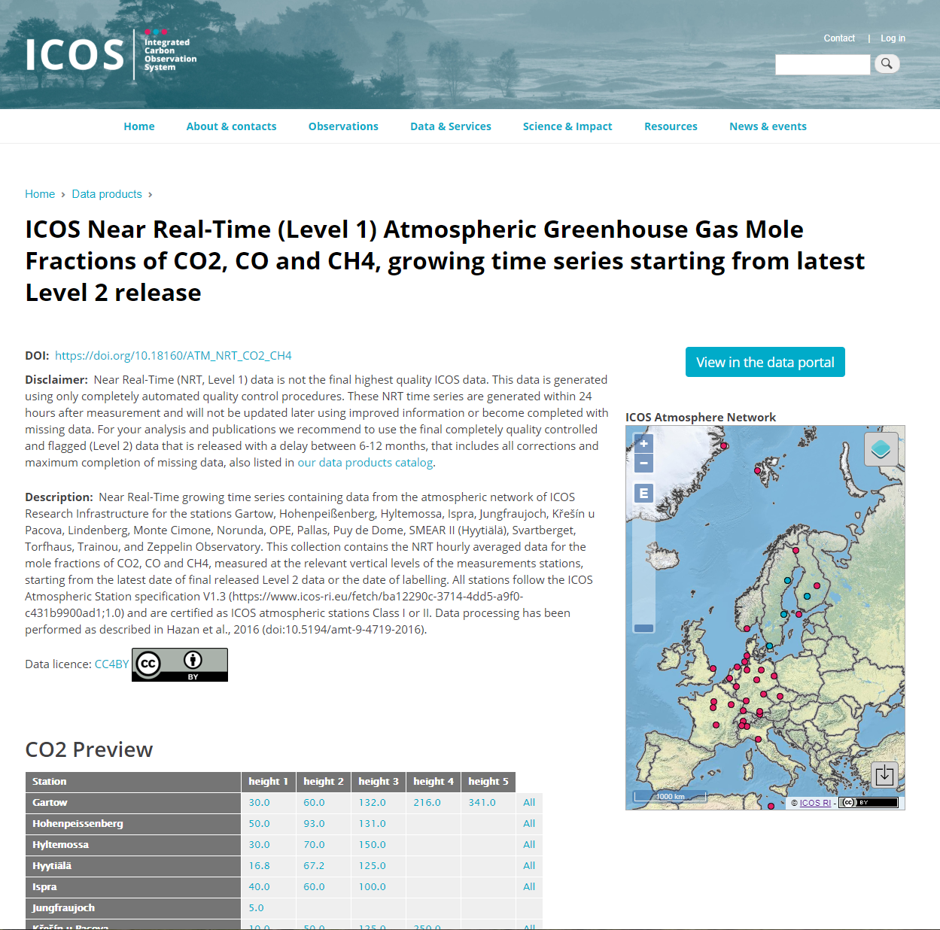
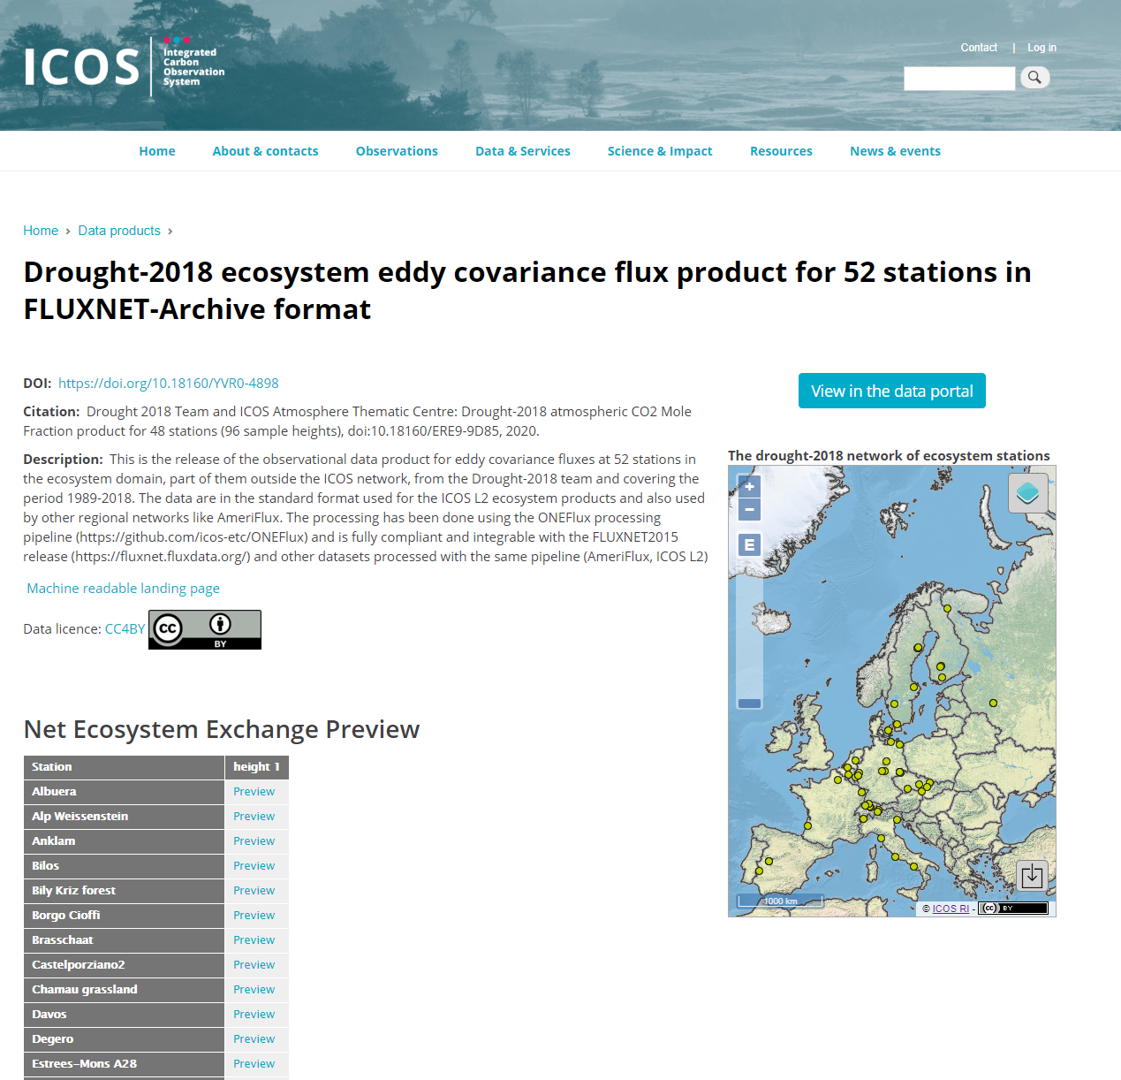
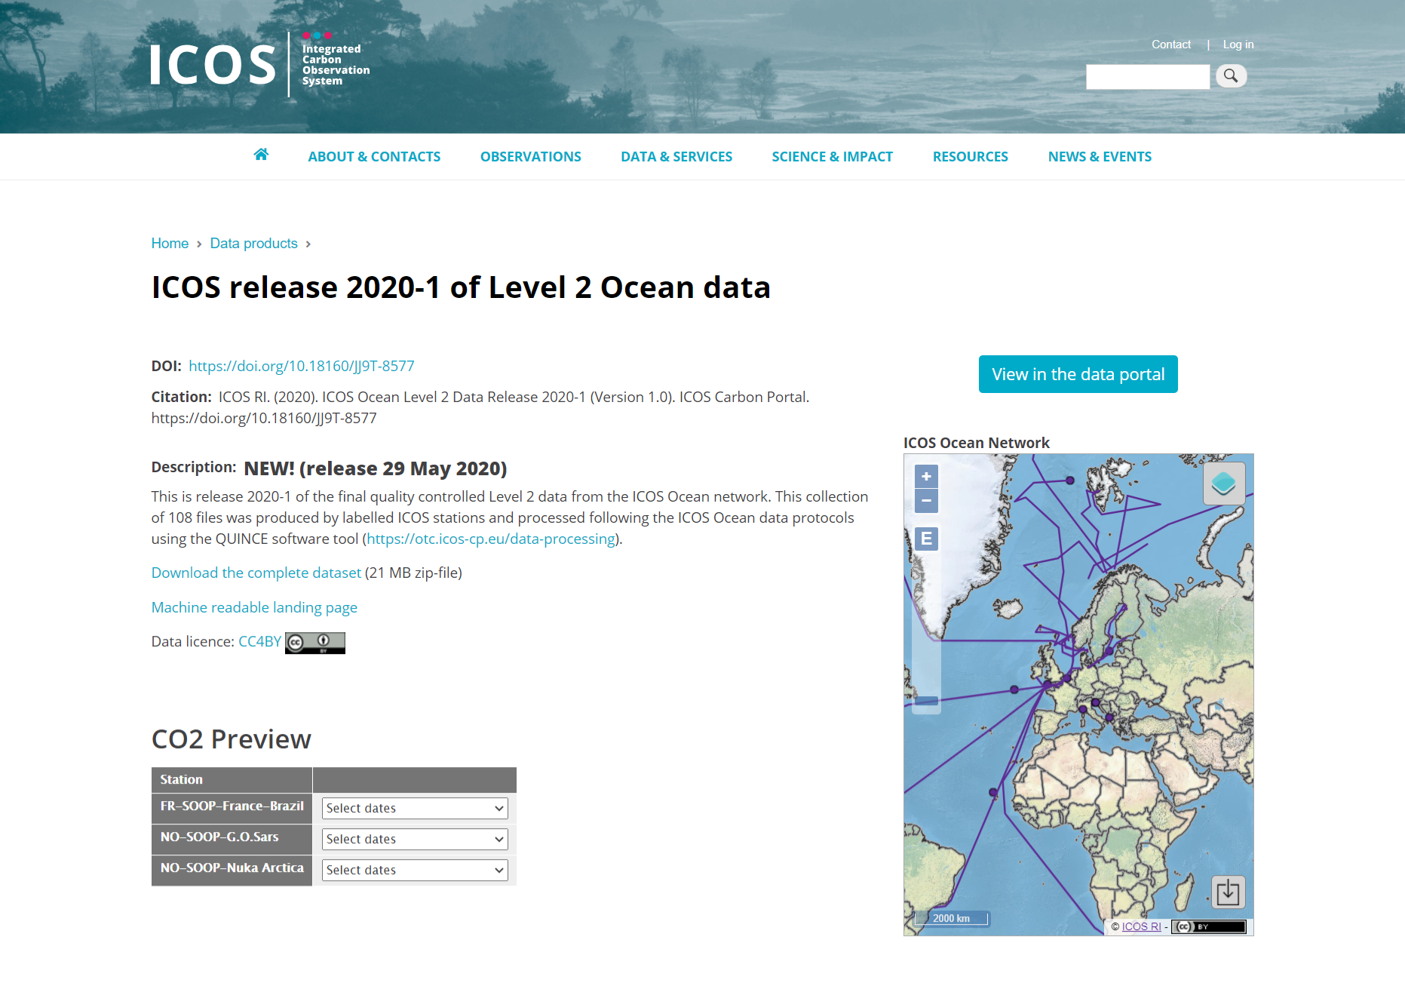
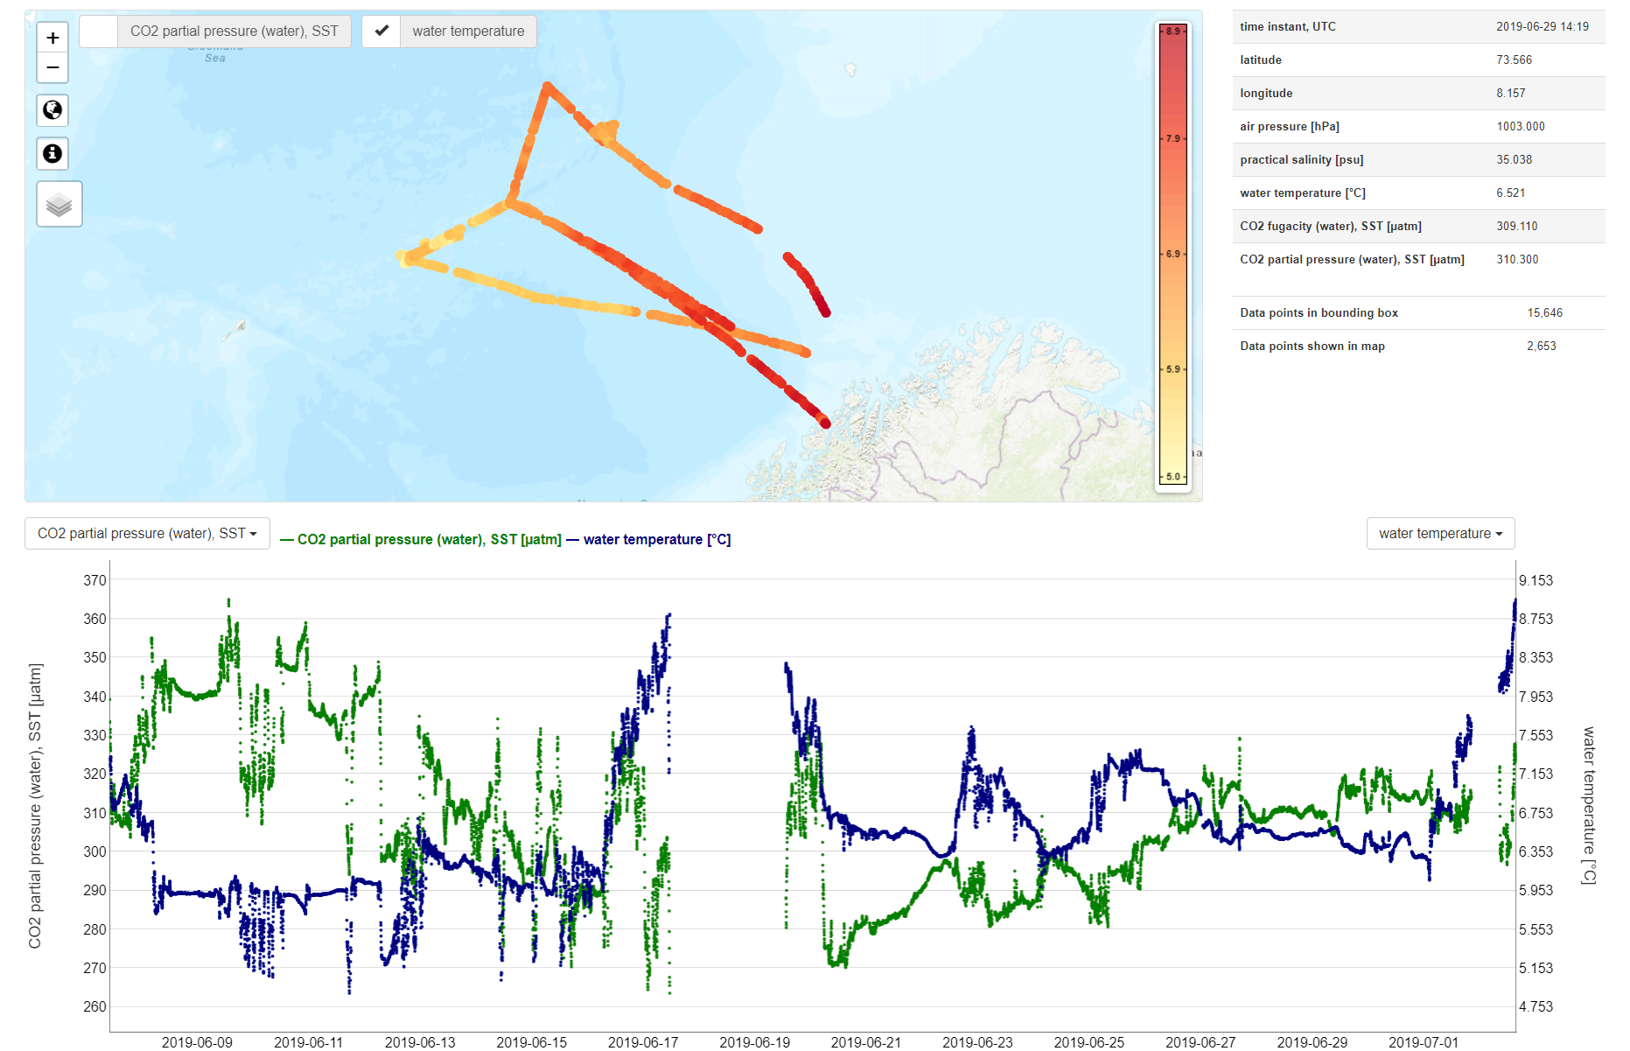
www.icos-cp.eu/dataproducts

Slide 22
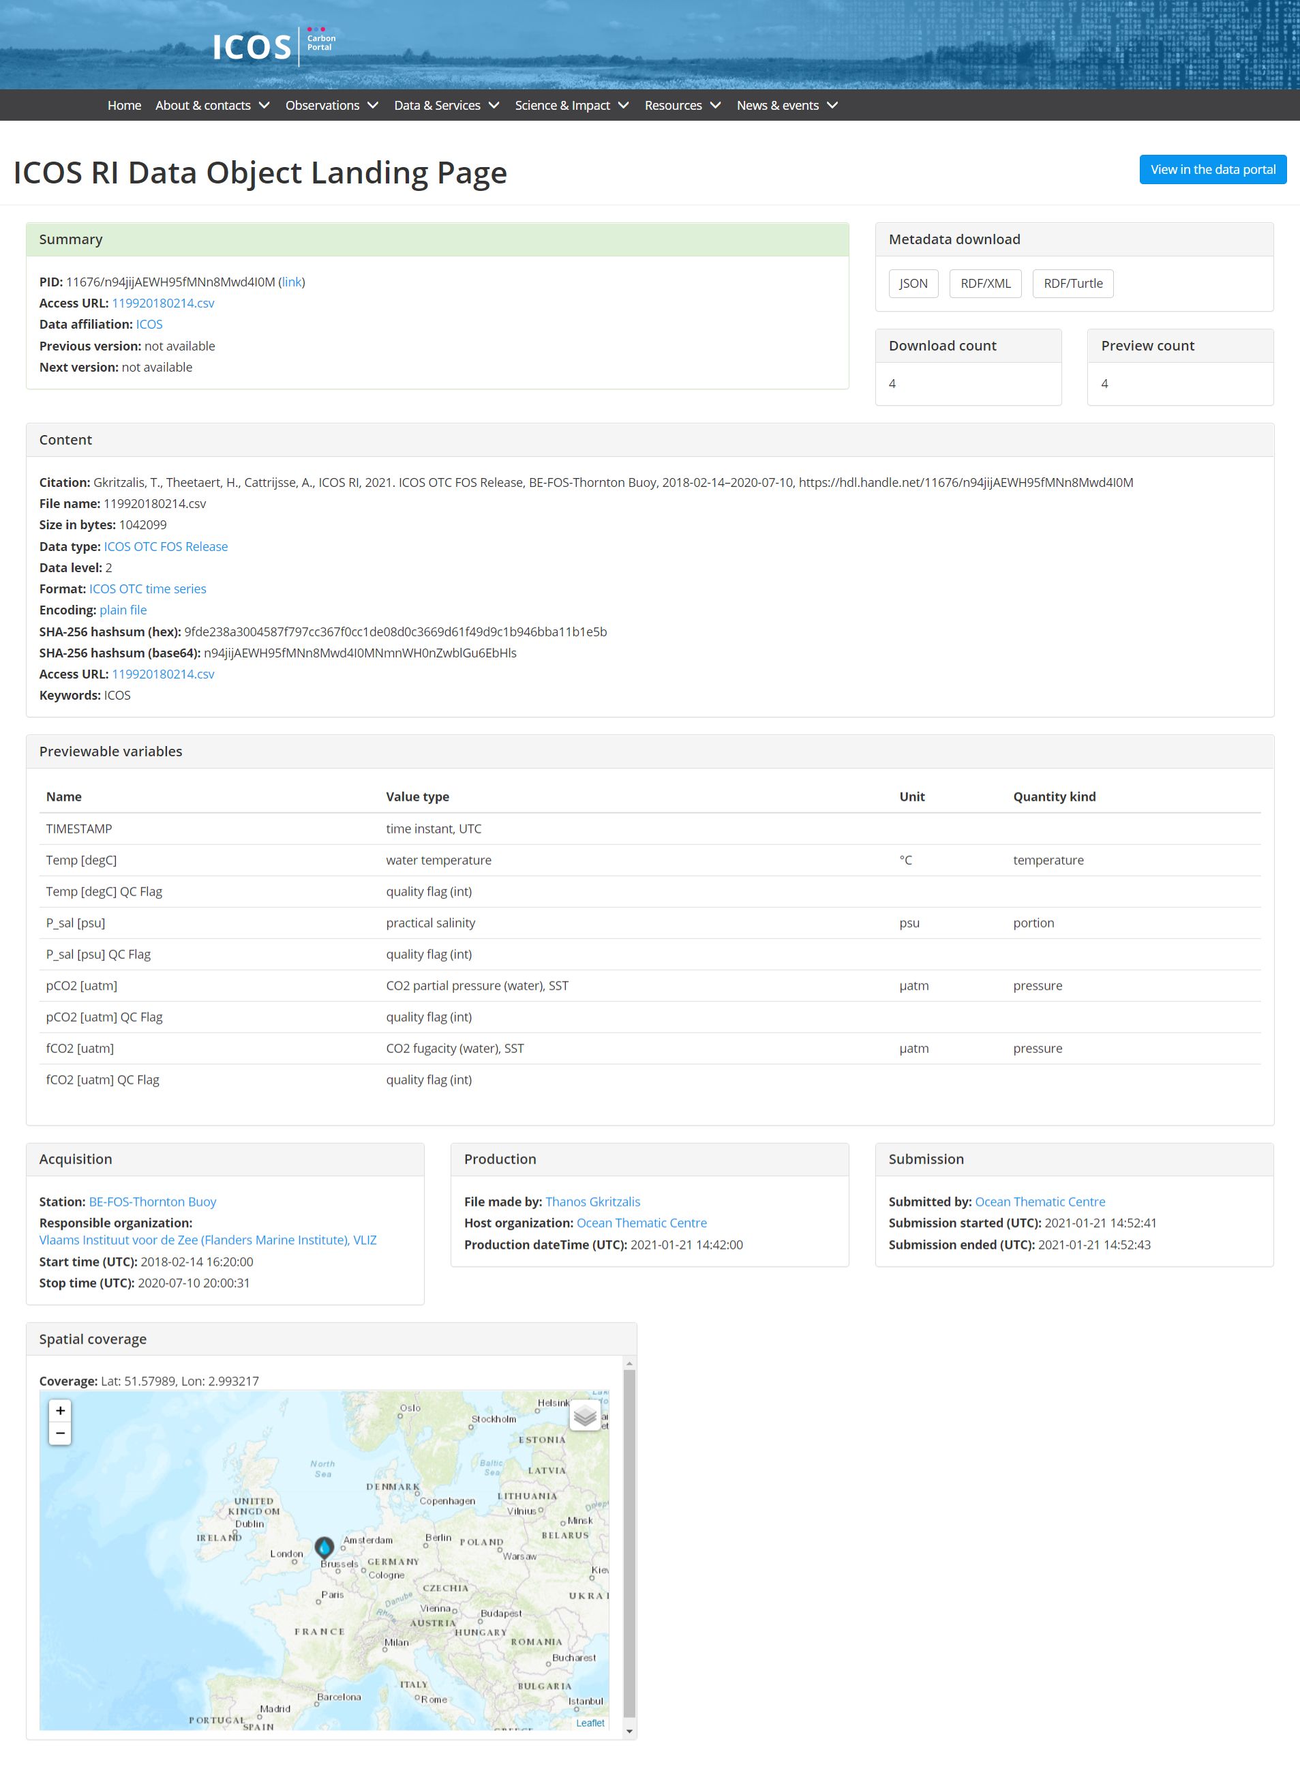
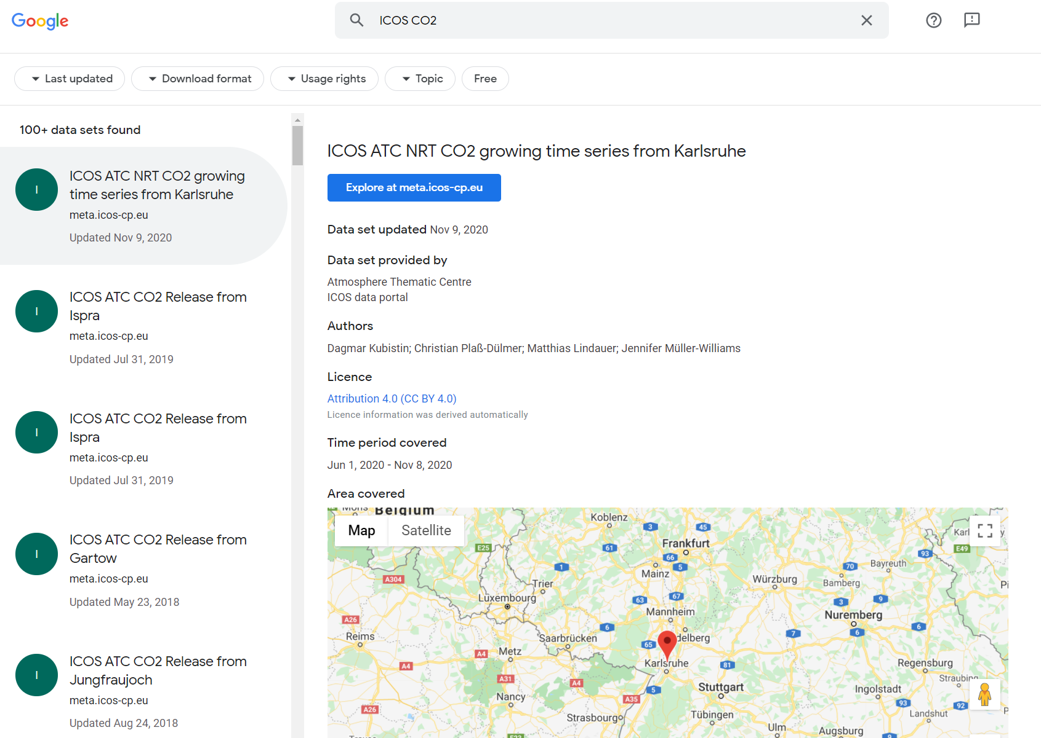
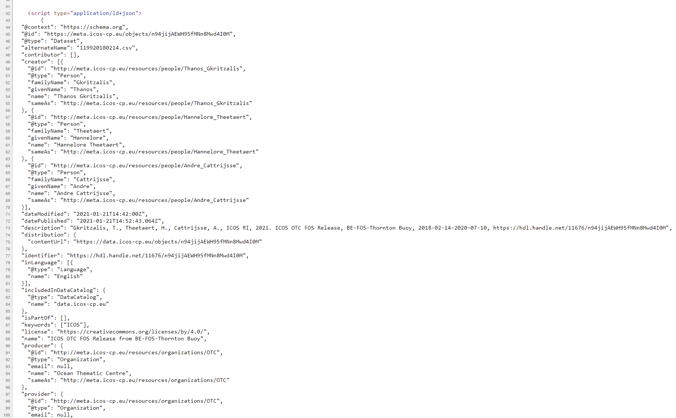
Schema.org annotation of landing->Google dataset search indexing

Slide 23
Jupyter Notebooks at ICOS CP
Project Specific Jupyter Notebooks https://jupyter.icos-cp.eu
  Analysis of simulated fossil fuel CO₂ time series (RINGO)
  Evaluation of sampling strategies (RINGO)
  EUROCOM inversion intercomparison
Open Access Jupyter Notebooks https://exploredata.icos-cp.eu
  Explore ICOS Atmospheric Data
  Compare atmospheric model results (STILT) to ICOS Atmospheric Data
Educational Jupyter Notebooks (part of exploredata)
  Carbon Cycle & Python Programming --- > Swedish Science Centres
  Drought 2018 & Python Programming --- > Highschool pupils & BSc &PhD students
Further development: PID4Notebooks
  Registers all data used, results, dependencies and code in one publishable and citable archive referenced by DOI and PID

Slide 24
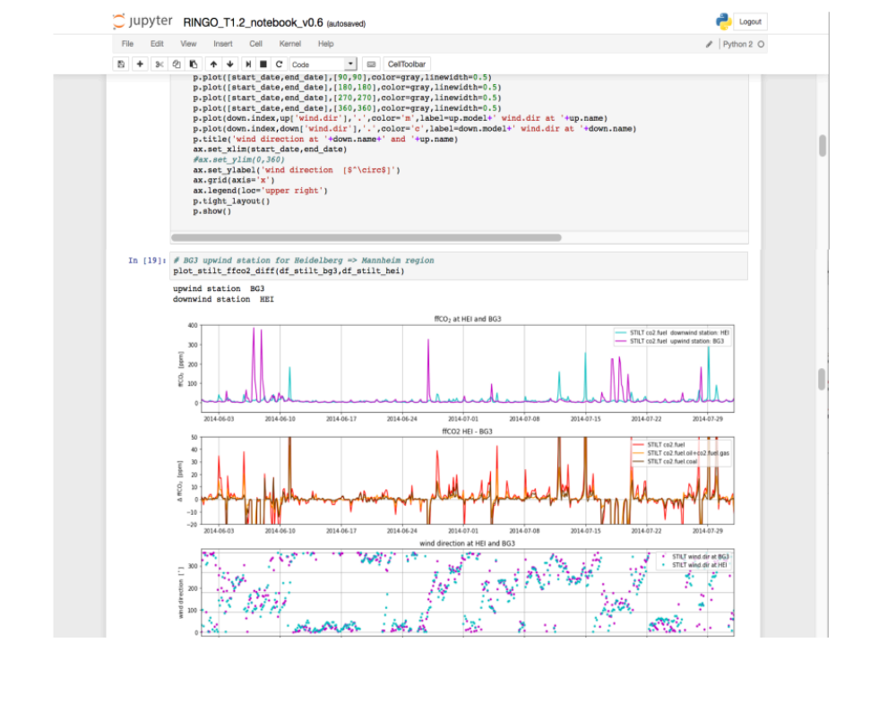
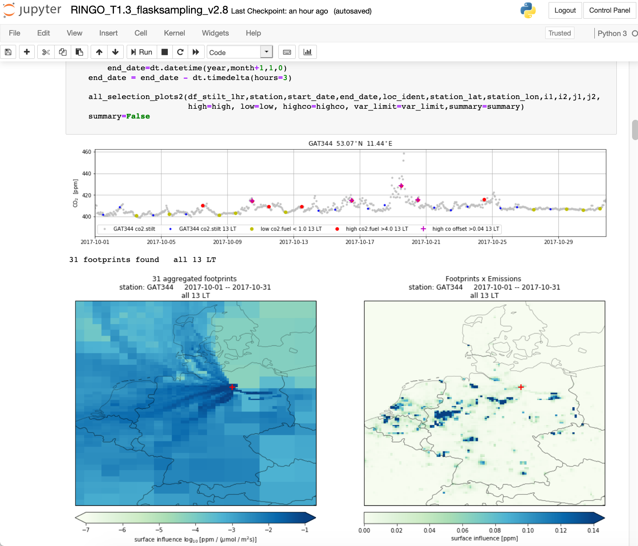
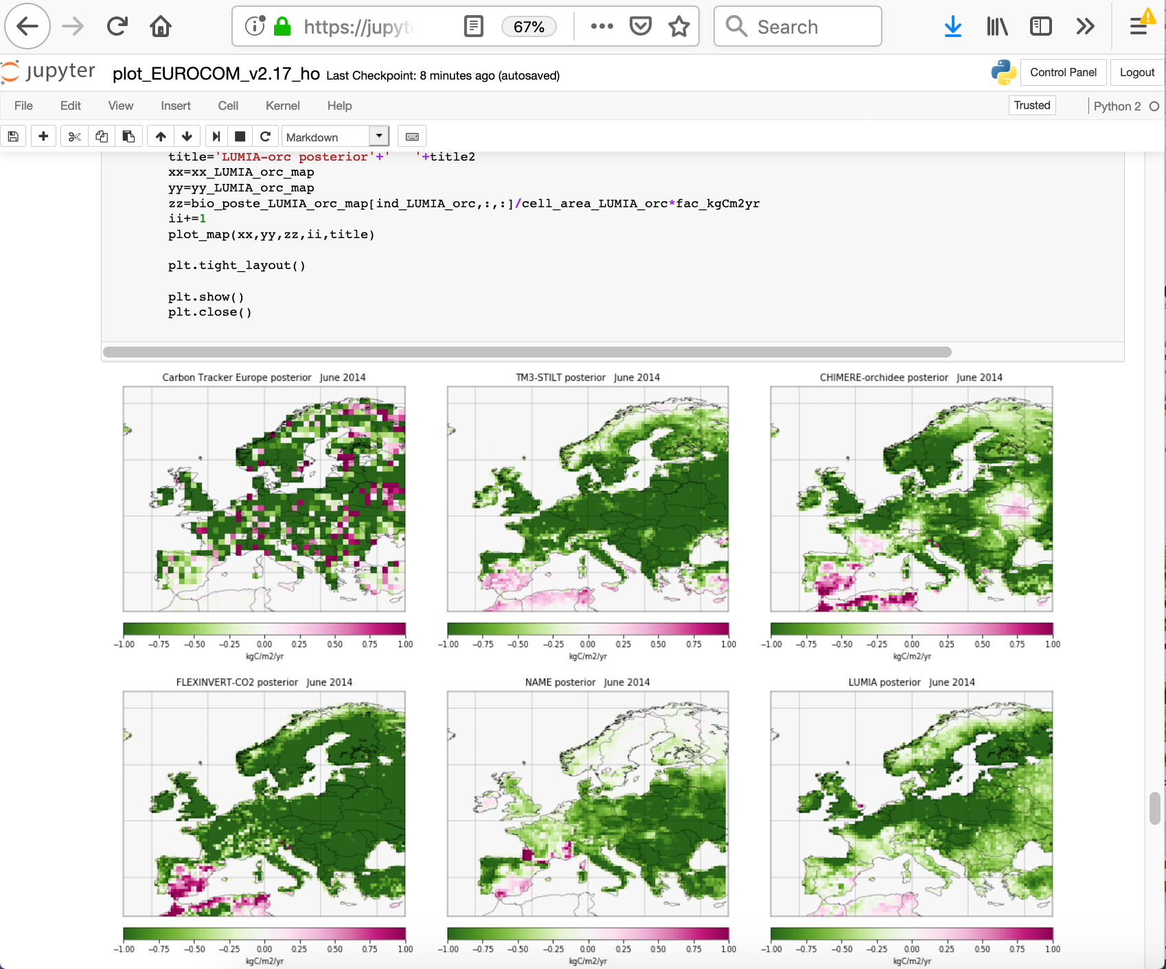
Project-specific Jupyter notebooks
Analysis of simulated fossil fuel CO₂ time series (RINGO)
Evaluation of sampling strategies (RINGO)
EUROCOM inversion intercomparison
…

Slide 25
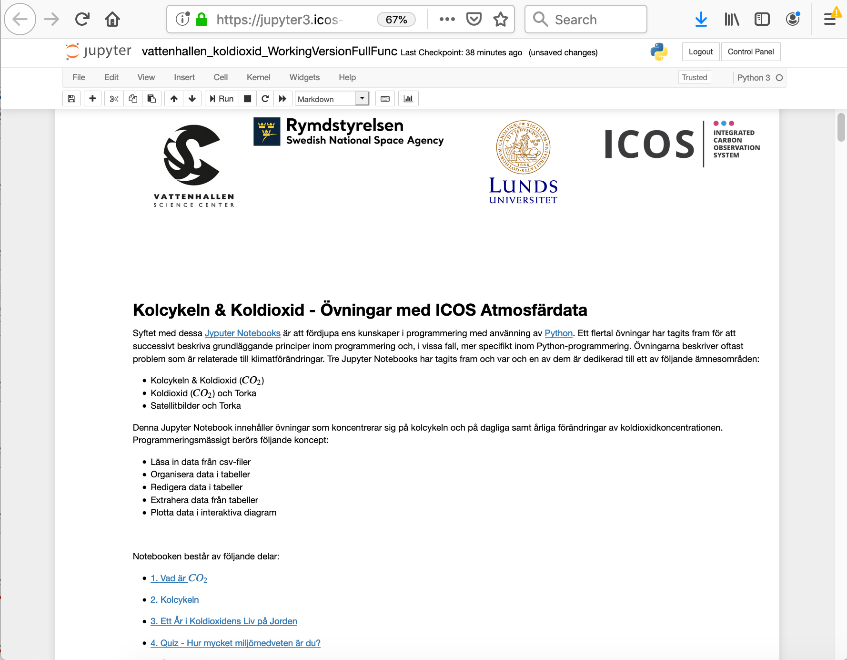
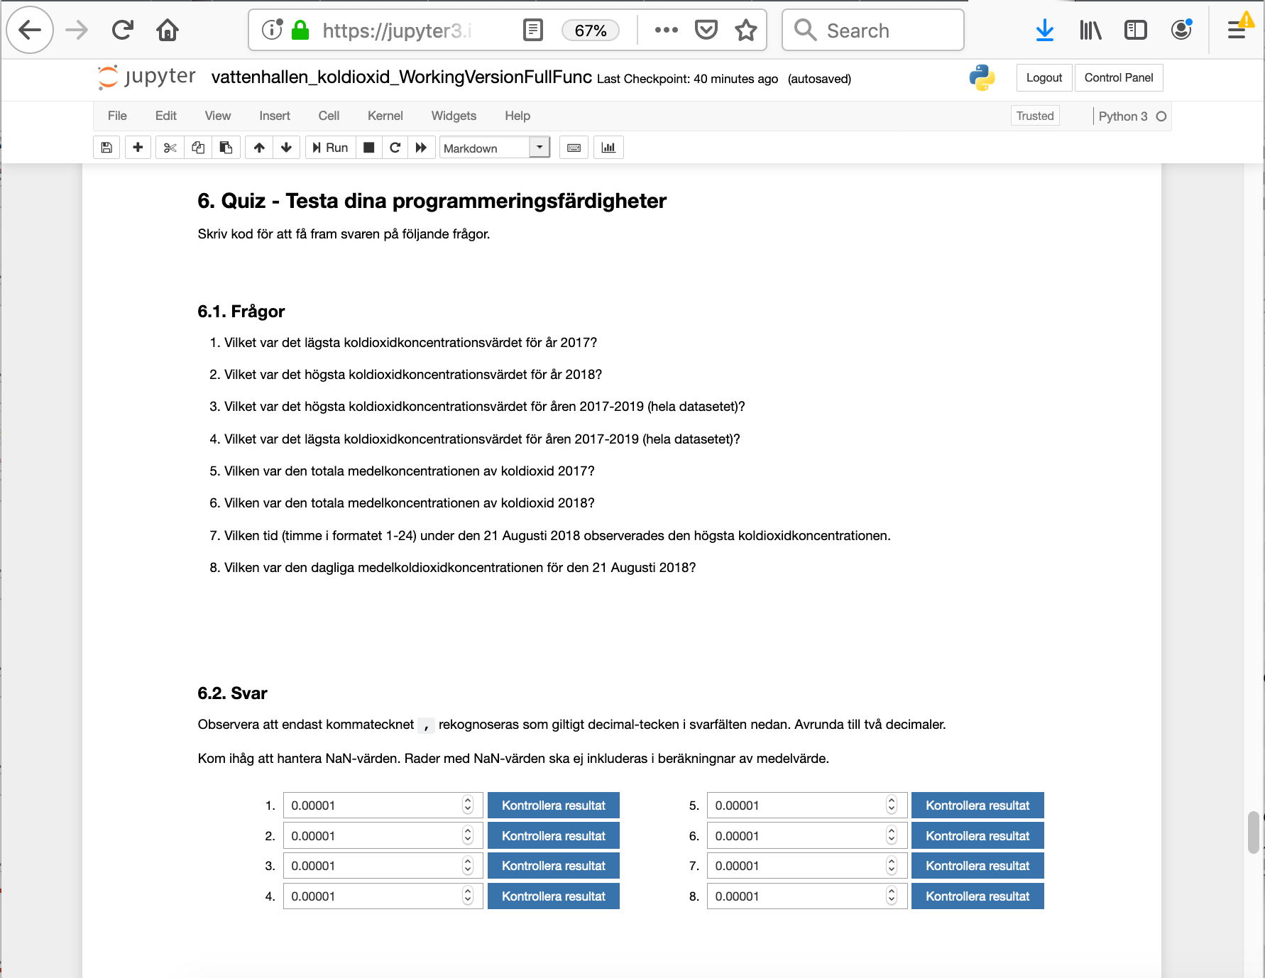
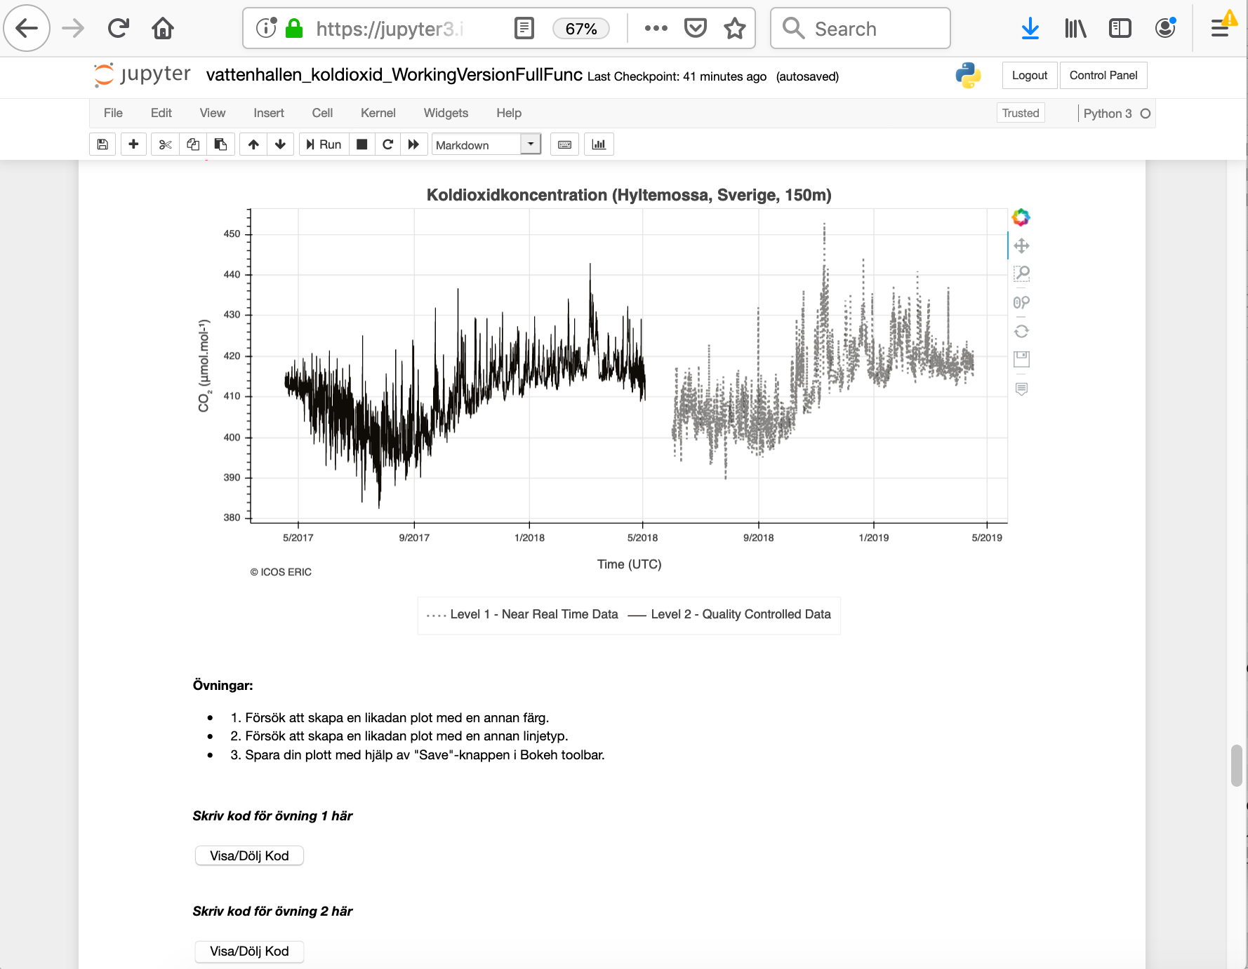
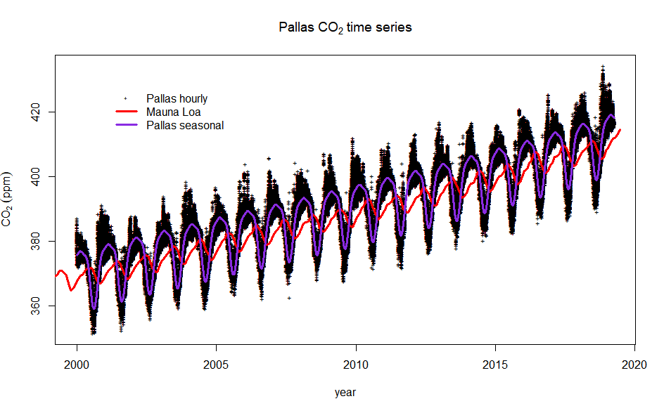
Jupyter notebooks for educational purposes
Teaching material for university and high-school combining data analytics, coding, and natural sciences
Display at Swedish Science centers

Slide 26
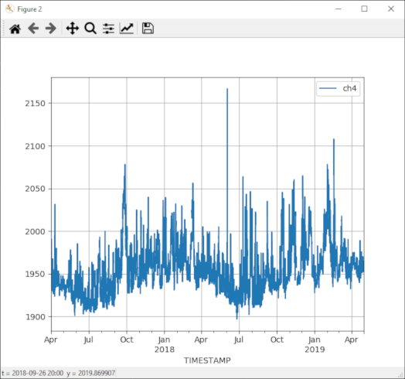
Python library for (meta)data access
Python library
https://github.com/ICOS-Carbon-Portal/pylib
https://icos-carbon-portal.github.io/pylib/
Find stations, data, collections, variables
conda create -n icos python
activate icos
pip install icoscp
import matplotlib.pyplot as plt
from icoscp.cpb.dobj import Dobj
dobj = Dobj('https://meta.icos-cp.eu/objects/lNJPHqvsMuTAh-3DOvJejgYc')
dobj.data.plot(x='TIMESTAMP', y='ch4', grid=True)
plt.show()

Slide 27



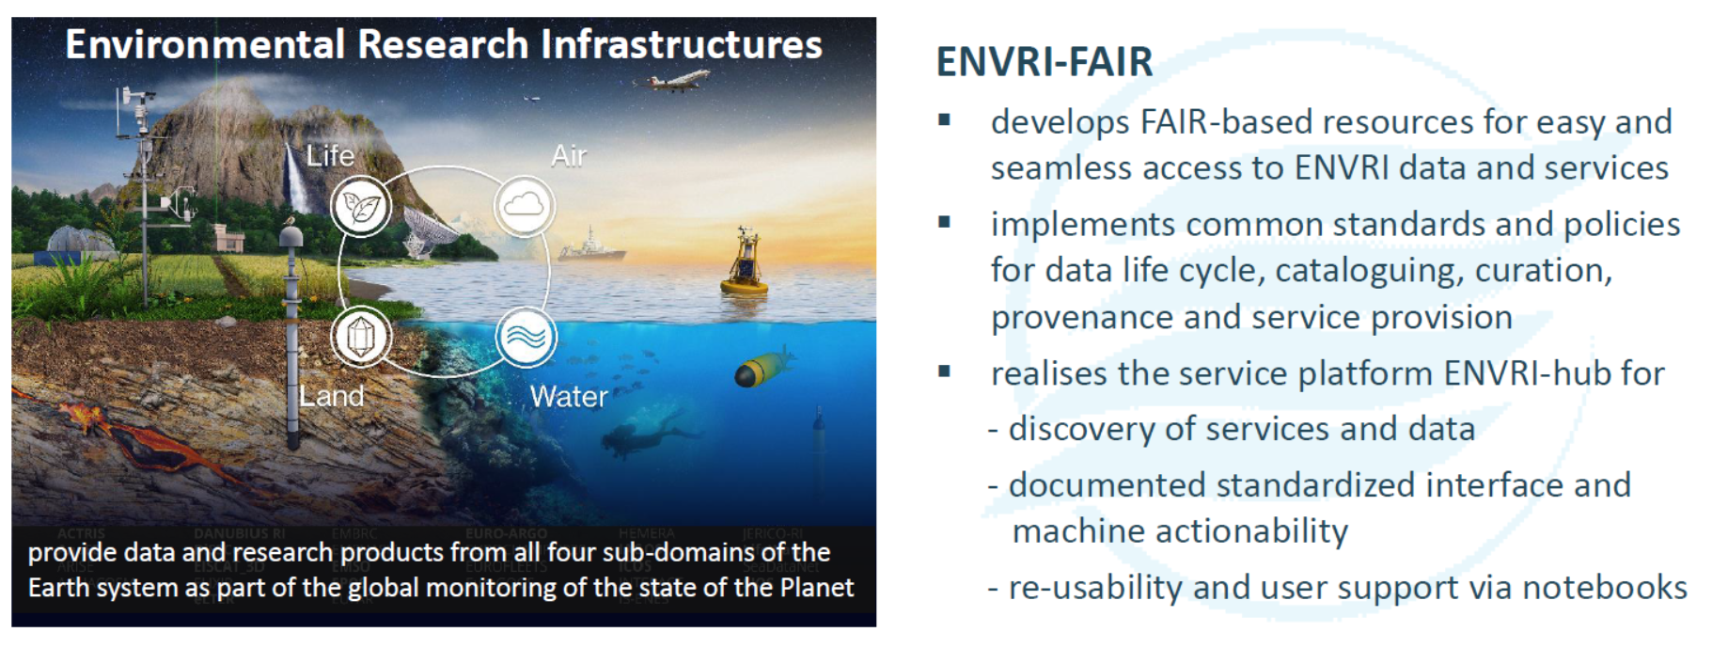

Further development
FAIRness is an ambition and is never finished
Application for CoreTrustSeal certification
Further develop the user services: e.g. ATMO ACCESS
Improve the global links to WMO GAW, Obspack, SOCAT and FLUXNET
See Petzold et al: https://meetingorganizer.copernicus.org/EGU21/EGU21-8052.html

Slide 28
Conclusion
FAIR principles are essential elements of a repository
Other requirements also need to be met:
  TRUST
  Stakeholder needs
  Attribution
  Usage tracking
  Links to the (legacy) global data system
ICOS Carbon Portal combines all based on an open source ontology based linked open data system
Flexibility is key, develop first your own ontology with minimal dependencies on which to build your business logic
Then, only then, map to (global) standards and vocabularies

Slide 30
Some selected links to the ICOS data portal
https://data.icos-cp.eu/portal
https://exploredata.icos-cp.eu
https://www.icos-cp.eu/data-products
https://stilt.icos-cp.eu/viewer/
https://stilt.icos-cp.eu/worker/
https://github.com/ICOS-Carbon-Portal
https://www.icos-cp.eu/data-products
https://data.icos-cp.eu/stats/
Account required:
https://cpauth.icos-cp.eu/login/
https://jupyter.icos-cp.eu
https://meta.icos-cp.eu/uploadgui/
https://doi.icos-cp.eu/
https://meta.icos-cp.eu/sparqlclient/
https://fileshare.icos-cp.eu
(any name+ password on request)
Main search interface
Anonymous Jupyter notebooks
Main ICOS obs. data products
View footprints and concentrations
Calculate your own footprints
ICOS CP source code repo
ICOS main data products summary
Download statistics
Login/create account
Jupyter service (sep. account needed)
User friendly data upload
DOI minting and metadata edit service
GUI for open SparQL endpoint
ICOS fileshare, online document editing

Slide 31

Carbon Portal Technology stack
Backend:
MongoDB
Java and Scala, Akka
RDF, OWL, SPARQL, Postgres, Eclipse, RDF4J
Front end:
Javascript, Redux, Leaflet, OpenLayers, React, Bootstrap, RESTHeart
Infrastructure:
NGiNX, Docker, JVM, EGI Cloud (Grid), B2SAFE, Jupyter Hub, Ansible

