Slide 1
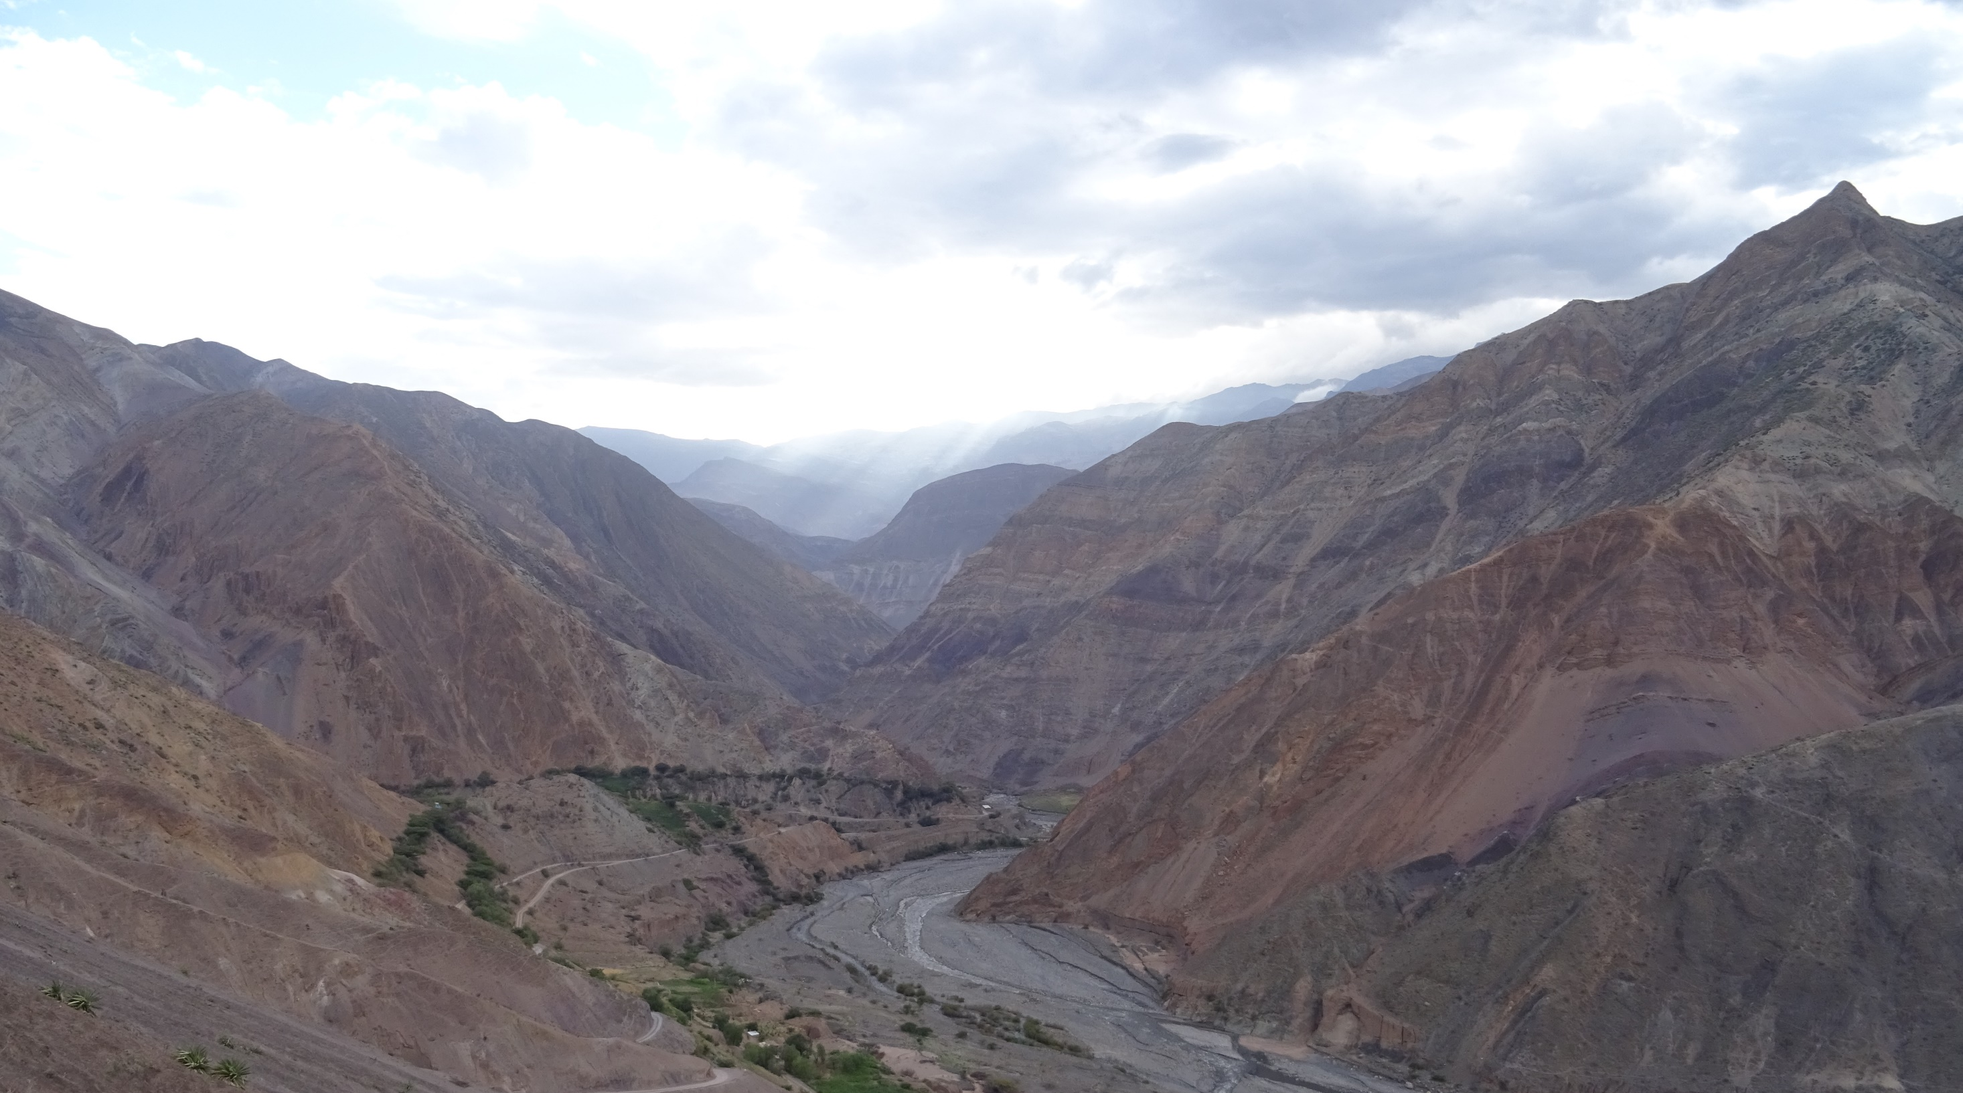
Supporting materials
Assessing the contribution of natural and anthropogenic processes on sediment dynamics in the Rio Santa (Peru) through sediment fingerprinting
jessica.kitch@plymouth.ac.uk
Jessica Kitch, Caroline Clason, Sally Rangecroft, Sergio Morera, Will Blake

Slide 2
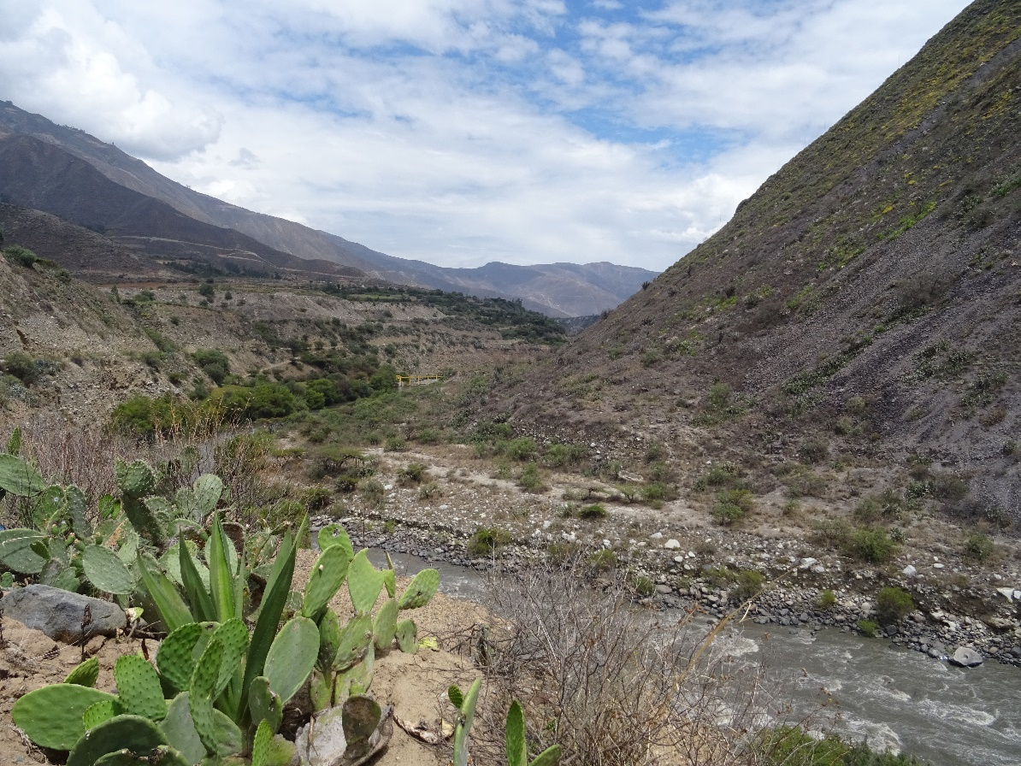
Aims and Objectives
This project aims to improve understandings of sediment sources and dynamics in the Andean catchment of the Rio Santa
The current investigation focuses on the in channel sediment of the Rio Santa
To better understand sediment dynamics sediment fingerprinting will be used
Jessica Kitch, Caroline Clason, Sally Rangecroft, Sergio Morera, Will Blake

Slide 3
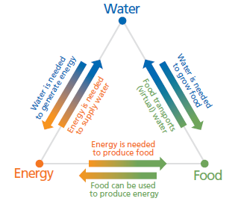
Soil Erosion Problem
Rates of soil erosion are unsustainable
Greater volumes of soil are leaving catchments compared to production rates
Water security, food security and energy security are all linked and effected by soil erosion
Sediment can carry pollutants and this can effect drinking water supplies
Sediment can cause issues with hydroelectric dams and thus energy production
flores.unu.edu​
Jessica Kitch, Caroline Clason, Sally Rangecroft, Sergio Morera, Will Blake

Slide 4
Rio Santa Catchment
The Rio Santa catchment is located in Peru
The main channel sites between the glaciated Cordillera Blanca and unglaciated Cordillera Negra
Samples were collected in November 2019 from the main channel and tributaries of the Cordillera Blanca and the Cordillera Negra
Figure 1: Rio Santa location and geology (FAO, 2003)
Jessica Kitch, Caroline Clason, Sally Rangecroft, Sergio Morera, Will Blake

Slide 5
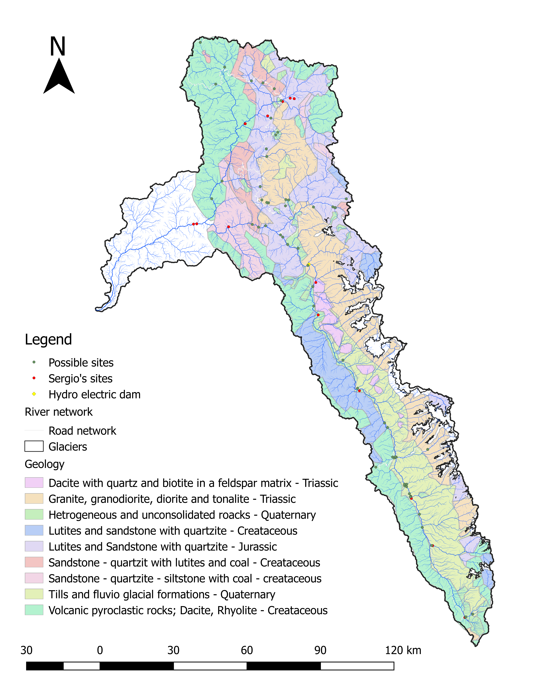
Rio Santa Sampling
TCN
TCE
TC
Samples were taken in November 2019
The samples taken were of deposited sediment along both the Rio Santa and the Tablacacha
The main channels were sampled along with tributaries that best represented the two Cordilleras (Blanca and Negra)
This presentation will focus on the Rio Santa
RS
SC
SCN
RS: Rio Santa
TC: Tablachaca Catchment
TCN: Tablachaca Catchment North
TCE: Tablachaca Catchment East
SC: Santa Catchment
SCN: Santa Catchment Negra
SCB: Santa Catchment Blanca
SCB
Jessica Kitch, Caroline Clason, Sally Rangecroft, Sergio Morera, Will Blake

Slide 6
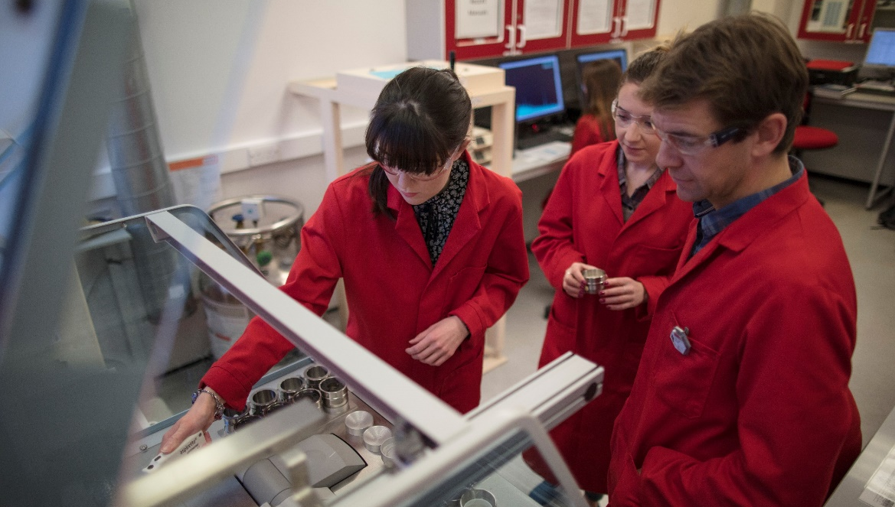
Sample Analysis
Samples were processed and the geochemistry analysed using Wavelength Dispersive X-ray Fluorescence (WD XRF)
XRF provides the geochemistry for samples
Samples were processed first by sieving to <63µm and then milled and mixed with a wax binder to produce pellets
Research, consultancy, training, teaching, ISO9001:2008 accreditation
Contact: william.blake@plymouth.ac.uk
Jessica Kitch, Caroline Clason, Sally Rangecroft, Sergio Morera, Will Blake

Slide 7
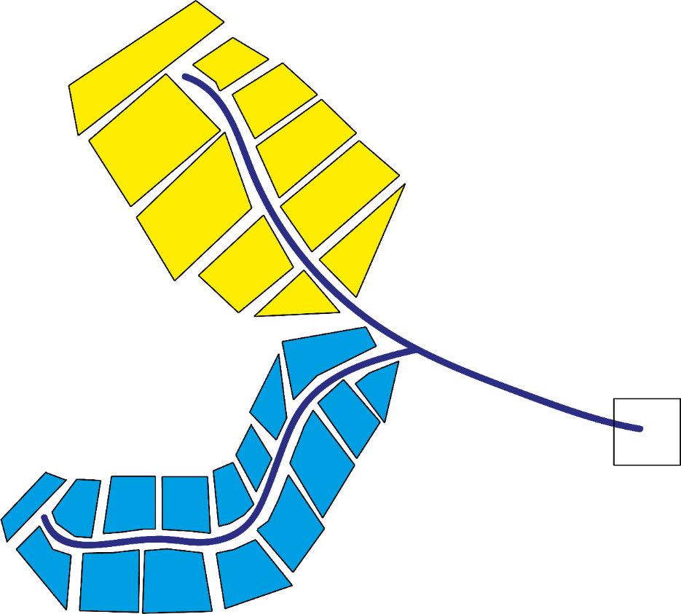
Sediment Fingerprinting Concept
For example, a catchment could have 2 sources of sediment
Sediment fingerprinting can identify the fingerprint that is present in the downstream sediment (mix)
The main contributor to the sediment mix can also be identified
Statistical models are used to unravel the multiple sources using geochemical fingerprints
The MixSIAR mixing model was used in this study (Stock et al., 2018)
?
? =
or
or
A mix
Jessica Kitch, Caroline Clason, Sally Rangecroft, Sergio Morera, Will Blake

Slide 8
MixSIAR mixing model
The MixSIAR model uses geochemical data
The geochemical composition of source samples is compared to the mix samples
The mixing model will apportion the sediment sources
Jessica Kitch, Caroline Clason, Sally Rangecroft, Sergio Morera, Will Blake

Slide 9
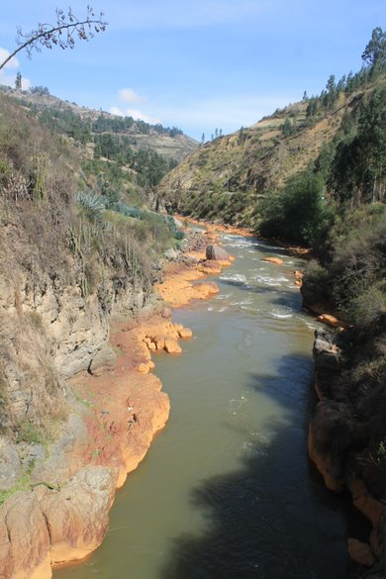
Upstream of Huaraz
Unmixing of samples taken upstream of Huaraz city
The MixSIAR model shows the Cordillera Blanca is the largest sediment contributor
The Cordillera Negra contributes the least to sediment
Jessica Kitch, Caroline Clason, Sally Rangecroft, Sergio Morera, Will Blake

Slide 10
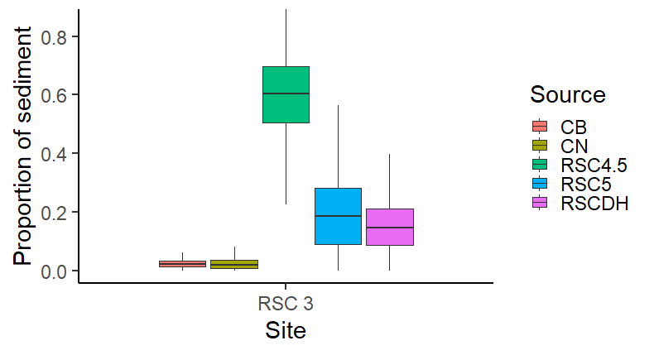
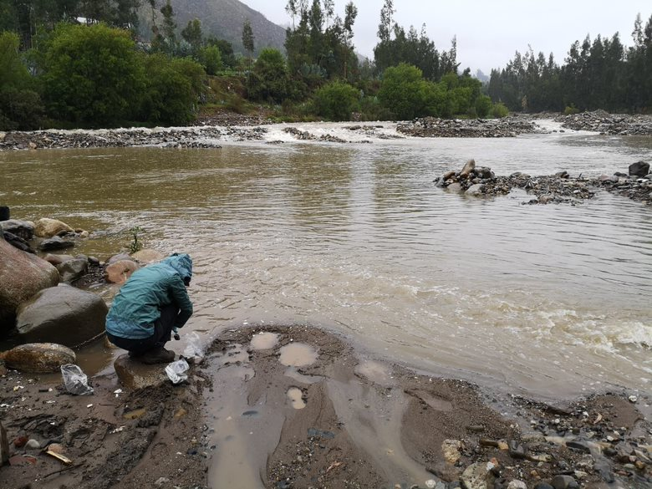
Downstream of Huaraz
As the previous slide shows, glaciated Cordillera Blanca is the main contributor for this RSC4.5 result
Unmixing of samples taken downstream of Huaraz city
The MixSIAR model shows the main stream sample sediment has been transported downstream
The Cordilleras are contributing less at the point
Jessica Kitch, Caroline Clason, Sally Rangecroft, Sergio Morera, Will Blake

Slide 11
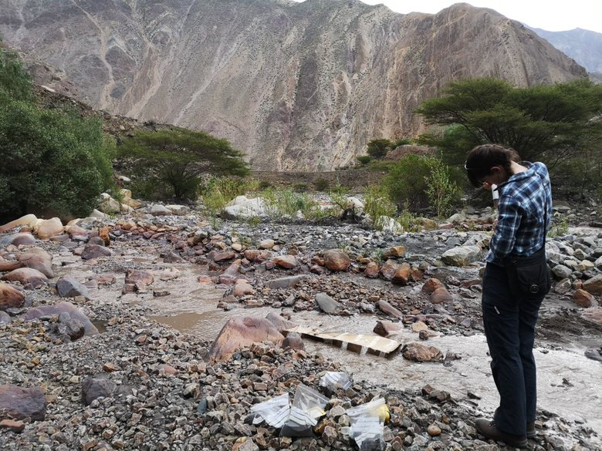
Before the Confluence
Unmixing of samples taken close to the confluence of the Rio Santa and Tablacacha, and down stream of Huaraz
The MixSIAR model shows sediment from the upstream main channel has been transported further downstream
Sediment from close to the Rio Santa source (RSC5) is less significant at the point
Jessica Kitch, Caroline Clason, Sally Rangecroft, Sergio Morera, Will Blake

Slide 12
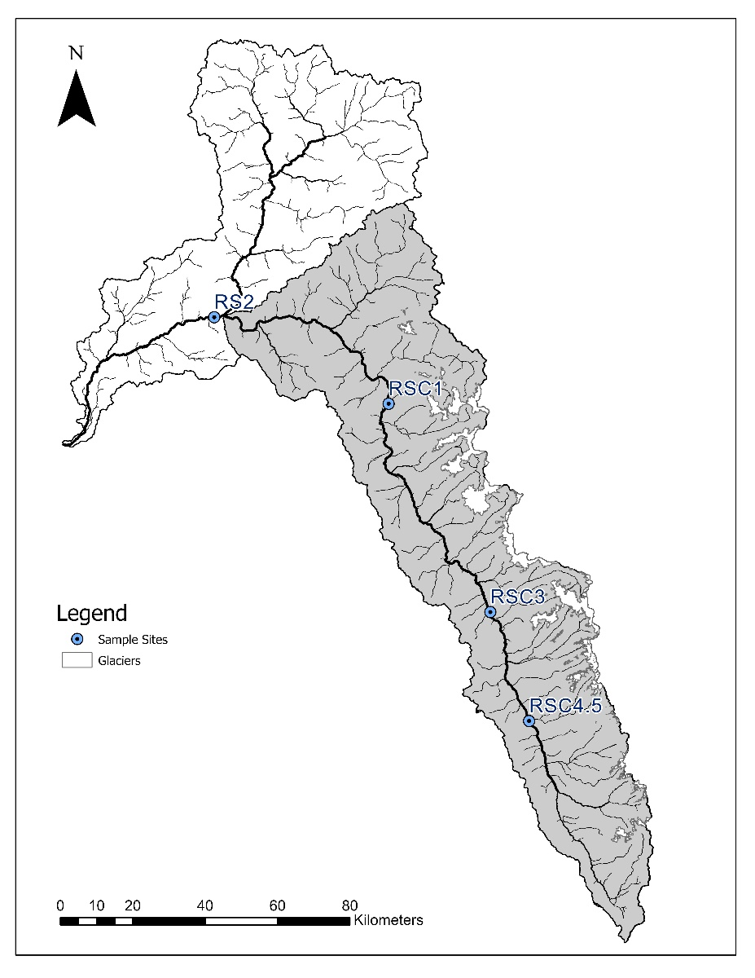
Rio Santa from Lake to Confluence
The sample taken near the lake is consistently the greatest contributor to sediment in the Rio Santa
The Cordillera Blanca is the second greatest contributor and is likely due to the presence of glaciers
The model suggests in channel sediment near the lake is transported to the outlet at RS2
Jessica Kitch, Caroline Clason, Sally Rangecroft, Sergio Morera, Will Blake

Slide 13
Research questions
Following this project a study of a sub basin in the Rio Santa will take place to investigate the impact of land cover on sediment dynamics
A land cover map will be developed and land cover samples taken to investigate anthropological impacts
Sediment fingerprinting will be used alongside the ‘Soil Water Assessment Tool’ to better understand dynamics
Future climate projections will be used to help predict the changes in sediment dynamics in the future
The impact of glacier change will also be investigated
Jessica Kitch, Caroline Clason, Sally Rangecroft, Sergio Morera, Will Blake

Slide 14
Any questions – please get in touch
jessica.kitch@plymouth.ac.uk
Jessica Kitch, Caroline Clason, Sally Rangecroft, Sergio Morera, Will Blake

