Slide 1
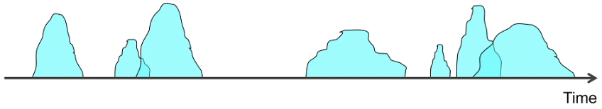
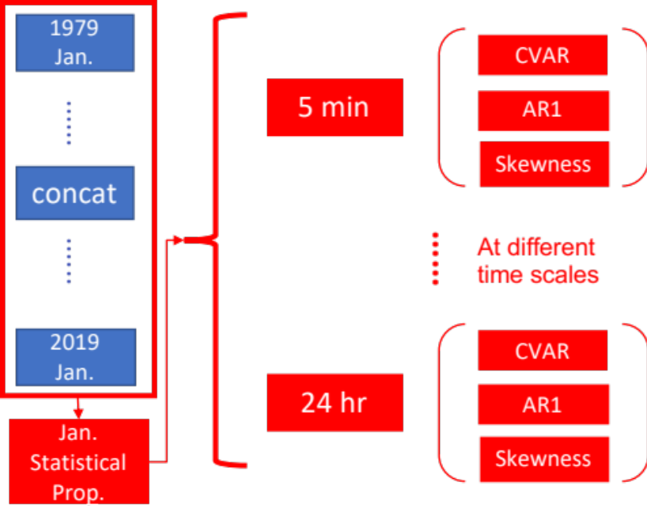

pyBL: An open source Python package for stochastic high-resolution rainfall modelling based upon a Bartlett Lewis Rectangular Pulse model
Raw rainfall data
Statistical properties calculation
Calibration
Sampling
Generated data
raw_rainfall.csv
Stats_prop.csv
Theta.csv
generated_data.csv
Weight_prop.csv
Calibration
Sampling
Post-process & Utility
Global Optimization
Sample storms
Basin-hopping
Dual-annealing
Merge Cells
Stay tuned with the update of pyBL on Github
Regularise
Local Optimization
Nelder-Mead
L-BFGS-B
Ting-Yu DAI
r08521605@ntu.edu.tw
Dr. Li-Pen WANG
lpwang@ntu.edu.tw

