Slide 1
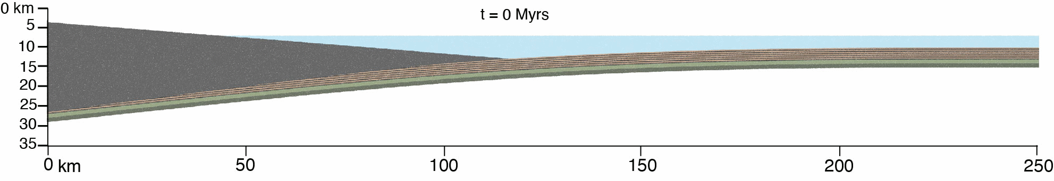



Underplating altered oceanic crust: Insights from numerical modelling
Zoe Braden, Jonas B. Ruh, & Whitney M. Behr
Structural Geology & Tectonics Group, Dep. of Earth Sciences, ETH Zürich, Switzerland
zoe.braden@erdw.ethz.ch

Slide 2
Altered oceanic crust
Megathrust faults can develop in mafic oceanic rocks, and underplating of mafic oceanic crust occurs at a variety of subduction depths.
Mafic rocks have different rheological properties than sedimentary rocks and this can impact long-term subduction rates and short-term slip behaviour.
We implement a weakened layer of altered oceanic crust, comparable to what has been suggested by drill core and field studies of oceanic crust (e.g. Alt et al. 1986; Niwa 2006; Ujiie et al. 2007; Kameda et al. 2011; 2017), that is 1 km thick and sits on top of a stronger, less-reactive layer of oceanic crust.
Underplating occurs when the altered oceanic crust reaches 160°C at near-lithostatic fluid pressure levels and weakens, creating a décollement. This threshold is based on the temperature at which significant fluid is released through compaction and dehydration reactions.

Slide 3
Question: What impacts underplating of oceanic crust during subduction?

Slide 4
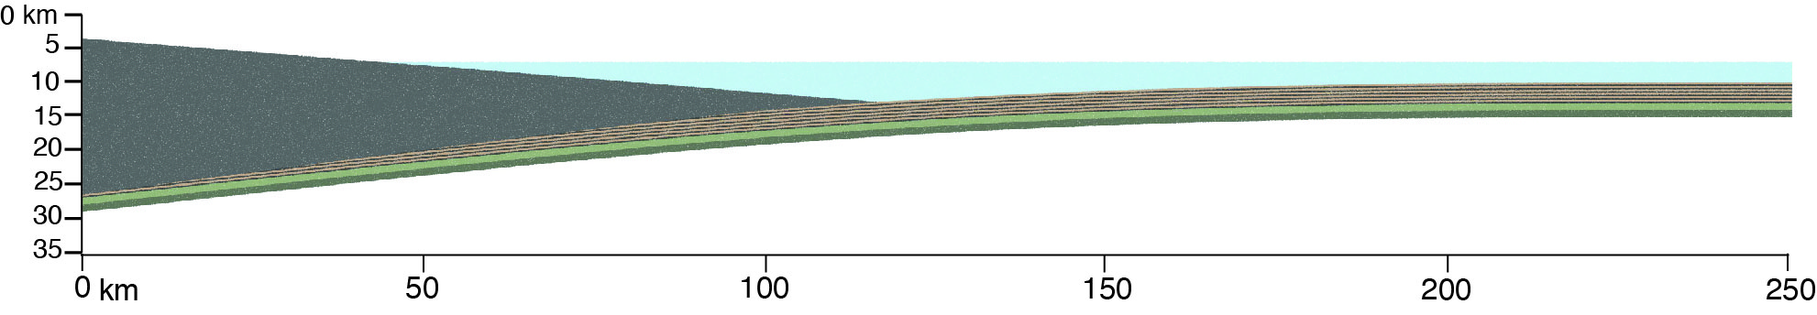
Model set up
(2D finite difference numerical code with visco-elasto-plastic rheology for all lithologies, based on Ruh 2017; 2020)
Water
Backstop/upper plate
3 km Sediments
1 km Altered Oceanic Crust
Geothermal gradient = 20°C/km
1km Unaltered Oceanic Crust
Note: λ = P_{f} (pore fluid pressure) / σ_{v} (vertical stress)
λ in sediments = linear increase between 0.4 (top of seds) to 0.9 (base of seds)
λ in altered oceanic crust = 0.99 between 160°C – 330°C
λ in oceanic basement = 0.4

Slide 5
Reference model time series
Underplating initially occurs beneath backstop & propagates towards right/foreland
By 15 myrs, underplating steps forward and material begins to accumulate beneath wedge as wedge thickens

Slide 6
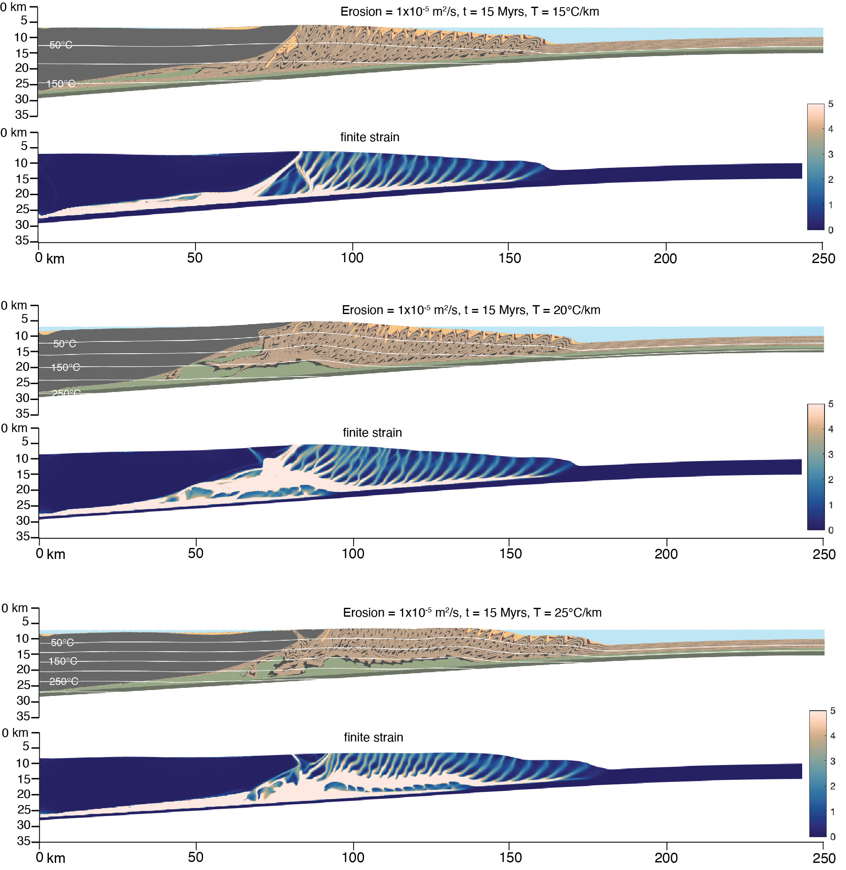
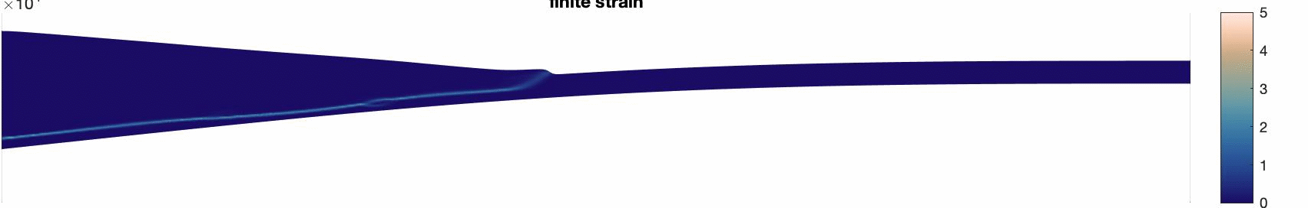
Reference model time series: Accumulated finite strain
t = 0 – 20 Myrs
Lenses of underplated oceanic crust are low strain, surrounded by high strain shear zones
High strain along interface focused in altered oceanic crust and in base of sedimentary rocks

Slide 7
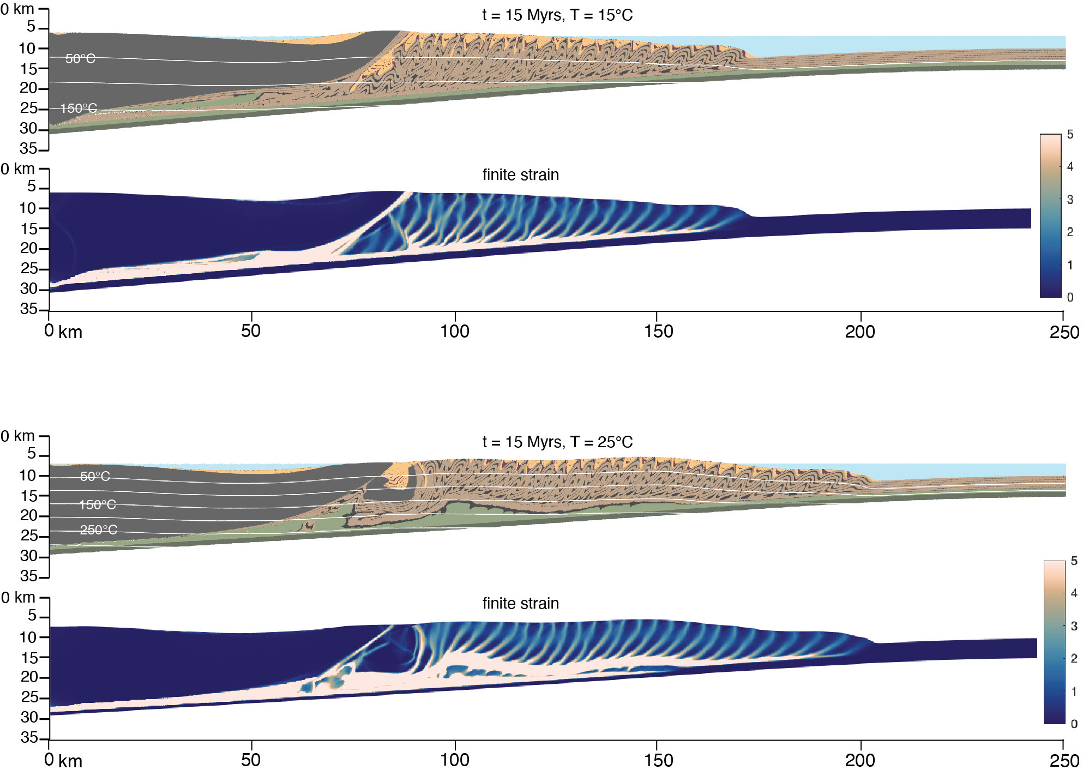
Geothermal gradient variations
Lower temperature gradient
Single, thin slice of underplated altered OC
Underplating initialised further toward left boundary at rear of backstop
Underplated material is predominantly high strain & concentrated in narrow zone
Higher temperature gradient
Underplating progresses more quickly than in reference model
Altered OC is underplated in thick, irregular-shaped lenses
Underplating initialises further toward right, under tip of backstop
Thicker zone of accumulated high strain material surrounds low-strain lenses

Slide 8
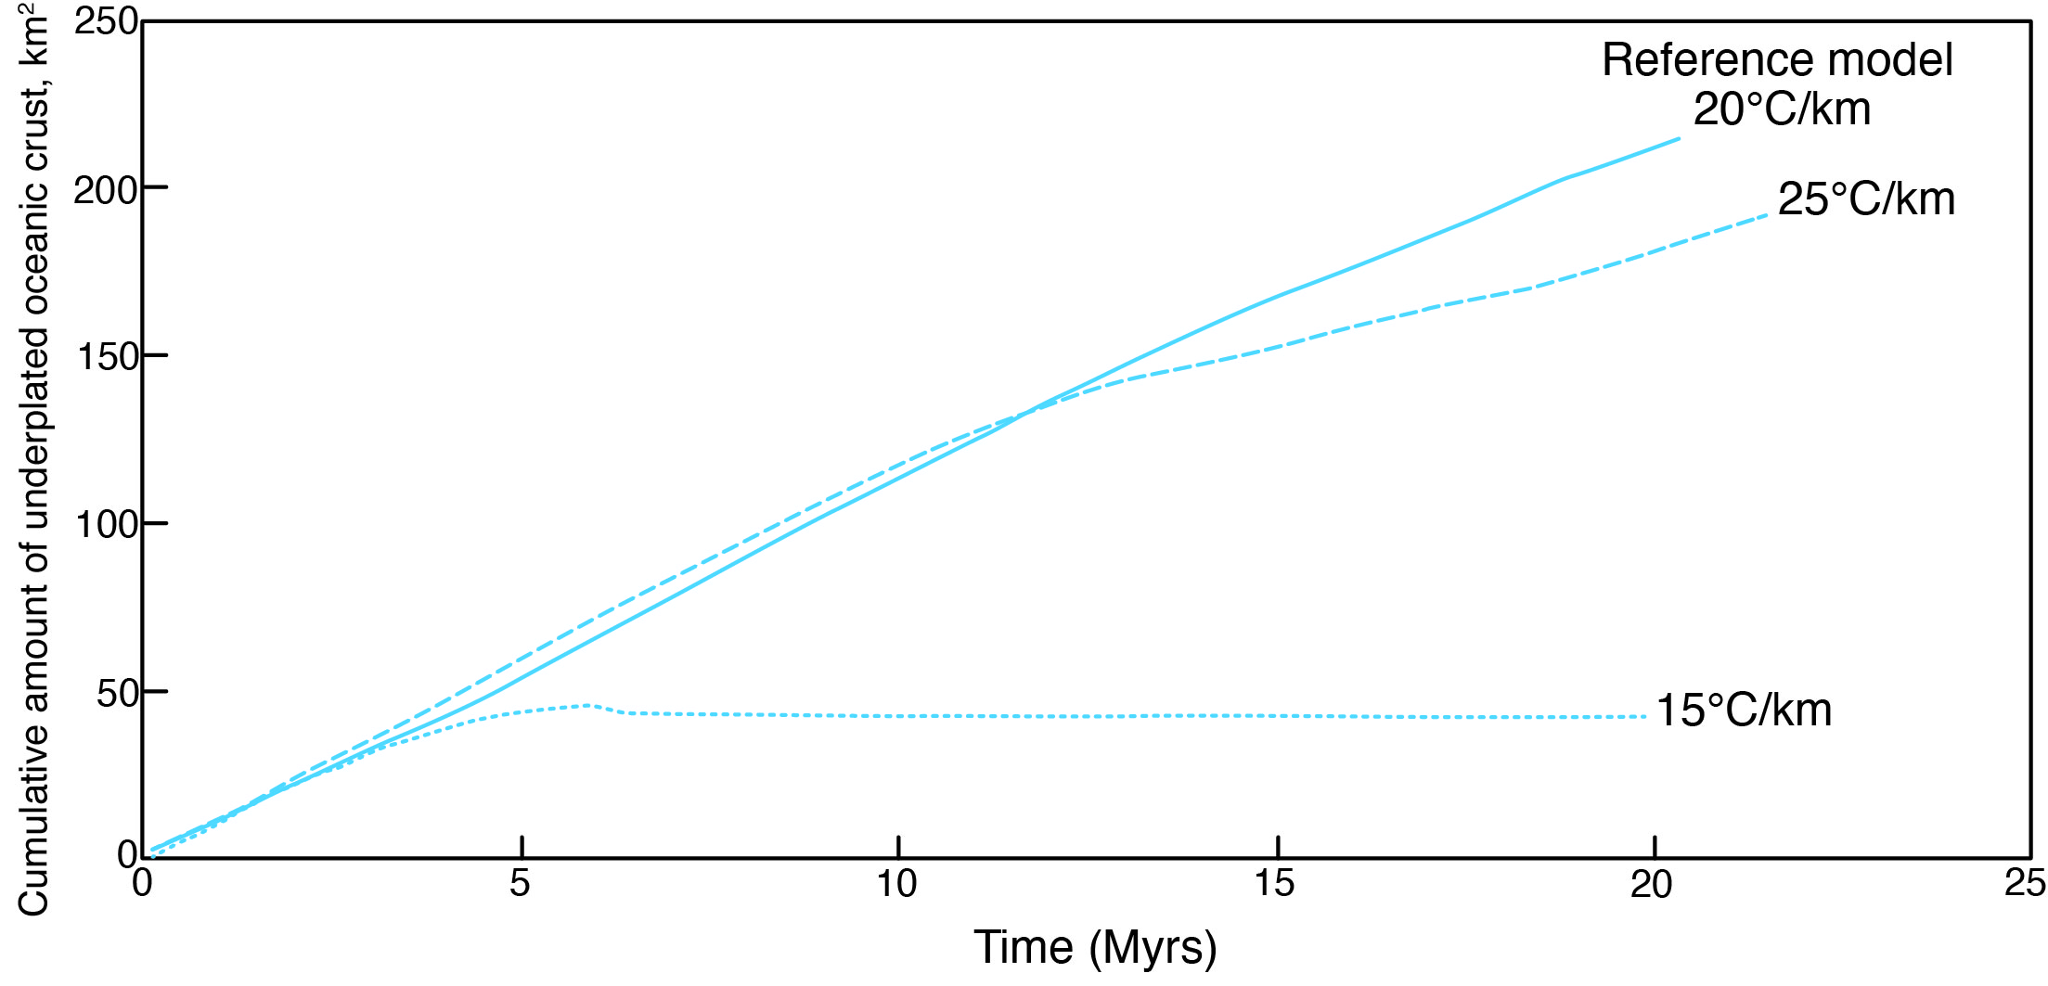
Geothermal gradient variations: Amount of underplated oceanic crust
Above certain geothermal gradient threshold, the amount of underplated material is very similar.
With low geothermal gradient (15°C/km), much less oceanic crust is underplated (compatible with altered oceanic crust being weakened with a temperature-dependent fluid pressure).

Slide 9
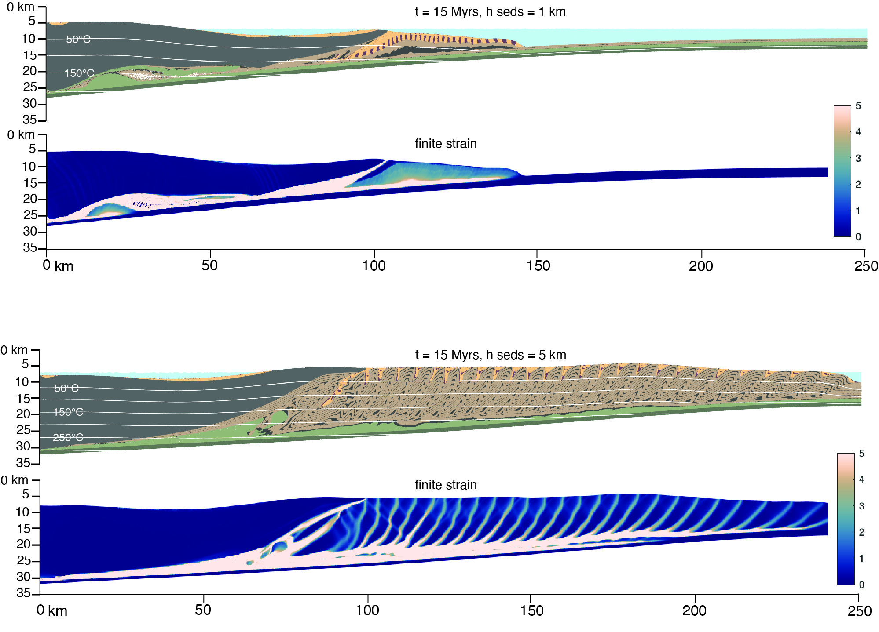
Sediment thickness variations
Thinner initial sediments
No foreland fold-thrust wedge develops
Underplating initialises further towards left boundary compared to reference model
Altered OC underplated first in long thin slice, then further underplated in short, thick lens
Thicker initial sediments
Thick foreland wedge develops more rapidly than in ref model
Underplating intialises beneath toe of backstop and moves progressively towards the right as wedge thickens
Altered OC is underplated in thin, irregulary-shaped lenses and blocks

Slide 10
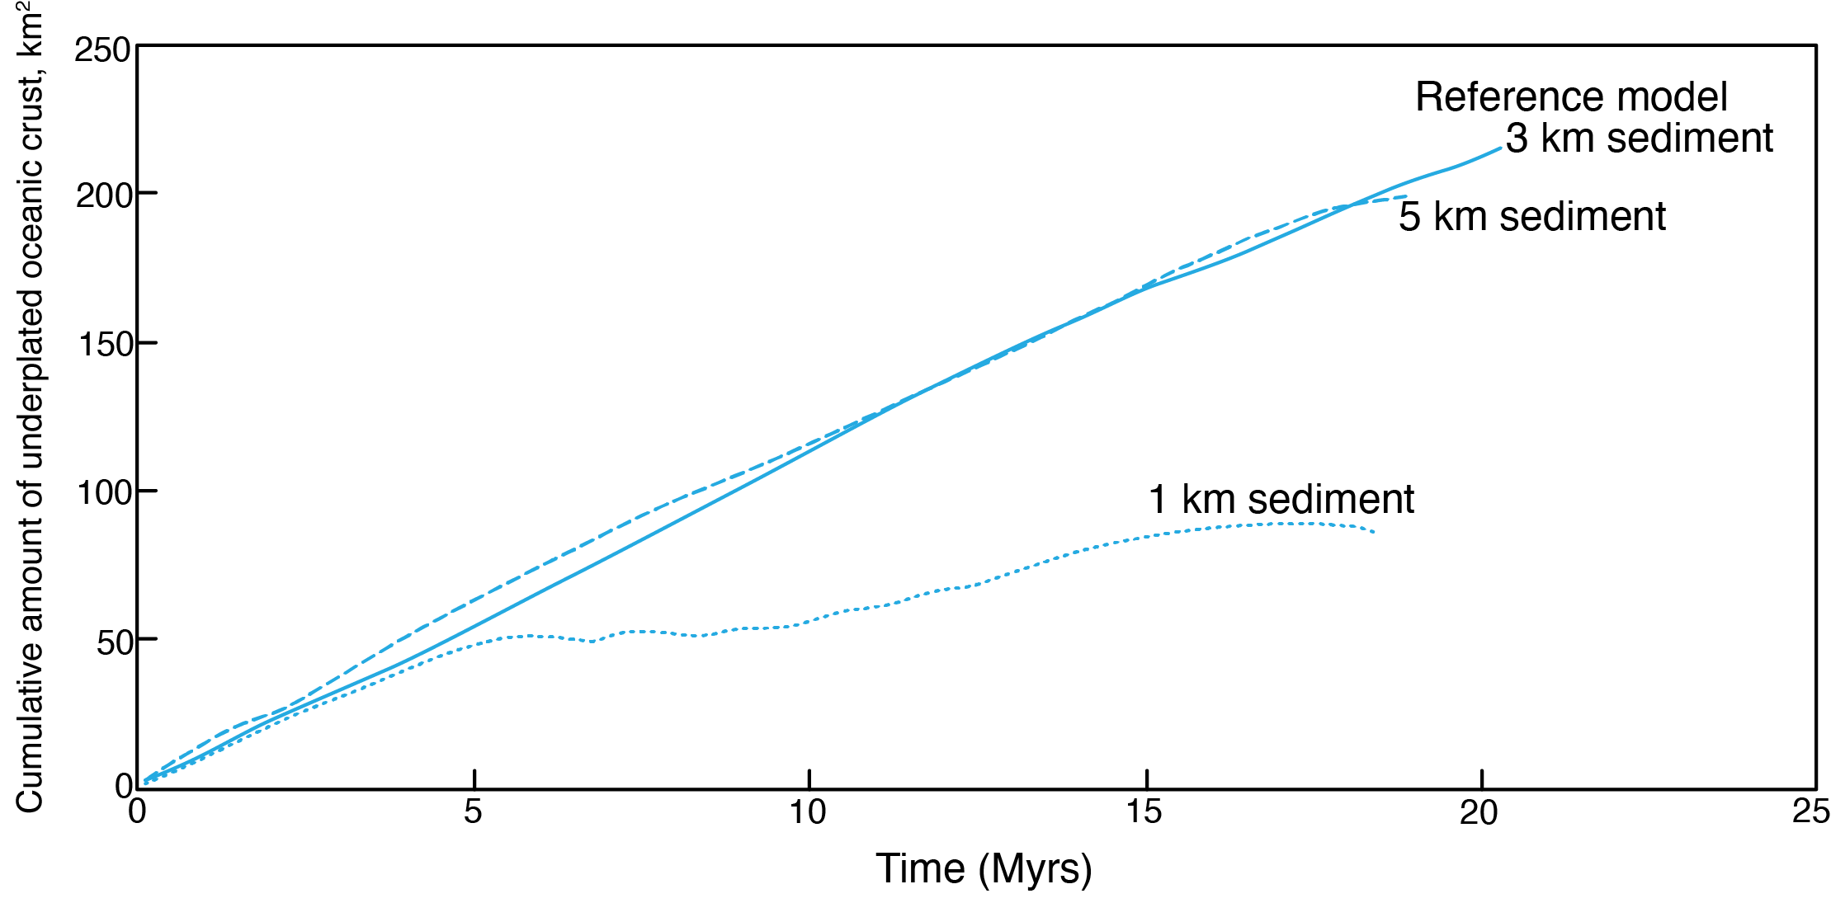
Sediment thickness variations: Amount of underplated oceanic crust
Over certain sediment thickness threshold, the amount of underplated oceanic crust is very similar.
With thin initial sediment thickness (1 km), much less oceanic crust is underplated.

Slide 11
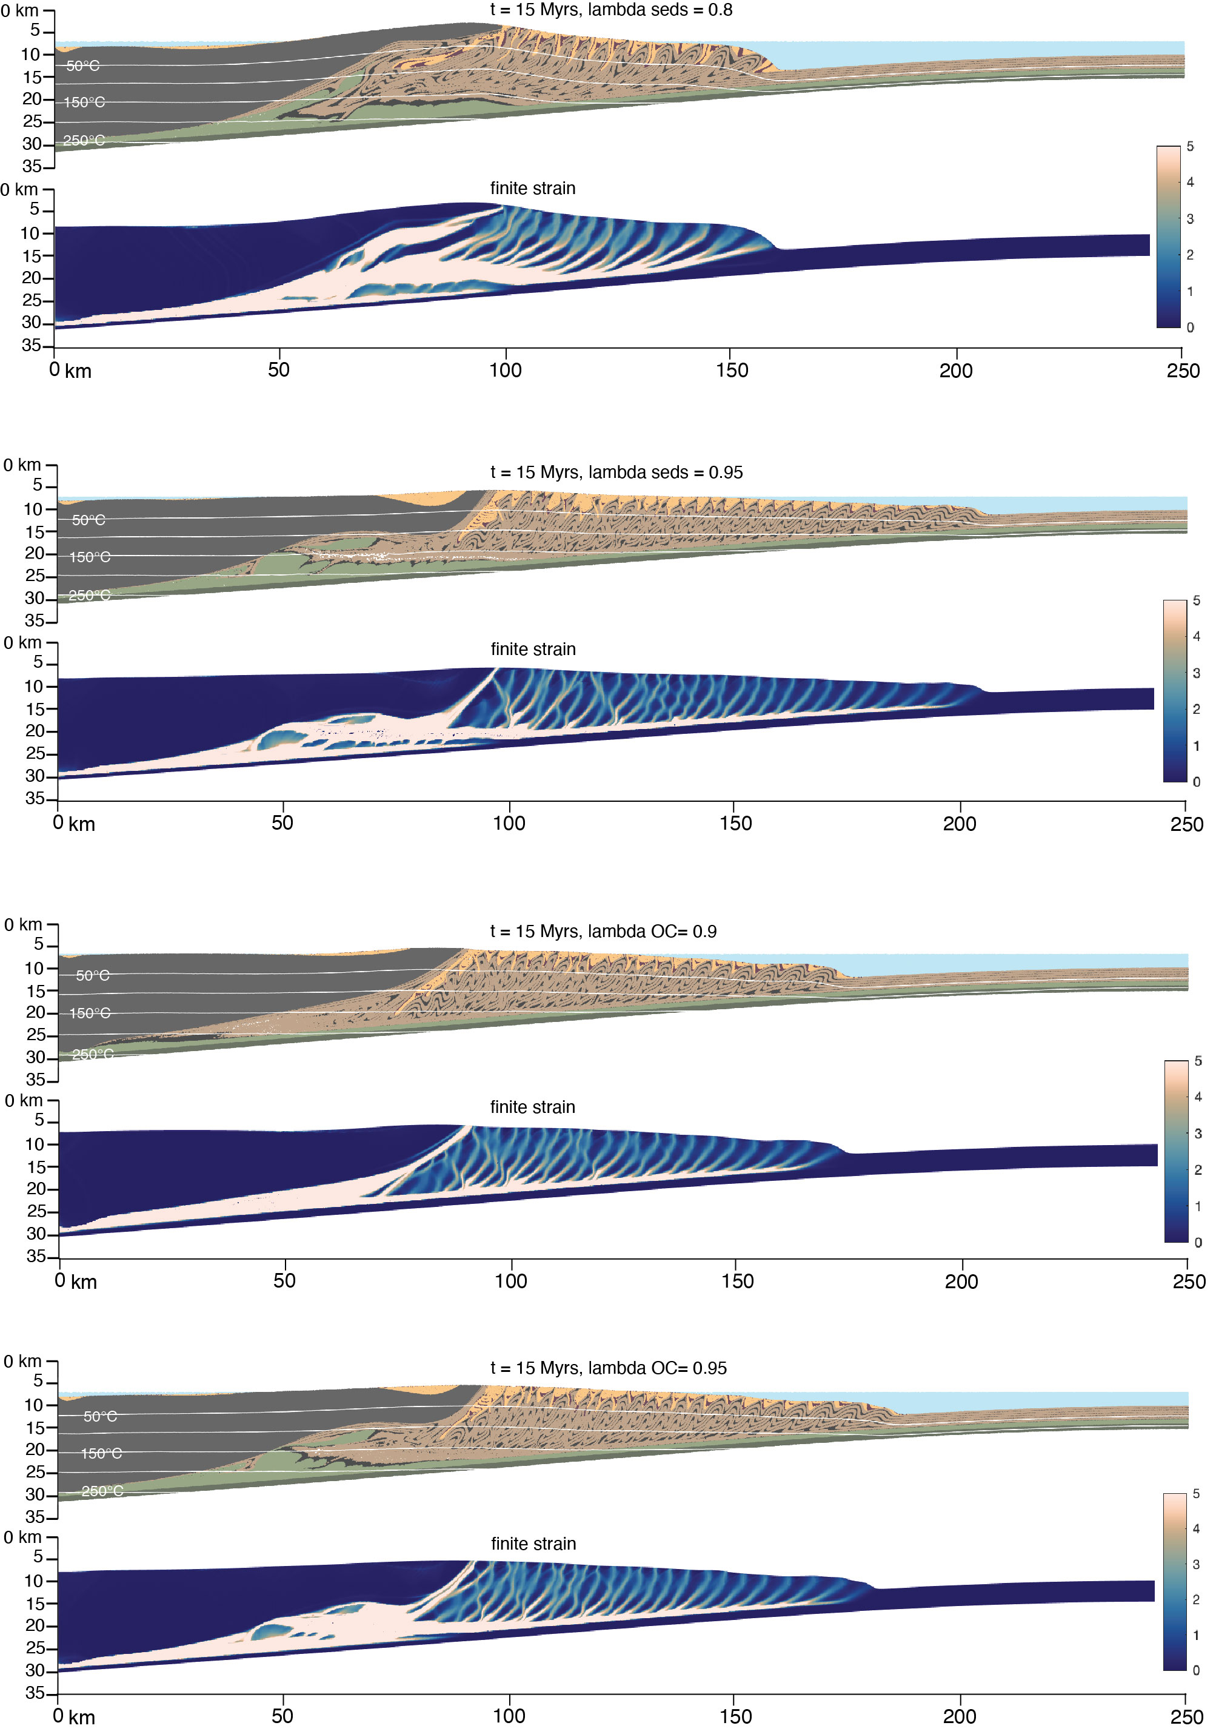
Fluid pressure variations – in sediments
Lower λ at base of sediments = greater difference in λ b/w sediments & OC
Foreland wedge is shorter & thicker
More sediments underplated than in reference model
Altered OC underplated intially in thin slice, then piles up in irregular lenses
Significant out-of-sequence thrust localised in sediments at base of backstop
Higher λ at base of sediments = smaller difference in λ b/w sediments & OC
Similar evolution to reference model
Altered OC underplated in many, smaller (low strain) lenses compared to reference model

Slide 12
Fluid pressure variations – in oceanic crust
Lower λ in OC, λ is the same at base of sediments & in OC
Almost no underplating of altered OC occurs
Very thin accumulation of altered OC beneath backstop at left of model, along active interface
Interface & underplated material are uniformly high strain
More sediments underplated
Lower λ in OC, smaller difference between base of sediments & OC
Very similar to reference model evolution & to model with higher λ in base of sediments
Altered OC underplated in irregular, low-strain lenses that pile up beneath backstop

Slide 13
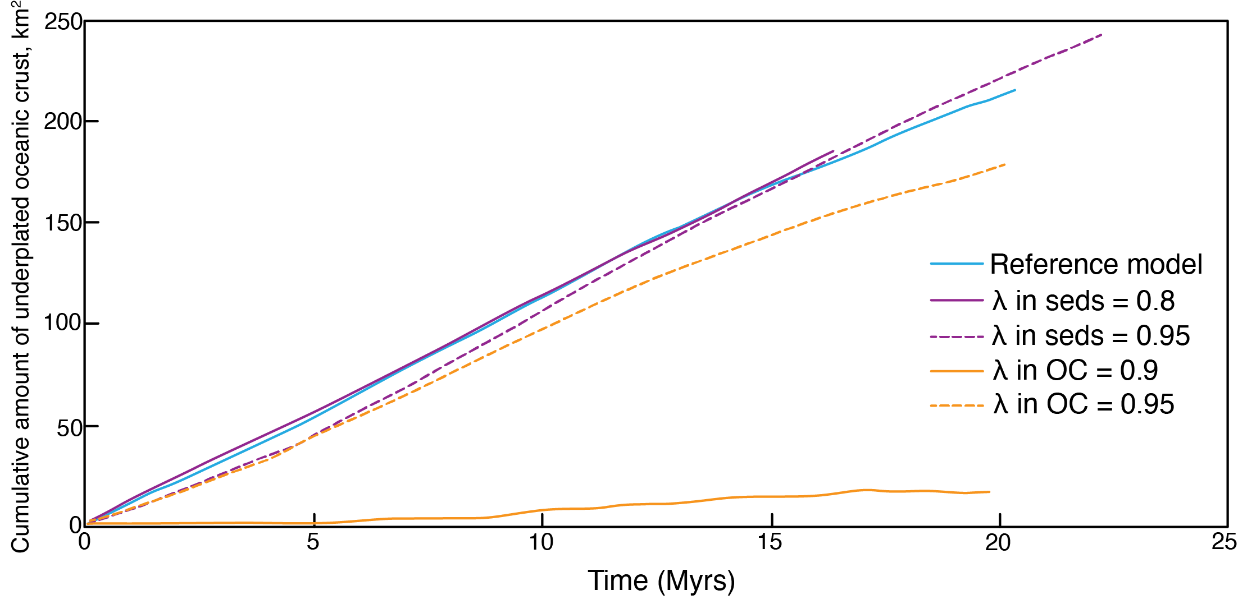
Fluid pressure variations: Amount of underplated oceanic crust
(λ = 0.99)
When the fluid pressure at the base of the sediment package is the same as within the altered oceanic crust, very little underplating occurs.
All other fluid pressure variations (both a greater difference in fluid pressure between the sediments and the altered oceanic crust, and a smaller difference) result in comparable amounts of underplated altered oceanic crust.

Slide 14
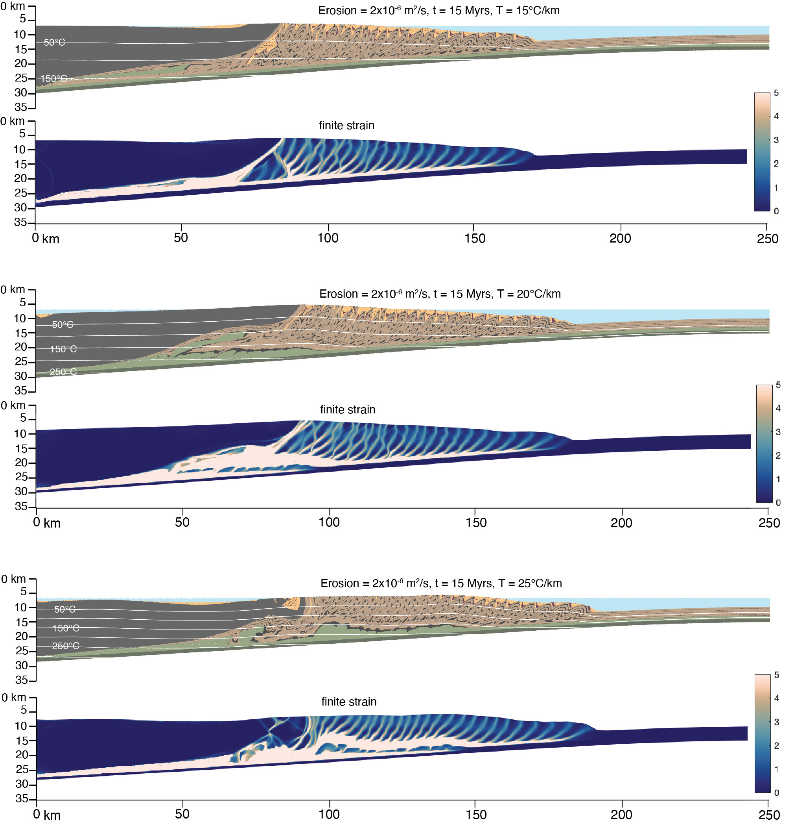
Surface erosion rate variations + same geothermal gradient as reference model
Faster erosion rate
Shorter foreland wedge than reference model
Tip of backstop uplifted & eroded away compared to reference model
OC underplated in many, small, low-strain lenses
Shorter foreland wedge than reference model
Tip of backstop even more uplifted & eroded away compared to reference model
Normal fault cuts through tip of backstop
OC underplated in many, low-strain lenses that are thicker than above
Much faster erosion rate

Slide 15
Surface erosion rate variations + lower geothermal gradient
Faster erosion rate
Both models are nearly identical to the low geothermal gradient model (with reference model surface erosion rates – see slide 8)
Thinner wedge compared to low geothermal gradient model
Much faster erosion rate

Slide 16
Surface erosion rate variations + higher geothermal gradient
Faster erosion rate
Thicker wedge than reference model but more deeply eroded
Chaotic undeplating of OC towards left, beneath backstop
OC underplated in many small lenses beneath wedge
Tip of backstop folded and overthrust
Much faster erosion rate
Thicker wedge than reference model but more deeply eroded
Chaotic undeplating of OC towards left, beneath backstop
OC underplated in many small lenses beneath wedge
Tip of backstop folded and eroded away

Slide 17
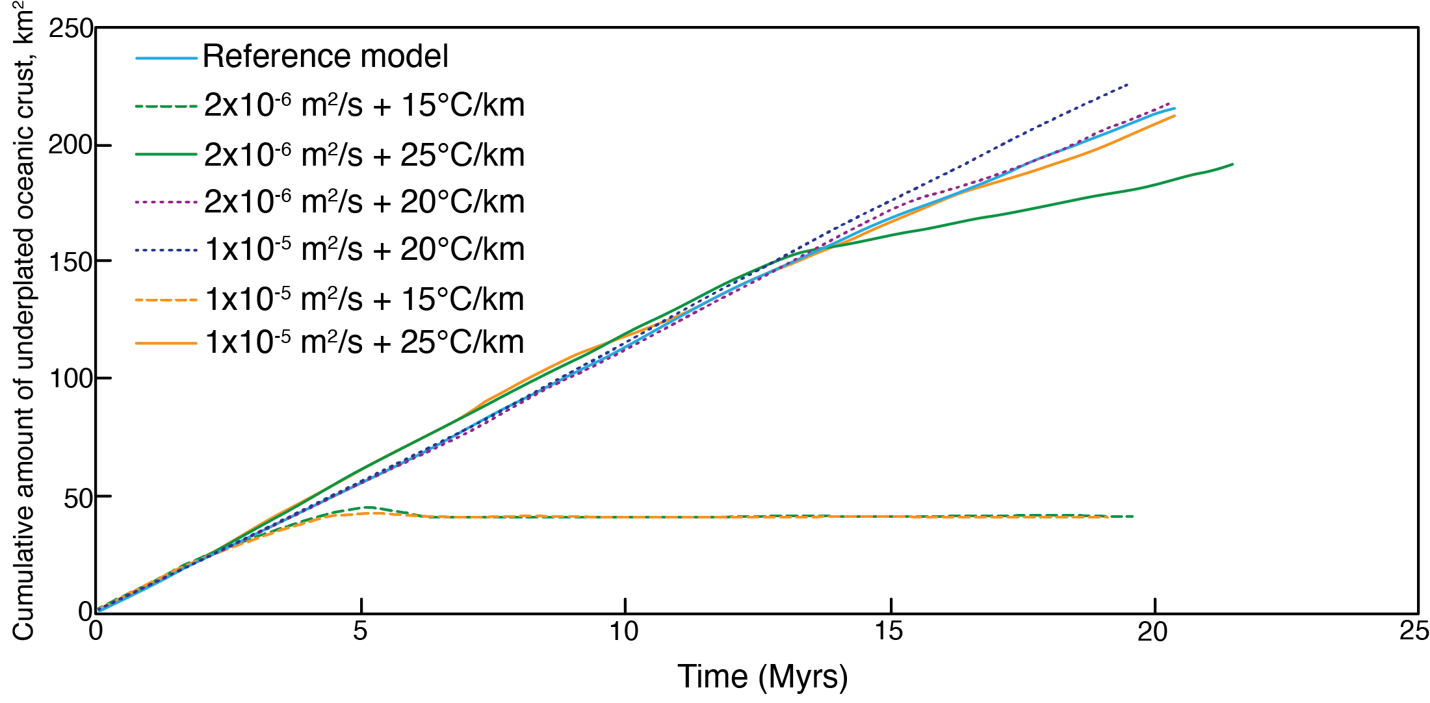
Surface erosion rate & geothermal gradient variations:
Amount of underplated oceanic crust
The geothermal gradient has a more significant impact than surface erosion rate on the amount of oceanic crust that is underplated. (b/c the altered OC is weakened with a temperature trigger)

Slide 18
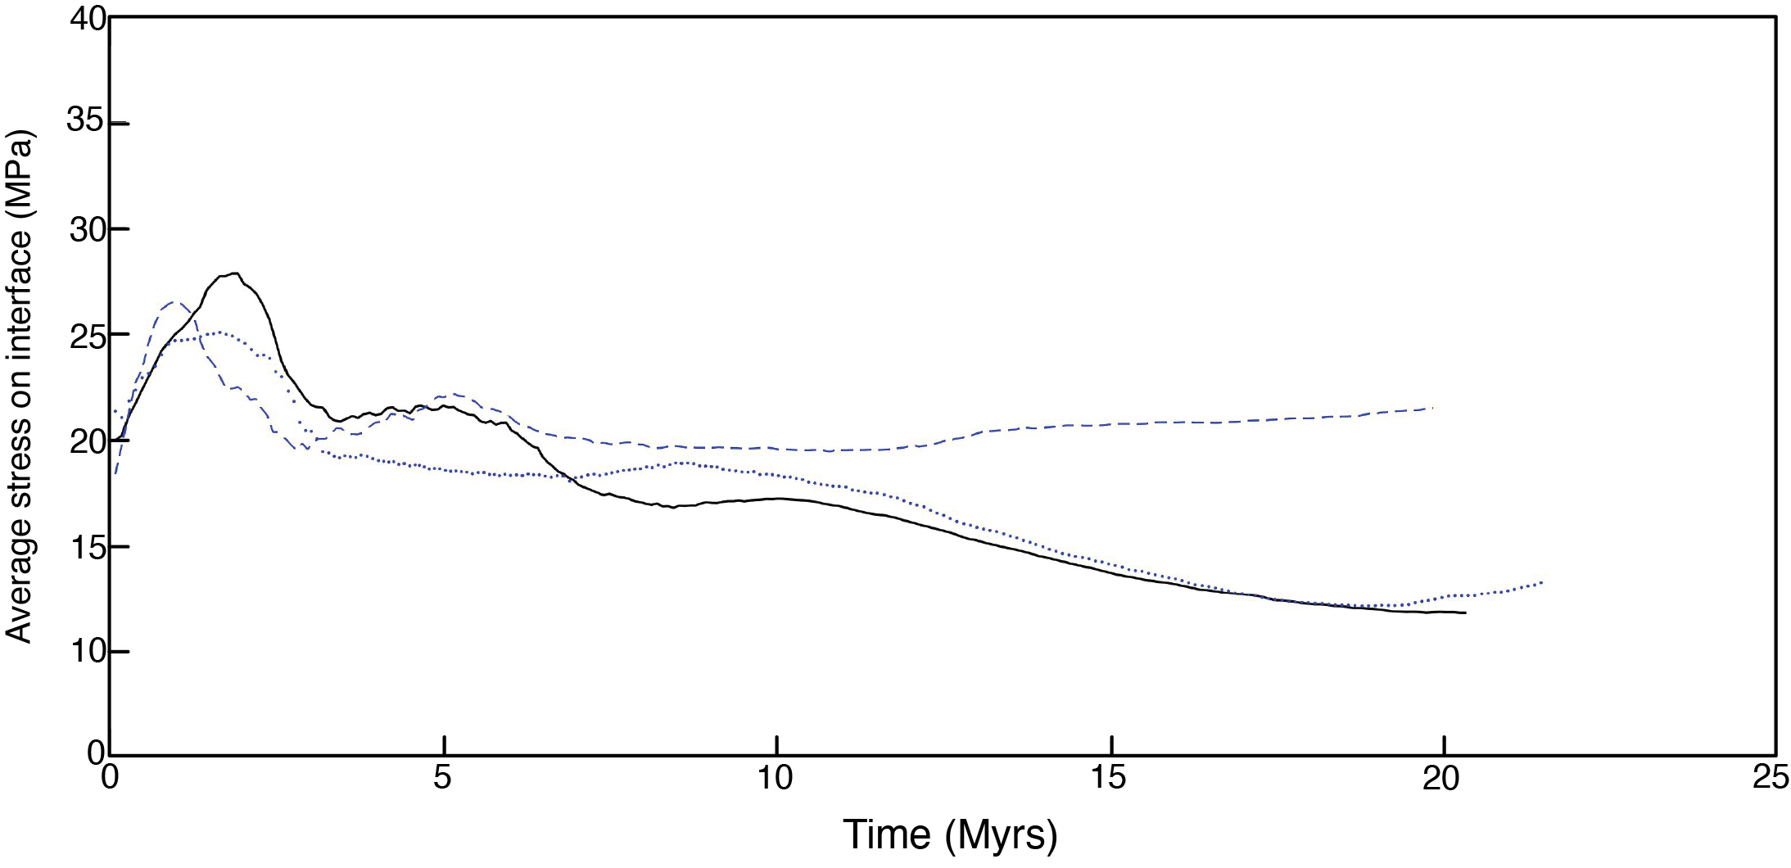
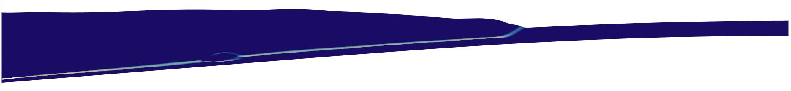
Average stress along interface:
Geothermal gradient variations
15°C/km
25°C/km
20°C/km km
Reference model
High strain interface

Slide 19
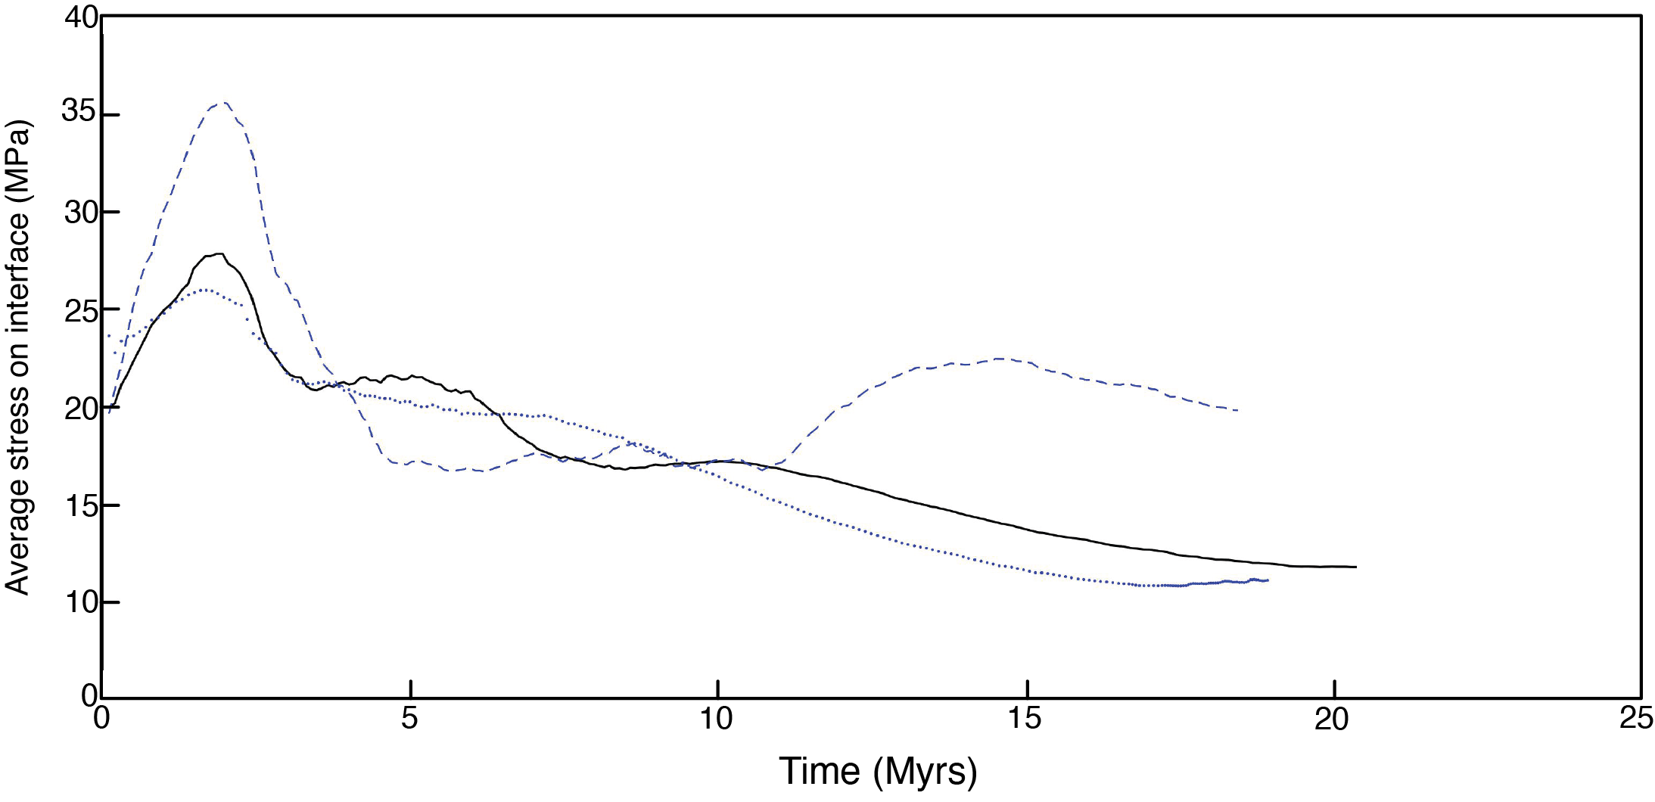
Average stress along interface:
Sediment thickness variations
1 km Sediment
3 km Reference model
5 km Sediment
High strain interface

Slide 20
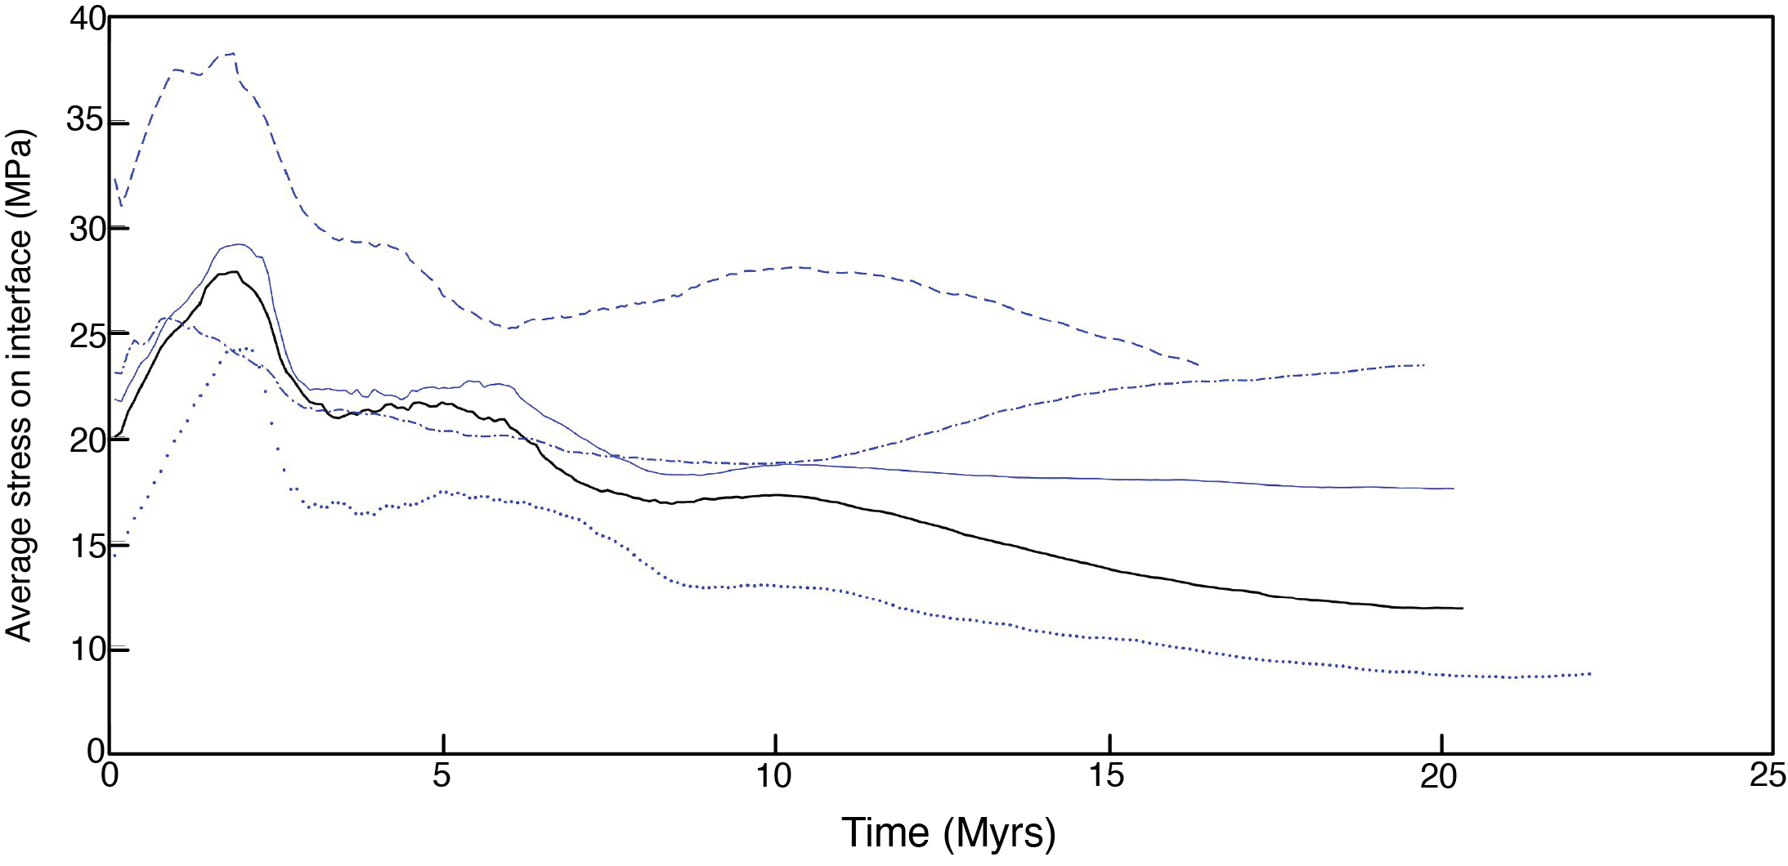
Average stress along interface:
Fluid pressure variations
λ = 0.8 in sediments
Greater difference in λ
b/w based of seds & OC
λ = 0.9 in OC
λ at base of sed is the same as in OC
λ = 0.95 in OC
Smaller difference in λ
b/w based of seds & OC
Reference model
λ in OC = 0.99
λ in sediments = 0.9
λ = 0.95 in sediments
Smaller difference in λ
b/w based of seds & OC
High strain interface

Slide 21
Summary
Generally:
Thin incoming sediments = higher stress on interface & less underplated oceanic crust
Thick incoming sediments = lower stress on interface & similar amounts of underplated oceanic crust to reference model
Lower geothermal gradient = higher stress on interface & less underplated oceanic crust
Higher geothermal gradient = similar stress on interface & similar amount of underplated oceanic crust to reference model
Fluid pressure variations do not significantly impact the amount of underplated oceanic crust
Larger difference in fluid pressure between oceanic crust and seds (lower λ in seds) = higher overall stress on interface
Smaller difference in fluid pressure between oceanic crust and seds (lower λ in OC) = similar initial stress to reference model then progresses towards higher stress
Smaller difference in fluid pressure between oceanic crust and seds (higher λ in seds) = lower overall stress
Same in fluid pressure in oceanic crust and seds = initially similar average stress to reference model then progresses towards much higher stress

