Slide 1

Co-production of knowledge: towards a co-design of geothermal heat utilization
eva.schill@kit.edu
Eva Schill, Florian Bauer, Katharina Schätzler, Christine Rösch, Melanie Mbah, Christina Benighaus, Sophie Kuppler, Judith Krohn
Notes:
1) More than 50% of the energy-related CO2 emissions in Germany are linked to heating and cooling
2) Geothermal heat bears a large mitigation potential for example in the Upper Rhine Graben)
3) but is technologically challenging

Slide 2
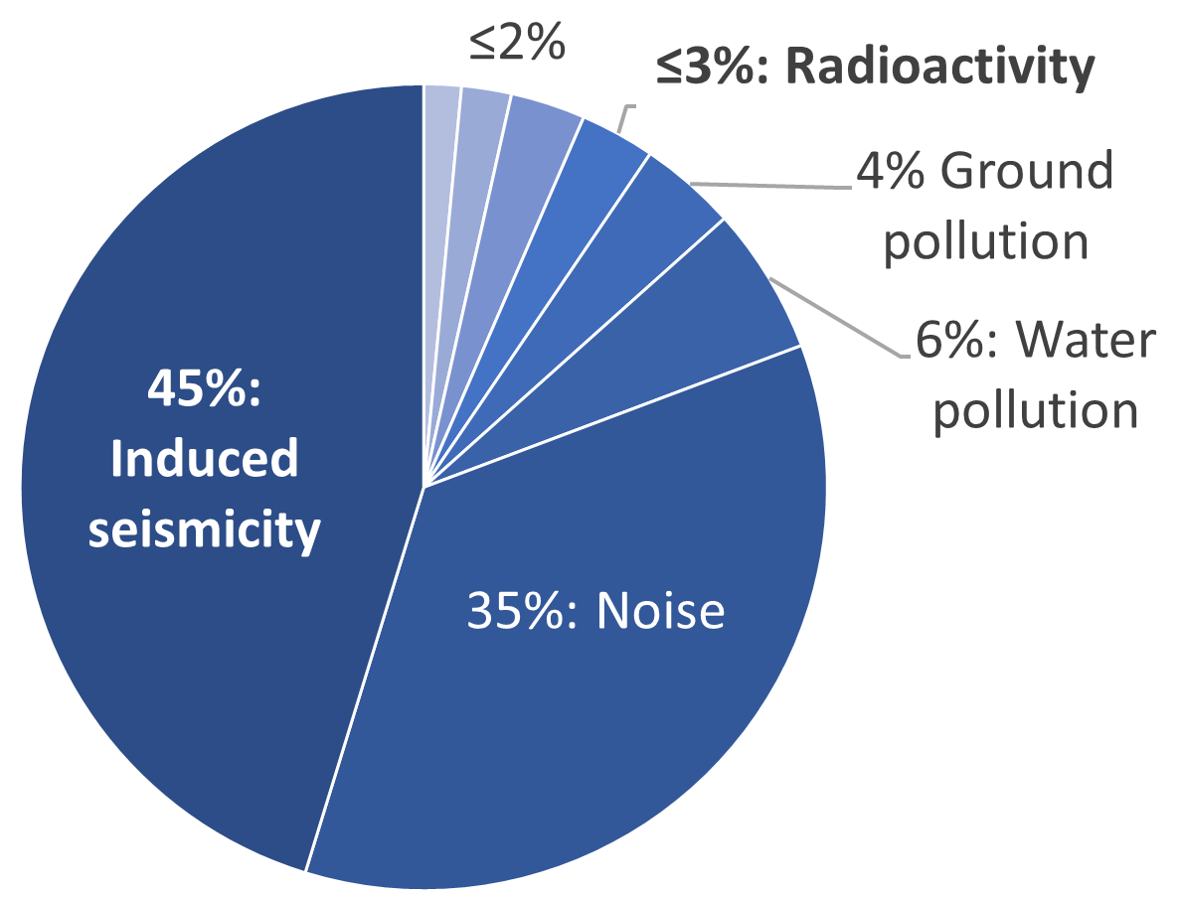
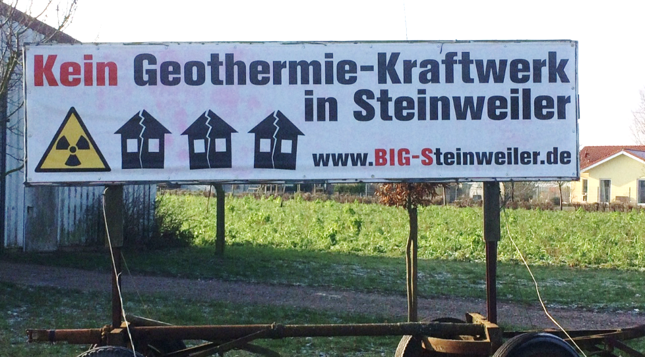
01
Partly negative perception of geothermal energy in the society
Meller et al. (2017)
Notes:
Besides industrial noise, induced seismicity is percepted as negative side effect since the early 2000
In connection with proto-expertise, refusal of geothermal plants developed in parts of the society.

Slide 3
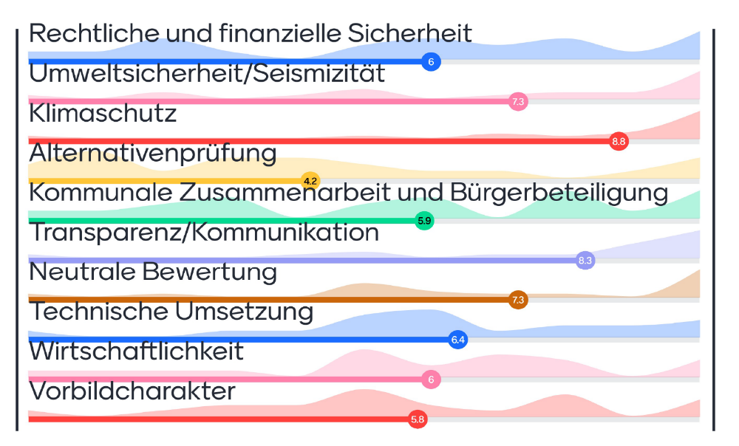
02
Co-production of knowledge
Criteria workshop
Notes:
To prevent such development, in GECKO, a co-design of geothermal heat utilization is envisaged.
Therefore, a criteria workshop was hold during the initial phase of the KIT geothermal project (before planning)
to identify and weight the arguments of proto-expertise in the surrounding communities
Criteria were separated into technical and non-technical criteria

Slide 4
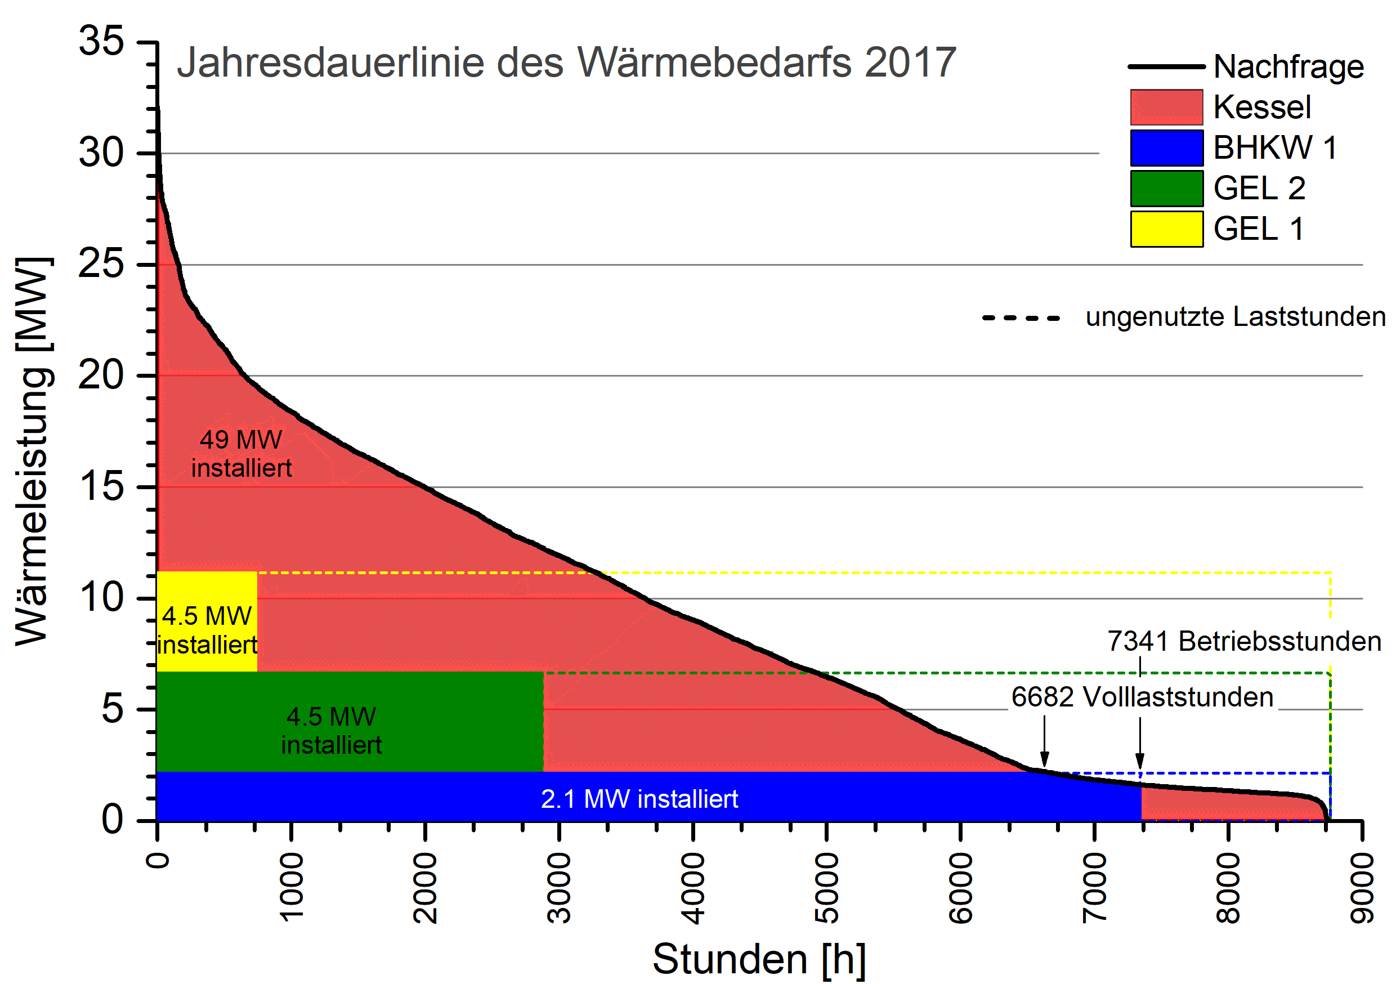
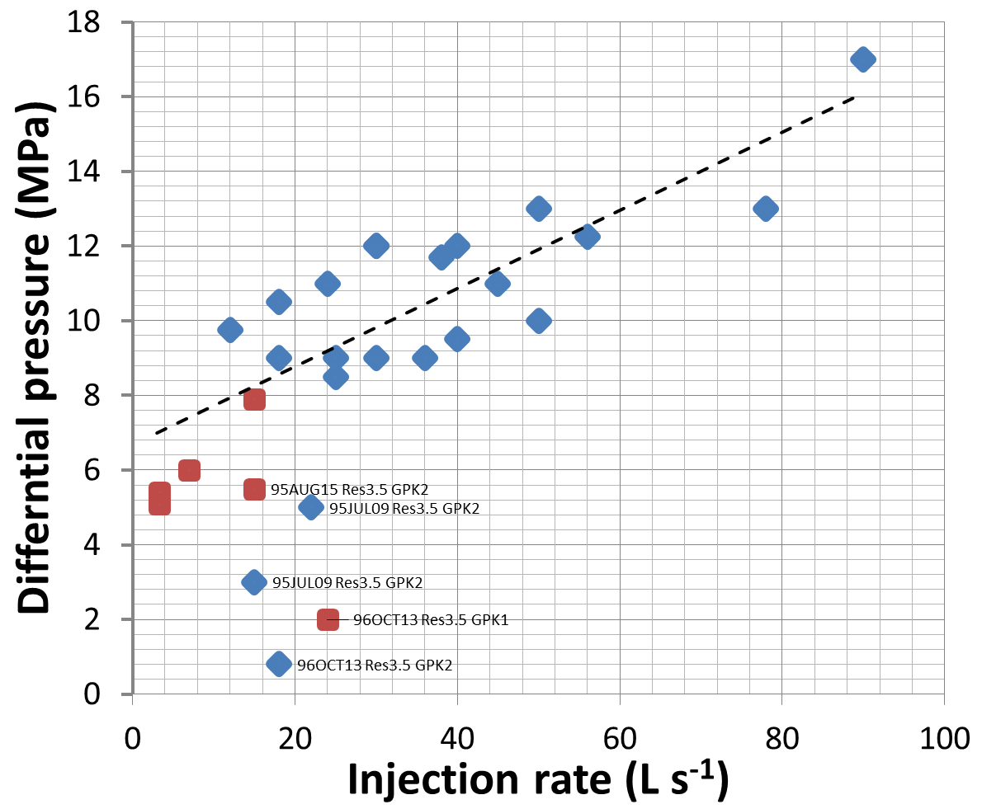
02
Technological solutions: Mitigation of induced seismicity
Heat consumption KIT CN 2017
Concept of moderate injection rate from 55 scientific experiments
15’000 t CO_{2 equ.}
Heat power (MW)
Recovery
DeepHeat
Storage
Operational hours (h)
Notes:
Technical criteria are now implemented in utilization scenarios on the basis of experience from proto-type projects in the Upper Rhine Graben
New and more sustainable concepts (including seasonal heat storage) have been developed!

Slide 5
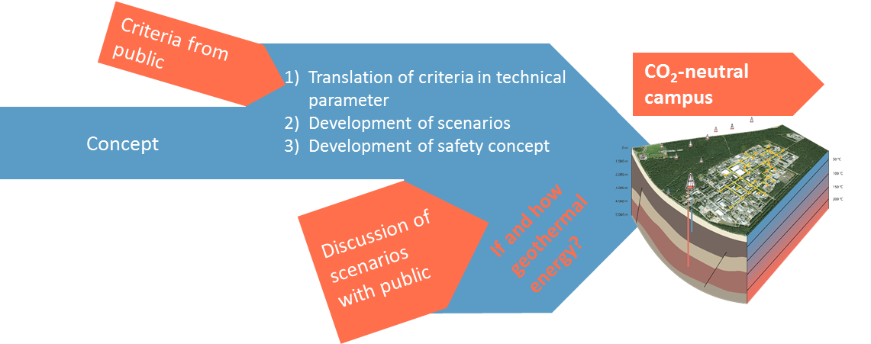
02
Concept of GECKO
Notes:
The scenarios will now be discussed in a scenario workshop.
Recommendations will be formulated.

Slide 6
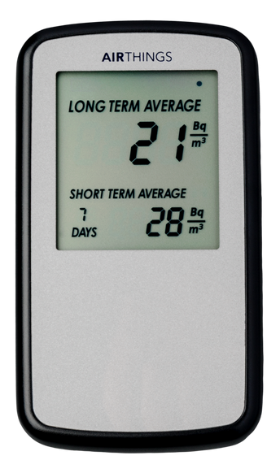
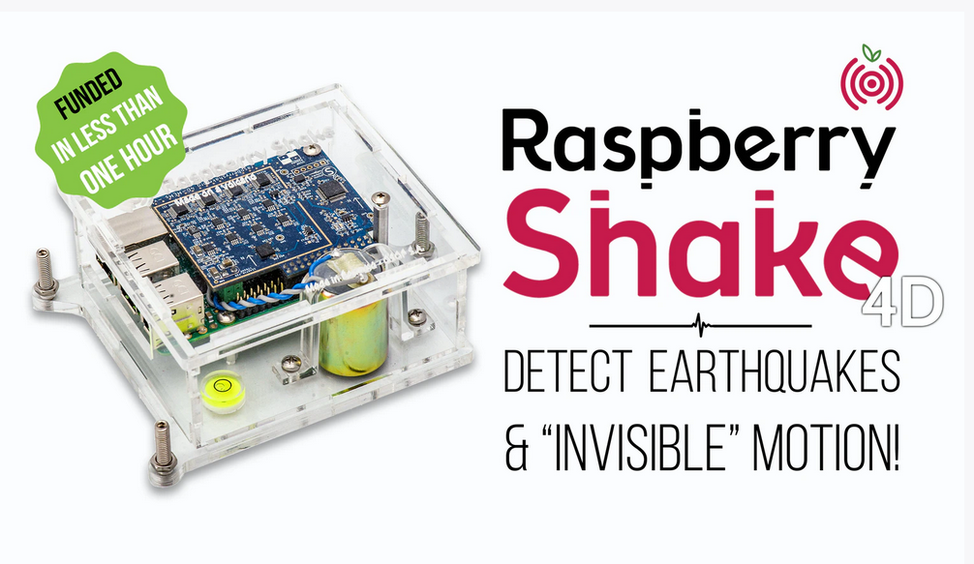
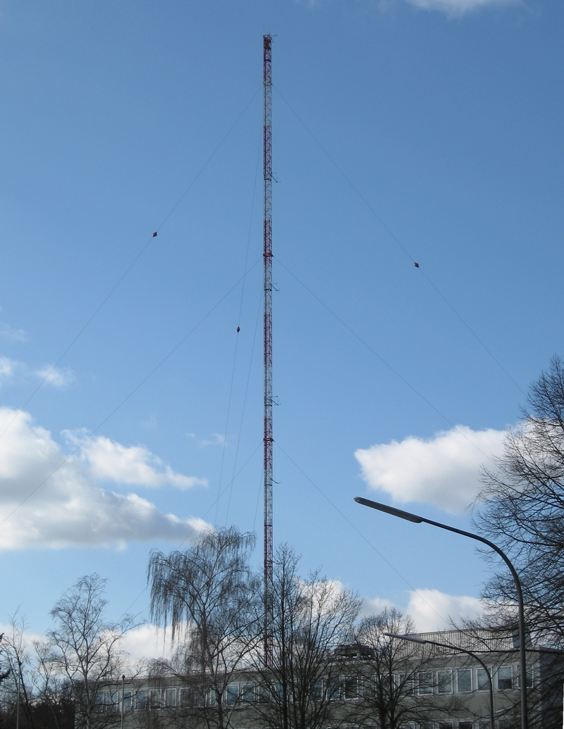
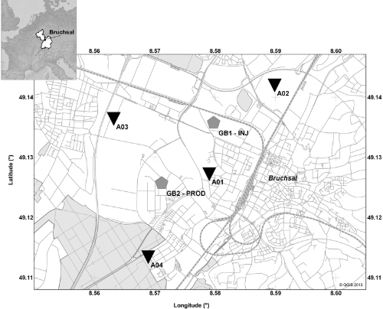
02
Outlook: Citizen Science in construction and operation phase
Data acquisition
scientific (at KIT)
distributed (by citizens)
Parameter
Induced seismicity
Radon
Notes:
Further concepts of citizen involvement are planned are planned for the construction and operation period.

