Slide 1

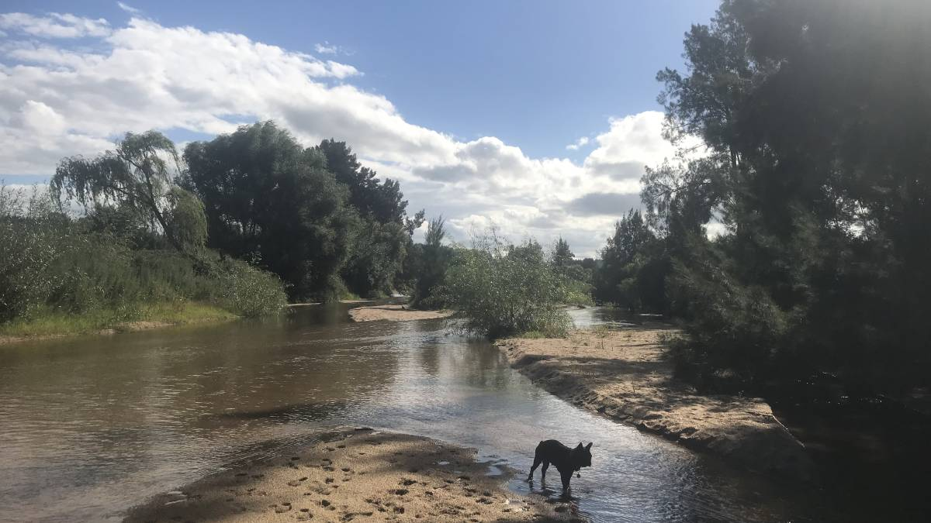



contact: marco.tangi@polimi.it
A dynamic, network scale sediment (dis)connectivity model
to reconstruct historical sediment transfers
and river reach sediment budgets
Marco Tangi
Simone Bizzi
Kirstie Fryirs
Andrea Castelletti

Slide 2
The original CASCADE model
a) CASCADE first extracts the river network and assigns static hydro-morphologic parameters to each reach.
b) Second, user-defined external sources are described in terms of sediment supply rates and supplied grain size distribution. Dams can also be included by specifying their sediment trap efficiency.
c) Third, the sediment connectivity is described as a combination of individual sediment transport processes called cascades, each one with a unique source and downstream path.
In each reach, the model determines the reach sediment budget by applying empirical sediment transport formulas, and then deposits part of the fluxes transported by the passing cascades or creates a new cascade to adjust to this threshold.
The resulting outputs are information on sediment flux and origins in each river reach and information on the fate of sediment from each source as it travels through the downstream network.

Slide 3
The original CASCADE model
In the CASCADE toolbox by Tangi et al, 2019, each cascade is composed by multiple sub-cascades (lines in figure on the left).
This structure allows each sediment source to supply not only a single grain size, but rather a distribution of multiple grain sizes.
The toolbox creates cascades composed of a fixed a-priori number of sediment classes (three in the figure).
This framework is useful to represent more realistically processes supplying different grain sizes classes to the river network, e.g., mass movements might supply both very fine and very coarse sediment fractions at the same location.
Visualization of the sediment routing process

Slide 4
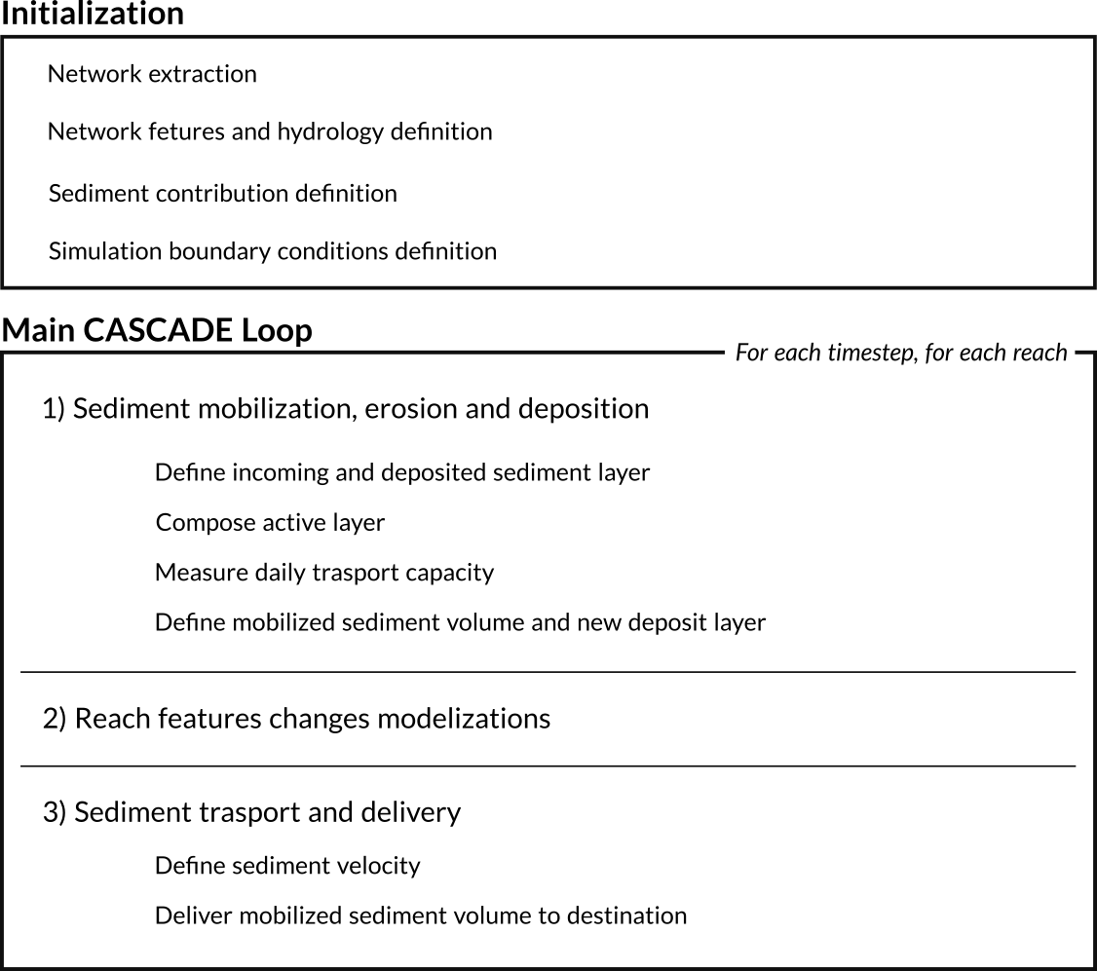
The Dynamic-CASCADE model
The new D-CASCADE model introduce a discrete, daily time representation.
Cascades are still defined by their provenance, and the volume carried is subdivided into pre-defined sediment classes.
Cascades movement’s are traced in space and time across the network
Alteration in some morphological reach features is also modelled using specific add-ons component, designed to simulate 2D and 3D processes that the 1D structure of the framework cannot capture, e.g channel width and gradient alterations
Visualization of the D_CASCADE modelling structure

Slide 5
D-CASCADE - Initialization
Each reach is defined by a unique set of geomorphological features, that may fall into three categories:
Constant features, fixed for the entirety of simulation and defined once for each reach.
Changing features, whose values may change in each timestep. Defined a-priori for each reach and for each timestep.
Modelled features, simulated in each timestep by a specific component. Require only to be initialized for the first timestep.
Features | Description | Classification for the Bega case study
﻿Slope [m/m] | Channel gradient. Initialized from data surveys or Digital Elevation models (DEMs) | Modelled feature
﻿Length [m] | Desired length of individual reaches. Depends on the partitioning method used on the network. | Constant feature
Q [m³/s] | ﻿Discharge in the timestep. Obtained from interpolation of gauging station datasets (Schmitt et al., 2016b) or spatially distributed hydrological models (Schmitt et al., 2018b). | Changing feature
Active channel width [m] | ﻿Width of the channel section in the timestep. Initialized from satellite imagery (Schmitt et al., 2018b, 2016b, 2014), field studies, or global data. | Modelled feature
Grain size distribution (GSD) | ﻿Grainsize distribution parameters of sediment in the riverbed. Interpolated from available point sediment samples, expert-based assessments, or based on hypothesis regarding river sediment transport regimes. | Modelled feature
Manning’s n | ﻿Manning's roughness coefficient for the bed material in the channel. Obtained from field data or estimated from literature. | Changing feature
Sediment deposit [m³] | Total amount of sediment stored in each reach, in each timestep. Estimated by field surveys, drone or satellite imagery. | Modelled feature

Slide 6
D-CASCADE – Main Loop
The main D-CASCADE loop is divided into three steps with three distinct goals:
Mobilized sediment definition: according to the reach sediment transport capacity, the model defines the volume of sediment to be transported downstream, from the deposit layer, the cascades delivered from upstream in the previous timestep. All other volumes are transferred to the deposit layer.
Geomorphic features change: the framework updates modelled geomorphic features using specific add-ons components. For the Bega river, the modelling components are described in slide 18-19
Sediment delivery: the mobilized sediment is delivered downstream according to the sediment velocity
Visualization of the D_CASCADE modelling structure

Slide 7
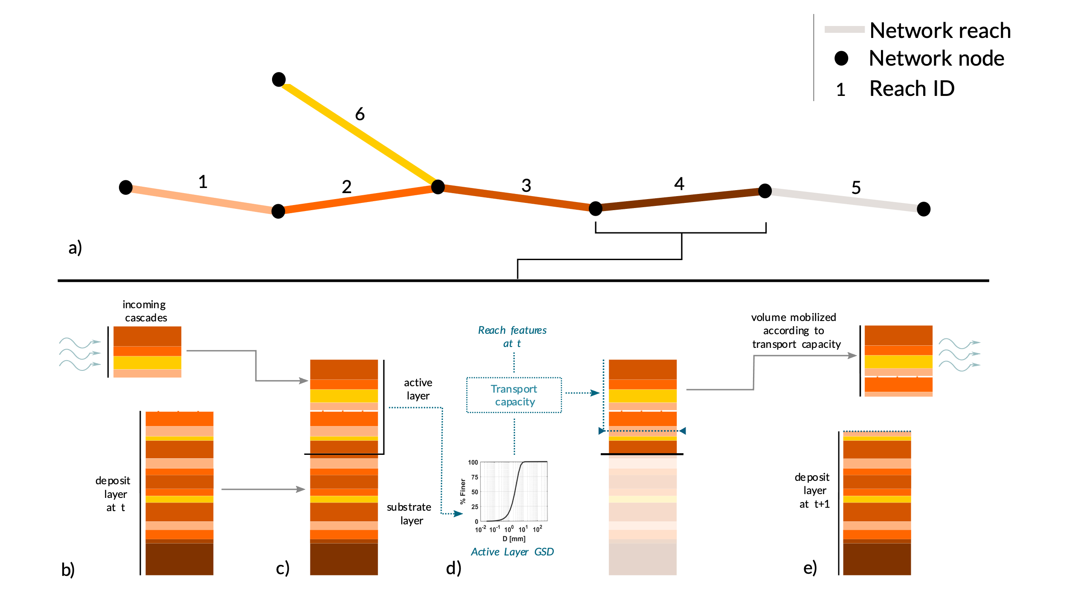
D-CASCADE – Mobilized sediment definition
Mobilized sediment definition steps in a network reach for timestep t:
In each timestep, the model loops to all reaches in order to network topology hierarchy, from upstream to downstream
The incoming cascades and deposit layer are extracted from the results of the previous timestep
The deposit is divided into active and substrate layer, according to the active layer thickness
The model calculates the transport capacity, with Ackers and White (1973) formula, for the sediment in the active layer
The mobilized volume and new deposit layer are defined.
Representation of the sediment budget definition in D-CASCADE
The colours of the layers indicate the cascade provenance.

Slide 8
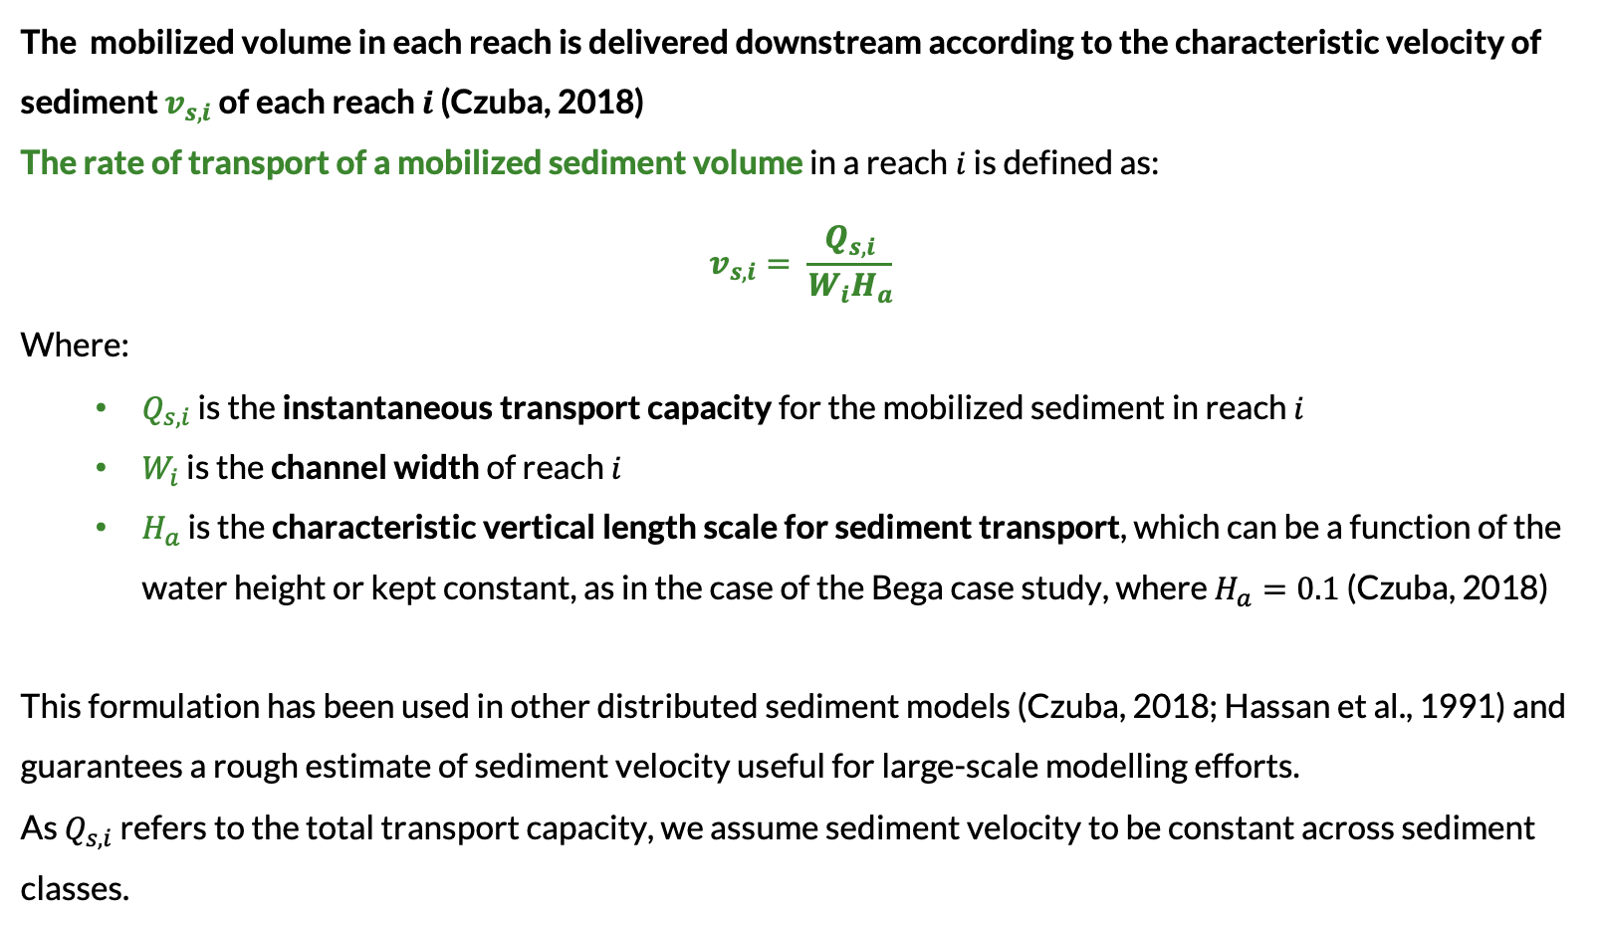
D-CASCADE – Sediment delivery
The mobilized volume in each reach is delivered downstream according to the characteristic velocity of sediment $v_{s,i}$ of each reach $i$ (Czuba, 2018)
The rate of transport of a mobilized sediment volume in a reach$i$ is defined as:
$$v_{s,i}= \frac{Q_{s,i}}{W_{i}H_{a}}$$
Where:
  $Q_{s,i}$ is the instantaneous transport capacity for the mobilized sediment in reach $i$
  $W_{i}$ is the channel width of reach $i$
  $H_{a}$ is the characteristic vertical length scale for sediment transport, which can be a function of the water height or kept constant, as in the case of the Bega case study, where $H_{a}=0.1$ (Czuba, 2018)
This formulation has been used in other distributed sediment models (Czuba, 2018; Hassan et al., 1991) and guarantees a rough estimate of sediment velocity useful for large-scale modelling efforts.
As $Q_{s,i}$ refers to the total transport capacity, we assume sediment velocity to be constant across sediment classes.

Slide 9
Bega river - research objectives
  To do so, we reconstructed the pre-settlement geomorphic features and hydrology of the river network, and then modelled the network sediment transport processes in the last two centuries introducing the different drivers of change observed historically in the proper chronological sequence.
Predict future trajectories
  We used the knowledge acquired by historical simulations to provide estimations on future trajectories of sediment transport and sediment budgets at the river reach scale.
1
Reproduce the historical sediment transfers and associated river reach sediment budgets.
2

Slide 10
Bega river - the case study
The Bega river catchment:
Drainage area - 1930 km²
Length - 42 km
100 y return period flood discharge - 10,400 m³/s
Water regime - flood dominated
  Lengthy period of drought broken by intensive flood in summer and autumn
The river network was extracted using a Digital elevation model (DEM) with 2 m resolution.
Reaches are extracted uniformly with an average length of 2 Km.
In total, the network is partitioned into 218 reaches
The Bega river network structure:

Slide 11
Bega river - the case study
Historic changes and major drivers
  The Bega river catchment underwent massive geomorphological changes following the establishment and expansion of European settlements (ES) , starting from the XIX century.
  Massive deforestation, including riparian vegetation, lead to bank instability and triggered massive channel expansion in the lowland. Channel expanded from 40-45 meters to 150 m from 1850 to 1890
  Vegetation clearance and swamp drainage, in turn, caused massive incision in valley fills reaches at the base of the escarpment. Around 10 Mm³ of material was released from 1910 onward. This material was then transported across the network, depositing in the lowland.
11

Slide 12
Bega river – type of morphological change
Reaches are classified into 4 categories according to the type and magnitude of geomorphic changes experienced:
Type 1 reaches are located above the escarpment line or along still vegetated river stretches and experienced no significant morphological changes.
Type 2 reaches, located in the middle portion of the basin, have experienced minor channel expansion due to bank destabilization.
Type 3 reaches, located in the lower part of the basin, have experienced substantial channel expansion due to bank erosion after 1850.
Type 4 reaches are valley fills reaches at the base of the escarpment affected by massive incision during the first decades of the 1900s.
12

Slide 13
Bega river – pre-ES conditions
Pre-settlement geomorphic features of the river network were reconstructed from historical observations and expert-based reconstruction:
Lowland pre-ES channel condition from Brooks and Brierley (1997)
Sediment deposit yielded from Fryirs and Brierley (2001)
Pre-ES conditions of incised valley fills from remaining intact valley fills in the basin
 | Reach Type
 | Type 1 | Type 2 | Type 3 | Type 4
Sed deposit | No deposit | 0-10x10⁴ m³/km | 5-20x10⁴ m³/km | 10-35x10⁴ m³/km
GSD | set to post-ES | set to post-ES | D50: 425 μm for lowland reaches. set to post-ES otherwise. | set to post-ES
Width | set to post-ES | reduced by 20% from post-ES if deposit is present | 42.5 m | 178.1 m Equal to existing intact valley fills in the Bega network
Slope | set to post-ES | set to post-ES | set to post-ES | 0.02 – 0.028 Equal to existing intact valley fills in the Bega network
Manning’s n | set to 0.1 | set to 0.1 | set to 0.1 | set to 0.2
13

Slide 14
Bega river – Hydrological data reconstruction
Given the D-CASCADE model daily timestep, a complete simulation of the entirety of the time horizon would require continuous daily discharge data for all 263 reaches.
However, as the Bega river network is characterized by a flood-dominated hydrological regime, most of the sediment movement in the network is concentrated during the flood events, with neglectable transportation during the remaining periods.
To reduce the hydraulic data requirement, we simulated only the daily timesteps when historic flood events with 1-year return period (RP) or more occurred, assuming sediment transport to be nil or negligible otherwise.
We need a dataset of flood discharge for all reaches in the simulation scenario (1850-2020)

Slide 15
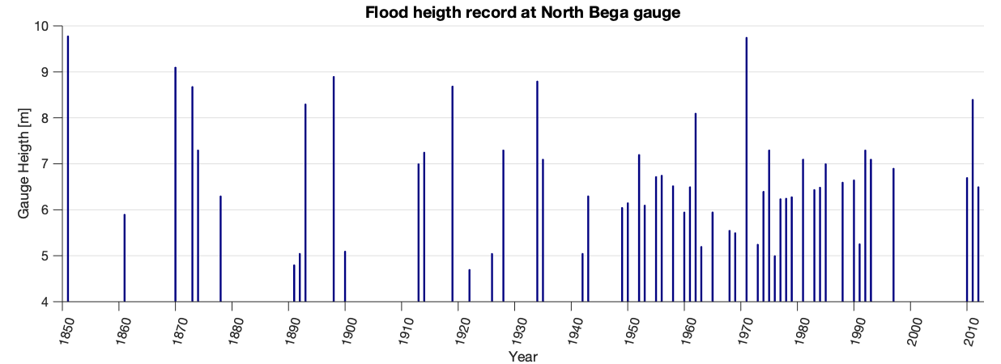
Bega river – Hydrological data reconstruction
Major available hydrological data in the Baga basin:
Discharge from gauging stations: available starting from 1944 in Morans Crossing, located in the middle section of the river. The record shows systematic underestimation of discharge during major floods.
Water height from historic records: available starting from 1850 in North Bega Crossing, near Bega Town.
ARR-Rational method hydraulic model: estimate flood discharge for all reaches for return period classes 1, 2, 5, 10, 20, 50, 100 yr, used on the Bega river by Fryirs and Brierley, 2001

Slide 16
Bega river – Hydrological data reconstruction
We applied a 4-step method to reconstruct historical hydrology for all reaches
We correlate recorded flood height with the discharge and return period (RP) reported for that flood from the Morans Crossing gauging station using an exponential law (R² = 0.46)
We extrapolate for each flood in the height record a return period derived by the gauging station data, to obtain an historic record of the return period of each flood events. Given the limited area of the basin, we assume each flood event have the same return period for all reaches.
We determine for each reach the discharge for the 1-, 2-, 5-, 10-, 20-, 50-, 100-year flood events, using the ARR-Rational method hydraulic dataset.
Finally, we reconstruct the historic flood discharge for all reaches by attributing to the RP found in step 2) the reach-specific RP and discharge obtained in step 3 ).

Slide 17
Bega river – Hydrological data reconstruction
The methodology used presents large uncertainty in the reconstruction of the hydrology.
We defined four different scenarios of discharge devised to cover a wide range of possible discharge conditions.
The scenarios differentiate according on how the return period for each flood is associated to a class of discharge in step 4).
Return Period | High Discharge (HighQ) | Medium discharge (MediumQ) | Low discharge (LowQ) | Mixed discharge (MixQ) - type 4 | Mixed discharge (MixQ) - others
1 | 0 | 50 | 84 | 0 | 84
2 | 88 | 73 | 56 | 88 | 56
5 | 51 | 25 | 13 | 51 | 13
10 | 12 | 8 | 4 | 12 | 4
20 | 4 | 4 | 8 | 4 | 8
50 | 8 | 6 | 2 | 8 | 2
100 | 3 | 2 | 1 | 3 | 1

Slide 18
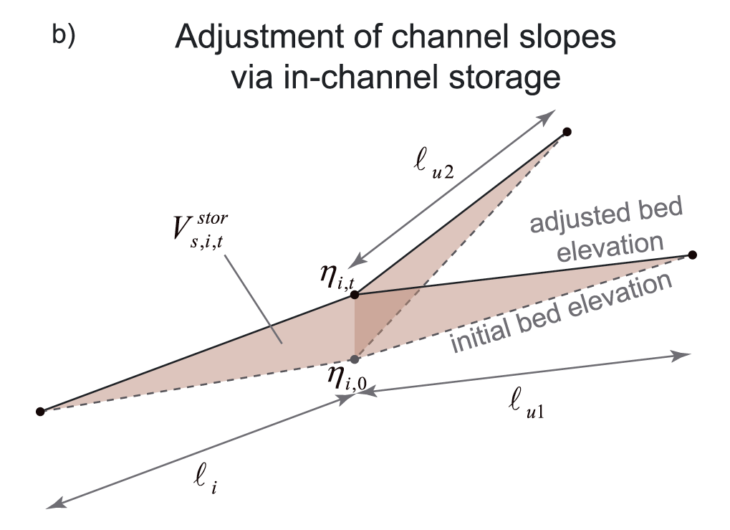
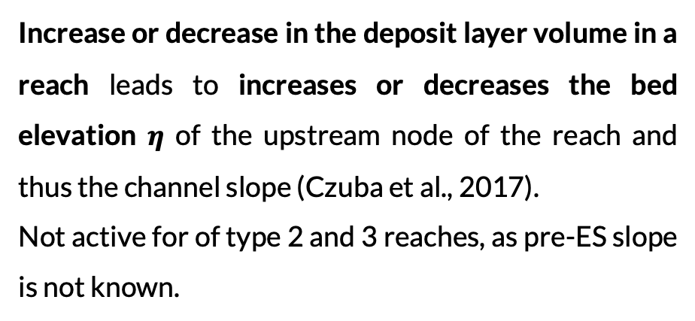

Bega river – Reach features modelization
To reproduce network feature change due to changes in sediment delivery, we implemented 3 plug-in modelling component in the model
Channel Slope
Channel width
Increase or decrease in the deposit layer volume in a reach leads to increases or decreases the bed elevation $η$ of the upstream node of the reach and thus the channel slope (Czuba et al., 2017).
Not active for of type 2 and 3 reaches, as pre-ES slope is not known.
The erosion of the reach sediment deposit is correlated with the increase in historic channel width. As bank sediment gets eroded, channel width progressively increases up to present-day levels.
$$V^{dep}$$
Adjustment of channel slope in case of sediment deposition
Figure from Czuba et al., 2017

Slide 19
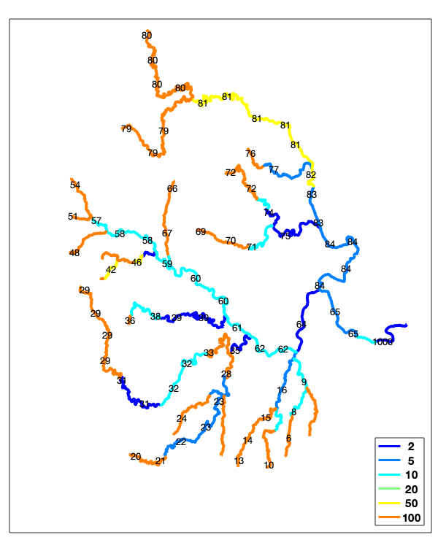
Bega river – Reach features modelization
Overbank flooding
If the water discharge causes overbank flooding in a reach , the model limits sediment entraining from the deposit layer. This limit is defined by the transport capacity relative to the discharge of highest return period class not associated to overbanking for the reach.
Thus, we decrease the flow to the return period indicated by expert-based analysis when we calculate the transport capacity accounting for the volume eroded from the reach. The transport capacity governing sediment transport from upstream remain unchanged.
However, as to not limit bank erosion during overbank floods ,this limitation is only active when the deforestation process is complete in 1890 (phase 3).
Note: the channel width is always kept constant, the only parameter changing in the tr.cap calculation is the discharge.
Return period flood leading to discharge going overbank

Slide 20
Bega river – historic drivers of change
Based on the historical evidence available, we can define the major driver of geomorphological change in the basin:
For type 2 and 3 reaches, the decrease in channel roughness and increased bank material availability for erosion due to vegetation clearance, and subsequent banks instability.
For type 4 reaches, the narrowing of channel width due to swamp drainage and channelization, together with decrease in channel roughness from deforestation.
20

Slide 21
Simulation structure
The simulation in CASCADE is divided into 4 phases, according to the presence and effects of drivers of change on the simulation:
Phase 1: Lowland expansion 1850 – 1890
  The n_Man is decreased linearly to post_ES values in all reaches marked ”type 2 and 3”. At the same time, the sediment layer is made available for erosion proportionally to the changes in n. The width is increased to post_ES proportionally to the percentage of erosion of the stored material (ex. If 50% of the material is eroded, a reach with pre_ES width = 20 and post_ES width = 100 will be set to width = 60 )
Phase 2: Pause 1890 – 1910
  The model is kept running, no new changes is introduced. The width of the lowland channels can keep changing
Phase 3: Valley fill erosion 1910 – 1920
  In a short timeframe, the width and n_Man of the reaches marked “type 4” are linearly decrease to match the post_ES conditions.
Phase 4: Aftermath 1920 – 2020
  The model is kept running, no new changes is introduced.

Slide 22
Simulation structure – changes per reach type
Change type 1
No sed. deposit
Width, D50 and Slope set to post-ES
n_Man set to 0.1
n_Man decreased linearly to post-ES
No changes
No changes
No changes
Sed. deposit as defined by Fryirs and Brierley, 2001
Width reduced by 20% if deposit is present
n_Man set to 0.1
Slope set to post-ES, not changing
n_Man decreased linearly to post-ES
Sediment deposit made available for erosion proportionally to the changes in n_Man
Width increased to post_ES according to the erosion of the sed.deposit
Change type 2
No changes
No changes
No changes
Sed. deposit as defined by Fryirs and Brierley, 2001
Width as defined by Brooks and Brierley, 1997
n_Man set to 0.1
Slope set to post-ES, not changing
D50 as defined by Brooks and Brierley, 1997 (only for reach 64)
n_Man decreased linearly to post-ES
Sediment deposit made available for erosion proportionally to the changes in n_Man
Width increased to post_ES according to the erosion of the sed.deposit
No changes
No changes
No changes
Change type 3
Sed, deposit as defined by Fryirs and Brierley, 2001
Width equal to reach 5 or 18
n_Man set to 0.2
Slope equal to reach 5 or 18
D50 set to post-ES
No changes
No changes
n_Man and Width decreased linearly to post-ES
No changes
Change type 4
Initialization
1850
Phase 1
1890
Phase 2
1910
Phase 3
1920
Phase 4
2020

Slide 23
Validation parameters
To quantify the D-CASCADE model simulation performances in reproducing historical geomorphic variations in the Bega river, we defined seven indicators based on field data and historical reconstruction.
Value used for indicators refers to 2001.
1-3.
Sediment delivery ratio in lowland reaches, Bemboka, Bega Town and outlet
Channel width in the lowland
Swamp emptying: average fraction of initialized sediment deposit released in the reaches; we expect it to be 100% by 2001
Mean slope in type 4 reaches: compared to intact valley fills (0.024), channel gradient is decreased in incised valley fills (0.018)
Mean D50 in the lowland: originally very fine (0.5 mm), sediment grain size has increased in the lowland (1,2 mm) due to coarse sediment supply from valley fills incision
4.
5.
6.
7.

Slide 24
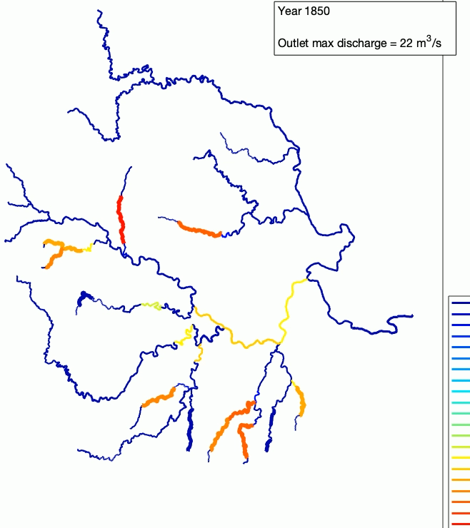

Results – MedQ scenario
Total sediment material in the reach [ ,000 m³]
The video on the left shows the volume of sediment present in a reach (deposited and mobilized) in each timestep of the simulation.
The line width changes according to reach channel width.
According to the model, before 1900, all bank material available has been eroded and channels width reaches present-day values.
After 1910, valley fills incision begins to slowly supply material which accumulates mostly in lowland reaches

Slide 25
Results – medium scenario
Results – medium scenario
Variations in total sediment volume and channel width in different locations in the lower river network during the simulation horizon, for the MedQ scenario. Bars on the background indicates the flood return period, with a 3 timestep average
Section A to C, and H, after sediment release, behave like sediment transit zones, with little to no storage.
Section D to G behave like sediment sinks, trapping most material delivered upstream.
Channel expansion is driven by large floods
25

Slide 26
Results – medium scenario
Results – medium scenario
Variations in total sediment volume and channel slope in different locations for type 4 reaches during the simulation horizon, for the MedQ scenario. Bars on the background indicates the flood return period, with a 3 timestep average
Sediment release is slow, and not all reaches are emptied for 2020. However, the majority of the stored material is delivered downstream.
26
26

Slide 27
Scenario comparison
Variation of total sediment volume and channel width in the downstream section for the four hydrology scenarios. Discharge is shown for the Qhigh scenario .
Channel expansion velocity remains also mostly the same across the scenarios.
In HighQ and MedQ, material seems to station less in section E, instead depositing in section F after the Brogo confluence
The roles of downstream section for the sediment connectivity stay largely the same (A-C and H transit, D-F sinks)

Slide 28
Scenario performances
Performances of the four hydrology scenarios for the seven validation parameters.
The gray and black line represents, respectively, the pre-ES and the present-day values for the parameters. Performances are considered better the closer they are at the black line.
All scenarios are able to reproduce all major processes in the lowland: channel expansion, bed material coarsening and upstream sediment trapping
Only high discharge scenarios for type 4 shows erosion of valley fills sediment deposit consistent with field data
The roles of downstream section for the sediment connectivity stay largely the same (A-C and H transit, D-F sinks)

Slide 29
Scenario performances
Performances of the four hydrology scenarios for the seven validation parameters.
The gray and black line represents, respectively, the pre-ES and the present-day values for the parameters. Performances are considered better the closer they are at the black line.
As expected, the Qmix scenario performs the best, as it guarantees both high discharge in type 4 reaches the swamps to consistently remove material and Low discharge in the lowland that leads to higher sediment trapping and lower sediment delivery to the outlet

Slide 30
Future trajectories generation
We selected the Qmix scenario as the starting point for future trajectories, as it performs the best in the validation criteria
We extracted from the historical records in Morans Crossing the yearly probability for each return period discharge (which is different for the swamps given the scenario considered)
We created 100 scenarios composed by 50 independently generated flood events scenarios , and run the D-CASCADE model for each scenario starting from 2020.

Slide 31
Future trajectories results
Range of trajectories of sediment transfer and sediment delivery ratio obtained combining the future scenarios outputs, from 2020 to 2070. Data before 2020 refers to MixQ scenario
The model does not seem to suggest changes in the role of the reaches in the network connectivity
the rate of increase in sediment delivery ratio is higher in the upstream reaches (A to C)
Downward trend of the trajectories in section D and E in the last decades of the simulation suggest a gradual emptying of the sediment sinks.
Notes:
Risultati più interessanti

Slide 32
Future trajectories results
Performances of the future hydrology scenario, for the last timestep of the simulation. The red line represents the performance of the MixQ scenario relative to the final year of the historic horizon (2020). The color on the line indicates the mean flood discharge at the outlet for the 50 timestep of the future trajectories.
Outlet mean discharge [m³/s]
The increase in sediment delivery ratio compared to 2020 is higher upstream.
The restraining potential of the sediment sinks seems to cumulate and intensify as we move downstream, and less sensitive to variations in discharge
As sediment deposit in type 4 reaches is almost depleted in 2070, we can expect channel slope to not decrease further.
Notes:
Risultati più interessanti

Slide 33
Conclusions
CASCADE is able to reproduce historical morphological changes in the Bega river network and reconstruct reach connectivity roles with suitable accuracy
The future trajectories shows that sediment released for valley fills incision will mostly remain trapped within the sediment sinks in the lowland, with minimal delivery to the estuary
Channel expansion in particular is accurately reconstructed both in timing and locations, as in all scenario channel width reaches today’s conditions around 1890. Bank erosion and channel expansion seems to be mostly driven by large flooding events
All simulations correctly reproduce the roles downstream reaches take in the sediment connectivity of the basin identified by Fryirs and Brierley (2001) , either sediment transit zone or sinks
Only simulations with high discharge for type 4 reaches (HighQ and MixQ) guarantees that most of the material stored in valley fills is mobilized and delivered downstream by 2001. This is probably due to simplifications introduced when modelling sediment entraining, that are not able to reproduce the complex dynamics of channel incision and gullies formations

Slide 34
Limitations and opportunities
The application of D-CASCADE of the Bega river network showcases the potential of network-scale sediment connectivity model to model dynamic changes in multiple sediment transport and connectivity processes.
The flexible framework structure allows for the inclusion of modelling components for specific network features, to model channel adjustment to changing sediment processes. The complexity of said component can be chosen according to data and system knowledge available for calibration.
D-CASCADE may be a useful instrument for modelling future trends of sediment connectivity and transport, or quantifying future alterations in time and space caused by the introduction of multiple anthropic disturbances in the system. Thus it can be employed in strategic decision-making contexts, to provide indicators of sediment connectivity alteration for multiple decision portfolio.
Addressing of uncertainties is fundamental when applying D-CASCADE. Stochastic approaches and multiple scenarios exploration should be always used. In particular, while the formulas for sediment transport and velocity we used were already used in other basin-scale sediment connectivity models, and the results validated the historic trajectories observed, future studies should focus with more details on their validation and exploration of alternatives.

Slide 35
Literature
On CASCADE
Schmitt, R.J.P., Bizzi, S., Castelletti, A., 2016a. Tracking multiple sediment cascades at the river network scale identifies controls and emerging patterns of sediment connectivity. Water Resour. Res. 52, 3941–3965. https://doi.org/10.1002/2015WR018097
Schmitt, R.J.P., Bizzi, S., Castelletti, A.F., 2016b. Tracking multiple sediment cascades at the river network scale identifies controls and emerging patterns of sediment connectivity. Water Resour. Res. 52, 3941–3965. https://doi.org/10.1002/2015WR018097
Schmitt, R.J.P., Bizzi, S., Castelletti, A., Kondolf, G.M., 2018a. Improved trade-offs of hydropower and sand connectivity by strategic dam planning in the Mekong. Nat. Sustain. 1, 96–104. https://doi.org/10.1038/s41893-018-0022-3
Schmitt, R.J.P., Bizzi, S., Castelletti, A.F., Kondolf, G.M., 2018b. Stochastic Modeling of Sediment Connectivity for Reconstructing Sand Fluxes and Origins in the Unmonitored Se Kong, Se San, and Sre Pok Tributaries of the Mekong River: Stochastic connectivity modelling. J. Geophys. Res. Earth Surf. 123, 2–25. https://doi.org/10.1002/2016JF004105
Schmitt, R., Bizzi, S., Castelletti, A., Opperman, J.J., Kondolf, G.M., 2019. Planning dam portfolios for low sediment trapping shows limits for sustainable hydropower in the Mekong. Sci. Adv. 5, eaaw2175. https://doi.org/10.1126/sciadv.aaw2175
Tangi, M., Schmitt, R., Bizzi, S., Castelletti, A., 2019. The CASCADE toolbox for analyzing river sediment connectivity and management. Environ. Model. Softw. 119, 400–406. https://doi.org/10.1016/j.envsoft.2019.07.008
Others
Ackers, P., White, W.R., 1973. Sediment Transport: New Approach and Analysis. J. Hydraul. Div. 99, 2041–2060. https://doi.org/10.1061/JYCEAJ.0003791
Brooks, A.P., Brierley, G.J., 1997. Geomorphic responses of lower Bega River to catchment disturbance, 1851–1926. Geomorphology 18, 291–304. https://doi.org/10.1016/S0169-555X(96)00033-5
Czuba, J.A., 2018. A Lagrangian framework for exploring complexities of mixed-size sediment transport in gravel-bedded river networks. Geomorphology 321, 146–152. https://doi.org/10.1016/j.geomorph.2018.08.031
Fryirs, K., Brierley, G.J., 2001. Variability in sediment delivery and storage along river courses in Bega catchment, NSW, Australia: implications for geomorphic river recovery. Geomorphology 38, 237–265. https://doi.org/10.1016/S0169-555X(00)00093-3

