Slide 1





Elbe 2020 –
Investigating a River-Sea System
from Upstream into the North Sea
H. Brix, N. Kamjunke, I. Bussmann, E. Achterberg, P. Dietrich, P. Fischer, G. Flöser, M. Friedrich, F. Geißler, U. Koedel, M. Koschorrek, L. Rewrie, C. Schütze

Slide 2
The Setting
Understanding river-sea-systems requires a thorough understanding of processes that span different Earth system compartments
Issues arise when scientific disciplines interact due to differences in:
  Measurement and calibration standards
  Quality Control approaches
  Data formats and handling
MOSES (Modular Observation Solutions for Earth Systems) addresses this type of problem through:
  Sensor comparison and intercalibration campaigns
  Joint field campaigns involving partners from different Earth compartments and disciplines

Slide 3
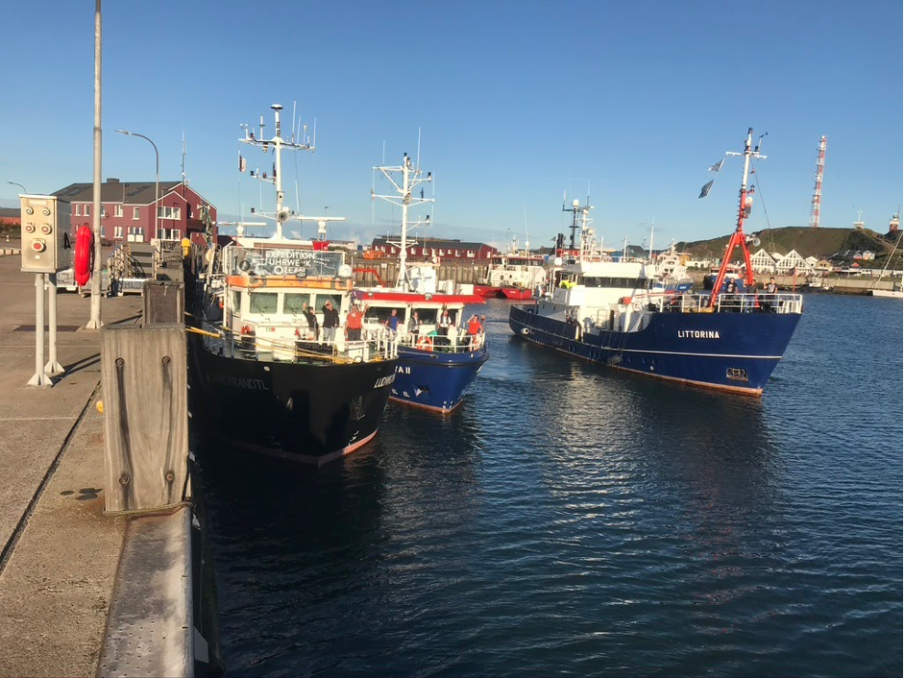
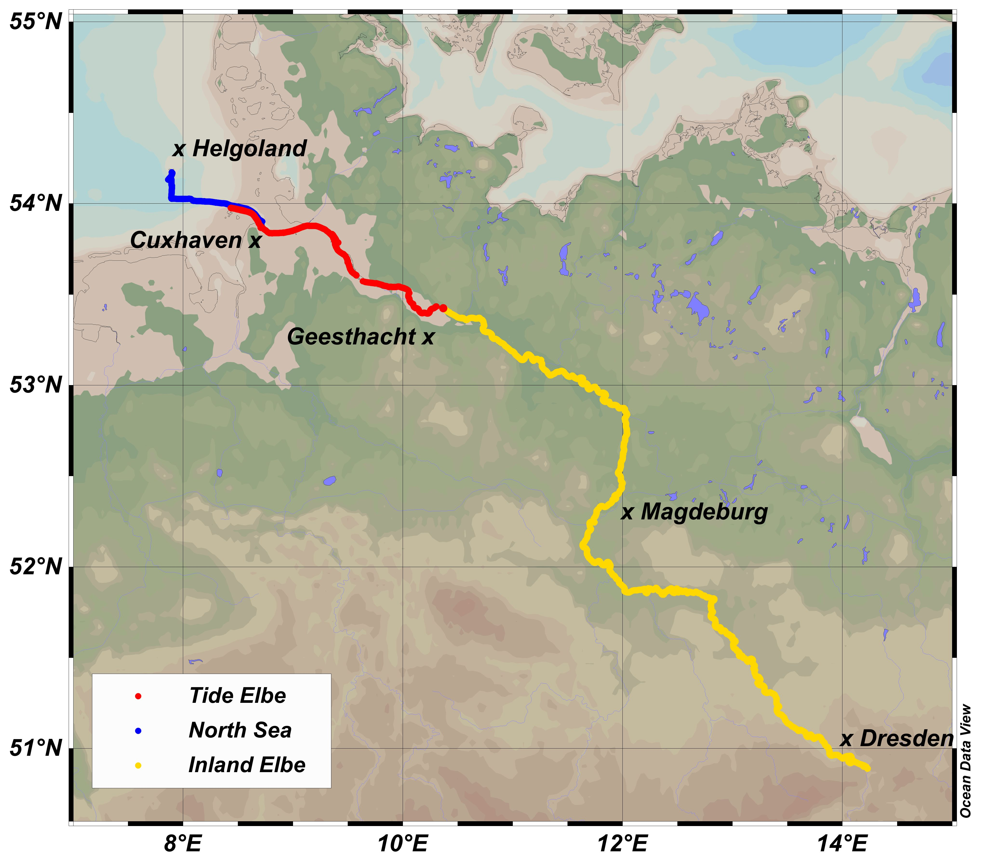
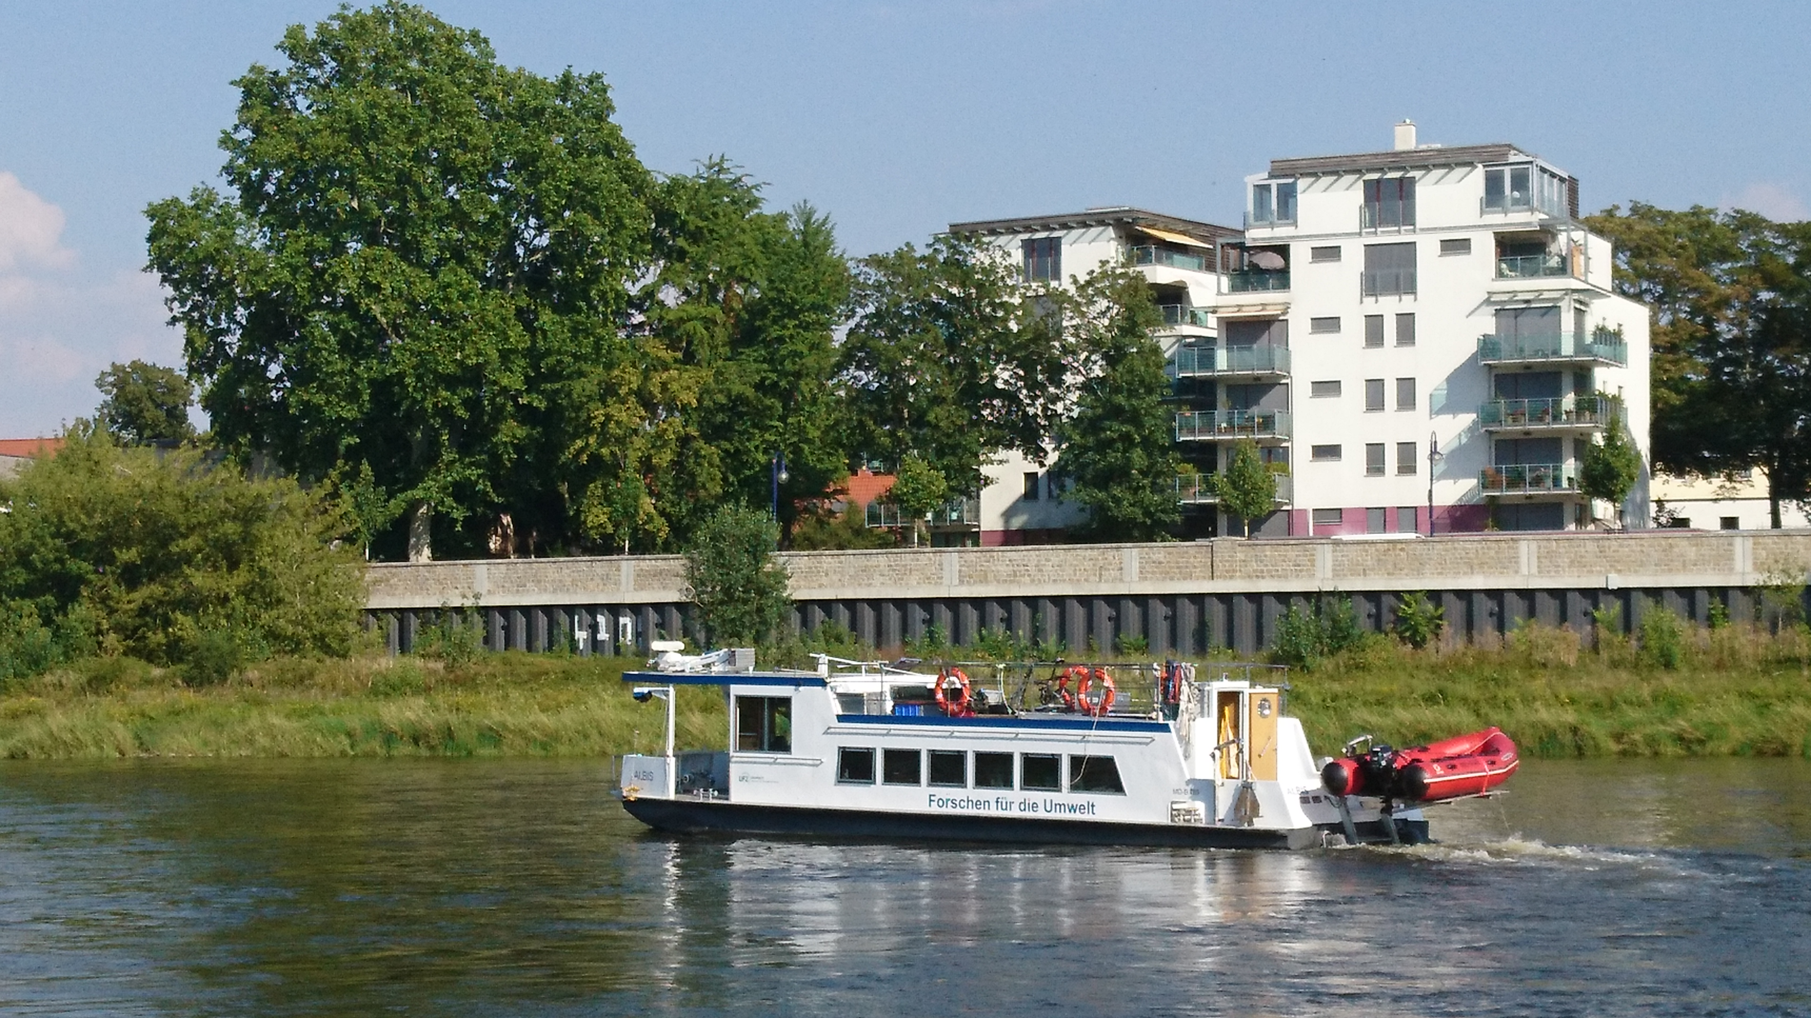
The Elbe2020 Campaign
Inland Elbe cruise, 4. – 12. Aug 2020
Tide Elbe cruise, 25. -26. Aug 2020
Part of Sternfahrt 5, 31.8 – 3.9 2020

Slide 4
Objectives
Establish scientifically sound and resilient sampling procedures for multiple ships (inland waters and ocean going, fresh and sea water, …)
Create reference data for main environmental parameters for future investigations of extreme events such as river floods or draught events
Test communication logistics
Establish common data flows and protocols

Slide 5
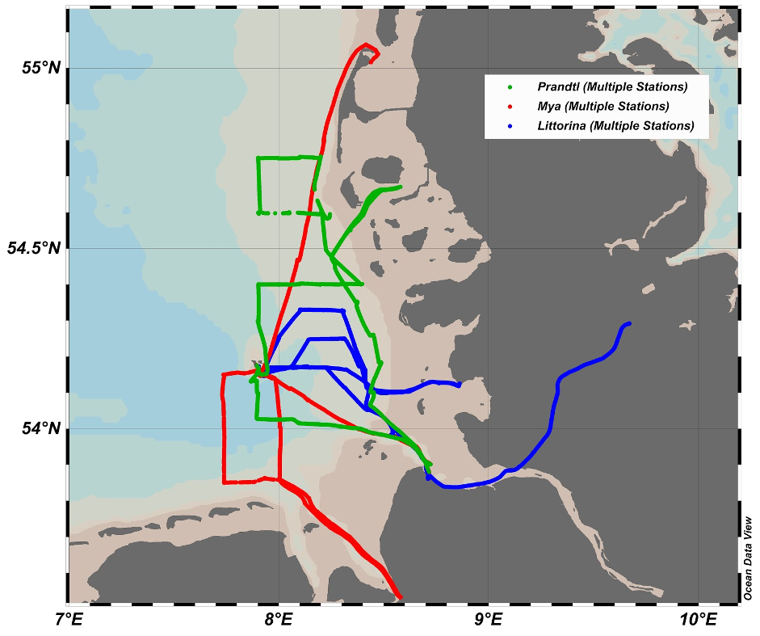

Logistics and Realization
Four research vessels from four research institutions
Duration: two months
Measurements:
  Standard hydrological and oceanographic parameters
  Nutrients, carbonate system
Two cruises in the river (fresh water and tidal sections)
Three ships in the German Bight

Slide 6
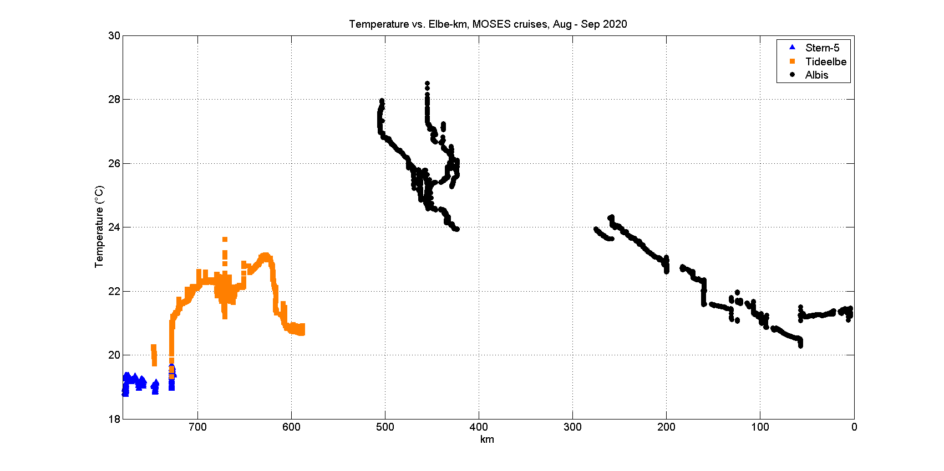
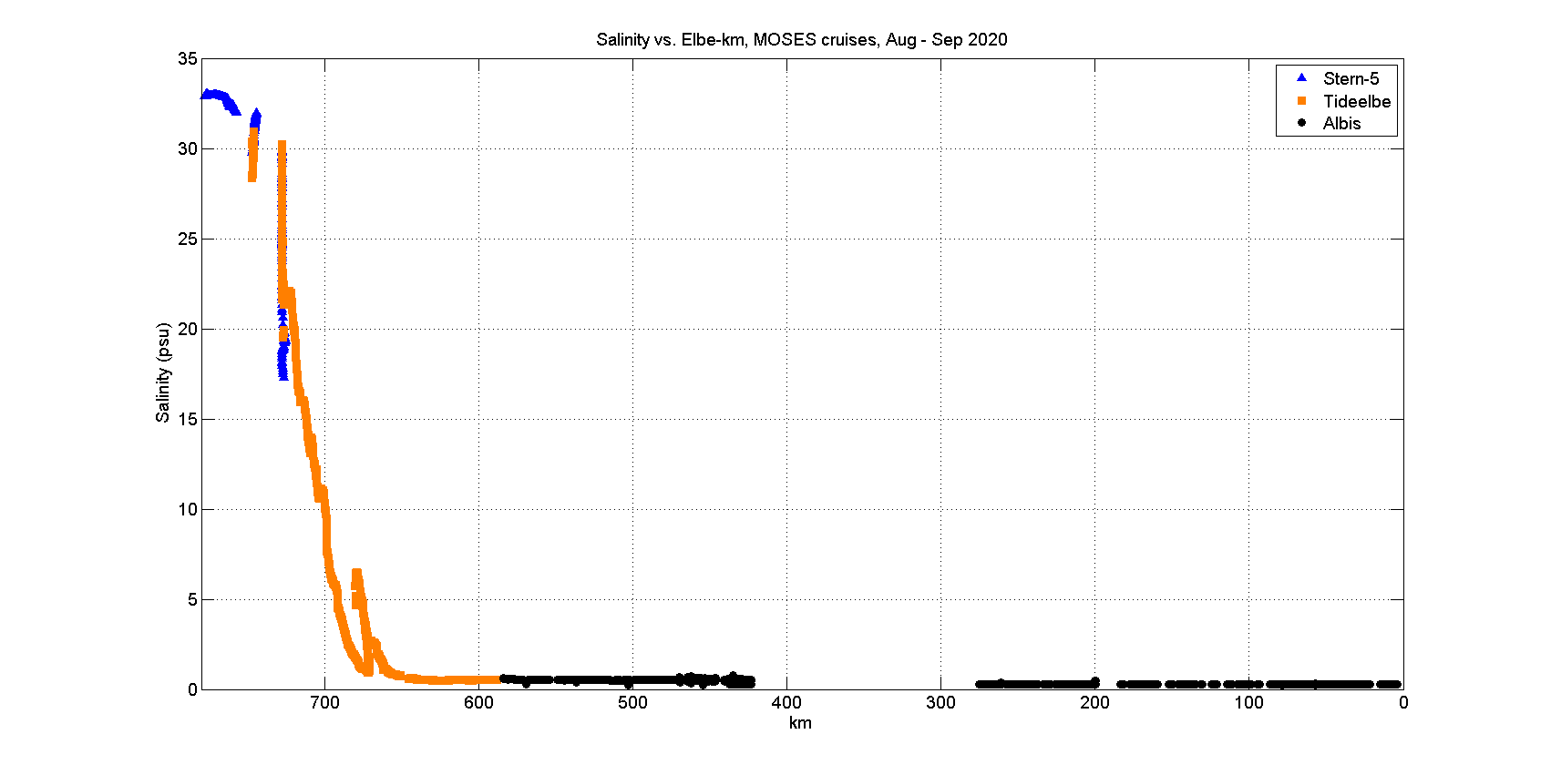
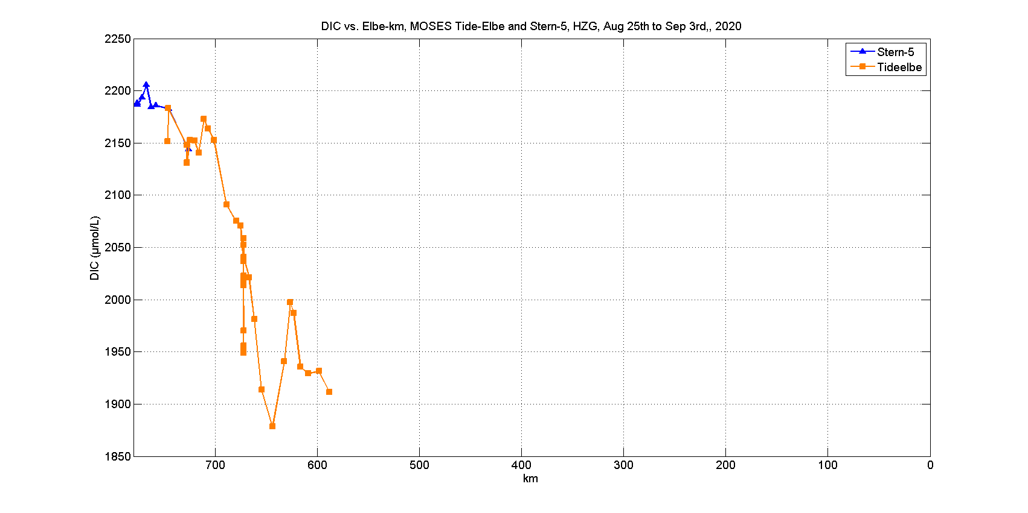
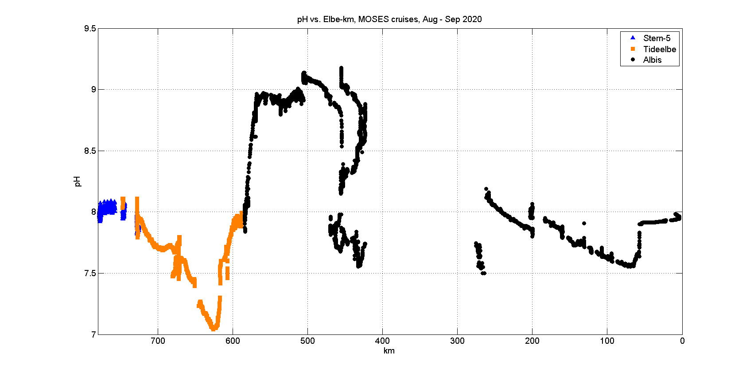
Results along the river:
Helgoland – Czech Republic
30
28
26
24
22
20
18
35
30
25
20
15
10
5
0
Temperature (ºC) Salinity
German Upriver German Upriver
Bight Bight
2250
2150
2050
1950
1850
9.5
9.0
8.5
8.0
7.5
7.0
DIC ($μ$mol/L) pH
German Upriver German Upriver
Bight Bight

Slide 7
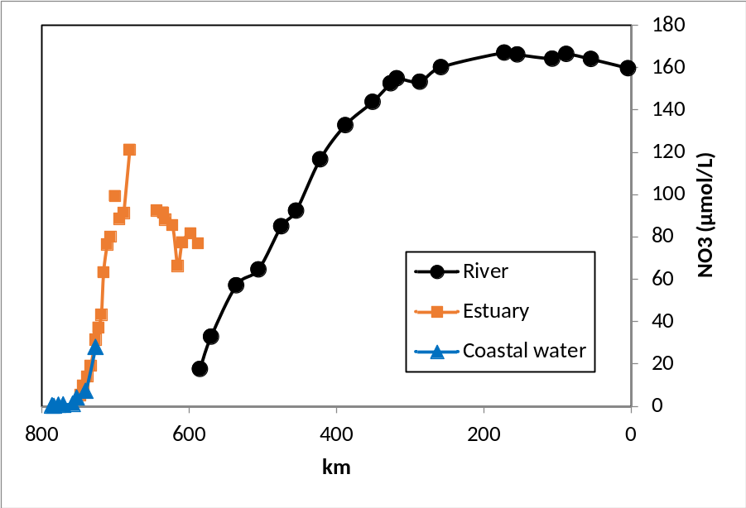
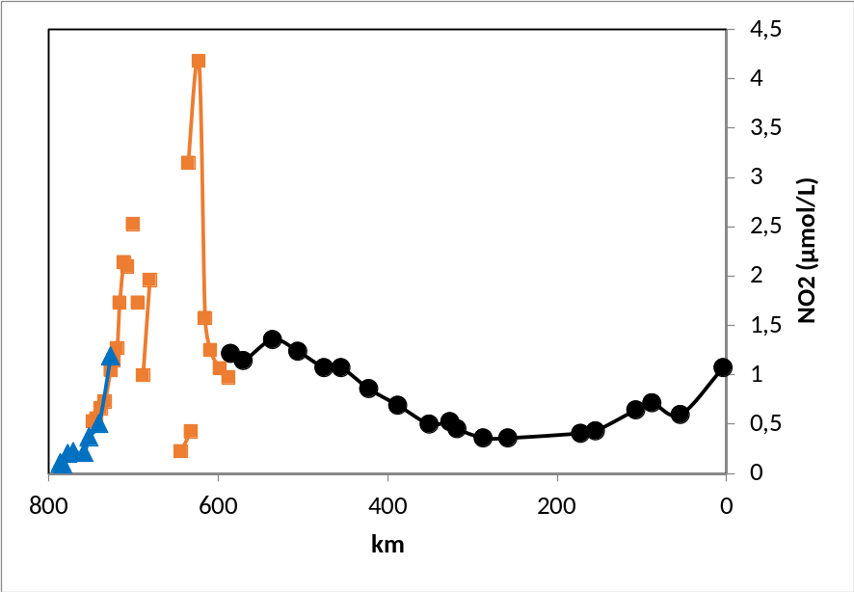
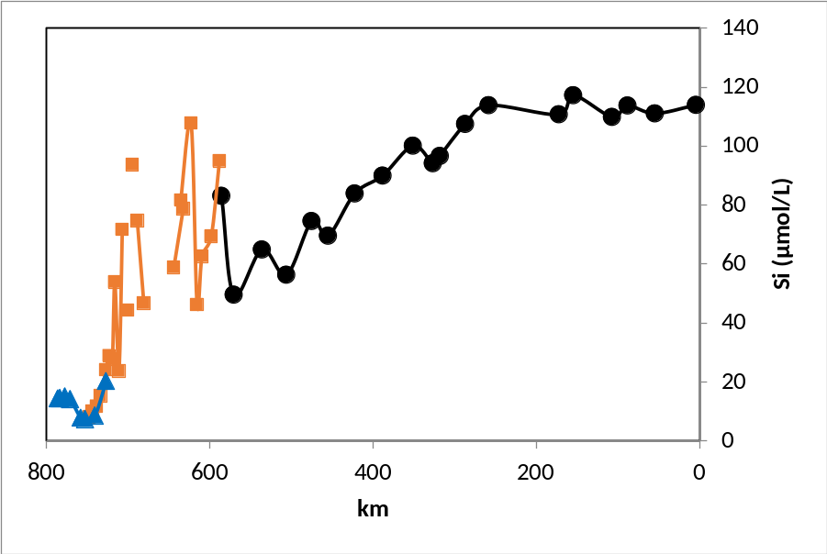
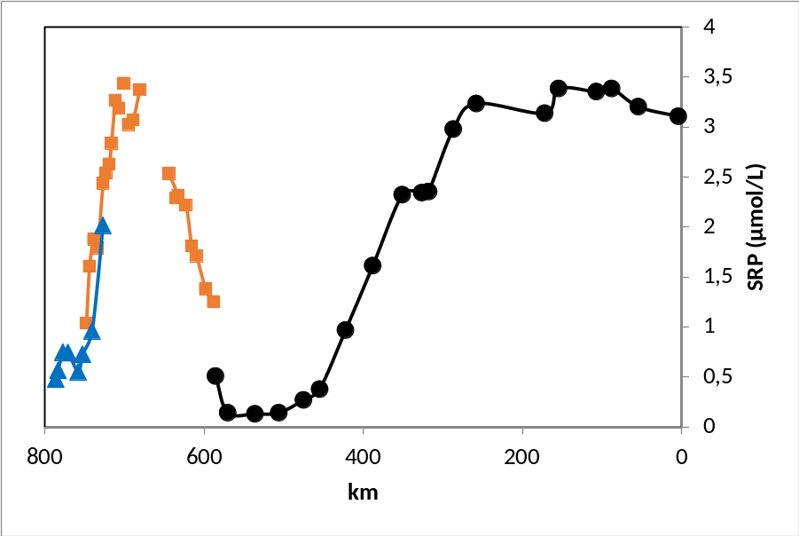
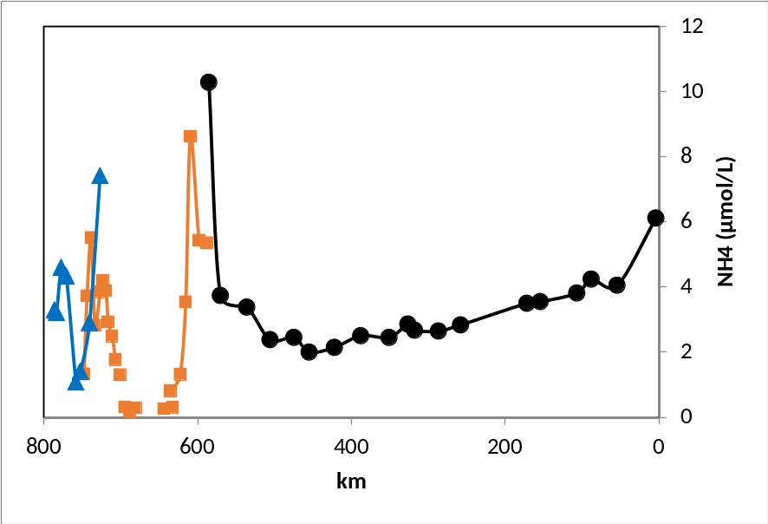
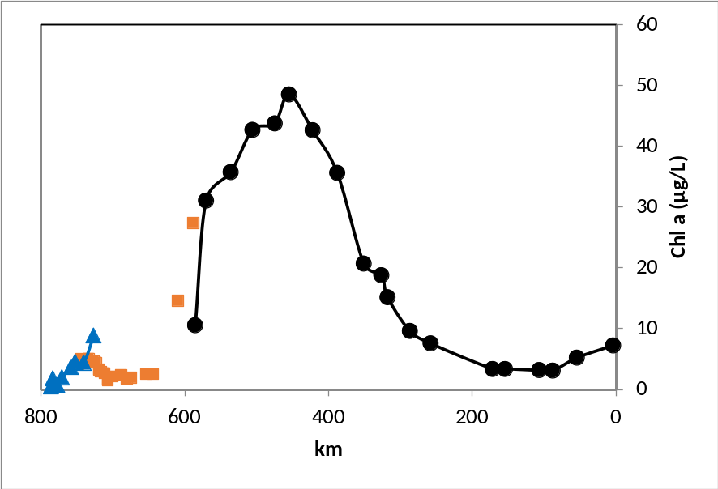
Results along the river:
Helgoland – Czech Republic

Slide 8
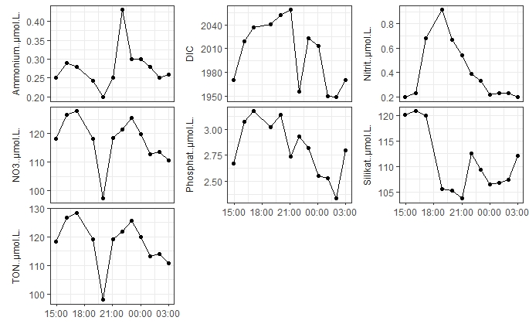
Results for the Tidal Cycle
NH4 DIC NO2
NO3 PO4 SiO4
TON

Slide 9
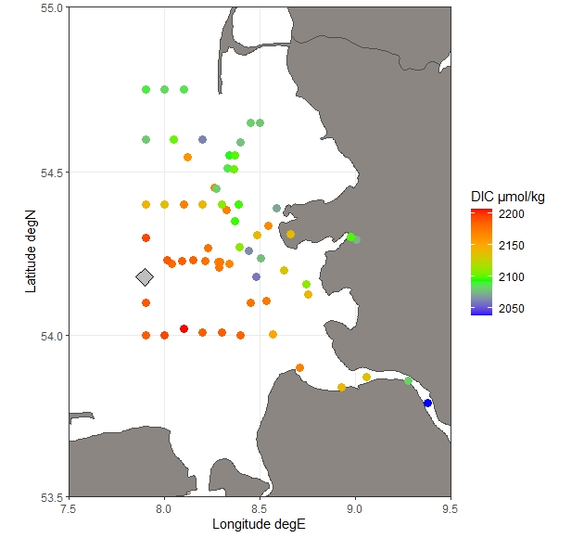
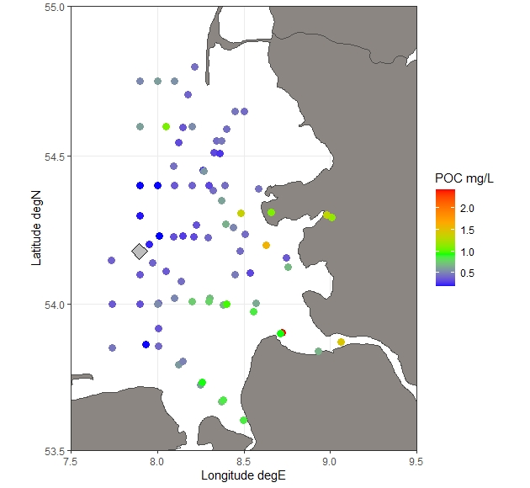
Results in the estuary and beyond
DIC POC

Slide 10
Conclusions
Measurements across compartments require:
  Logistical effort
  Cross-calibration
  Shared data handling
Coordination effort is:
  Time consuming
  Challenges old habits
  (Not straightforward)
Results help answer local / regional research question as well as enhance systems understanding
Challenges:
  Communication in the field
  Sustaining network for operations to monitor extreme events

Slide 11
Acknowledgements
Crew and captains of RVs Albis, Littorina, Ludwig Prandtl and Mya II
Numerous lab technicians at all participating institutes
Numerous colleagues “behind the scenes” supporting with logistics, instruments, knowhow and advice
Thank you for your attention !

