Slide 1
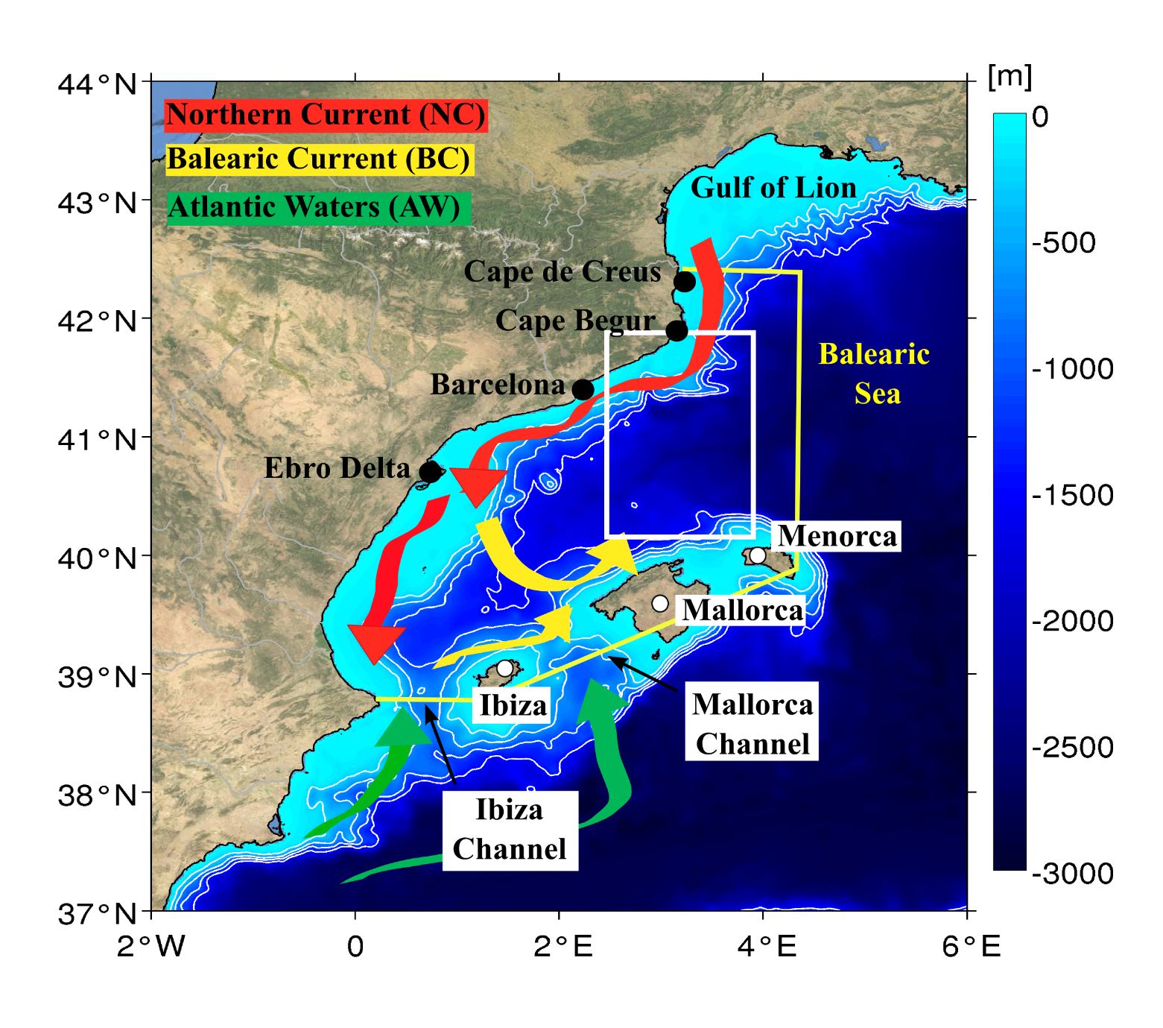
Figure 1– Main oceanographic features in the study area: Northern and Balearic currents (NC and BC). Green arrows denote waters of recent Atlantic origin that occasionally flows northward trhough the Ibiza and Mallorca Channels. The boundary of the Balearic Sea is marked by yellow lines. The black dot in Cape Begur denotes the eddy-generation area while the white box represents the eddy-influence area. Bathymetric contours are depicted for 300m – 700 – 1100 and 1500 m depth levels.

Slide 2
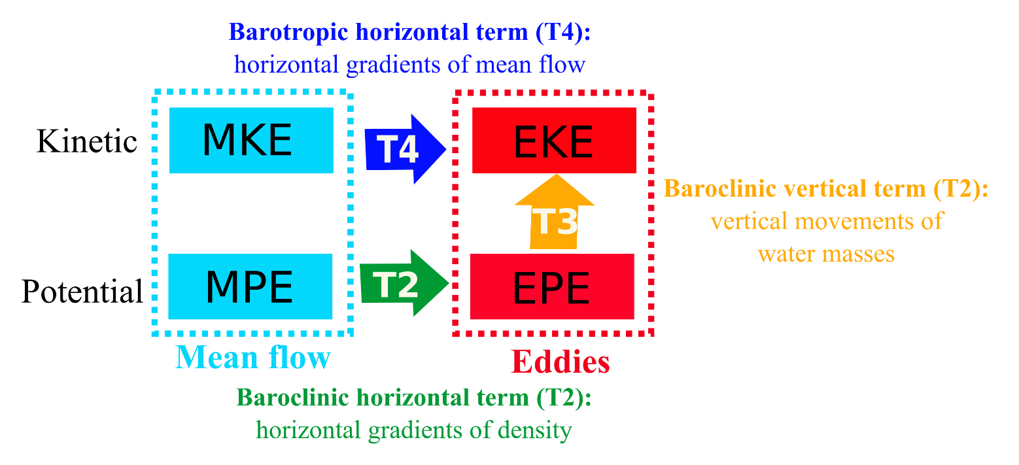
Figure 2– Diagram of eddy-mean flows interaction. Eddies can receive kinetic energy from the kinetic energy of the mean flow (MKE), potential energy of the mean flow (MPE) and/or from their own potential energy (EPE). This energy can be conveyed through horizontal gradients of the mean flow (T4), horizontal gradients of density (T2) and/or vertical movements of water masses (T3). Diagram simplified from Kang & Curchitser (2015).

Slide 3
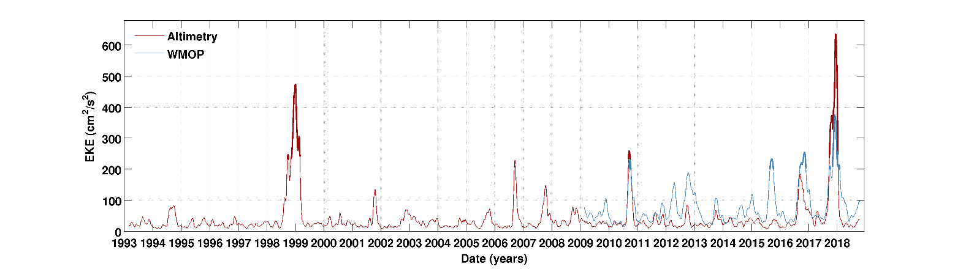
Figure 3- Spatially-averaged EKE from altimetry and WMOP over the eddy-influence area depicted in Figure 1 [2.5º - 4ºE; 40.2º- 41.8ºN]. Strong long-lived anticyclonic eddies in the Balearic Sea are defined as those events whose signal is higher than two standard deviations of the time series during more than 30 days. These events are represented with thick lines in the figure.

Slide 4
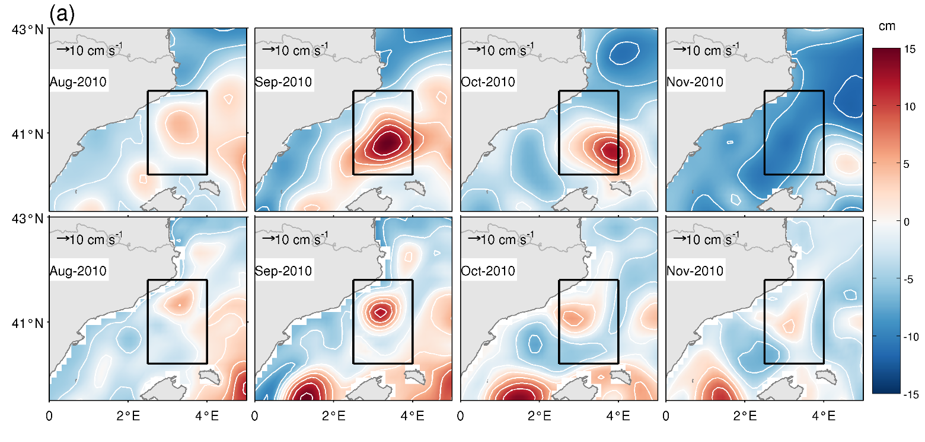
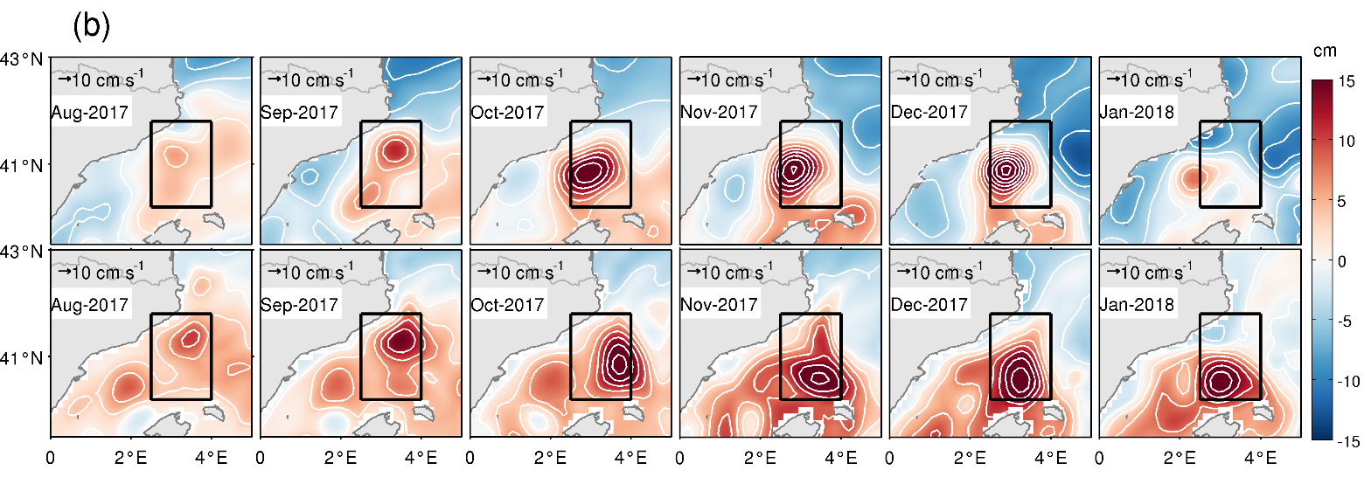
Figure 4–Monthly-averaged sea level anomalies (SLA, white contours depicted each 3 cm) computed from (a) August 2010 to November 2010 and, (b) from August 2017 to January 2018 using altimetry (upper row) and WMOP model data (lower row).. WMOP data was re-gridded to the altimeter grid for a more realistic comparison. Black box represents the eddy-influence area.

Slide 5
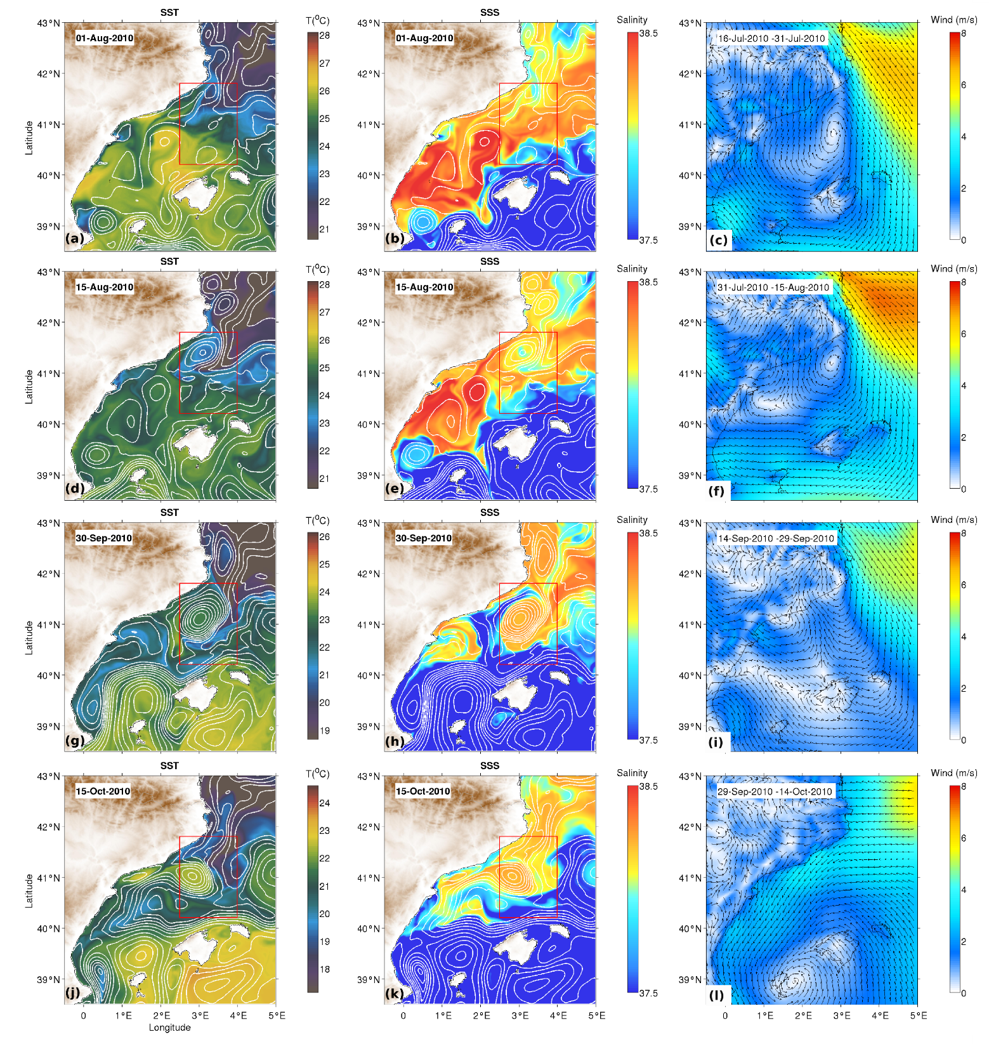
Figure 5–Snapshots of sea surface temperature (SST) and sea surface salinity (SSS), both with sea surface height contours depicted each 2 cm (white lines), in the Balearic Sea during the 2010 event. Fortnightly averaged winds during the previous 15-days are also represented in the last column. Red square denotes the limits of the eddy-influence area.

Slide 6
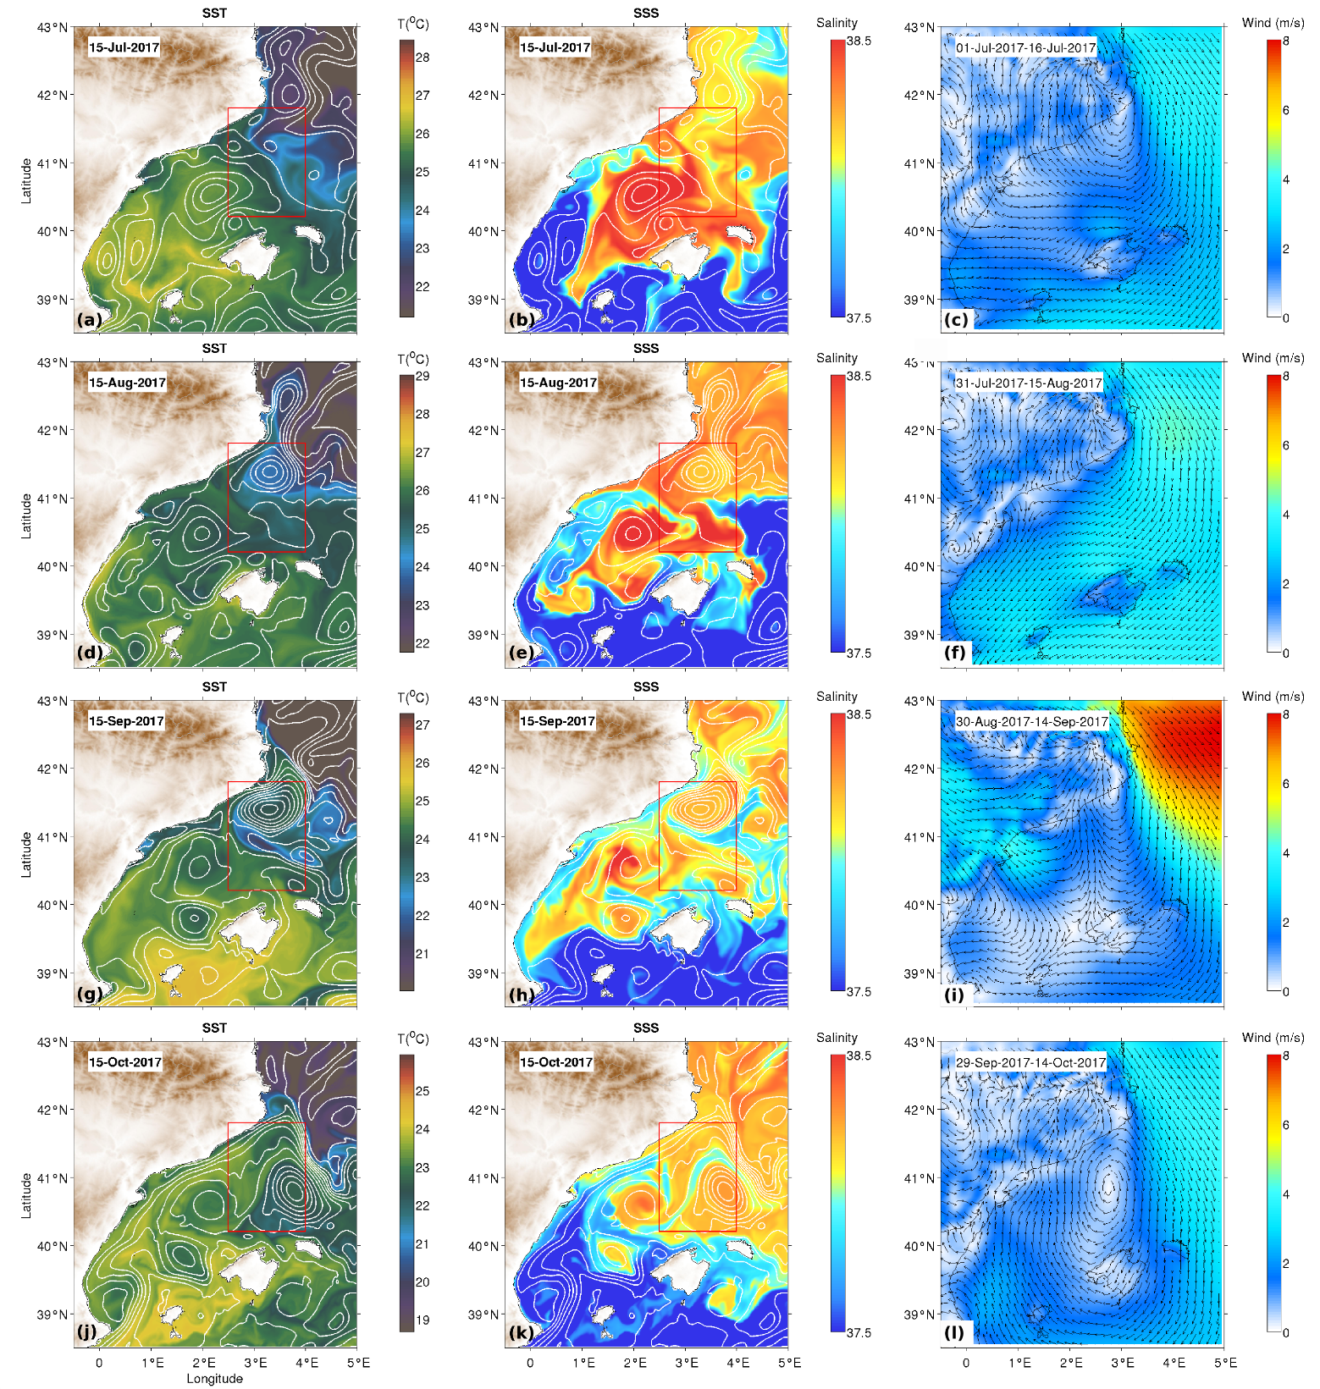

Slide 7
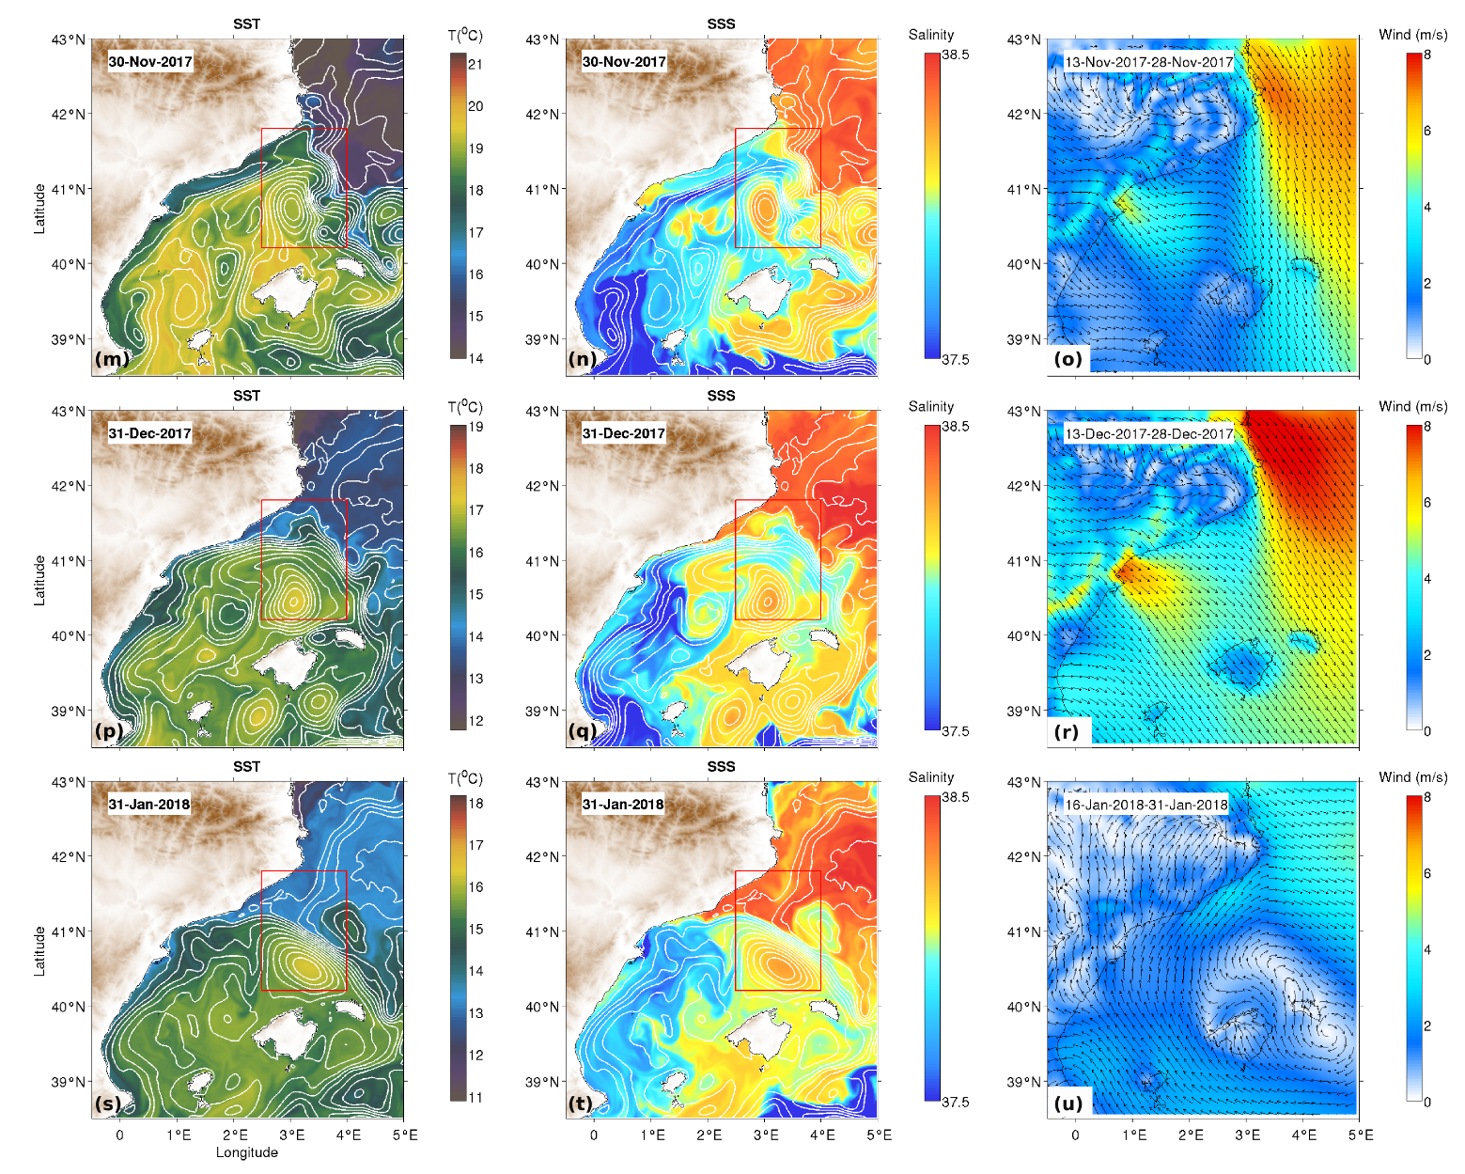

Slide 8
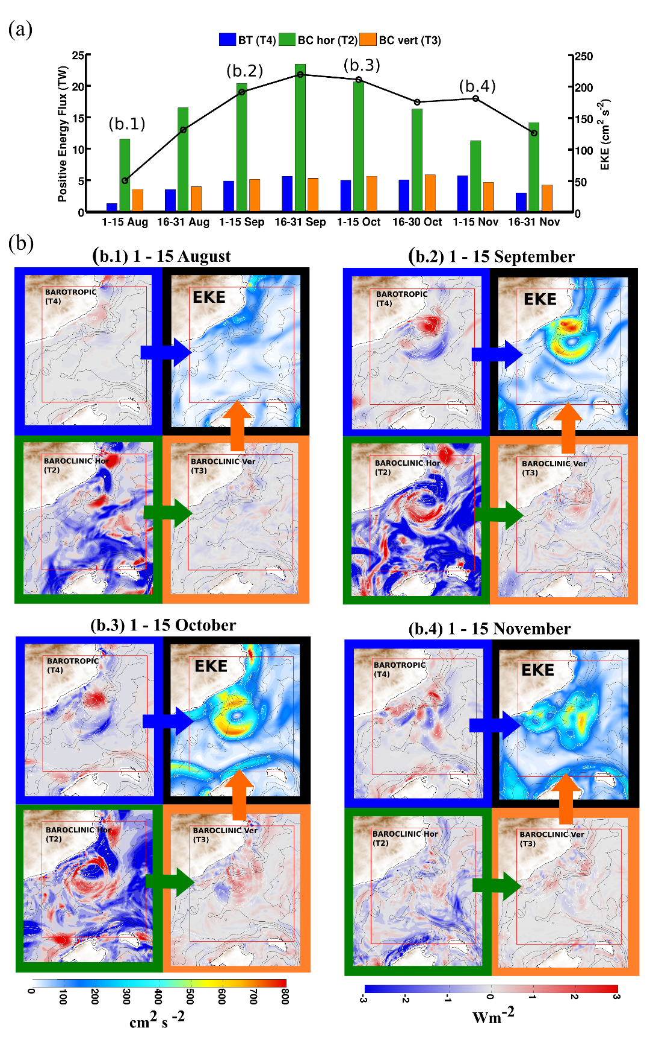
Figure 7– Temporal evolution (a) and spatial distribution (b) of the energy conversion terms and the EKE for the year 2010. In the upper figure (a), the bars represent the positive values of each energy term: in blue the barotropic term (BT; T4), in green the baroclinic horizontal term (BChor; T2), and in orange the baroclinic vertical term (BCver; T3). These terms are summed fortnightly within the eddy-generation area and in the upper 200m (the EKE rapidly decays from this depth, not shown). The black line denotes the spatially averaged EKE within the same box (right axis). The figures below show the spatial distribution of the EKE (black panel) and of each energy conversion term responsible for the EKE production at different moments over the duration of the event (b.1, b.2, b.3, b.4…). The energy conversion terms follow the same color legend as above: BT (T4, blue), BChor (T2, green) and the BCver (T3, orange).

Slide 9
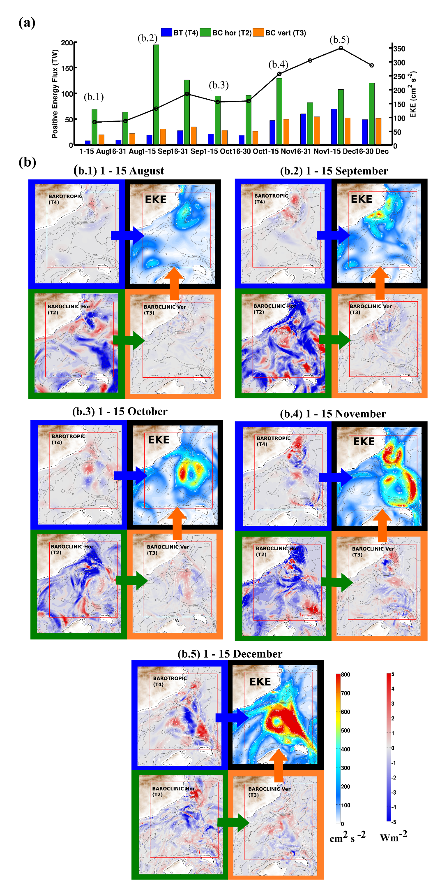

Slide 10
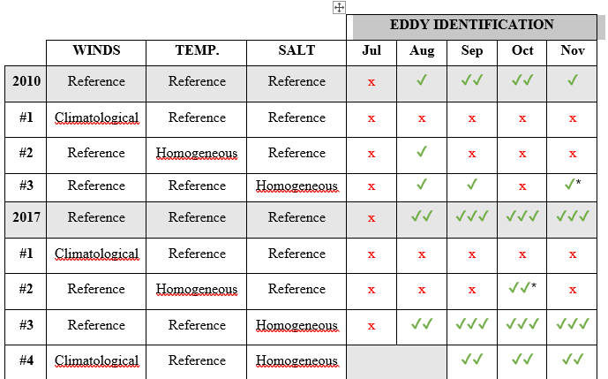
Table 1. Results of the sensitivity experiments carried out from July to December of 2010 and 2017 to evaluate the effect of the main forcings on eddy generation and intensification. Red cross indicates absence of eddy while single/double/triple green-tick indicates low/moderate/high intensity of the eddy based on its surface spatially-averaged SSH signature (✔: SSH<= -14cm, ✔✔: -14<SSH<= -7cm, ✔✔✔: SSH> -7cm). * indicates the cases in which the OW method detect eddies that have different origin that the eddy of interest.

Slide 11
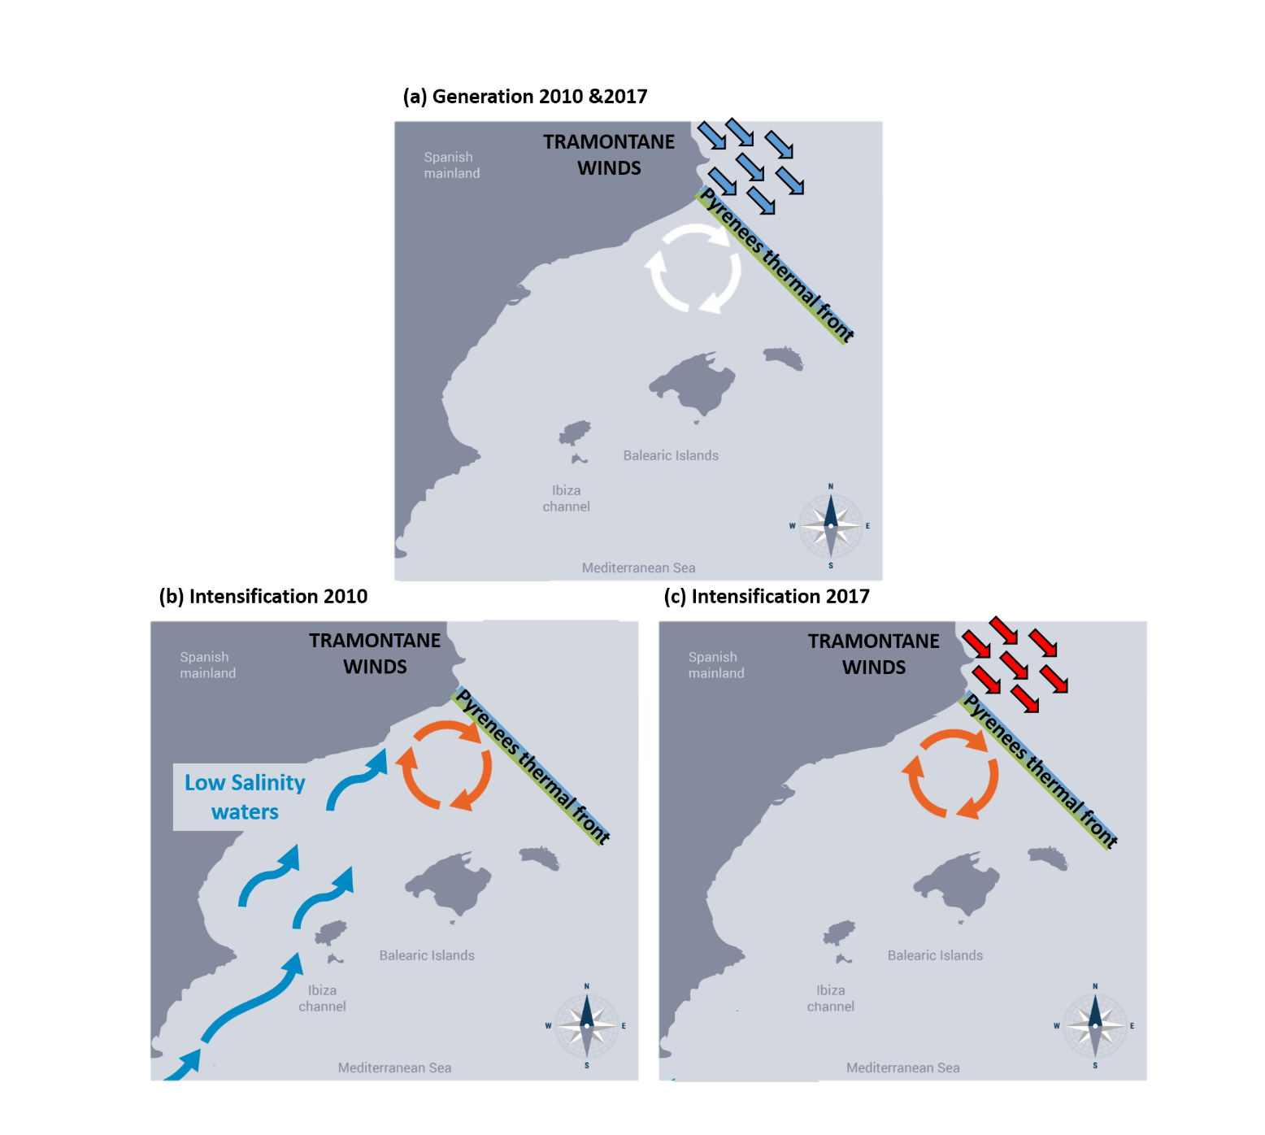
Figure 9– Proposed scenario for the development and intensification of long-lived anticyclonic eddies in the Balearic Sea. The generation of eddies is a result of (1) barotropic instability in the NC arising from the intense northwesterly winds, and (2) baroclinic instability associated with the relatively warmer northward inflows that reach the Pyrenees thermal front. The intensity and duration of the two eddies differed between the two years: in 2010 these properties were driven by the entrance of low-salinity waters from the south; in 2017, additional energy was provided by the constant northwesterly winds, which provide mechanical stress and reinforce the thermal front between the Gulf of Lions and the Balearic Sea.

Slide 12
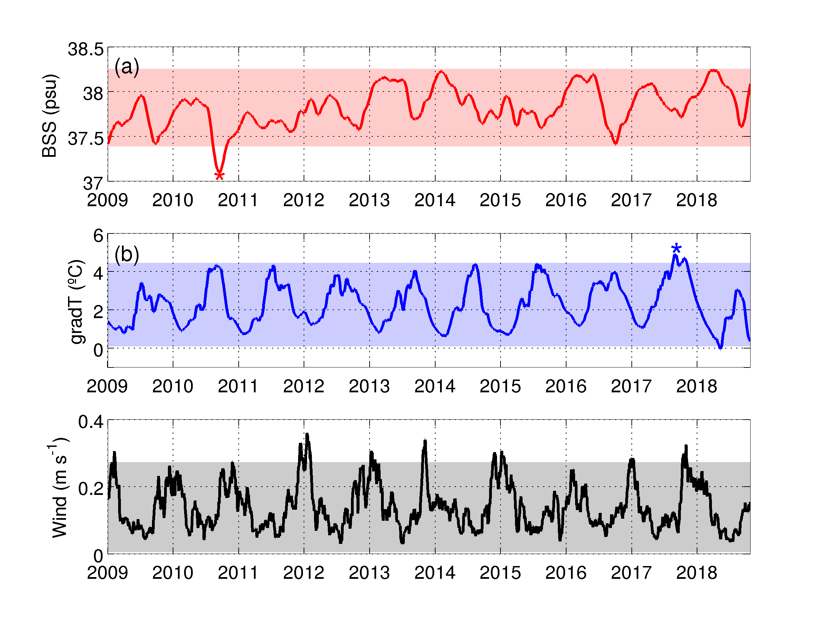
Figure 10 – Inter-annual time series from WMOP model of the spatially-averaged ocean surface salinity within the Balearic Sea (a), the temperature gradient between the Balearic Sea and the Gulf of Lion (b), and the wind intensity spatially-averaged in the Gulf of Lion (c). The shadow areas marks ± two standard deviations of the time series. Events higher or lower than these thresholds are considered as anomalous.

Slide 13

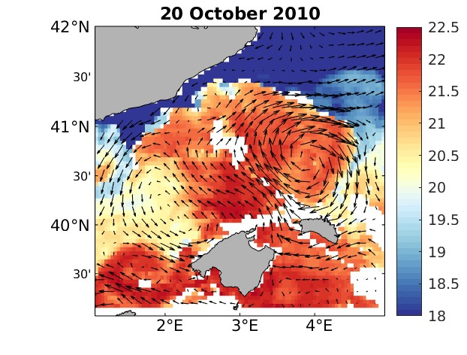
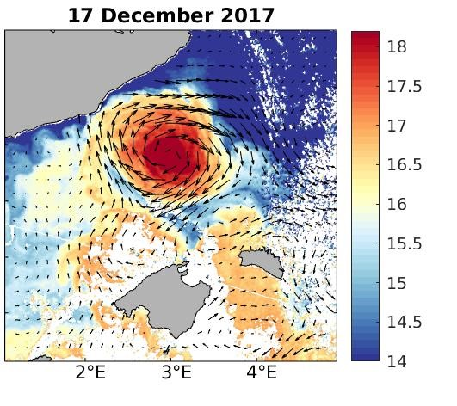

Figure 11–Sea surface temperature and associated geostrophic currents from satellite data on 20 October of 2010 and 15 December of 2017.

Slide 14
Appendix A: results of the sensitivity experiments carried out from July to December of 2010 and 2017 to evaluate the effect of the main forcings on eddy generation and intensification. The maps show the monthly-averaged SSH and their corresponding geostrophic velocities. Blue contours indicates the signature of the eddy by means of the OW values lower than the threshold (OWo) and within a radius of 0.2 º from the eddy center. Black square denotes the area of eddy generation reported in Figure1
A.0 Reference years: simulations without any modification
A.1 Configuration #1: simulations forced using climatological winds
A.2 Configuration #2: simulations forced using homogeneous temperature
A.3 Configuration #3: simulations forced using homogeneous salinity
A.4 Configuration #4: simulation 2017 forced using climatological winds and homogeneous salinity

