Slide 1



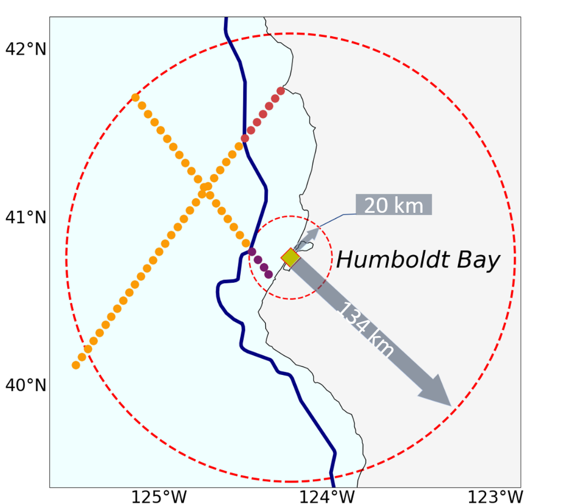
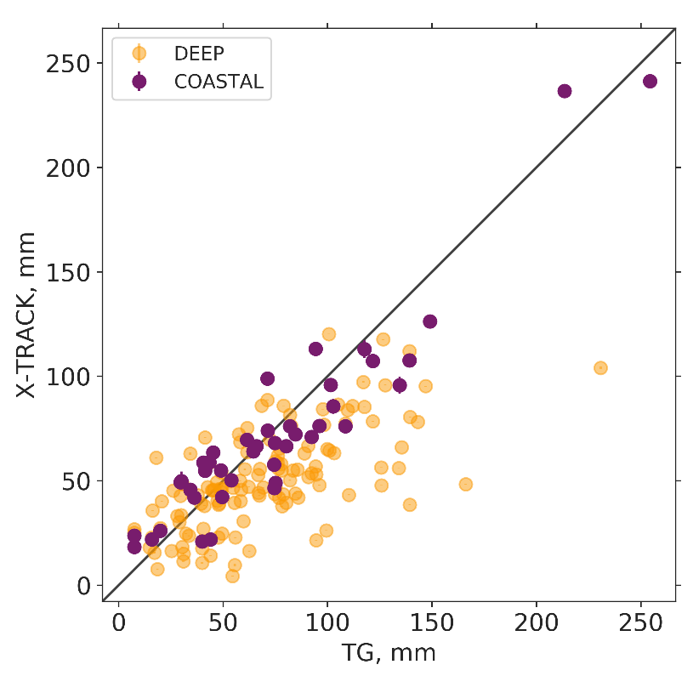
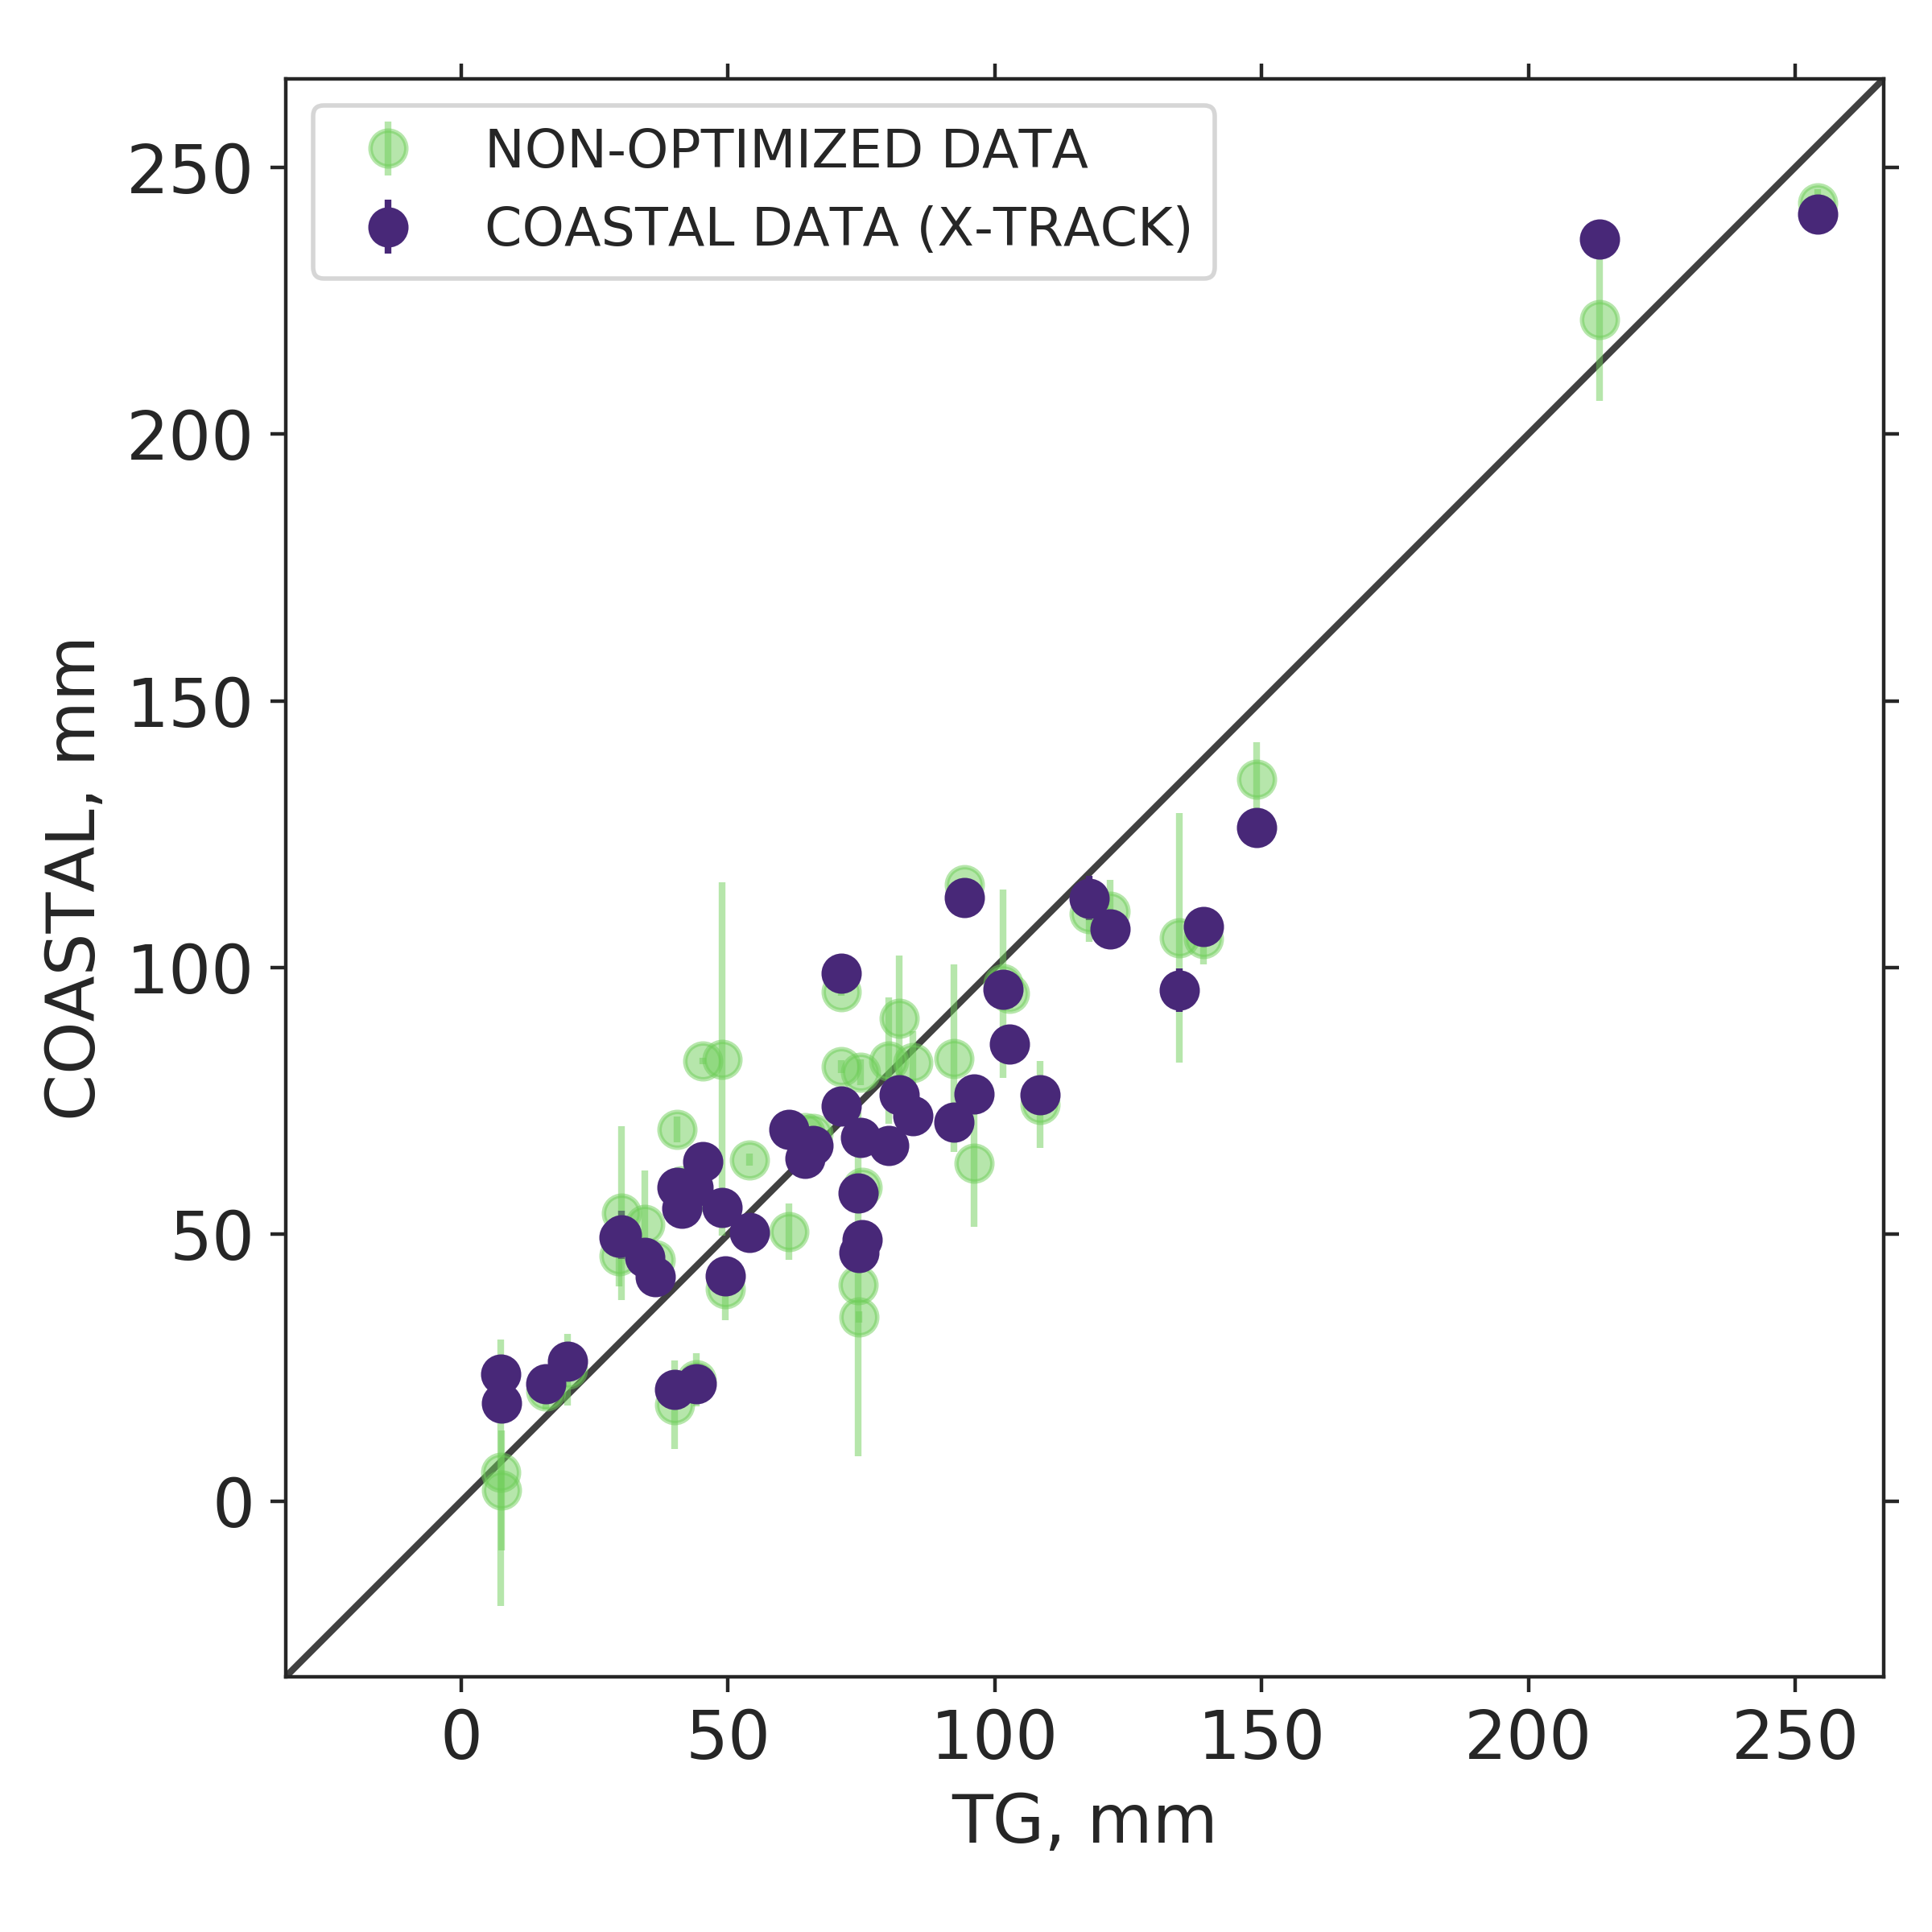
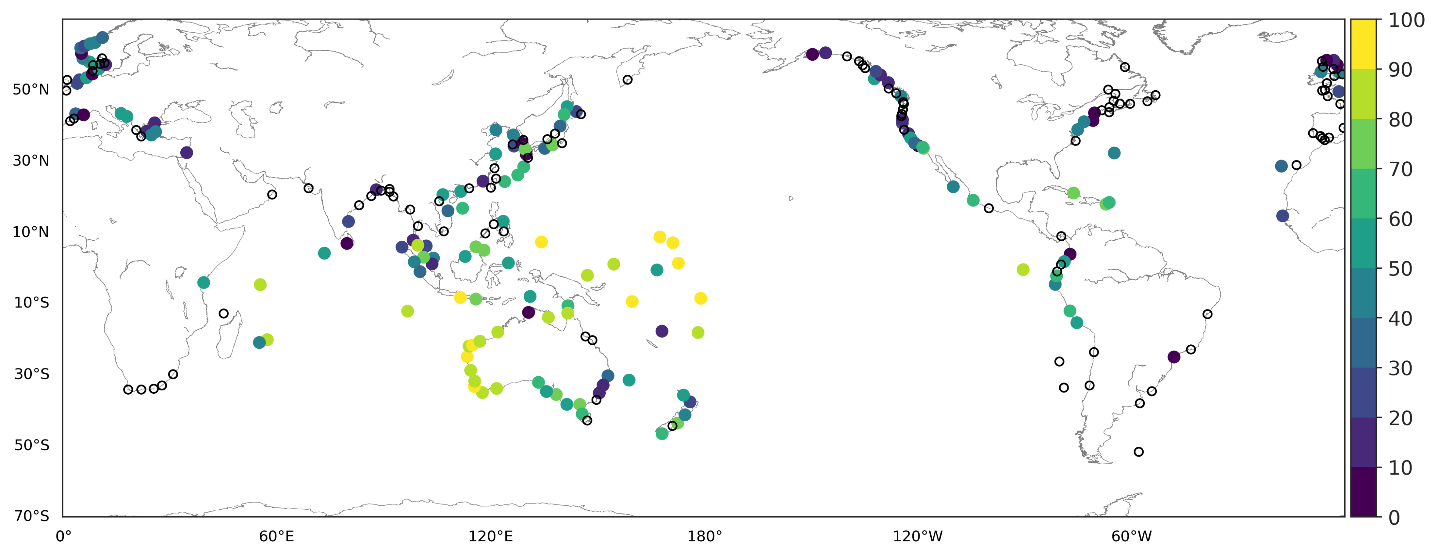
Annual and inter-annual sea-level variability from coastal altimetry and tide gauge data
Anara Kudabayeva¹, Michael Schindelegger¹, Rui M. Ponte² , Bernd Uebbing¹
¹ Institute of Geodesy and Geoinformation, University of Bonn, Germany
² Atmospheric and Environmental Research, Lexington, MA, USA
Synopsis
◄ ① Example of Humboldt Bay tide gauge station and spatial averaging of nearby along-track altimetry data: “coastal” includes altimetry observations within a 20-km radius, and points inside the big red circle (radius of 134 km) are split into „shallow“ and „deep“ categories relative to the 200-m isobath
We revisit earlier attempts of connecting tide gauge (TG) and altimetry observations of low-frequency sea-level changes across the coastal zone (Vinogradov & Ponte 2011)[1]
Of interest are (i) short spatial-scale structures, and (ii) benefits of using a coastal altimetry product (X-TRACK) over non-optimized multi-mission along-track data*
The annual cycle is chosen as first benchmark (see Figure 2 and Table), spatial averaging is performed in three categories
200 m
Deep
Shallow
Coastal
(a)
(b)
▲ ② Scatter plots of mean annual sea-level amplitudes at TG vs. average (a) coastal (violet) and deep (yellow) X-TRACK values;
(b) coastal X-TRACK (blue) and non-optimized altimetry (green).
*Integrated Multi-Mission Ocean Altimeter Data for Climate Research Version 4.2
► ③ Percentage of variance of inter-annual variability in along-track coastal altimetry (X-TRACK) explained by TGs (134-km radius = “deep”)
Category | No. TG | RMS difference (cm)
 |  | X-TRACK | Non-optimized data
Coastal | 42 | 1.86 | 2.26
Shallow | 187 | 2.4 | 2.6
Deep | 132 | 3.1 | 3.1
Contact: Anara Kudabayeva, * s7ankuda@uni-bonn.de
[1] Vinogradov, S. V., and Ponte, R. M. (2011). Low-frequency variability in coastal sea level from tide gauges and altimetry. J. Geophys. Res., 116(C7)

