Slide 1
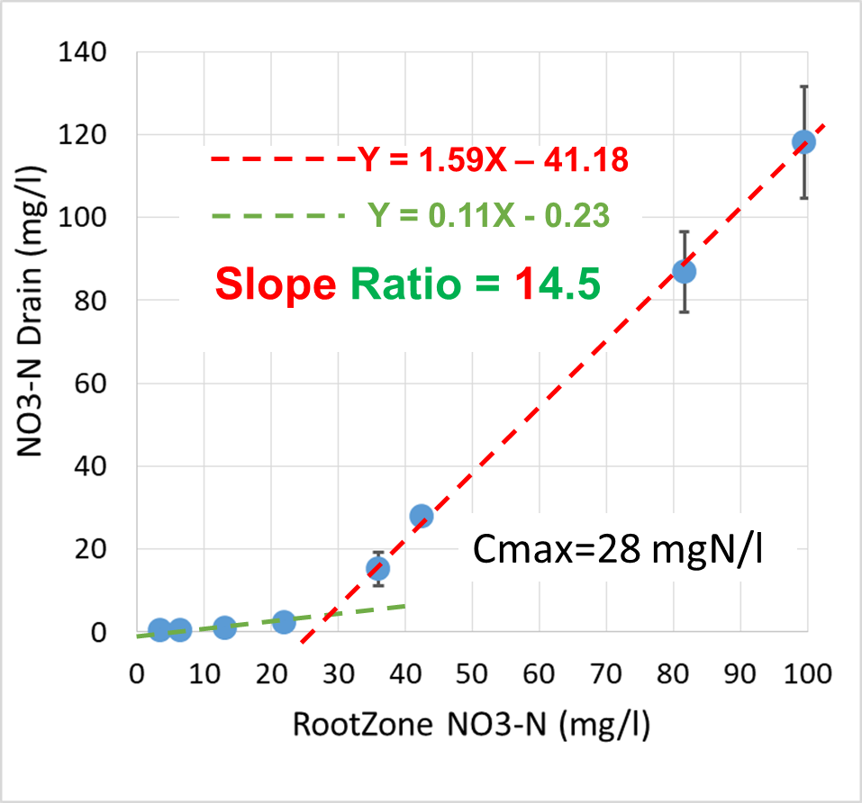
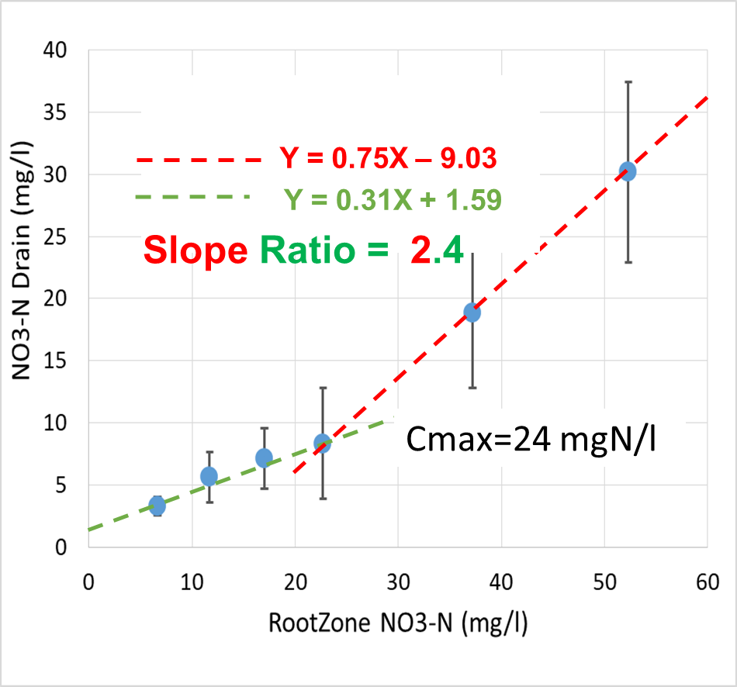
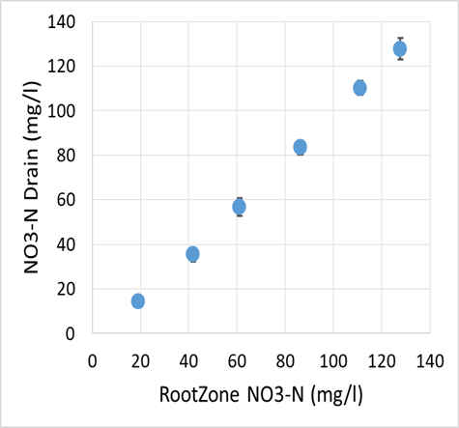
Reducing leaching using the threshold nitrate root-uptake phenomenon. Kurtzman, Kanner, Levy, Nitzan & Bar-Tal
SoluteUptake(x,t) = S(x,t) * Minimum[C(x,t), Cmax]; Šimůnek and Hopmans, 2009
Summer Crop, low leaching fraction – Robust Threshold
Winter Crop, high leaching fraction – Week Threshold
Short Season Crop, high
leaching fraction – No Threshold
Corn
Potato
Lettuce
In 5 crops Cmax calculated from experiments and models 20 – 45 mgNO3-N/l
Kurtzman et al., 2013; Levy et al., 2017; Kurtzman et al., 2021

