Slide 1
Gross rates of soil N₂O emission and uptake and denitrification gene abundance in temperate cropland agroforestry and monoculture systems
Jie Luo¹, Lukas Beule², Guodong Shao¹, Edzo Veldkamp¹, Marife D. Corre¹
¹Soil Science of Tropical and Subtropical Ecosystems, Faculty of Forest Sciences and Forest Ecology, University of Goettingen, Germany
²Molecular Phytopathology and Mycotoxin Research, Faculty of Agricultural Sciences, University of Goettingen, Germany

Slide 2
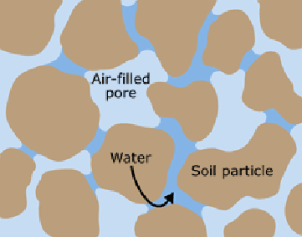
Introduction
Gross N₂O emission accounts for:
N₂O emitted from soil to atmosphere
N₂O reduced to N₂ within soil
Gross N₂O uptake accounts for both:
reduction of N₂O from atmosphere
reduction of N₂O within soil pores
Gross N₂O emission
N₂O
Atmosphere
Soil
N₂O
N₂
N₂
Interconnected soil air-filled pores
N₂O
N₂O
N₂
N₂O
N₂O
N₂O
N₂
N₂
Gross N₂O uptake

Slide 3
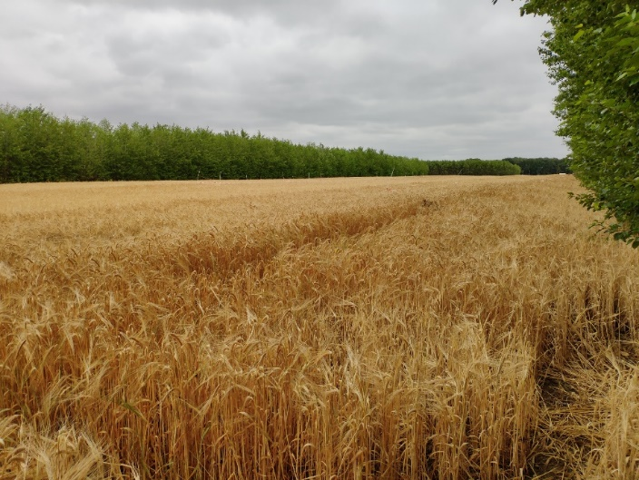
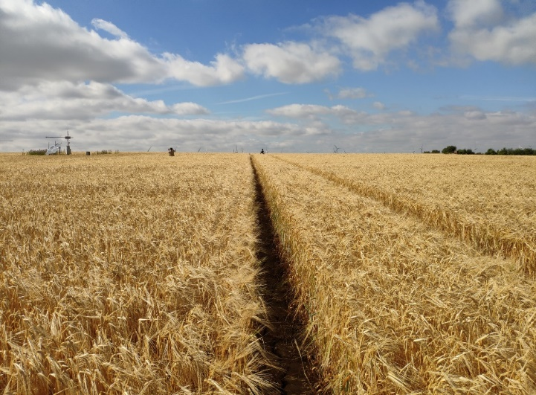
Introduction
Background:
No study systematically compares gross N₂O emission and uptake in agroforestry and monoculture systems
No information on seasonal variation of gross N₂O emission and uptake and that of denitrificaiton gene abundacne over one-year measurement in agroforestry and monoculture systems
A first study combined ¹⁵N₂O pool dilution with modern molecular techniques
Cropland agroforestry (AF)
Cropland monoculture (MC)
Objectives:
quantify gross N₂O emission and gross N₂O uptake in agroforestry and monoculture systems
assess the soil factors controlling gross N₂O fluxes in agroforestry and monoculture systems.

Slide 4
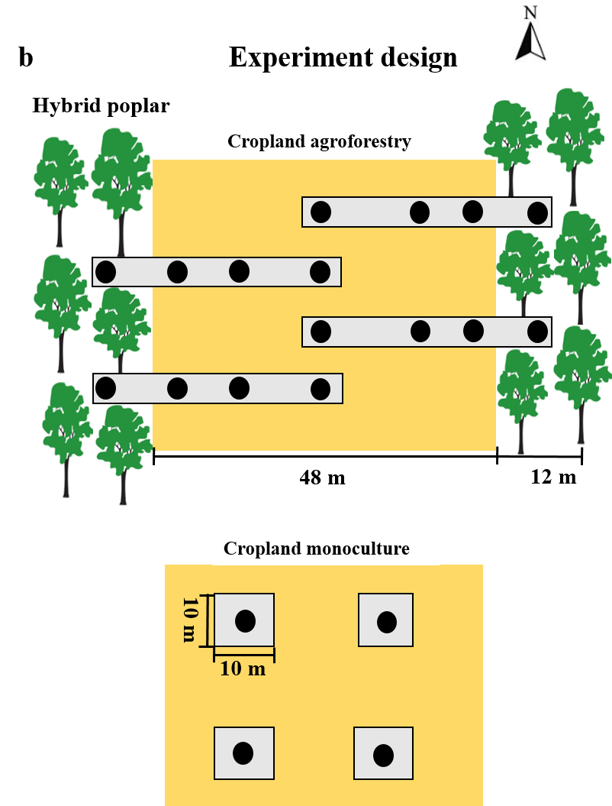
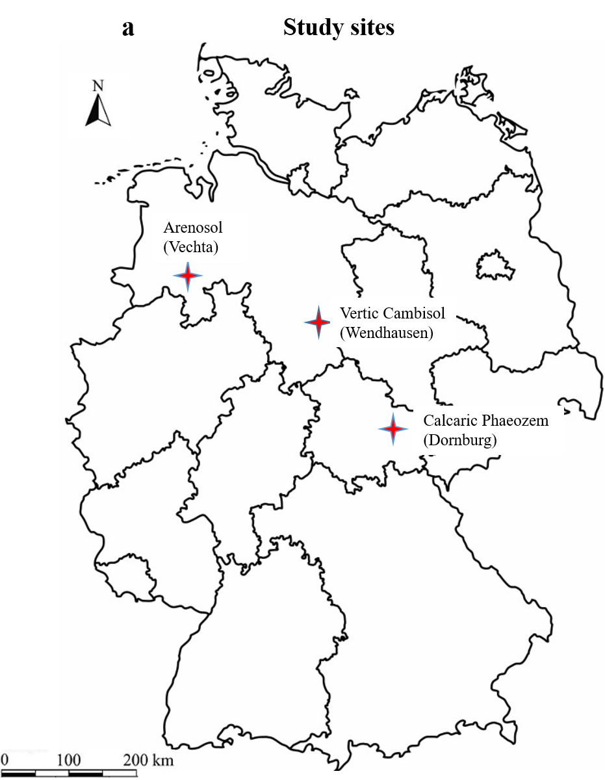
Methods
For cropland agroforestry:
4 replicate plots;
For each replicate plot:
4 sampling locations
(tree row, 1 m, 7 m, 24 m)
24 m
7 m
1 m
For cropland monoculture:
4 replicate plots
Notes:
This study was conducted at three sites in Germany, they were D&W&V. For soil type, D is Calcaric Phaeozem, W is Vertic Cambisol, and V is Arenosol. Hereafter, I would refer to these study sites by their soil types.
Dornburg and Wendhausen had paired cropland agroforestry and monoculture and Vechta was only cropland monoculture during the measurement period.
Each agroforestry system consisted of 12-m wide poplar rows and 48-m wide crop rows.
Each AF had four replicate plots, and for each replicate plot had 4 sampling locations: tree row, 1m, 7m,24m, from the tree row within the crop row. For MC, we also established 4 replicate plots.

Slide 5
Methods
Site description
Study site | Dornburg | Wendhausen | Vechta
Soil type | Calcaric Phaeozem | Vertic Cambisol | Arenosol
Mean annual air temperature (2010-2019) & (2018-2019) | 10.7 ± 0.3 ℃ 11.5 ± 0.1 ℃ | 10.7 ± 0.3 ℃ 11.5 ± 0.1 ℃ | 10.1 ± 0.1 ℃ 10.9 ± 0.1 ℃
Mean annual precipitation (2010-2019) & (2018-2019) | 567 ± 32 mm 450 ± 35 mm | 587 ± 41 mm 479 ± 99 mm | 643 ± 35 mm 577 ± 157 mm
Elevation (m above sea level) | 289 m | 82 m | 37 m
year of agroforestry system establishment | 2007 | 2008 | none
Harvest of the aboveground tree biomass of the agroforestry | January 2015 | January 2014 | none
Crop rotation (2018-2019) | winter wheat-summer barley | winter wheat-corn | rye-corn
Fertilization rates in 2018 & 2019 (kg N-P-K ha⁻¹ yr⁻¹) | 213 - 0 - 0 (2018) 36 - 22 - 31 (2019) | 166 - 0 – 116 (2018) 101 - 0 - 0 (2019) | 188 - 26 - 108 (2018) 153 - 54 - 62 (2019)

Slide 6
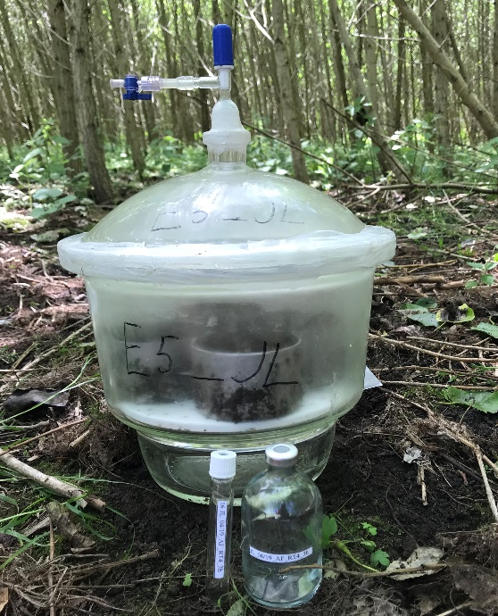
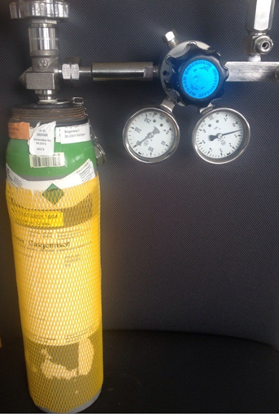
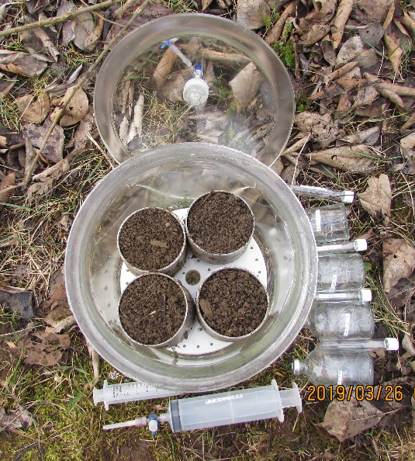
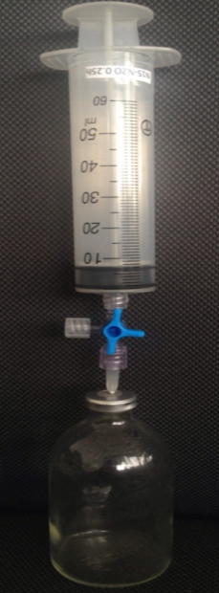
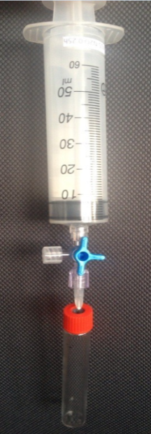
Methods
Measurement of gross N₂O emission and uptake ⸺¹⁵N₂O pool dilution method
¹⁵N₂O
2
7 ml labelled gas (¹⁵N-N₂O) is injected to increase ¹⁵N-enrichment to ~13.2 atom %
1
4 soil cores in a 6.6 L exiccator
100 ppmv of 98% ¹⁵N-N₂O, 344 ppbv SF₆ and synthetic air
3
Gas sampling at 0.5 h, 1 h, 2 h, and 3 h
23 ml gas for N₂O and SF₆ concentration
100 ml gas for ¹⁵N₂O atom %
Atmospheric N₂O concentration & natural abundance ¹⁵N₂O

Slide 7
Methods
Calculation of gross N₂O emission and uptake ⸺¹⁵N₂O pool dilution method
$$Net flux=E−U$$
Gross N₂O emission is measured by dilution of the ¹⁵N₂O label in the chamber headspace by ¹⁴N₂O production. ^{1, 2, 3}
$$Net flux=\frac{d[N_{2}O]}{dt}=E−k×{[N_{2}O]}_{t}$$
$$\frac{{d[}^{14}N_{2}O]}{dt}=F_{14}×E−\left(k_{14}+k_{l}\right)×[^{14}N_{2}O]_{t}$$
$$\frac{{d[}^{15}N_{2}O]}{dt}=F_{15}×E−\left(k_{15}+k_{l}\right)×[^{15}N_{2}O]_{t}$$
Gross N₂O uptake is determined from the decrease of ¹⁵N₂O tracer in the headspace, corrected by physical loss (SF₆) . ^{1, 2, 3}
$$U=\left(k14×\left[14N2O\right]\right)+(k15×[15N2O])$$
¹ von Fischer and Hedin, 2002; ² Yang et al., 2011; ³ Wen et al, 2017
Notes:
- Principle: gross N2O emission is measured by dilution of the ¹⁵N₂O label in the chamber headspace by ¹⁴N₂O production.
- how to address it. The changes in 14N2O and 15N2O concentrations in the chamber headspace during the incubation period can be modeled with the following equations:
Gross N₂O uptake is determined from the decrease of ¹⁵N₂O tracer in the headspace, corrected by physical loss.
We use this equation to calculate gross N2O uptake.

Slide 8
Methods
Area-weighted average for agroforestry as a whole:
𝐴𝑔𝑟𝑜𝑓𝑜𝑟𝑒𝑠𝑡𝑟𝑦 = (F_{𝑡𝑟𝑒𝑒} × $\frac{6}{30}$) + (F_{1𝑚} × $\frac{4}{30}$) + (F_{7𝑚} × $\frac{18}{30}$)+ (F_{24𝑚} × $\frac{2}{30}$)
𝐴𝑔𝑟𝑜𝑓𝑜𝑟𝑒𝑠𝑡𝑟𝑦 crop row = (F_{1𝑚} × $\frac{4}{24}$) + (F_{7𝑚} × $\frac{18}{24}$)+ (F_{24𝑚} × $\frac{2}{24}$)
F_{𝑡𝑟𝑒𝑒}, F_{1𝑚}, F_{7𝑚}, F_{24𝑚} represent gross N₂O fluxes in the tree row and crop row at 1m, 7 m, 24 m distance from the tree row, respectively

Slide 9
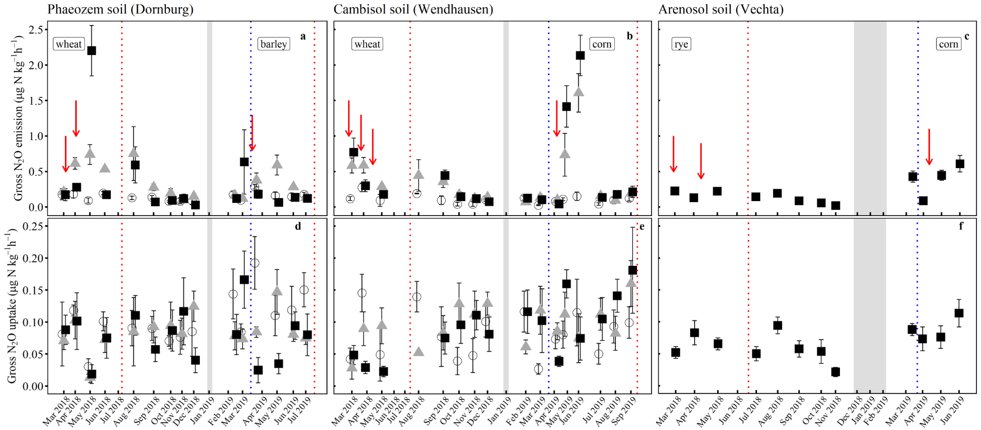
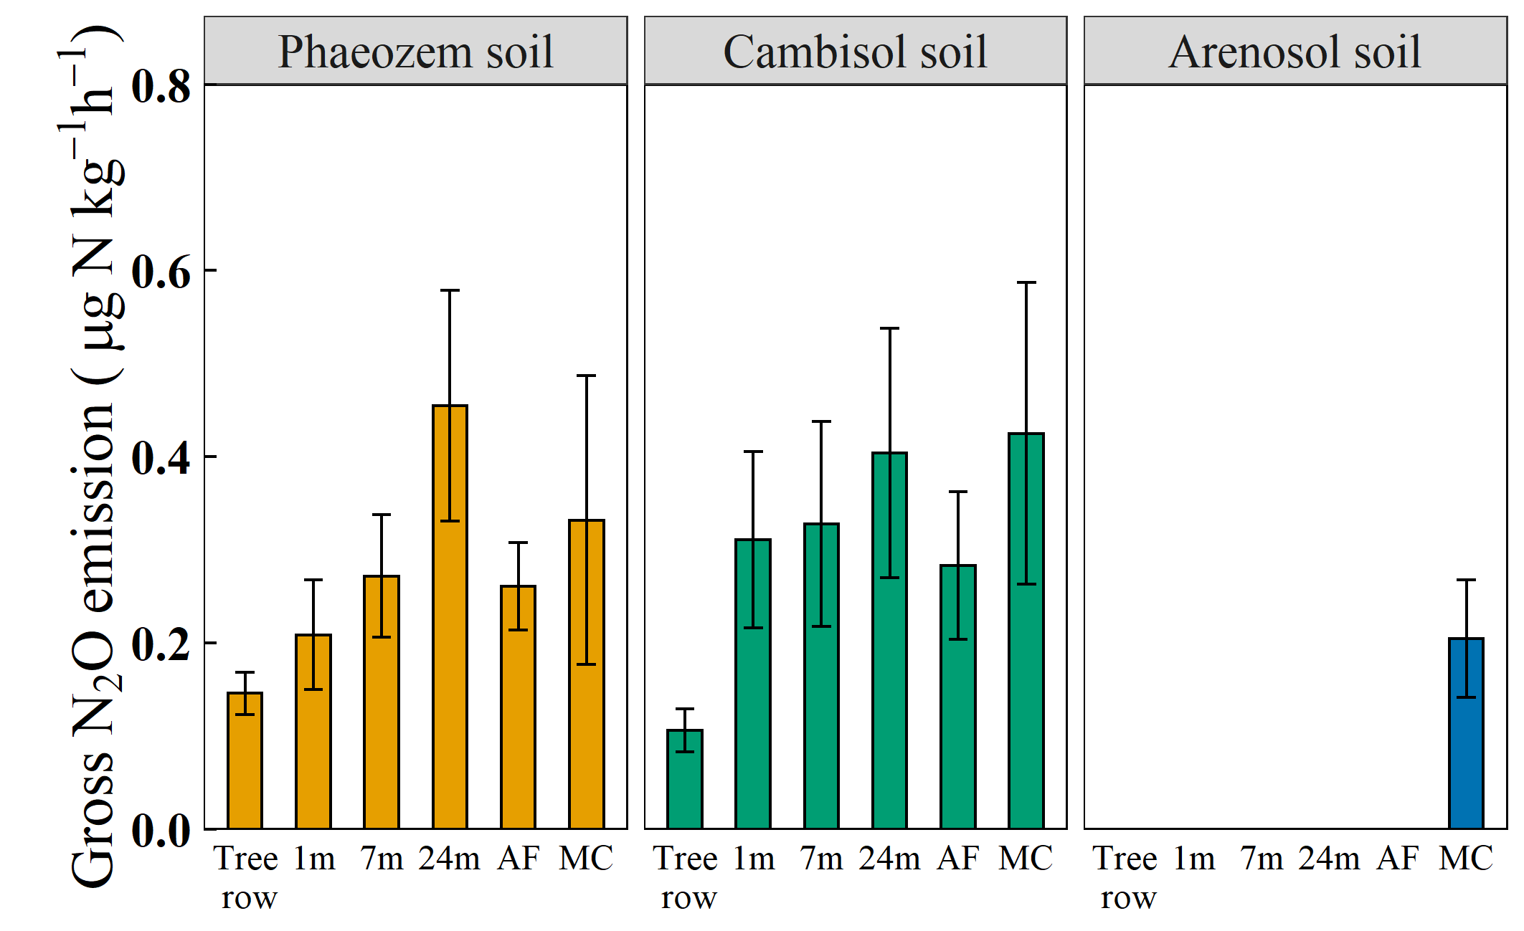
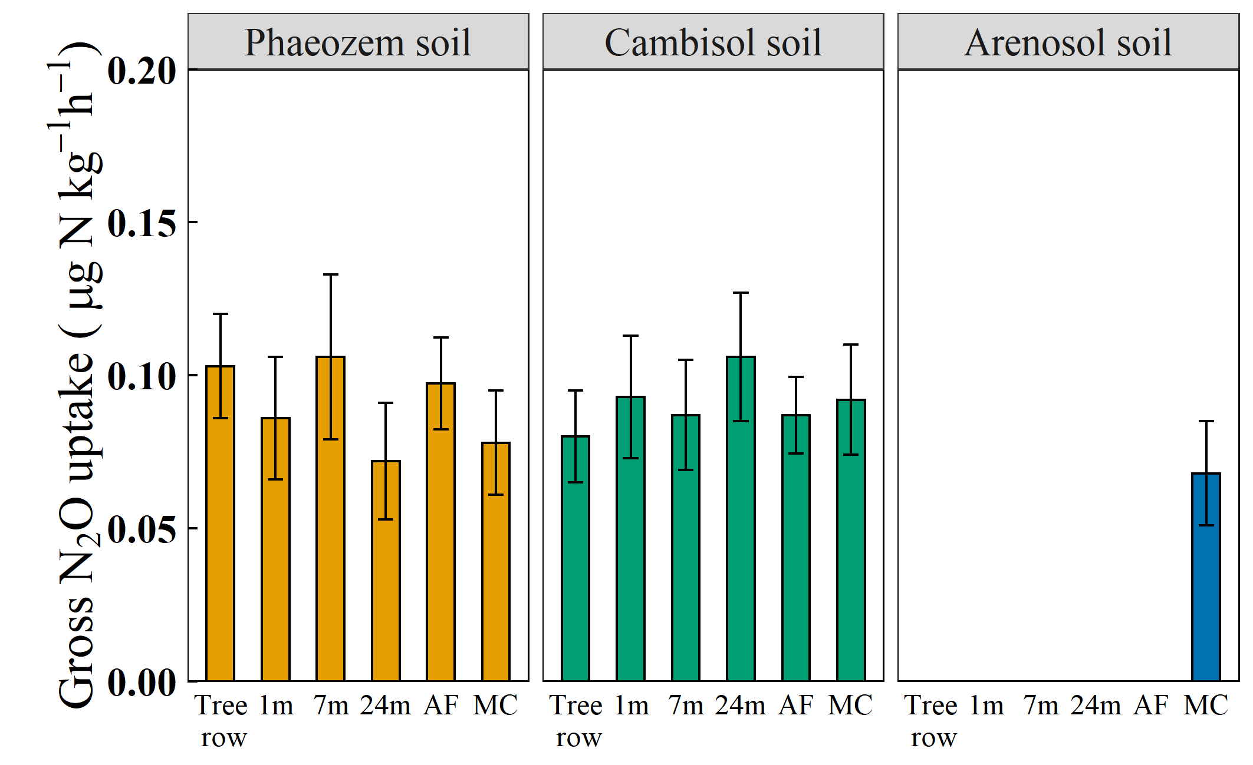
Results
○ tree row▲ crop row ■ MC
Peaks of gross N₂O emissions in crop rows of AF and MC corresponded to the periods of fertilization
Fertilization
Low mineral N in tree row
Low gross N₂O emissions in tree row
Gross N₂O emission: AF < MC
AF (24%) < MC
AF (36%) < MC
AF (25%) > MC
AF ≈ MC
a
A
A
Gross N₂O uptake: AF > MC
A
A
a
a
ab
ab
a
A
B
a
a
A
A
a
a
ab
ab
a
a
ab
b
a
Low N but high C availability in the tree row
b
b
b

Slide 10
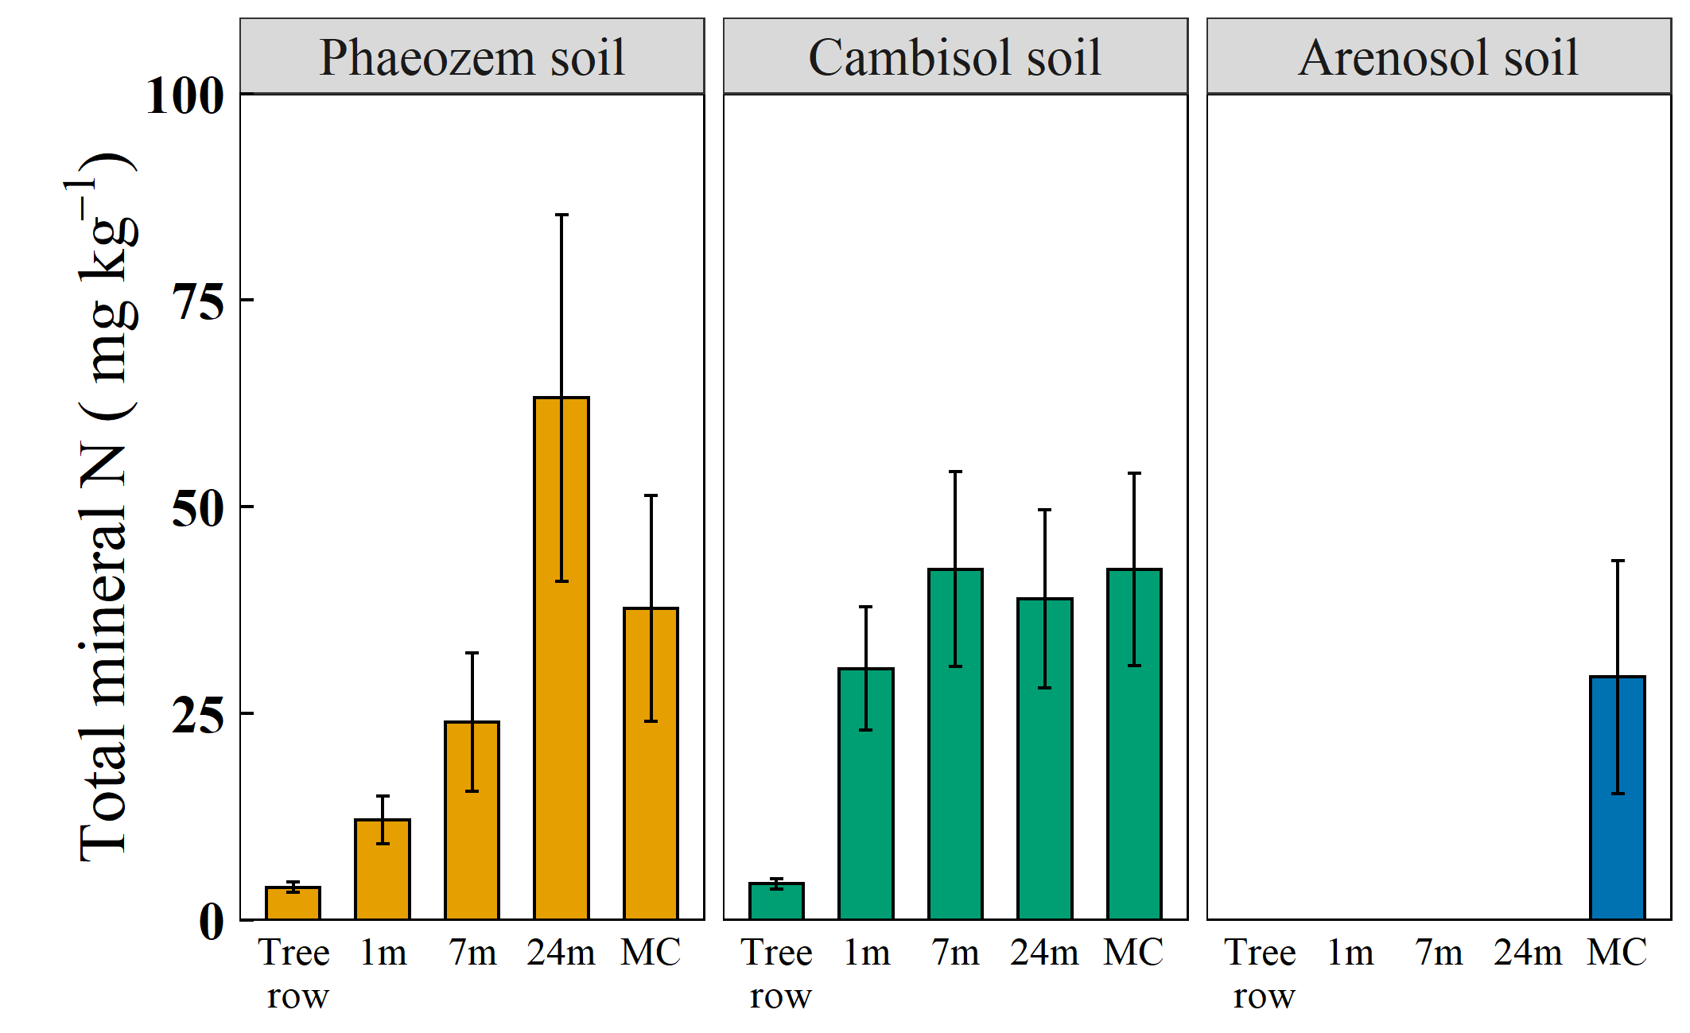
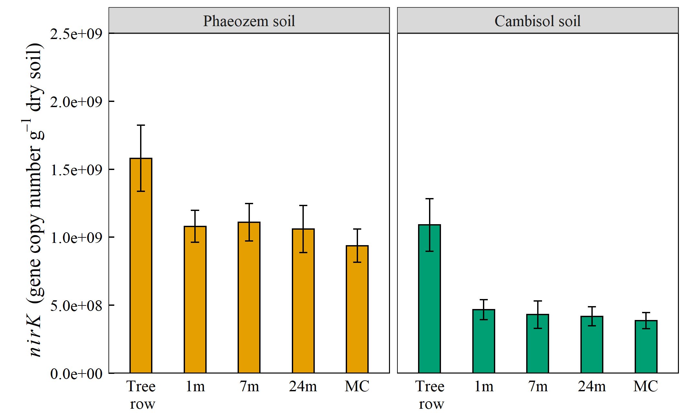
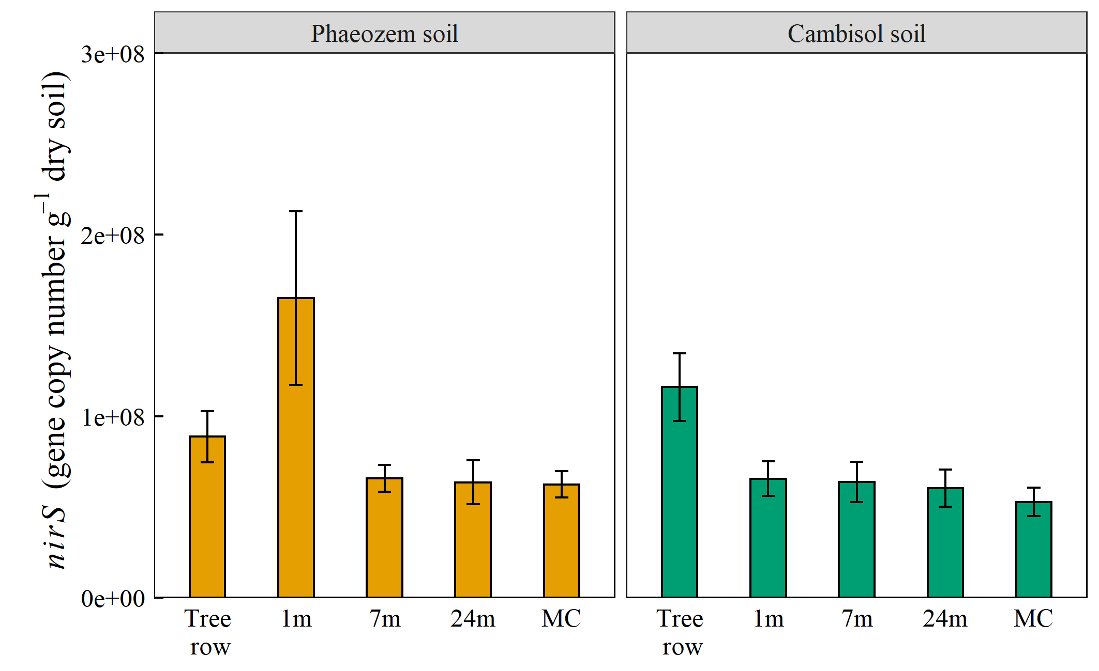
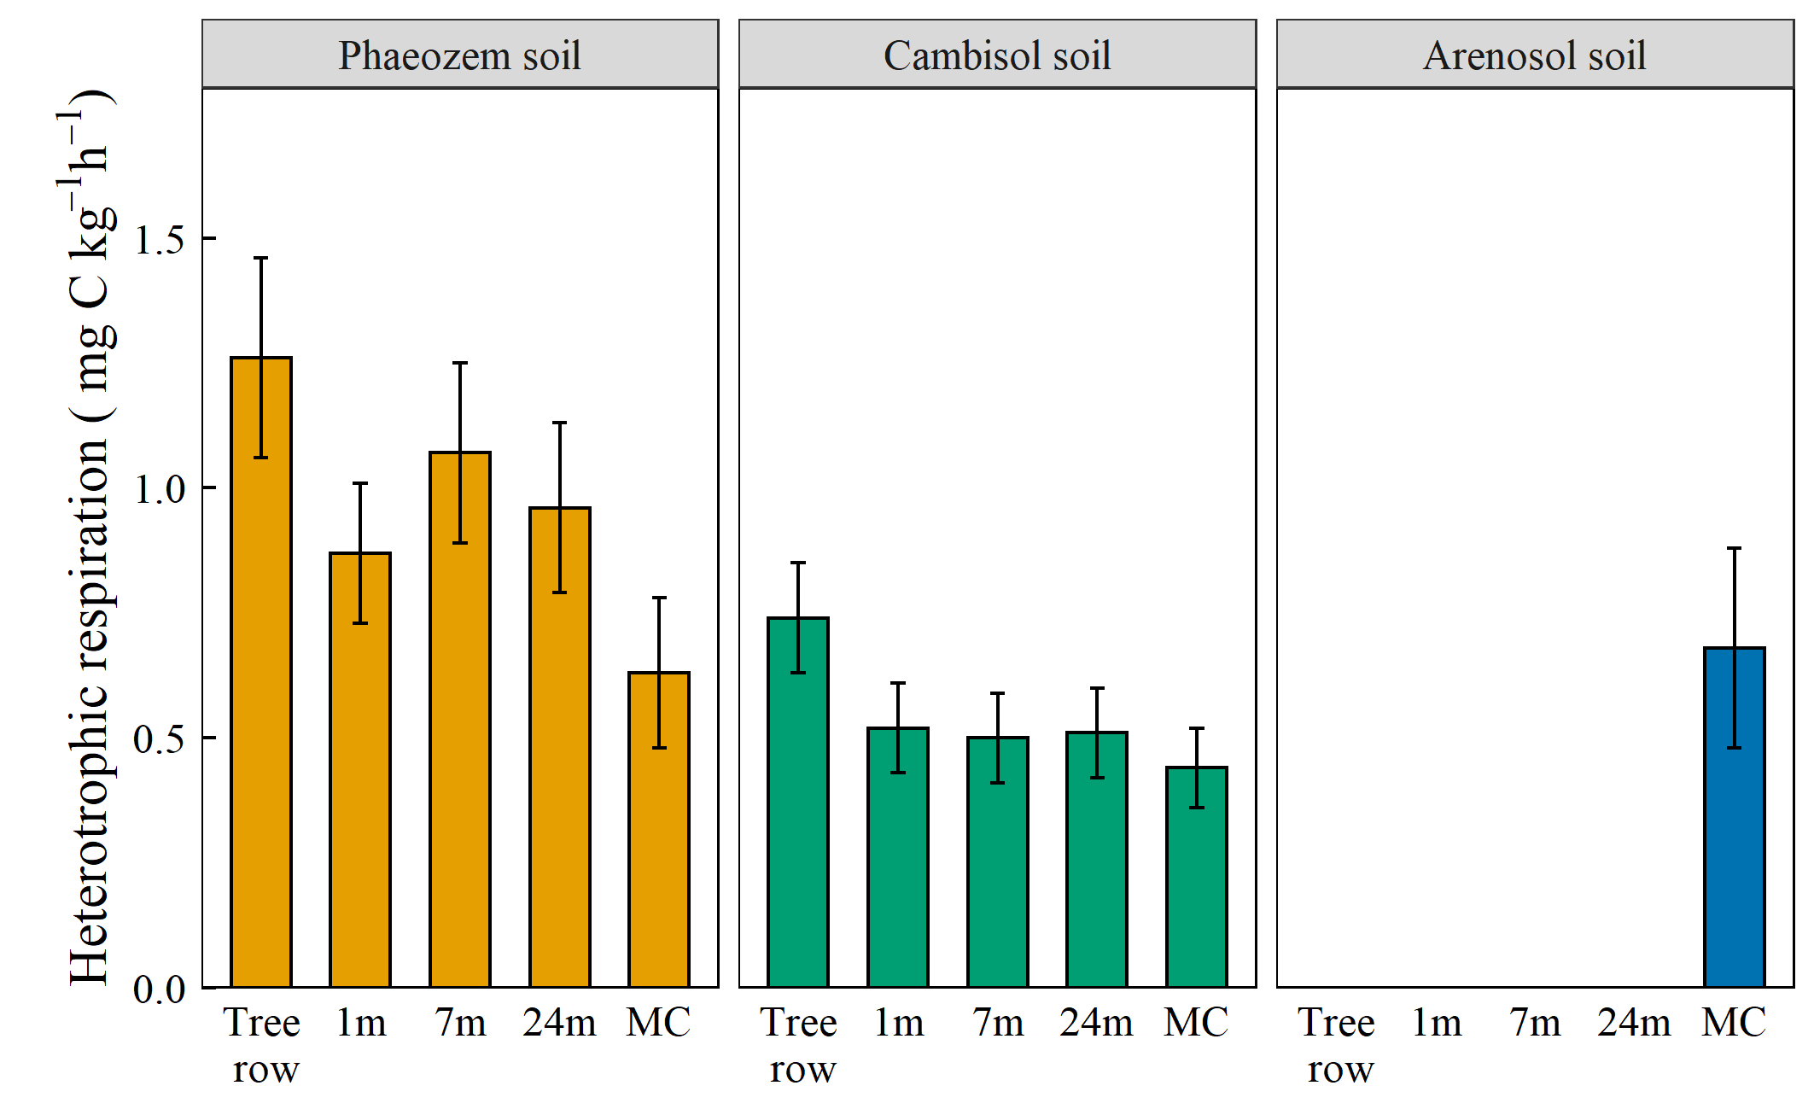
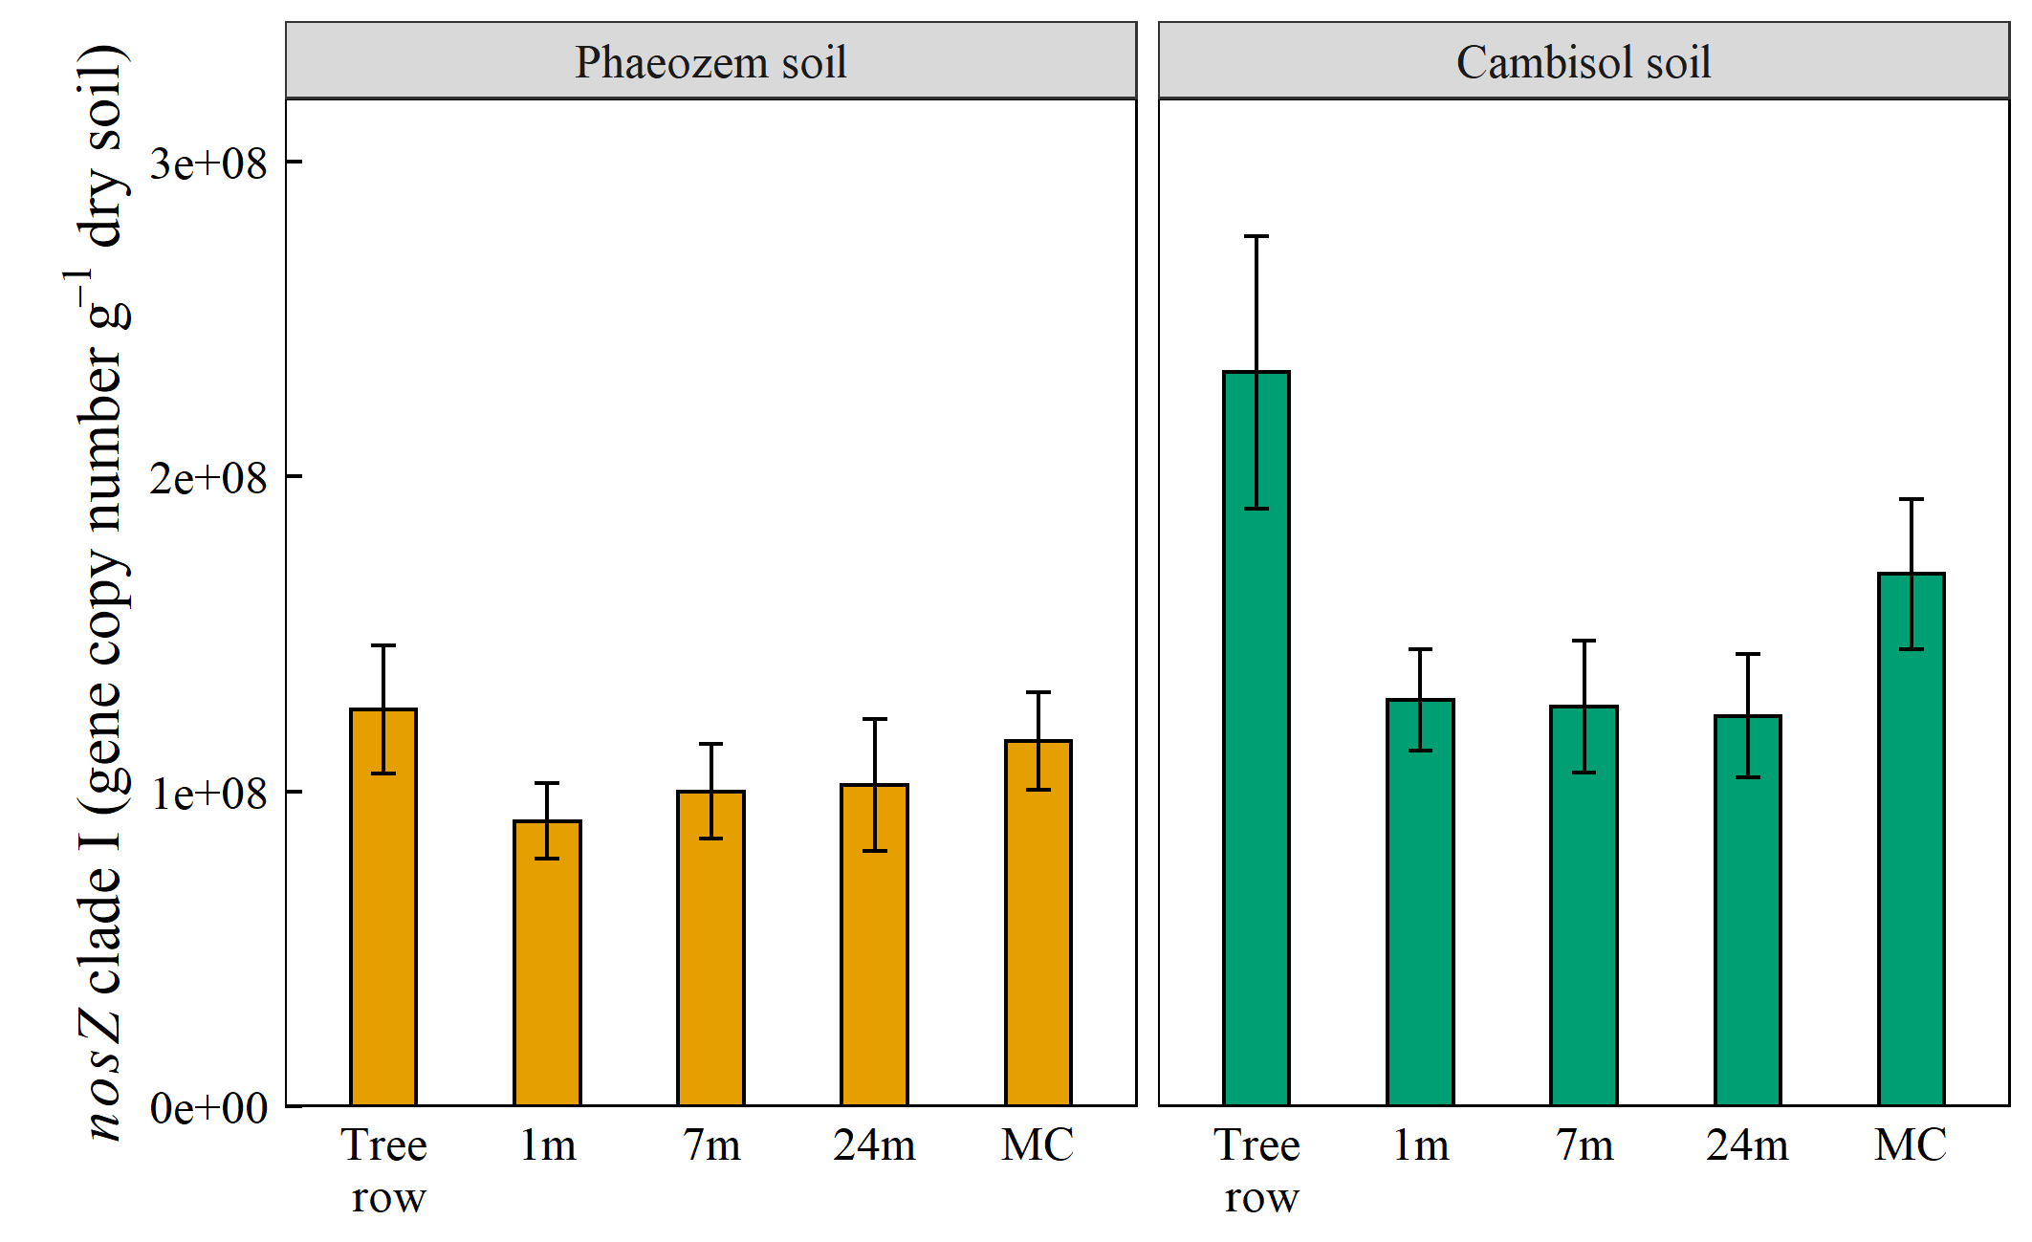
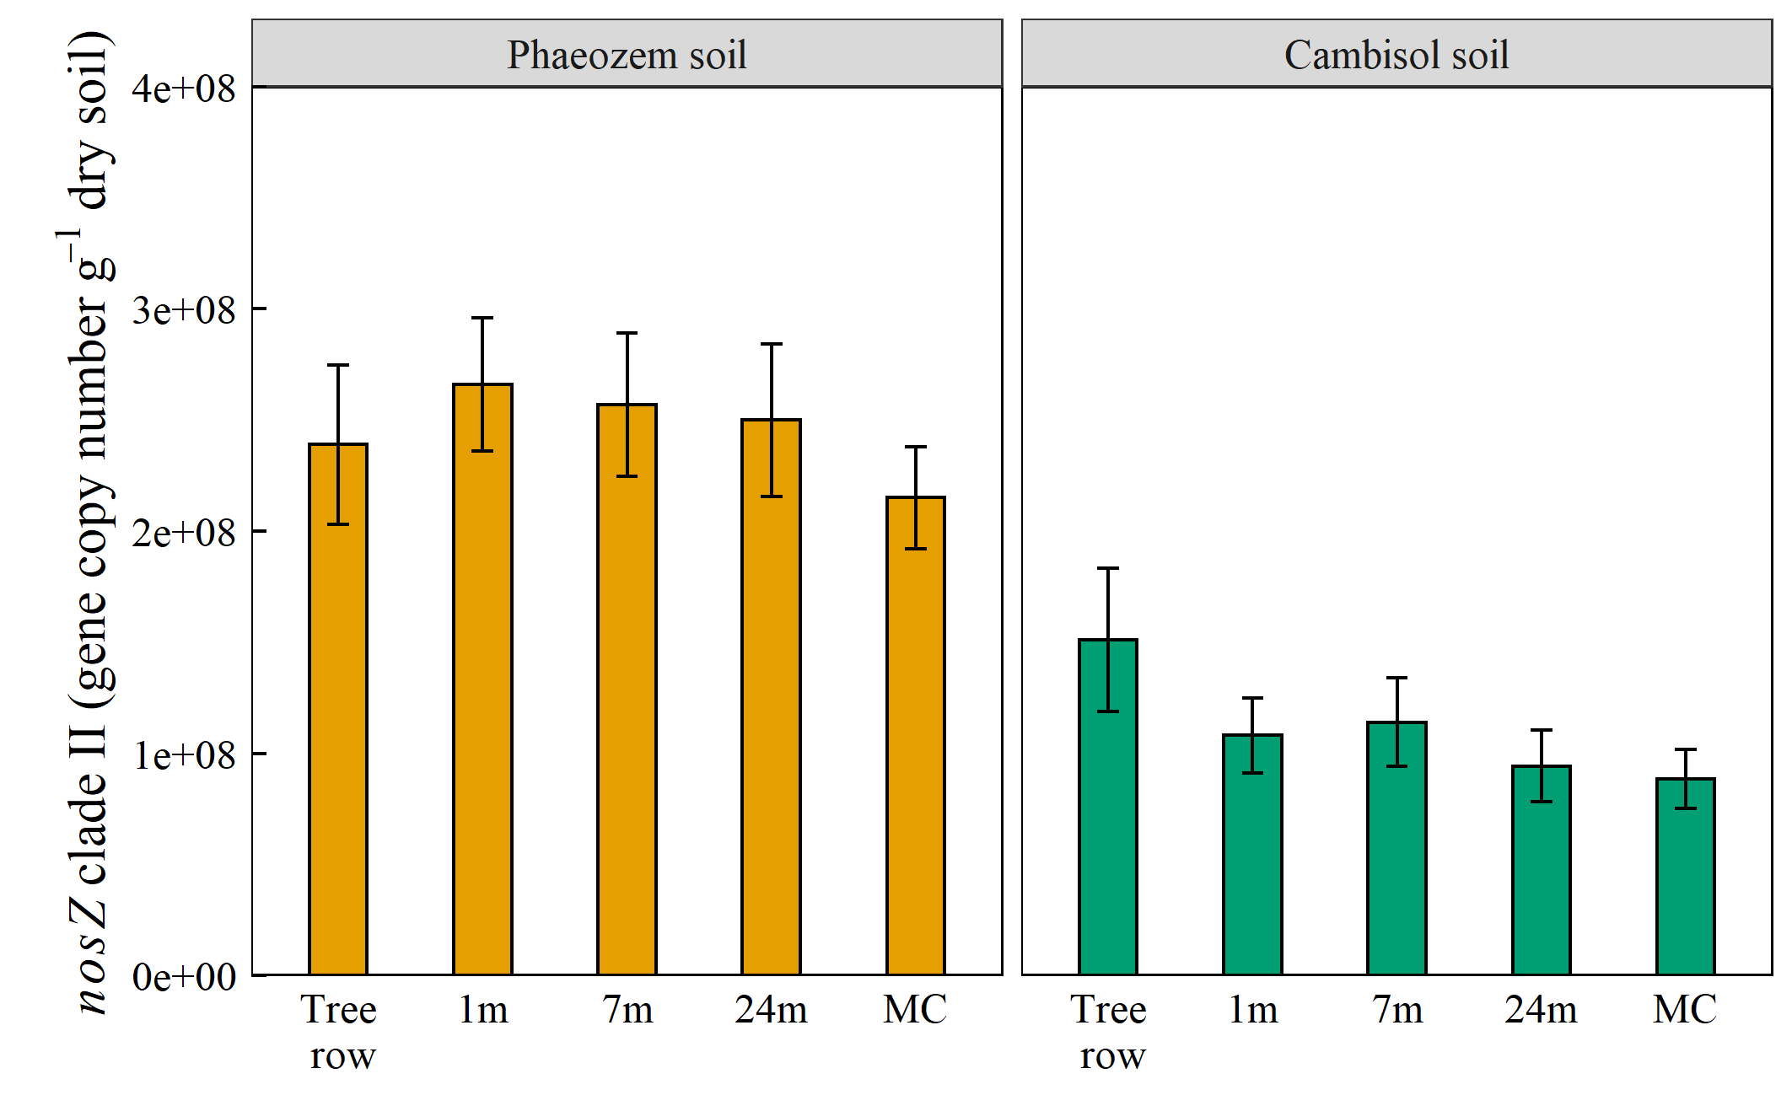
Results
a
a
a
ab
a
a
a
b
b
b
a
a
a
b
a
bc
b
b
b
ab
b
ab
b
b
b
b
c
b
d
b
Substrate availability
Denitrification gene abundance
a
a
ab
a
a
a
a
bc
ab
ab
a
c
a
a
bc
c
c
a
b
b
b
b
a
a
a
a
a
a
a
a
Management systems | n | Regression equations | P value | R²
Agroforestry (AF) | 124 | Gross N₂O emission = 0.004 × total mineral N + 0.132 × heterotrophic respiration + 0.072 | < 0.001 | 0.32
Tree row | 31 | Gross N₂O emission = 0.017 × total mineral N + 0.056 | 0.002 | 0.28
Crop row | 93 | Gross N₂O emission = 0.004 × total mineral N + 0.009 × WFPS – 0.159 | < 0.001 | 0.26
Monoculture (MC) | 43 | Gross N₂O emission = 0.006 × total mineral N + 0.019 × WFPS + 0.271 × heterotrophic respiration – 0.677 | < 0.001 | 0.49
N and C availability and WFPS rather than denitrifier gene abundance controlled gross N₂O emissions in AF and MC systems

Slide 11
Conclusion
Agroforestry systems can decrease gross N₂O emission and increase gross N₂O uptake relative to cropland monocultures
These reductions and increases were mainly through unfertilized tree rows that regulated C, N availability, and WFPS while denitrifier abundance was not a limiting factor for gross N₂O fluxes
The predominant control of mineral N on gross N₂O emissions across agroforestry and monoculture systems reflected the practical importance of reducing gross N₂O emissions through the unfertilized tree rows
The reduction of gross N₂O emission and the increase of gross N₂O uptake in agroforestry system should be considered into the economic and ecological evaluation to support its policy implementation.

Slide 12
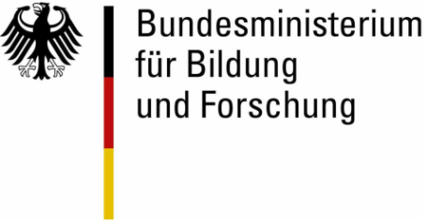
Other studies in our project:
Session BG3.19 – Exchange of GHG and reactive gases in agricultural ecosystems
EGU21-2553
Soil N₂O emissions from temperate cropland agroforestry and monoculture systems by Guodong Shao et al.
Session SSS9.7 - 'Impact of conventional agriculture and organic farming on soil functions‘
EGU21-10463 Soil-N cycling in temperate alley cropping agroforestry and monoculture croplands by Xenia Bischel et al.
Thanks for your attention!
Notes:
12

