Slide 1
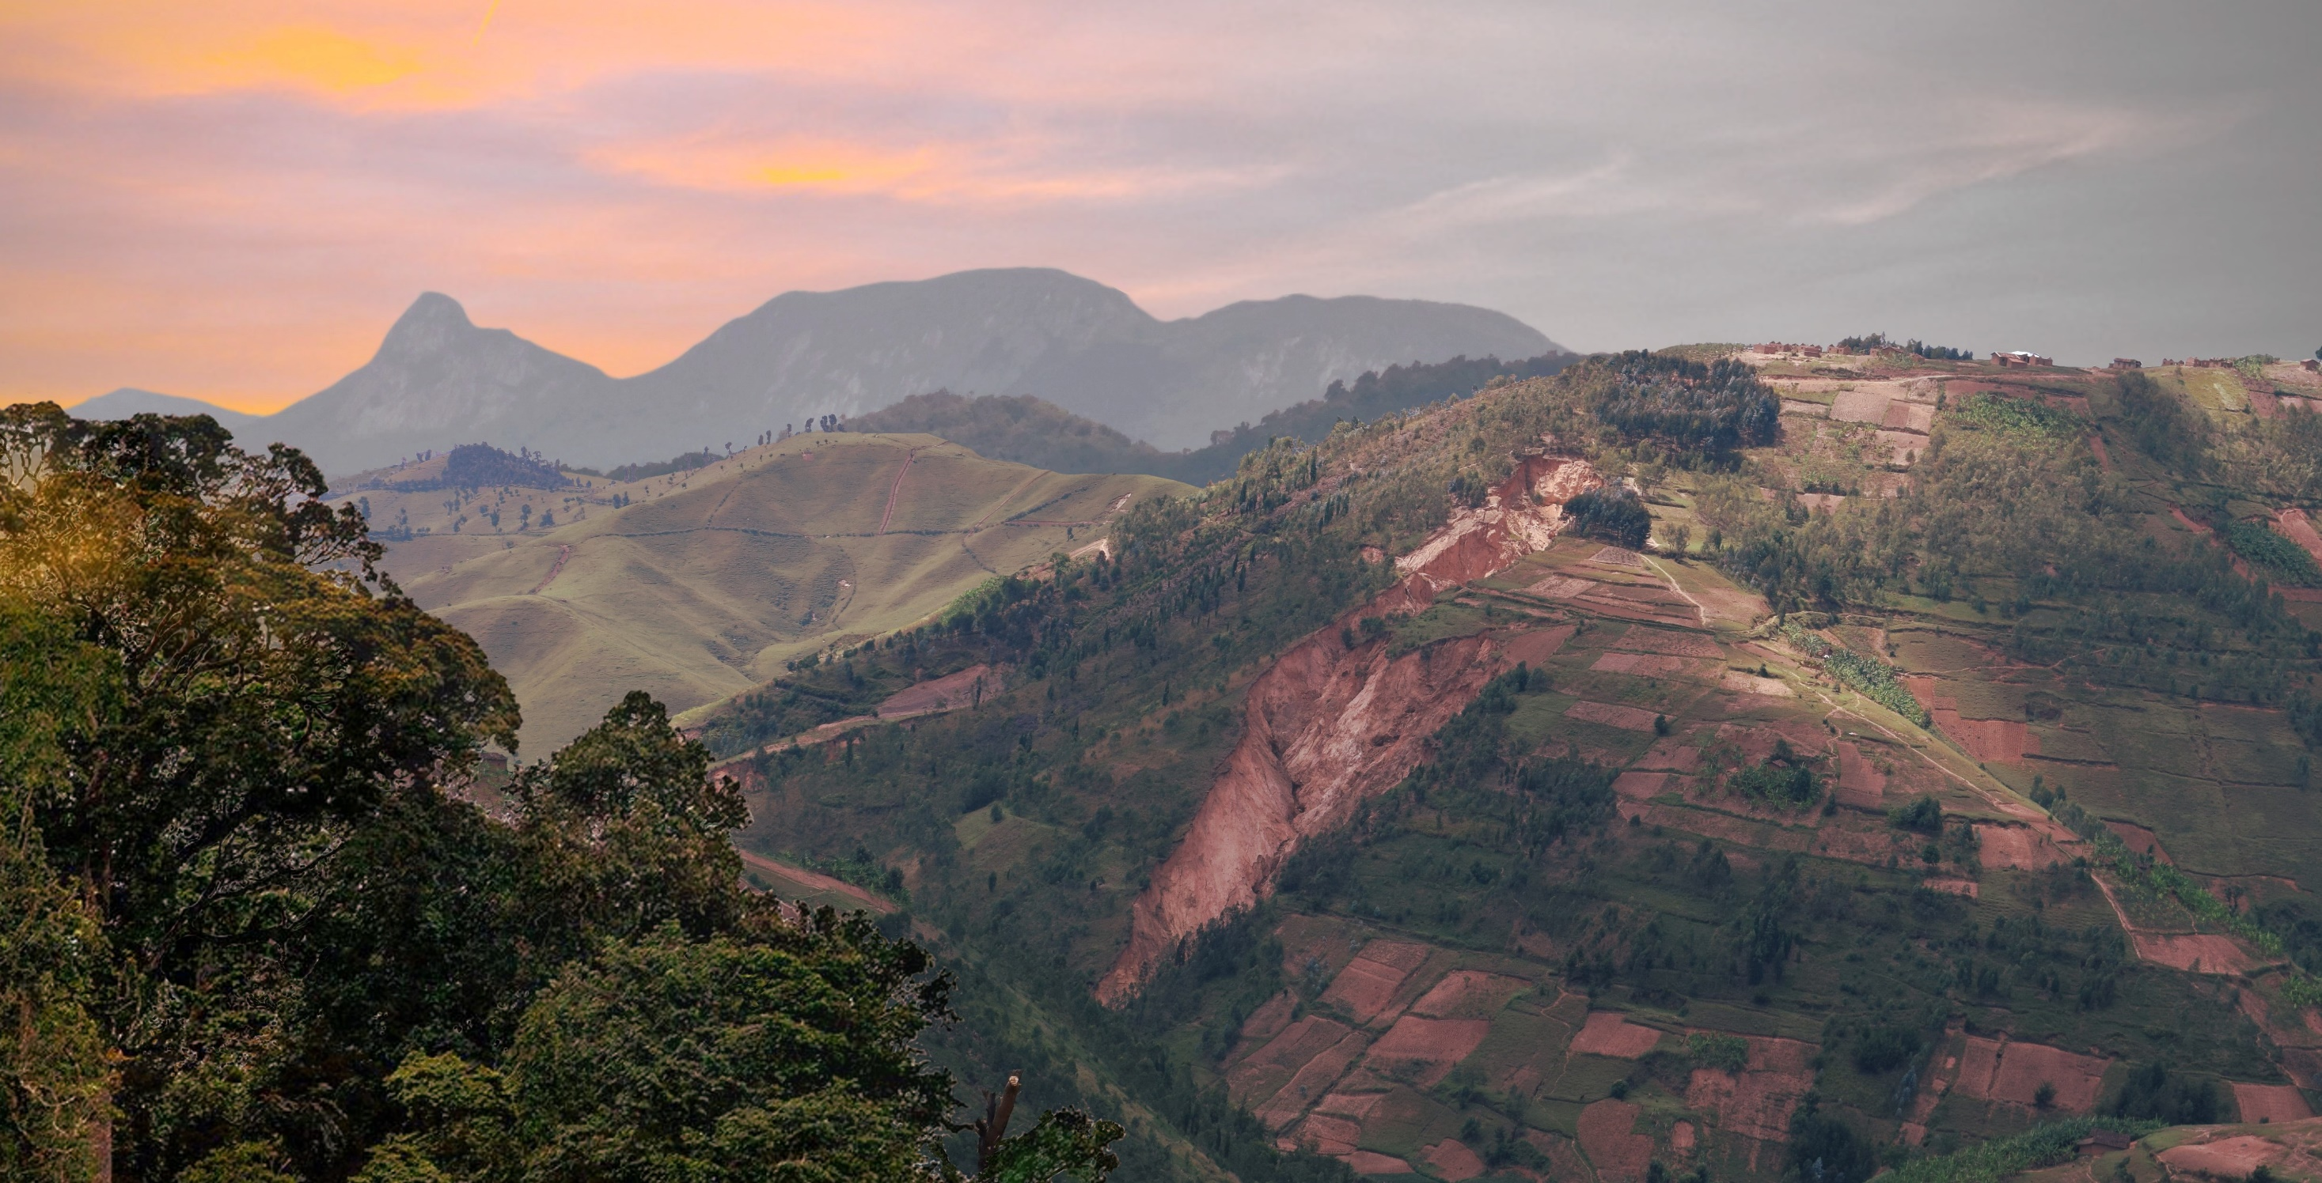






Landslide risk trends in the Kivu Rift and the impact of environmental and societal dynamics
Arthur Depicker¹, Liesbet Jacobs, Nicholus Mboga, Benoît Smets, Anton Van Rompaey, Moritz Lennert, François Kervyn, Caroline Michellier, Olivier Dewitte, and Gerard Govers
¹ arthur.depicker@kuleuven.be
>> START <<

Slide 2
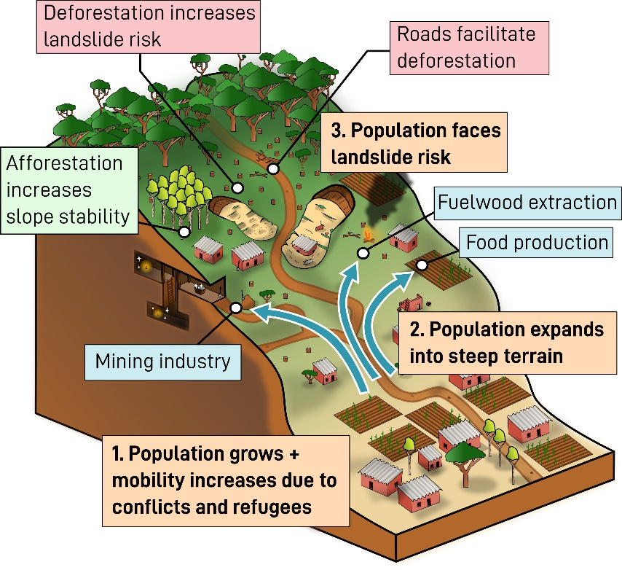
Main Menu
Overview of the Kivu Rift
Reconstruct forest cover changes 1958-2016
Link forest cover changes to landslide susceptibility
Link landslide susceptibility to hazard
Risk = hazard x exposure x vulnerability
Conclusion
Click on this figure to get more information!

Slide 3
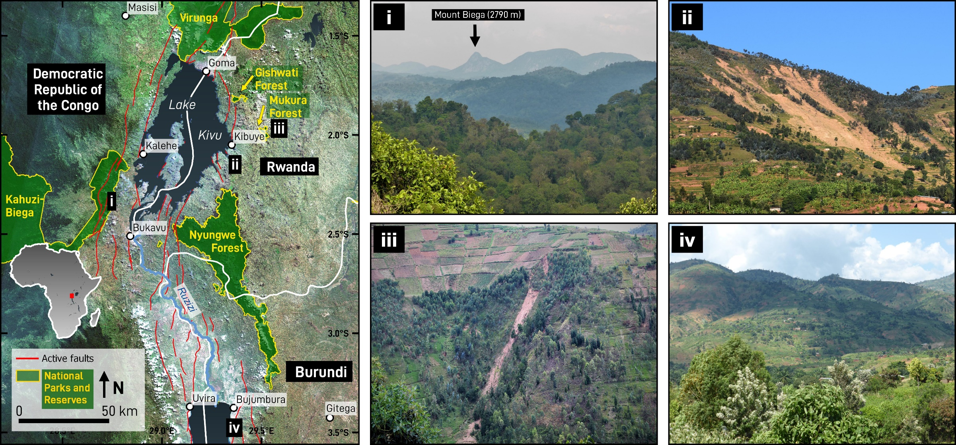
Kivu Rift
Main menu

Slide 4
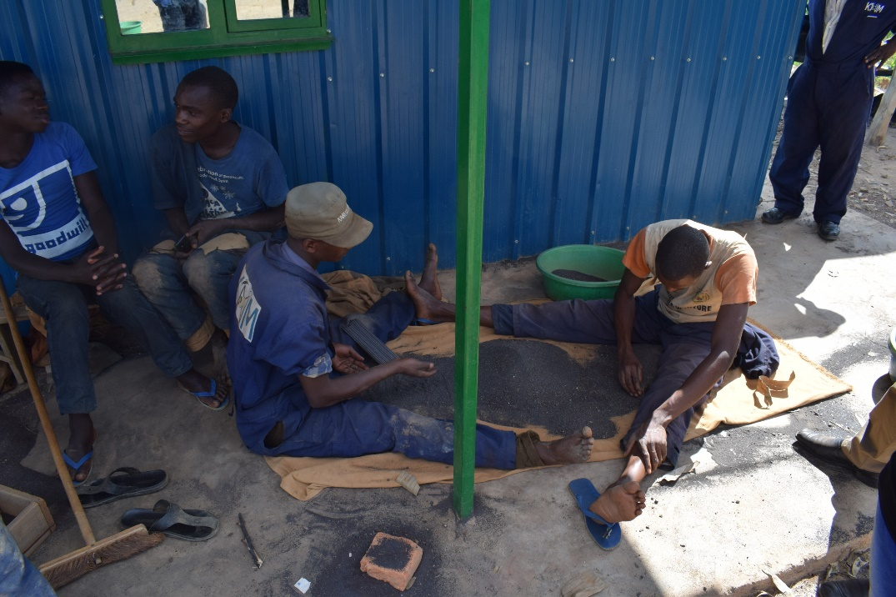
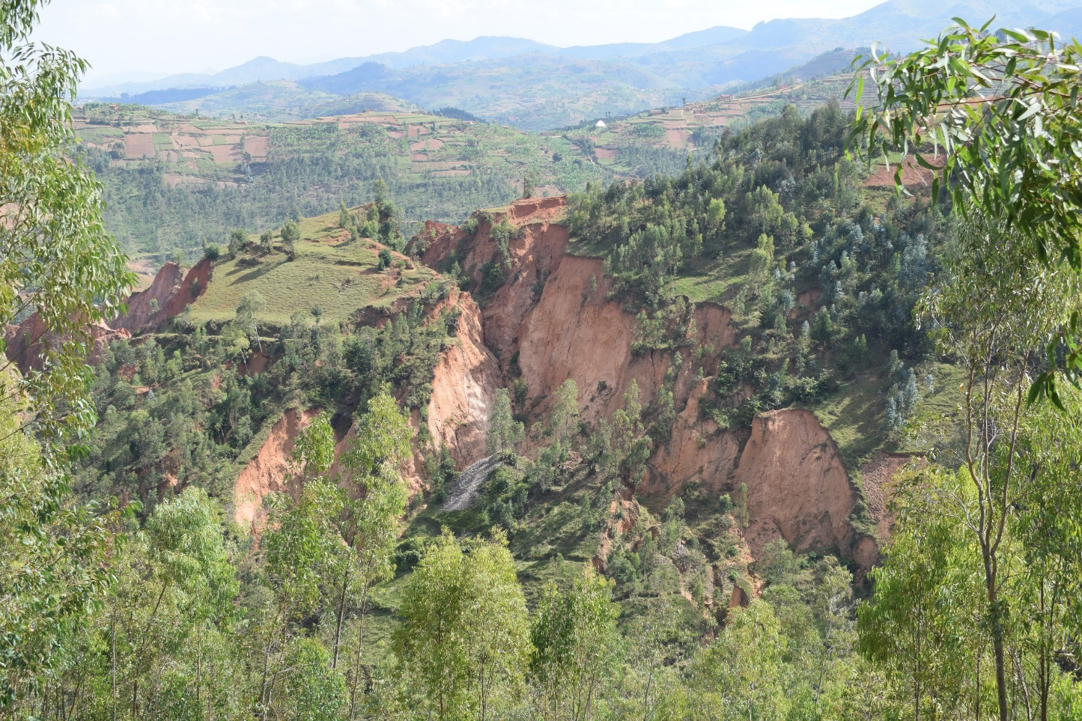
Mining industry
Gold
3T minerals
  Tin
  Tantalum
  Tungsten
Boom during 90s
Coltan mine in Western Rwanda
Main menu

Slide 5
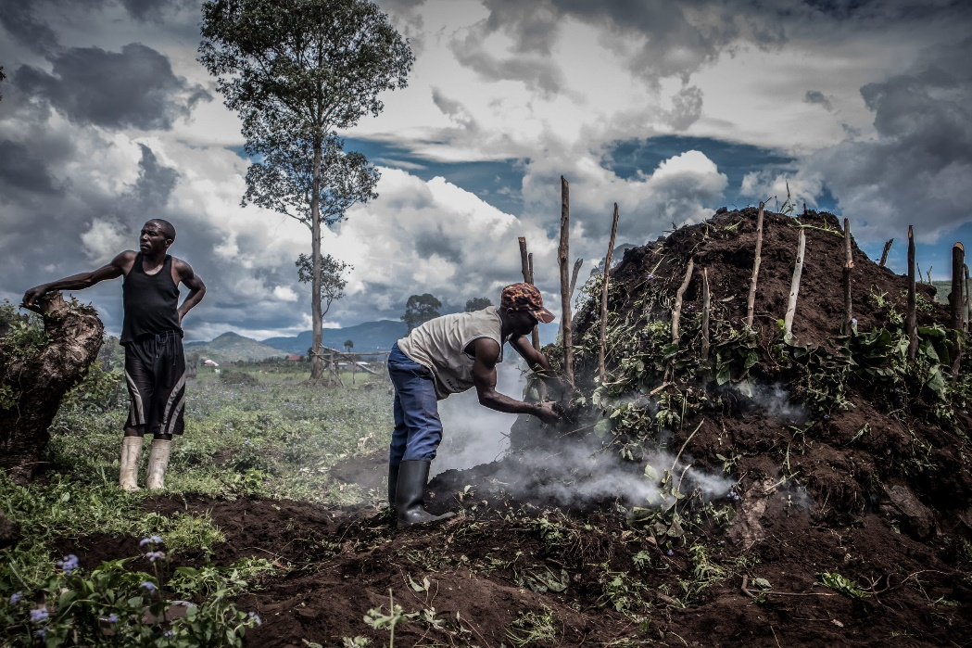
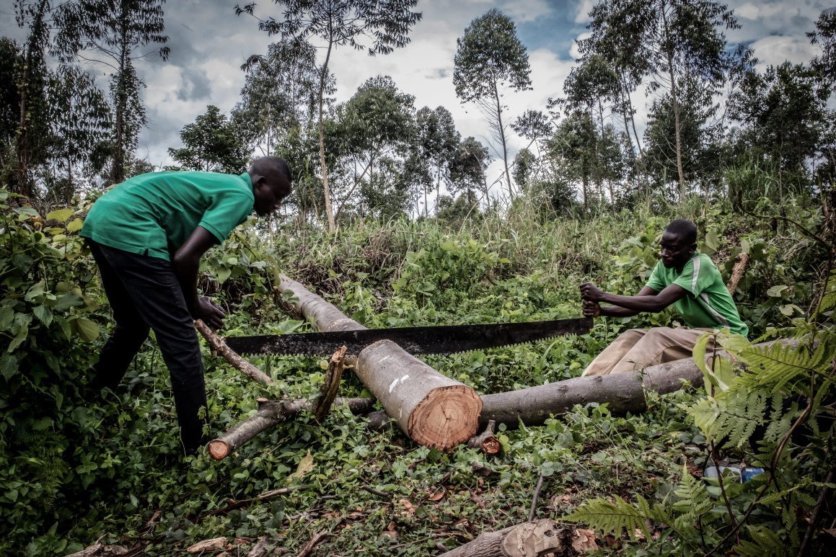
Fuelwood extraction
Wood (and charcoal) are an important source of energy for rural and urban households
Deforestation and charcoal production north of Goma, DRC
Main menu
© Guerchom Ndebo

Slide 6
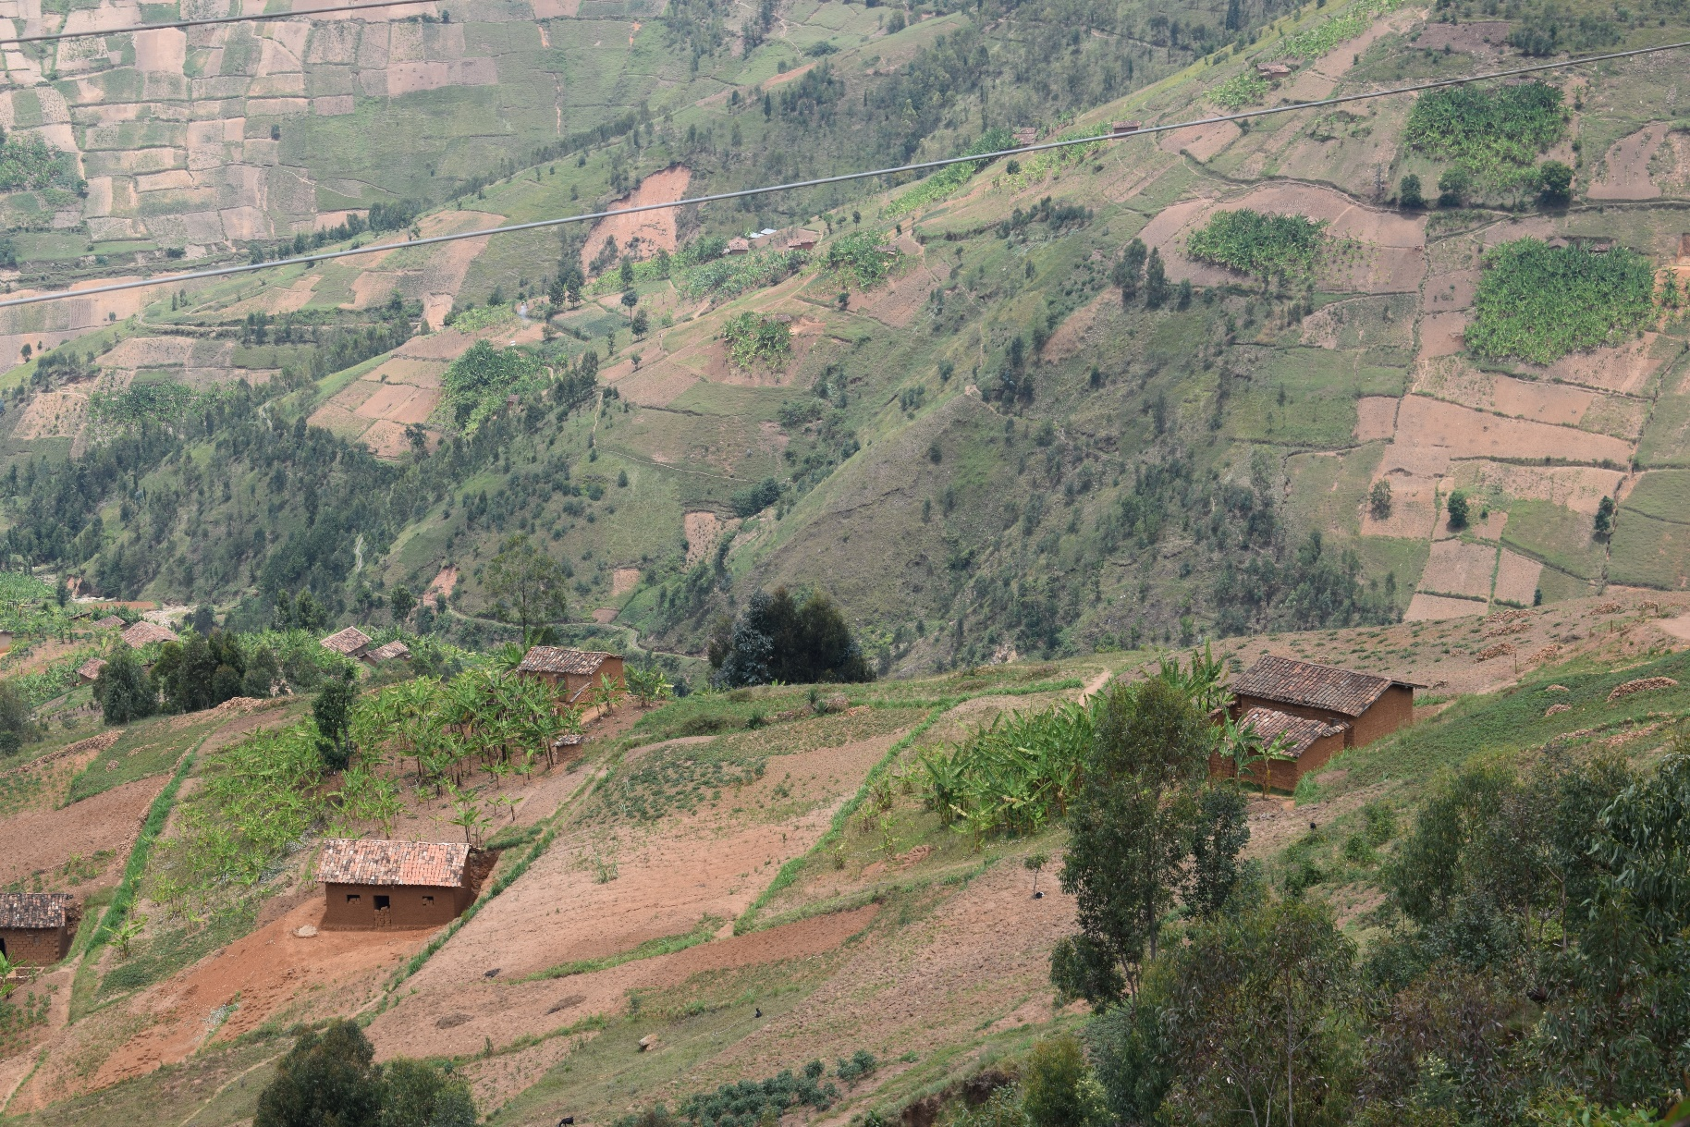
Food production
The growing demand for food incites people to cultivate steep terrain
Main menu
Most of the hillslopes in Rwanda have been converted into cropland

Slide 7
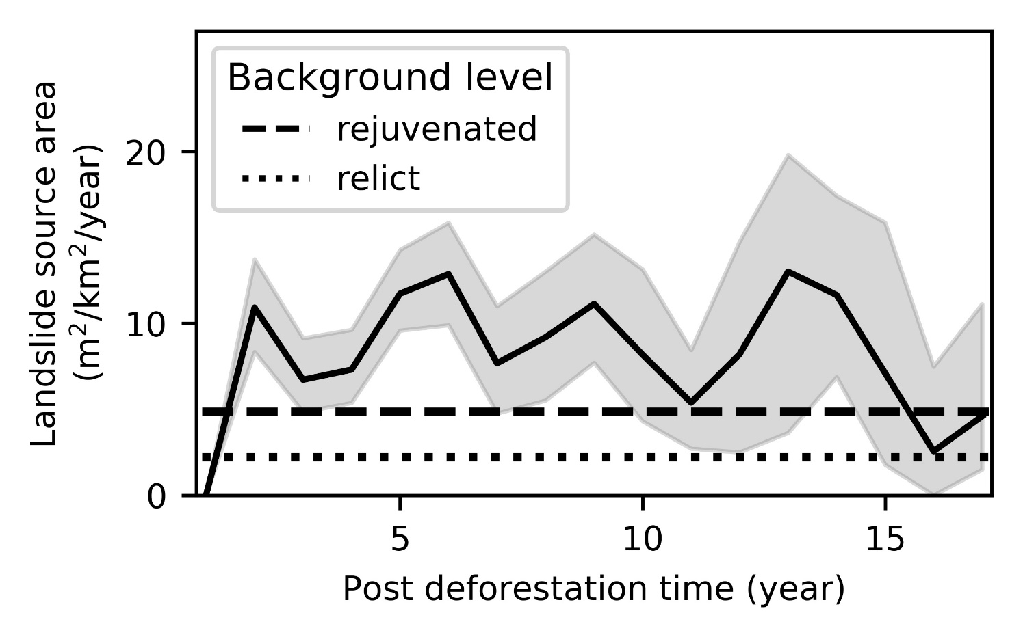
Deforestation increases landslide hazard
Deforestation alters drainage and decreases soil cohesion as roots decay
Deforestation increases landslide hazard
Potentially, the increased hazard can also exacerbate risk
Deforestation increases landslide activity for a period of roughly 15 years (Depicker et al., 2021 - Interactions between deforestation, landscape rejuvenation, and shallow landslides in the North Tanganyika - Kivu Rift region, Africa)
Main menu
https://esurf.copernicus.org/preprints/esurf-2020-87/

Slide 8
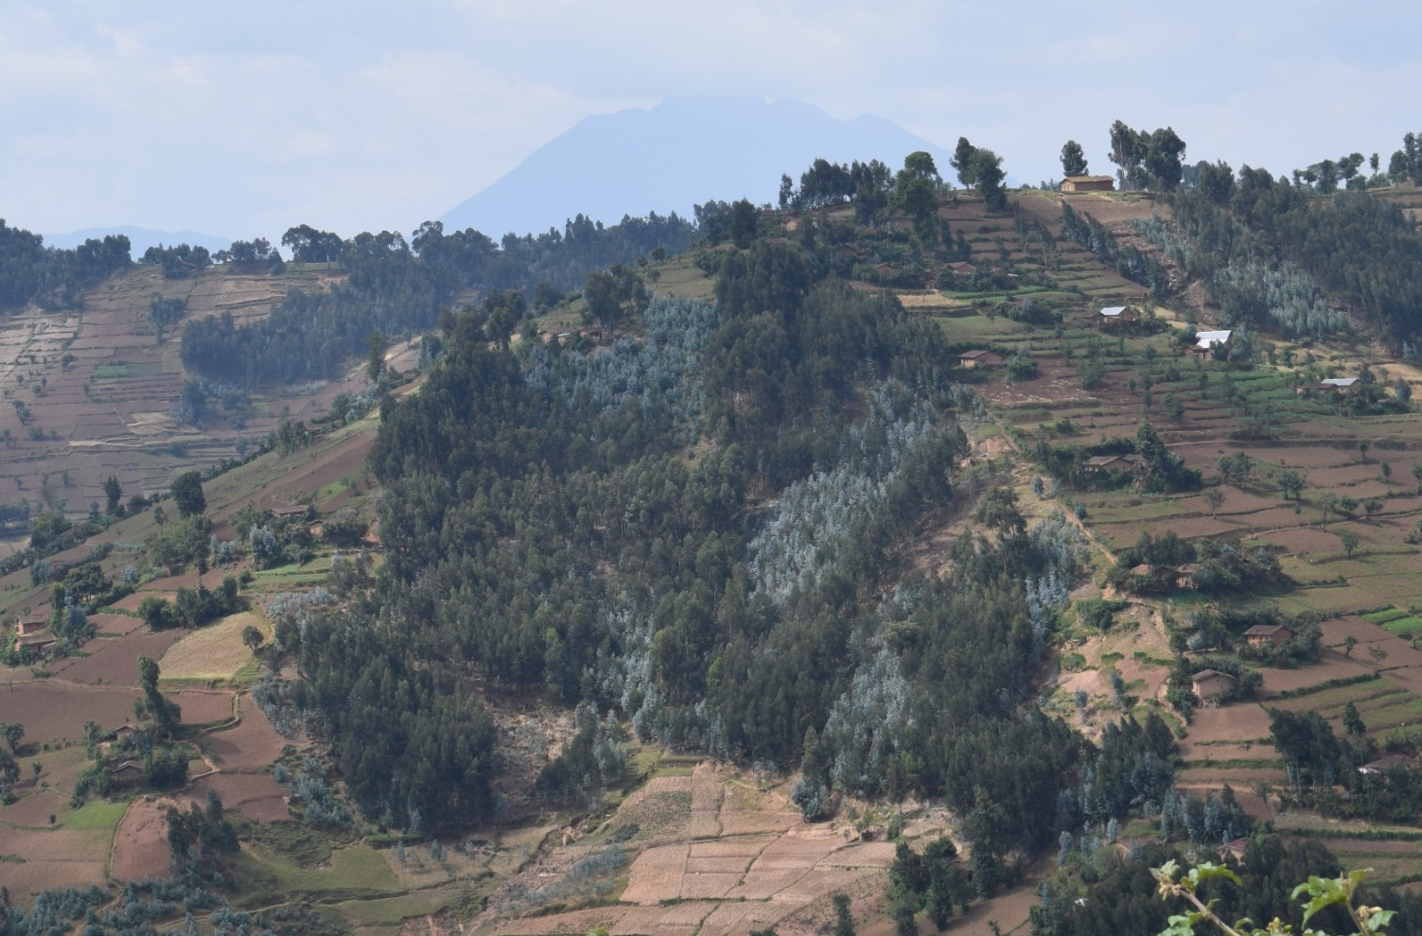
Afforestation decreases landslide hazard
Tree plantations and naturally regenerated forests may increase the slope stability
Planted forest in Northern Rwanda
Main menu

Slide 9
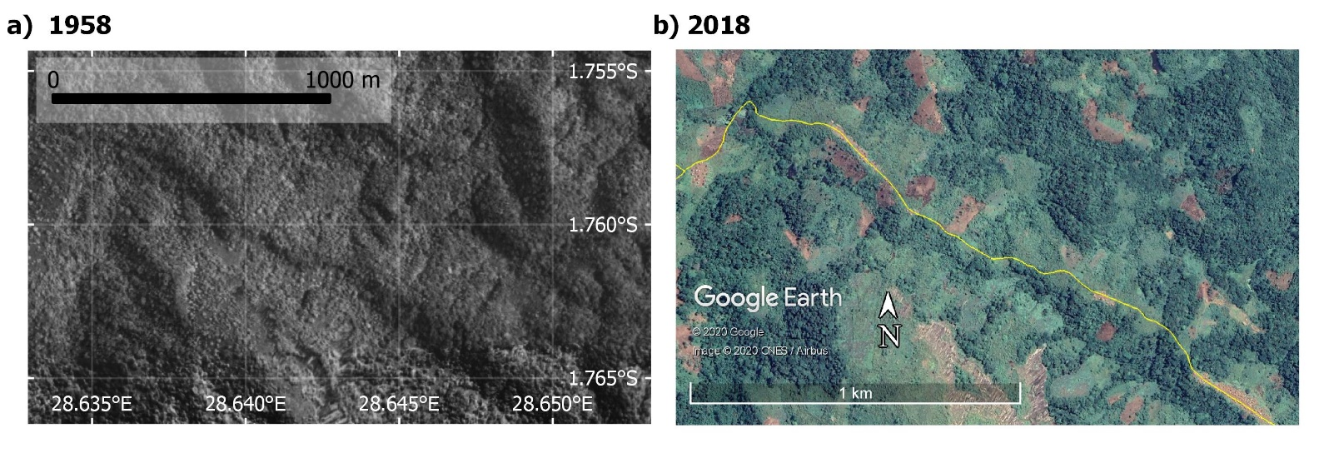
Roads facilitate deforestation
Road construction unlocks the access to primary forest, facilitating deforestation
Impact of a new road on land cover in the eastern DRC
Main menu

Slide 10
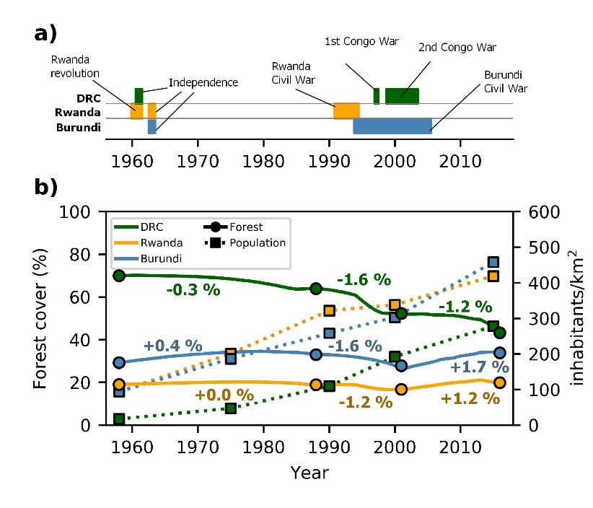
Population growth
Exponential population growth since the 60s
Conflicts increase mobility
1 M Rwandan refugees were relocated in the eastern DRC in 1994
Population growth and deforestation between 1958 and 2015. The percentages indicate the average annual forest loss.
Main menu

Slide 11
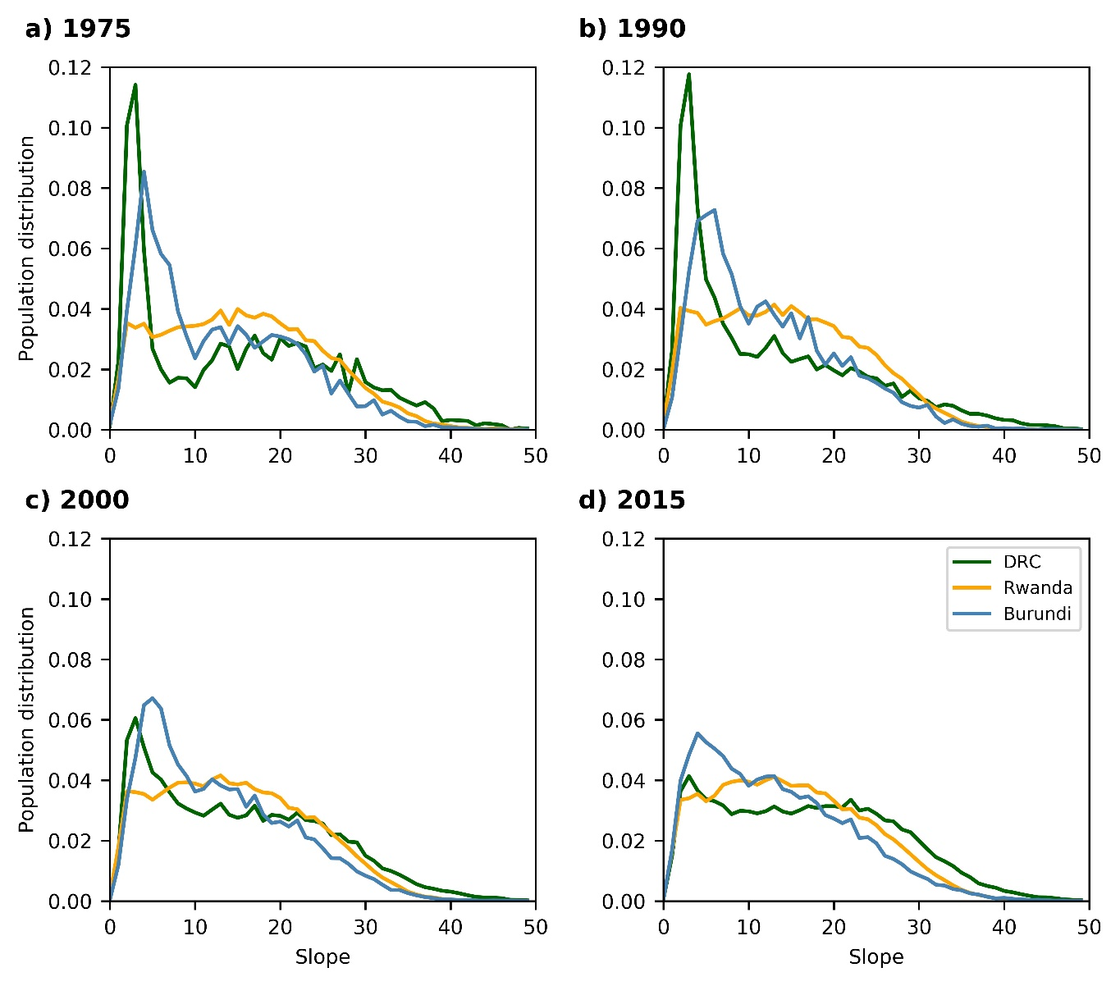
Population expands on steeper terrain
Expansion is driven by
  Need for cropland
  Need for fuelwood
  Mining industry
Main menu
Population density shifts towards steeper terrain, especially in the eastern DRC

Slide 12
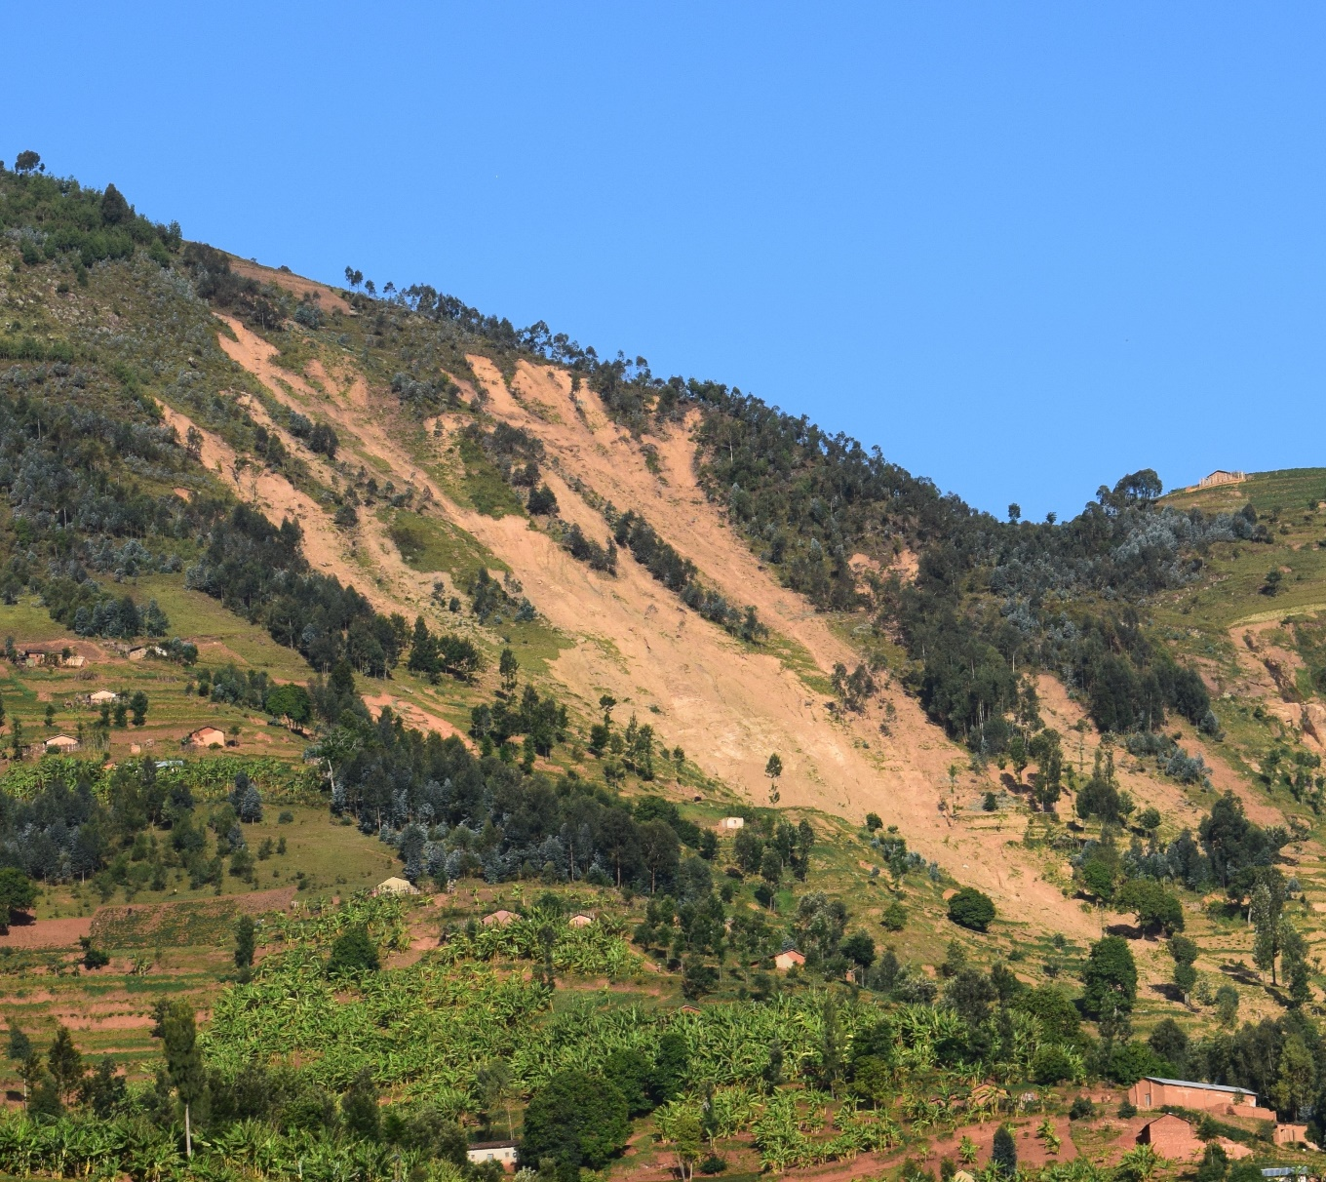
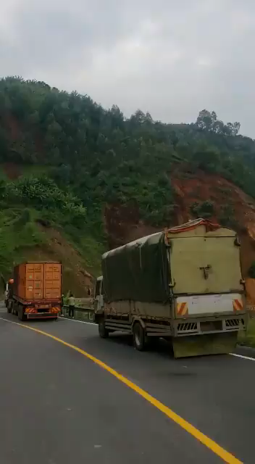
Population faces landslide risk
May 6, 2018. Twenty people were killed by rainfall-induced landslides in Western Rwanda
Main menu
Landslide along road in Rwanda

Slide 13
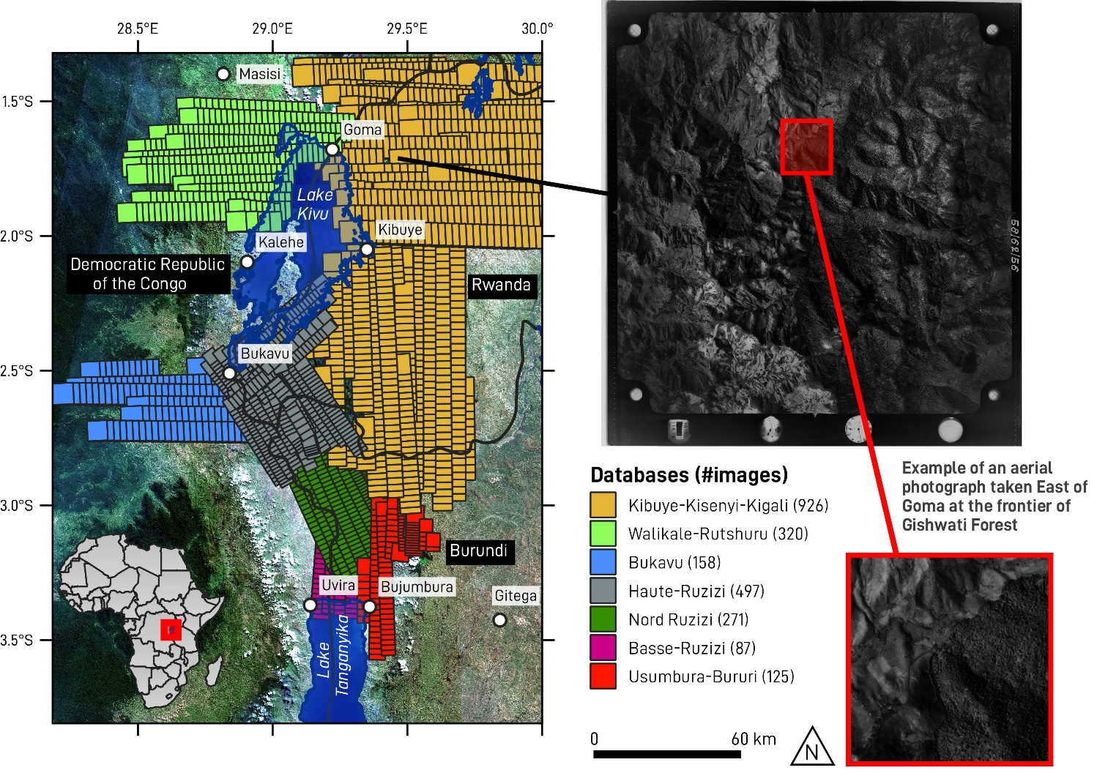
1. Reconstruct forest cover changes
Panchromatic orthomosaic with historical aerial photographs
Resolution ~ 1 m
next
Main menu

Slide 14
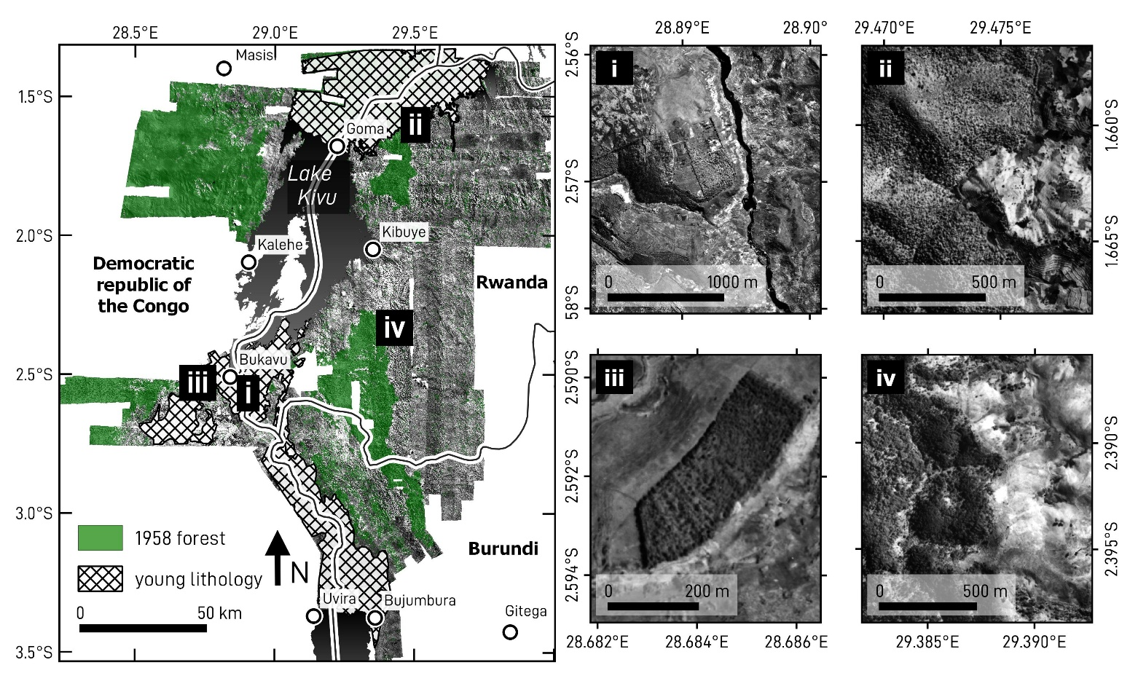
1. Reconstruct forest cover changes
Object-based classification techniques to derive forest cover
back
next
Main menu

Slide 15
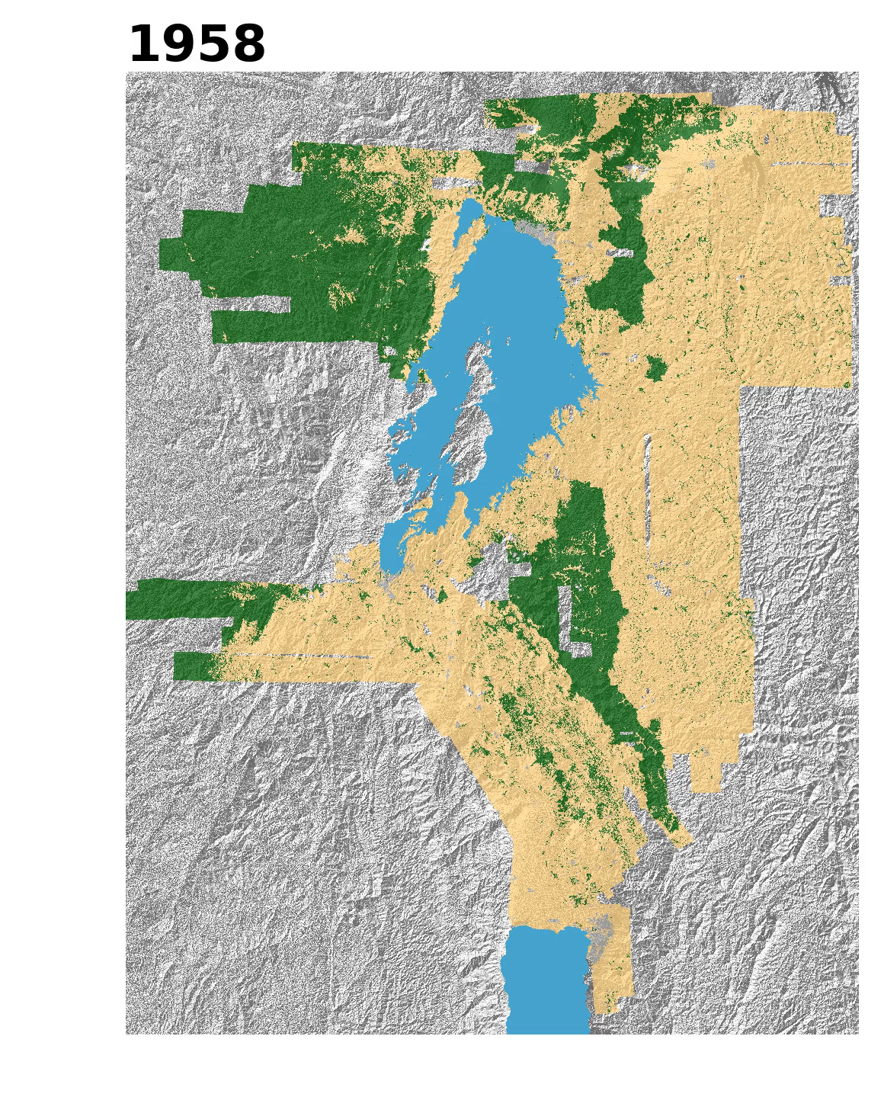
1. Reconstruct forest cover changes
Use of 1958, 1988, 2001 and 2016 data to reconstruct annual change
2 components:
  Where does deforestation/afforestation happens? (likelihood)
  How much of it happens per year? (rate)
back
Main menu

Slide 16
1. Where will deforestation happen?
Deforestation and afforestation likelihood model
Logistic regression
  Distance to roads
  Protected area (0/1)
  Forest edge (0/1)
  Deforestation contagion (0/1)
  Elevation
  Slope
  Distance to rivers
back
Main menu

Slide 17
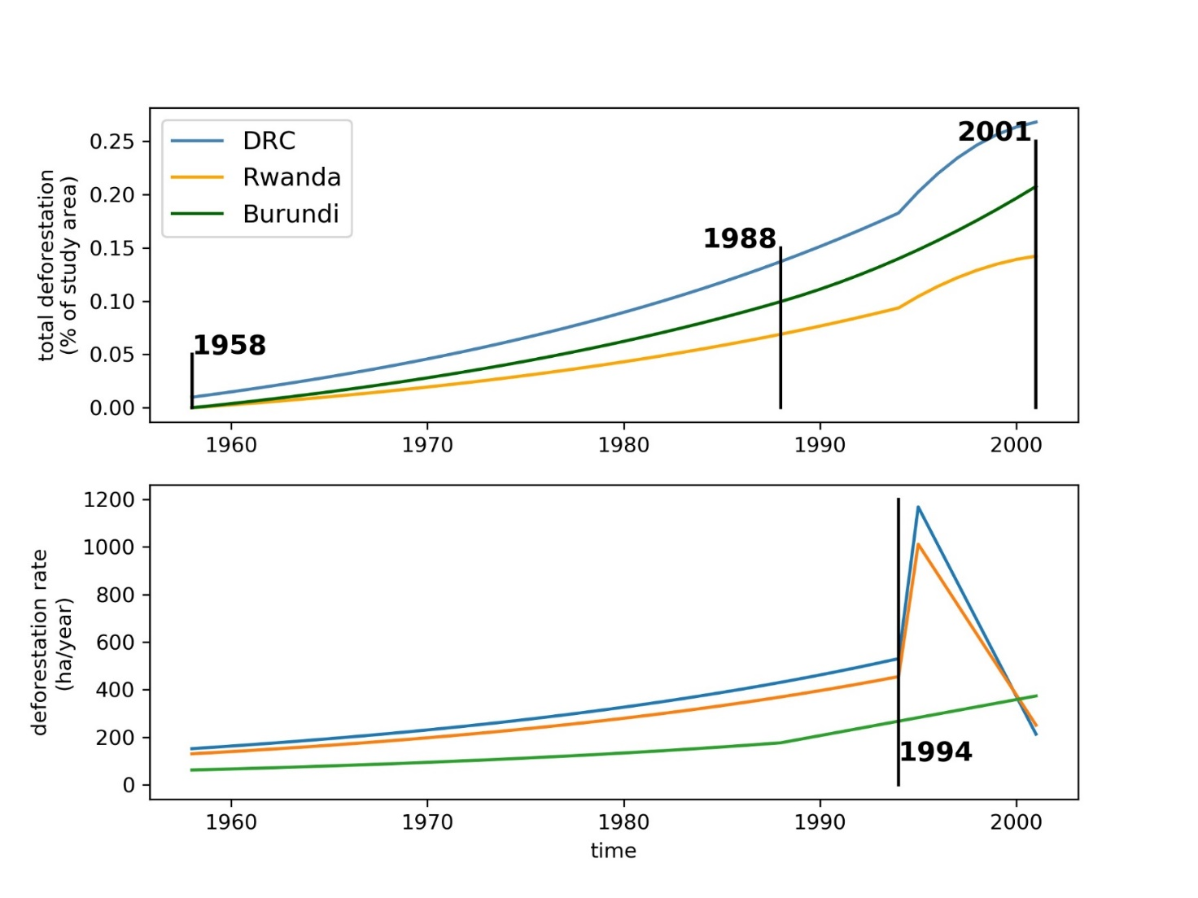
1. How much deforestation per year?
Reconstructed deforestation rate. Literature describes a surge in 1994 due to refugee fluxes
Annual deforestation rate?
  Doubles evry 20 years
  Surge after 1994 Rwandan Civil War
Annual afforestation rate?
  Assumed constant
back
Main menu

Slide 18
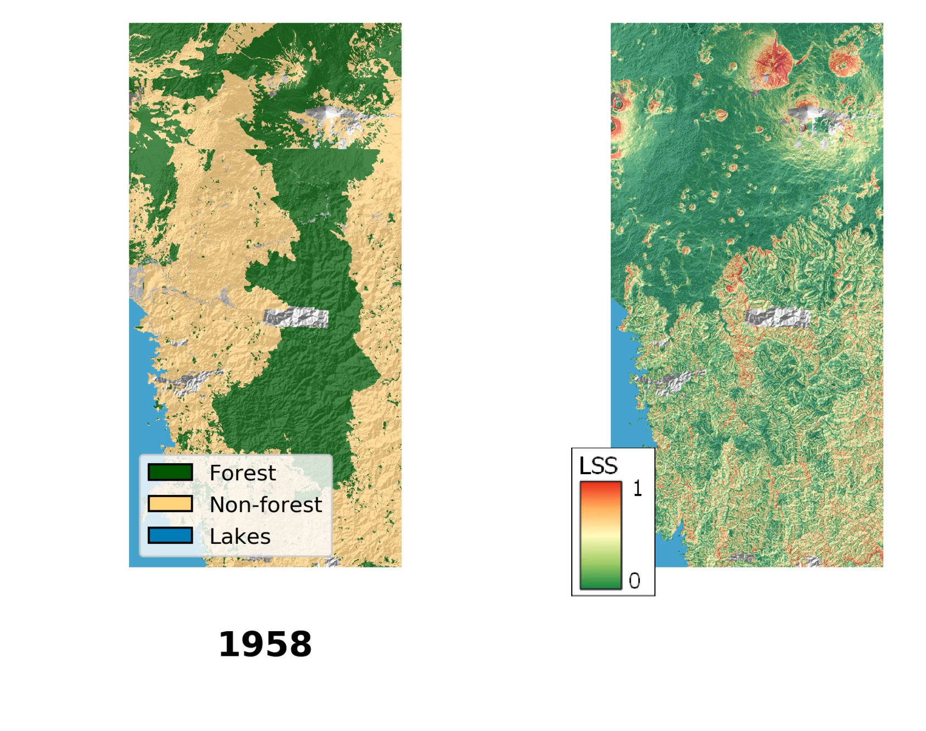
2. Link forest cover to landslide susceptibility
The decline of Gishwati forest is expected to increase landslide susceptibility
4,367 shallow landslides
Logistic regression
Dynamic land cover variable
  Includes the 15 year post-deforestation wave
Main menu

Slide 19
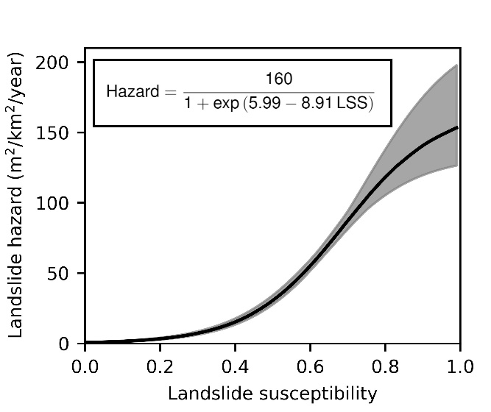
3. Link hazard to susceptibility
Calibrate hazard~susceptibility
Apply to the annual susceptibility maps
next
Main menu
Main menu

Slide 20
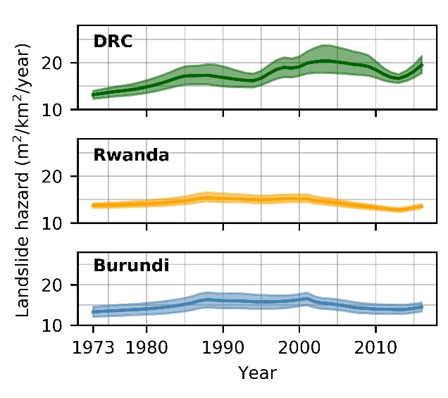
3. Link hazard to susceptibility
Hazard highest in the DRC
Peak around 2001
Increase in 1988-2001 due to increased deforestation
back
Main menu
Main menu

Slide 21
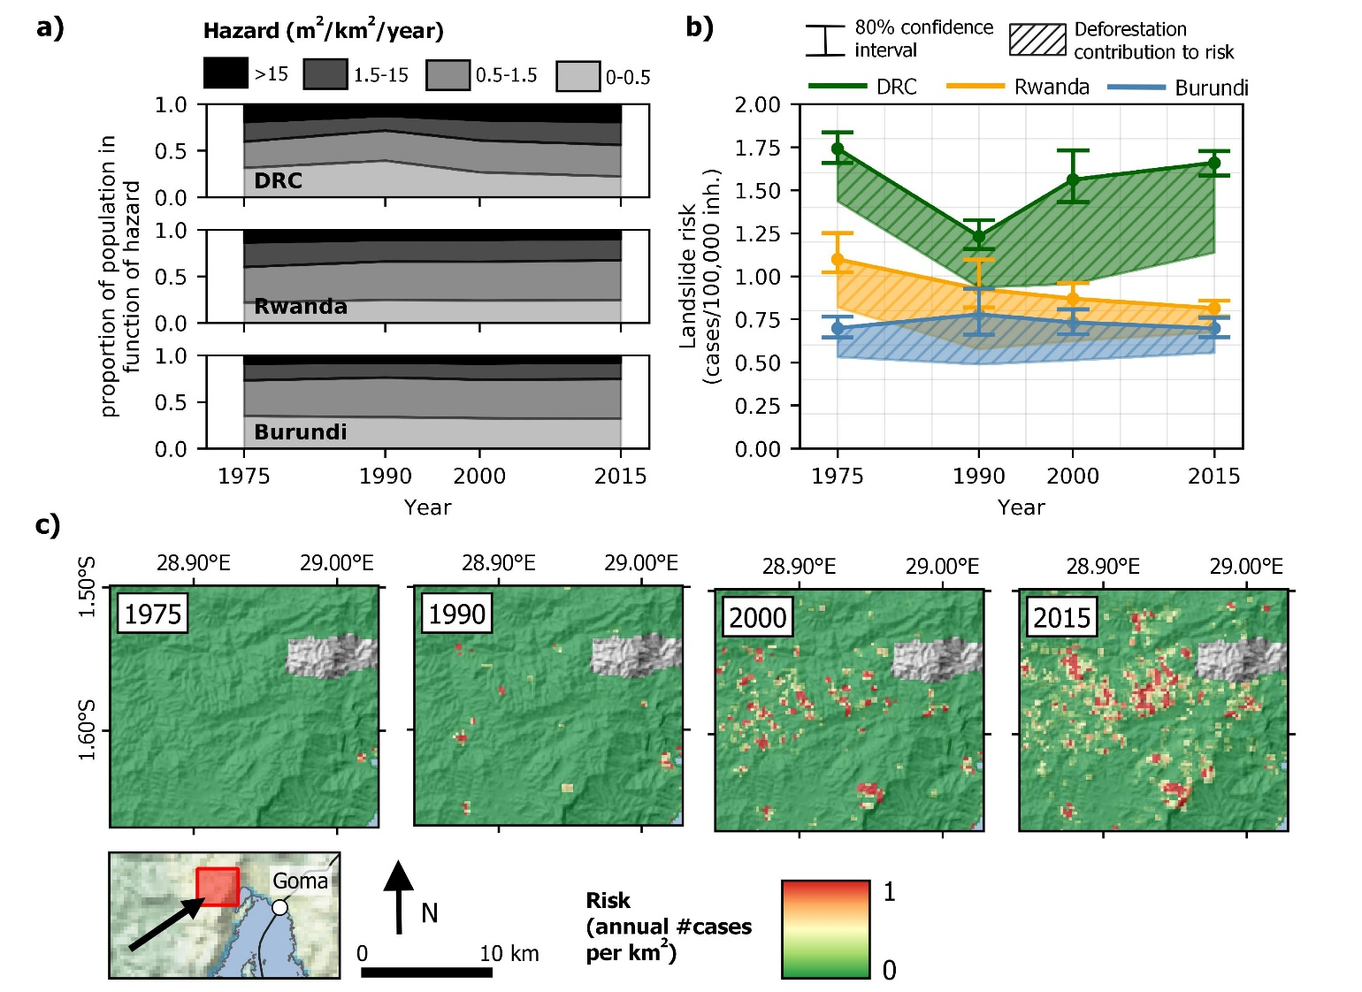
4. Risk = hazard x exposure x vulnerability
No data on vulnerability, but it is assumed high (~1)
Exposure ~population grids in 1975, 1990, 2000, 2015 (Global Human Settlement Layer)
Risk highest in DRC, but only partly due to deforestation
Conclusion
Main menu
Main menu

Slide 22
Conclusion
Risk is higher in the DRC
  Due to deforestation
  Due to location of people on steeper (hazardous) terrain
    Refugee influx population growth agricultural expansion
    Mining sector
What now?
  Reduce deforestation and incentives to settle in steep terrain
    Sensibilization
    Increase productivity in existing cropland
    Use alternative energy sources other than fuelwood
    More efficient use of wood (e.g. better stoves)
    Rely on forest plantations
    …
Main menu
Main menu

