Slide 1
The effect of recurrent cyclonic surge events on drinking pond and near-surface groundwater salinities in coastal Bangladesh
Chi San Tsai, Adrian P. Butler and Mo A. Hoque
EGU General Assembly 2021
Online 30th April 2021

Slide 2
Outline
Impacts of salinity in coastal Bangladesh
The study area
The conceptual model
Salinity dynamics as storm surges hit the area
Salinity dynamics as the pond was clean-up at 7days after storm surges hit
How recurrent surge events affected long-term salinity
Salinity management options

Slide 3
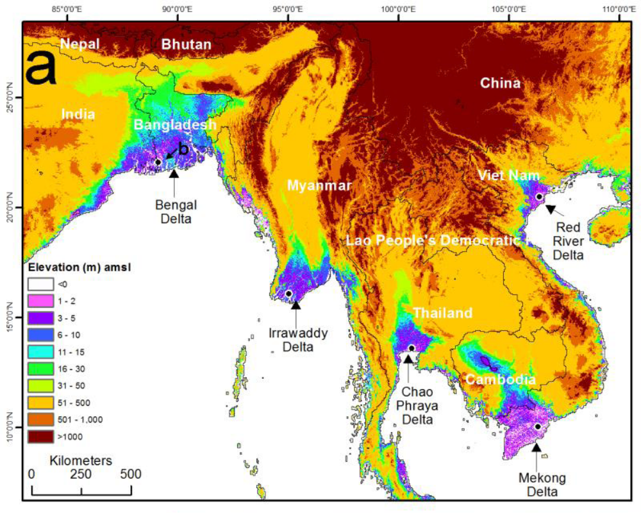
Bangladesh is located at Mega deltas Ganges-Brahmaputra-Meghna
Deltaic coastal plains
vulnerable to storm surges,
tidal surges &flooding
Salinity is a widespread problem
Bangladesh situated the world largest river system delta. These low-lying delta plains are subject to tropical cyclones.
Figure source from [3]

Slide 4
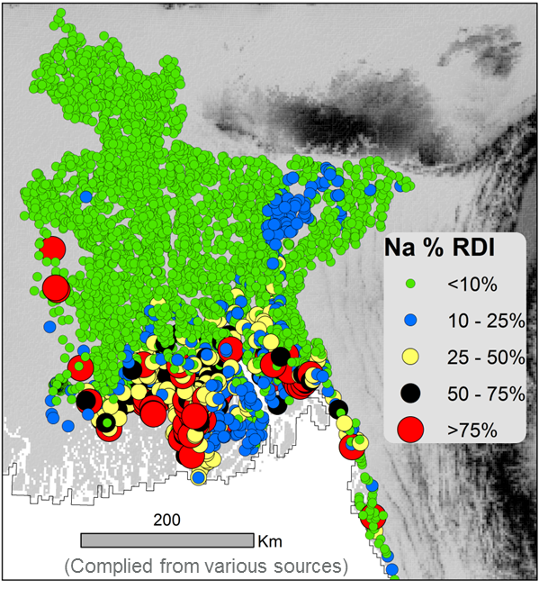
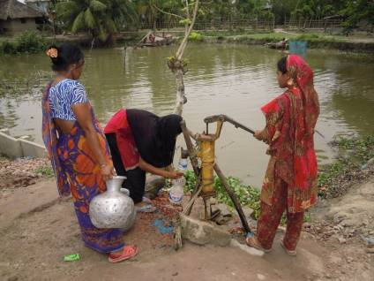
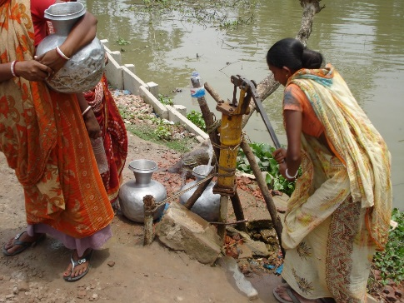
Human health & the drinking water crisis
Impacts of salinity in coastal deltas
Salinity in drinking water causes negative effects on human health such as hypertension[7]&[9]. These high salinities means that local residents need to reply on alternative water resources, such as ponds, rivers and canals.
Groundwater salinity is quite high along the
coastal areas[3].
Local residents are dependent on alternative water resources, such as ponds, rivers and canals[3].
Groundwater salinity is high along the coastline
Alternative water resources: pond water &river water

Slide 5
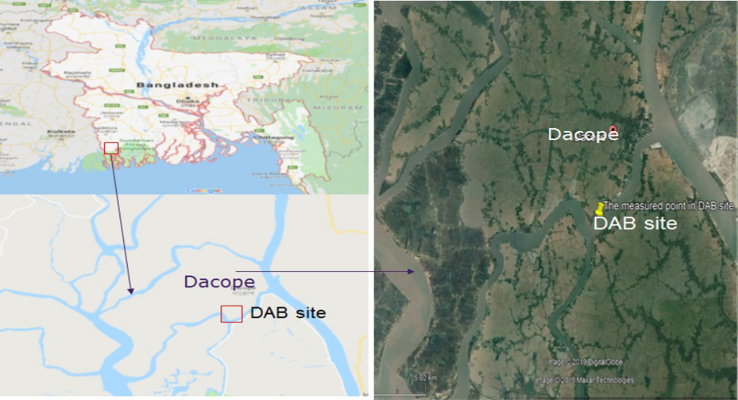
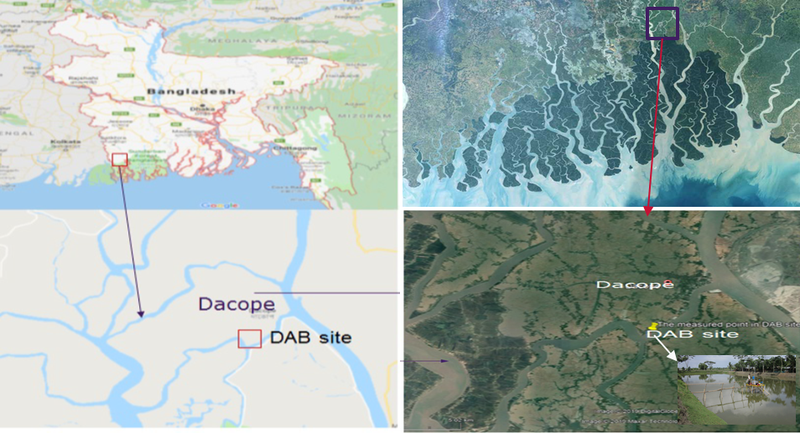
The study area
2D cross section
A₀
B₀
The study area is located in the Dacope Upazila of southwest coastal district Khulna in Bangladesh.
DAB pond
Bangladesh has a climate consisting of dry winters (November-April) and a tropical monsoon (May-October).
Cyclonic storm surge normally hit this area in early monsoon such as Aila or early dry season such as Sidr.

Slide 6
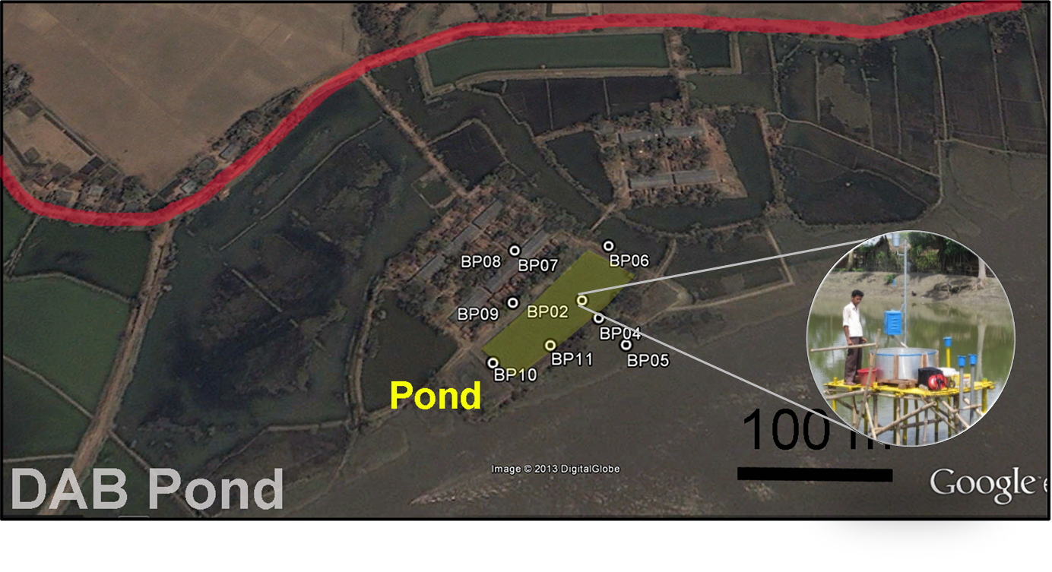
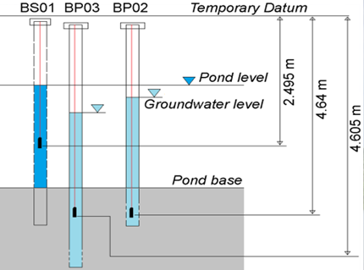
Monitoring pond & groundwater data
Polder
Pond data(BS01) & two piezometers at 1m (BP02) and 3m (BP03) depth below the pond) [1]
DAB pond is outside polder

Slide 7
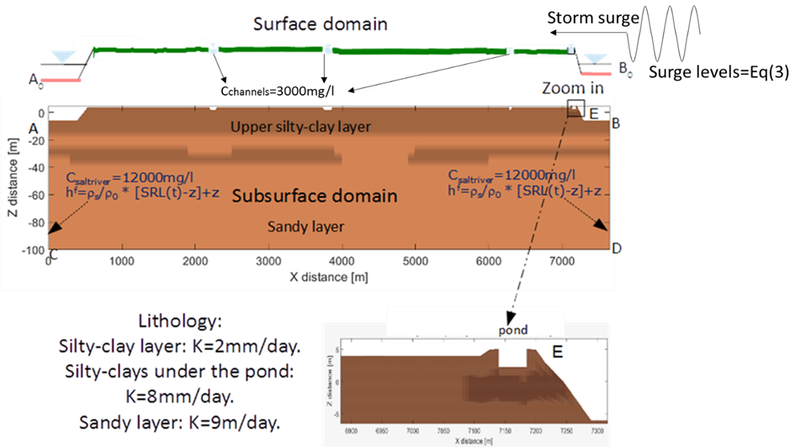
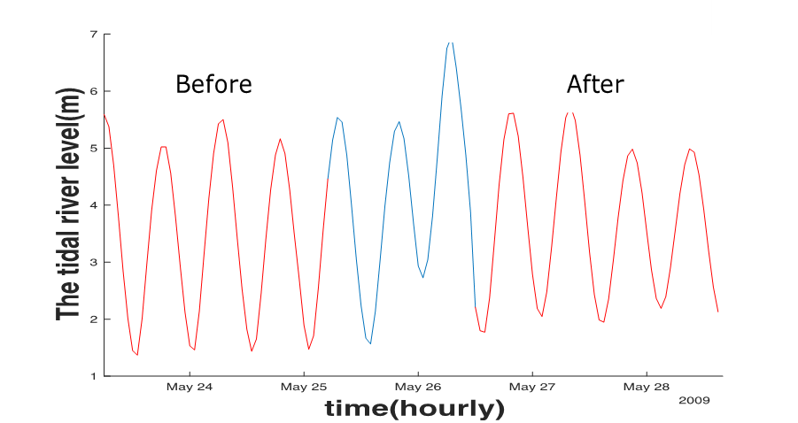
The conceptual model
Surge levels were introduced into the model
Storm surge levels at Chittagong station. These surge water levels are from University of Hawaii (uhslc.soest.hawaii.edu/thredds/uhslc_quality_hourly.html)

Slide 8
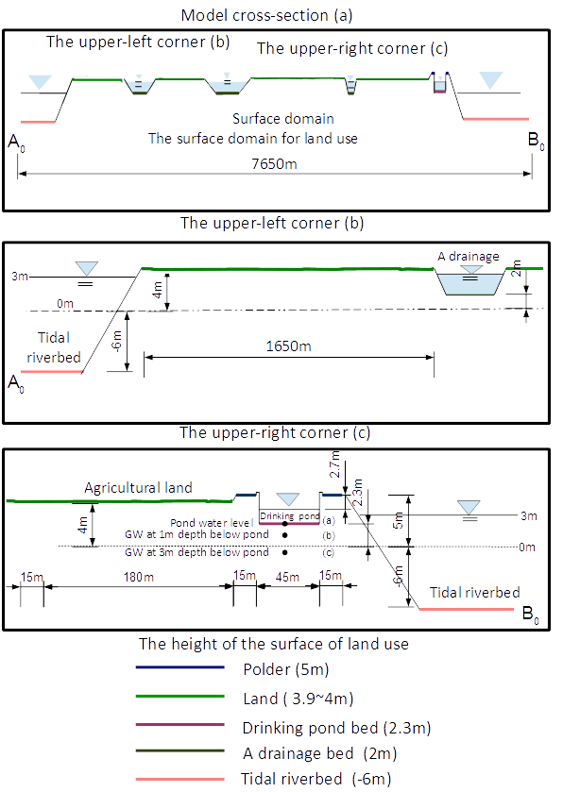
The conceptual model ( for surface feature)

Slide 9
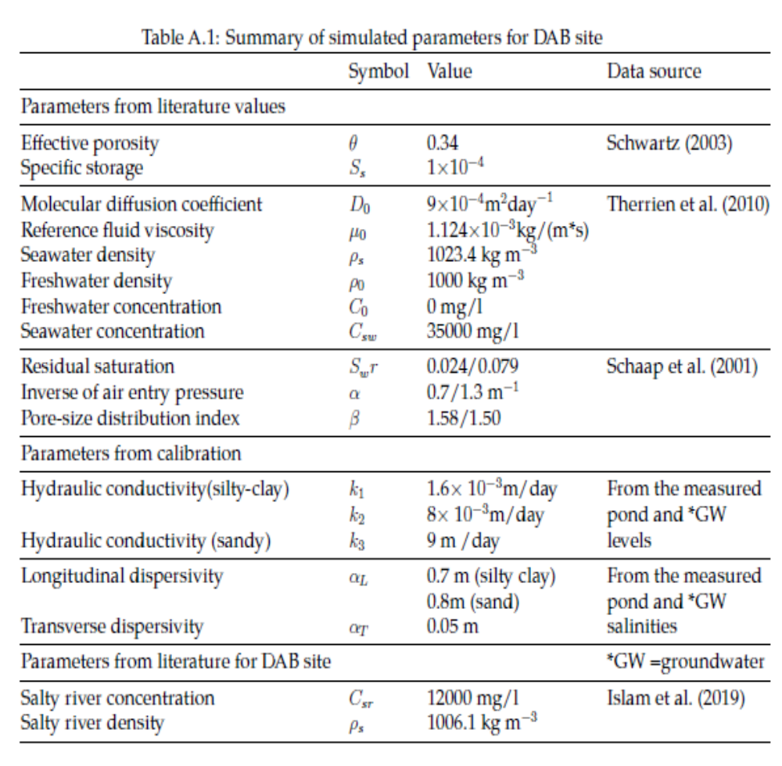
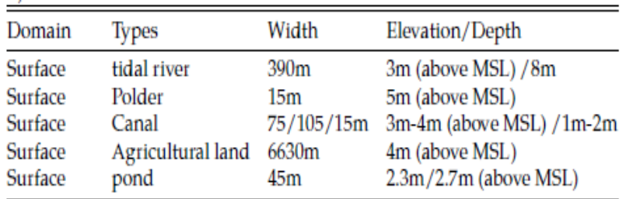
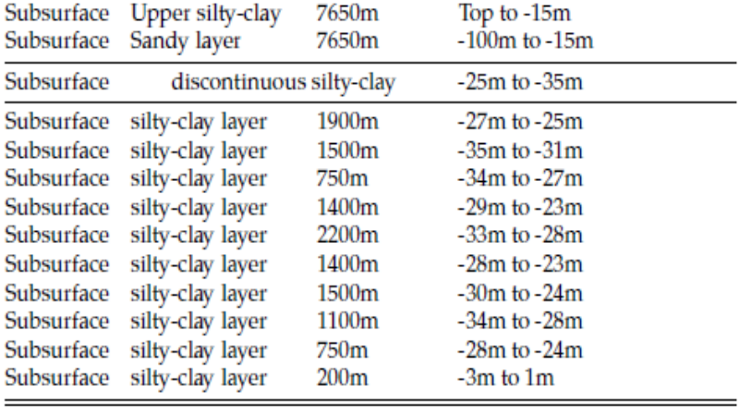
Simulated parameters, land use feature & lithology
Notes:
For longitudinal dispersivity, from previous studies it usually gets from Gelhar who wrote ‘a critical review of data on the field scale dispersion in aquifer.
Here longitudinal dispersivity are obtained from comparing the measured pond and gw salinities and calculated pond and gw salinities.
The third way is from the study area.
Time dependent river salinity was set using average seasonal values and calculated data from bangladesh water development board at chalna station.

Slide 10
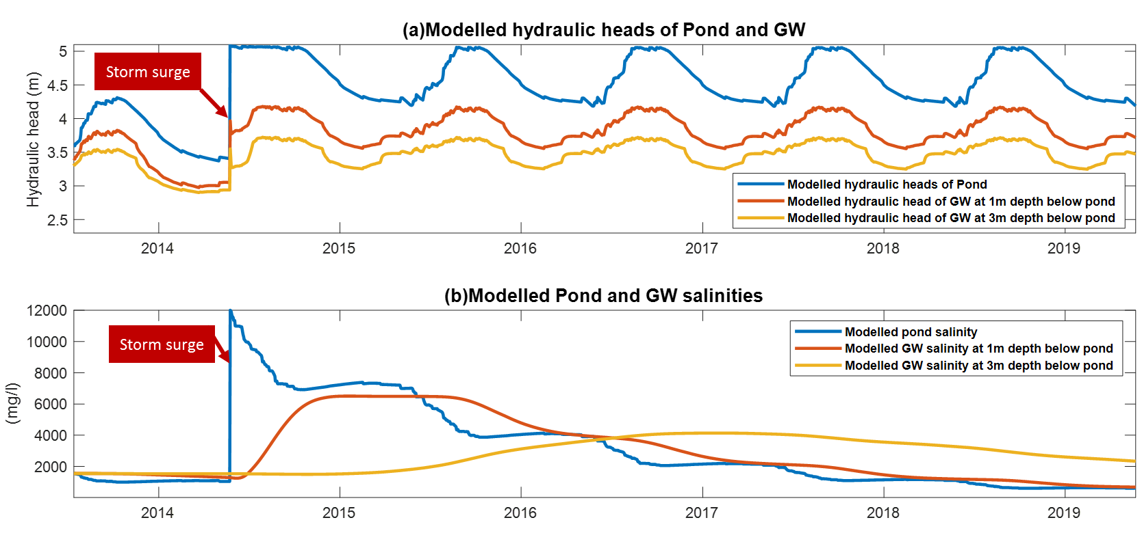
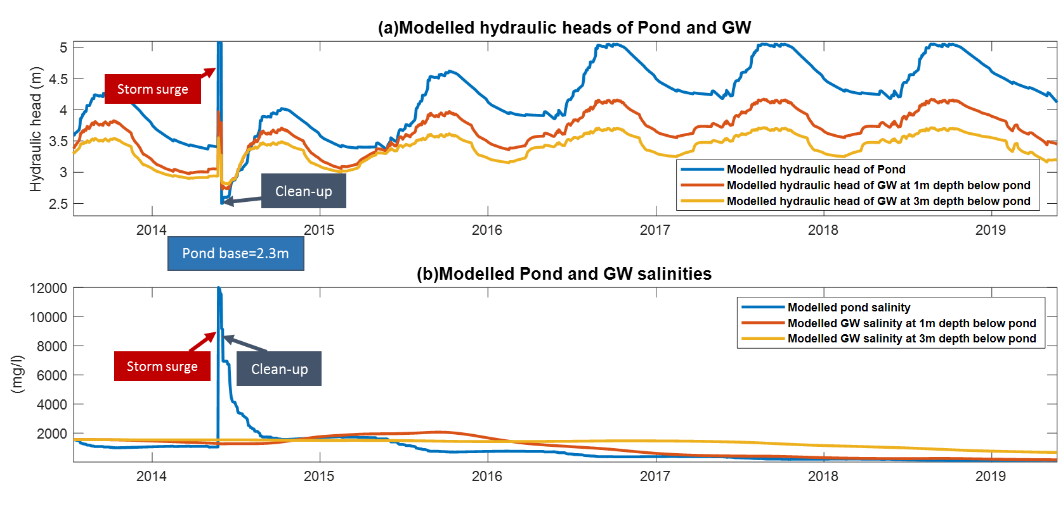
Salinity dynamics as cyclonic surge hit the area
When storm surge hit in monsoon season
Without any remediation
Monsoon season (May-October)
Salinities(mg/l)
High salinity
The pond was clean-up at 7days after storm surge hit
Salinities(mg/l)
Low salinity
Clean-up the pond may stop the salt from surge water or inundation
to build-up the salt in the underlying sediment below the pond

Slide 11
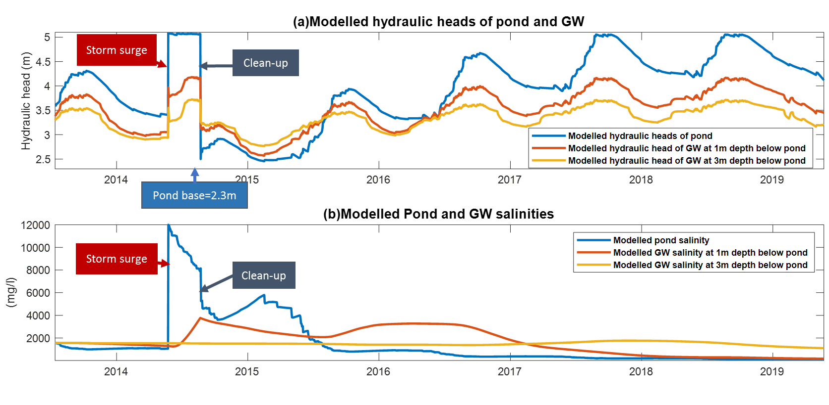
Salinity dynamics as cyclonic surge hit the area(2)
When storm surge hit in monsoon season
Monsoon season (May-October)
The pond was clean-up at 3 months after storm surge hit
Hydraulic heads
Upward gradient
Upward gradient is caused by
groundwater head > pond head,
which led salt re-enter to the pond
Salinities(mg/l)
The built-up salinity back to the pond
Low salinity
If the pond can be clean-up as soon as possible,
it can prevent the salt build-up in the underlying sediment below the pond

Slide 12
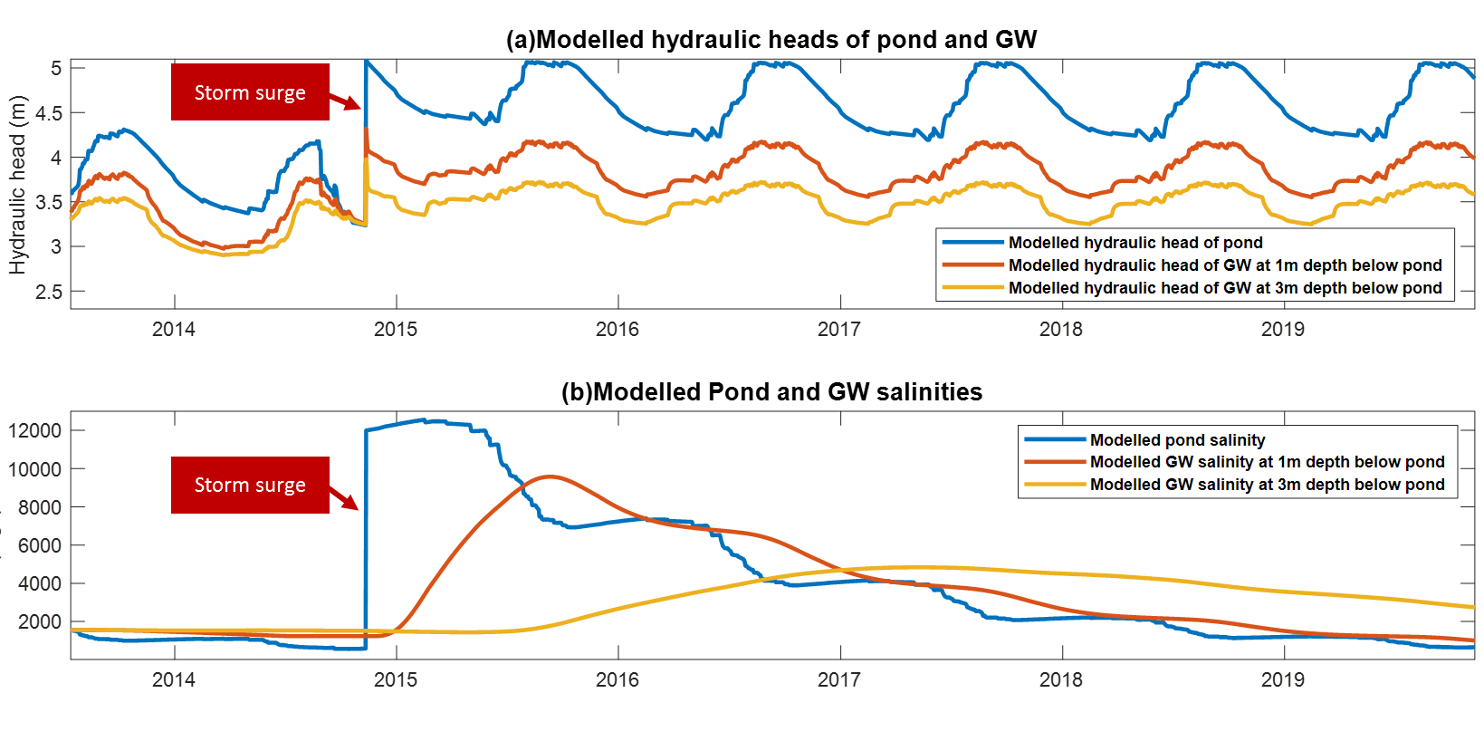
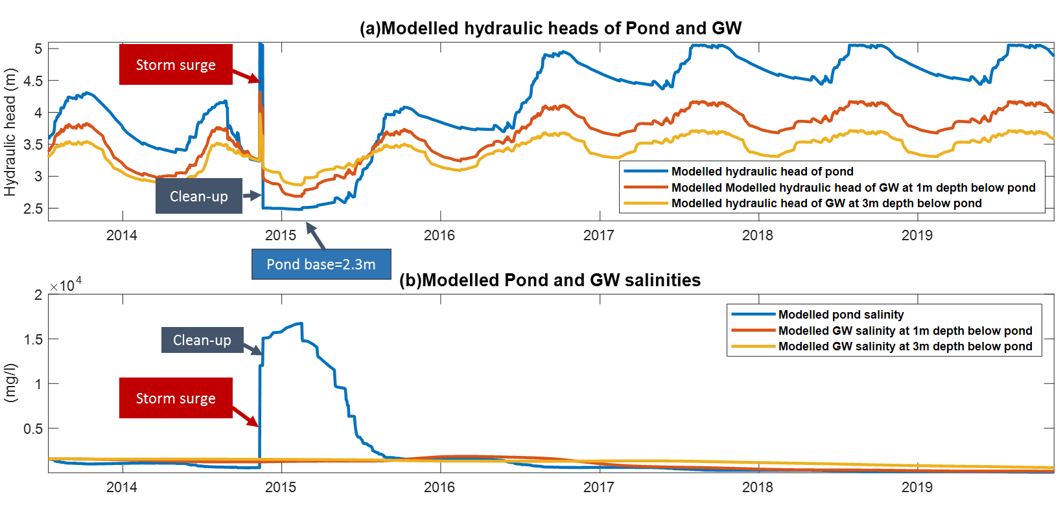
Salinity dynamics as cyclonic surge hit the area
When storm surge hit in dry season
Without any remediation
Dry season (Nov-Apr)
Salinities(mg/l)
High salinity
The pond was clean-up at 7days after storm surge hit
Salinities(mg/l)
Low salinity
Our study shows that the storm surge hit in dry season may cause more serious effect on pond and its underlying sediment. However, even there is no rainfall for first few months after clean-up the pond, it still prevents salinity from surge water to build up in the underlying sediment below the pond.

Slide 13
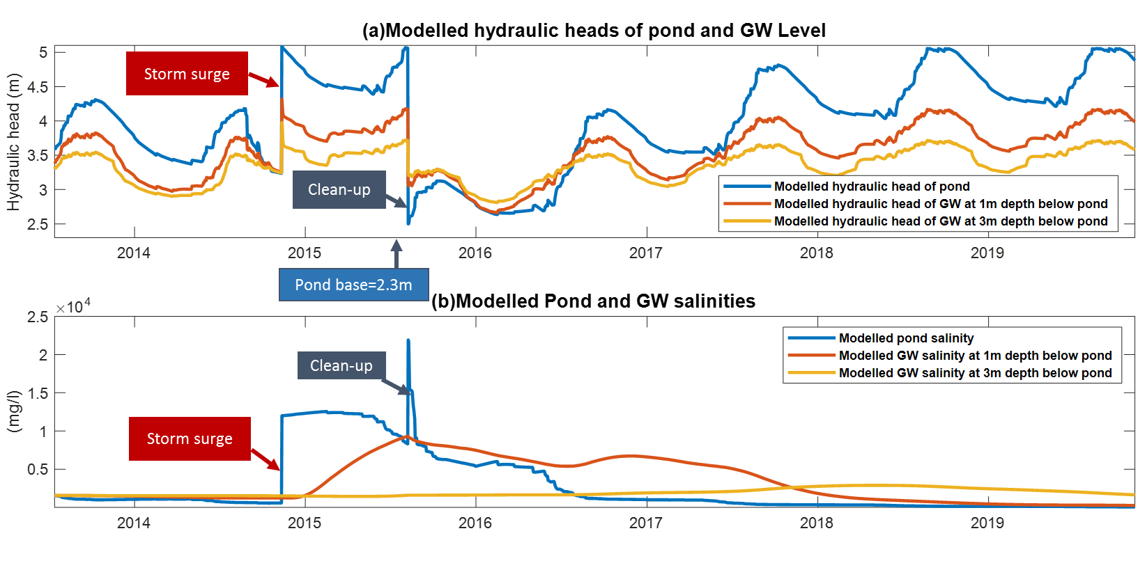
Salinity dynamics as cyclonic surge hit the area (2)
When storm surge hit in dry season
The pond was clean-up at 9 months after storm surge hit
Dry season (Nov-Apr)
Hydraulic heads
Upward gradient
Upward gradient is caused by
groundwater head > pond head,
which led salt re-enter to the pond
Salinities(mg/l)
The built-up salinity back to the pond
Low salinity
Pond salinity is much higher than it was after the pond was clean-up.
This is because:(1) the salinity re-enter to the pond
(2) no rainfall to dilute pond salinity
(3) evaporation to dry pond water out and the salt left behind

Slide 14
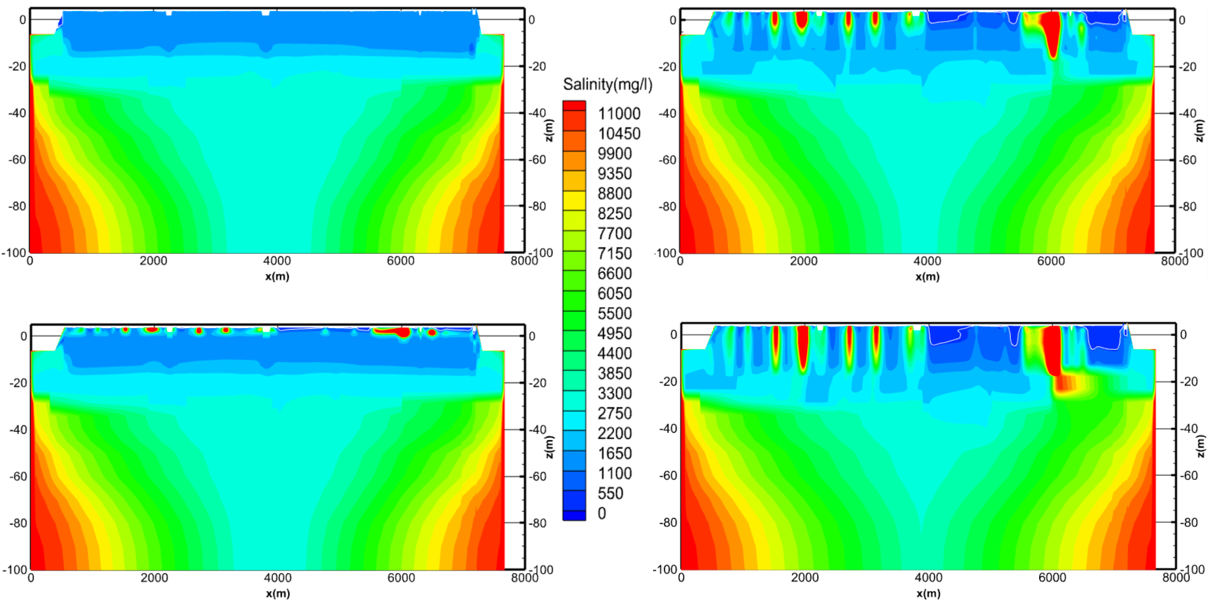
Recurrent surge events (every 8 years) affected long-term groundwater salinity
Initial state
40 years
8years
80 years
Figures show that groundwater salinity as the storm surges hit in monsoon season every 8years for its initial state, 8years,40 years and 80 years. Our study indicate that recurrent intervals of the cyclones did profoundly affect the near-surface groundwater salinity which extended downwards over time.

Slide 15
Summary
High salinity in drinking water is a serious issue in coastal Bangladesh.
A fully coupled surface-subsurface model is used to investigate the role of tropical cyclone on salinity of water resources
In the study
The episodic cyclonic storms lead to build-up salt in the underlying sediment.
The cyclone hit the area in dry season may cause more serious salinity issues than it hit the area in monsoon season.
Salinity management options
Cleaning-up a pond as soon as possible after a storm surge event
Encouraging development of freshwater ponds
Allowing the area to be inundated the salinity when river water is less saline.
These methods may reduce the salinity in near-surface aquifer.

Slide 16
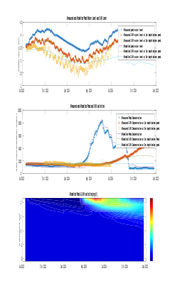
Thank you
Reference
Collaborators:
Professor Adrian P. Butler
Dr.Mo A. Hoque
Technique support:
Dr. Steven Berg
HydroGeoSphere community
[1]Gelhar, L. W., Welty, C., and Rehfeldt, K. R. (1992). A critical review of data on fieldscale dispersion in aquifers. Water Resources Research, 28(7):1955–1974. tex.eprint: https://agupubs.onlinelibrary.wiley.com/doi/pdf/10.1029/92WR00607.
[2]Harun, M. A. Y. A. and Kabir, G. M. M. (2013). Evaluating pond sand filter as sustainable drinking water supplier in the Southwest coastal region of Bangladesh. Applied Water Science, 3(1):161–166.
[3]Hoque, M.A. and Butler, A.P., 2016. Medical hydrogeology of Asian deltas: status of groundwater toxicants and nutrients, and implications for human health. International journal of environmental research and public health, 13(1), p.81.
[4]Islam, M.A., Hoque, M.A., Ahmed, K.M. and Butler, A.P., 2019. Impact of Climate Change and Land Use on Groundwater Salinization in Southern Bangladesh—Implications for Other Asian Deltas. Environmental management, 64(5), pp.640-649.
[5]Rahman, A. K. M. M., Ahmed, K. M., Butler, A. P., and Hoque, M. A. (2018). Influence of surface geology and micro-scale land use on the shallow subsurface salinity in deltaic coastal areas: a case from southwest Bangladesh. Environmental Earth Sciences, 77(12).
[6]Schaap, M. G., Leij, F. J., and van Genuchten, M. T. (2001). rosetta : a computer program for estimating soil hydraulic parameters with hierarchical pedotransfer functions. Journal of Hydrology, 251(3-4):163–176. Schwartz, F. W. (2003). Fundamentals of ground water /. Wiley, Chichester :.
[7]Scheelbeek, P. F., Chowdhury, M. A., Haines, A., Alam, D. S., Hoque, M. A., Butler, A. P., ... & Vineis, P. (2017). Drinking water salinity and raised blood pressure: evidence from a cohort study in coastal Bangladesh. Environmental health perspectives, 125(5), 057007.
[8]Shammi M, Rahman MM, Bondad SE, Bodrud-Doza M. Impacts of Salinity Intrusion in Community Health: A Review of Experiences on Drinking Water Sodium from Coastal Areas of Bangladesh. Healthcare (Basel). 2019;7(1):50.
[9]Therrien, R., McLaren, R. G., Sudicky, E. A., and Panday, S. M. (2010). A Three-dimensional Numerical Model Describing Fully-integrated Subsurface and Surface Flow and Solute Transport. page 456.
[10]World Health Organization (2017). Guidelines for drinking-water quality. OCLC: 975491910

