Slide 1
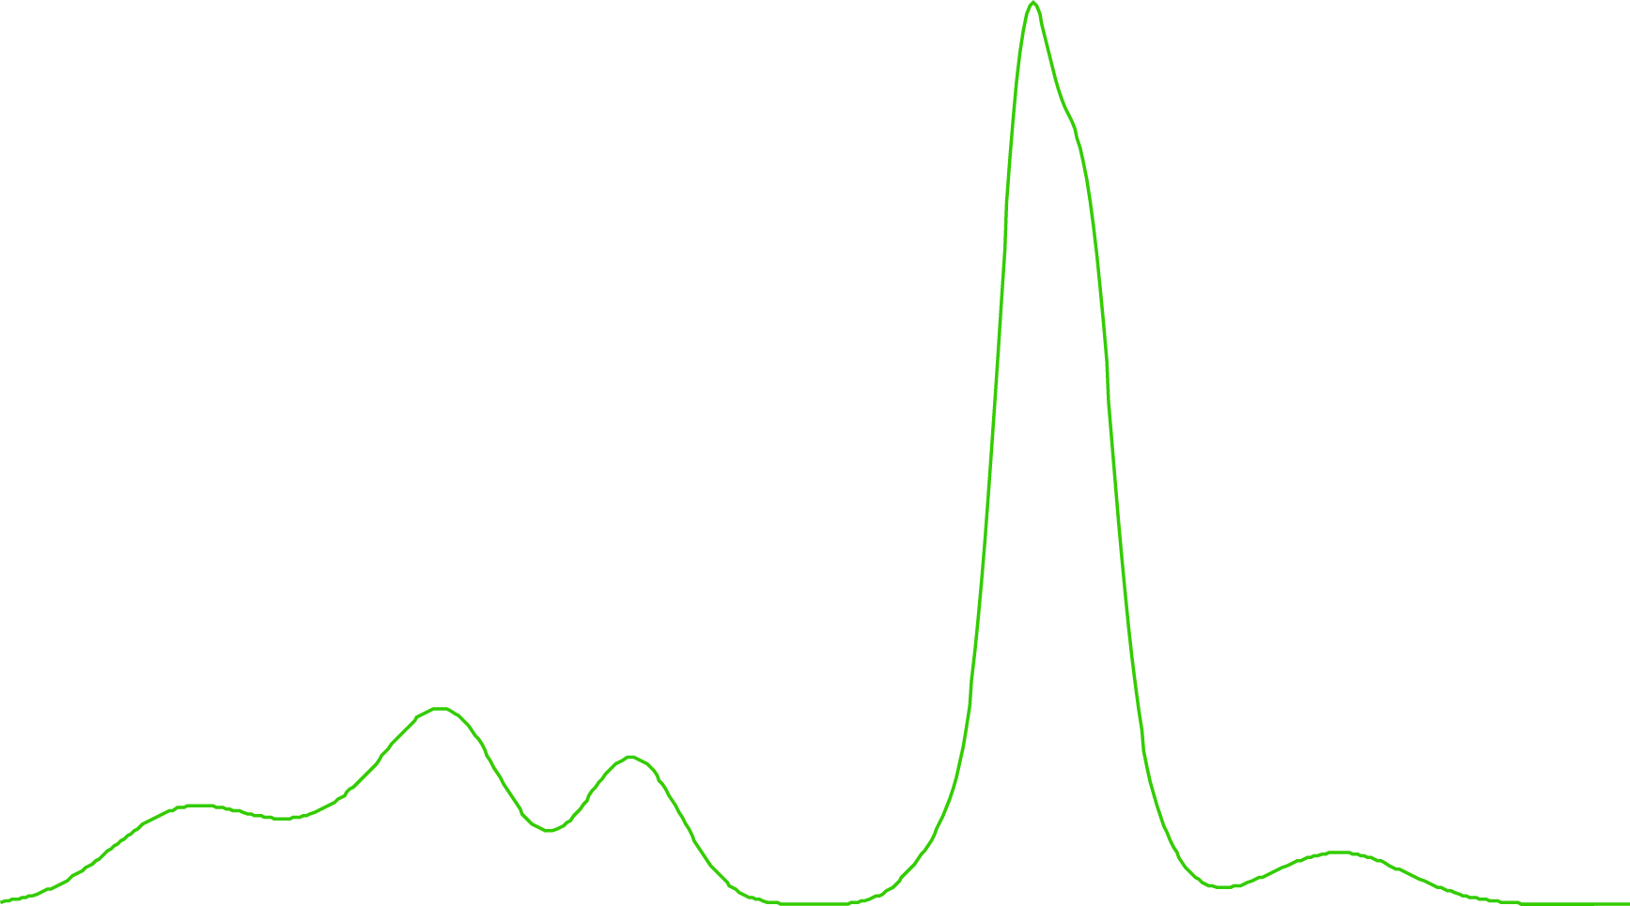
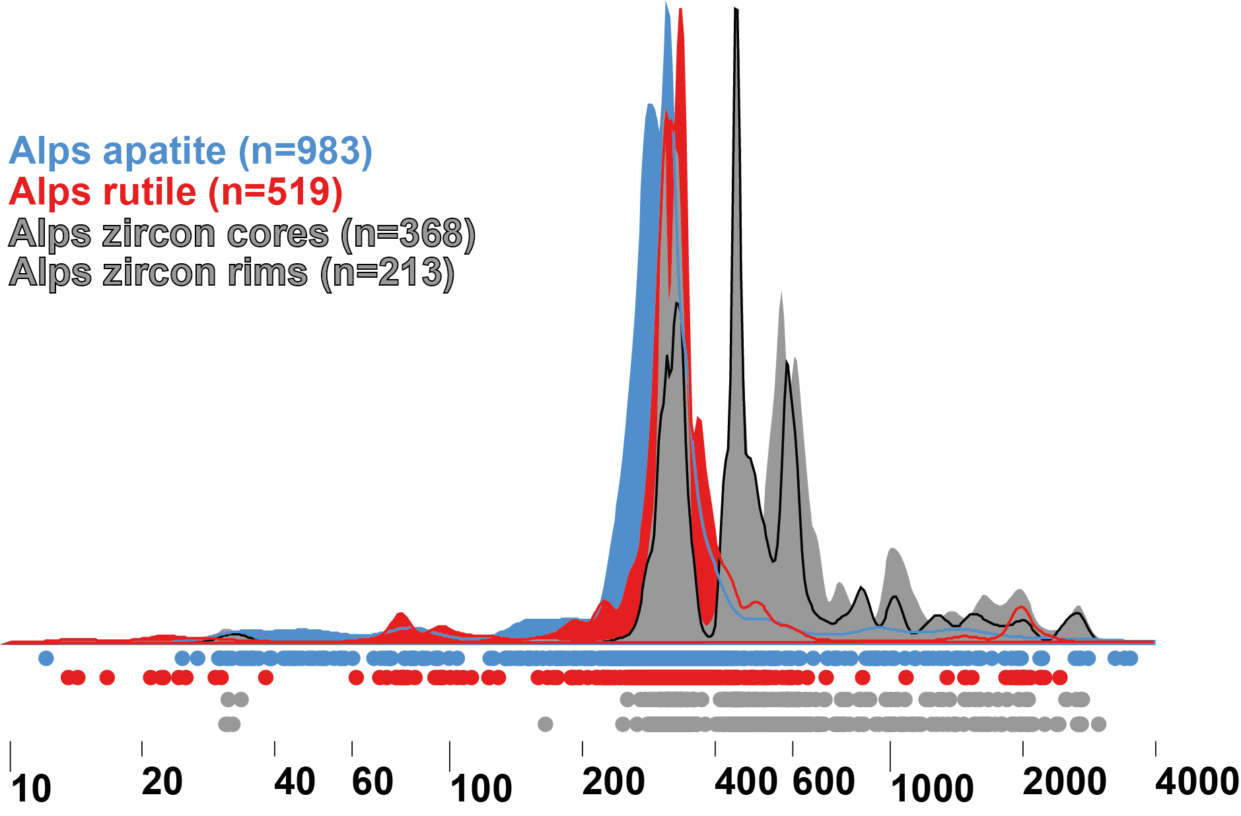
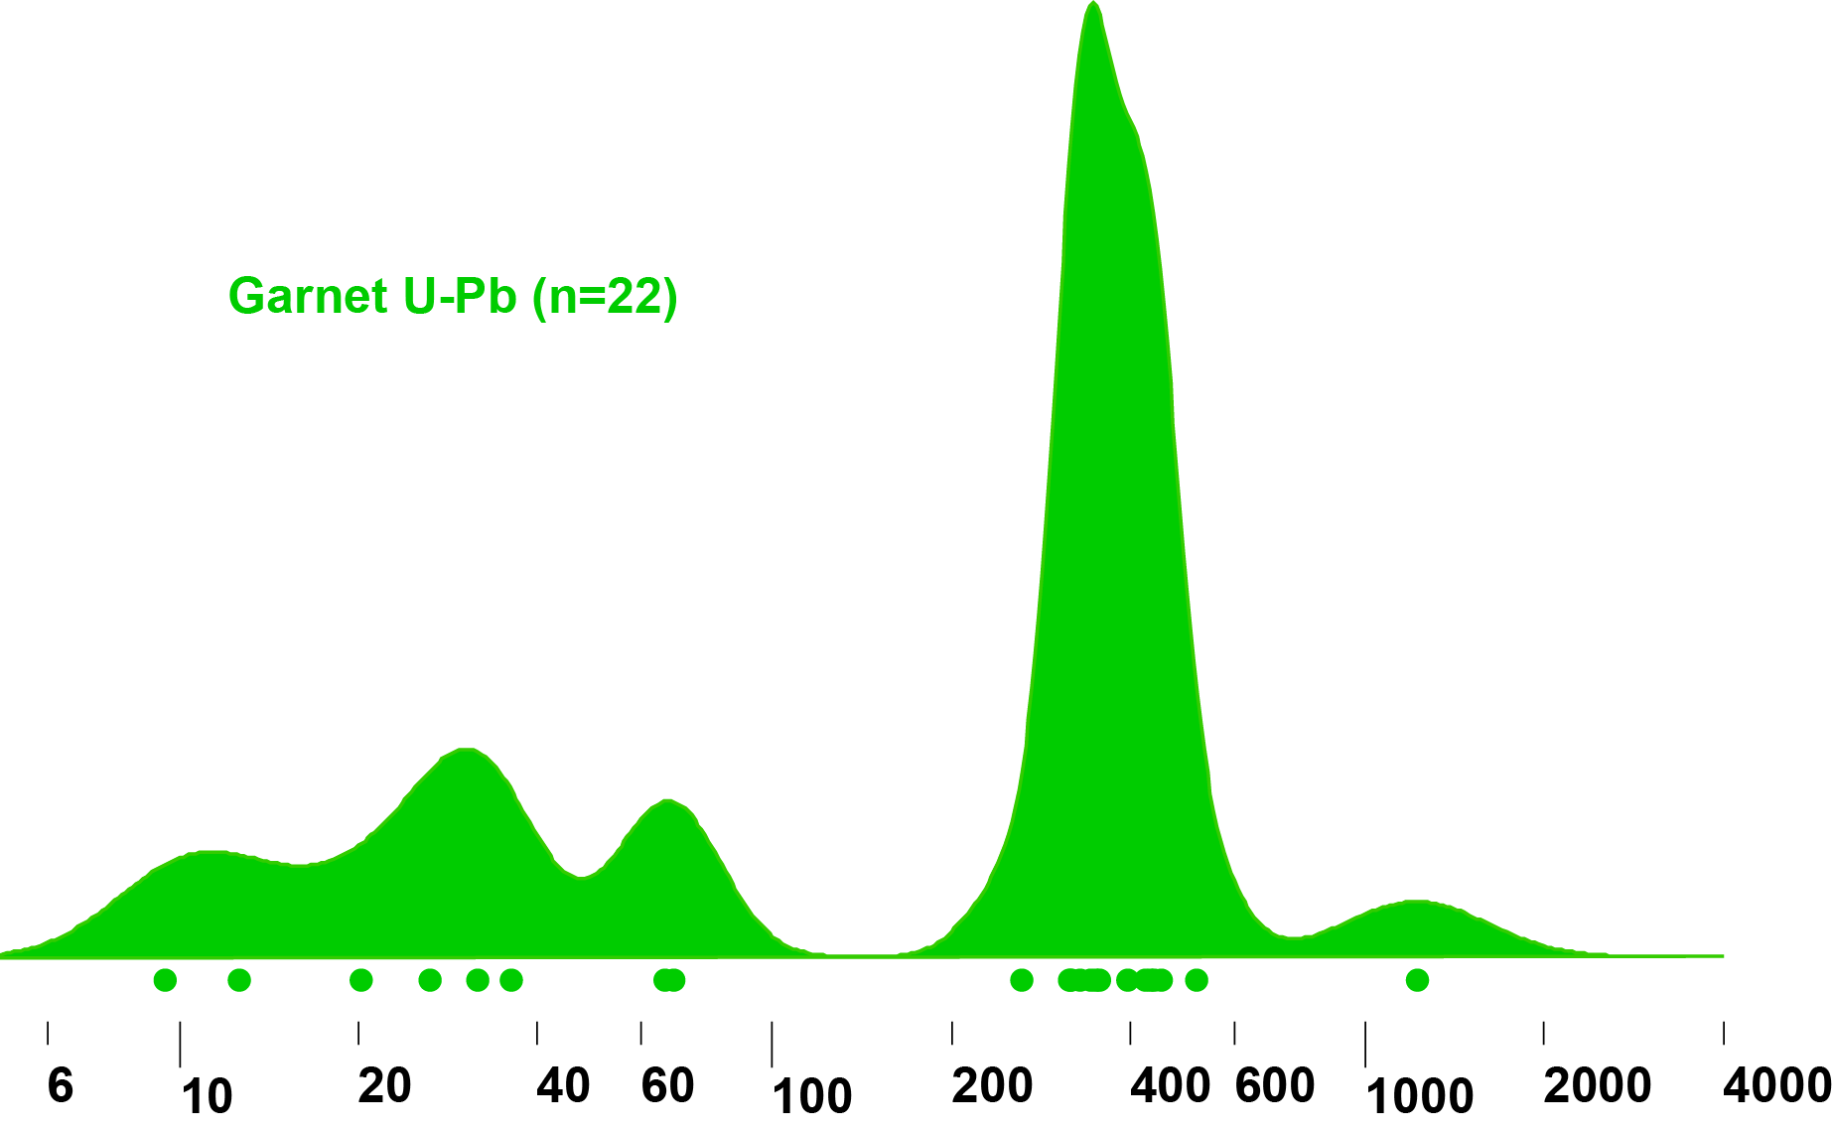
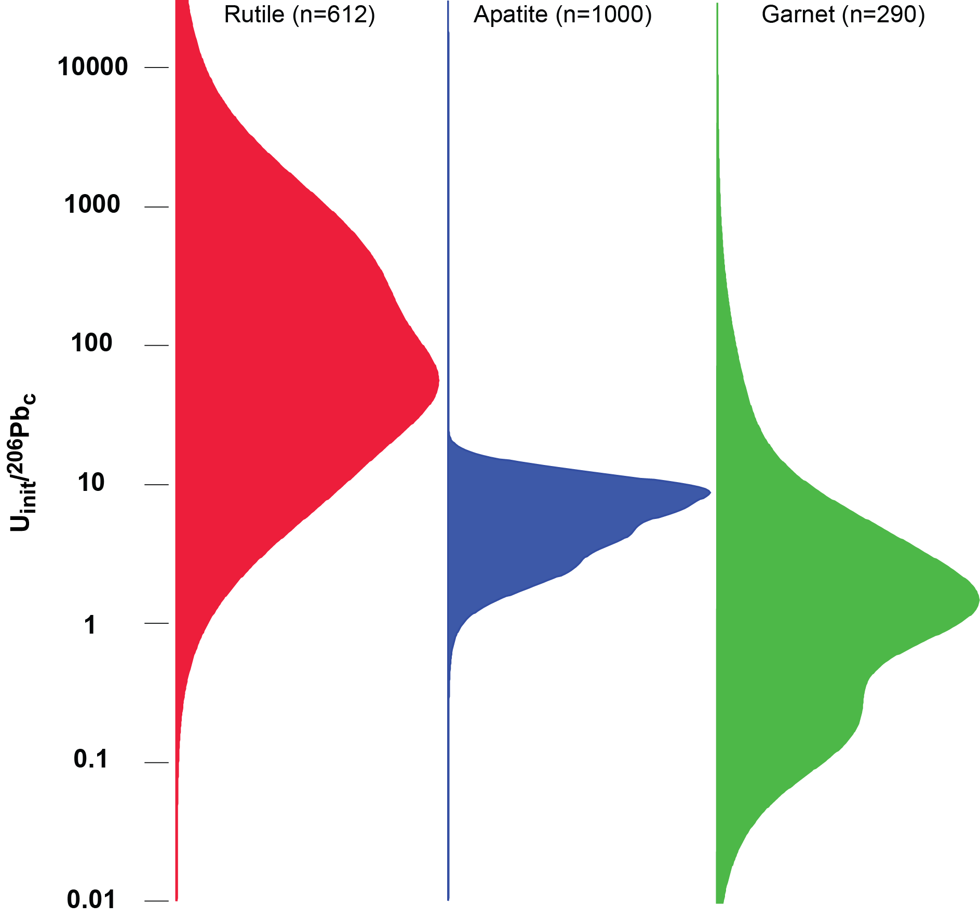
Detrital U-Pb analyses from the Alpine pro-foreland: Comparing garnet with existing methods.
(C)
Garnet: A rock-forming and accessory mineral in a wide range of metamorphic (rarely also igneous) rocks. Resistance to weathering and diagenesis comparable to apatite & titanite
-> widely present in detrital record.
Detrital garnet seldom persists in metamorphic rocks beyond sub- to lower-greenschist facies grade
-> less prone to recycling than zircon or titanite.
In Alpine pro-foreland, 35% of garnet U-Pb ages record the Alpine orogen…<1% of zircon U-Pb ages do so (A).
However, garnet initial U/common Pb ratios nearly two orders of magnitude lower than rutile (B)
-> many garnet grains undatable (C).
(A)
Alps garnet (n = 22)
Hover mouse to view video controls
Undateable
Date obtained
81
8
1
(B)
Median U_{init} /²⁰⁶Pb_{c}
Age (Ma)
Mark et al., 2016, 2018; Zimmerman et al., 2018

