Slide 1

Yield estimation of the 2020 Beirut explosion using
open access waveform and remote sensing data
Christoph Pilger¹, Peter Gaebler¹, Patrick Hupe¹, Andre Kalia¹,
Felix Schneider², Andreas Steinberg¹, Henriette Sudhaus³, Lars Ceranna¹
¹ BGR Bundesanstalt für Geowissenschaften und Rohstoffe, Hannover
² GFZ Geoforschungszentrum, Potsdam
³ CAU Christian Albrechts Universität, Kiel
Contact: christoph.pilger@bgr.de
EGU21-89, NH8.6

Slide 2
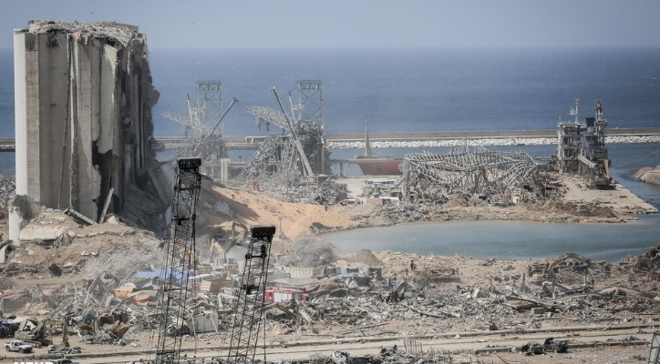
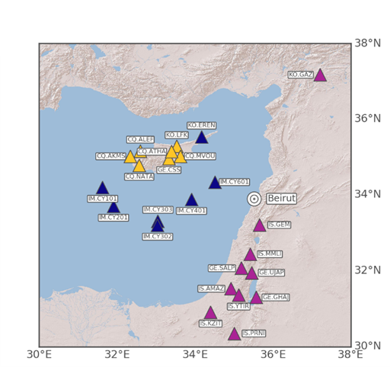
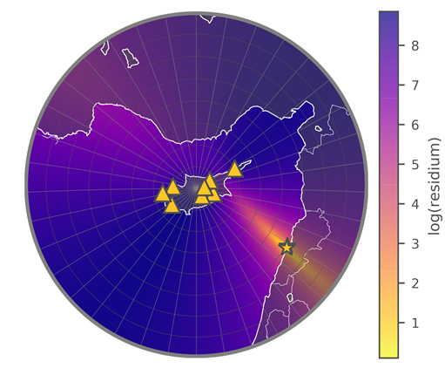
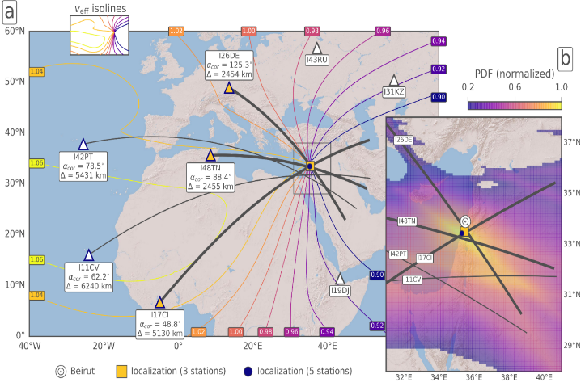
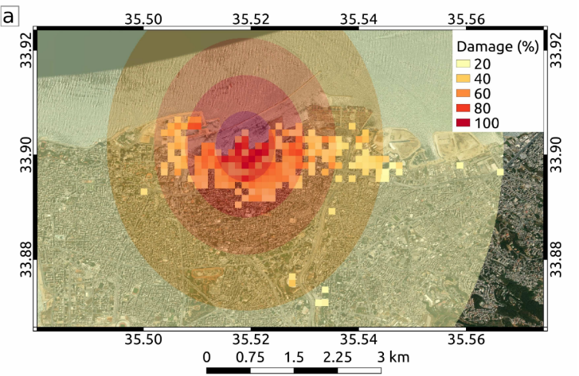
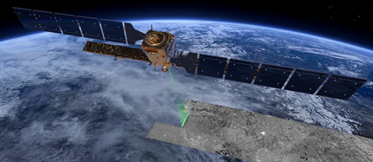
Introduction
SHA-data analysis
4. August 2020 15:08 UTC, Beirut harbor warehouse
Accidental combustion of 2.75 kt ammonium nitrate
24 accessible seismometers in up to 400km distance
Seismic+Hydroacoustic+Acoustic signatures recorded
>200 fatalities,
huge damage
and shock wave
3x yield estimation
with independent,
open-access data
moment tensor
location and
yield estimation
Accuracy < 1 km
Yield ~ 1.1 kt TNT
Source: Mehr News
Infrasound signatures
InSAR damage maps
5 IMS infrasound stations up to 6240 km distance
Array processing and two empiric yield relations
Interferometric radar images before/after explosion
Damage estimation and peak overpressure relation
Grid search
location and
yield estimation
Accuracy ~44 km
Yield 0.86-1.06
kt TNT
Relative vs
expected
damage to
quantify yield
Yield 0.8-1.1
kt TNT

Slide 3
We report on a multi-technique analysis using publicly available data for investigating the huge, accidental explosion that struck the city of Beirut, Lebanon, on August 4, 2020. Its devastating shock wave led to thousands of injured with more than two hundred fatalities and caused immense damage to buildings and infrastructure. Our combined analysis of seismological, hydroacoustic, infrasonic and radar remote sensing data allows us to characterize the source as well as to estimate the explosive yield. The latter ranges between 0.8 and 1.1 kt TNT (kilotons of trinitrotoluene) equivalent and is plausible given the reported 2.75 kt of ammonium nitrate as explosive source. Data from the International Monitoring System of the CTBTO are used for infrasound array detections. Seismometer data from GEOFON and IRIS complement the source characterization based on seismic and acoustic signal recordings, which propagated in solid earth, water and air. Copernicus Sentinel data serve for radar remote sensing and damage estimation. As there are strict limitations for an on-site analysis of this catastrophic explosion, our presented approach based on openly accessible data from global station networks and satellite missions is of high scientific and social relevance that furthermore is transferable to other explosions.

Slide 4
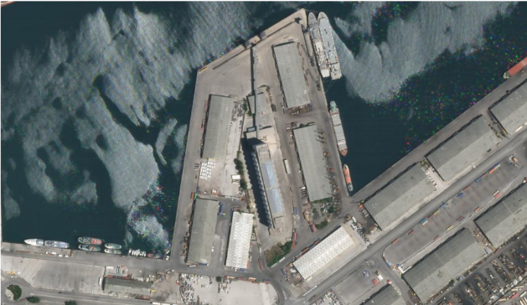
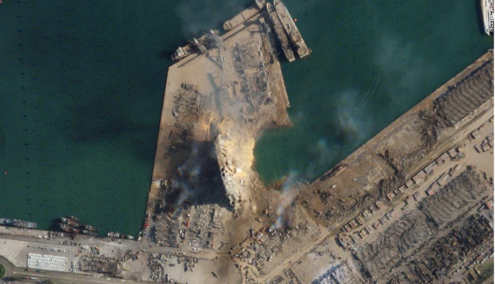
Origin and Aftermath
huge, accidental explosion in the city of Beirut, Lebanon
4th of August 2020 around 18:08 local time (15:08 UTC)
combustion of approximately 2.75 kt ammonium nitrate
stored in harbor warehouse, followed by huge shock wave
  thousands of casualties with more than 200 fatalities
  immense damage to buildings and infrastructure
local authorities conducted on-site investigations
limited access to the explosion site due to various reasons
  Destruction, contamination, SARS-CoV-2 pandemic
  sparse direct information and data from the explosion
Independent, third-party estimation of the yield of the explosion
from the analysis of publicly available waveform and remote sensing data
before
after
Source: Planet Labs Inc.

Slide 5
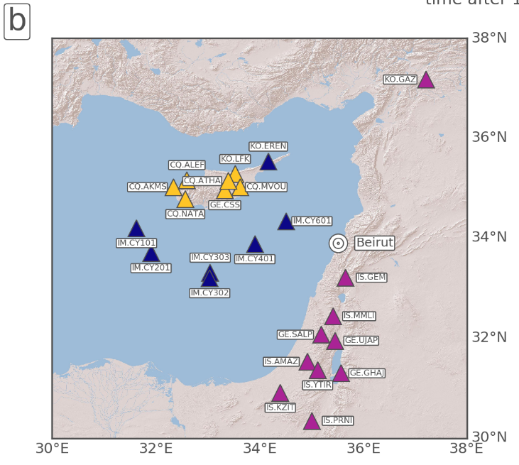

Publicly available data from seismometers
seismometers located in the region around Beirut
data publicly available from GEOFON/IRIS networks
  signals detected by at least 24 seismometers in distances of up to 400 km
  identification of seismic, hydroacoustic and acoustic phases
    seismic phases: onshore north and south of Beirut
    hydroacoustic: at ocean bottom seismometers
    acoustic phases: seismometers located on Cyprus

Slide 6

Localization using the acoustic arrivals on Cyprus
grid search method (distances up to 400 km, backazimuth up to 360 degrees)
linear regression analysis to fit apparent velocity to observed seismic arrivals
  best fitting apparent velocity: 0.344 km/s
  best source location: 33.863°N, 35.502°E
  origin time: 15:08:18 UTC
Yield estimation using seismic data
moment tensor inversion using local seismometer stations
  moment magnitude: 3.47, estimated yield: 1.08 kt TNT
  (using relation of moment magnitude to strain energy drop
  via shear stress-change/modulus, Kanamori 1977)
relation of body wave magnitude measurement to yield (as a lower limit threshold)
  Body wave magnitude: 3.2 (REB), estimated yield: 0.13 to 0.34 kt TNT
(using wet hard rock and dry unconsolidated rock assumption.
Dolomite rock at explosion site, Brax et al. 2016)

Slide 7
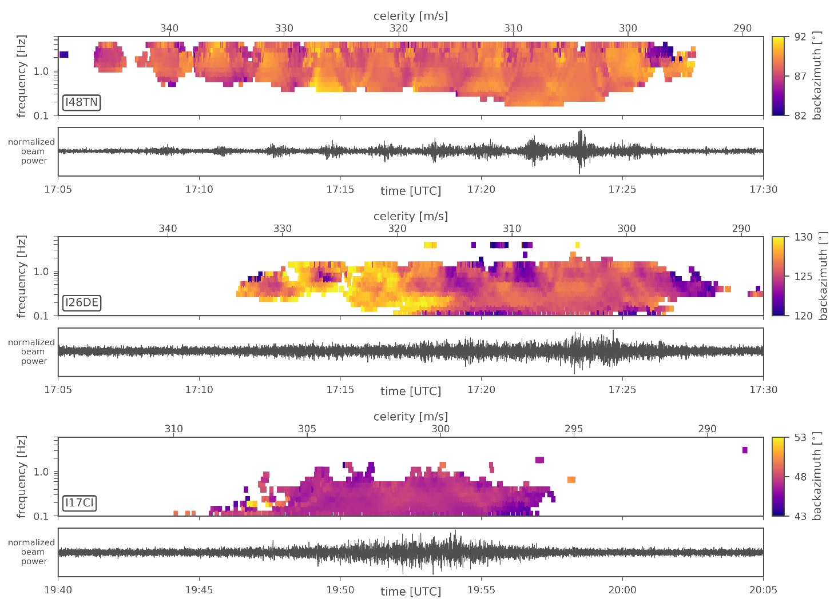
Infrasonic signatures
IMS infrasound arrays in distances of up to 10000 km from Beirut were investigated
detections associated with the explosion found at 5 IMS infrasound arrays:
  I48TN (Tunisia)
  I26DE (Germany)
  I17CI (Ivory Coast)
  I42PT (Azores)
  I11CV (Cape Verde)
PMCC (progressive multi-
channel correlation) method
for the determination of
  backazimuth of the signal
  for source localization
  amplitude/period of the
  signal for yield estimation

Slide 8

Localization using IMS infrasound arrays
source localization using
a grid-search algorithm
selection of a station subset
of the three best-
detecting stations
(I26DE, I48TN, I17CI)
source location around 44 km
away from ground truth
also using three best-detecting stations I26DE, I48TN, I17CI
application of two yield relations (AFTAC: ReVelle et al. 1997; LANL: Whitaker et al. 2003)
  estimated yield: 0.86 to 1.06 kt TNT
Yield estimation using infrasound

Slide 9

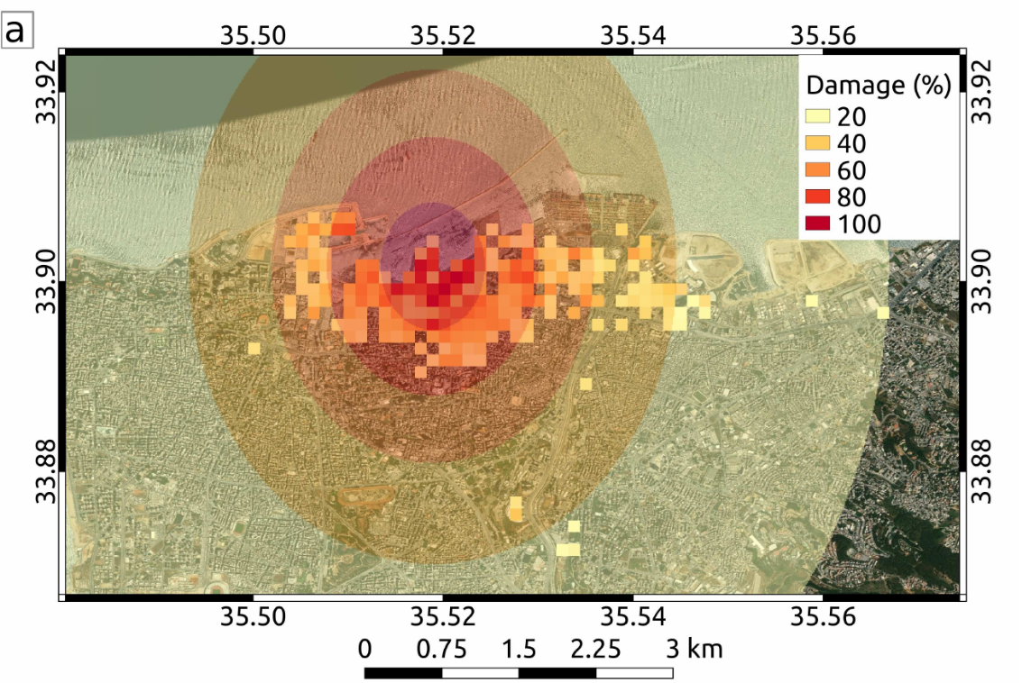
InSAR: Relative and expected damage
InSAR
(Interferometric
synthetic-aperture
radar) from
Sentinel-1 Satellite
blast of the explosion caused a wide range
of damage to buildings
  Strong differences in space-borne SAR
  images before and after the explosion
quantification of this differences by
interferometric coherence, which is related
to the relative damage
Relative damage is measured in percent of
pixels that experienced significant loss of
interferometric coherence
  Comparison of relative damage
  to expected damage
  after relative damage classes
Source: ESA

Slide 10

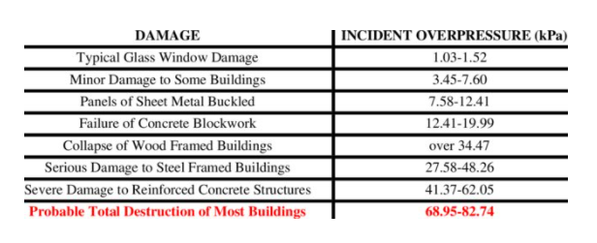
Linking overpressure simulations and InSAR derived damage maps
“BOOM” equation (Douglas 1987) relates yield
of an explosion to resulting peak overpressure
assumption of a relation between peak
overpressure and resulting damage
80 kPa overpressure are set to result in 100% destruction
calibration using ground-truth (media report) information
Best fitting and upper boundary curves: estimated yield: 0.8 – 1.1 kt TNT
Yield estimation using InSAR

Slide 11
Summary
Beirut explosion produced seismic, hydroacoustic and infrasonic waveforms
Damage to city infrastructure observable in InSAR remote sensing satellite images
Location accuracy: 44km (IMS-infrasound arrays), < 1km (adding regional seismometers)
Yield estimation using seismometers, infrasound arrays, InSAR satellite images:
  consistent best yield estimation: 0.8 to 1.1 kt TNT
  good agreement with other published results (Rigby et al. 2020; Diaz 2021)
  lower (body wave) boundary: 0.13-0.3 kt TNT, upper (InSAR) boundary: 1.1 kt TNT
Utilization of open-access data from seismometers, infrasound arrays, satellites
  involves CTBT-IMS sensors as well as additional national technical means
  allows reliable identification, localization and characterization of the explosion
  fulfills the IMS design goal to detect any explosion with a yield around 1kt TNT

Slide 12
Yield estimation of the 2020 Beirut explosion using
open access waveform and remote sensing data
Christoph Pilger, Peter Gaebler, Patrick Hupe, Andre Kalia,
Felix Schneider, Andreas Steinberg, Henriette Sudhaus, Lars Ceranna
Contact:
christoph.pilger@bgr.de
Preprint:
https://doi.org/10.31223/X5W027
(study submitted to Scientific Reports, under review)

