Slide 1
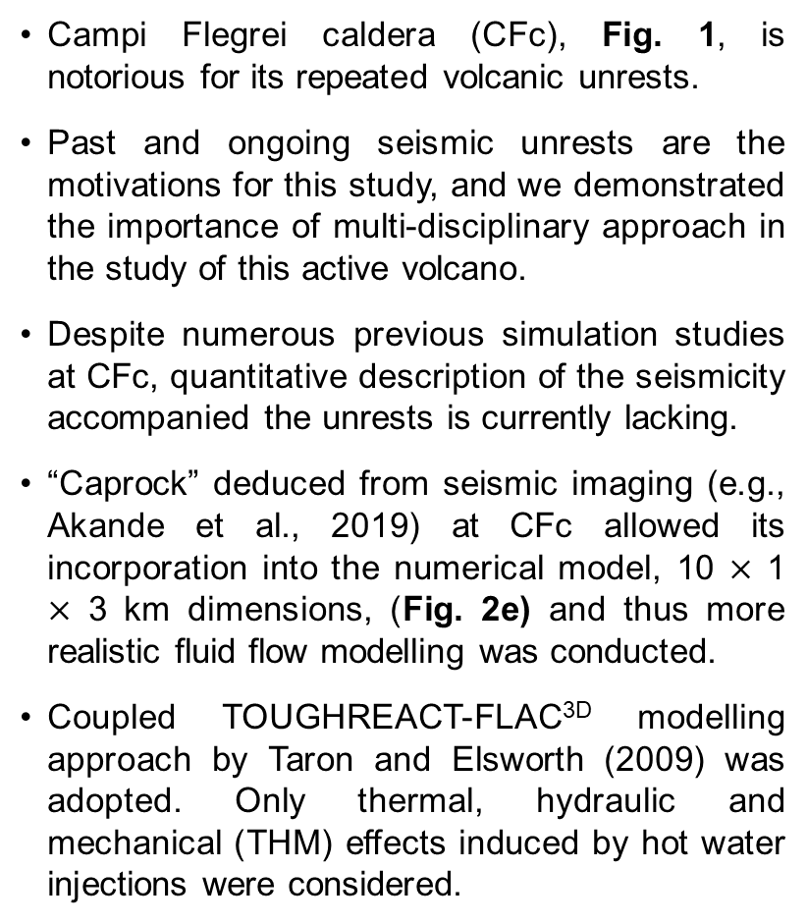
Numerical Modelling of Injection-induced Seismicity at Campi Flegrei Caldera, Southern Italy
Waheed Gbenga Akande, Quan Gan, David G. Cornwell, and Luca De Siena
Real seismicity data recorded at observatory (INGV-OV, Vesuvius Italy) between Aug. 5 – Dec. 5, 2019 (Panel a).
Campi Flegrei caldera (CFc), Fig. 1, is notorious for its repeated volcanic unrests.
Past and ongoing seismic unrests are the motivations for this study, and we demonstrated the importance of multi-disciplinary approach in the study of this active volcano.
Despite numerous previous simulation studies at CFc, quantitative description of the seismicity accompanied the unrests is currently lacking.
“Caprock” deduced from seismic imaging (e.g., Akande et al., 2019) at CFc allowed its incorporation into the numerical model, 10 $×$ 1 $×$ 3 km dimensions, (Fig. 2e) and thus more realistic fluid flow modelling was conducted.
Coupled TOUGHREACT-FLAC^{3D} modelling approach by Taron and Elsworth (2009) was adopted. Only thermal, hydraulic and mechanical (THM) effects induced by hot water injections were considered.
The key questions are: (1) Can the highest recorded seismicity since April 1984 (i.e., in 2019 and 2020) be induced solely by hot-water injections from depths?, and (2) Is the unrest seismicity better modelled by isothermal (HM) or non-isothermal (THM) conditions?
Fig. 3: Comparison of Magnitude-Depth plots of the real (a) versus THM modelled (b-d) seismicity.
Fluid injection causes overpressure beneath the caprock and its contrasting basal and top stress regimes caused deformation (Fig. 2a-d).
Caprock deformation determined the timing of fault slip/reactivation and magnitudes of seismicity (Fig. 3); and this is modulated by fluid injection rates and temperatures, heterogeneities due to fault and caprock and their host rocks, and thermal contrasts between injection fluid and reservoir.
The unrest seismicity was better modelled under isothermal approximations, thermal effect is 2⁰.
THM-modelled seismicity (max. mag. of ~2.5Mw within ~2 km), reproduced the magnitude at the onset of ongoing seismicity on Oct. 5th, 2019 in comparison with the recorded data at OV-INGV.
Fig. 2: Fluid injection and caprock deformation. Panel (e) is the model in 2D. Panels (a) and (b) are for Isothermal, while Panels (c) and (d) are respective Non-isothermal. A-A′ is a line of section laterally through the caprock.
Fig. 1: Location of Campi Flegrei caldera (CFc), Southern Italy.

