Slide 1

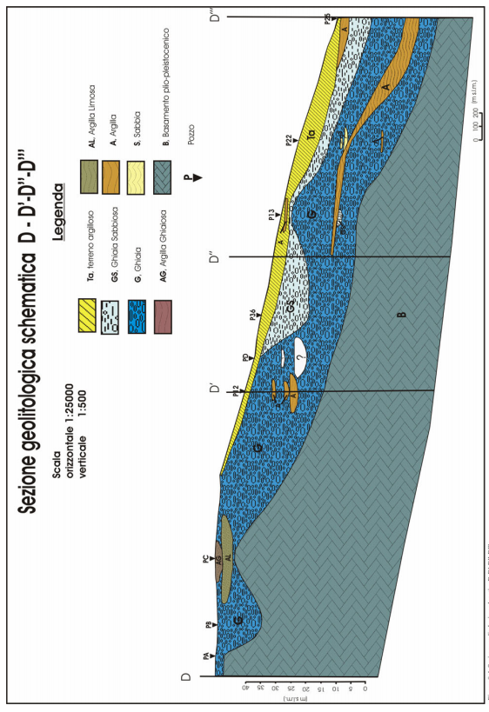
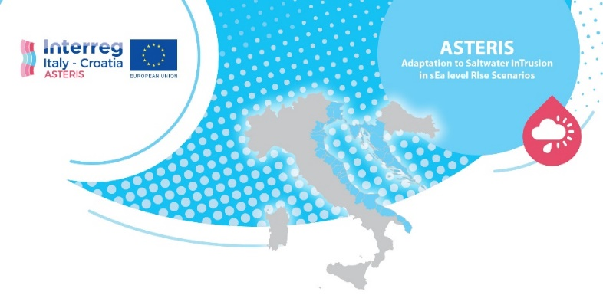
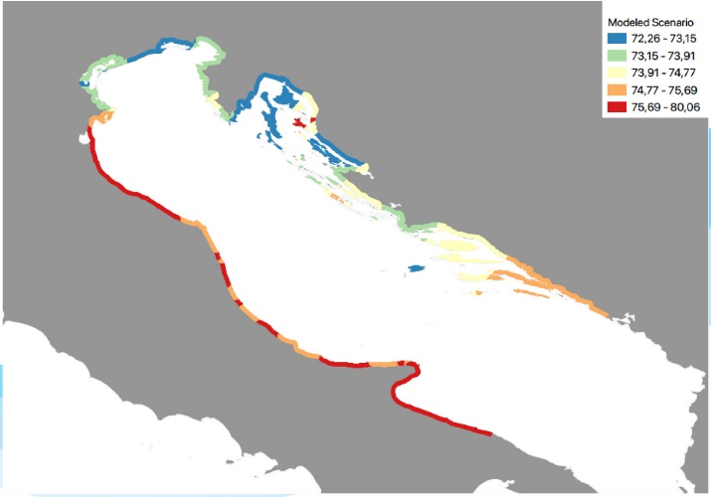
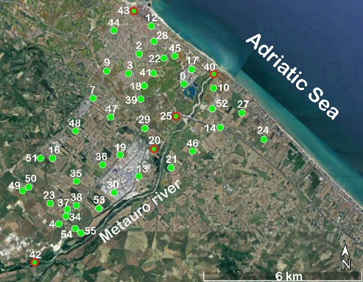
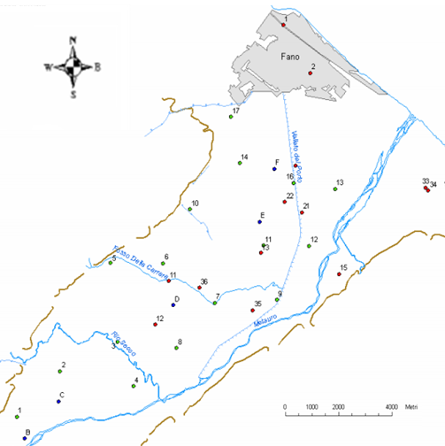
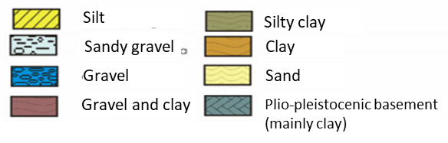

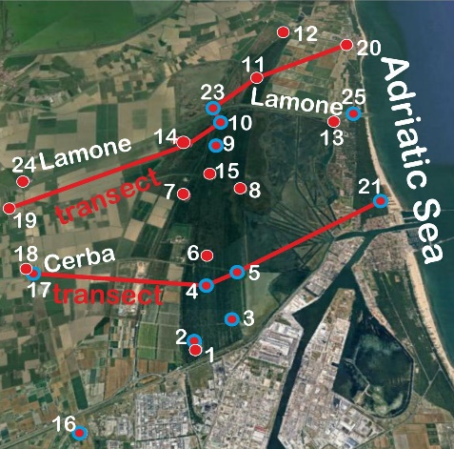
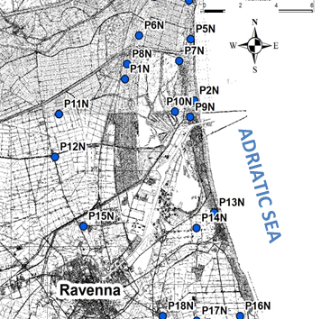
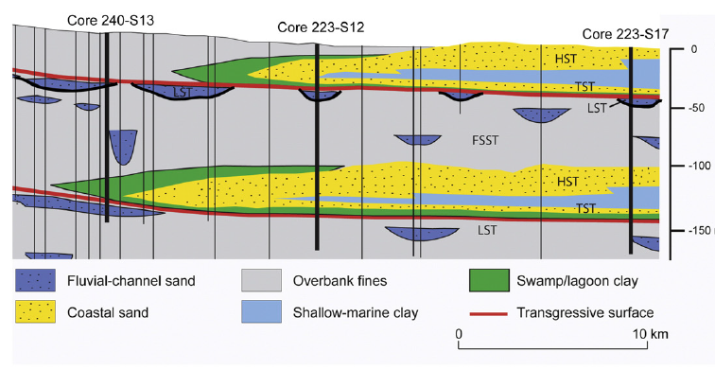


Adaptation to Saltwater inTrusion in sEa level RIse Scenarios (ASTERIS): hydrogeochemical surveys and aquifer modelling for groundwater behavior assessing in the coastal areas of Fano and Ravenna (central-eastern Italy)
HS 8.2.2
9069
Barbara Nisi¹, Matia Menichini¹, Marco Doveri¹, Jacopo Cabassi², Orlando Vaselli^{2,3}, Serena Botteghi¹, Giulio Masetti¹, Brunella Raco¹, Linda Franceschi¹, Enrico Calvi¹, and Sandra Trifirò¹
1-CNR-IGG, Institute of Geosciences and Earth Resources, Pisa, Italy (barbara.nisi@igg.cnr.it); 2-CNR-IGG, Institute of Geosciences and Earth Resources, Firenze, Italy; 3-Department of Earth Sciences, Firenze, Italy
FUTURE SCENARIOS FOR SEA LEVEL IN ADRIATIC BASIN
Case studies: Fano and Ravenna coastal areas
Fano
FANO
ADRIATIC SEA
Ravenna
Fano
The ASTERIS project has been financed at the Call for proposal 2017 Priority Axis Safety and resilience of Interreg V Italia-Croazia 2014-2020 Programme.
Adriatic Sea
Monitoring: from June 2019 to December 2020
3 surveys for water sampling and physicochemical parameters at Fano and Ravenna
Ravenna
5 surveys for piezometric and physicochemical parameters at Fano
4 surveys for piezometric and physicochemical parameters along two main transects orthogonal to the coastline at Ravenna
Concluding remarks
Geochemical modeling and hydrogeological investigations evidenced that the Ravenna aquifer is already affected by a significant (up to 80 %) contribution of saline intrusion whereas that of Fano is still apparently dominated by fresh waters fed by the Apennine chain and Metauro River.
The Ravenna and Fano aquifers are thus representing two important end-members for modeling and simulating different scenarios related to possible future climate changes and, eventually, export these results to other areas of the Adriatic Sea.

