Slide 1
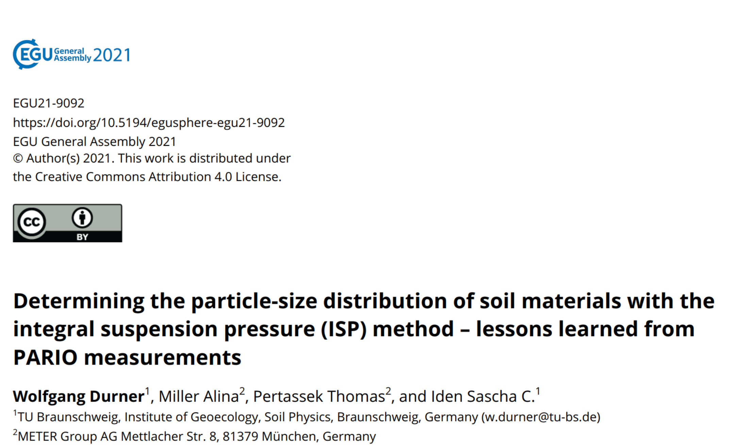

Slide 2
Overview
Intro
Factors affecting the accuracy of PARIO
ISP⁺
Test with
real data

Slide 3
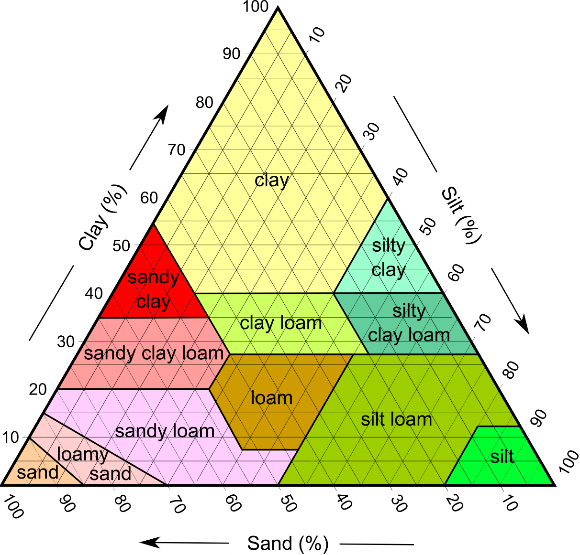
Particle size distribution determines soil texture
Example:
20 % sand
60 % silt
20 % clay
→
„silt loam“

Slide 4
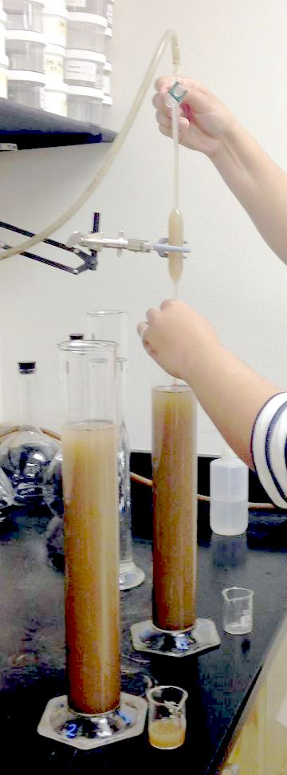
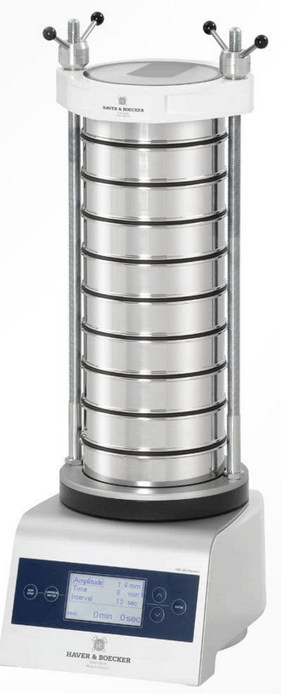
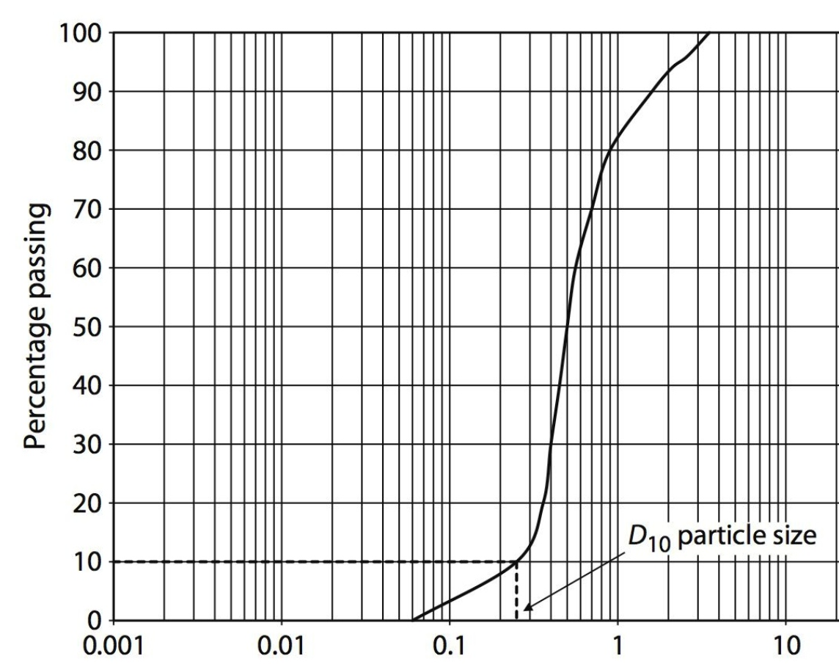
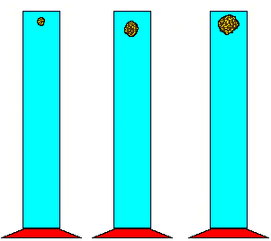

Cumulative particle-size distribution curve is obtained by sieving and sedimentation
clay
silt
sand
gravel

Slide 5
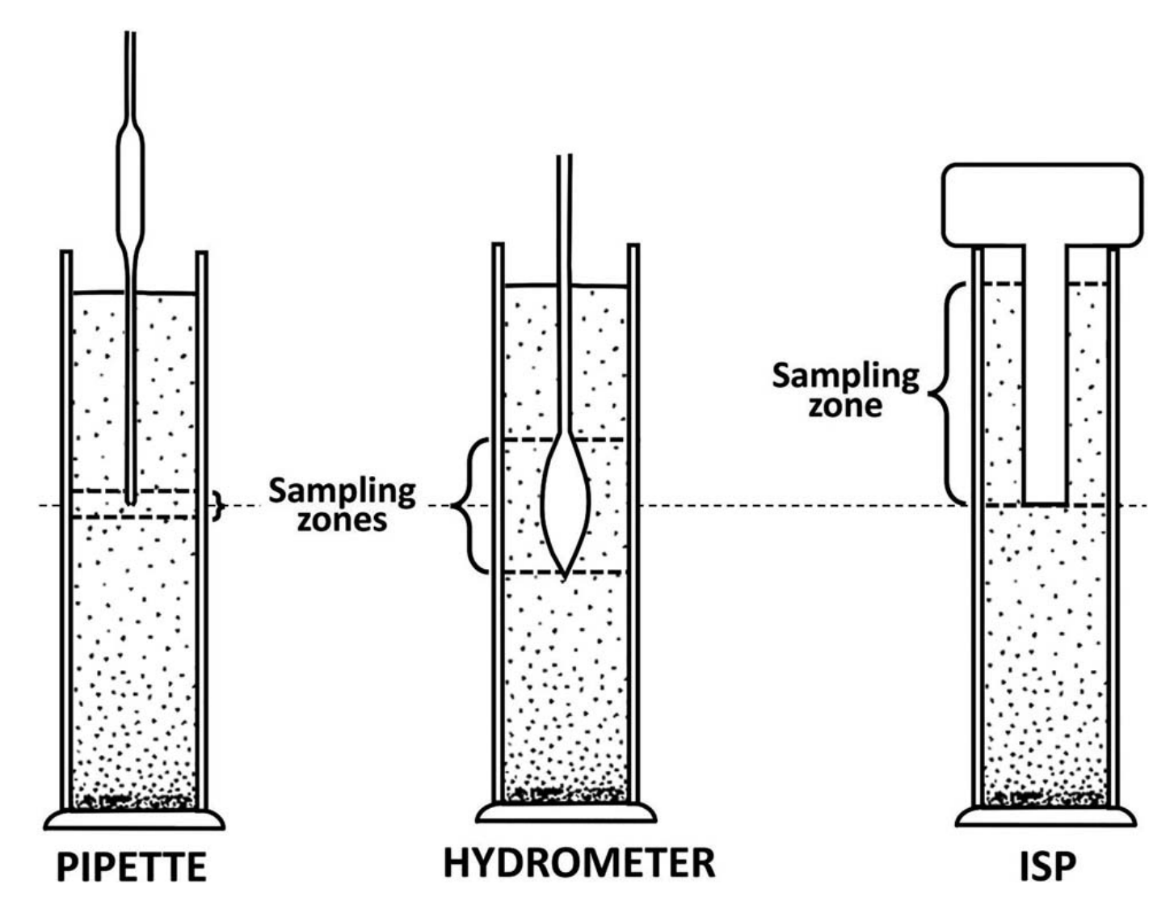
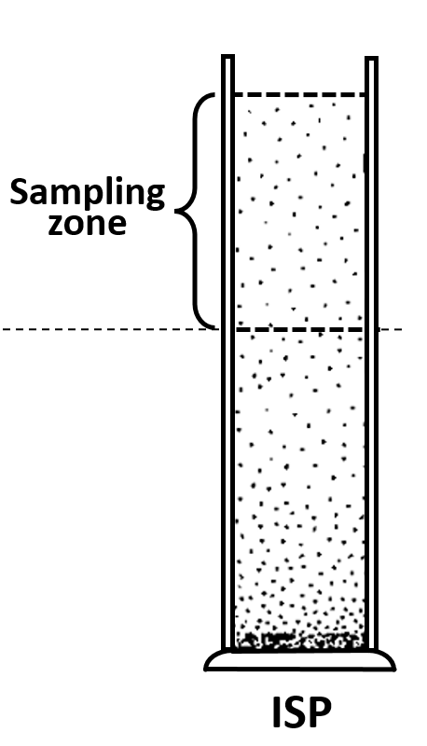



Three alternative methods for sedimentation analysis
Sedimentation of particles: pedological reference method for particle size distribution (PSD)
Particles settle with size-dependent velocity in a sedimentation cylinder.
Sinking fronts are formed and the particle size distribution can be determined traditionally by taking an aliquot of the suspension (PIPETTE method) or by measuring the buoyancy of a body (HYDROMETER method).
$$p$$
HYDROMETER
Köhn, 1931
Casagrande, 1934
Durner et al., 2017
A recent variant is the integral suspension pressure method (ISP), in which the suspension pressure is measured continuously at one depth and the particle size distribution is determined by an inverse simulation of the change in pressure signal over time.

Slide 6
Overview
Intro
Factors affecting the accuracy of PARIO
ISP⁺
Test with
real data

Slide 7
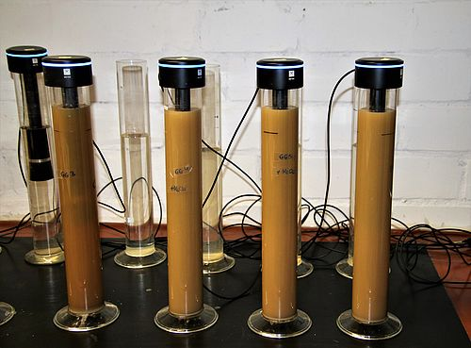
Accuracy of PARIO with ISP
Practical tests:
accuracy of the ISP is less than theoretically expected ( ±1.5 %)
measurement time exceeds it’s theoretical expectation (6 h).

Slide 8
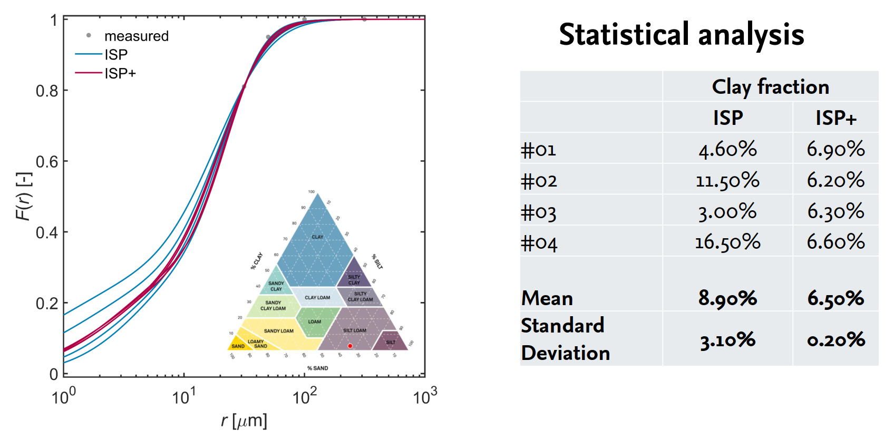

ISP classic: Low accuracy for clay fraction

Slide 9
Reason: Variability of initial pressure decrease

Slide 10
Causes and remedies
  → Mixing (overhead shaking vs. stirring)
  → Temperature effects
  → Errors in soil mass
  (air dry vs. oven-dry )
  → Organic matter destruction
  → Mass of dispersant

Slide 11
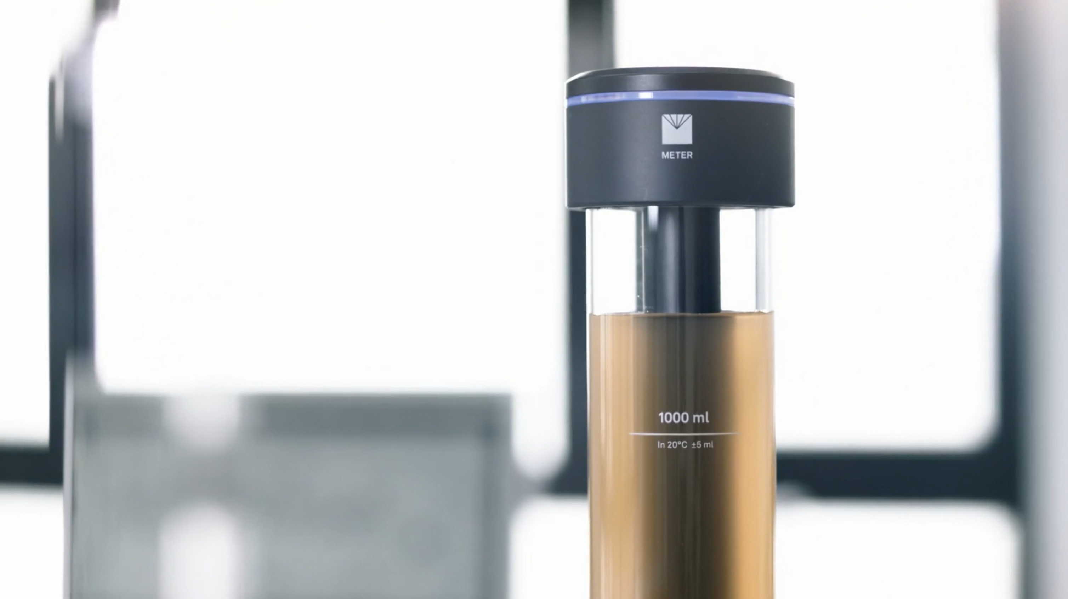
1,5 h am präzisesten, Abweichung zum Erwartungswert kann noch verringert werden
Schluffgehalte im Verhältnis zu Tongehalten nur ungenau bestimmt
Oxidation organischer Substanz beschleunigen
Auf Ablass nicht komplett verzichten, aber auf zweistufigen Ablass
Konstante Temperatur während Messung gewährleisten
Influence of mixing
  → Mixing wets all the material above the supension level and causes retarded flow on walls into the suspension in the early measurement phase

Slide 12
Pressure change by water flow from cylinder wall
Overhead shaking
Vertical stirring

Slide 13
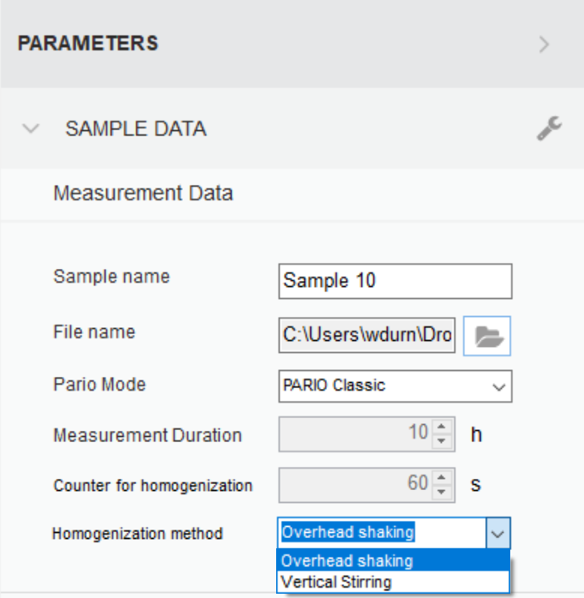
Remedy: Empirical compensation of wall flow: overhead shaking

Slide 14
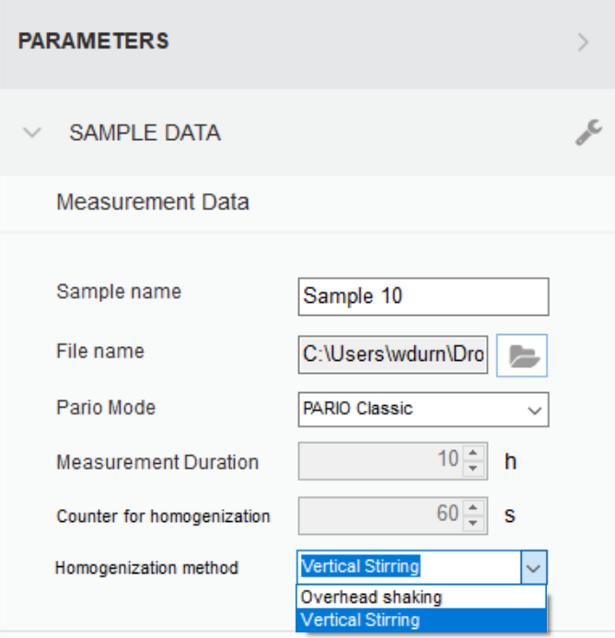
Remedy: Empirical compensation of wall flow: vertical stirring

Slide 15
Causes and remedies
  → Mixing (overhead shaking vs. stirring)
  → Temperature effects
  → Errors in soil mass
  (air dry vs. oven-dry )
  → Organic matter destruction
  → Mass of dispersant

Slide 16
Initial temperature drift in PARIO measurements

Slide 17
Initial temperature drift causes pressure drift

Slide 18
Forced temperature drift causes pressure drift

Slide 19
Pressure deviation vs. temperature deviation
ΔT

Slide 20
Empirical correction for temperature drift
Δp
ΔT

Slide 21
Remedy: Effect of the T-drift correction

Slide 22
Causes and remedies
  → Mixing (overhead shaking vs. stirring)
  → Temperature effects
  → Errors in soil mass
  (air dry vs. oven-dry )
  → Organic matter destruction
  → Mass of dispersant

Slide 23
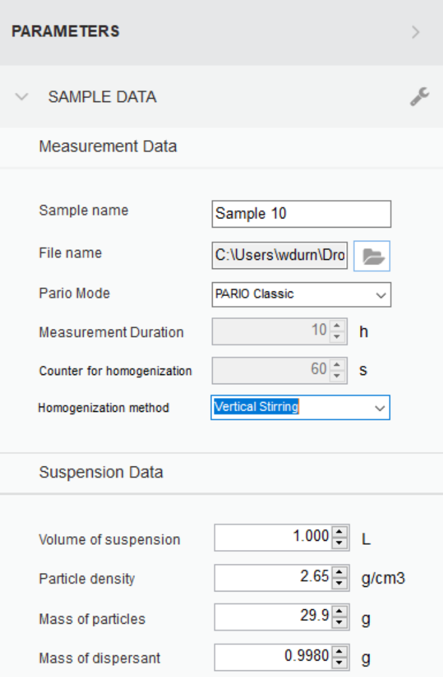
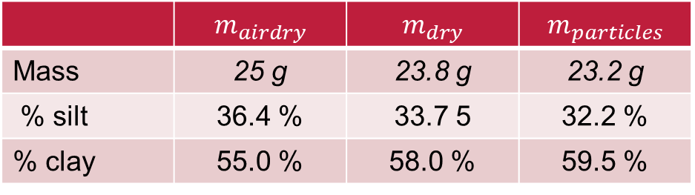
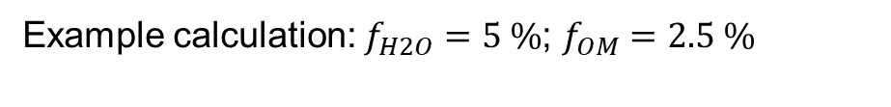


Soil mass must be dry net mass of sedimenting particles
When calculating the mineral particle weight, pay attention to the water content of the air-dry mass and, if necessary, the content of organic matter to be destroyed.
$m_{dry}=m_{airdry}∙(1−f_{H2O}$)
$m_{particles}=m_{dry}∙(1−f_{OM}$)
Example calculation: $f_{H2O}=5 \%$; $f_{OM}=2.5 \%$
 | $$m_{airdry}$$ | $$m_{dry}$$ | $$m_{particles}$$
Mass | 25 g | 23.8 g | 23.2 g
% silt | 36.4 % | 33.7 5 | 32.2 %
% clay | 55.0 % | 58.0 % | 59.5 %
Notes:
PARIO derives the silt content from the pressure changes as absolute mass and relates this to the original mass. Thus, any error in the dry soil mass strongly influences the analysis. An incorrect total mass can be caused, for example, by using air-dry material and entering this in the PARIO Control interface as total (oven) dry mass. To avoid this error, the gravimetric water content in the air-dry mass must be known to recalculate the oven-dry mass. Another source of error can be caused by not considering the mass loss by destruction of organic matter during the preparation of the suspension. If organic matter is destroyed, it also must be subtracted from total air-dry mass

Slide 24
Causes and remedies
  → Mixing (overhead shaking vs. stirring)
  → Temperature effects
  → Errors in soil mass
  (air dry vs. oven-dry )
  → Organic matter destruction
  → Mass of dispersant

Slide 25
Problem: Gas formation by incomplete oxidation

Slide 26
Problem: Gas formation by incomplete oxidation

Slide 27
Problem: Gas formation by incomplete oxidation

Slide 28
Remedy
If H₂O₂ is used :
Ensure complete oxidation by adding enough heat and providing enough time.
Problem is particularly virulent for clay-humus complexes.

Slide 29
Causes and remedies
  → Mixing (overhead shaking vs. stirring)
  → Temperature effects
  → Errors in soil mass
  (air dry vs. oven-dry )
  → Organic matter destruction
  → Mass of dispersant

Slide 30
Mass of dispersant: problem and solution
Example Na₂P₄O₇ × 10 H₂O
(tetra-sodium diphosphate decahydrate, )
Original concentration of dispersant salt in dispersant solution | 44.6 g/L
dry concentration of dispersion salt in dispersant solution | 26.6 g/L
Errors in the assumed salt concentration is of less relevance in mode PARIO classic, but of utmost importance in PARIOplus.

Slide 31
Overview
Intro
Accuracy of PARIO
ISP⁺
Test with
real data

Slide 32
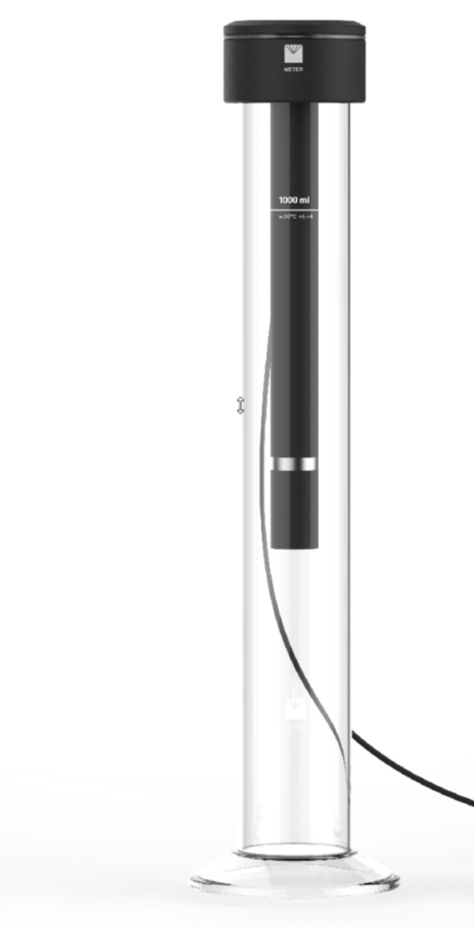
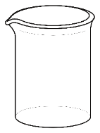
ISP⁺ ?
    ISP⁺ (read “ISP plus”) is an extension of the experimental protocol.
    At some time in a ISP⁺ measurement, part of the suspension is released laterally from the sedimentation, collected in a beaker, and oven-dried.
    The dry mass of the collected soil particles is included into the objective function of the inverse problem.
ISP measurement
Release of suspension

Slide 33
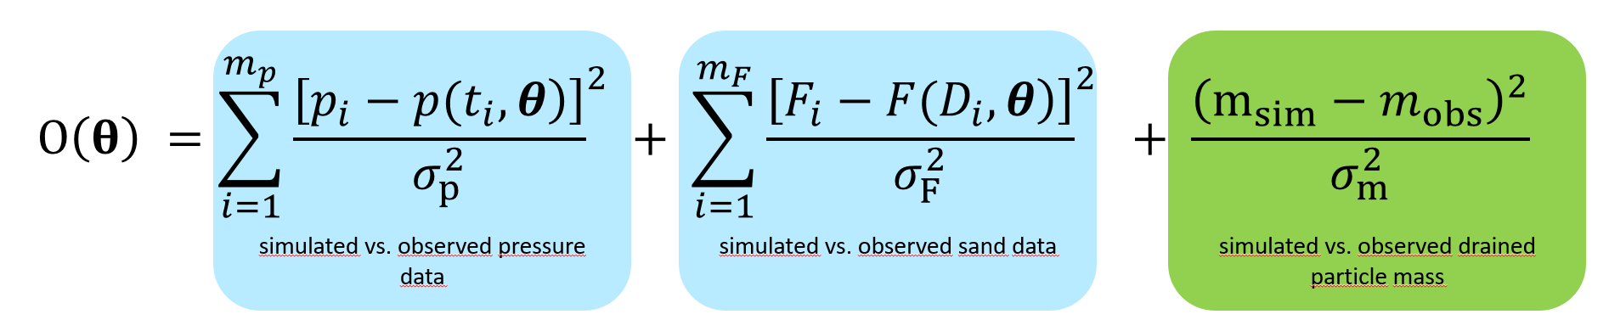
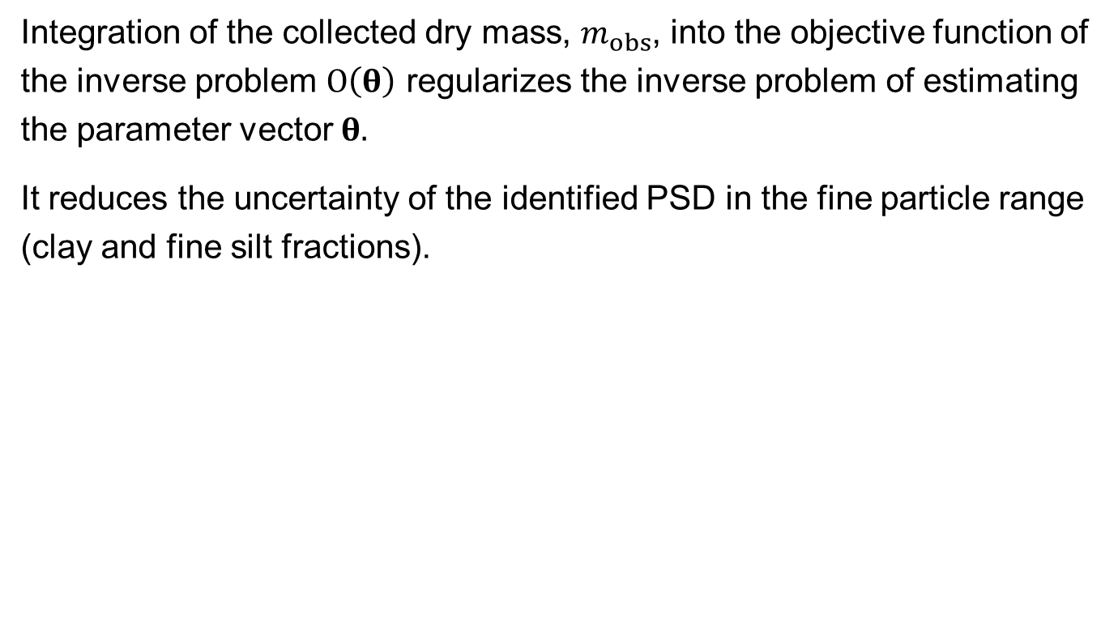
Object function in ISP⁺
    Integration of the collected dry mass, $m_{obs}$, into the objective function of the inverse problem $O\left(θ\right)$ regularizes the inverse problem of estimating the parameter vector $θ.$
    It reduces the uncertainty of the identified PSD in the fine particle range (clay and fine silt fractions).

Slide 34
Overview
Intro
Theory ISP
Theory ISP⁺
Test with
real data

Slide 35
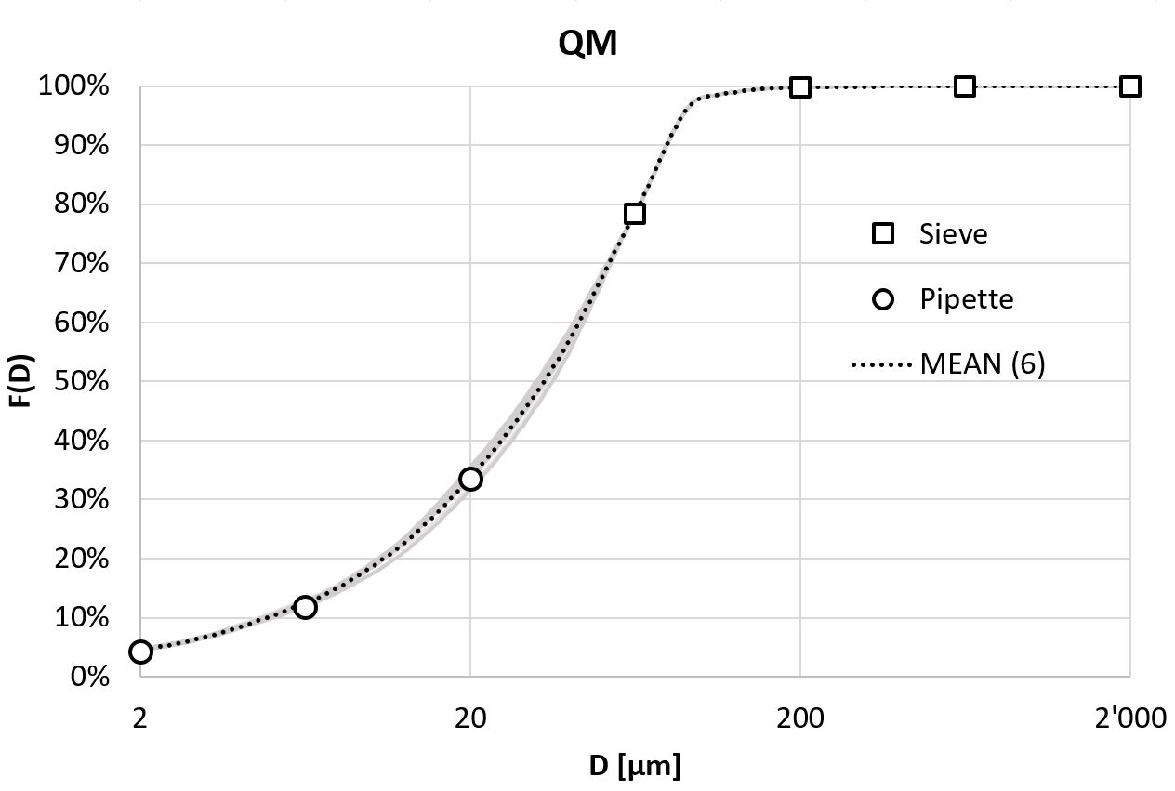
PARIOplus Test Soil 1

Slide 36
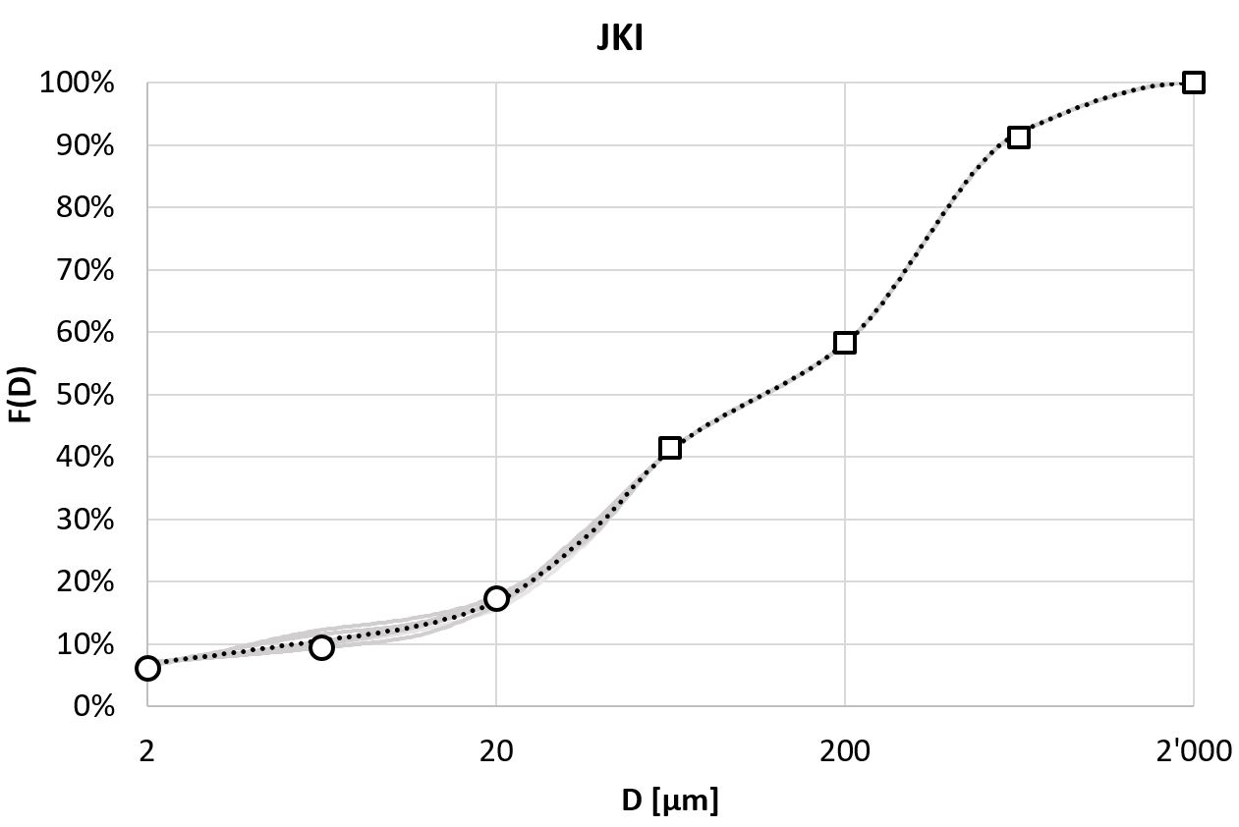
PARIOplus Test Soil 2

Slide 37
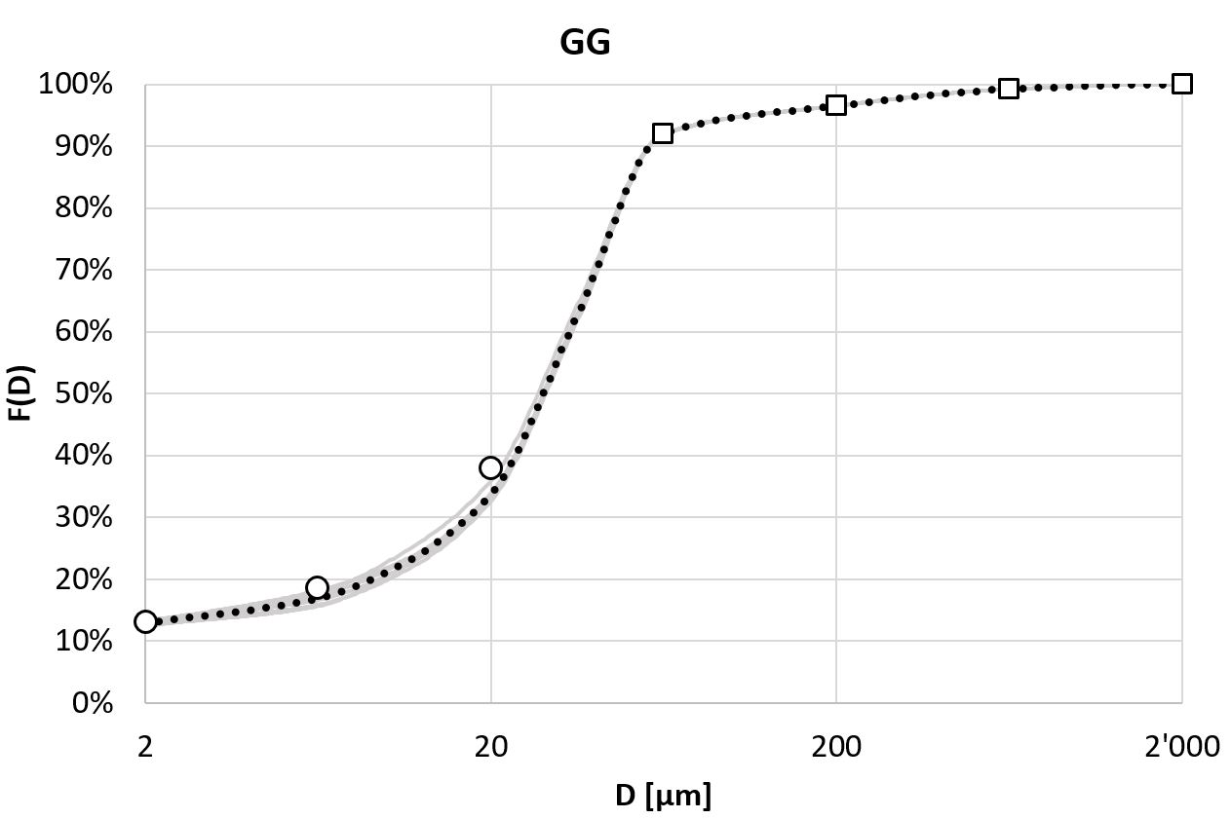
PARIOplus Test Soil 3

Slide 38
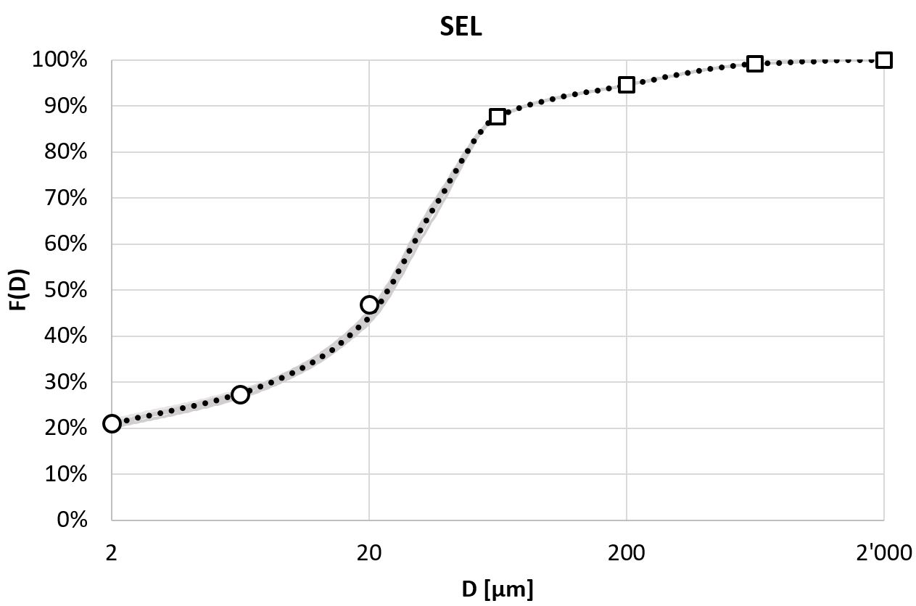
PARIOplus Test Soil 4

Slide 39
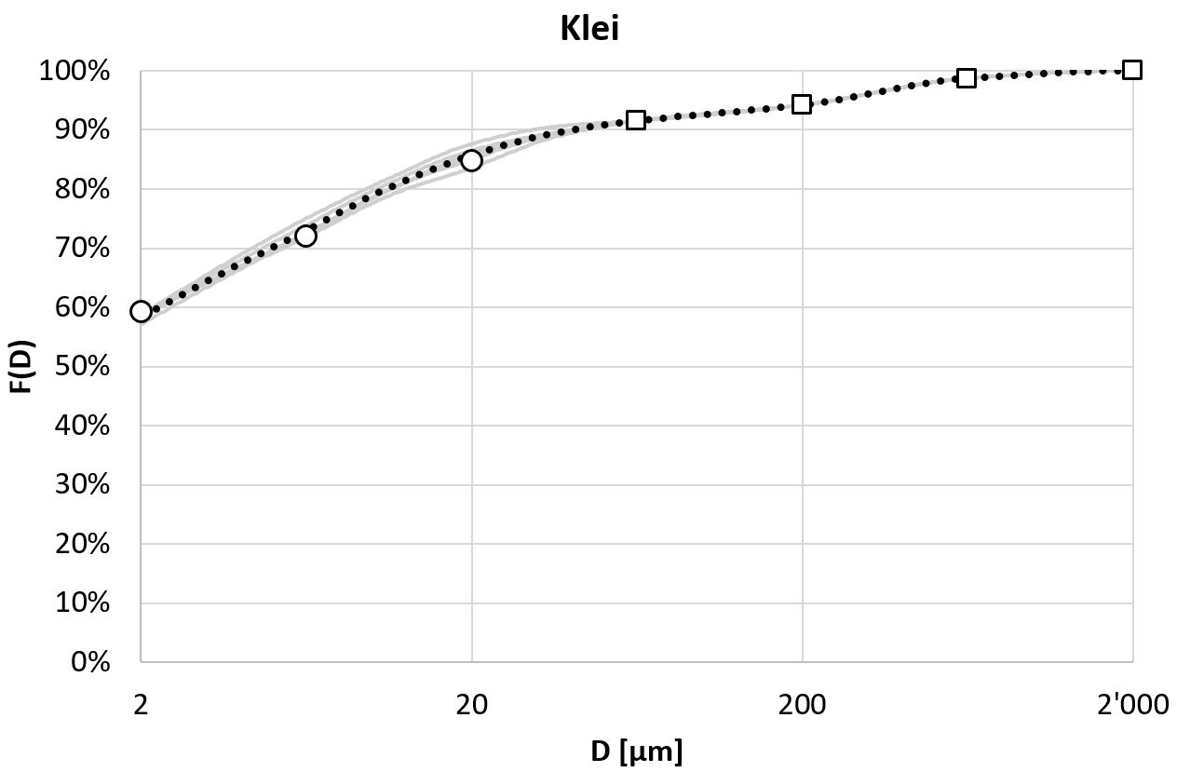
PARIOplus Test Soil 5

Slide 40
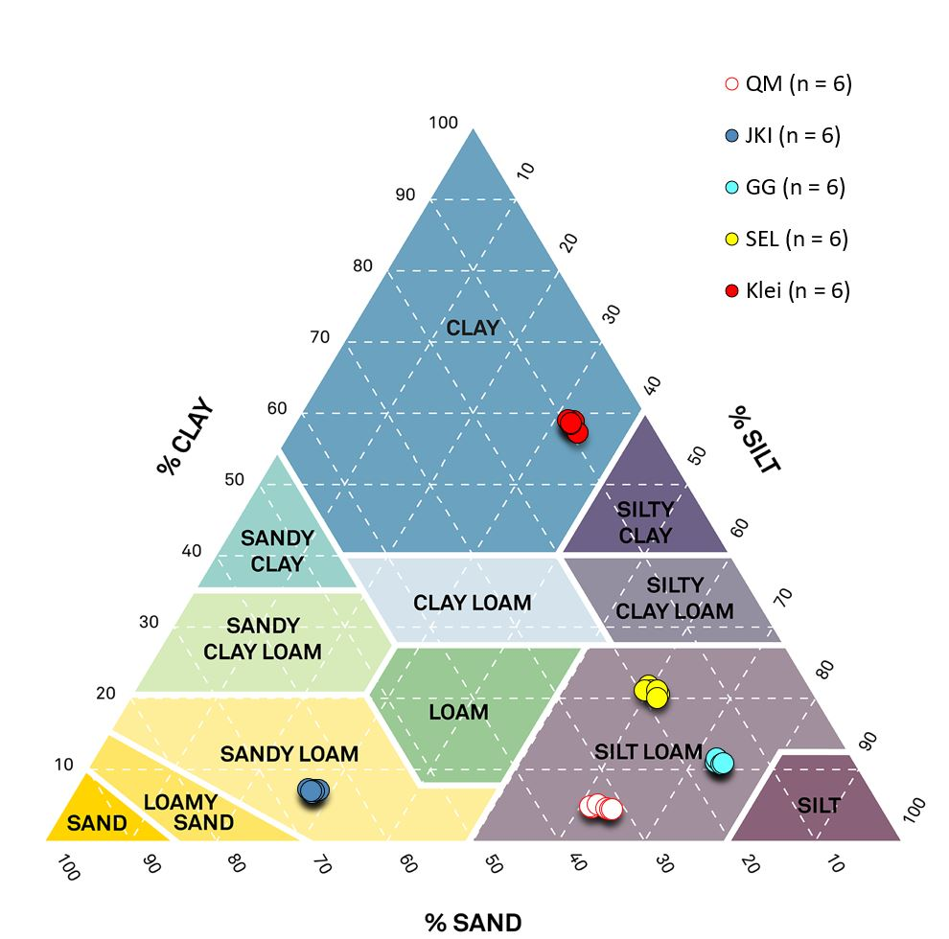
Results of replicate analyses for five test soils.

Slide 41
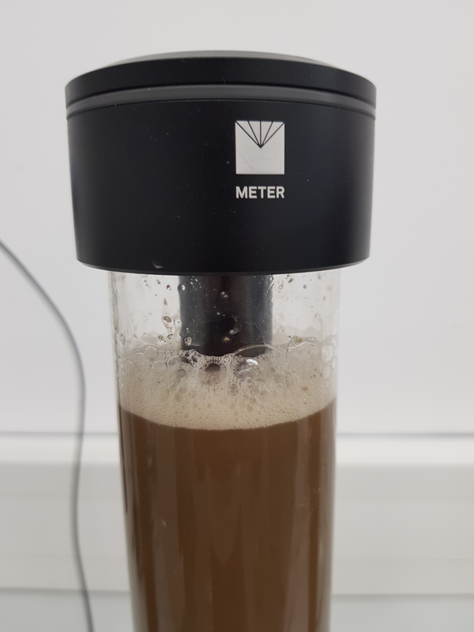
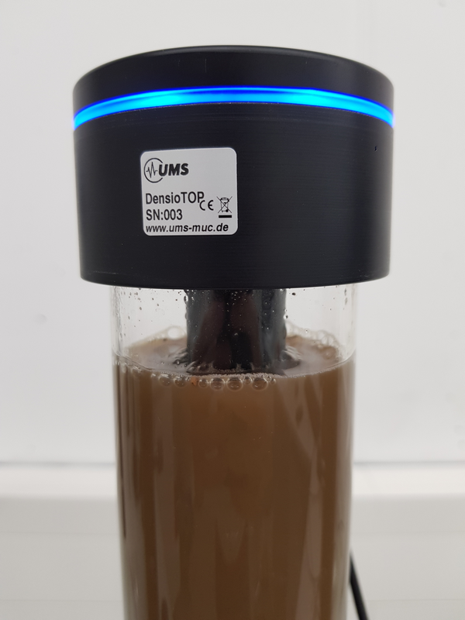
Further problems: Foam

Slide 42
Foam and/or gas bubble formation

Slide 43
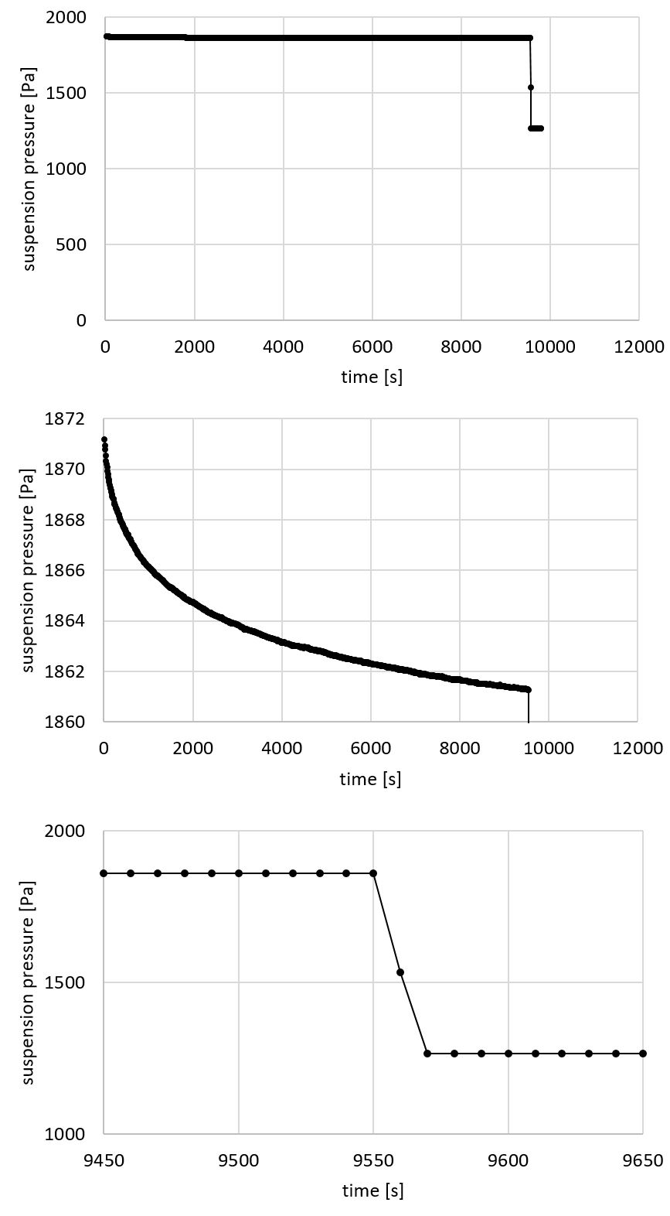
Conclusions
Temperature effects, water flow from cylinder and PARIO walls cause uncertainties in the early pressure recordings of PARIO, leading to uncertain determination of the coarse silt fraction in ISP.
Errors in coarse silt fractions pause through to complementary errors in the clay fraction.
The ISP+ method solves the problem of uncertainty of the clay fraction determination.
Also, measurement time for the particle size distribution analysis can be shortened down to ~2 hrs.
ISP measurement
Release of suspension

Slide 44
Supplementary material
Theory of the ISP method

Slide 45
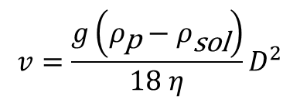
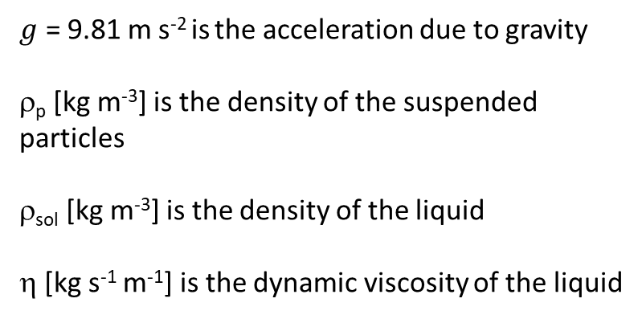
Theory (1): Settling of particles by Stokes‘ law
$$\text{Stokes}\text{‘ }\text{law} \text{describes} \text{the} \text{terminal} \text{sedimentation} \text{velocity} v\text{ [}\text{m} \text{s}\text{−1}\text{] }\text{of} \text{spherical} \\ \text{particles} \text{as} \text{a} \text{function} \text{of} \text{their} \text{diameter} D \text{[}\text{m}\text{]}$$
$g$ = 9.81 m s⁻² is the acceleration due to gravity
ρ_{p} [kg m⁻³] is the density of the suspended particles
ρ_{sol} [kg m⁻³] is the density of the liquid
η [kg s⁻¹ m⁻¹] is the dynamic viscosity of the liquid
$$v=\frac{g\left(ρ_{\text{p}}−ρ_{\text{sol}}\right)}{18 η}D^{2}$$

Slide 46
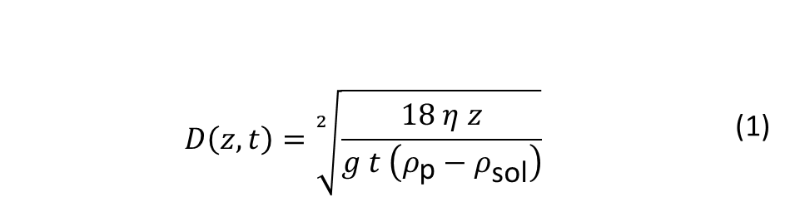
Theory (2): Diameter of particles reaching z after settling time t
The equivalent diameter of the particles which have reached
depth z after time t is calculated by noting that z=v t
$$D\left(z,t\right)=\sqrt[2]{\frac{18 η z}{g t \left(ρ_{\text{p}}−ρ_{\text{sol}}\right)}}$$ | (1)

Slide 47
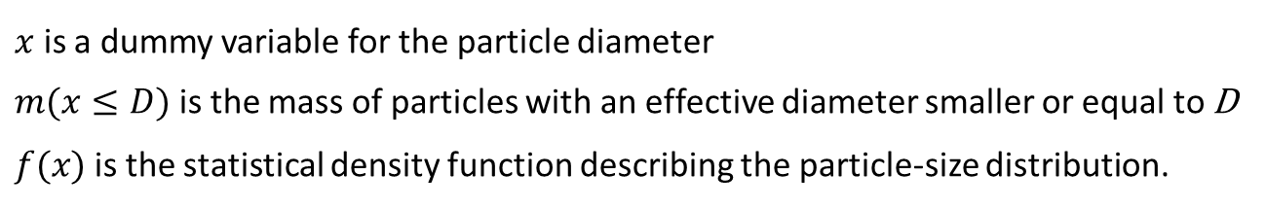
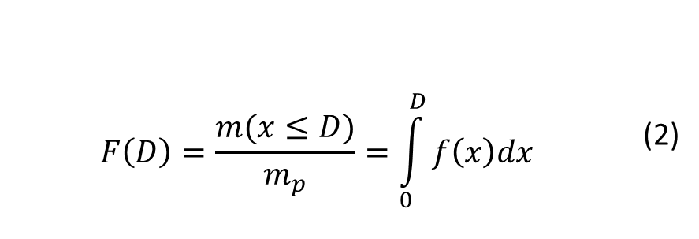
Theory (3): relating mass fraction F to hydrodynamic diameter D
The corresponding mass fraction is given by the cumulative particle mass distribution function F(D) [-] which is defined as:
$$F\left(D\right)=\frac{m(x≤D)}{m_{p}}=\int_{0}^{D}{f\left(x\right)dx}$$ | (2)
$x$ is a dummy variable for the particle diameter
$m(x≤D)$is the mass of particles with an effective diameter smaller or equal to D
$f(x)$is the statistical density function describing the particle-size distribution.

Slide 48
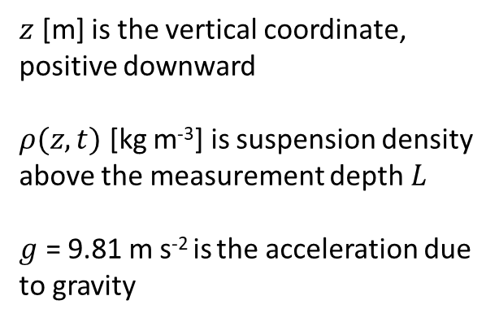
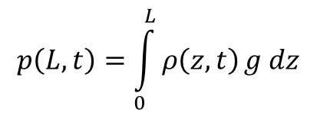
Theory (4): Pressure in a suspension at a detain depth z
$z$ [m] is the vertical coordinate, positive downward
$ρ(z,t)$ [kg m⁻³] is suspension density above the measurement depth $L$
$g$ = 9.81 m s⁻² is the acceleration due to gravity
$$p\left(L,t\right)=\int_{0}^{L}{ρ\left(z,t\right)}g dz$$

Slide 49
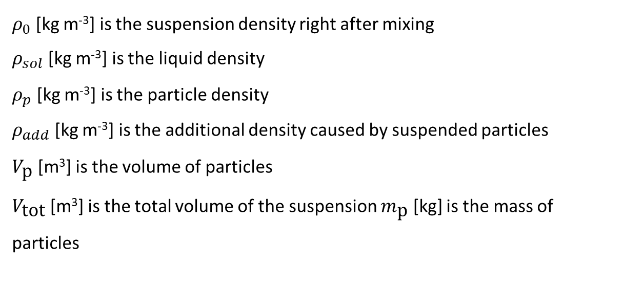
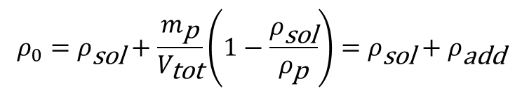
Theory (5): Initial density of suspension
$$ρ_{0}=ρ_{\text{sol}}+\frac{m_{\text{p}}}{V_{\text{tot}}}\left(1−\frac{ρ_{\text{sol}}}{ρ_{\text{p}}}\right)=ρ_{\text{sol}}+ρ_{\text{add}}$$
$ρ_{0}$ [kg m⁻³] is the suspension density right after mixing
$ρ_{sol}$ [kg m⁻³] is the liquid density
$ρ_{p}$ [kg m⁻³] is the particle density
$ρ_{add}$ [kg m⁻³] is the additional density caused by suspended particles
$V_{\text{p}}$ [m³] is the volume of particles
$V_{\text{tot}}$ [m³] is the total volume of the suspension $m_{\text{p}}$ [kg] is the mass of particles

Slide 50
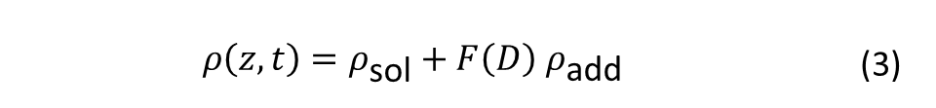
Theory (6): relating density at z to F(D)
The density of the suspension at depth z and at time t is obtained by extending Eq. (2) by the mass fraction given by F(D)
$$ρ\left(z,t\right)=ρ_{\text{sol}}+F\left(D\right) ρ_{\text{add}}$$ | (3)

Slide 51
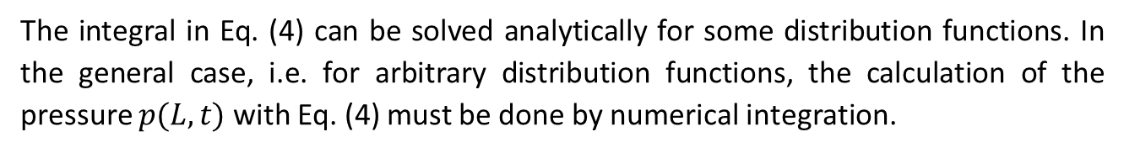
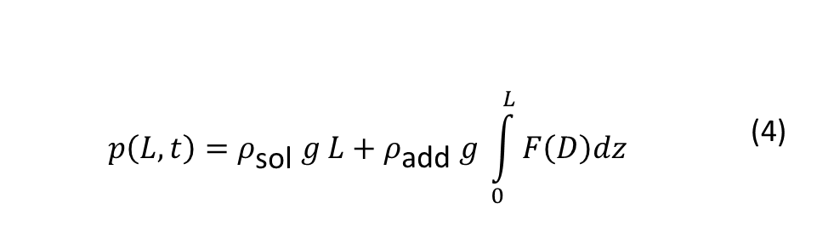
Theory (7): relating pressure at z to F(D)
This relates the integral of the cumulative mass distribution function to the measured pressure at depth $L$.
$$p\left(L,t\right)=ρ_{\text{sol}} g L+ρ_{\text{add}} g \int_{0}^{L}{F\left(D\right)dz}$$ | (4)
The integral in Eq. (4) can be solved analytically for some distribution functions. In the general case, i.e. for arbitrary distribution functions, the calculation of the pressure $p(L,t)$with Eq. (4) must be done by numerical integration.

Slide 52
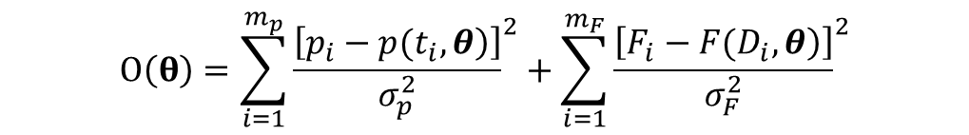
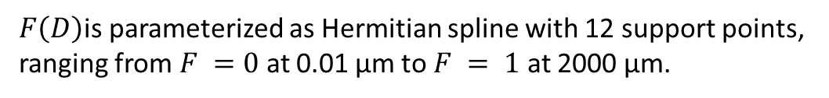
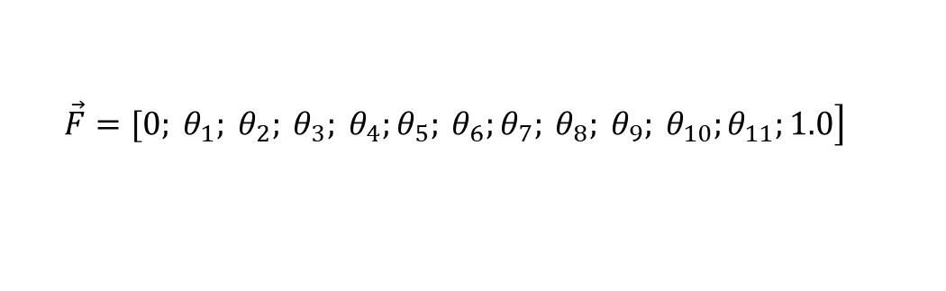
Estimation of F(D) by inverse modelling
$F\left(D\right)$is parameterized as Hermitian spline with 12 support points,
ranging from $F =0$at 0.01 µm to $F = 1$ at 2000 µm.
$$\left.\vec{F}=[0; θ_{1}; θ_{2}; θ_{3}; θ_{4};θ_{5}; θ_{6};θ_{7}; θ_{8}; θ_{9}; θ_{10};θ_{11};1.0\right]$$
$$\vec{D}=\left[0.01;0.63;2.0;3.6;6.3;11.3;20;36;63;125;200;630;2000\right] µm$$
Object function contains measured pressure data and measured data for sand
$$O\left(θ\right)=\sum_{i=1}^{m_{p}}{{\frac{\left[\left.p_{i}−p(t_{i},θ\right)\right]}{σ_{p}^{2}}}^{2}}+\sum_{i=1}^{m_{F}}{{\frac{\left[\left.F_{i}−F(D_{i},θ\right)\right]}{σ_{F}^{2}}}^{2}}$$

Slide 53
Capillary, film and vapour flow during transient evaporation: Inverse simulation of lab experiments using pressure head and humidity data
Introduction on Evaporation
Improved simple parametrizations of soil hydraulic properties (saturation to complete dryness)
Soil hydraulic properties identified by numerical inversion of evaporation experiments

Slide 54
Soil Hydraulic Properties:
An example from Mualem‘s soil catalogue (1976)
capillary
film & corner
vapor
Peters, A., Water Resources Research, 2013
Iden S.C. and W. Durner, Water Resources Research, 2014
Peters, A., Water Resources Research, 2014
Notes:
Soil hydraulic properties are required to predict evaporation from soil
In particular during stage-two evaporation, soil water retention and hydraulic conductivity curve are needed
They are also needed for predicting the duration of stage-one (atmosphere-driven) evaporation
For K(h) three regions can be distinguished: capillary. film and corner, vapor flow

Slide 55
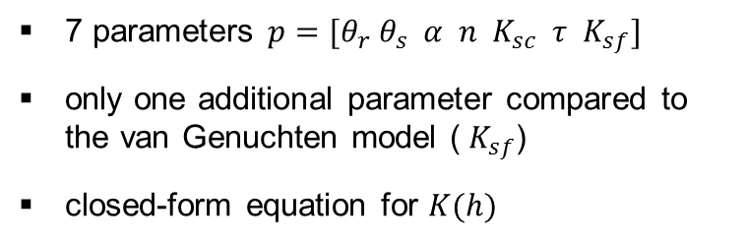



Parametrization of soil hydraulic properties: the PDI model (Peters, Durner, Iden)
$$K_{sc}$$
$$K_{sf}$$
$$θ_{r}$$
7 parameters $p=[θ_{r}{ θ}_{s} α n K_{sc} τ{ K}_{sf}]$
only one additional parameter compared to the van Genuchten model (${ K}_{sf}$)
closed-form equation for $K(h)$
slope of relative conductivity function for film flow can be set to constant value under some assumptions (Tokunaga, 2009; Peters, 2013)

Slide 56
Inverse modeling of evaporation experiments:
Goodness-of-Fit and colinearity (Belsley, 1991)
Model | Number of parameters | Belsley-Index
VG | 5 | 42
VG-VAP | 6 | 11
PDI-NOFILM | 6 | 28
PDI | 7 | 20
PDI-A | 8 | 26
Note: The number of estimated is NOT a good proxy of parameter identifiability!

Slide 57
Overview
Intro
Theory ISP
Theory ISP⁺
Test with
real data

Slide 58
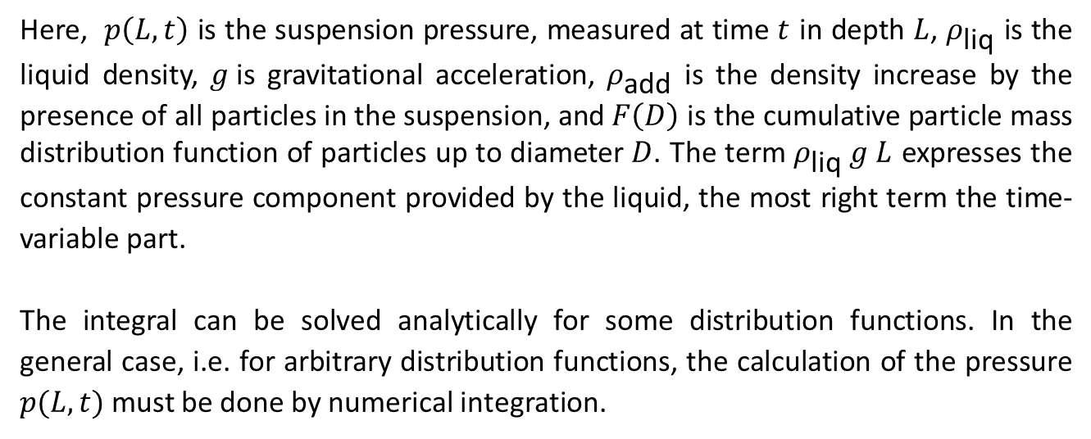
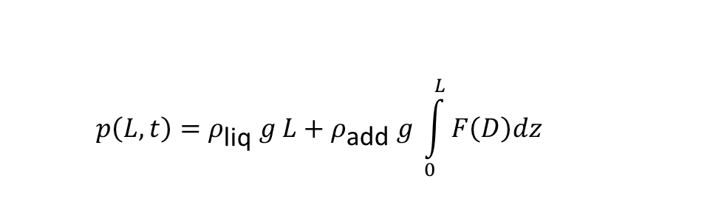
In a nutshell: The ISP theory
In the ISP method, the integral of the cumulative mass distribution function is related to the measured pressure at depth $L$ by
$$p\left(L,t\right)=ρ_{\text{l}\text{iq}} g L+ρ_{\text{add}} g \int_{0}^{L}{F\left(D\right)dz}$$
Here, $p\left(L,t\right)$ is the suspension pressure, measured at time $t$ in depth $L$, $ρ_{\text{liq}}$ is the liquid density, $g$is gravitational acceleration, $ρ_{\text{add}}$ is the density increase by the presence of all particles in the suspension, and $F\left(D\right)$ is the cumulative particle mass distribution function of particles up to diameter $D$. The term $ρ_{\text{liq}} g L$ expresses the constant pressure component provided by the liquid, the most right term the time-variable part.
The integral can be solved analytically for some distribution functions. In the general case, i.e. for arbitrary distribution functions, the calculation of the pressure $p(L,t)$must be done by numerical integration.

Slide 59
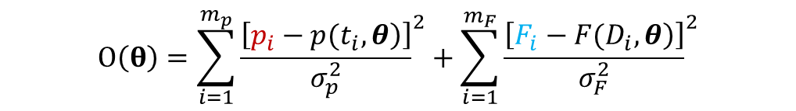
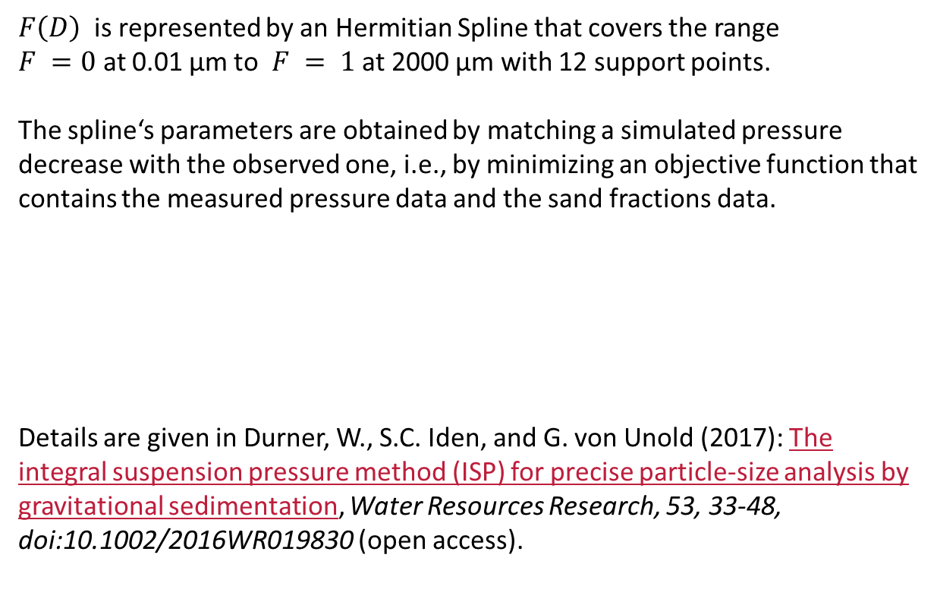
ISP: Estimation of F(D) by inverse modelling
$F\left(D\right)$ is represented by an Hermitian Spline that covers the range
$F =0$ at 0.01 µm to $F = 1$ at 2000 µm with 12 support points.
The spline‘s parameters are obtained by matching a simulated pressure decrease with the observed one, i.e., by minimizing an objective function that
contains the measured pressure data and the sand fractions data.
Details are given in Durner, W., S.C. Iden, and G. von Unold (2017): The integral suspension pressure method (ISP) for precise particle-size analysis by gravitational sedimentation, Water Resources Research, 53, 33-48, doi:10.1002/2016WR019830 (open access).
$$O\left(θ\right)=\sum_{i=1}^{m_{p}}{{\frac{\left[\left.p_{i}−p(t_{i},θ\right)\right]}{σ_{p}^{2}}}^{2}}+\sum_{i=1}^{m_{F}}{{\frac{\left[\left.F_{i}−F(D_{i},θ\right)\right]}{σ_{F}^{2}}}^{2}}$$

Slide 60

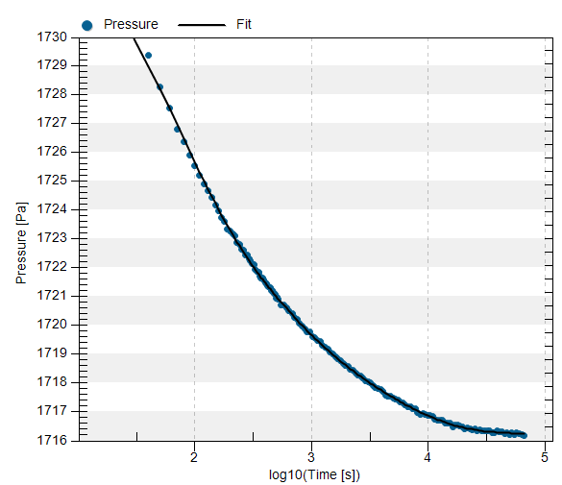





Illustration of ISP Parameter identification
Defined initial condition
$$real \\ system$$
Pressure measurement $p(t)$
Predicted
decrease of $p$
$p(L,t)$
simulation
Parameter estimation by „Maximum-Likelihood“ principle
Model parameter vector for $F(D)$
$$θ$$

Slide 61

Implementation of the method in PARIO
The ISP method was made commercially available by a measuring instrument called PARIOTM, manufactured and traded by METER Group AG, Munich.
Pressure measurement

