Slide 1

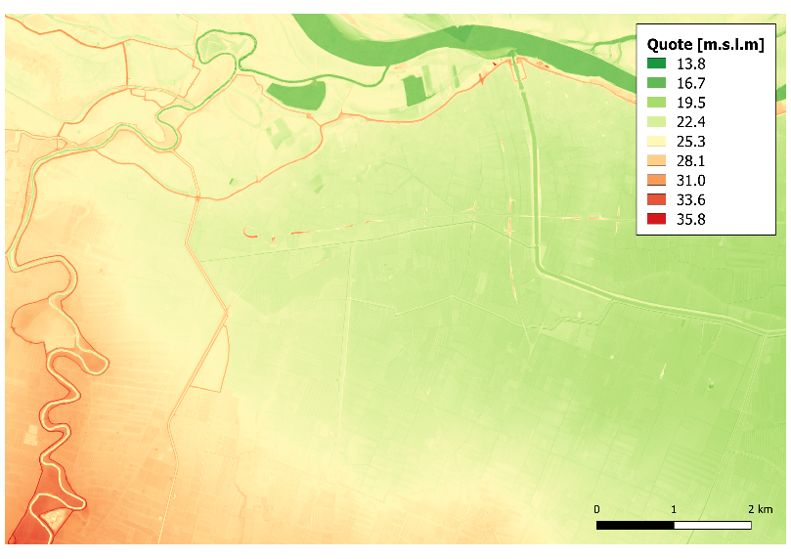
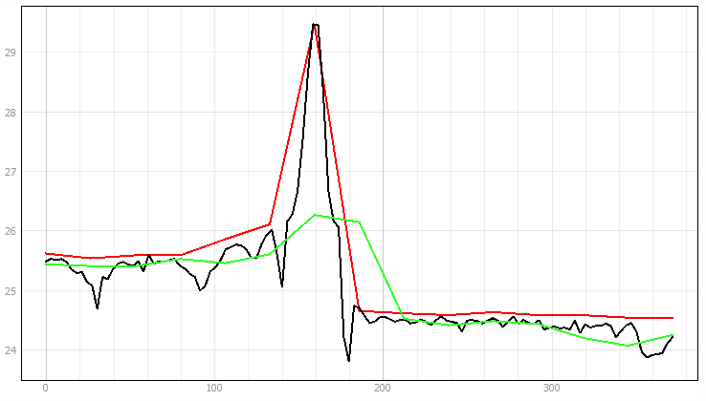
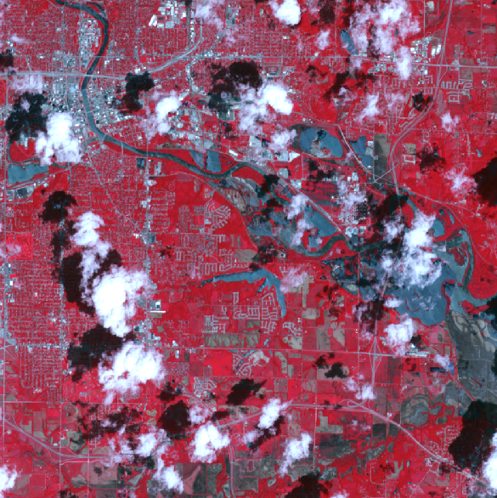
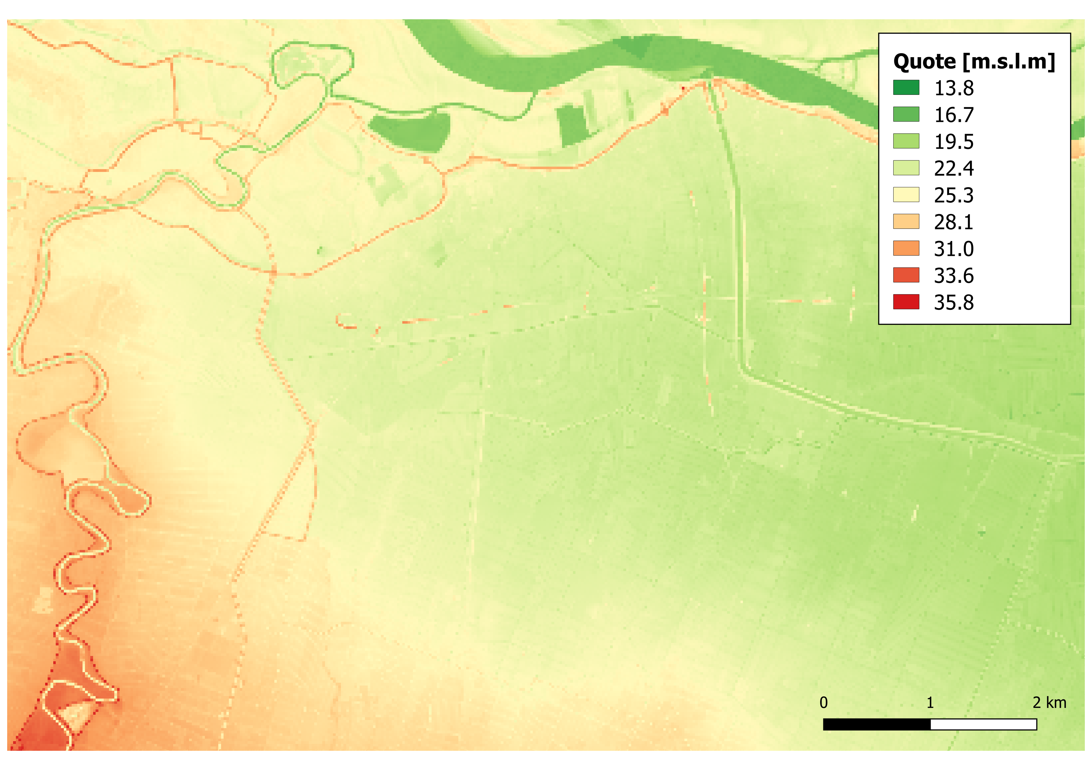
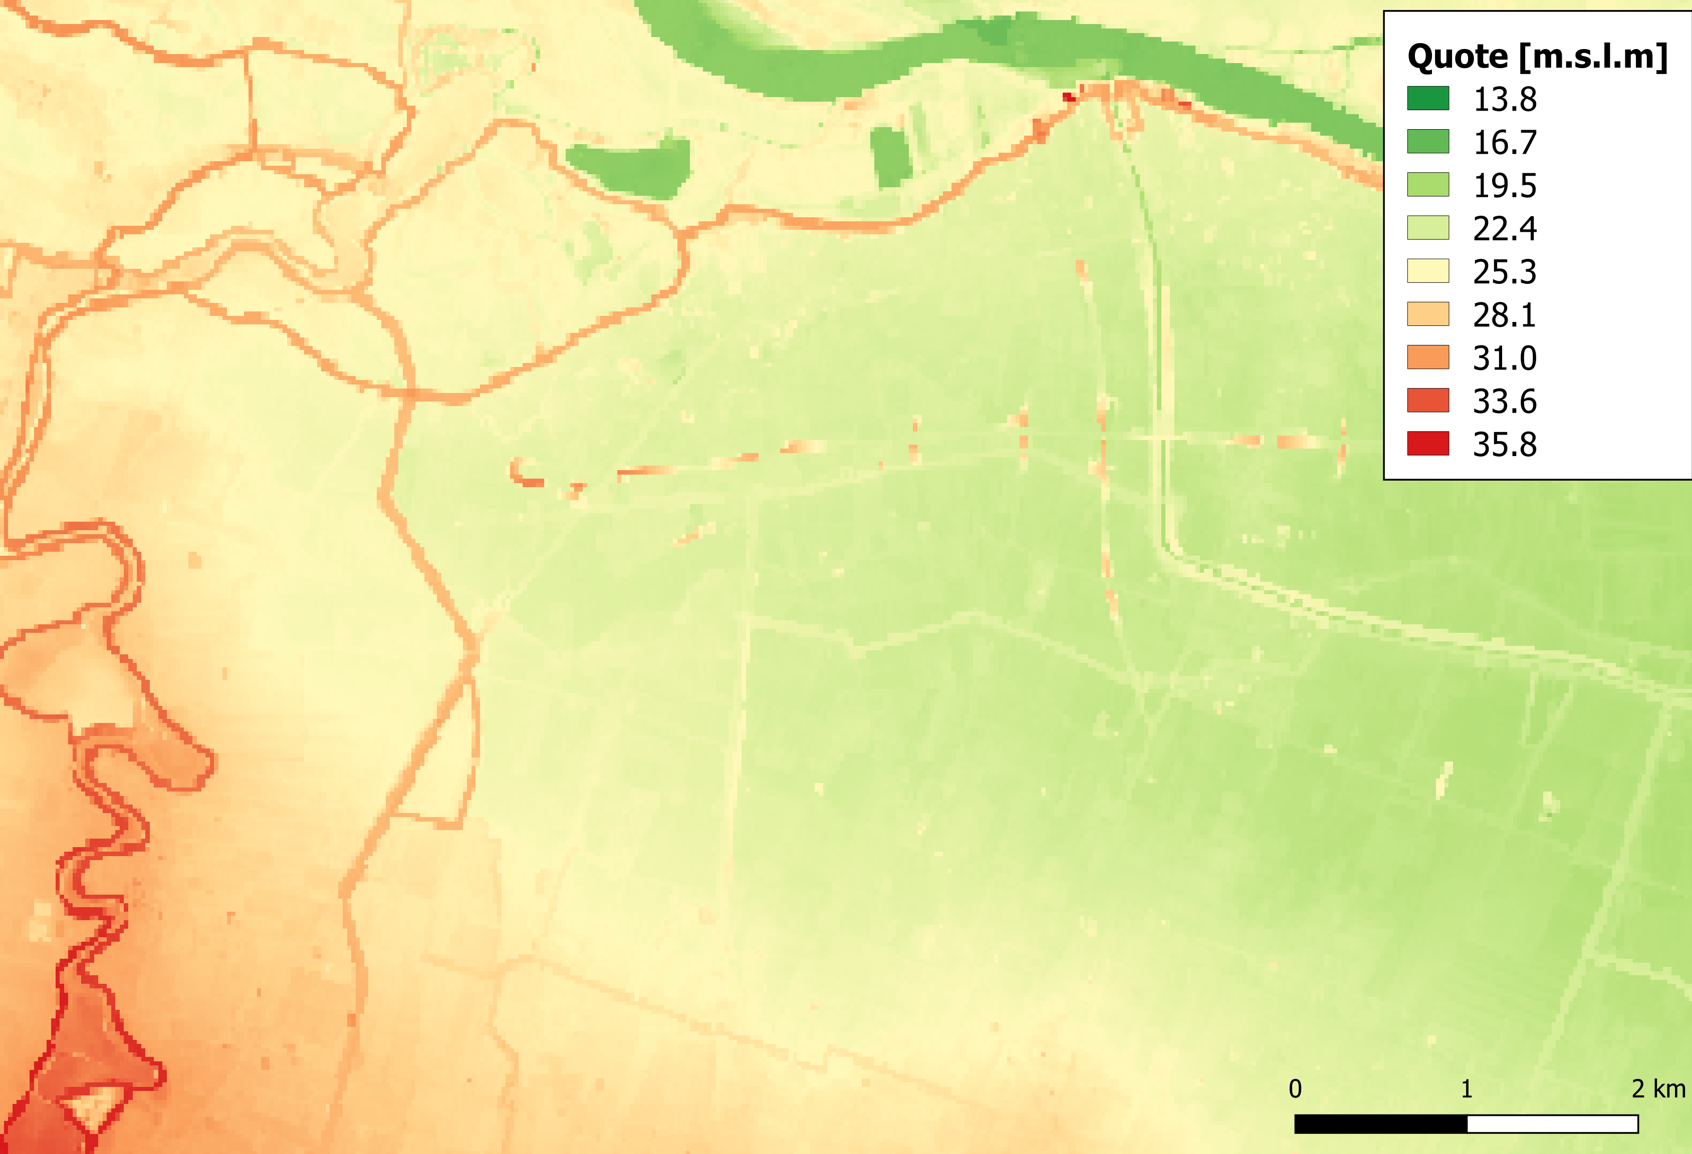
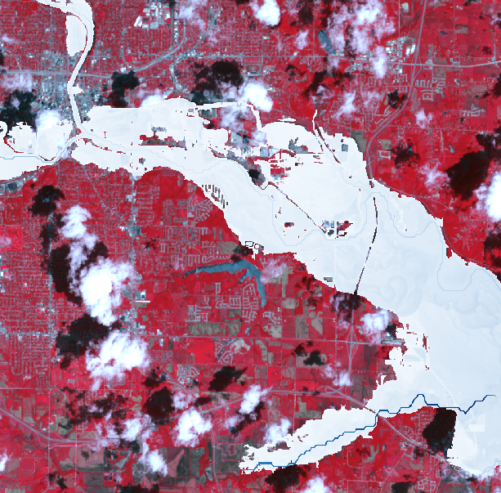
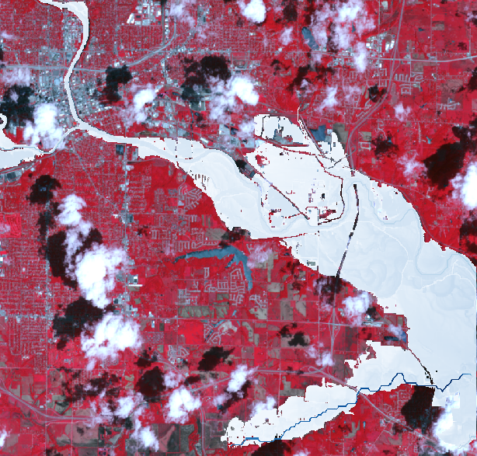

The role of small-scale topographic features on inundation dynamics: potential impacts on large-scale investigations
NH9.1/GM12.4/HS2.5.5
Alessio Domeneghetti¹, Antonio Leonardi¹, Oliver E. J. Wing^{2,3}, Francesca Carisi¹, Armando Brath¹
University of Bologna, DICAM, Bologna, Italy (alessio.domeneghetti@unibo.it)
School of Geographical Sciences, University of Bristol, Bristol, UK
Fathom, Bristol, UK
Large-scale (LS; i.e., continental or global) hydraulic modeling are typically associated to a compromise in terms of model resolutions (the finer being of tens of meters, with a coarsened representation of the terrain) and, thus,
accuracy on representing the topographic peculiarities of the flood-prone areas.
Levee failure
Des Moines River, Iowa, U.S.A., June 2008
LiDAR
NO obstacles
WITH obstacles
Observed
HIGH resolution DTM
(Lidar 2m)
NOT suitable for LS analysis
LS simulation
(WITH OBSTACLES)
Enza river, Italy December 2017
NO OBSTACLES
WITH OBSTACLES
LOW resolution DTM
(e.g. 25-50 m)
adopted for LS simulation
LOW resolution DTM
(e.g. 25-50 m)
adopted for LS simulation
LS simulation
(NO OBSTACLES)
Main scope of the study: investigating how the automatic detection of minor topographic discontinuities can enhance the estimation of flood dynamics of large-scale models
Get in contact to see details and evidences from three case studies

Slide 2
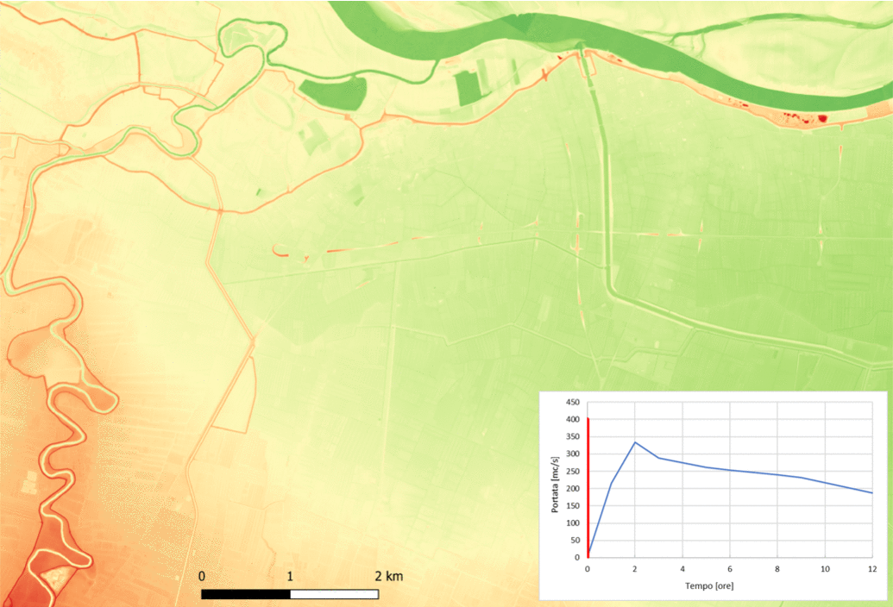
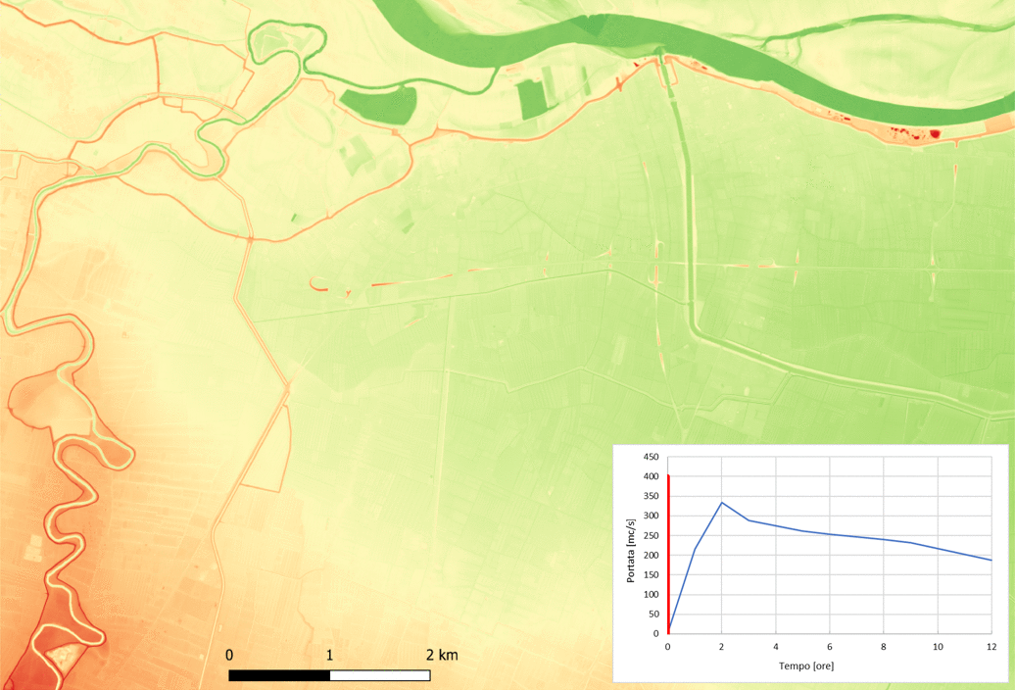
Motivation
For large-scale flood analysis DEM coarsening is a necessary step. Nevertheless, the experience gained observing the dynamics of past inundations highlights the role of small-scale topographic features (e.g., minor embankments, road deck, railways, etc.) in driving the flow paths.
To prevent the loss of information during the standard DTM coarsening process, the method proposed by Wing et al., (2019) automatically ensures that flood defense structures remain represented in the terrain data employed.
TRADITIONAL DTM COARSENING
DTM resolution = 25 m
NO calibration
Computation time = 3 min
“OBSTACLES-AWARE” DTM COARSENING
DTM resolution = 25 m
NO calibration
Computation time = 3 min

Slide 3
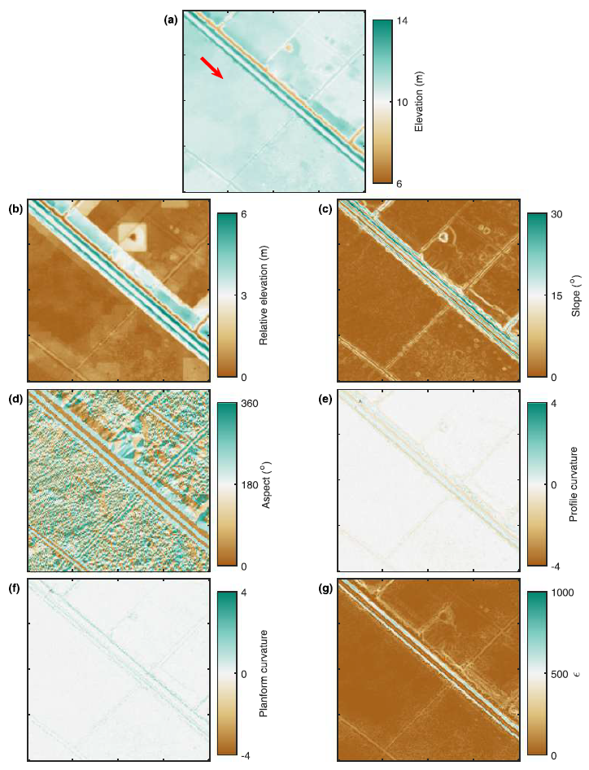
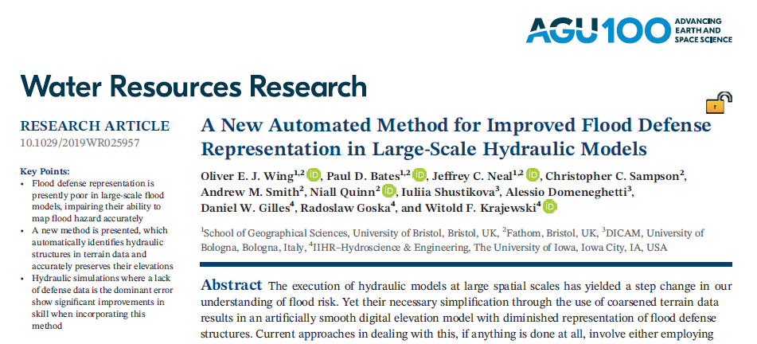
Methods
LiDAR
The present study extends the Automated approach to flood-prone areas by investigating how the automatic detection of minor topographic discontinuities can enhance the estimation of flood dynamics of large-scale models.

Slide 4
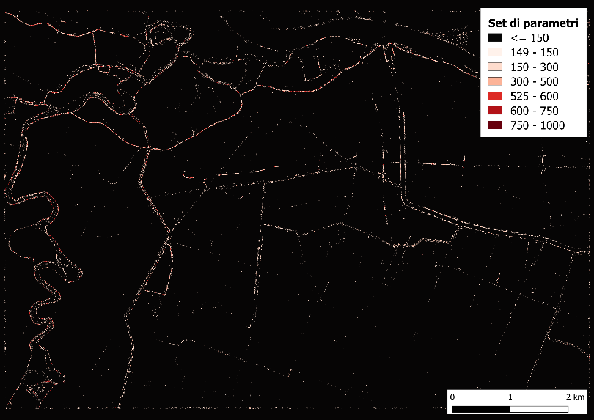

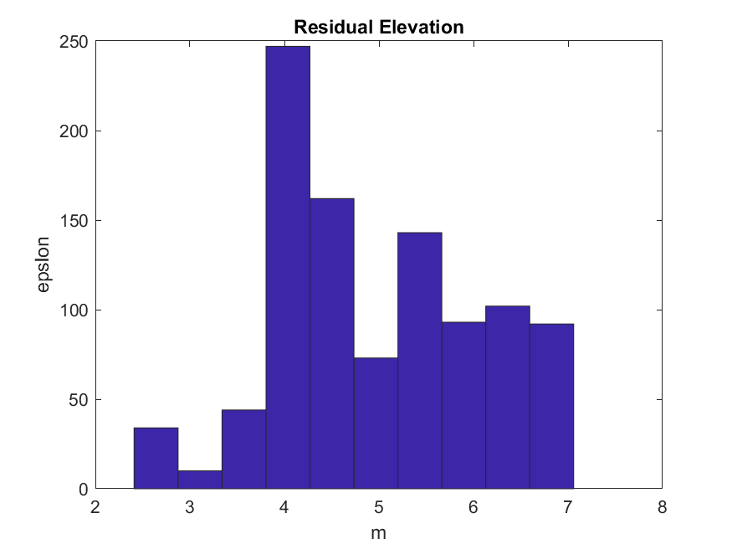
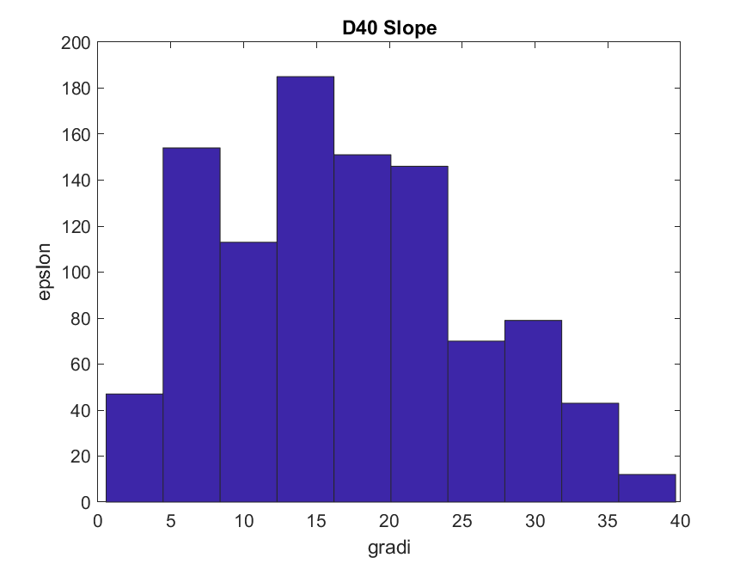
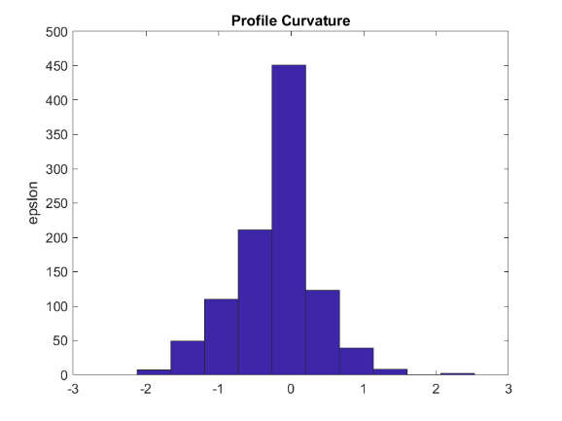
Pre-Processing of high resolution DTM
Continuous features (obstacles) are detected in relation to different topographic indexes through a calibration process
Relative elevation
Slope
Aspect difference
Profile Curvature
Planform curvature
DTM
(es. Lidar, 2-3m)
DTM (25m)

Slide 5

DTM coarsening keeping track of the height of the pixel identified as «obstacle»
LiDAR
Low Resolution (LR) DTM
Pixels are pointed out as obstacles in relation to their topographic parameters, which are in agreement with those of few topographic elements (e.g., embankments, road deck, etc.) specified by the user during the calibration process.

Slide 6

Results
parametri geomorfologici caratterizzanti gli ostacoli
Altezza relativa
Pendenza
Direzione di massima pendenza
Curvatura del profilo
Curvatura planimetrica
HR DEM (1-3 m)
LR DTM (25 m) – NO OBSTACLES (NOBS)
LR DTM (25 m) – WITH OBSTACLES (OBS)
High Resolution (HR) DTM (e.g. Lidar, 2-3m)
NO OBSTACLES
WITH OBSTACLES
LR DTM (25m)
LR DTM (25m)

Slide 7
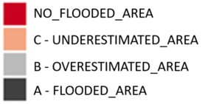
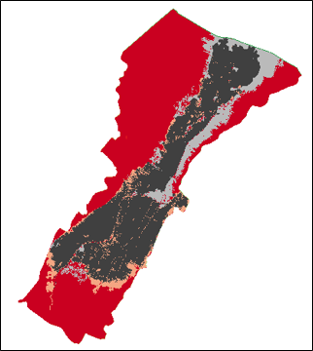
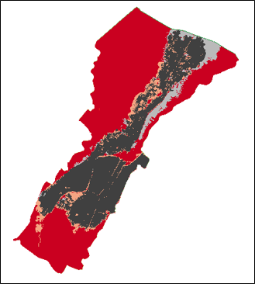
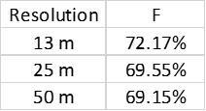
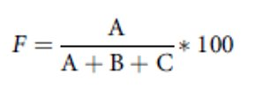
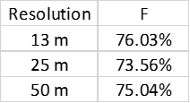
Examples (1/3)
Secchia River – January 2014
“Ref” vs. “NOBS”
“Ref” vs. “OBS”
DTM = 13 m
DTM = 13 m

Slide 8
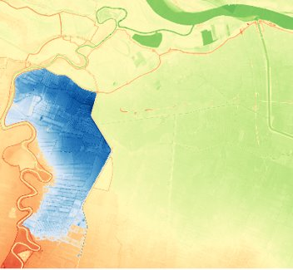
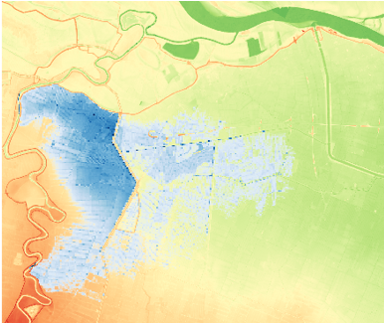
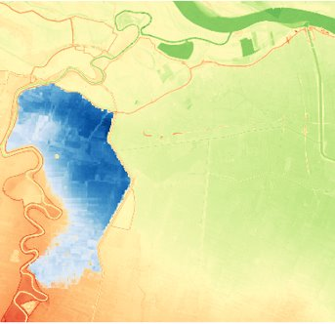
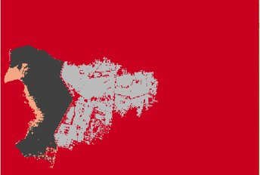

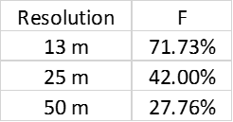

OBSERVED
Examples (2/3)
Enza River – 2017
NO OBSTACLES
DTM = 25 m
DTM = 25 m
“Ref” vs. “NOBS”
“Ref” vs. “OBS”
WITH OBSTACLES

Slide 9
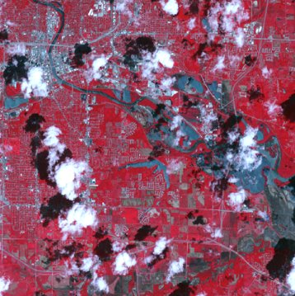
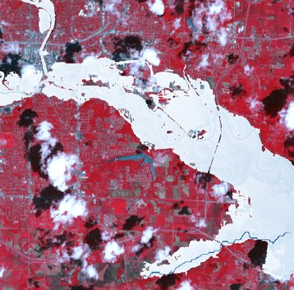

Examples (3/3)
Des Moines, Iowa, 2008
“Ref”
“NOBS”
“OBS”
DTM = 25 m

Slide 10
Main Outcomes
The methodology enables the proper and automatic identification of all obstacles in the flood prone areas considering different DTM resolution.​
Inundations performed with ”OBS” detection has performances (i.e., Flood index, water depth, etc.) much higher than those carried out without taking them into considerations. Those performances are not significantly impacted by the DTM resolution.​
“OBS” configuration, combined with literature-based Manning coeff., provides performance like those achieved with calibrated model.​
Pre-processing of high resolution DTM would enable high accuracy flood-hazard and flood-risk mapping with affordable computational efforts, also for large-scale applications.

