Slide 1

Compositional modelling
of impure gas injection into saline aquifers
with the MUFITS simulator
Andrey Afanasyev, Elena Vedeneeva
afanasyev@imec.msu.ru
www.mufits.imec.msu.ru

Slide 2

Contents
Click on the panel to go to the corresponding slides
1. Why impure
gas injection?
3. Governing equations
5. Validation of the software
7. Modelling cushion gas substitution with CO₂
2. Compositional module of MUFITS
4. Library of EoS coefficients
6. Modelling flue gas injection into a saline aquifer
8. Summary & Supplementary material
Overview of MUFITS
New modelling option; Mathematical formulation; Implementation in the software
Application examples

Slide 3
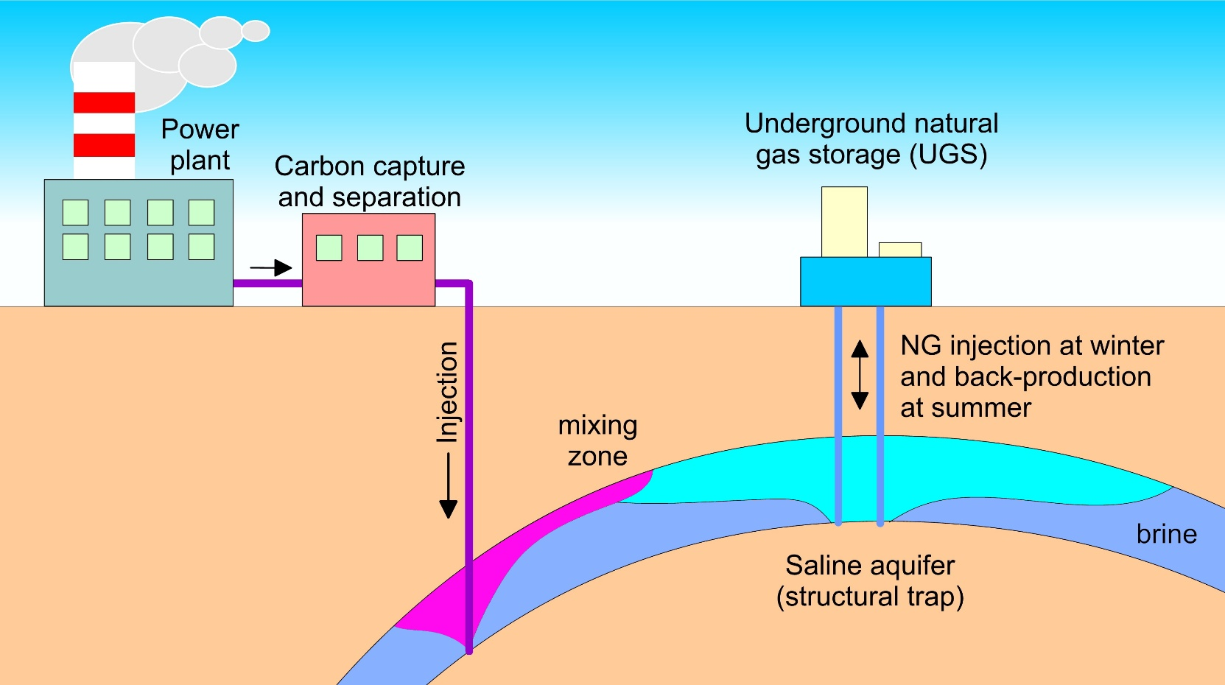
Implications of impure gas injection
Back to Contents
Can UGS performance be improved by subsurface storage of CO₂?
More exhaust gas can be accommodated if CO₂ purification reached only ~90%
How to increase competitiveness of CCS?
Flue gas injection into subsurface
(reduce the cost of CO₂ separation)
Cushion gas substitution with CO₂
(explore the benefits of CO₂ injection into UGS facilities)
We aim at developing a software to predict such processes
A flue gas injection
(CO₂, N₂, O₂, CH₄)

Slide 4
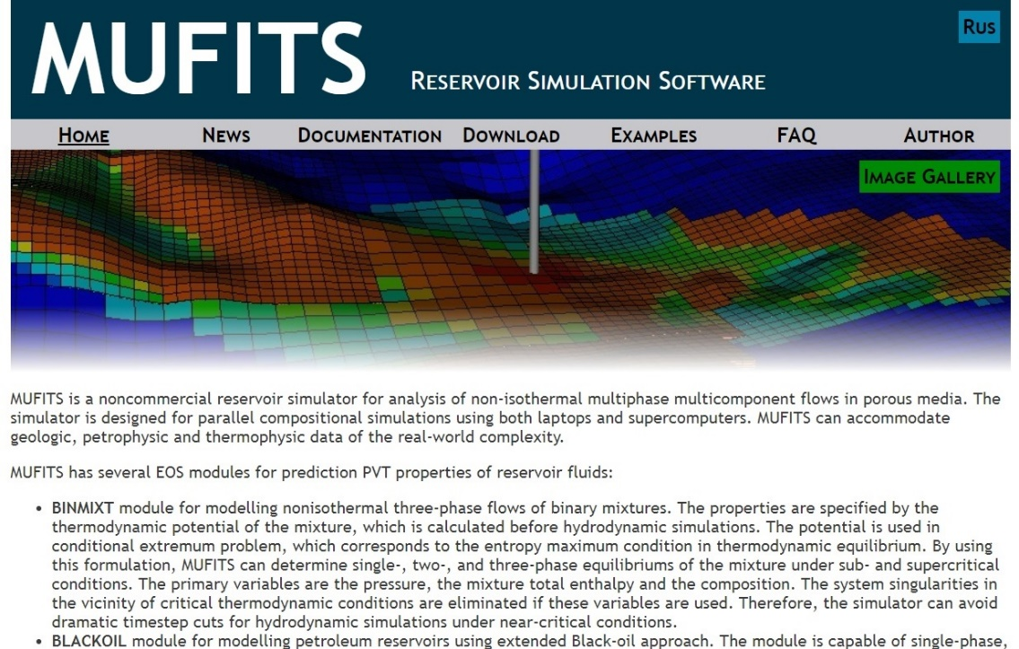
Overview of MUFITS
Back to Contents
Hydrodynamic simulator
Can be freely downloaded from its webpage:
www.mufits.imec.msu.ru
Numerical modelling of the non-isothermal flows in porous media and wellbores
Includes several EoS modules for predicting the fluid properties
BLACKOIL
GASSTORE
Contains several EoS-modules for fluid properties prediction
Other modules
COMPS
The compositional module is based on a cubic EoS. We intend to improve this module for modelling phase equilibria in aqueous solutions
A. Afanasyev, “Compositional Modelling of Petroleum Reservoirs and Subsurface CO₂ Storage with the MUFITS Simulator,” in ECMOR XVII, Sep. 2020, vol. 2020, no. 1, pp. 1–13.

Slide 5
Compositional module
Back to Contents
Only two-phase equilibria of aqueous solutions can be simulated by introducing the brine pseudo-component for the H₂O-NaCl fluid
Originally designed for modelling three-phase flows in petroleum reservoirs
Petroleum reservoirs
Gas injection into saline aquifers
Components
Water
Hydrocarbon mixture
(CO₂, N₂, CH₄, C₂H₆, C₃H₈, …)
Components
Water
Aqueous solution
(brine, CO₂, N₂, CH₄, …)
i=l
i=g
Phases
Water
Oil
Gas
Phases
Water
Oil
(brine phase)
Gas
does not mix with other components
each component is present in oil and gas
not used
oil is treated as
the aqueous phase
non-aqueous phase
Oil is regarded as the brine phase

Slide 6
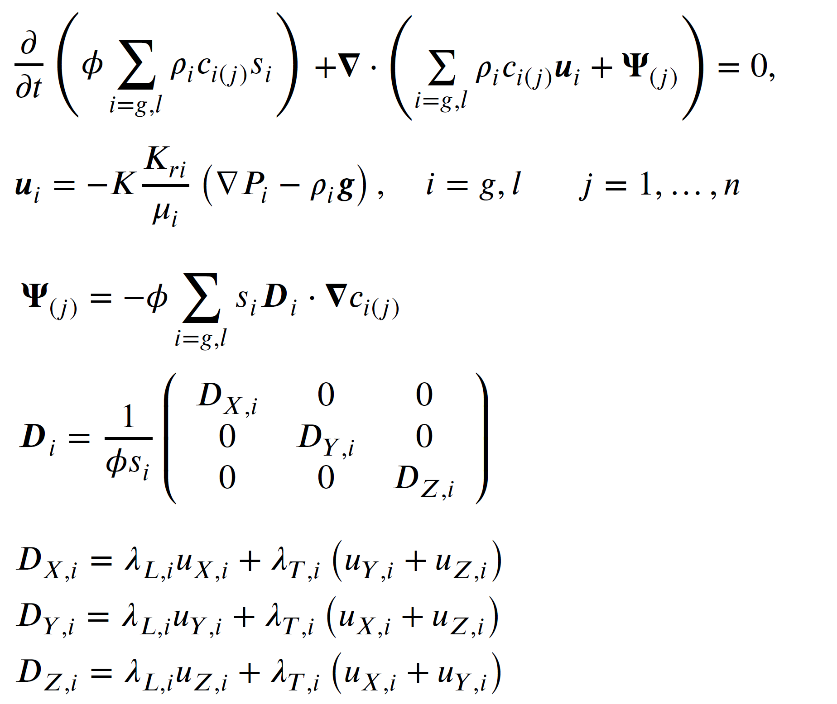
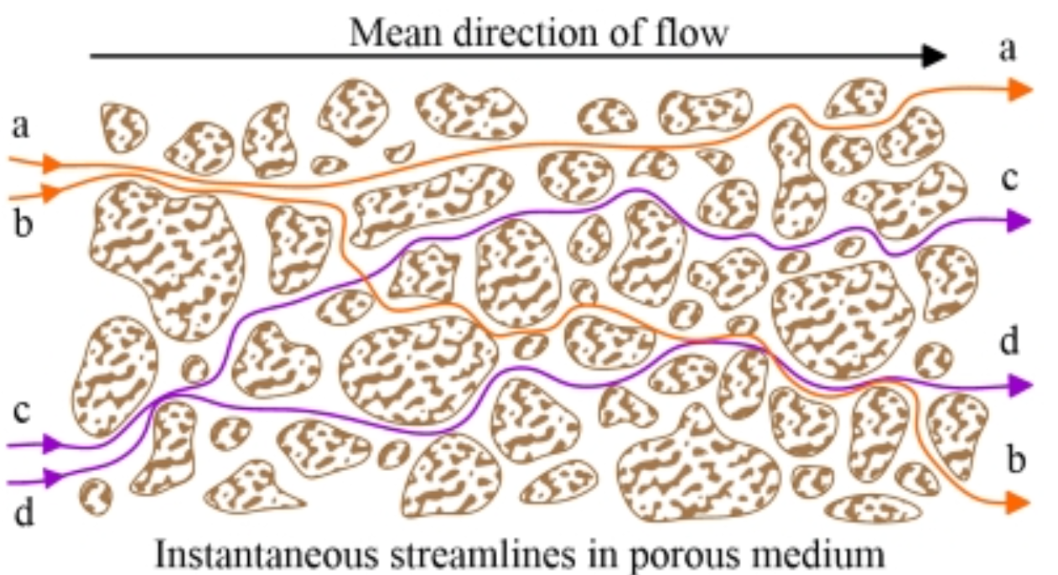
Transport equations
Back to Contents
- mass conservation equation for each fluid component
- Darcy’s law
We account for the mechanical dispersion, i.e. hydrodynamic mixing in porous media
λ_{L} and λ_{T} characterize the longitudinal and transverse dispersion on the pore scale
A. Afanasyev, “Numerical modelling of solute flow dispersion in porous media using simulator MUFITS,” J. Phys. Conf. Ser., vol. 1129, p. 012002, Nov. 2018.

Slide 7
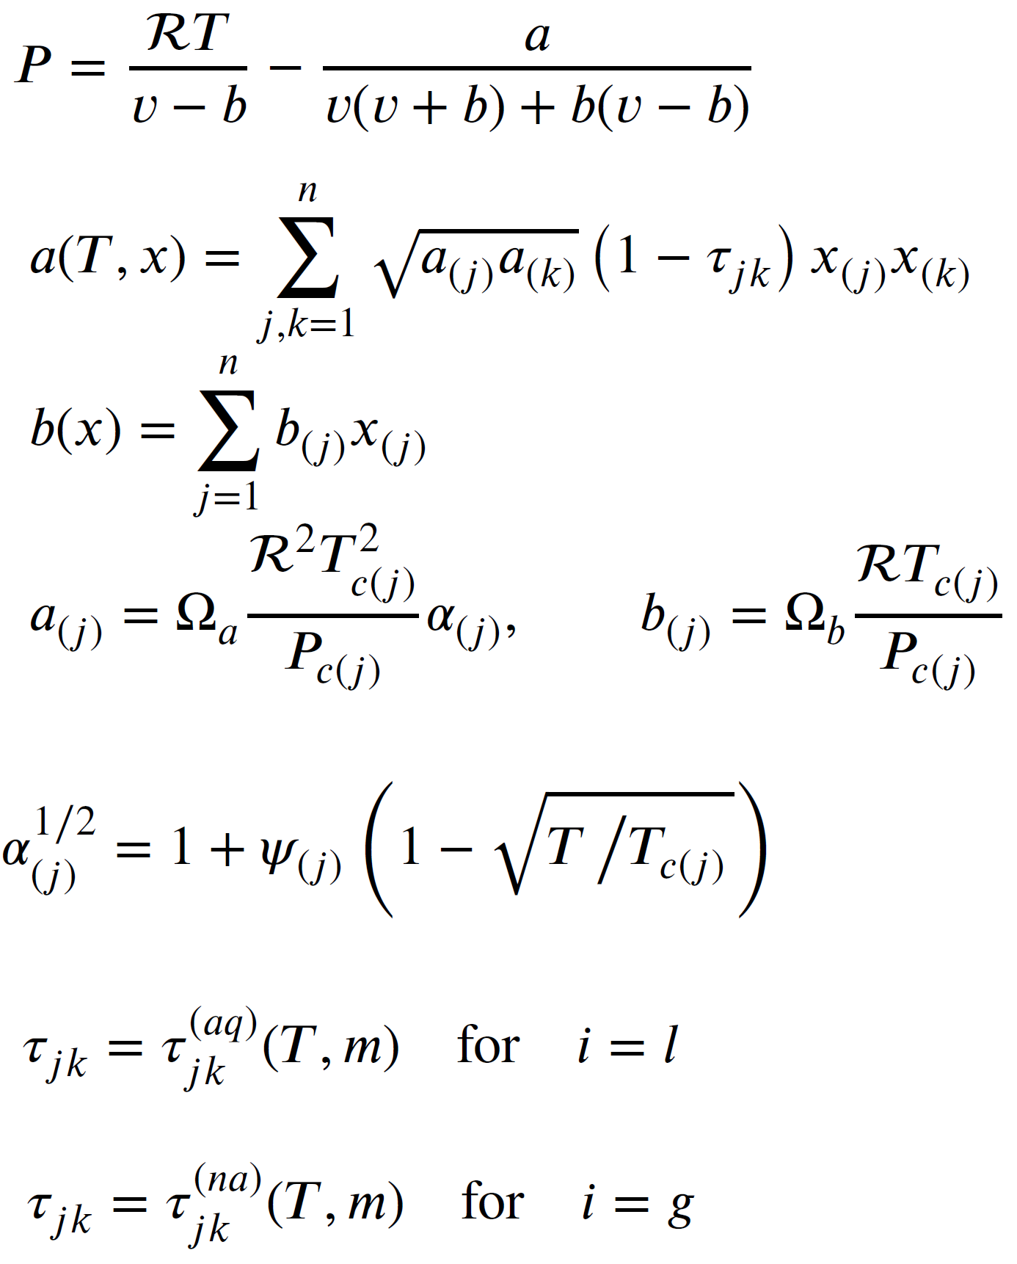
Equation of state (EoS)
Back to Contents
We employ the conventional Peng-Robinson EoS in the modification for aqueous solutions proposed by Soreide & Whitson (1992).
The modification concerns to different sets of the binary interaction parameters τ_{jk} for the aqueous and non-aqueous phase parametrized as the functions of temperature (T) and NaCl molality (m) to account for the brine effect.
The most recent (e.g. Chabab et al. (2020)) correlation for τ_{jk} are implemented in the software to ensure an accurate prediction of mutual solubilities.
To improve density predictions, additional correlations for the volume shift parameters have been developed.
I. Søreide and C. H. Whitson, “Peng-Robinson predictions for hydrocarbons, CO2, N2, and H2S with pure water and NaCI brine,” Fluid Phase Equilib., vol. 77, no. C, pp. 217–240, 1992.

Slide 8
Library of EoS coefficients
Back to Contents
The development is supplemented with the built-in library of the EoS coefficients. The library makes it simpler the usage of the compositional module by the scientific community. Since only the most basic data are entered and all other coefficients and correlations are built into the reservoir simulator, no knowledge of phase equilibria modelling is required to use MUFITS.
The library contains the coefficients for these components; so, the multicomponent fluid can contain any of these.
Brine is a mandatory component for aqueous solutions.
COMPS
(compositional module)
Built-in library of EoS coefficients
C₄H₁₀
CH₄
CO₂
Brine
Other components can be characterized by users
C₂H₆
N₂
H₂S
C₃H₈
O₂
H₂

Slide 9
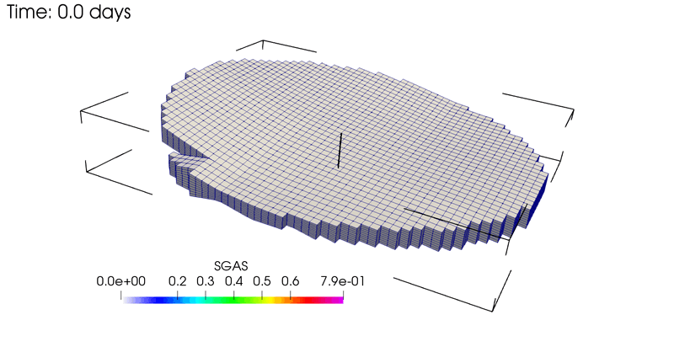
Validation of the software
Back to Contents
CO₂
To validate applicability of the developed module for modelling CO₂ injection into saline aquifers, we consider the two-component flow of the H₂O–CO₂ fluid by modelling a benchmark problem developed by Class et al. (2009). We consider a sector model of an aquifer with one injector. The injection over 25 yr is simulated, then it is stopped and further 25 yr of the gas flow are simulated. In this scenario pure CO₂ is injected.
The video on the left shows the CO₂ saturation near the caprock over time.
5540 m
2670 m
440 m
Gas saturation
Class et al., “A benchmark study on problems related to CO2 storage in geologic formations,” Comput. Geosci., vol. 13, no. 4, pp. 409–434, 2009.

Slide 10
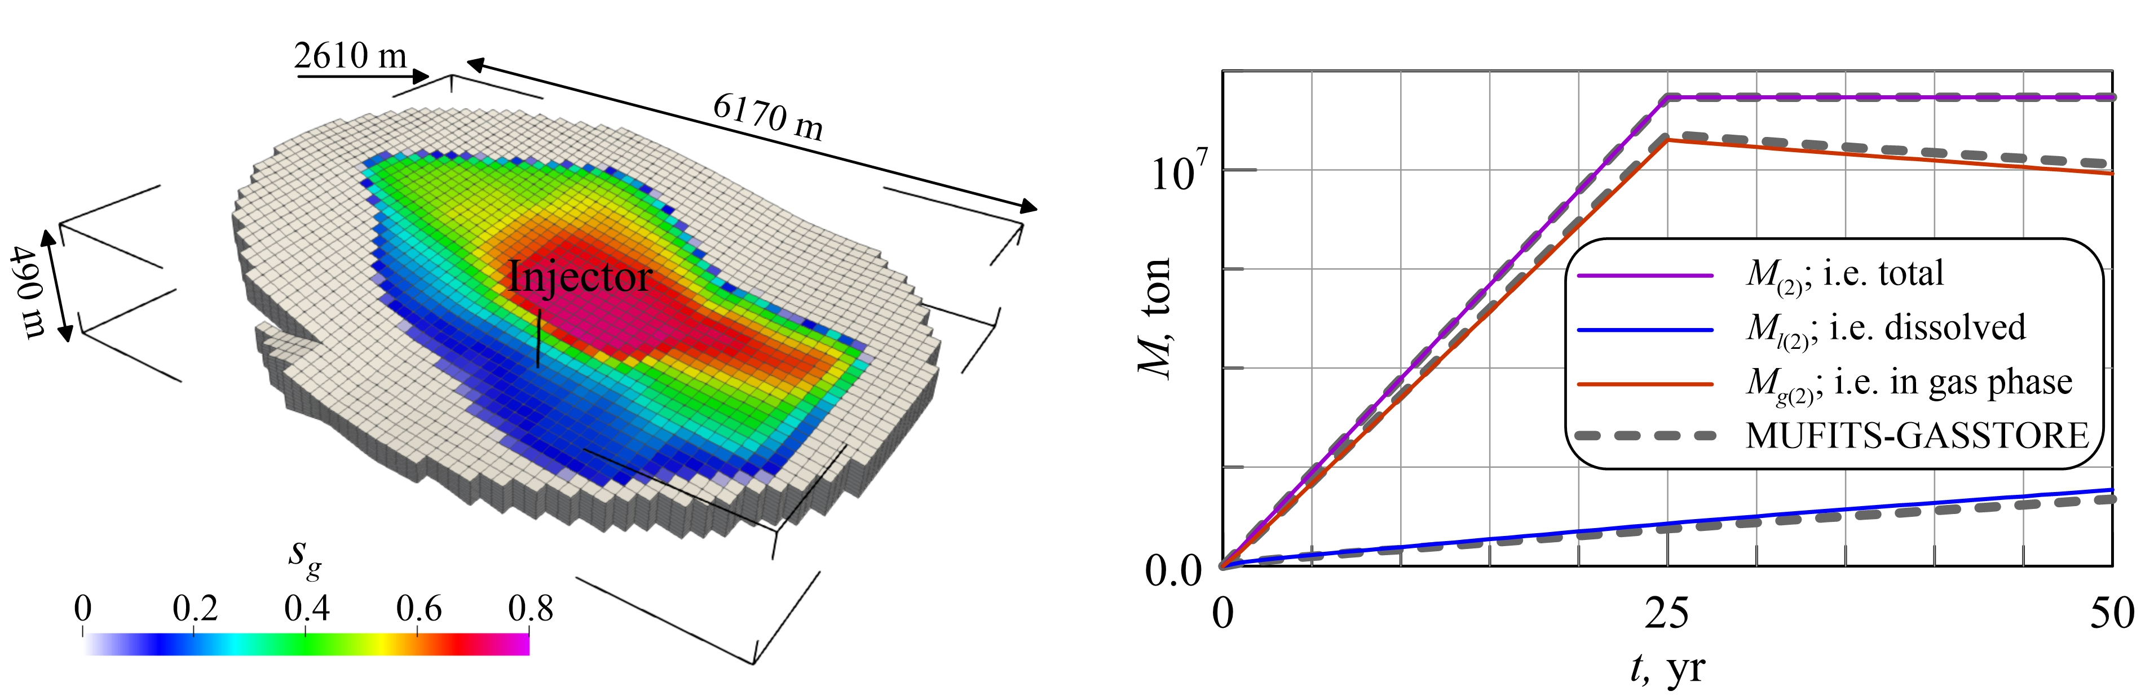
Validation of the software
Distribution of the gas saturation at t=50 yr
CO₂-in-place against time
CO₂ is injected over first 25 yrs. Then, the injection is stopped and further 25 yr of CO₂ migration are simulated
The distribution of the gas saturation can hardly be distinguished from that obtained with other modules of MUFITS or reported in Class et al. (2009).
A good correspondence between the prediction of the COMPS and GASSTORE modules (solid and dashed lines, respectively) validates a good accuracy of the COMPS module.
Afanasyev, et al., “Validation of the MUFITS Reservoir Simulator Against Standard CO₂ Storage Benchmarks and History-matched Models of the Ketzin Pilot Site,” Energy Procedia, vol. 97, pp. 395–402, Nov. 2016.

Slide 11
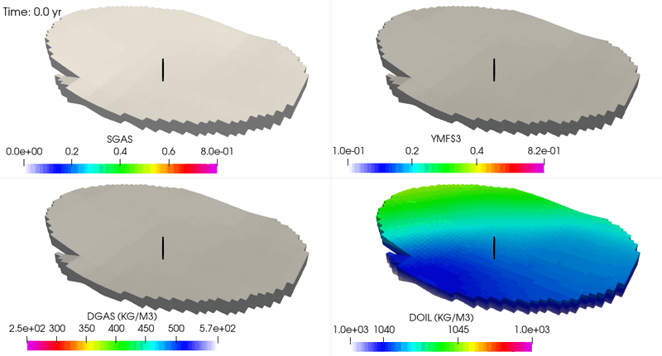
Modelling flue gas injection
Back to Contents
CO₂ (90%)+N₂ (10%)
Now we change the composition of injected gas. It consists of 90% of CO₂ and 10% N₂.
N₂ molar
fraction
in gas
The gas phase becomes richer in N₂ at the leading edge of the plume due to a much higher, as compared to N₂, solubility of CO₂ in brine.
Gas
saturation
Gas density at the leading front of the plume decreases. As a result, the plume propagates significantly farther in the structural dip direction.
Gas
density
Brine
density

Slide 12
Flue gas against pure CO₂
Back to Contents
at t=46 yr
Flue gas
injection
Total mass of CO₂ and N₂ in the domain (M₍₂₎ and N₂) and the mass of CO₂ in gas and liquid phases (M_{g(2)} and M_{l(2)}). The dashed line shows the average mass fraction of N₂ in the gas phase.
The plume of the flue gas propagates farther than that of pure CO₂.
at t=50 yr
Pure CO₂
injection

Slide 13

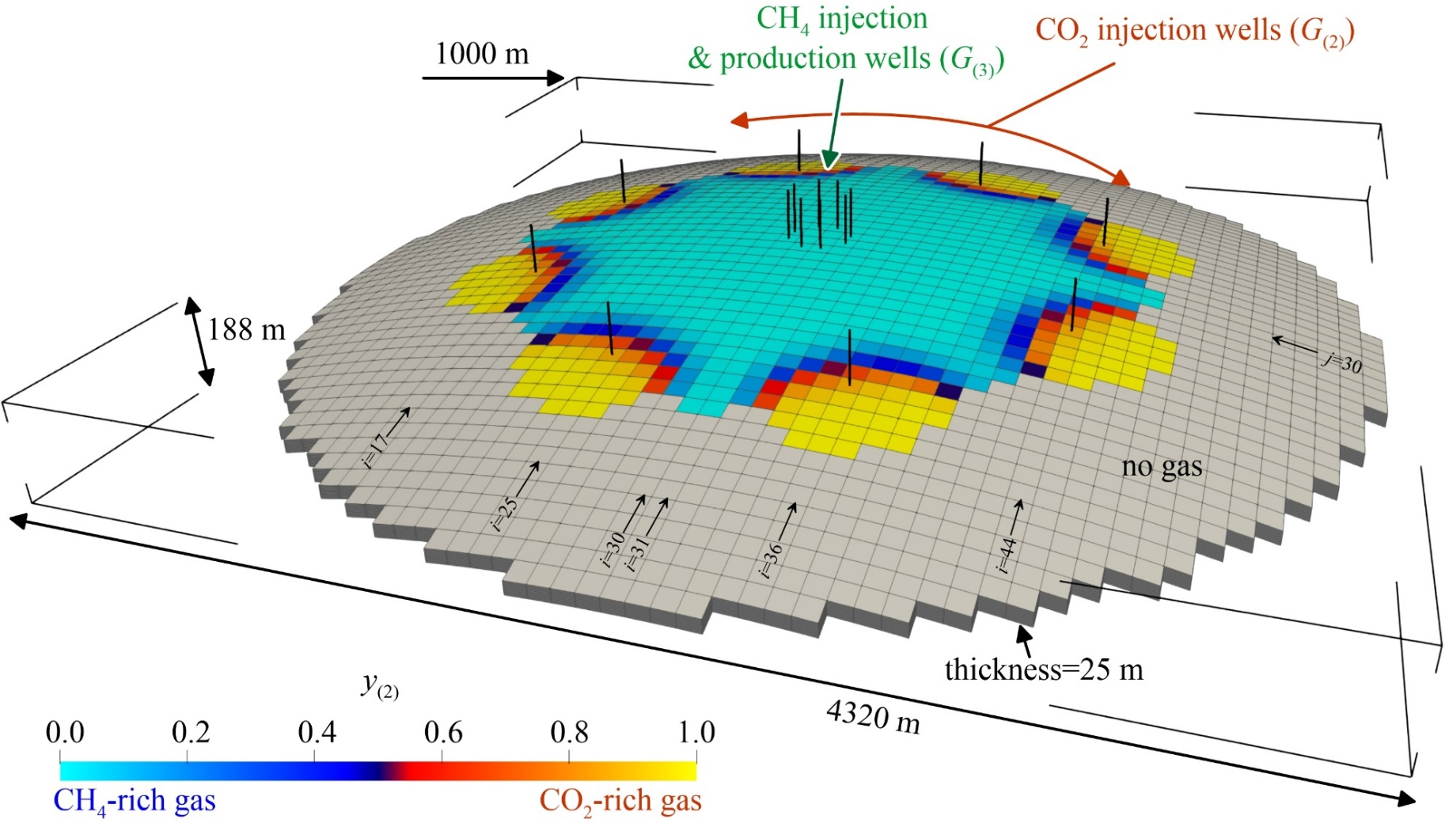
Cushion gas substitution with CO₂?
NG injection
Back-production
NG injection
Back-production
Summer Winter Summer Winter
t
We consider a synthetic model of a storage reservoir and simulate an initial period of CO₂ and CH₄ (is used as proxy for NG) injection followed by three cycles (seasons) of NG injection and production. We account for the mechanical dispersion to accurately simulate the mixing of gases.
Molar fraction of CO₂ in gas at the end of the initial period

Slide 14
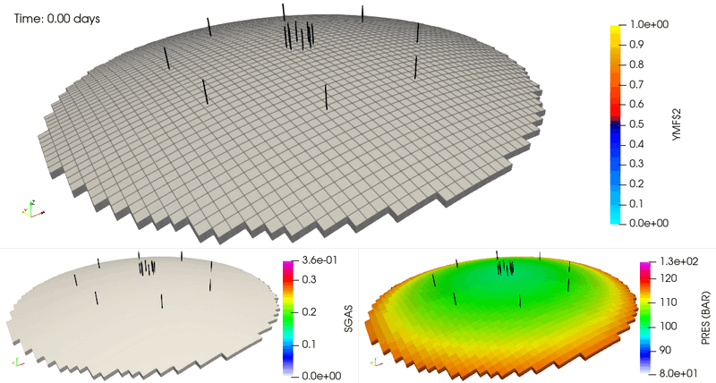
Cushion gas substitution with CO₂?
Back to Contents
CO₂ molar
fraction in gas
Gas
saturation
Pressure

Slide 15
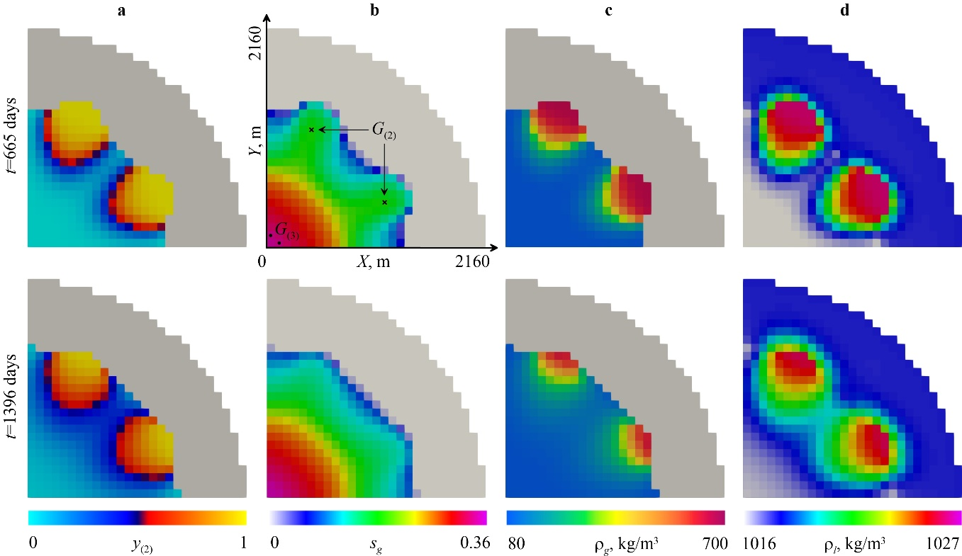
Parameters at the end the 1st and 3rd cycles
Back to Contents
At reservoir conditions, the density of CO₂ is much larger than that of CH₄. This, to some degree reduces the intensity of the mixing
End of
the 1st cycle
End of
the 3rd cycle
CO₂ molar
concentration in gas
Gas
saturation
Gas
density
Brine
density

Slide 16
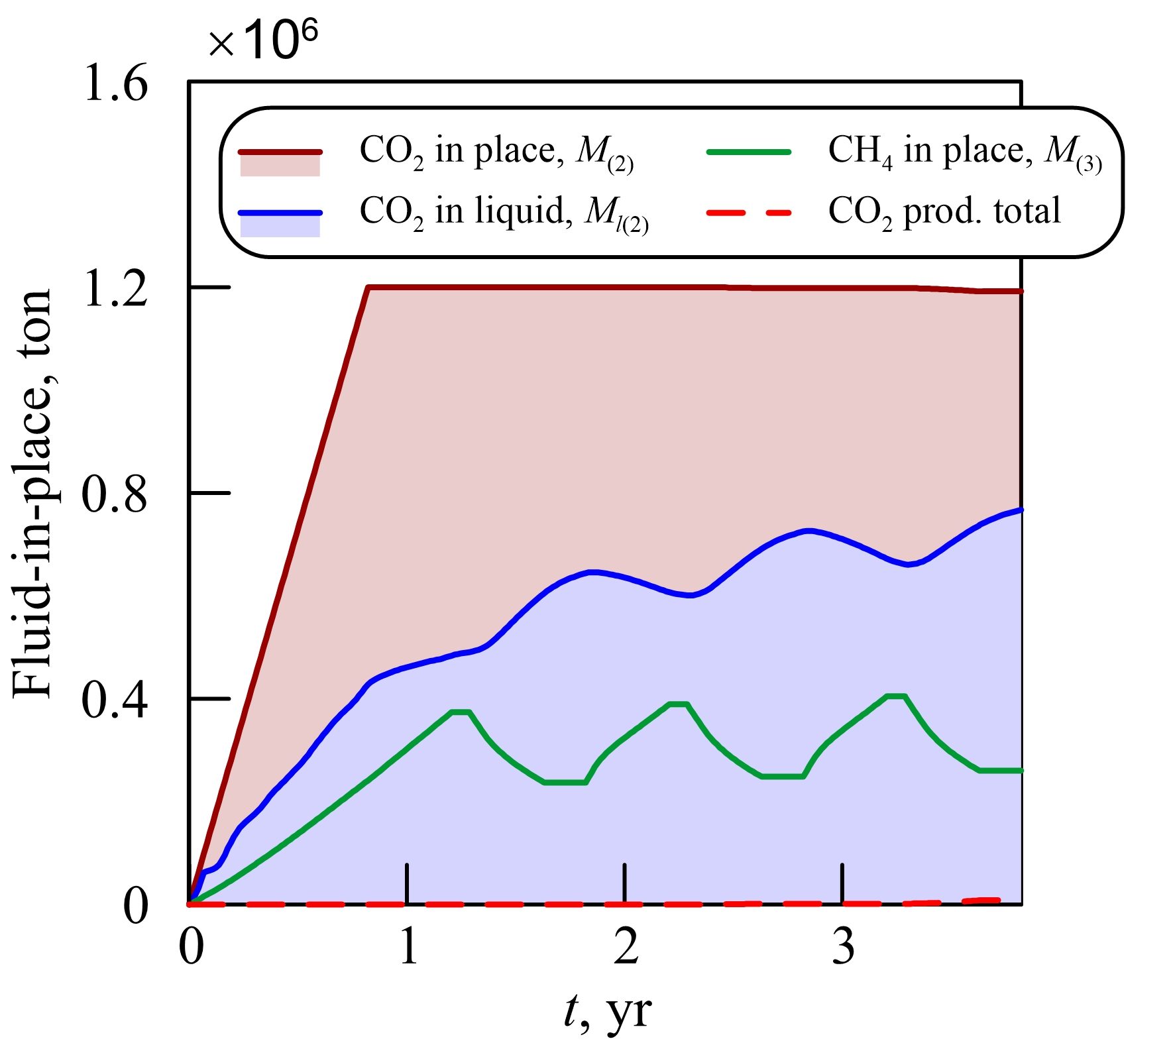
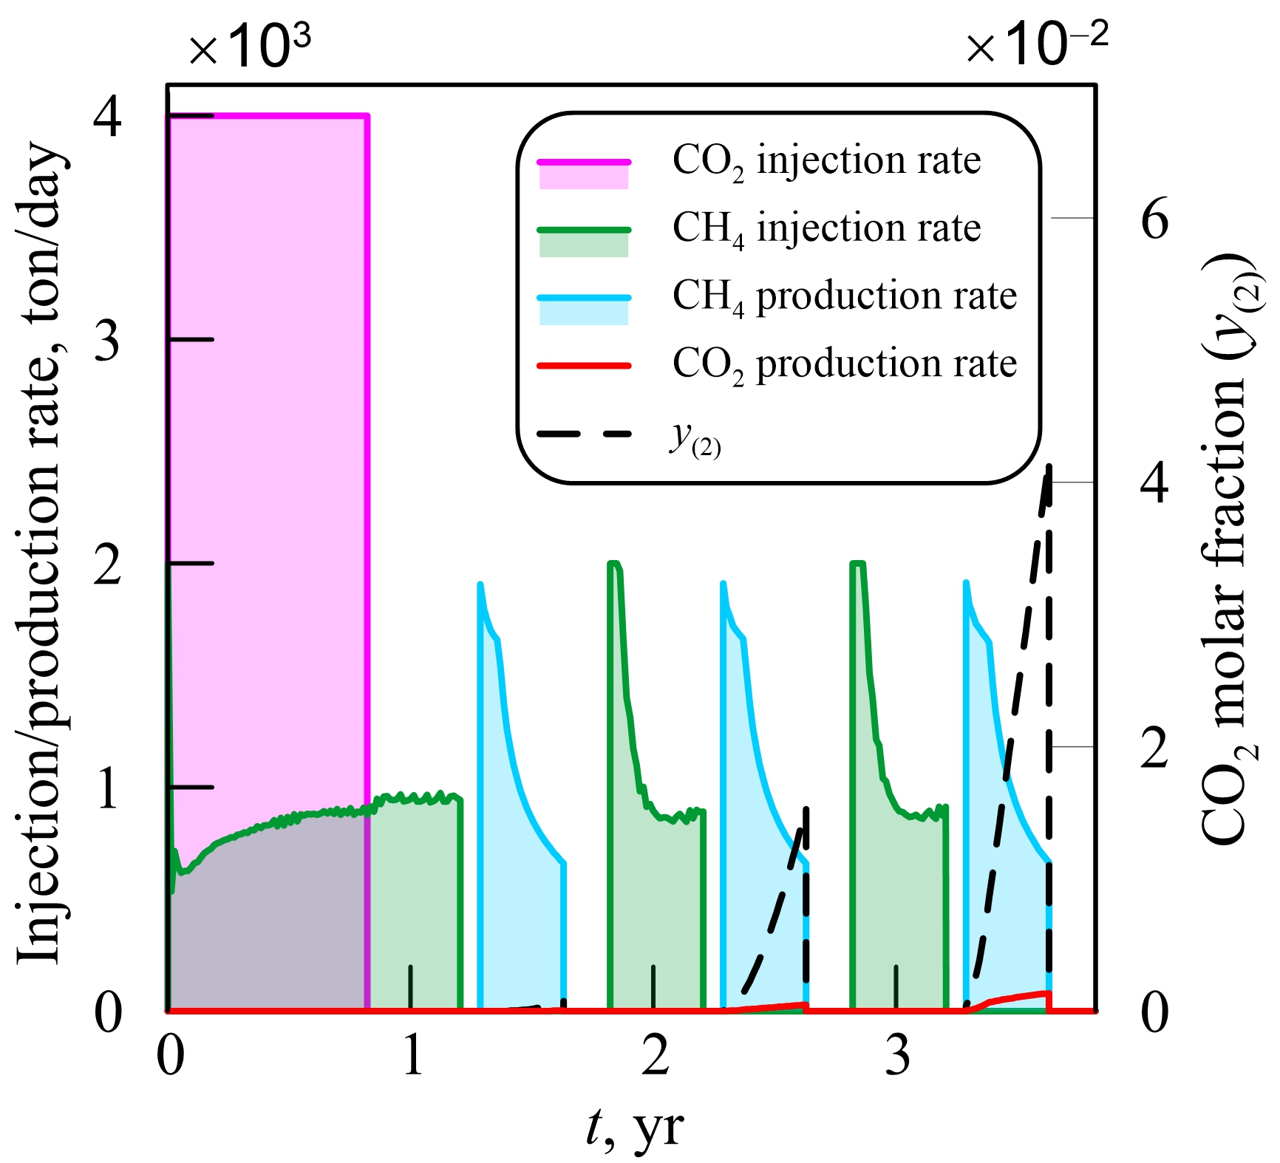
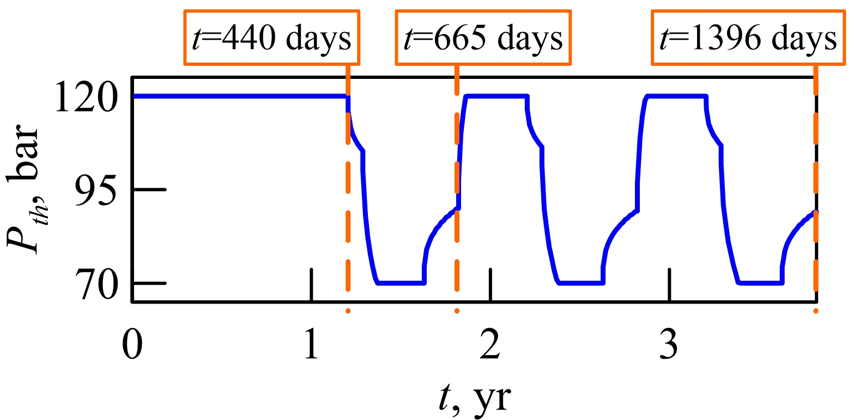
Fluid-in-place quantities
Back to Contents
Fluid-in-place quantities
Injection/production rates
Tubing head pressure
of an NG wells
The dashed line shows the molar fraction of CO₂ in the produced gas. Thus, due to intensive mixing, CO₂ spreads to the NG wells after 3 years when its concentration reaches 4%.
The total mass of injected CO₂ is several times larger than that of NG
Changes in the flow direction and the mechanical dispersion result in that more than a half of injected CO₂ is trapped by solubility after 3 cycles.

Slide 17
Summary
Back to Contents
We present an improved Søreide and Whitson EoS for modeling aqueous solutions. We supplement the SW EoS with correlations for volume shifts
We implement the SW EoS in the compositional module of the MUFITS simulator. It contains a built-in library of EoS coefficients to ease the usage of the software.
The gas plume is significantly wider for an impure CO₂ injection.
A simulation example of cushion gas substitution with supercritical CO₂ is presented. The mechanical dispersion can cause a rapid CO₂ spread into the wells used for natural gas production.
Acknowledgements: The authors acknowledge funding from Russian Science Foundation under grant # 19-71-10051.

Slide 18
Supplementary material
Back to Contents
Click on the links to download the supplementary material
MUFITS site
Reference manual
Input file to the benchmark study of CO₂ injection
Input files to the study of flue gas injection
Input files to the study of cushion gas substitution

