Slide 1
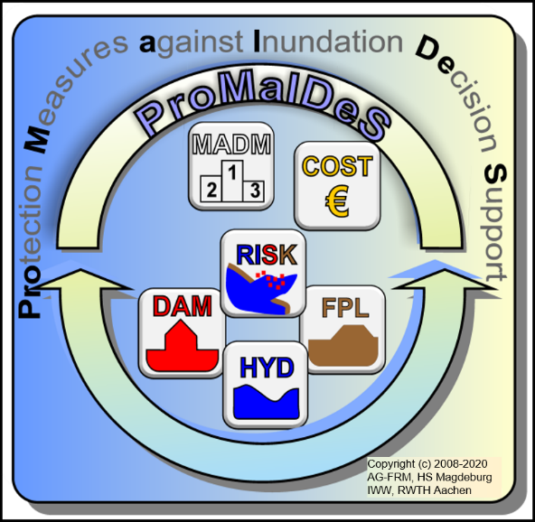
Conceptualization of a Critical Infrastructure Network – Model for Flood Risk Assessments
University of Applied Science Magdeburg
Dipl.-Ing Roman Schotten,
Prof.-Ing. Daniel Bachmann

Slide 2
Conceptualization
of a Critical Infrastructure
Network Model
for Flood Risk Assessments
Content of this presentation
Motivation & Objective
Modelling Framework - ProMaIDeS
Conceptualization of a CI Modelling Software
Sandbox Model
Data Inputs & Challenges
Outlook
Notes:
Situation – Complication – Question/Opportunity - Answer

Slide 3
Project & Consortium Motivation & Objective
This research is executed in the framework of the PARADeS project funded by the Federal Ministry of Education and Research (BMBF)
The consortium consists of a combination from German and Ghanaian Partners:
Notes:
Situation – Complication – Question/Opportunity - Answer

Slide 4
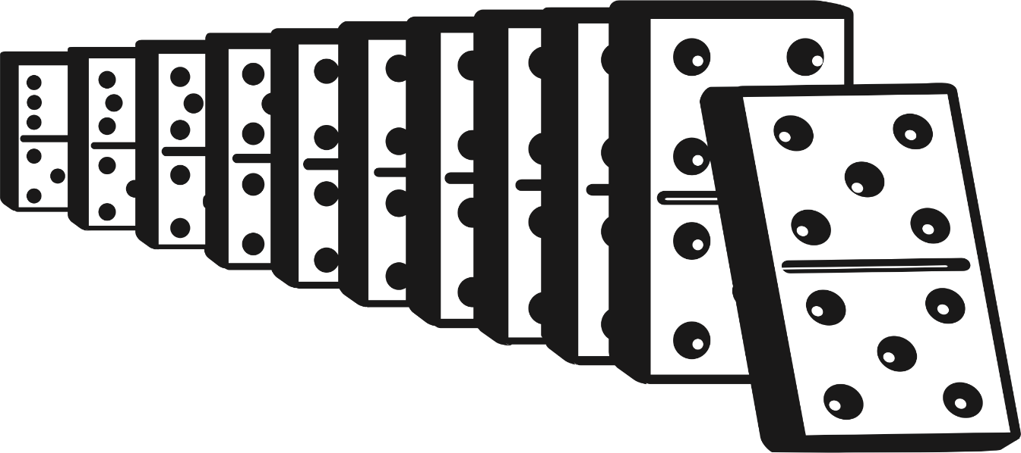
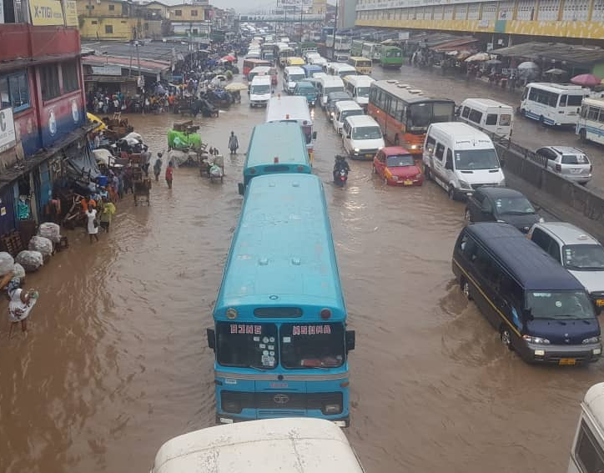
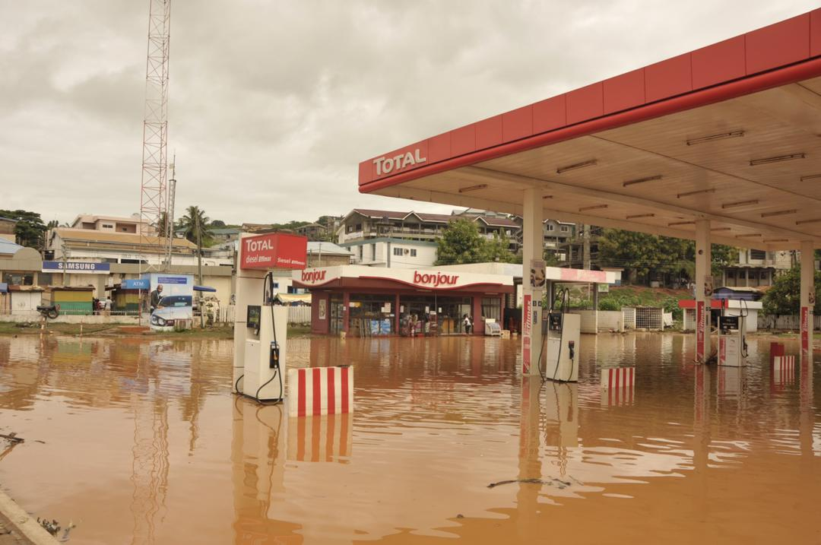
Why modelling Critical Infrastructure Networks? Motivation & Objective

Slide 5
Flood Damage Types Motivation & Objective
 | Tangible | Intangible
Direct | Buildings, Houshold | Affected People
 | Industry, Business | Ecological Values
 | Agriculture, Forestry | Cultural Values
 | Infrastructure | Personal Values
 | Cars | Critical Infrastructure Services
Indirect | Business Disruption | Loss of Trust in Region
 | Traffic Disruption | Psycho-Social Consequences
 | Cost of Emergency Measures | Epidemics and State of Emergency
 | Unavailability of Agricultural Land | Cascading Effects Critical Infrastructure Services
Direct Tangible Damages are by standard included in Flood Damage Modelling
→ Objective: Include quantified damage to Critical Infrastructure (Services) in FRM decision making
Notes:
Situation – Complication – Question/Opportunity - Answer

Slide 6
State of the Art Flood Risk Assessment Modelling Framework
ProMaIDeS - modular, free software for the risk-based assessment of flood protection measures including extensive documentation → www.promaides.h2.de
1. Hydraulic modelling – fluvial, pluvial, coastal
2. Damage modelling – e.g. economic, population ...
3. Dike failure probabilities
4. Risk calculation – e.g. climate change scenario’s
5. Measures and decision management - iterative
Notes:
Situation – Complication – Question/Opportunity - Answer

Slide 7
Damage Modelling with ProMaIDeS Modelling Framework
Damage modelling modules
ECN – Economic Damages
POP – Population Affected
SC – Simple Counting – special risk objects
CI – Critical Infrastructure Network
Notes:
Situation – Complication – Question/Opportunity - Answer

Slide 8
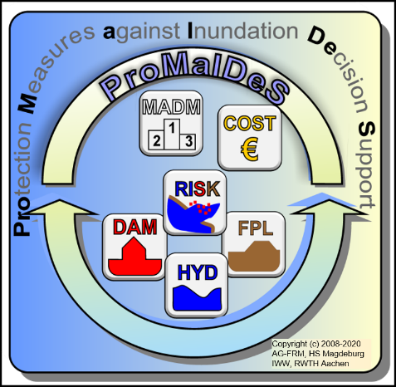
ProMaIDeS – Architecture Modelling Framework
Site Specific Input DEM, Land-Use-Data, Dikes, CI’s etc.
+ QGIS Plugins
Preprocessing
Visualisation Input + Results
Input Data
Local/ Remote Database
Calculation results
Calculation
Calculation results
Visualisation

Slide 9
Characteristics of a CI Network Conceptualization of a CI Modelling Software
CI – Element | Description | Example Sector: Electricity | Example Sector: Info Tec | Example Sector: Health Services
Points | Punctual CI structures | Transformators, power plants | Transmitting towers | Hospitals, nursing home
Connectors | Connections in between CI structures, services and users | physical, logical, geographical, cyber interdependency
Polygon | Coverage areas for CI services | Electricity costumers | mobile phone users | hospital catchment area, patients
Notes:
Situation – Complication – Question/Opportunity - Answer

Slide 10
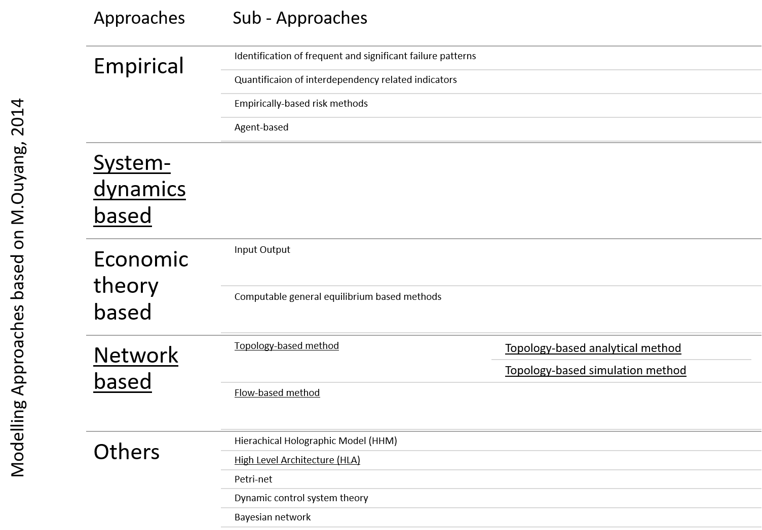
Approaches for CI Modelling Conceptualization of a CI Modelling Software
Notes:
Situation – Complication – Question/Opportunity - Answer

Slide 11
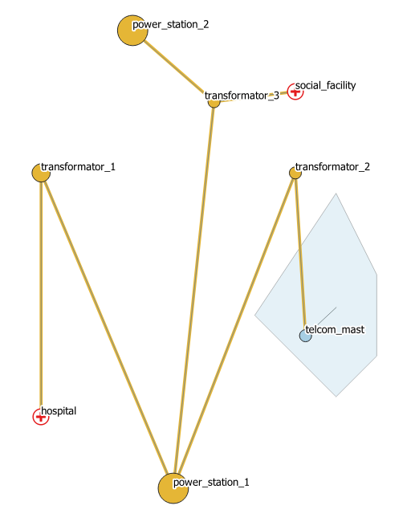
CI Module ‘Sandbox’ Model
Model basis: Resembling critical infrastructures with a combination of point, connector and polygon elements
As simple as possible + as complicated as necessary
Notes:
Situation – Complication – Question/Opportunity - Answer

Slide 12
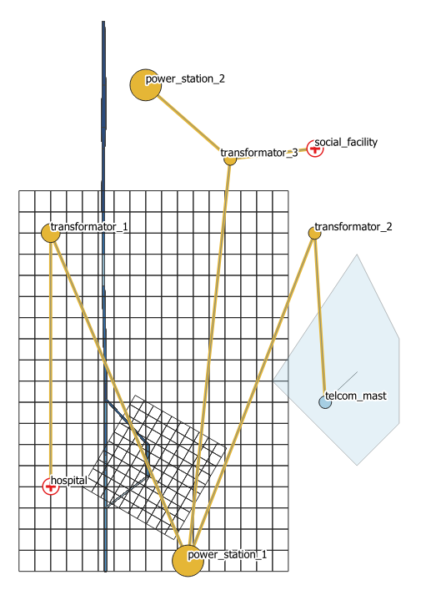
CI Module ‘Sandbox’ Model – Hydraulic Input
Combination of 1D and 2D hydraulic model
Coastal Boundary
Hydraulic model inflow
Notes:
Situation – Complication – Question/Opportunity - Answer

Slide 13
CI Module ‘Sandbox’ Model – Instationary Results
Notes:
Situation – Complication – Question/Opportunity - Answer

Slide 14
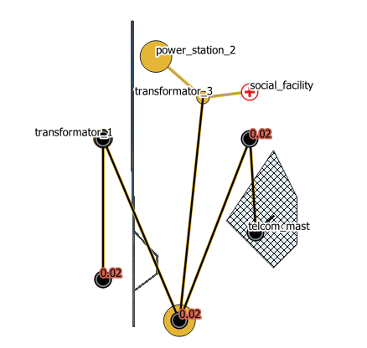
CI Module ‘Sandbox’ Model - Output
Last timestep before model is returning into its initial state
Red Numbers indicate the recovery time [days]
Other outputs here: Disrupted people x hours from Mobile Network Connectivity
Notes:
Situation – Complication – Question/Opportunity - Answer

Slide 15
Challenges for the CIN Module Data Inputs & Challenges
How to derive data on ...
... water level thresholds for critical infrastructure assets?
... the connectivity in between critical infrastructure sectors?
... the connectivity in between critical infrastructure sectors?
Notes:
Situation – Complication – Question/Opportunity - Answer

Slide 16
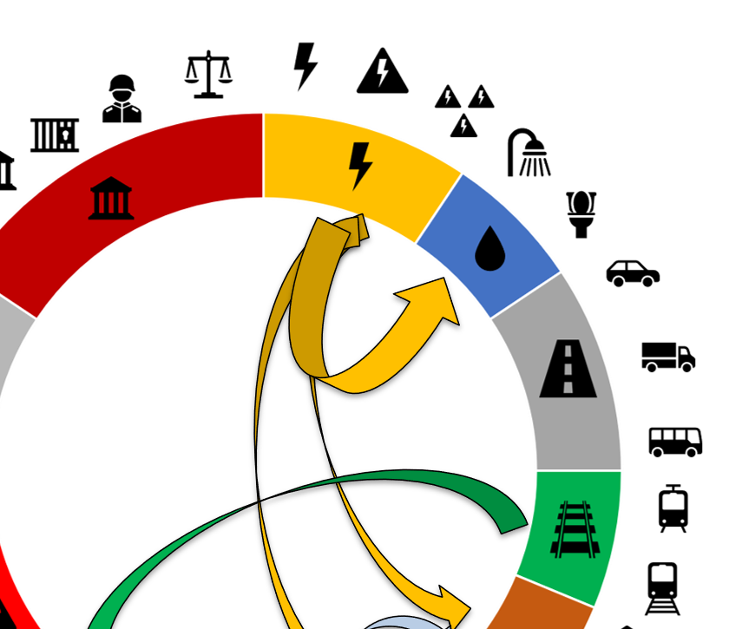
Tackling Challenges with ‘Circle’ and Public Data Data Inputs & Challenges
CIrcle - Critical Infrastructures: Relations and Consequences for Life and Environment
+ Open Street Maps
+ Expert Knowdlege
→ A method to derive critical infrastructure information through stakeholder engagement supported by a publicly available online tool
www.circle.deltares.org/

Slide 17
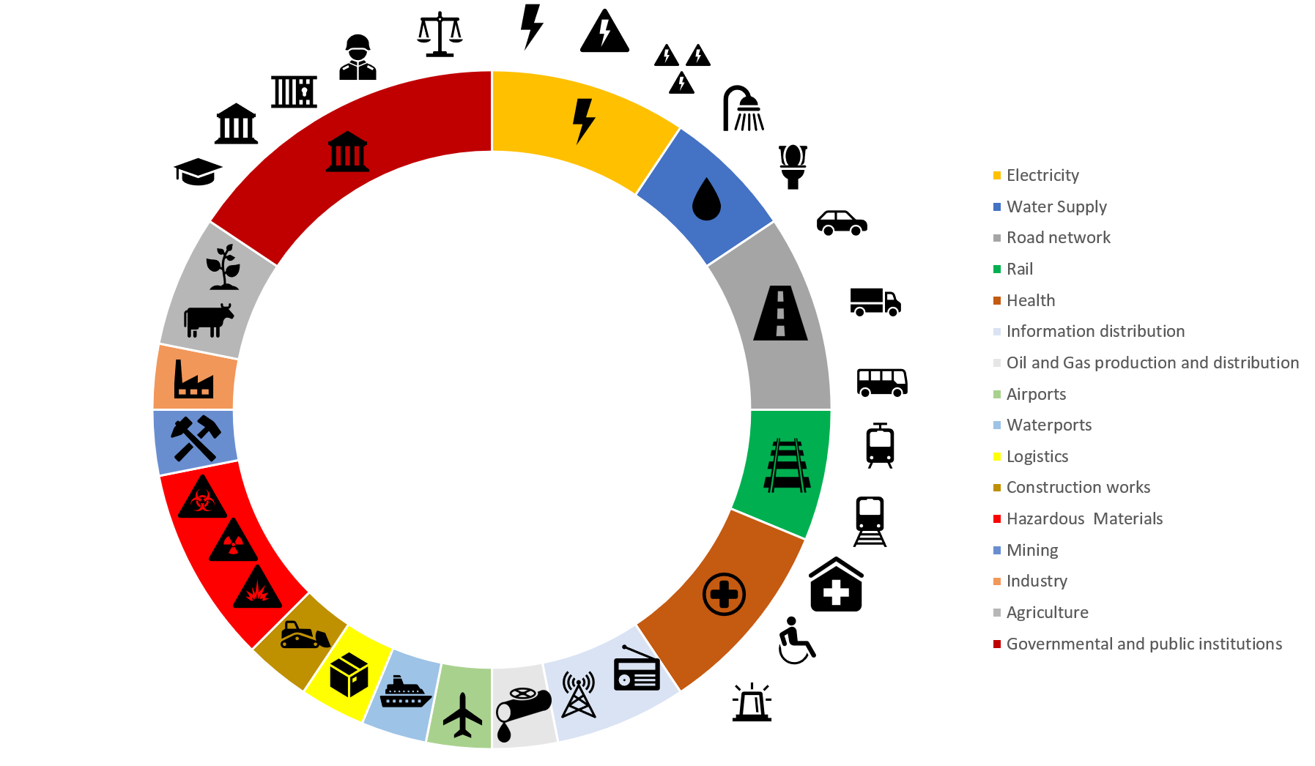
The ‘CIrcle’ Approach Data Inputs & Challenges
Step: Collaborative arrangement of the most relevantal critical infrastructure sectors in a circle
Step: Connecting the CI sectors with cascading effects and collecting threshold values
Step: Discussing mitigation measures to prevent cascades with all stakeholders
https://circle.deltares.org/

Slide 18
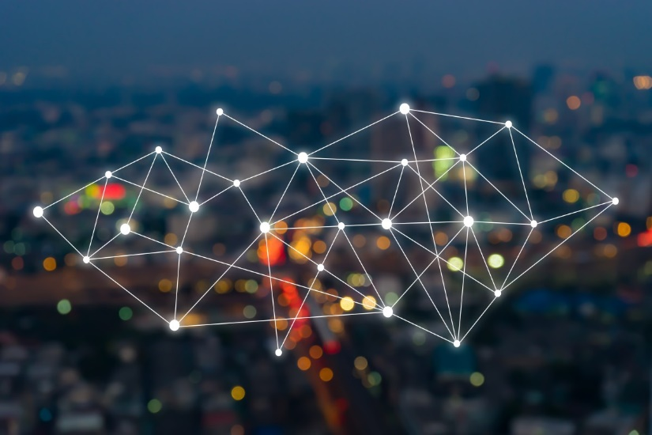
Outlook for the CI Module
Building a more complex model:
A higher number of nodes, connectors and polygons
More transsectoral connectors
Sectoral information staggered in multiple layors (power plant, high voltage transformator, low voltage transformator)
The validation of a critical infrastructure disruption model including cascading effects. How to quantify the accuracy of a CI model?
Damage calculations of critical infrastructures in flood risk management procedures. How to embed critical infrastructures in directives?

Slide 19
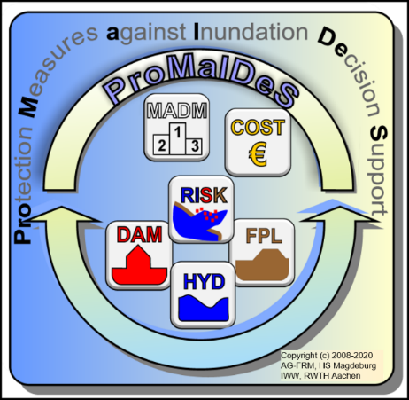
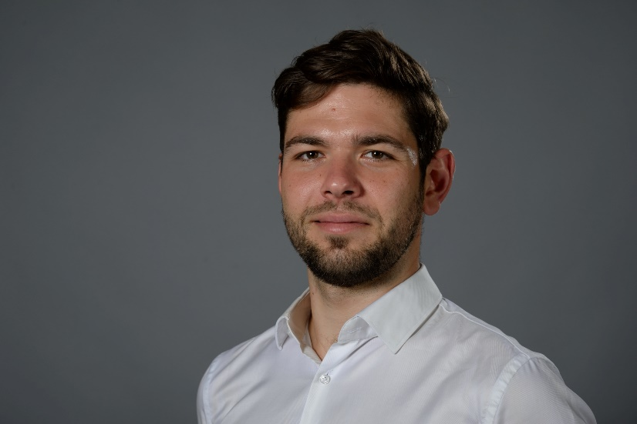
Thank you for your attention. I welcome your suggestions or critique.
www.promaides.h2.de

