Slide 1
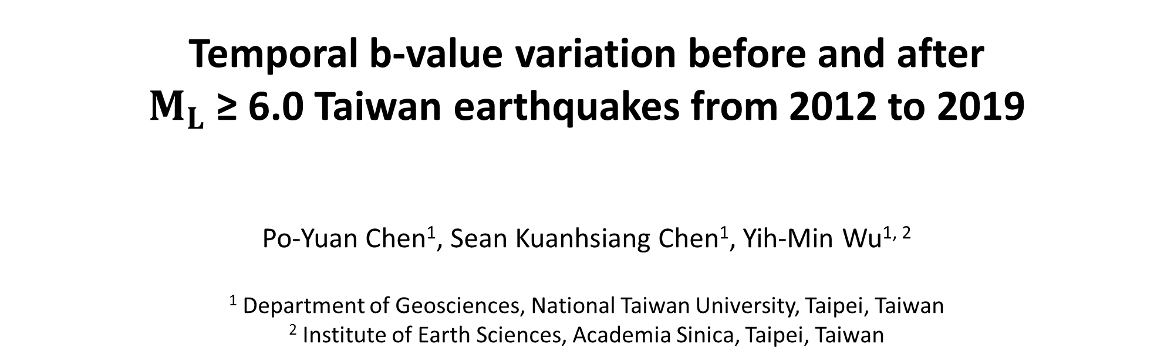
Temporal b-value variation before and after
$M_{L}$ ≥ 6.0 Taiwan earthquakes from 2012 to 2019
Po-Yuan Chen¹, Sean Kuanhsiang Chen¹, Yih-Min Wu^{1, 2}
¹ Department of Geosciences, National Taiwan University, Taipei, Taiwan
² Institute of Earth Sciences, Academia Sinica, Taipei, Taiwan

Slide 2
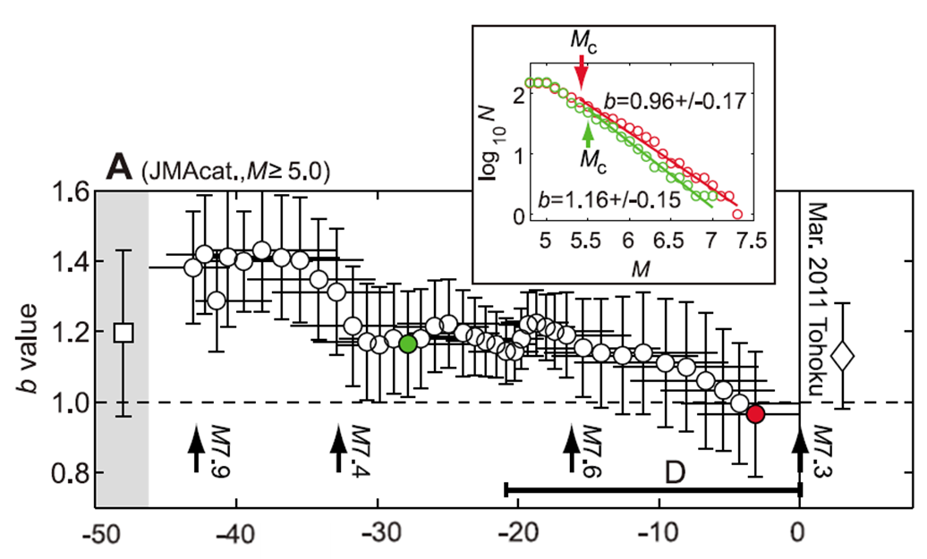
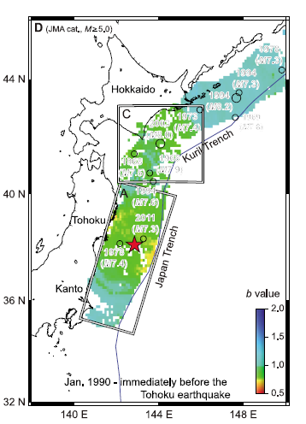
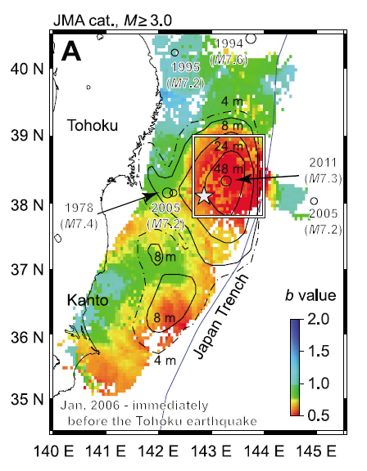
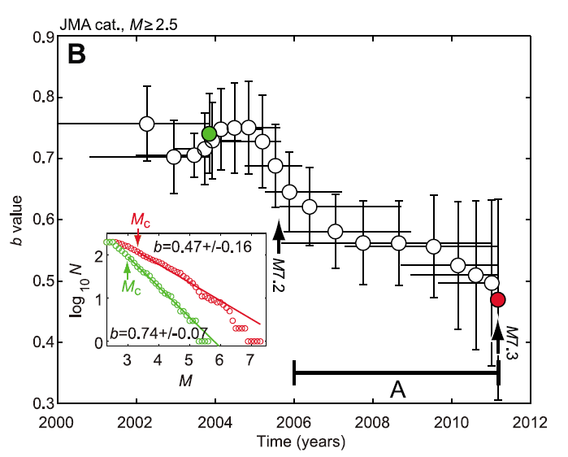

Introduction
(Nanjo et al., 2012)
GR law: $\log_{10}{N=a−bM}$
Before mainshock
Notes:
B-value is defined by GR law, and is a function of time and space
This figure shows the temporal b-value variation before Tohoku earthquake
Spatial volume is determined by the locations of aftershocks
We can see that 10 years before Tohoku earthquake, b-value started to decrease
Spatial volume for this figure is determined by the large co-seismic slip area
Again, b-value keeps going down in the 10-years period
The main objective in our study is to explore whether this temporal b-value decrease by a large earthquake can be frequently observed in Taiwan

Slide 3
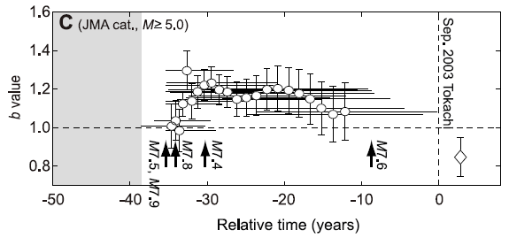
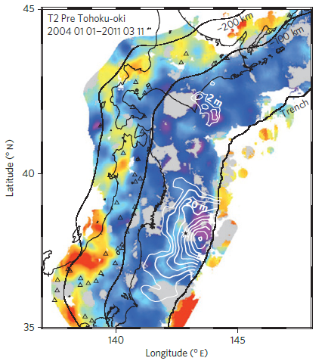
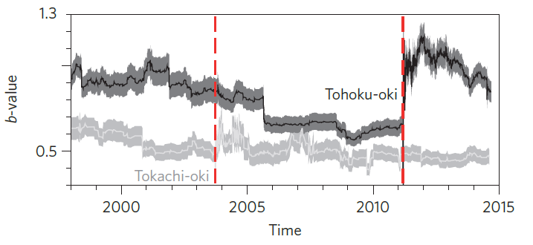

Introduction
(Nanjo et al., 2012)
(Tormann et al., 2015)
After mainshock
Notes:
We are also interested in the variation after mainshock
If b-value keeps going down after mainshock, it may imply there will be another large earthquake in the near future
Besides, we have observed that b-value increase immediately after Tohoku earthquake and then decrease

Slide 4
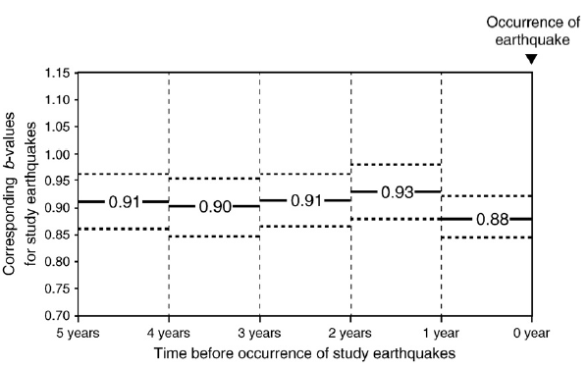
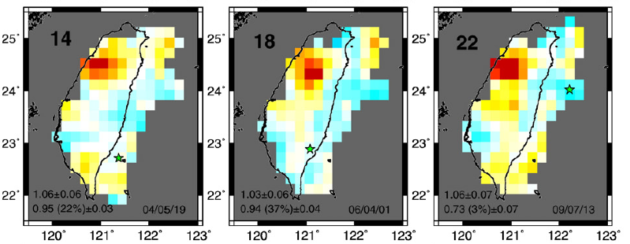
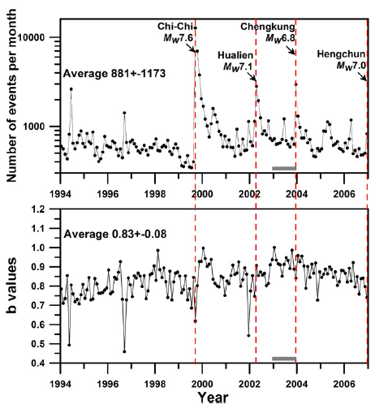
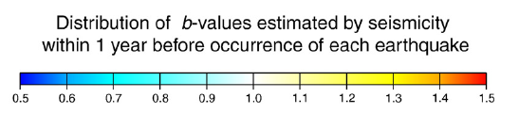
Introduction
(Wu et al., 2008)
(Chan et al., 2012)
Notes:
From previous studies in Taiwan
About 1 year before chi-chi earquake, b-value stared to decrease
chan et al analyze spatial variation of b-value before several M ≥ 6 earthquake during 1999 to 2009
They further analyzed temporal variation of b-value in these epicentral areas
They found that b-value is smaller one year before earthquake

Slide 5
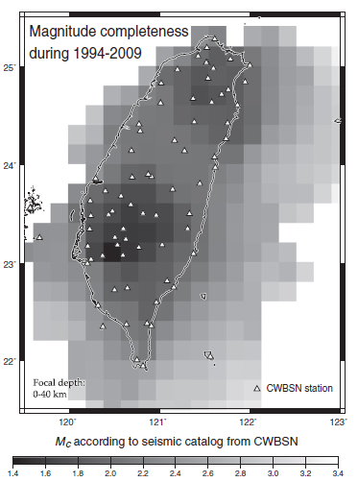
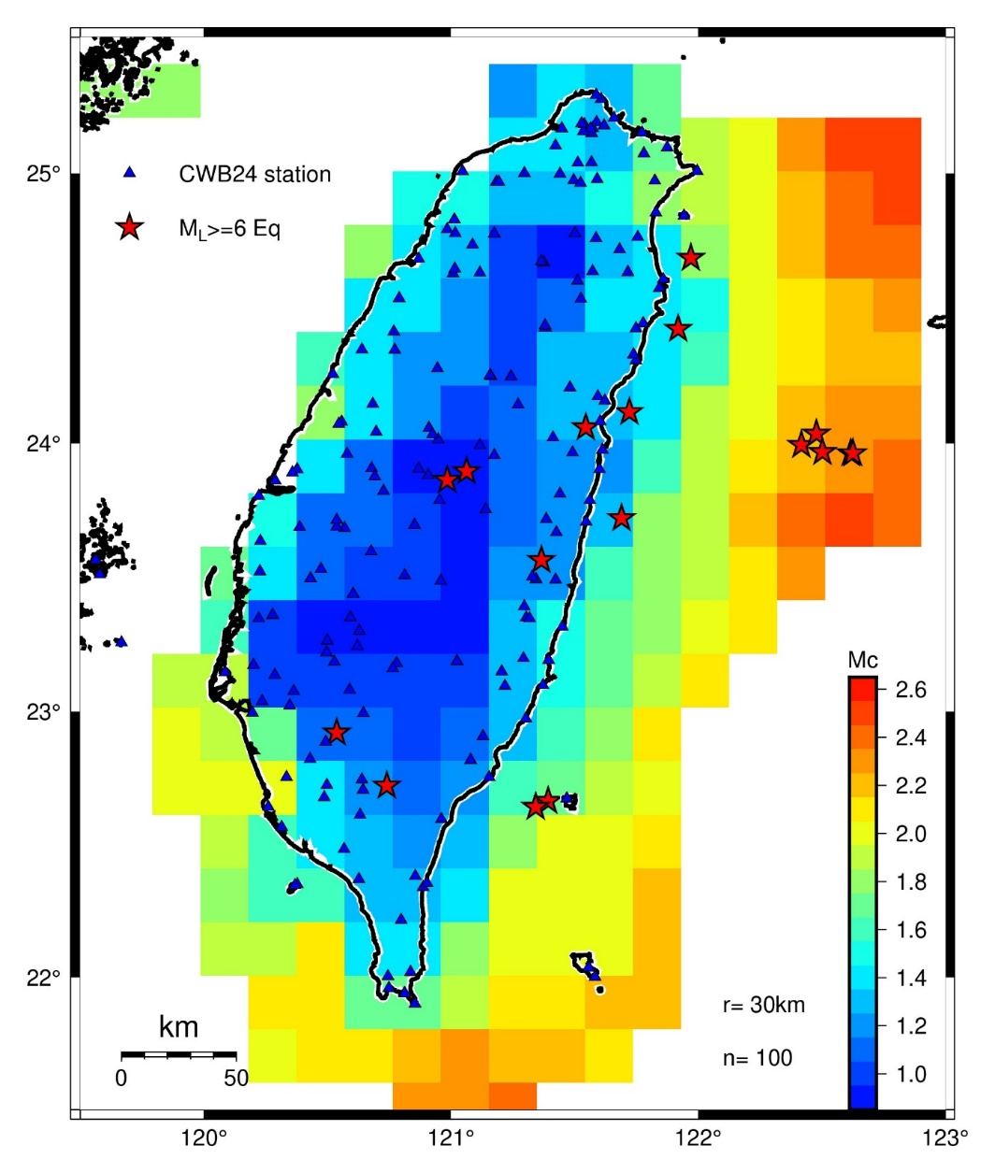
Motivation
CWB 24-bit Seismic Network (since 2012)
(Chan et al., 2012)
Notes:
since 2012, CWB have updated their seismic network
This figure shows Mc during 1994-2009, and this figure shows Mc during 2012-2019
we can see that earthquake detection capability is improved a lot after 2012
because Mc of inland regions decreased from 2 to 1.5

Slide 6
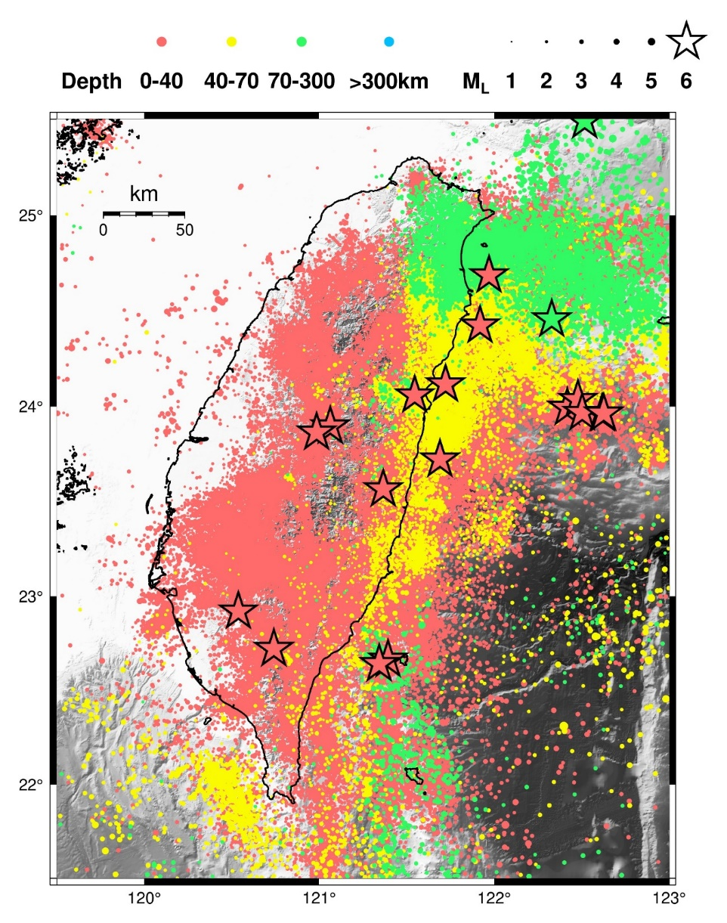
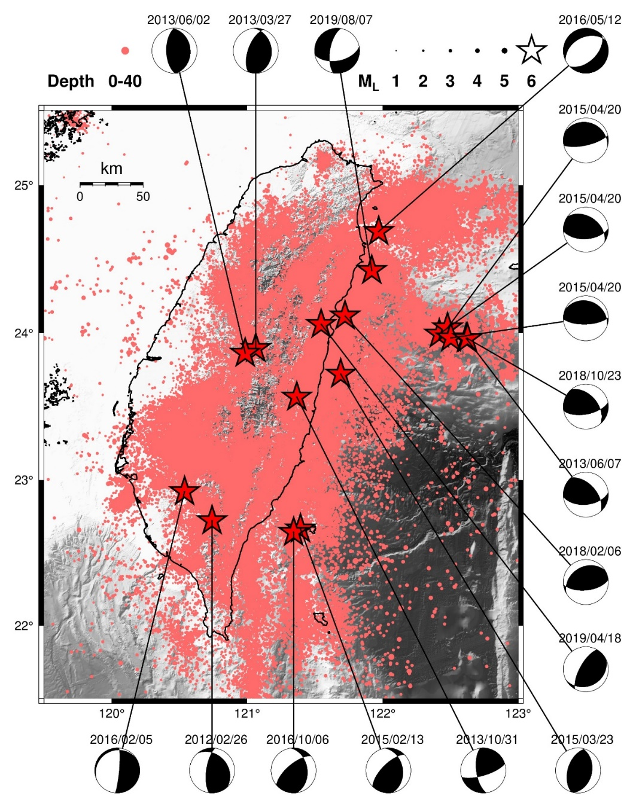
Data
relocated earthquake catalog from 2012/01/01 to 2019/12/31
Notes:
Left panel shows the seismicity
Different colors means different depth, stars are M>6 earthquakes
we use shallow earthquakes only to calculate b-value

Slide 7
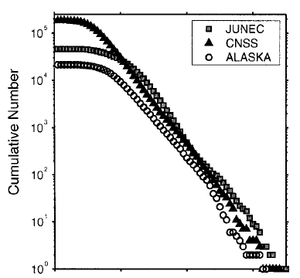
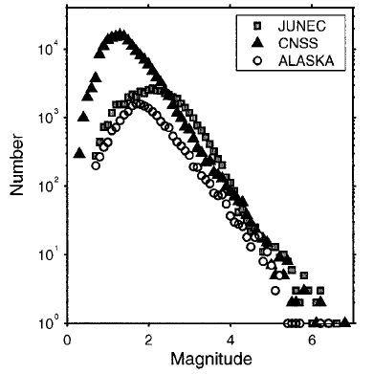
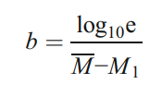
Methods
Maximum curvature plus 0.2 (Wiemer and Wyss, 2000; Woessner and Wiemer, 2005)
Maximum likelihood (Aki, 1965)
Notes:
In this approach, Mc is estimated by maximum curvature of frequency magnitude distribution
In practice, it will match the highest frequency magnitude bin in non-cumulative FMD
In our study, I determine Mc around the highest frequency magnitude bin
We use the maximum likelihood to calculate b-value
Mbar is average magnitude of the earthquakes larger than Mc, M1 is Mc

Slide 8

Research frame
GR law: $\log_{10}{N=a−bM}$
8 years
half year
moving window
background seismic activity at the epicenters of the ML ≥ 6.0 earthquakes
preliminary temporal b-value variation
sensitivity between r and n
continuous temporal b-value variation
Notes:
In the first step, we calculated the b value and Mc
In the second step,
we calculated b values and Mc per half year, and we have tested sensitivity between radius and n value

Slide 9

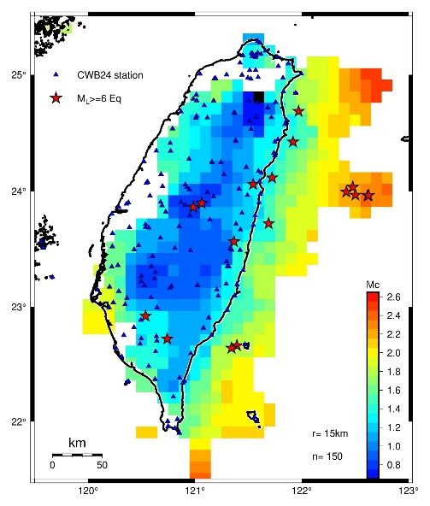
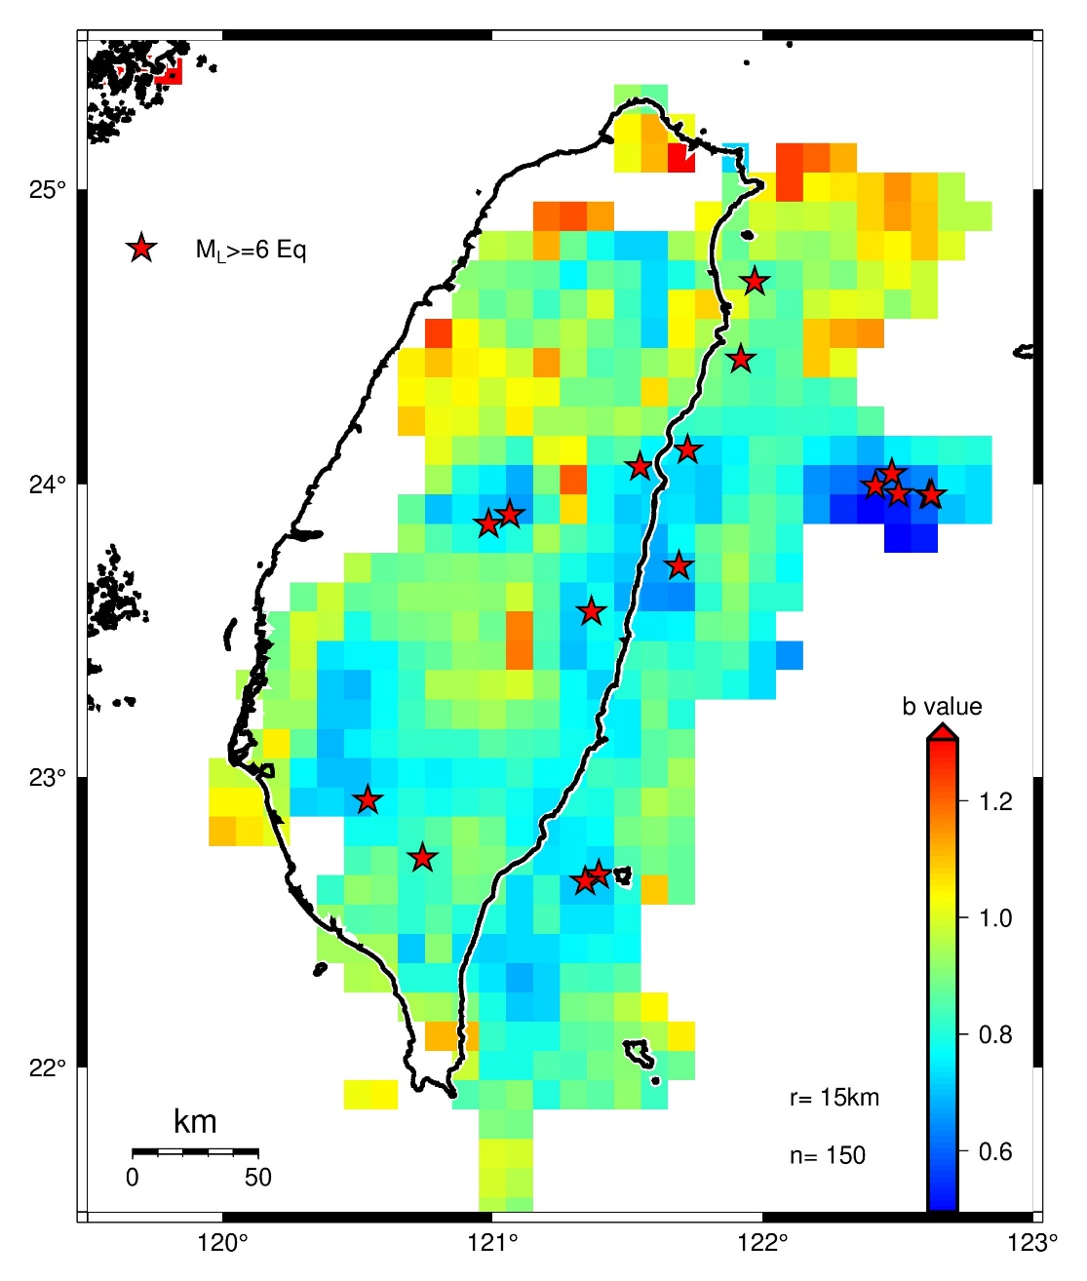
Results (first step)
Notes:
Here shows the results of the spatial Mc and b-value variation from r=15 n=150
We have tested different radius and n value
Finally, we found that r=15 n=150 is appropriate, considering distribution of seismicity
In the middle panel, we can see that spatial b-values have an average close to 1,
and the b values are systematically lower in the epicenters of M_{L} ≥ 6.0 earthquakes

Slide 10
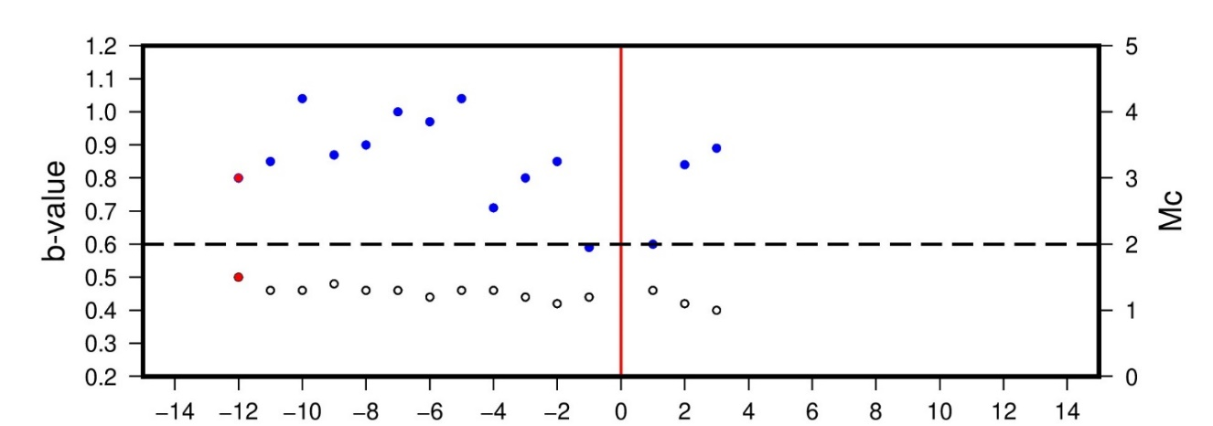

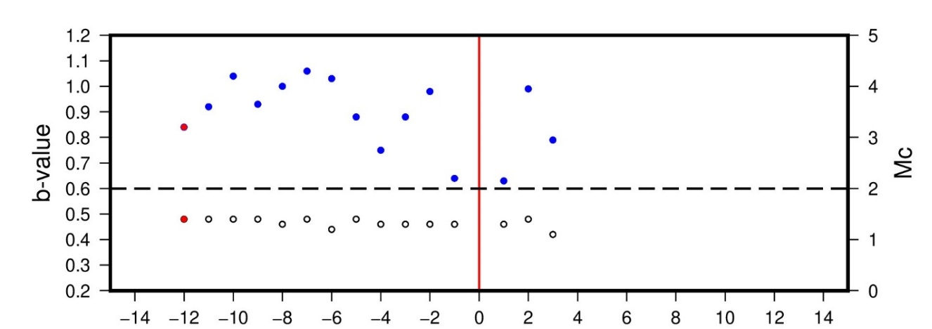
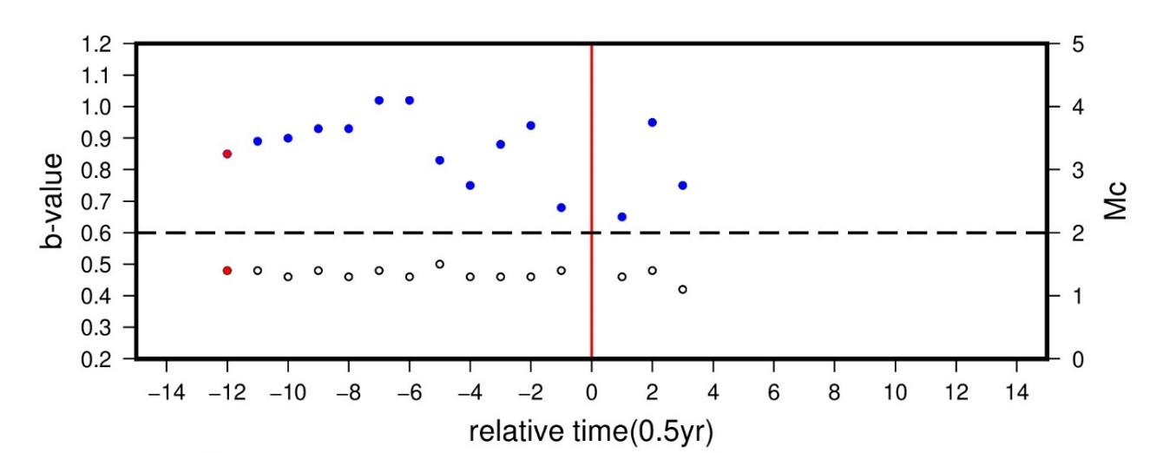
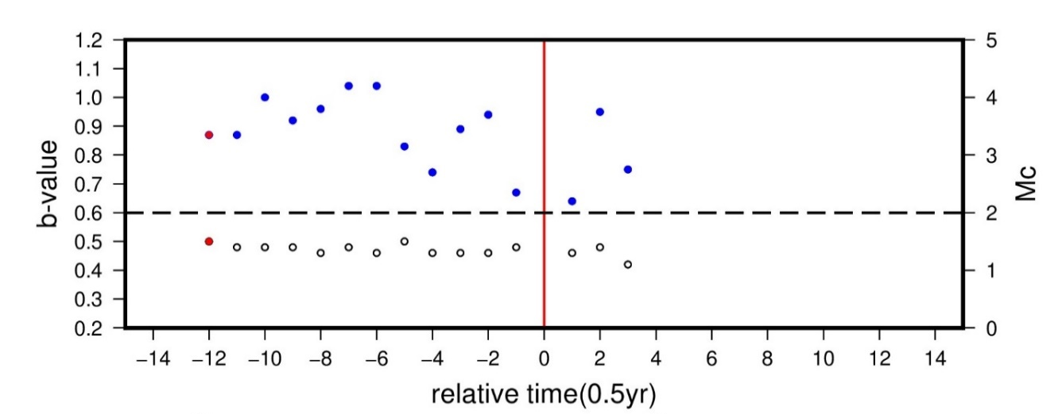
Results (second step)
2018/02/06 ML6.3 Hualien Earthquake
r=15km
F
r=20km
r=25km
r=30km
Notes:
we only observed clear temporal decrease of b-value before Hualien earthquake
And this signal can be seen from 15 to 30km

Slide 11
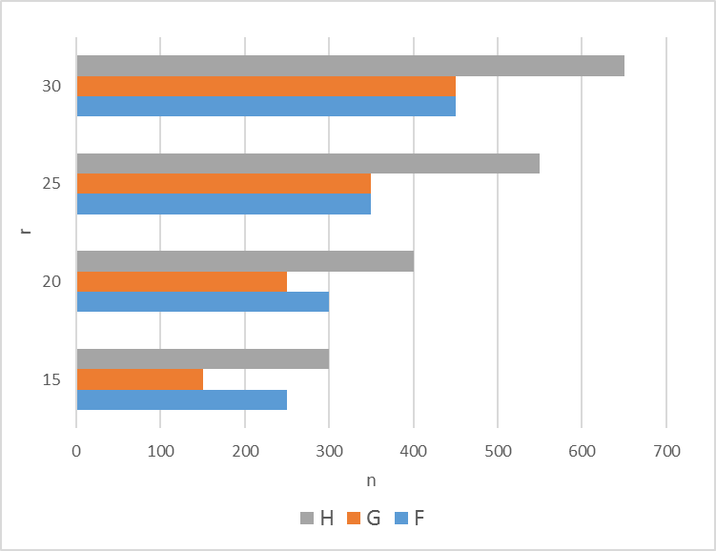
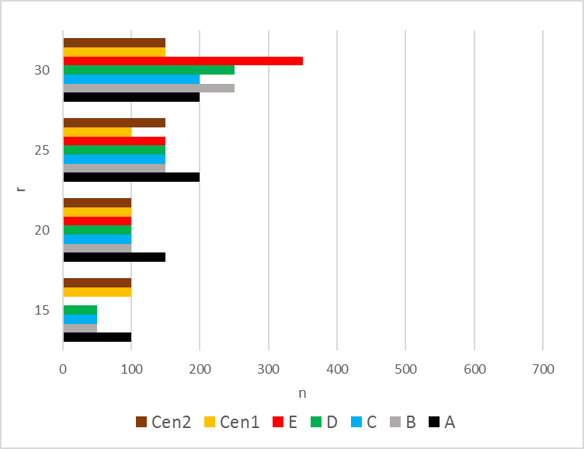
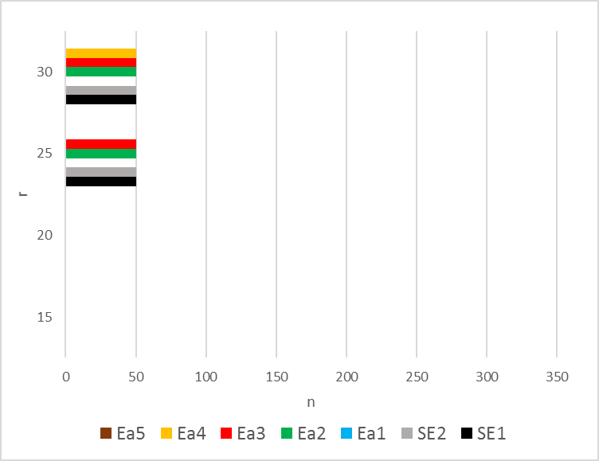

E
H
G
F
C
B
D
A
Notes:
Here shows the results of different radius, from 15km to 30km, for different regions
We require that there must be data per half year
In this case, when n=50, there are data per half year, and then we keep increasing n value
We can see that these epicenters share similar r and n values
Here’s the results of other regions

Slide 12
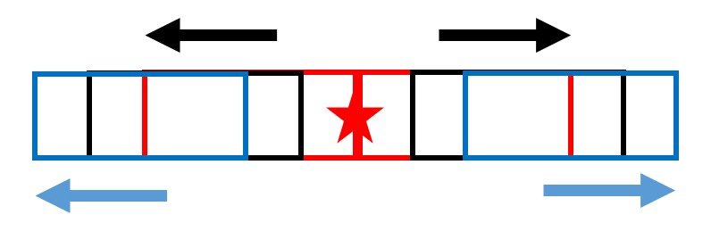
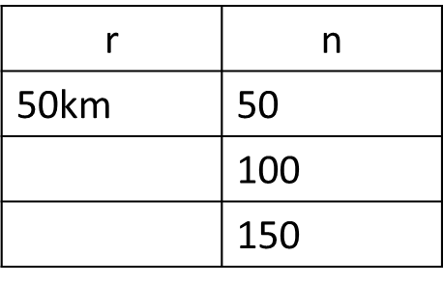
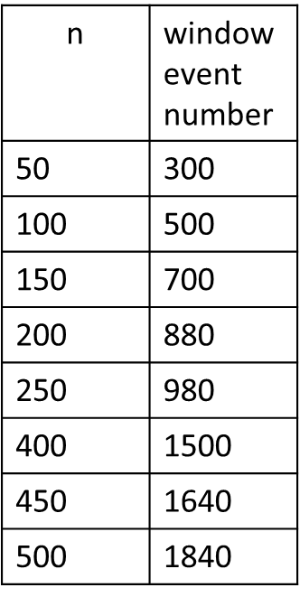
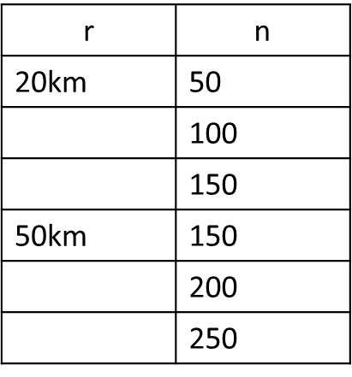
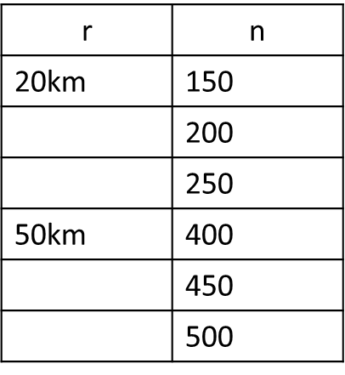
Results (final step)
region: SE1, SE2, Ea1-5
region: A, B, C, D, E, Cen1, Cen2
region: F, G, H
Notes:
This slide shows how I move windows
We only used two different radius in this step, 20km and 50km
Smaller one is determined from the second step
Larger one is determined by the locations of aftershocks

Slide 13
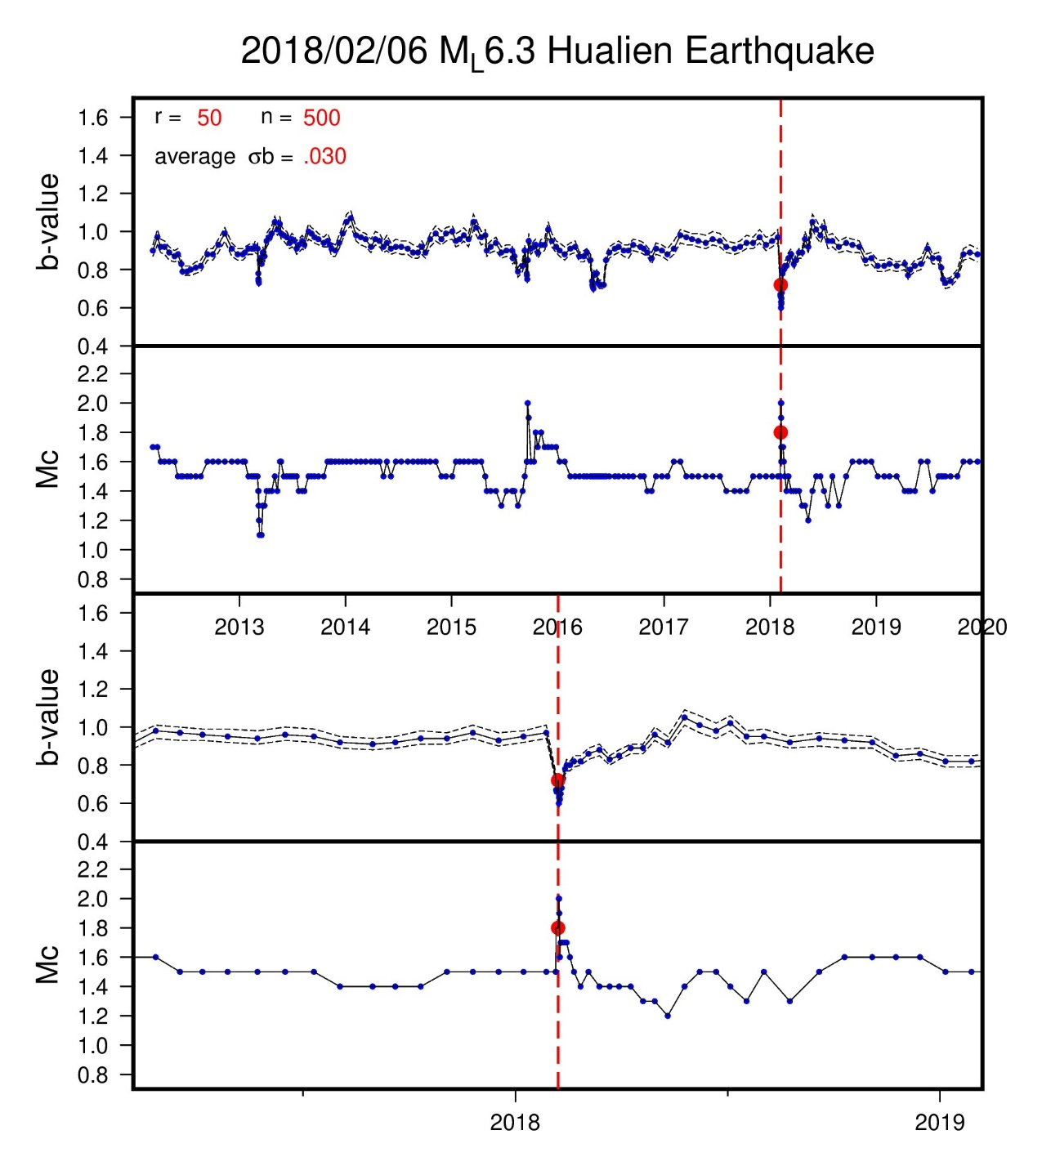
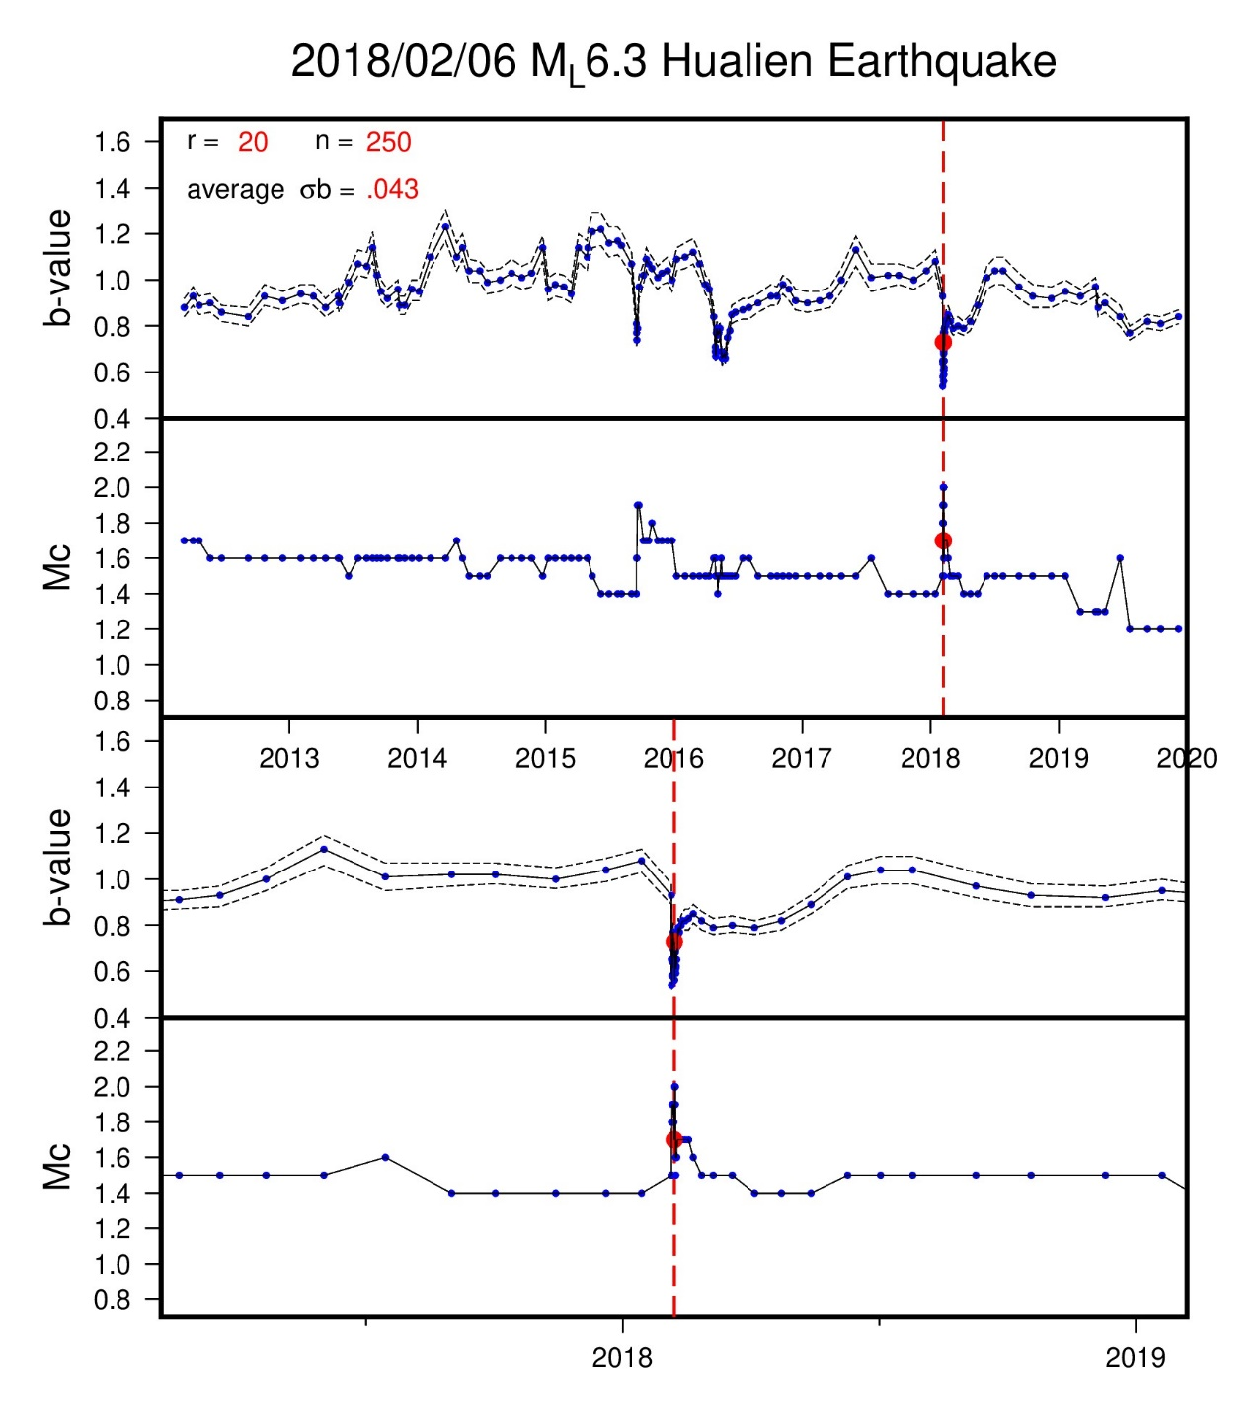
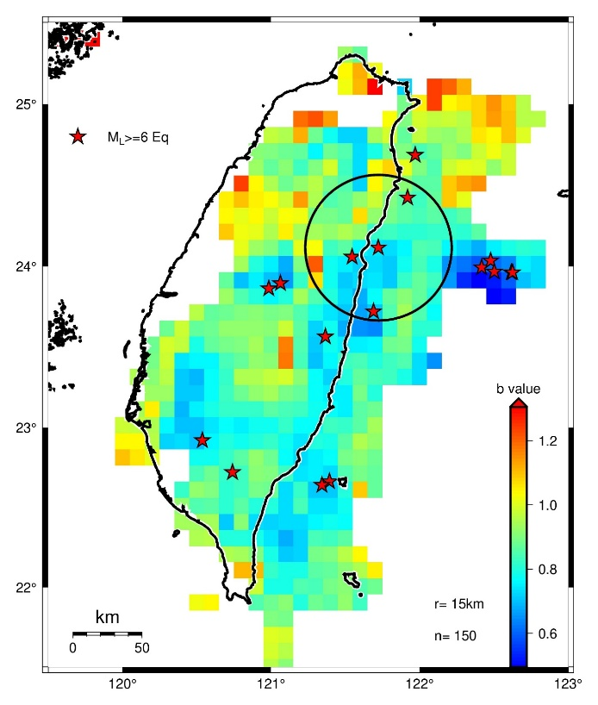
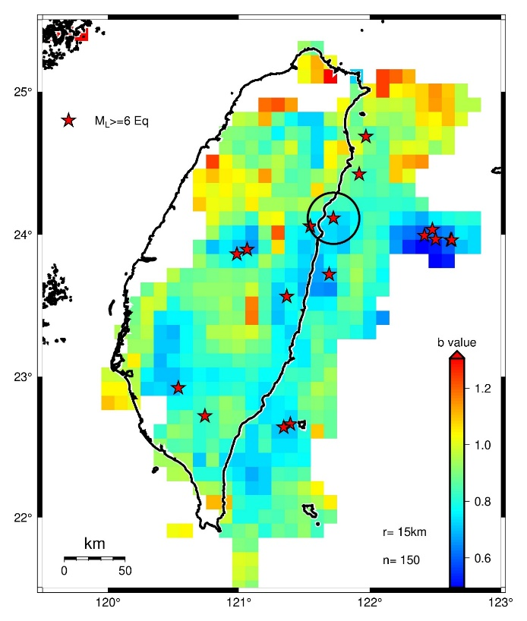
Notes:
From this figure, we can see temporal b-value decrease again as in the second step
Besides, we can see that Mc increase immediately after mainshock and then decrease gradually
These signals can be seen in r=50km, too
we don’t see temporal b-value decrease before mainshocks for other regions

Slide 14
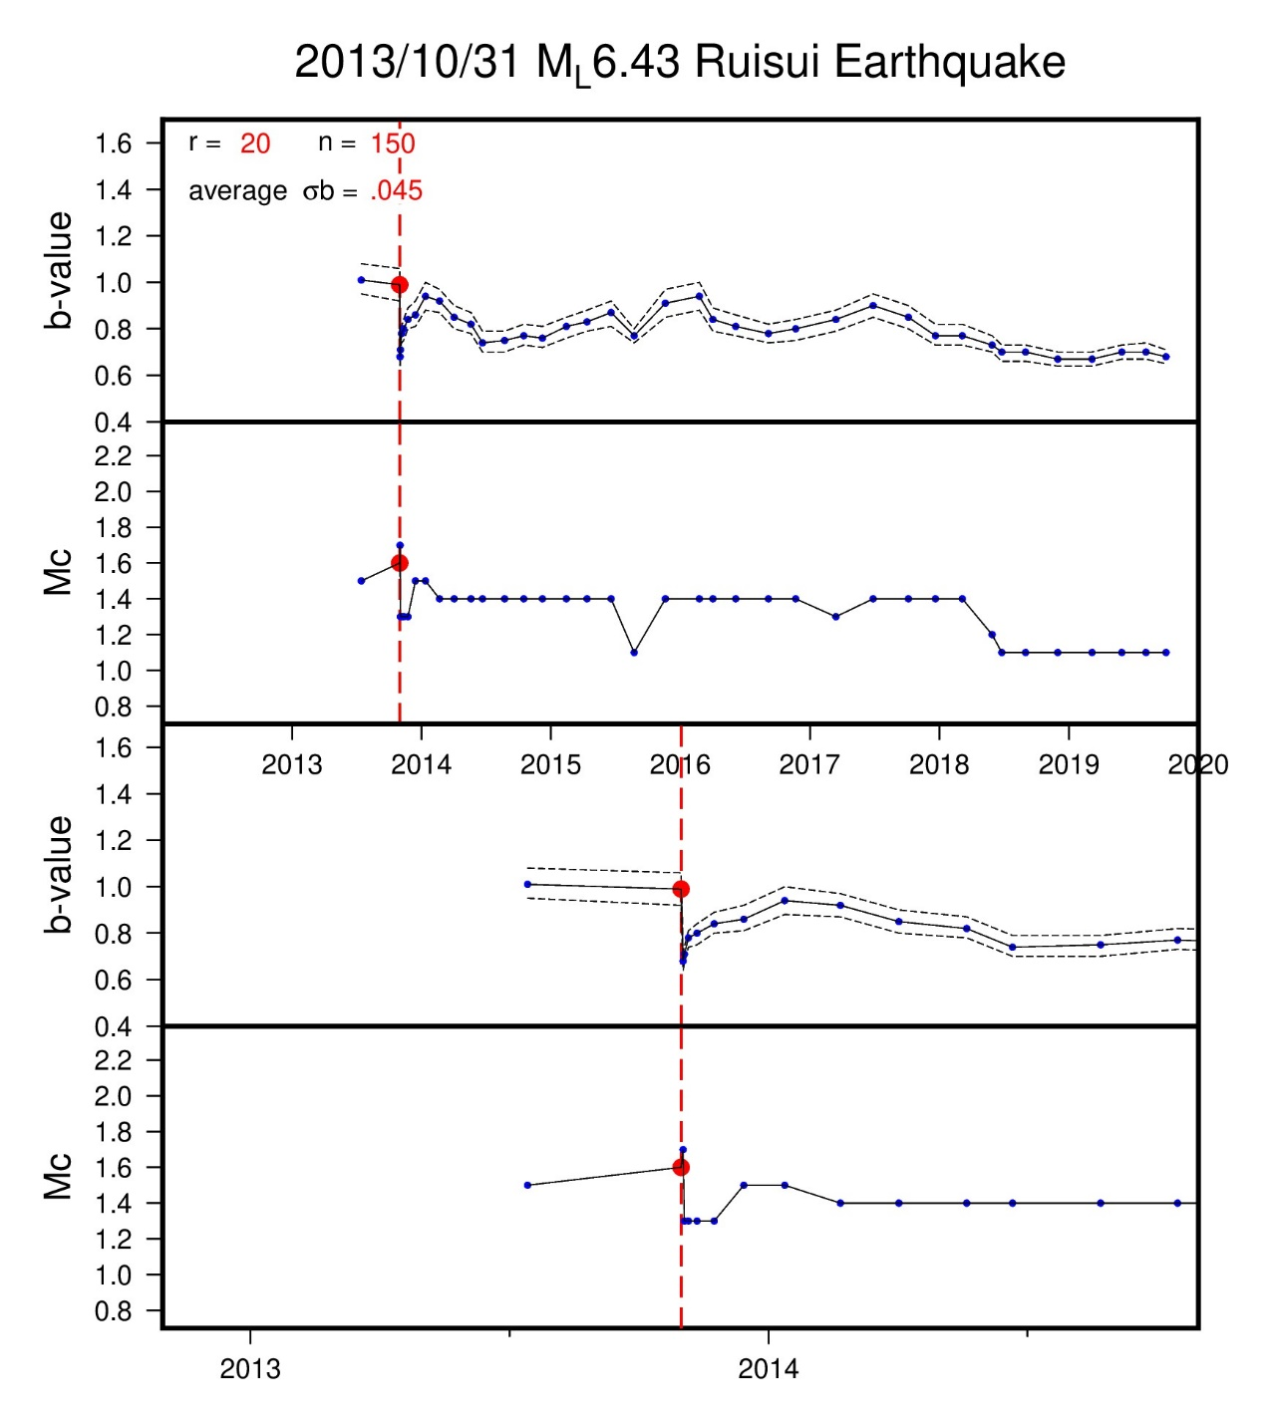
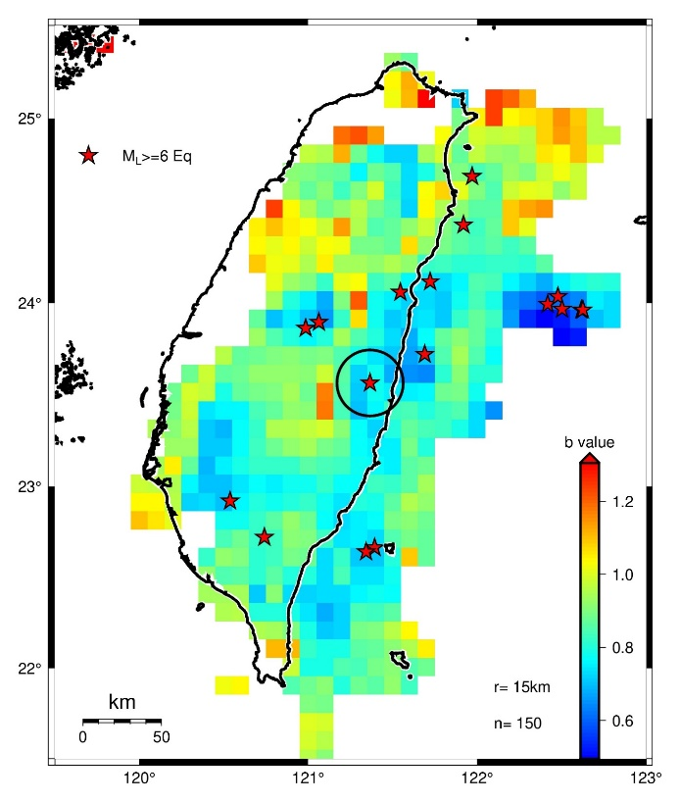
20km
Case 1 | 1
Case 2 | 1
Case 3 | 2
Case 4 | 6

Slide 15
Summary
Spatial b values in overall eight years are systematically lower in the epicenters of ML ≥ 6.0 earthquakes from 2012 to 2019
Some epicenters share similar r and n values (roughly three kinds of sensitivity)
We have observed decreasing and increasing b values before and after the 2018 ML 6.3 Hualien earthquake, respectively
Conclusion
We suggest that temporal b-value variations in Taiwan by the ML ≥ 6.0 localized earthquakes cannot be observed frequently in our data period.

Slide 16
Thank you for listening

Slide 17
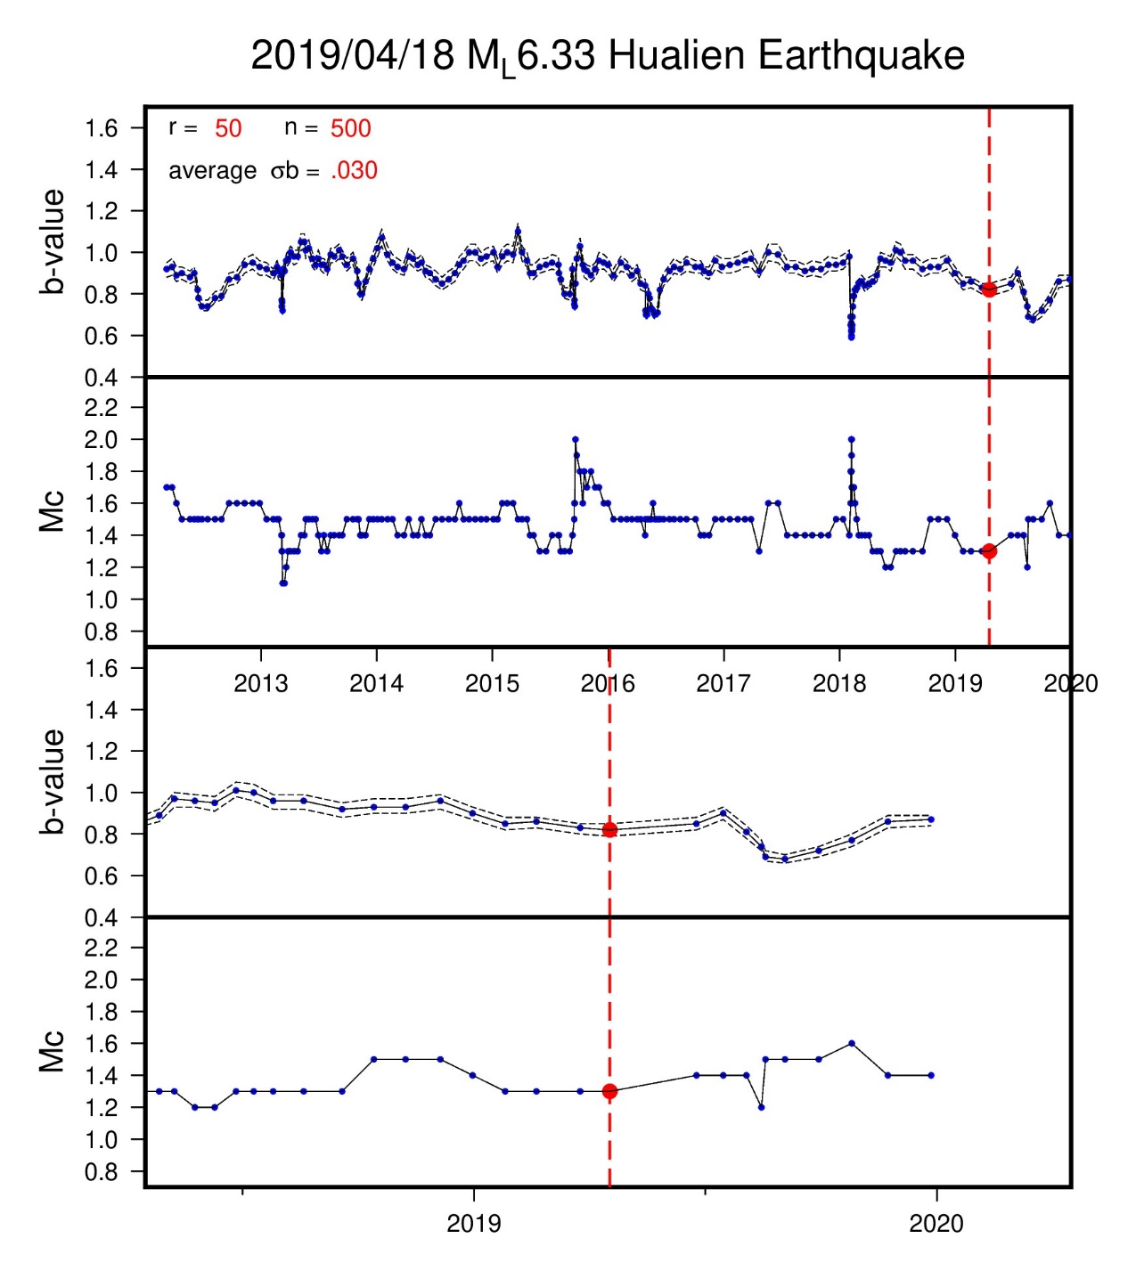
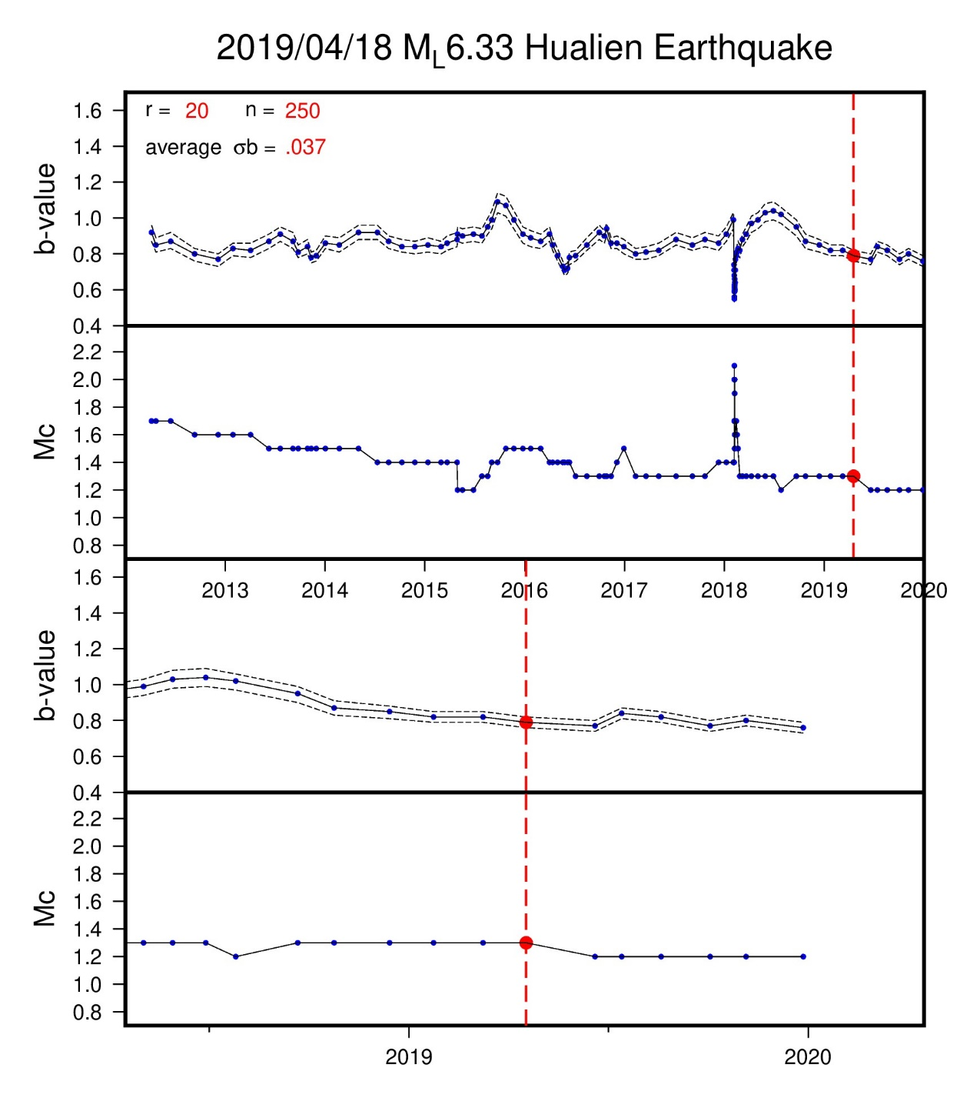


region G

Slide 18
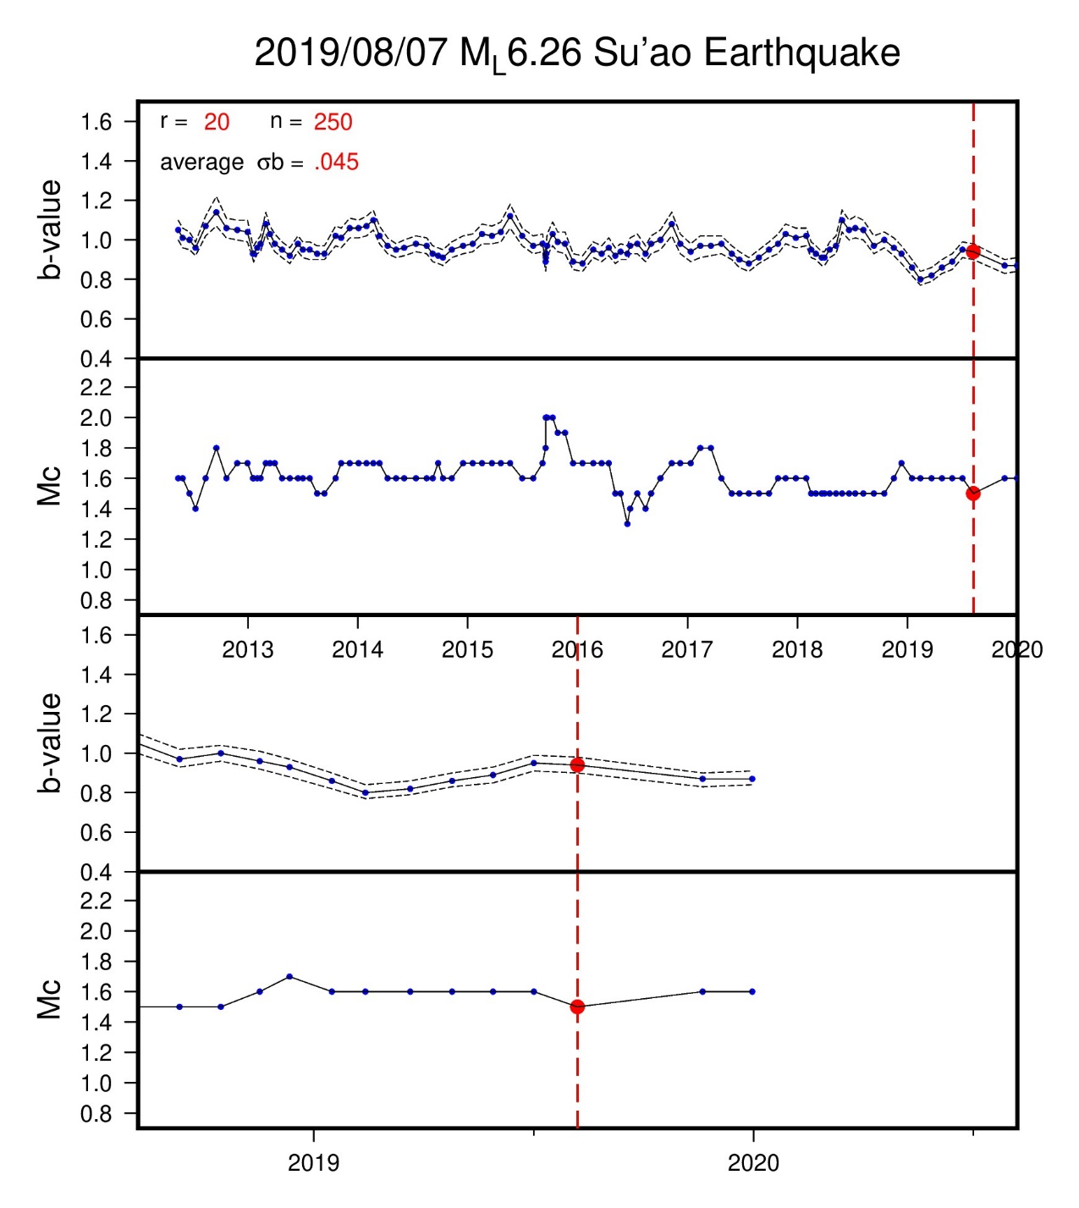
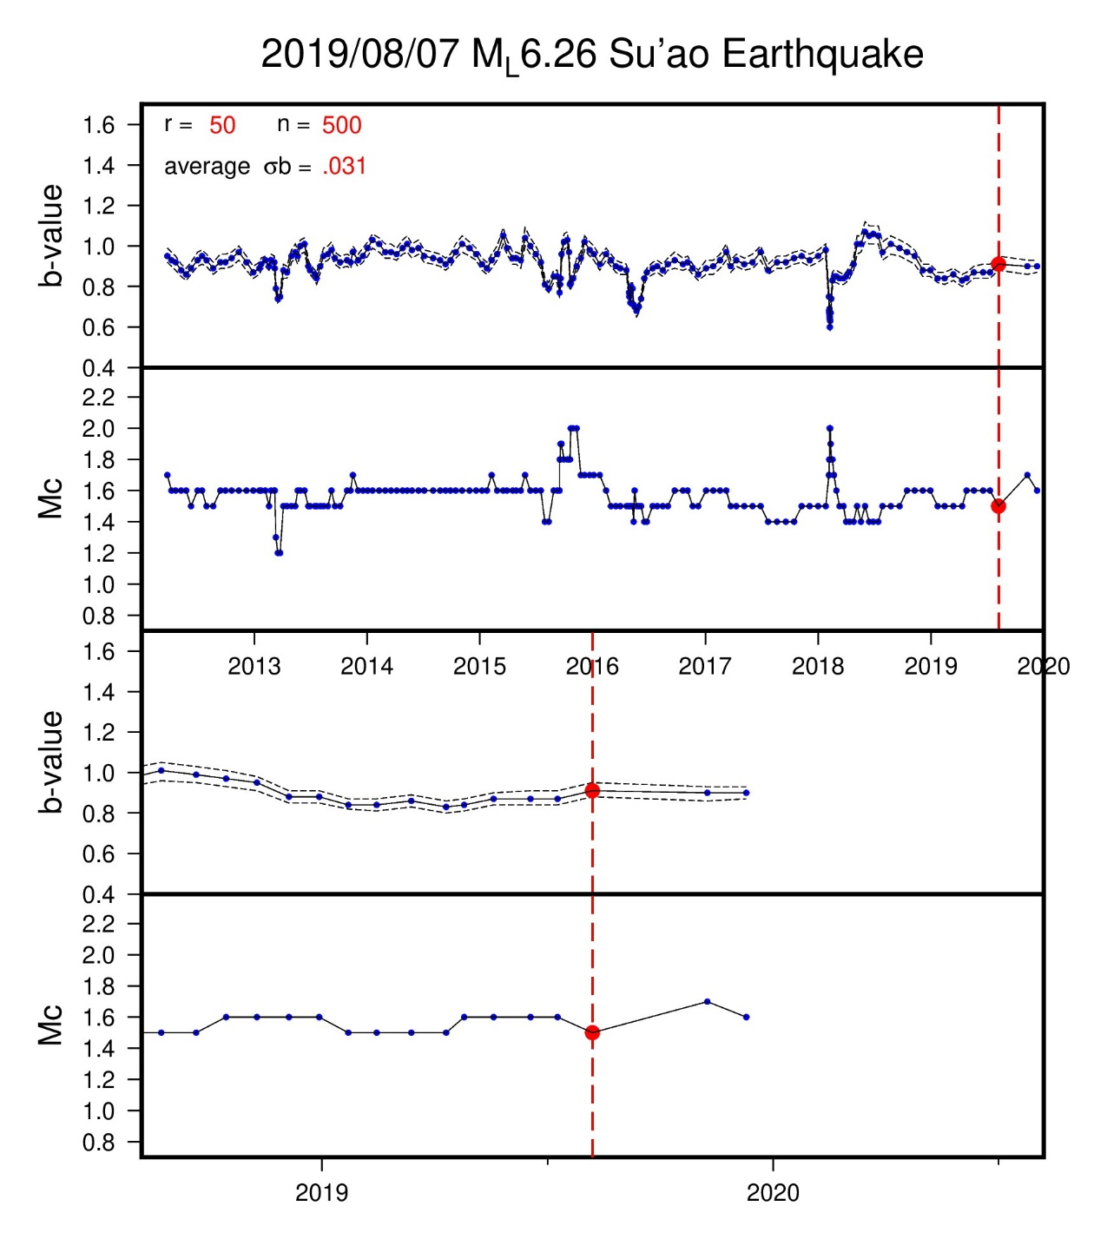
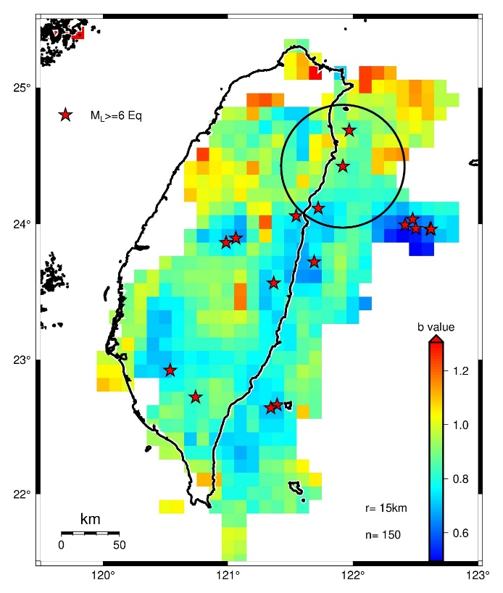
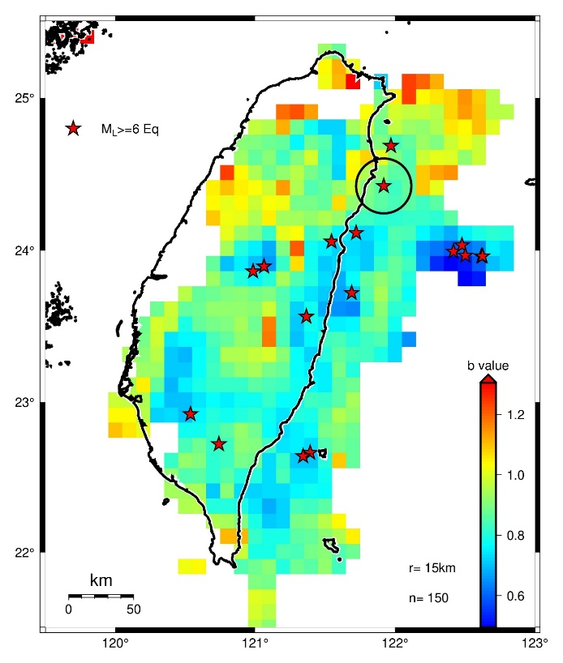
region H

Slide 19
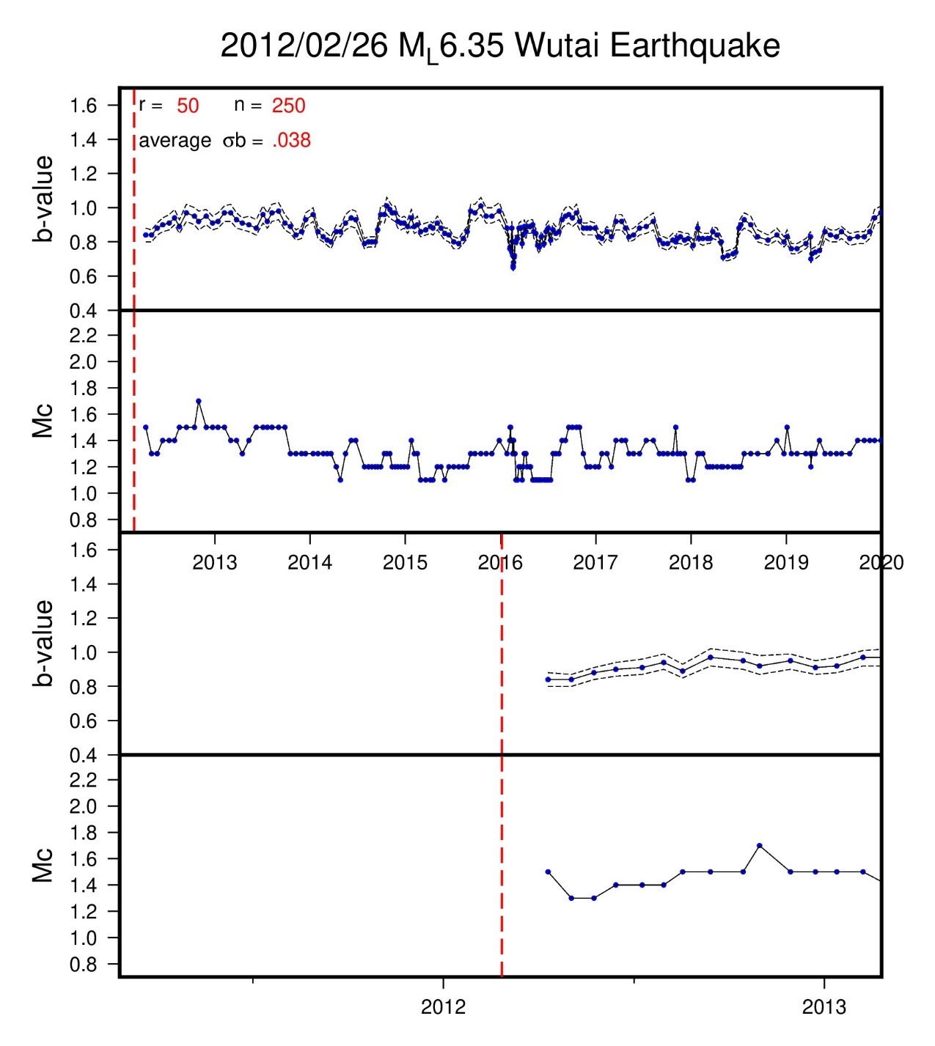
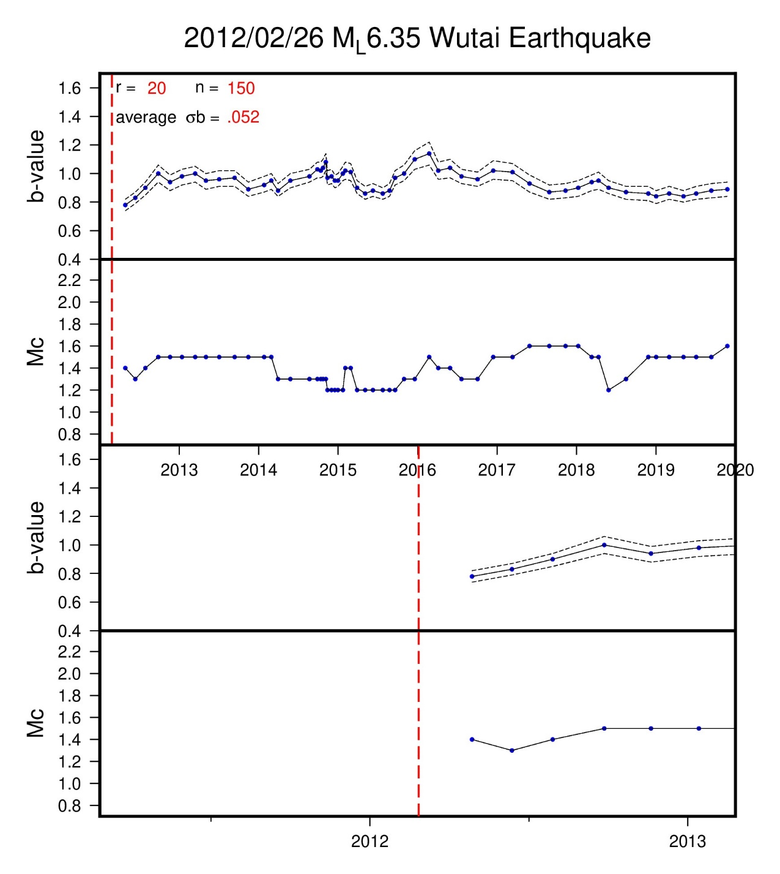
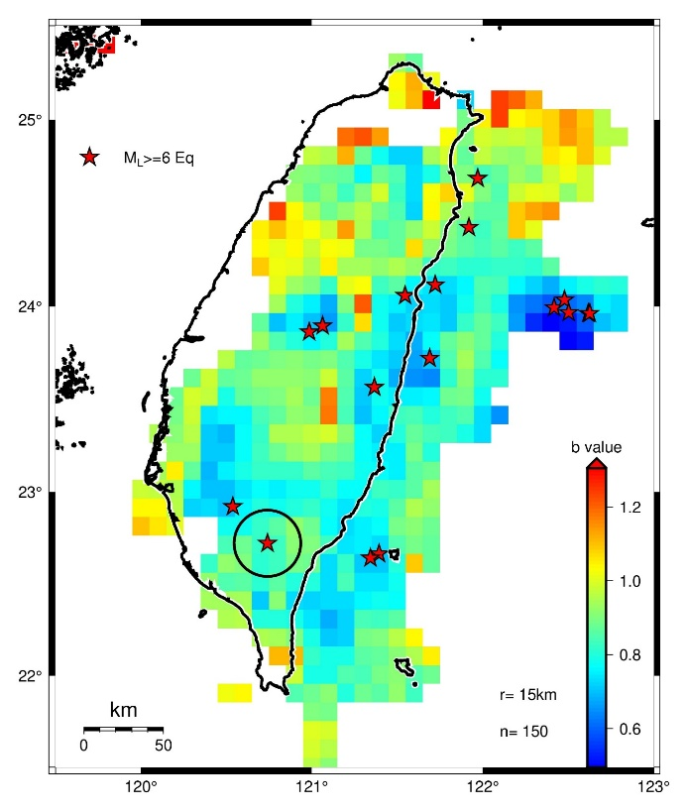
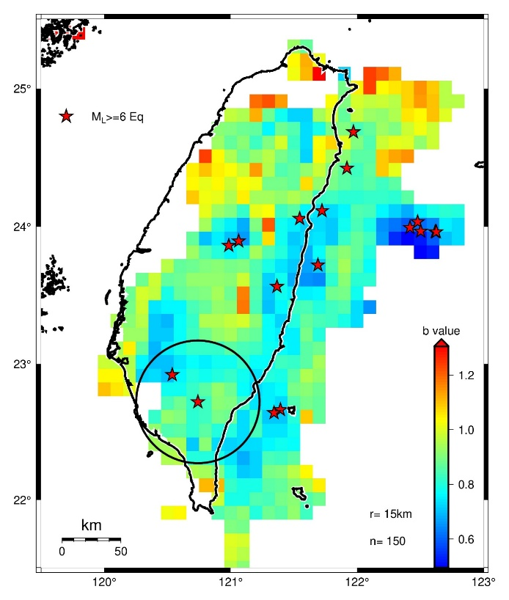
region A

Slide 20
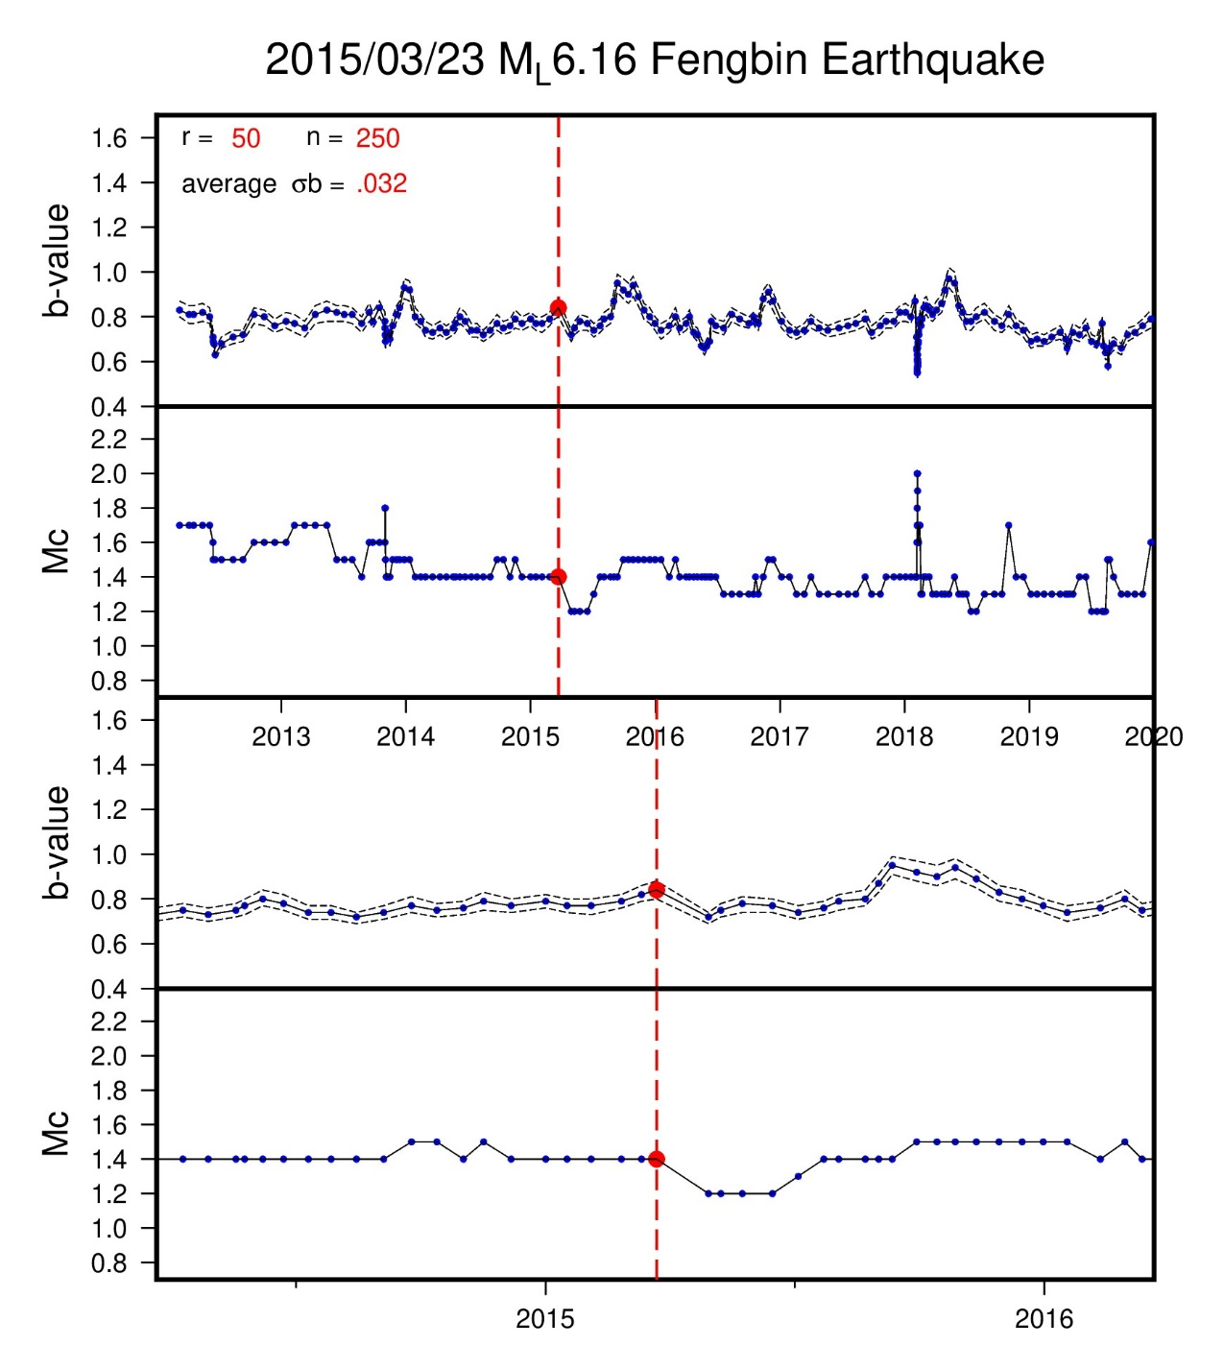



region C

Slide 21




region D

Slide 22




region E

Slide 23




region Cen1

Slide 24




region Cen2

Slide 25














offshore

Slide 26



(Tormann et al., 2015)
(Chen and Zhu, 2020)

Slide 27

(Gulia et al., 2018)

Slide 28


