Slide 1






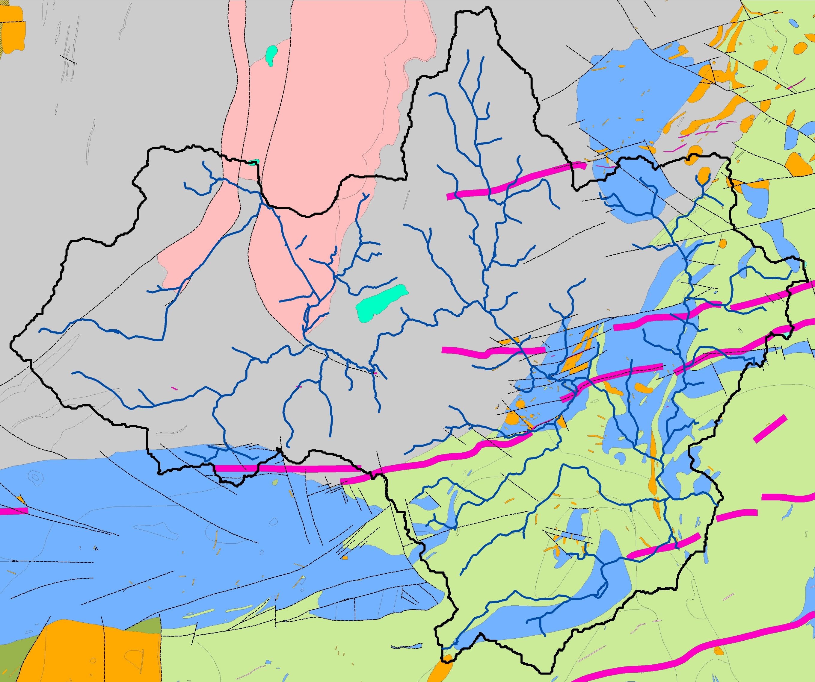
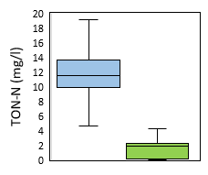
Preliminary conceptual models of groundwater and nutrient dynamics in typical agricultural river catchments underlain by hard-rock aquifers in Scotland and Northern Ireland
Hamish Johnson, Jean-Christophe Comte, Ulrich Ofterdinger, Rachel Cassidy, Mads Troldborg
Oxic Zone
Phosphorus sorption, nitrification and nitrate transport
Anoxic zone
Denitrification, phosphorus mobilisation and transport
Glacial till
Recharge
Alluvium
Flow Pathway
Bedrock
Discharge
Water table
Redox interface
River Ythan groundwater nutrient concentrations (SEPA) Aquifer type: superficial bedrock
Upper Bann sub-catchments UB15a and UB25 and River Ythan catchment

Slide 2
Upper Bann sub-catchments – UB15a and UB25
Background
UB15a and UB25 drain either side of a mountain col rising above the County Down drumlin swarm. The metasediments of UB15a consist of SW-NE striking, steeply inclined thrust-bound packages of greywacke turbidites belonging to the Southern Uplands-Down-Longford Terrane. The granodiorite of UB25 has been eroded into a glacial meltwater valley containing deep pockets of weathering in ice-lee locations.
Approach
A desk-based study of local hydrogeology has been supplemented with regional hydrogeological information across the SUDLT to develop preliminary conceptual models of groundwater and nutrient dynamics. A high-resolution LIDAR survey commissioned by AFBI has been analysed for topographic lineaments that are not associated with glacial or anthropogenic features assuming to relate to surface expressions of basement structures. AFBI groundwater and streamflow nutrient monitoring indicates UB15a consistently features lower TON concentrations but higher TP concentrations relative to UB25. This is interpreted to reflect the confinement of fractured bedrock aquifers in UB15a by glacial till aquitards generating anoxic conditions facilitating autotrophic denitrification and phosphorus mobilisation.
UB15a
UB15a
UB25
UB25
Geomorphology
Meltwater Channel
Drumlinoid feature
Superficial Deposits
Alluvium
Peat
Glacial Till
Bedrock
Metasediments
Granodiorite
Contains GSNI data. Crown Copyright 2021
Median groundwater nutrient concentrations (error bars: max – min; AFBI)

Slide 3
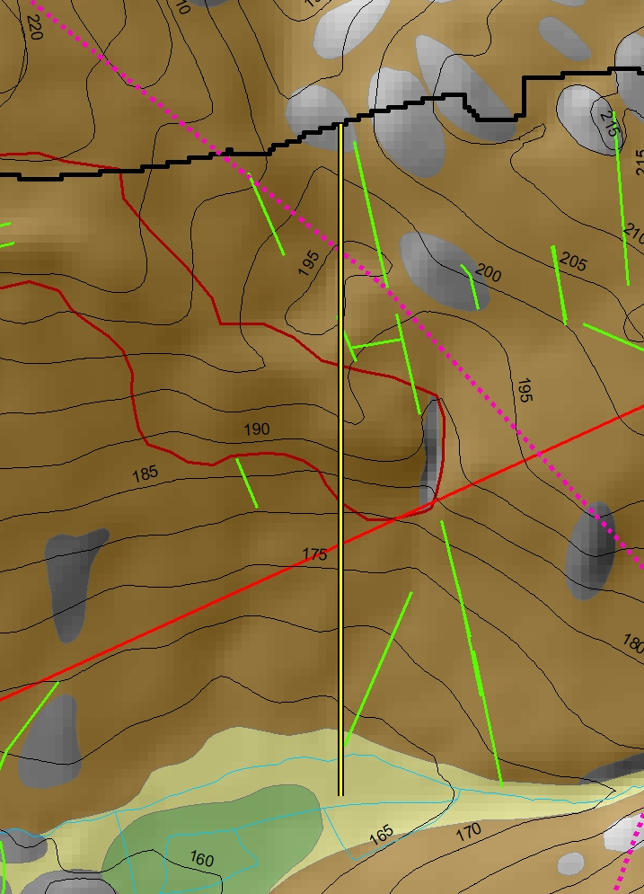
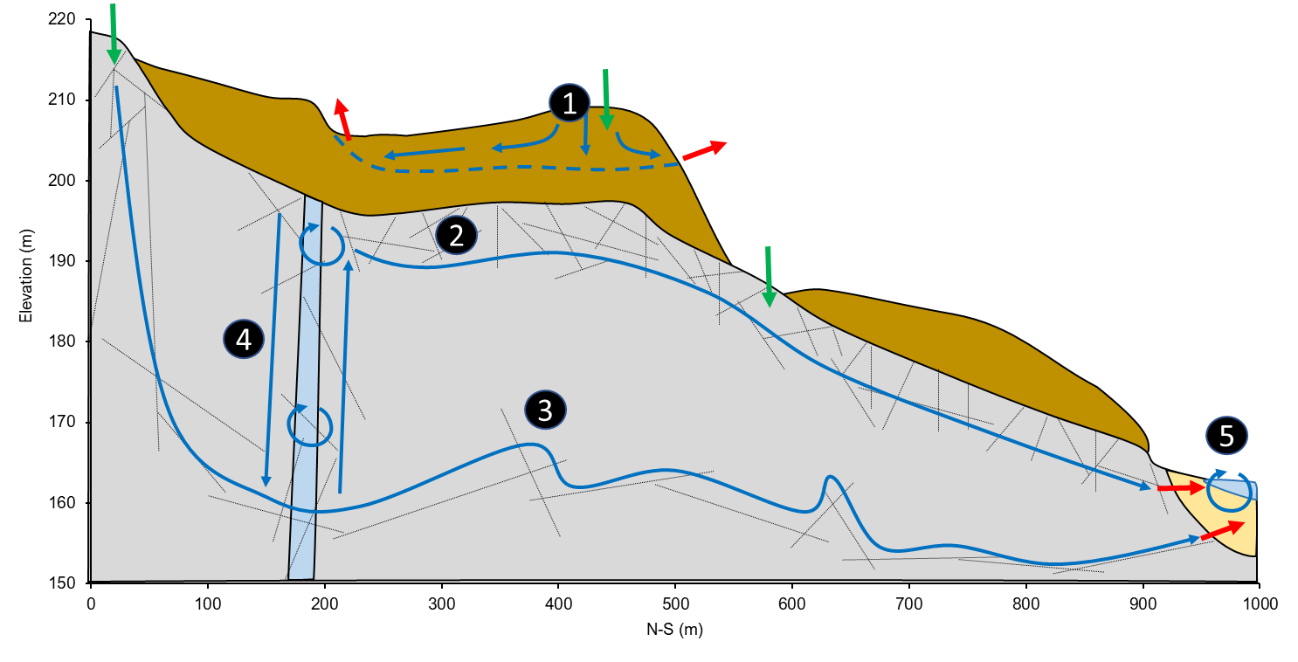
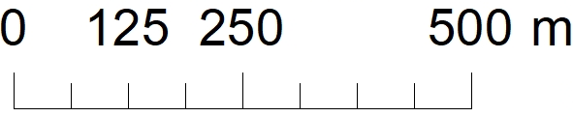
UB15a: Fractured metasediments with thick drumlinised clay-rich glacial till
Alluvium
Recharge
A
Glacial till
Flow Pathway
Basalt Dyke
Metasediments
Discharge
Fractures
Mixing
C
B
Click red boxes to view alternative conceptual models
1
Despite high clay mineral and iron oxide content, phosphorus sorption is limited by the low permeability of glacial till aquitards, where perched water tables may develop that do not recharge underlying fractured bedrock aquifers.
2
Majority of groundwater circulation occurs within shallow fractured horizons where groundwater is oxic unless confined by glacial till aquitards.
3
Faulted dyke contacts are a conduit for groundwater flow, where clay mineral weathering products support nutrient attenuation.
4
Deep fractured bedrock is disconnected from the surface allowing reducing conditions to generate Fe- and S- rich groundwaters. Anoxic groundwaters with potentially long residence time tortuous flow pathways support high denitrification rates but may transport phosphorus.
5
Oxic hypophreatic circulation is limited to alluvial aquifers, where phosphorus precipitation is limited by aquifer volume and abundance of sorbing agents.

Slide 4
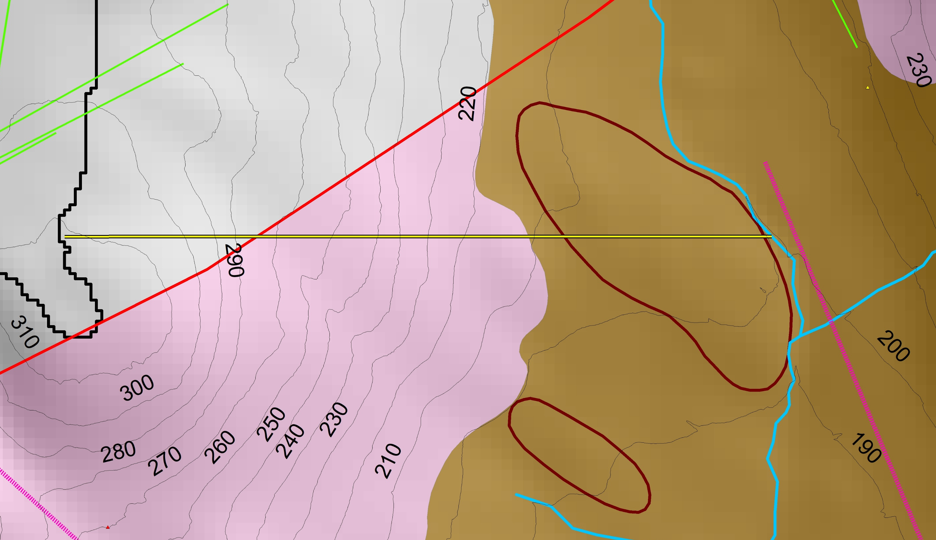
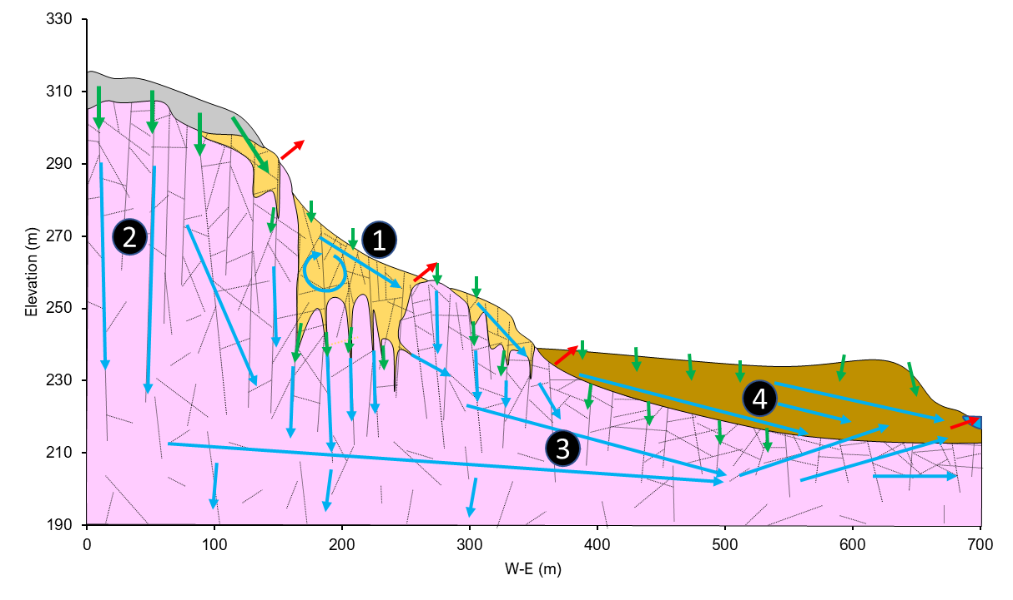
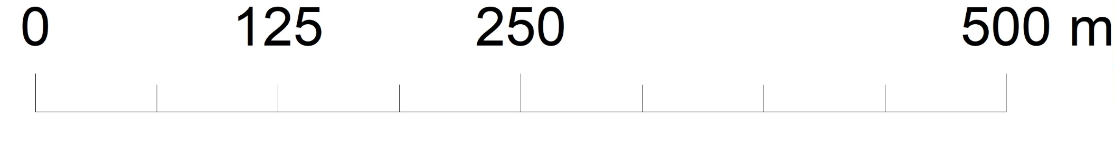
UB25: Weathered granodiorite glacial valley with sandy glacial till
A
B
Glacial till
Recharge
Weathered granodiorite
Flow Pathway
Granodiorite
C
Metasediments
Discharge
Fractures
Mixing
Click red boxes to view alternative conceptual models
1
Circulation of oxic groundwaters within deeply weathered granodiorite recharges underlying fractured bedrock and transports groundwater downslope where laterally continuous. Phosphorus is sorbed to iron oxide and clay mineral weathering products, and nitrogen species are nitrified to nitrate.
2
Oxic groundwater circulation within well connected vertical joints prevents denitrification. Discrete occurrences of granodiorite mineralisation may be important for phosphorus sorption.
3
Deep groundwater flows may remain oxic where flow pathways remain well connected to the surface through vertical joints.
4
Sandy glacial till derived from fresh and weathered granodiorite conducts groundwater flow is oxic at the surface supporting phosphorus sorption, but anoxic conditions may be present at depth. Patches of clay-rich material will be important for nutrient attenuation.

Slide 5
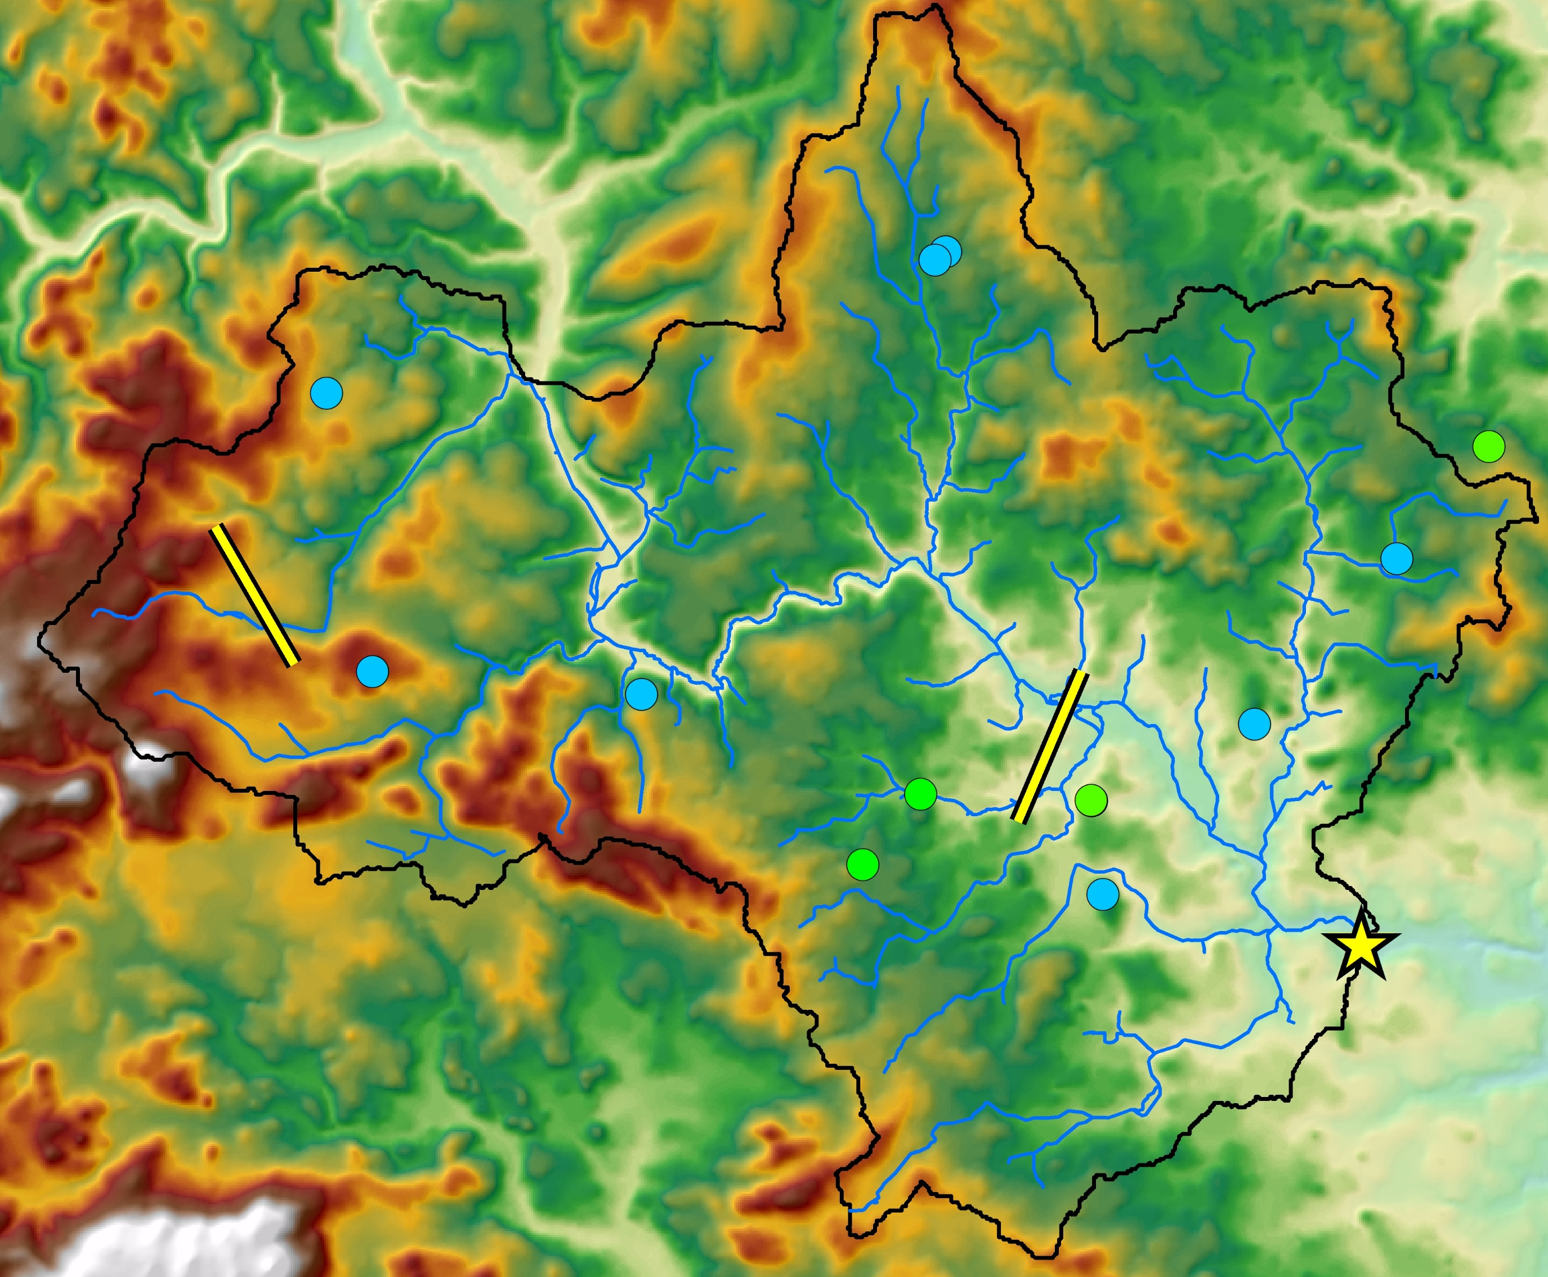
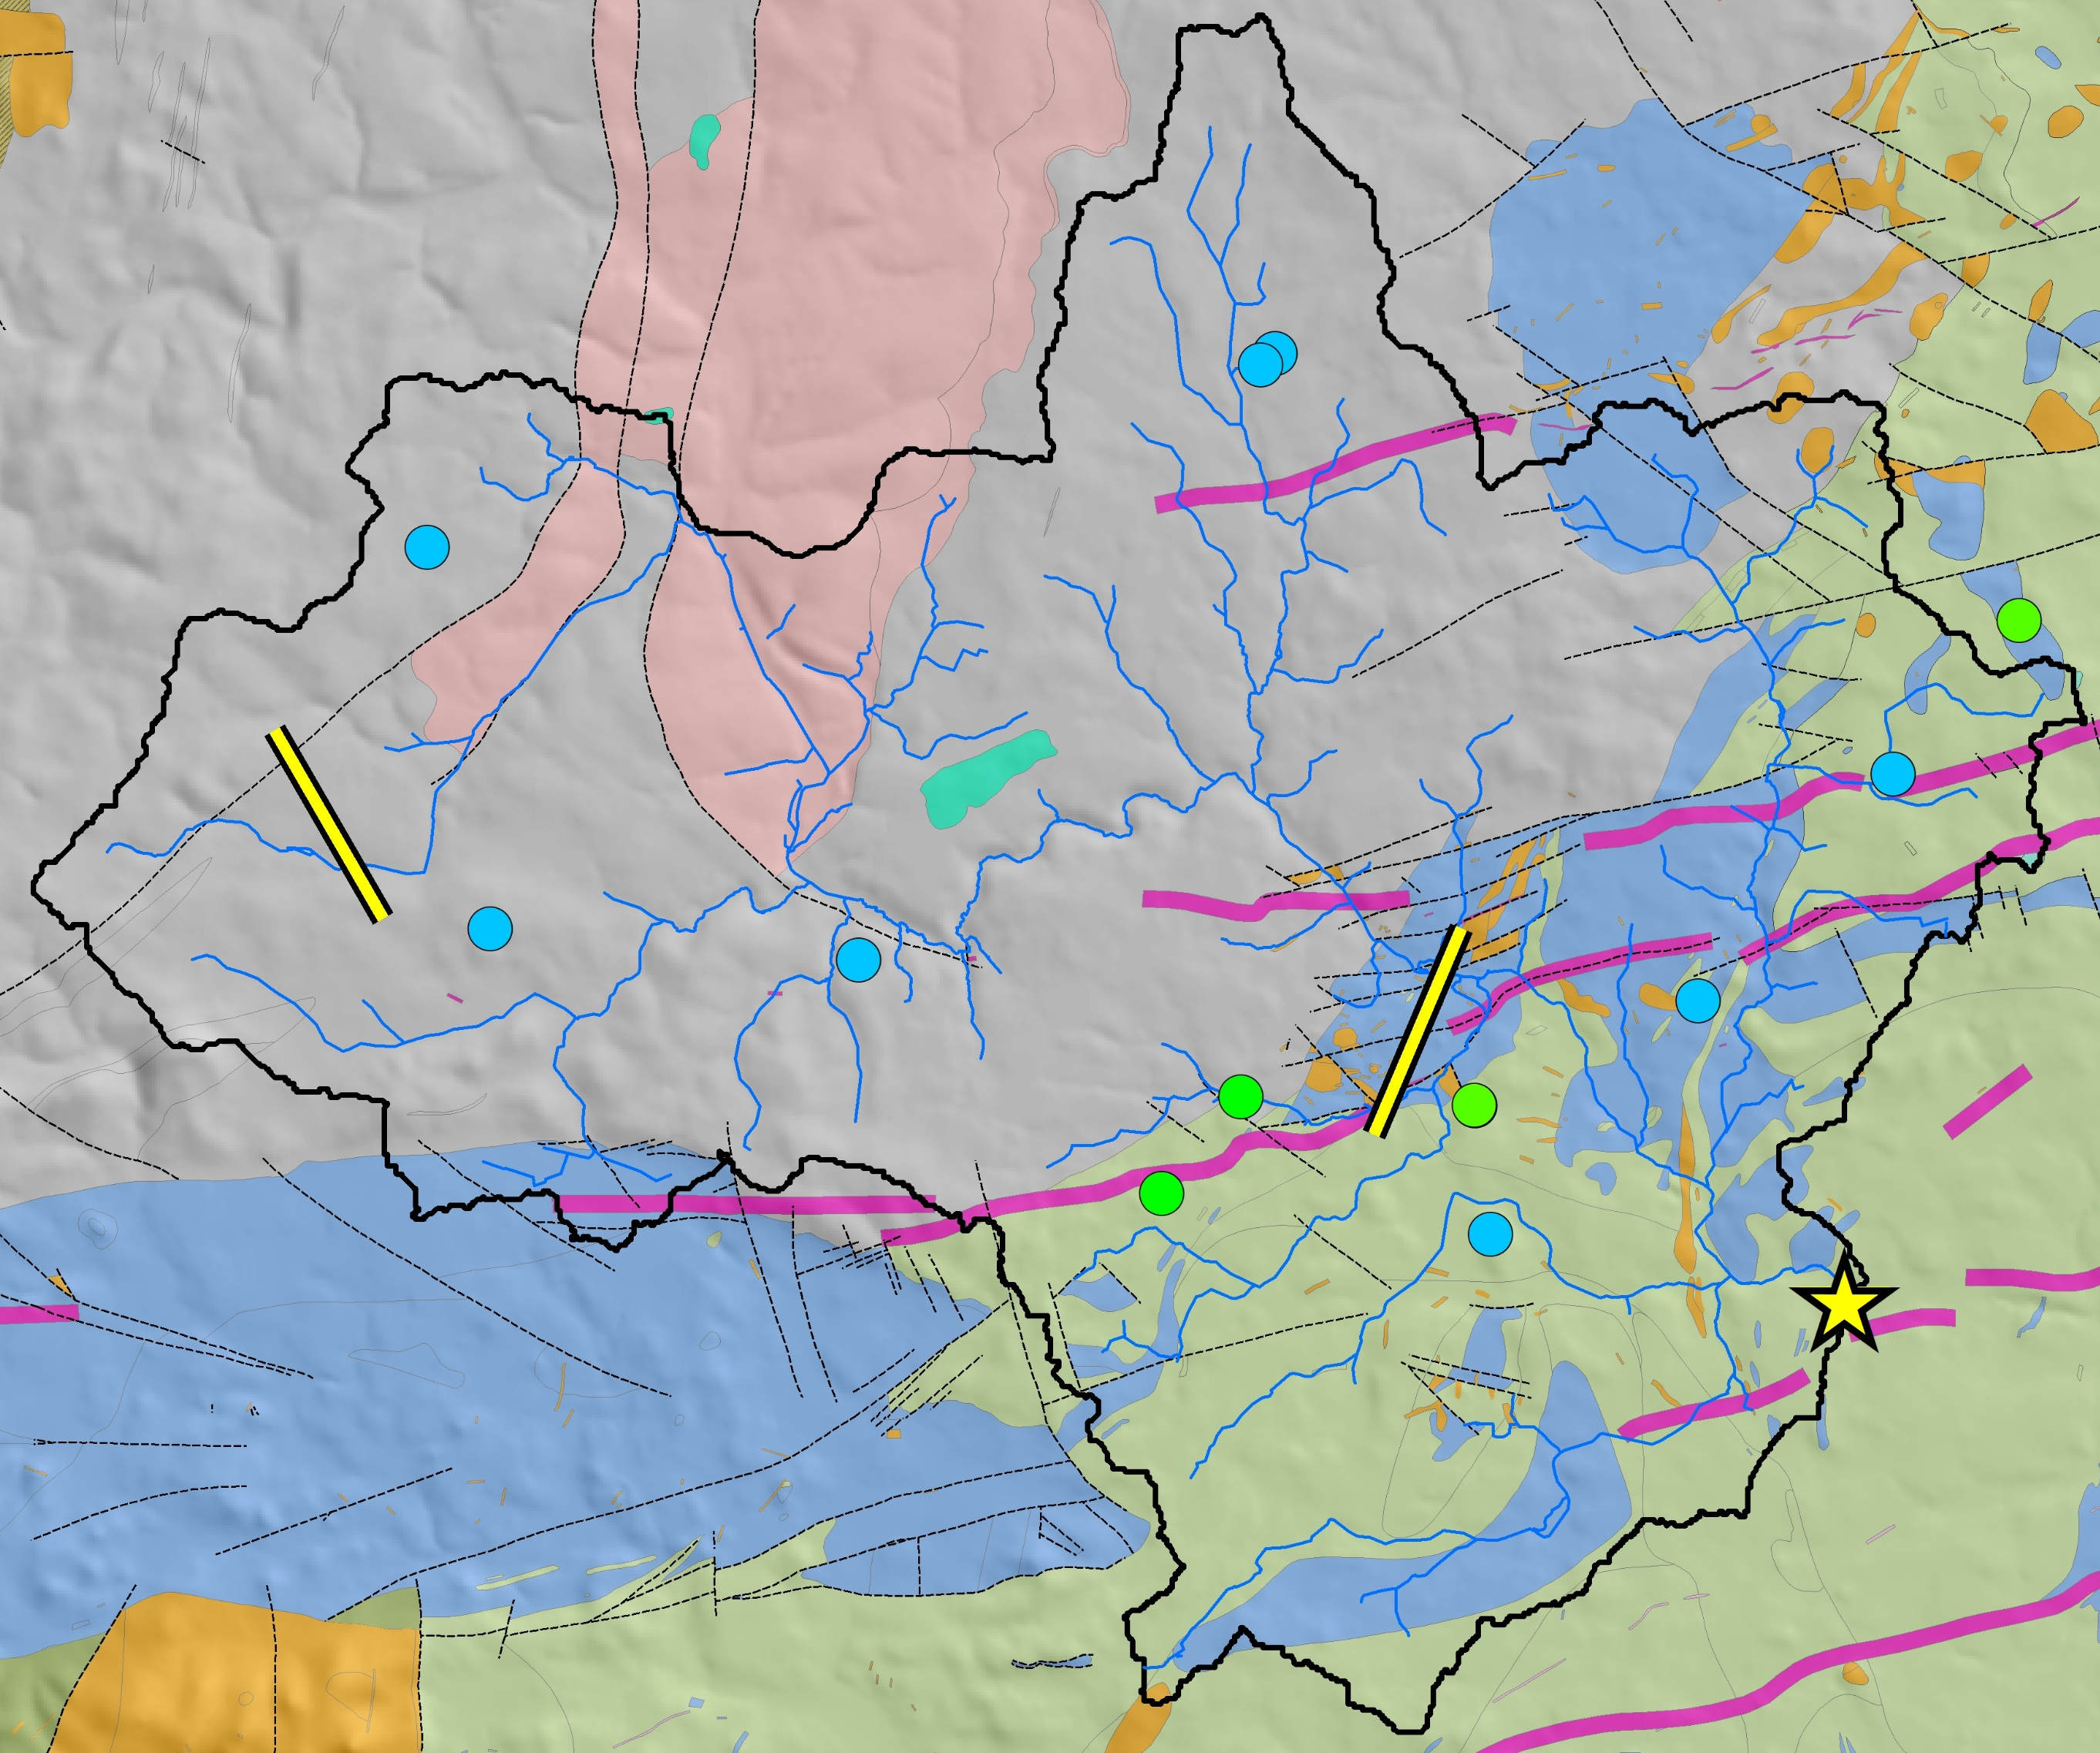
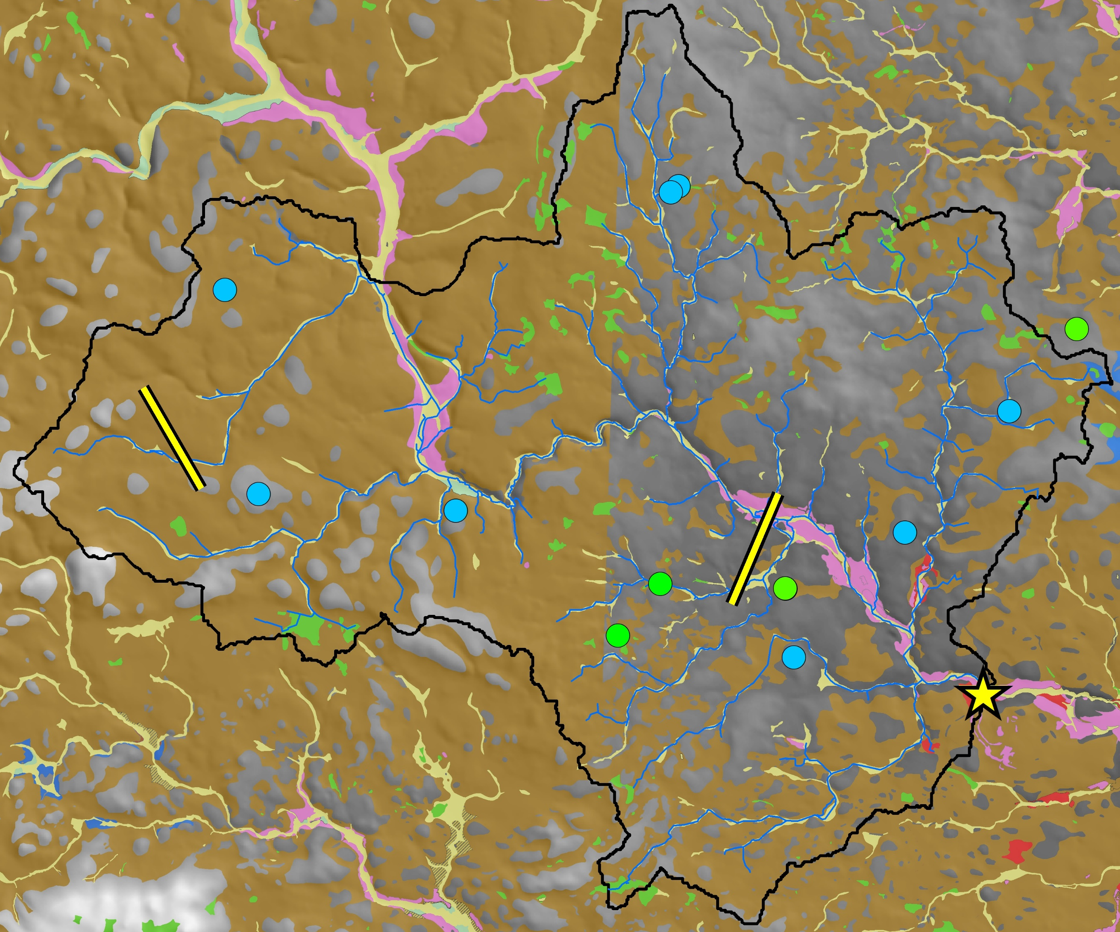
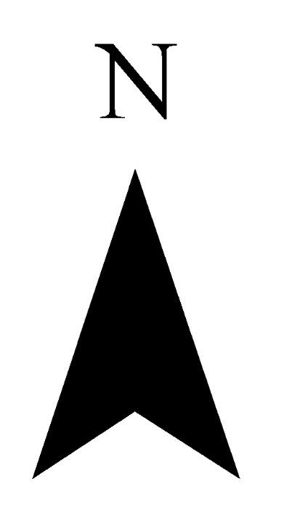
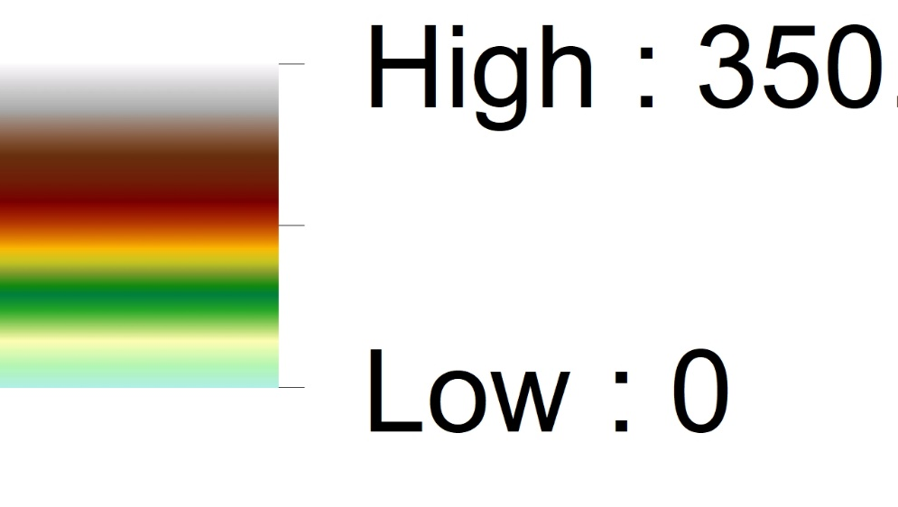
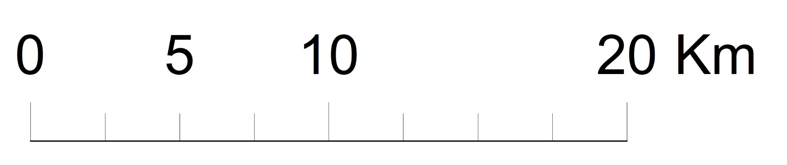
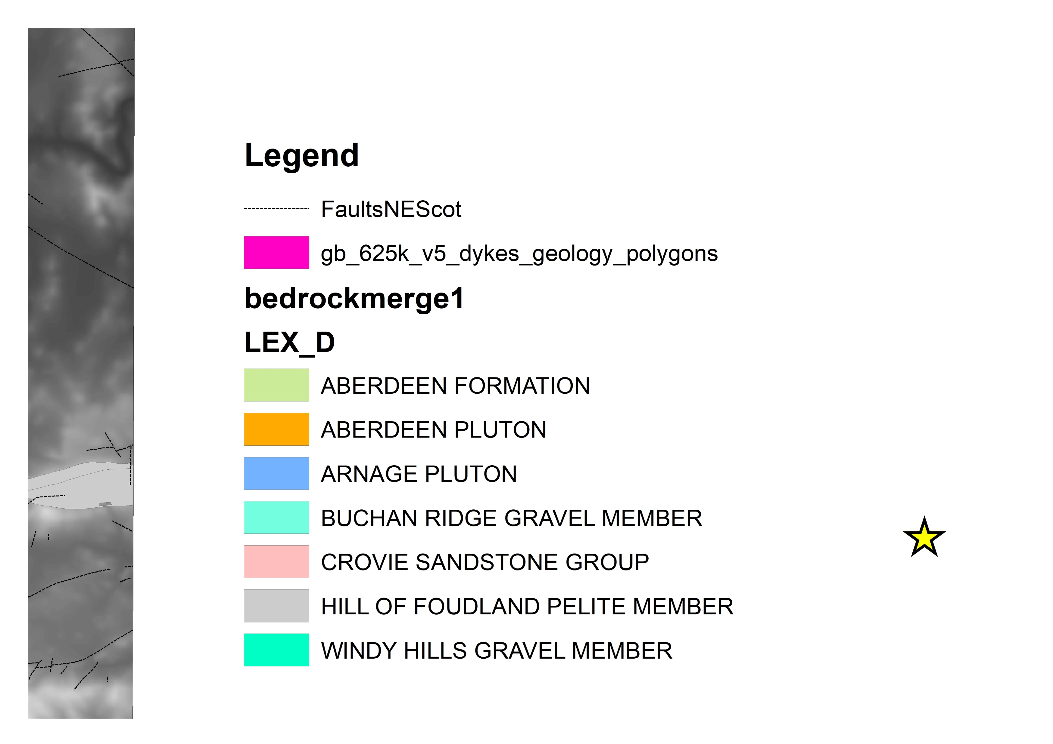
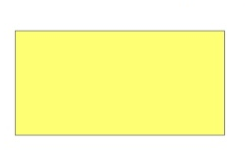


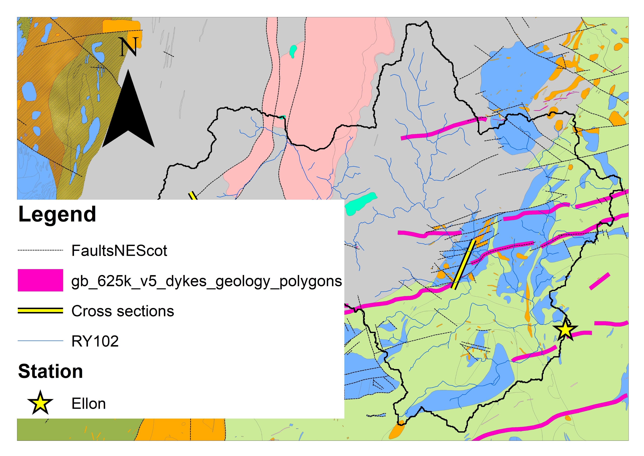





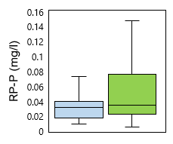
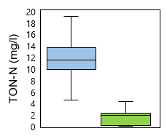
River Ythan Catchment
Background
The River Ythan catchment was designated a Nitrate Vulnerable Zone in 2000 due to the eutrophication if its estuary (SSSI; Ramsar Site). The Precambrian basement was sheared and regionally folded into a gentle SW-NE trending syncline-anticline pair during the Caledonian Orogeny. The syncline hosts a fault-bound Devonian outlier and later faults host W/SW-E/NE trending Carboniferous dykes. The deeply weathered peneplain only experienced modest glacial erosion where glacial meltwater drainage was focused into a pre-existing drainage network to deeply incise glaciofluvial channels.
Approach
Analysis of SEPA groundwater quality monitoring demonstrates lithological (Fig. 1) and redox (Fig. 2) controls on nutrient concentrations: (1) Shallow wells and springs within sediments feature high TON and low SRP due to oxic conditions; (2) Bedrock boreholes feature low TON and high SRP due to anoxic/suboxic conditions.
Nitrate isotope signatures (Fig. 3) indicate greater denitrification is occurring within bedrock aquifers relative to superficial aquifers.
Elevation (mAOD)
Bedrock Geology
Superficial Deposits
Alluvium
Peat
Head
Glaciofluvial
Glaciolacustrine
Glacial till
Sedimentary Outliers
Cretaceous gravels
Devonian conglomerates
Carboniferous intrusions
Quartz-dolerite dykes
Faults
Ordovocian intrusions
Acid rocks
Basic and ultrabasic rocks
Precambrian metasediments
Phyllite and schist
Gneiss
Groundwater monitoring
Superficial aquifer
Bedrock aquifer
River Ythan
Flow gauging station
(Fig. 3) Nitrate pools
NH4 fertiliser and rain
Soil nitrogen
Manure and septic tank waste
Figure 1. Groundwater nutrient concentrations (SEPA)
Figure 2. Groundwater DO vs pH (SEPA)
Figure 3. Groundwater nitrate isotope signatures (James Hutton Institute)

Slide 6
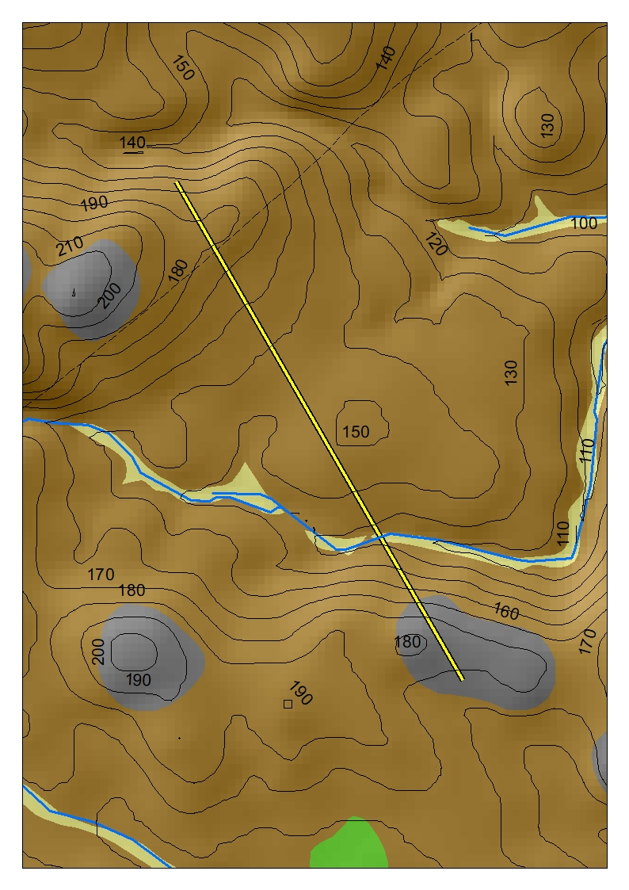
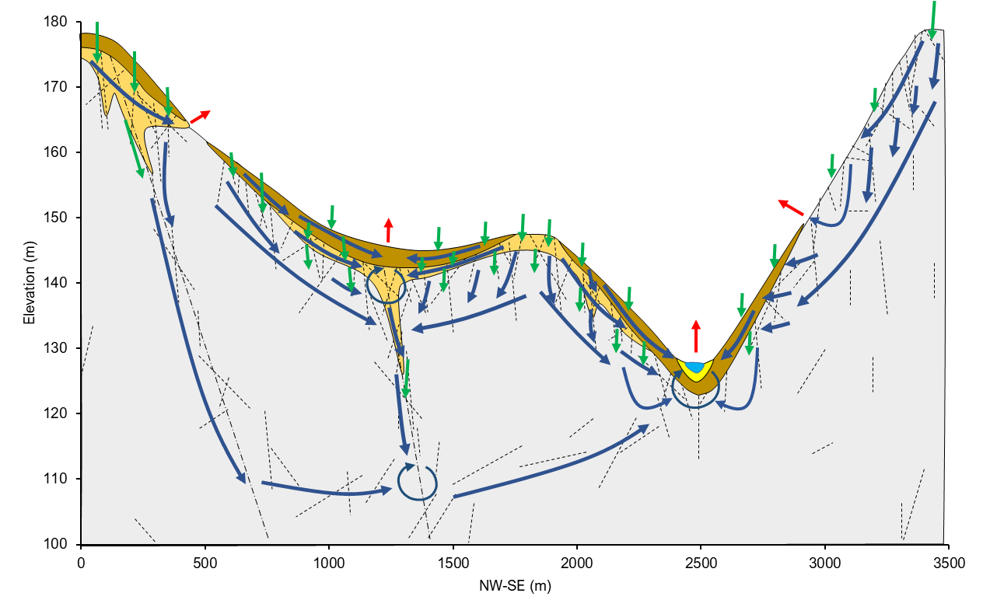
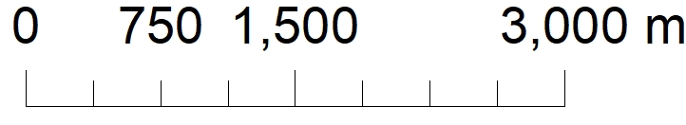
River Ythan: weathered metasediments with modest glacial erosion
Alluvium
Glaciofluvial deposits
Glacial till
A
Weathered bedrock
1
Metasediments
Fractures
2
3
Recharge
B
Flow Pathway
Discharge
Mixing
C
4
Click red boxes to view alternative conceptual models
1
Glacial tills derived from fresh bedrock feature higher concentrations of electron donors to support denitrification and more favourable hydraulic properties for groundwater flow relative to glacial tills derived from weathered bedrock.
2
Sandy grus saprolites feature oxic groundwaters unless confined by clay-rich glacial deposits. Continuous weathering covers support downslope groundwater flows, whereas heterogeneous weathering depths support focus recharge into underlying fractured bedrock aquifers.
3
Groundwater circulating within shallow fractured bedrock is predominantly oxic. Pelites are more susceptible to tectonic deformation than psammites and feature a greater abundance of clay minerals to support nutrient attenuation.
4
Deep groundwater flow pathways associated with faults are expected to be drained by discharge points within deeply incised valleys. Groundwaters are suspected to be anoxic due to iron staining of fractures intersecting valley sides implying phosphorus transport.

Slide 7
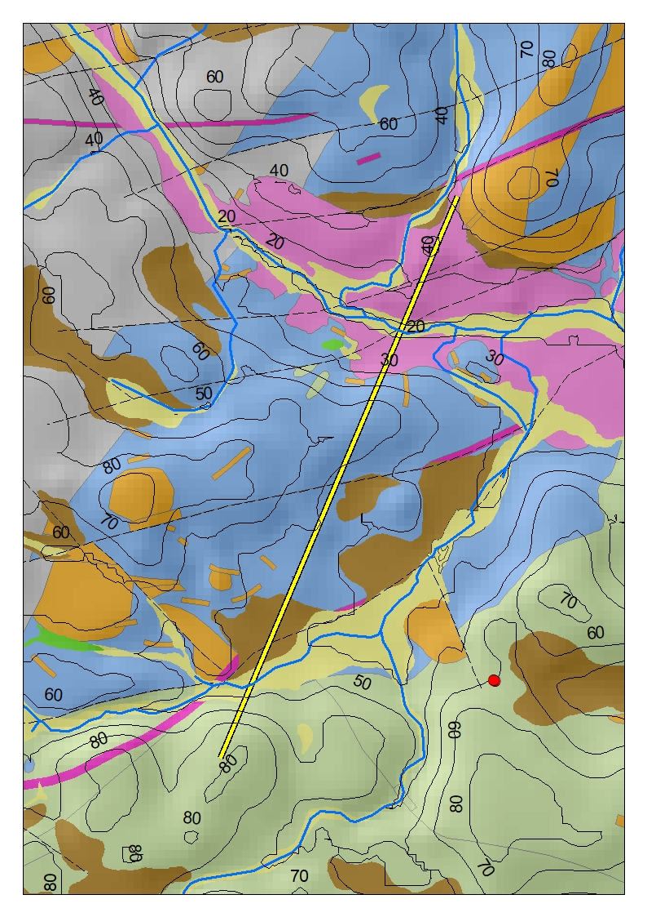
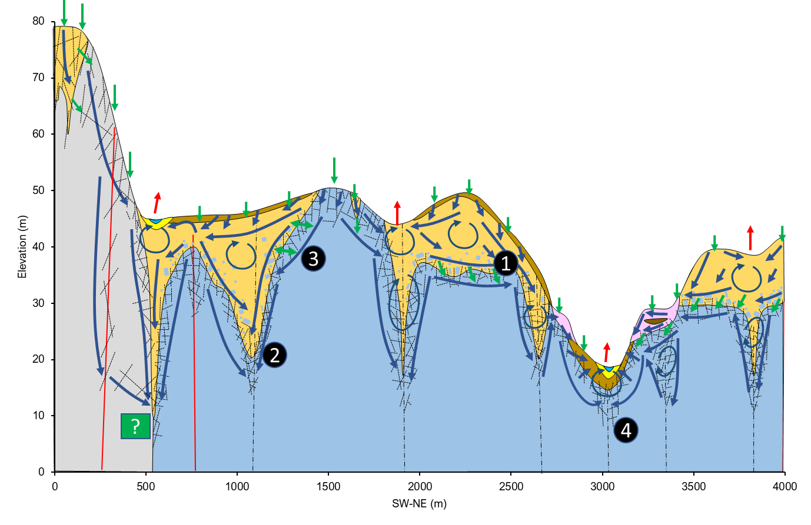
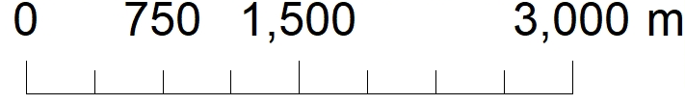
River Ythan: deeply weathered Precambrian basement with minimal glacial erosion
Alluvium
Glaciofluvial
Glaciolacustrine
Glacial till
Gabbro
Weathering profile
Metasediments
Basalt dyke
Fractures
Recharge
Flow Pathway
Discharge
A
?
B
Mixing
?
Unknown
Click red boxes to view alternative conceptual models
1
Areas of 10-20 m continuous weathering covers support high recharge rates and feature well-mixed oxic groundwaters. Nitrification prevails and high phosphorus sorption is expected where clay mineralogy dependence on parent rock type may be important.
2
Deep zones of weathering relating to sheared and faulted bedrock are expected to feature high residence time groundwaters where redox conditions depend on connection with near surface weathering zones. Geometry and drainage of these deeply weathered zones is poorly understood, but expected to drain into deeply incised river valleys.
3
Where weathering profiles have been removed from glaciation, groundwater flow is limited to fractured horizons of bedrock. Metasedimentary rocks are more fractured than igneous intrusions but feature lower abundances of electron donors and iron oxides for nutrient attenuation.
4
Nutrient loading to rivers is highly dependent on the sequence of glacial deposits surrounding and underlying the river channel, especially where river straths are used for agriculture.

Slide 8
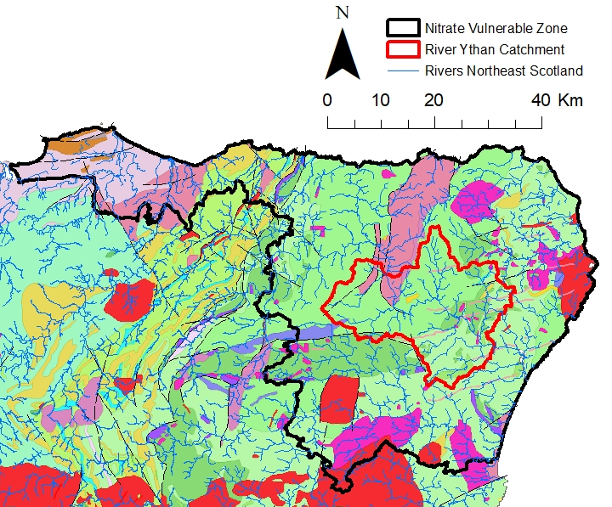
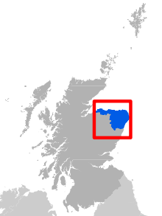
Conclusion
Key Points
Groundwater plays a key role in nutrient fate and transport, yet current agri-environmental policies (e.g., Nitrate Vulnerable Zones) do not fully consider the role of hydrogeological heterogeneity on nutrient loading to rivers.
Weathering profiles increase groundwater and phosphorus storage in river catchments, but associated oxic groundwater circulation results in nitrate transport.
The composition of glacial till determines the extent of phosphorus sorption and denitrification.
Confining conditions of fractured bedrock aquifers determine whether phosphorus is stored or transported and the extent of denitrification along flow pathways.
Riverine aquifers provide a final opportunity for nutrient attenuation before groundwater enters the surface water aquatic environment, where the nature of hypophreatic circulation plays a key role.
Research aims
Develop conceptual models of groundwater and nutrient dynamics for two contrasting river catchments within the postglacial basement terranes of Scotland and Northern Ireland that are impacted by agricultural nutrient pollution: River Ythan (nitrates); Upper Bann (phosphorus).
Elucidate the role of hydrogeological setting on agricultural nutrient fate and transport to support agri-environmental policy development for river catchment nutrient management.
Moray, Aberdeenshire, Banff and Buchan Nitrate Vulnerable Zone
Further Work
Multiscale hydrogeophysical characterisation of fieldistes using the TELLUS airborne geophysics for the Upper Bann and aeromagnetic mineral exploration surveys for the Ythan.
High-resolution nitrogen and phosphorus nutrient surveys in groundwater and surface water
Synoptic ³H and seasonal ¹⁸O and ²H isotopic dating of groundwaters to establish residence times and infer groundwater flow pathways.
Generate a suite of robust, plausible conceptual models of groundwater and nutrient dynamics.
Distributed numerical groundwater flow modeling and conceptual model testing (Modflow/Feflow).
References
Anderson, H. 2014. Cenozoic Faulting in North-East Ireland and the Irish Sea. Unpublished PhD thesis, University College Dublin, Ireland.
James Hutton Institute: National Water Inventory Scotland (NWIS) nitrate isotope data.
Holman, I. Howden, N. Whelan, M. 2008. An Improved Understanding Of Phosphorus Fate And Transport Within Groundwater And The Significance For Associated Receptors. Secure Archive For Environmental Research Data (SAFER) managed by Environmental Protection Agency Ireland.
Ó Dochartaigh, B.É, Macdonald, A.M, Fitzsimons, V, & Ward, R. 2015. Scotland's aquifers and groundwater bodies. British Geological Survey Open Report, OR/15/028.
Scottish Environmental Protection Agency (SEPA): River Ythan catchment groundwater quality monitoring data.
Smedley, P.L, Ó Dochartaigh, B.É, Macdonald, A.M, & Daring, W.G. 2009. Baseline Scotland: groundwater chemistry of Aberdeenshire. British Geological Survey Open Report, OR/09/065

Slide 9
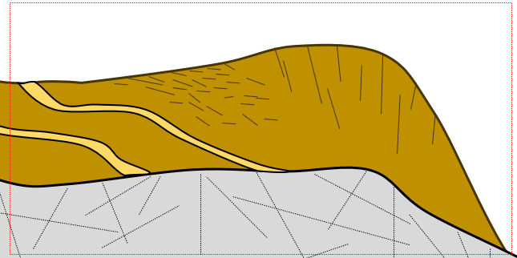
UB15a: Fractured metasediments with thick drumlinised clay till – alternative conceptual models
A
Alluvium
Recharge
Glacial till
Flow Pathway
Metasediments
Fractures
Reducing
Flow Pathway
Coarse-grained glacial deposits and other preferential flow features are present within the otherwise low permeability clay-rich glacial till:
Increased recharge to the fractured bedrock aquifer and delivery of oxic groundwaters along otherwise confined flow pathways reduce denitrification rates but may improve subsurface phosphorus sorption.
Click to go Back

Slide 10
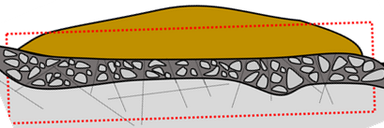
UB15a: Fractured metasediments with thick drumlinised clay till – alternative conceptual models
B
Glacial till
Recharge
Metasediments
Flow Pathway
Transition zone
Reducing
Flow Pathway
Fractures
Transition zones / basal surfaces of weathering have survived glaciation:
Where laterally connected, transition zones provide greater groundwater flow and nutrient transport rates compared to shallow fractured bedrock alone. Disconnected transition zone aquifers may provide greater groundwater storage increasing residence times and opportunities for nutrient attenuation.
Click to go Back

Slide 11
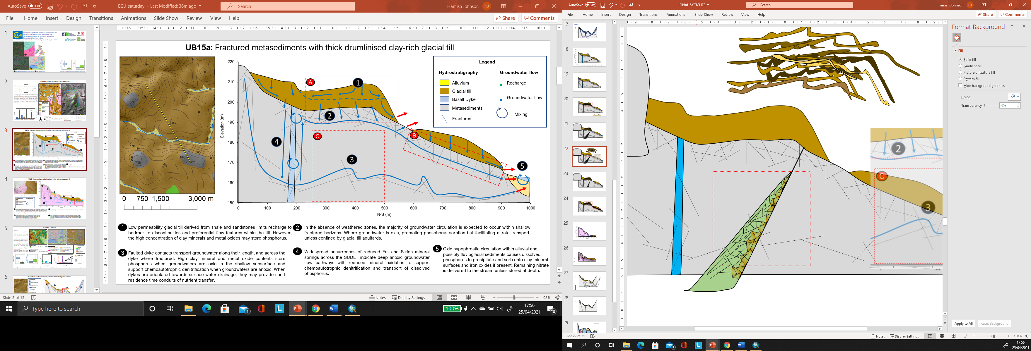
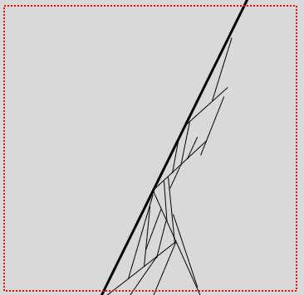
UB15a: Fractured metasediments with thick drumlinised clay till – alternative conceptual models
C1
C2
Shale
Weathered Shale
Metasediments
Fractures
Recharge
Flow Pathway
Discharge
Mixing
Benthic volcaniclastic shale present at the base of the accretionary tracts has not been cut out by thrusting and faulting:
Argillaceous shale is more susceptible to tectonic deformation and chemical weathering relative to the arenaceous turbidites. The shale provides a low permeability fractured/weathered zone supporting high denitrification rates due to abundance of electron donors.
The bedrock aquifer is poorly fractured:
Greater proportion of rainfall enters surface water streamflow generation pathways with shorter catchment residence times and lower nutrient attenuation. Groundwater circulation is limited to specific fracture zones relating to spatially limited areas of brittle tectonic deformation and igneous intrusion.
Click to go Back

Slide 12
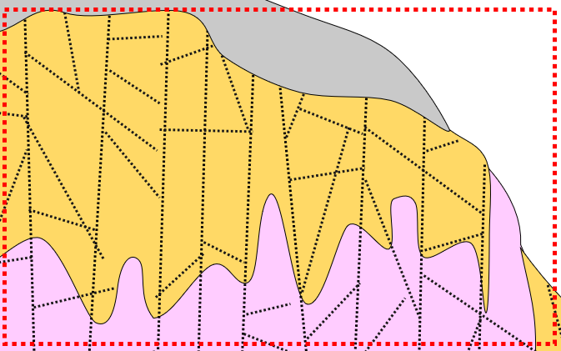
UB25: Weathered granodiorite glacial valley with sandy glacial till – Alternative conceptual models
A
Glacial till
Recharge
Weathered granodiorite
Flow Pathway
Granodiorite
Discharge
Metasediments
Fractures
Mixing
Deeply weathered granodiorite extends beneath metasedimentary roof in catchment headwaters:
High groundwater storage provided by weathering may recharge the UB15a subcatchment to the north. Greater opportunity for P sorption within a larger weathered zone, but fractures are more likely to be oxic at depth, thus reducing denitrification.
Click to go Back

Slide 13
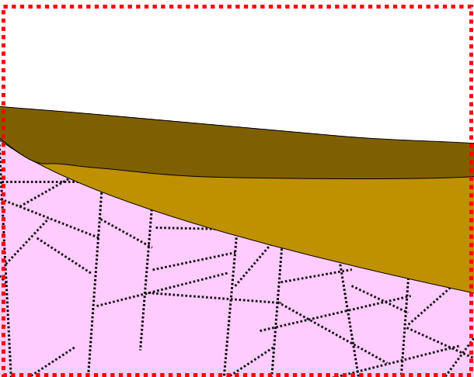
UB25: Weathered granodiorite glacial valley with sandy glacial till – Alternative conceptual models
B
Clay till
Sandy till
Granodiorite
Fractures
Recharge
Reducing
Flow Pathway
Clay-rich sandstone and shale glacial till confines sandy granitic/saprolitic glacial till in catchment headwaters:
Confined sandy glacial sediments are now a zone of denitrification, but phosphorus may be transported.
Click to go Back

Slide 14
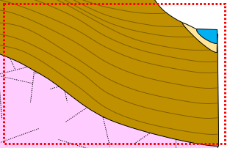
UB25: Weathered granodiorite glacial valley with sandy glacial till – Alternative conceptual models
C
Glacial till
Recharge
Weathered granodiorite
Flow Pathway
Granodiorite
Discharge
Fractures
Mixing
UB25 contains a buried valley covered by thick glacial deposits:
Greater groundwater residence times and extent of hypophreatic circulation are expected, leading to greater nutrient storage and attenuation.
Click to go Back

Slide 15
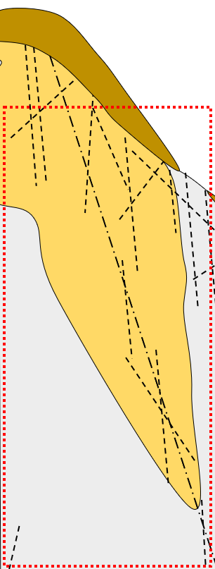
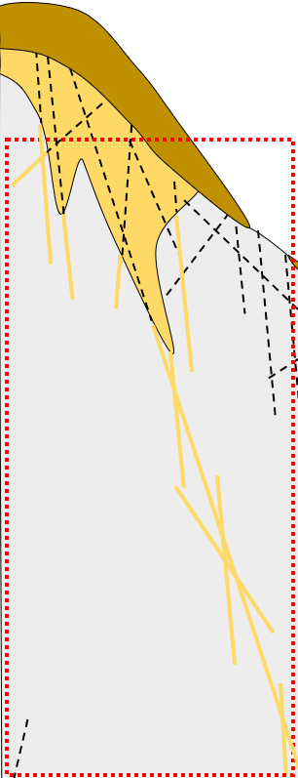
River Ythan: weathered metasediments with modest glacial erosion - alternative conceptual models
A1
A2
Significant depths of weathered bedrock are concealed by periglacial and glacial deposits:
Provides a high groundwater storage component delivering recharging underlying fractured bedrock. Redox conditions likely to be influenced by obscuring periglacial and glacial deposits.
Fractured bedrock is significantly weathered at depth:
Weathered fractures facilitate greater groundwater flows than fractured bedrock alone. Deeper bedrock is less likely to be confined, resulting in more opportunities for phosphorus sorption, and reduced denitrification at depth.
Glacial till
Recharge
Weathered bedrock
Flow Pathway
Metasediments
Fractures
Discharge
Click to go Back
Mixing

Slide 16
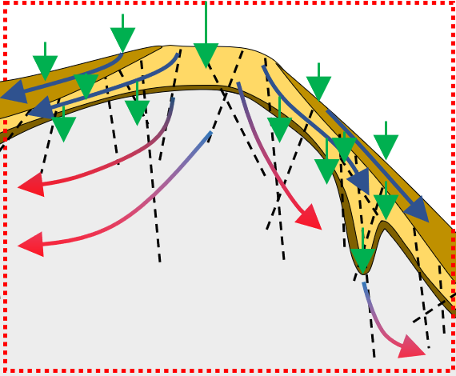
River Ythan: weathered metasediments with modest glacial erosion - alternative conceptual models
B
Glacial till
Weathered bedrock
Metasediments
Fractures
Recharge
Flow Pathway
Reducing
Flow Pathway
Accumulation of clay minerals at base of weathering profiles:
Reduced groundwater recharge to deeper fractured bedrock aquifers, which are then confined. Results in: higher P sorption to base of weathered zone, greater P transport through deeper bedrock; greater denitrification rates through both aquifers due to greater abundance of electron donors in the weathered zone and confined conditions in the fractured bedrock.
Click to go Back

Slide 17
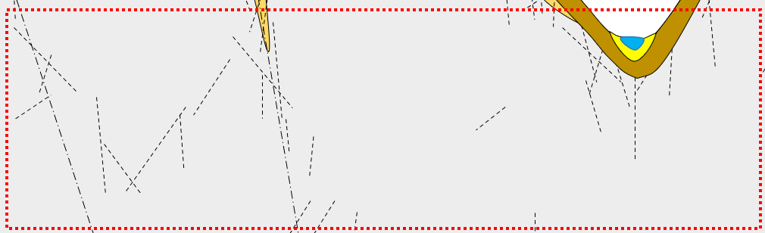
River Ythan: weathered metasediments with modest glacial erosion - alternative conceptual models
C
Alluvium
Glacial till
Weathered bedrock
Metasediments
Fractures
Recharge
Flow Pathway
Discharge
Mixing
Faults are drained by fracture networks transporting groundwater further downgradient across the catchment area:
Deep fractured bedrock may not drain into local surface water drainage systems, groundwaters are expected to feature longer residence times resulting in greater nutrient attenuation.
Click to go Back

Slide 18
River Ythan: deeply weathered Precambrian basement with minimal glacial erosion - alternative conceptual models
A
Glacial till
Gabbro
Weathering profile
Fractures
Recharge
Flow Pathway
Mixing
Pockets of deeply weathered basement are connected at depth by weathered fracture zones
Less mixing between surface weathered zones and deeply weathered zones as groundwater drains to depth. Groundwater residence time and redox gradients are likely to be complex, with deep pockets of weathering receiving groundwater from different depths of circulation.
Click to go Back

Slide 19
River Ythan: deeply weathered Precambrian basement with minimal glacial erosion - alternative conceptual models
B1
B2
B3
The deeply incised river channel is dominated by glaciofluvial and alluvial aquifers:
Greater extent of oxic hypophreatic circulation but reduced residence times where reduced groundwaters from bedrock aquifers carrying dissolved P are rapidly precipitated where clay minerals and iron oxides are present. Nitrate will be transported into the stream unless high biological activity associated with riparian zones.
River channel dominated by glaciolacustrine and glacial till deposits:
Aquifers in hydraulic connection to river are confined by clay-rich deposits = greater denitrification, but possibly greater P transfer. Greater residence times for nutrients derived from local sources.
The deeply incised river channel cuts down to bedrock:
Reduced hypophreatic circulation with less opportunities for nutrient attenuation.
Alluvium
Fractures
Glaciofluvial
Recharge
Glaciolacustrine
Flow Pathway
Glacial till
Gabbro
Discharge
Click to go Back
Weathering profile
Mixing

