Slide 1




EGU21-9285
Session HS8.1.8 “Emerging particles and biocolloids in terrestrial and aquatic systems”
Silver nanoparticles used to counter Monilinia fructicola fungicide-resistance and reduce fungicide environmental footprint
Constantinos V. Chrysikopoulos ⁽¹⁾, Anastasios Malandrakis ^{(1,2)}, Nektarios Kavroulakis ⁽³⁾ and Anthi Stefanarou ⁽¹⁾
(1)School of Environmental Engineering, Technical University of Crete, 73100 Chania, Greece (cvc@enveng.tuc.gr)
(2) Pesticide Science Laboratory, Department of Crop Science, Agricultural University of Athens, 75 Iera Odos, 118 55 Athens, Greece(tasmal@aua.gr)
(3) Hellenic Agricultural Organization “Demeter”, Institute for Olive Tree, Subtropical Plants and Viticulture, Agrokipio-Souda, 73164 Chania, Greece (nkavroulakis@nagref-cha.gr)

Slide 2
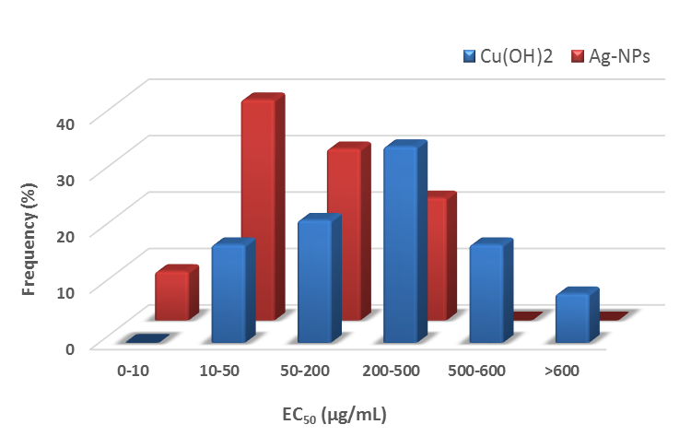
Silver nanoparticles used to counter Monilinia fructicola fungicide-resistance and reduce fungicide environmental footprint
EGU21-9285
Session HS8.1.8
Constantinos V. Chrysikopoulos ⁽¹⁾, Anastasios Malandrakis ^{(1,2)}, Nektarios Kavroulakis ⁽³⁾
and Anthi Stefanarou ⁽¹⁾
(1)School of Environmental Engineering, Technical University of Crete, 73100 Chania, Greece (cvc@enveng.tuc.gr) (2) Pesticide Science Laboratory, Department of Crop Science, Agricultural University of Athens, 75 Iera Odos, 118 55 Athens, Greece(tasmal@aua.gr), (3) Hellenic Agricultural Organization “Demeter”, Institute for Olive Tree, Subtropical Plants and Viticulture, Agrokipio-Souda, 73164 Chania, Greece (nkavroulakis@nagref-cha.gr)
PVP-coated Ag-NPs:
Effective against M. fructicola benzimidazole resistant/sensitive isolates
Sesitivity distribution

Slide 3
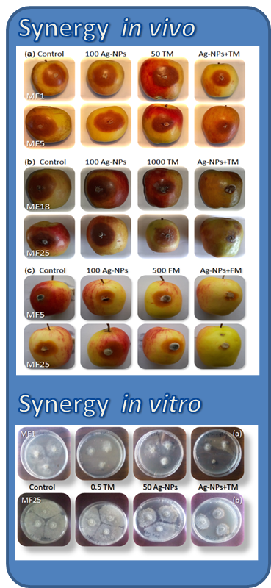
Silver nanoparticles used to counter Monilinia fructicola fungicide-resistance and reduce fungicide environmental footprint
EGU21-9285
Session HS8.1.8
Constantinos V. Chrysikopoulos ^{(1),} Anastasios Malandrakis ^{(1,2)}, Nektarios Kavroulakis ⁽³⁾
and Anthi Stefanarou ⁽¹⁾
(1)School of Environmental Engineering, Technical University of Crete, 73100 Chania, Greece (cvc@enveng.tuc.gr) (2) Pesticide Science Laboratory, Department of Crop Science, Agricultural University of Athens, 75 Iera Odos, 118 55 Athens, Greece(tasmal@aua.gr), (3) Hellenic Agricultural Organization “Demeter”, Institute for Olive Tree, Subtropical Plants and Viticulture, Agrokipio-Souda, 73164 Chania, Greece (nkavroulakis@nagref-cha.gr)
PVP-coated Ag-NPs:
Effective against M. fructicola benzimidazole resistant/sensitive isolates
Synergistic action with thiophanate methyl and fluazinam

Slide 4
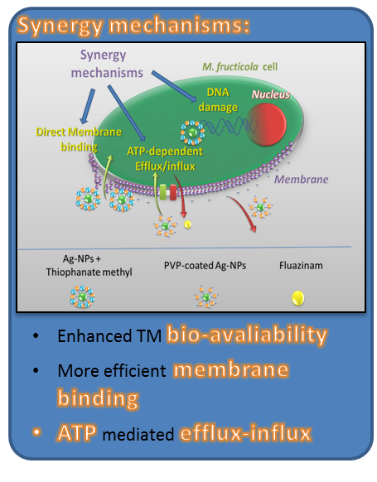
Silver nanoparticles used to counter Monilinia fructicola fungicide-resistance and reduce fungicide environmental footprint
EGU21-9285
Session HS8.1.8
Constantinos V. Chrysikopoulos ⁽¹⁾, Anastasios Malandrakis ^{(1,2)}, Nektarios Kavroulakis ⁽³⁾
and Anthi Stefanarou ⁽¹⁾
(1)School of Environmental Engineering, Technical University of Crete, 73100 Chania, Greece (cvc@enveng.tuc.gr) (2) Pesticide Science Laboratory, Department of Crop Science, Agricultural University of Athens, 75 Iera Odos, 118 55 Athens, Greece(tasmal@aua.gr), (3) Hellenic Agricultural Organization “Demeter”, Institute for Olive Tree, Subtropical Plants and Viticulture, Agrokipio-Souda, 73164 Chania, Greece (nkavroulakis@nagref-cha.gr)
PVP-coated Ag-NPs:
Effective against M. fructicola benzimidazole resistant/sensitive isolates
Synergistic action with thiophanate methyl and fluazinam
ATP metabolism rather than silver ion release is probably involved in mode of action

Slide 5
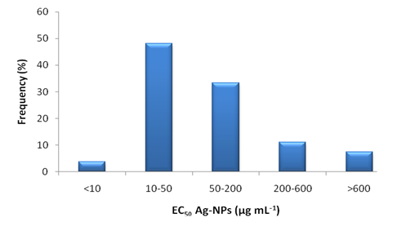
Silver nanoparticles used to counter Monilinia fructicola fungicide-resistance and reduce fungicide environmental footprint
EGU21-9285
Session HS8.1.8
Constantinos V. Chrysikopoulos ⁽¹⁾, Anastasios Malandrakis ^{(1,2)}, Nektarios Kavroulakis ⁽³⁾
and Anthi Stefanarou ⁽¹⁾
(1)School of Environmental Engineering, Technical University of Crete, 73100 Chania, Greece (cvc@enveng.tuc.gr) (2) Pesticide Science Laboratory, Department of Crop Science, Agricultural University of Athens, 75 Iera Odos, 118 55 Athens, Greece(tasmal@aua.gr), (3) Hellenic Agricultural Organization “Demeter”, Institute for Olive Tree, Subtropical Plants and Viticulture, Agrokipio-Souda, 73164 Chania, Greece (nkavroulakis@nagref-cha.gr)
PVP-coated Ag-NPs:
Sesitivity distribution
Effective against M. fructicola benzimidazole resistant/sensitive isolates
Synergistic action with thiophanate methyl and fluazinam
ATP metabolism rather than silver ion release is probably involved in mode of action
Great potential for combating resistance and reducing fungicide footprint in the environment

