Slide 1
Using systematic review to analyse climate change impacts and adaptation associated with mountain permafrost
Prashant Baral and Simon Allen
Figure 1. Distribution of the total number of reviewed publications from 2000 to 2019.

Slide 2
Using systematic review to analyse climate change impacts and adaptation associated with mountain permafrost
Figure 2. Percentage distribution of publications focused on different study areas in each decade.

Slide 3
Using systematic review to analyse climate change impacts and adaptation associated with mountain permafrost
Table 1. Percentage distribution of reviewed articles based on study areas discussed in the articles.
Study area | Percentage
China | 58
Central Asia | 6
General review | 16
Himalayan region | 7
Mongolia | 5
Russia (Siberia, Ural Mountains, Eurasia) | 10

Slide 4
Using systematic review to analyse climate change impacts and adaptation associated with mountain permafrost
Table 2. Percentage distribution of nationality of affiliations of the authors of reviewed articles
Countries (affiliation) | Percentage
Hungary, Italy, Spain, Australia, Greenland, Finland, Kyrgyz Republic, Nepal | < 1
Czech Republic, Kazakhstan, Poland, France, South Africa, Mongolia, Denmark | 1 - 2
Sweden, Norway, India, Japan | 3 - 4
Austria | 4.9
UK | 5.6
Canada | 7.5
Russia | 8.07
Germany | 10.6
Switzerland | 11.2
USA | 16.8
China | 59.6

Slide 5
Using systematic review to analyse climate change impacts and adaptation associated with mountain permafrost
Table 3. Percentage distribution of areas of publication of the source titles (scholarly journals)
of reviewed articles
Areas of publication | Percentage
Alpine/ Arctic/ Mountain/ Cryospheric Research | 13.7
Archaeology/Anthropology | 0.6
Atmosphere | 3.1
China | 3.1
Climate Change | 3.1
Earth Science/ Global Changes/ Natural Hazards | 13
Ecology/ Environment | 11.8
Geochemistry | 0.6
Geodesy | 0.6
Geography | 3.1
Geology | 2.5
Geomorphology | 4.3
Geophysics | 2.5
Hydrology | 6.2
Meteorology | 2.5
Multi-Disciplinary | 10.6
Permafrost and Periglacial processes | 6.8
Quaternary Science | 2.5
Remote Sensing | 3.7
Soil Science | 1.9
Tree | 3.1
Zoology | 0.6

Slide 6
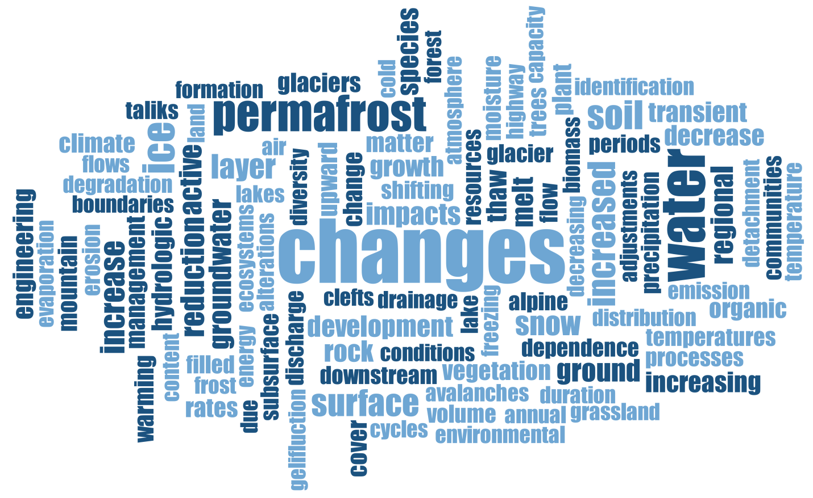
Using systematic review to analyse climate change impacts and adaptation associated with mountain permafrost
Figure 3. Word cloud based on the summary of climate change events, subsequent changes in permafrost features, and resulting hydrologic, geomorphic and ecologic impacts mentioned in the reviewed articles.

