Slide 1
Photosensitization is in the air and impacts SOA generation and properties
Christian George

Slide 2

Atmospheric Photosensitation
Photosensitizer P induces a reaction in M which is not absorbing
  P + hν → P*
      P* + M → P^{•-} + M ^{•+} Electron transfer
      → PH • + (M-H) • Hydrogen transfer
      → P + M* Energy transfer

Slide 3
Triplet state vs. Radical Chemistry
OH radicals (just to take the most reactive)
  Universal
    Produced everywhere
    Reacts with a very large range of compounds
Triplet state chemistry
  Specific
    Lower H-abstraction ability
    Charge transfert (e.g., NO₂ → HONO)
    Requires locally higher concentrations, but where?

Slide 4
Photosensitized SOA production…
Gaseous HO₂ production
hν
Seed particle
Light absorbing compound
e⁻/H transfer
SOA growth
Monge et al., PNAS, 2012
Aregahegn et al, Faraday disc., 2013
Rossignol et al., ES&T, 2014
VOC

Slide 5
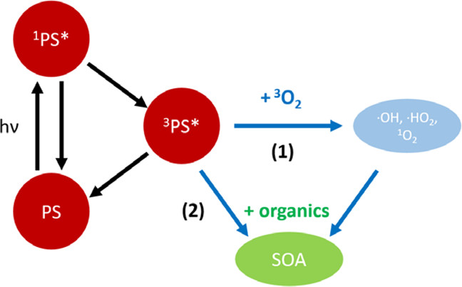
IC photochem not so important (Tsui et al)
Concentration is too low
Published in: William G. Tsui; Yi Rao; Hai-Lung Dai; V. Faye McNeill; Environ. Sci. Technol. 2017, 51, 7496-7501.
DOI: 10.1021/acs.est.7b01416
Copyright © 2017 American Chemical Society
SOA formation from photosensitizers and other organic material in photosensitized reactions.

Slide 6
If the triplet state is abundant… then it might be important…
But is IC the only possible photosensitizer?
(cf. Cort Anastasio measuring ΣT*)

Slide 7
Dependence of photooxidant concentrations on particle mass/water mass ratio (i.e., aqueous particle concentration)

Slide 8
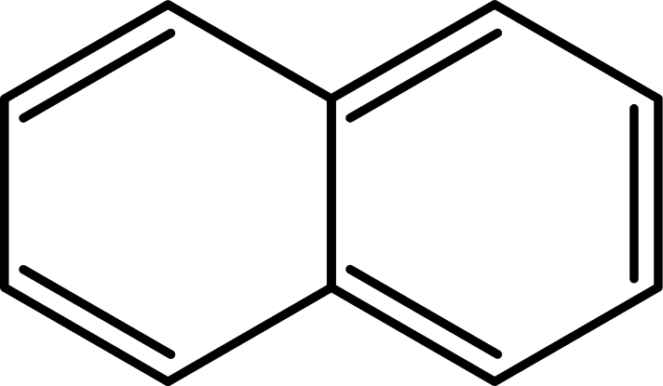
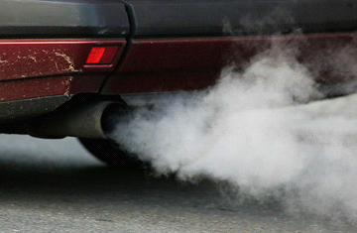
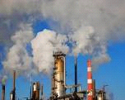
Anthropogenic VOCs

Slide 9
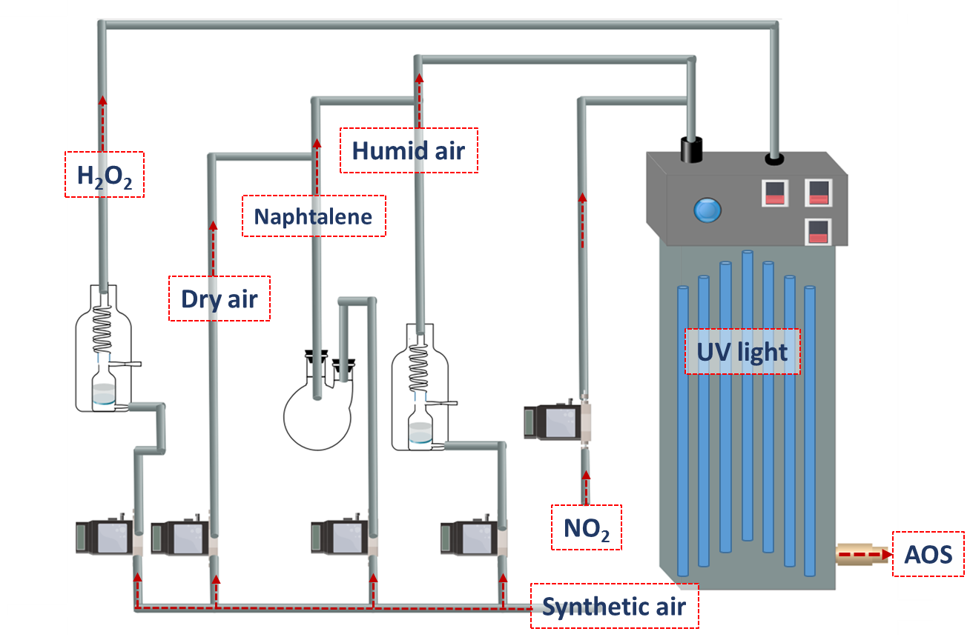
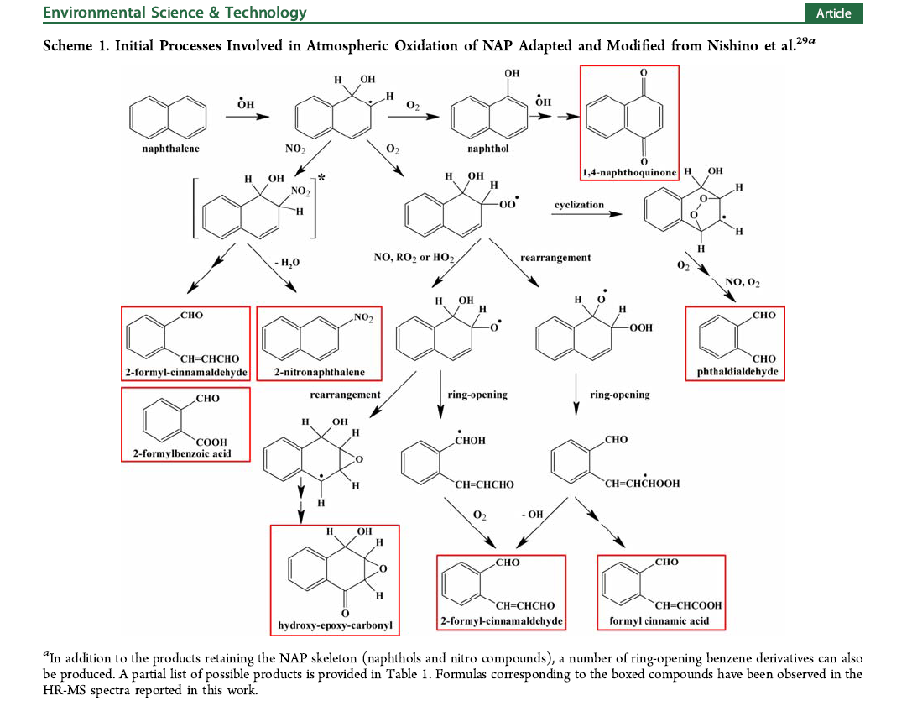
SOA formation

Slide 10
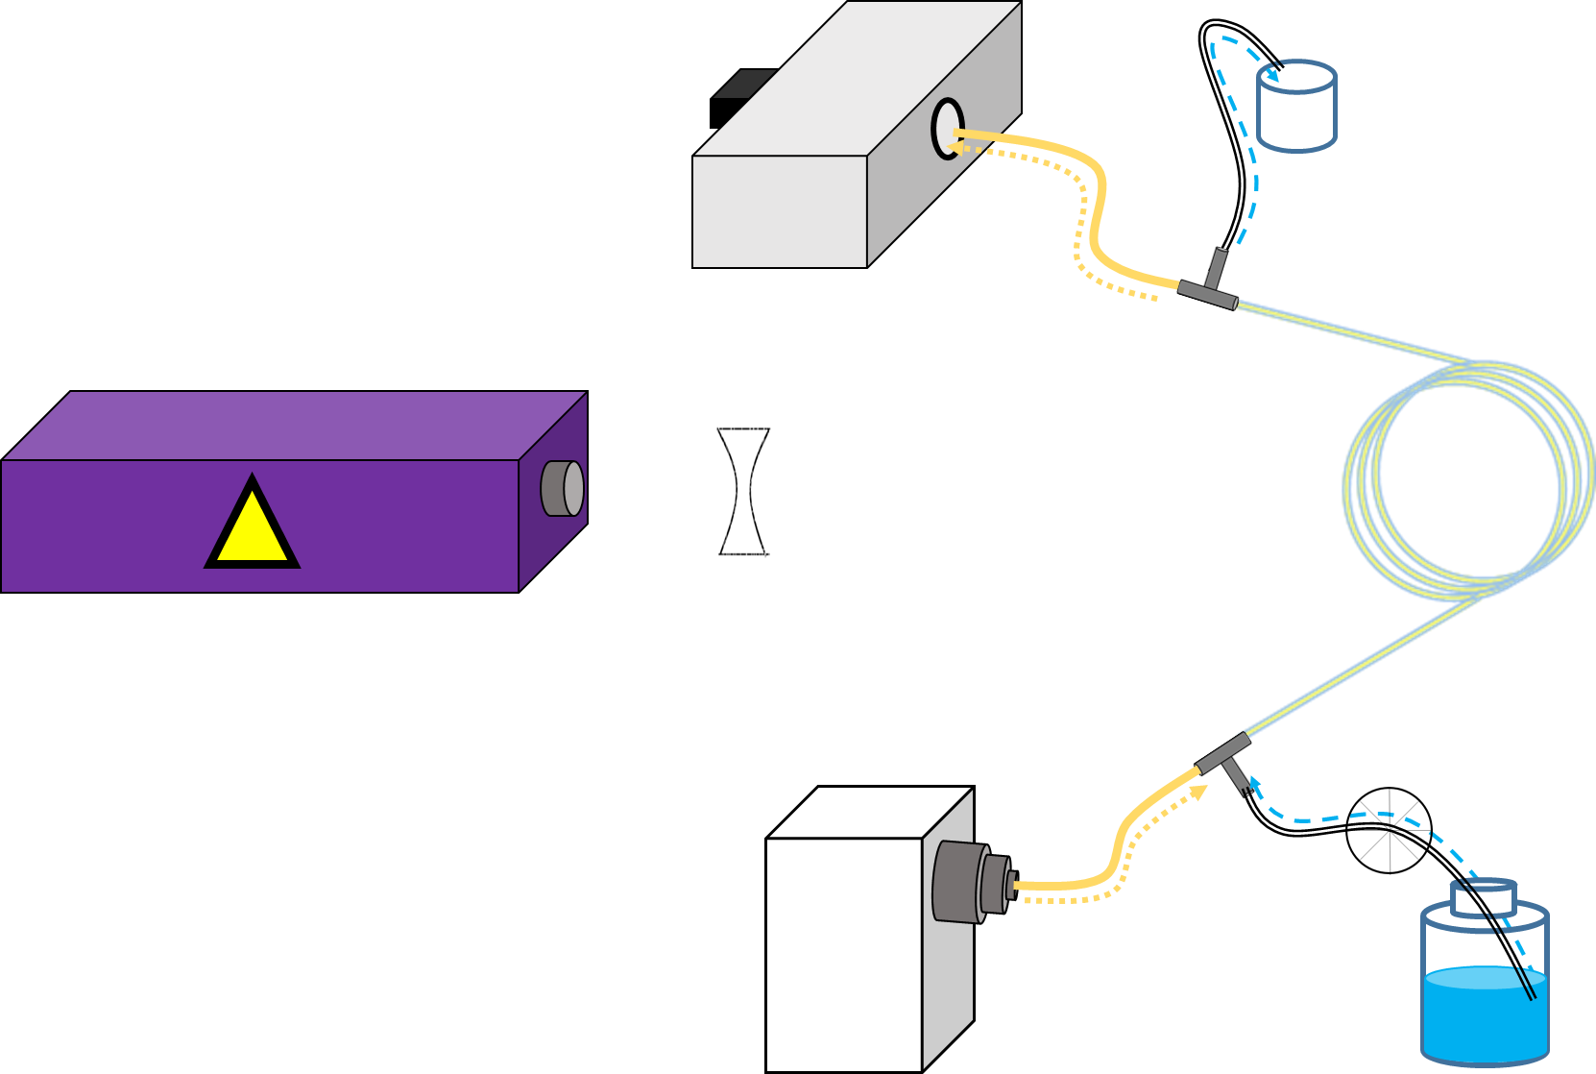


Transient absorption…
Monochromator
Waste
Laser Nd-YAG
 | Concave lens
 | Peristaltic pump
 | Solution flux
 | Xe Light flux
 | Optical fiber
 | waveguide
λ = 266 nm
Xenon lamp
photosensitizer

Slide 11
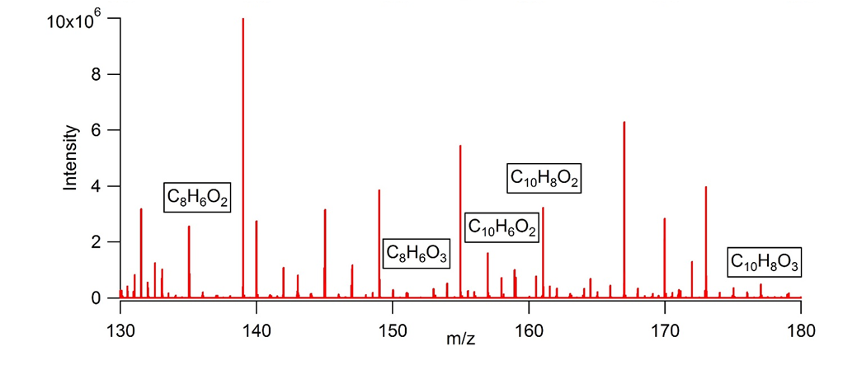
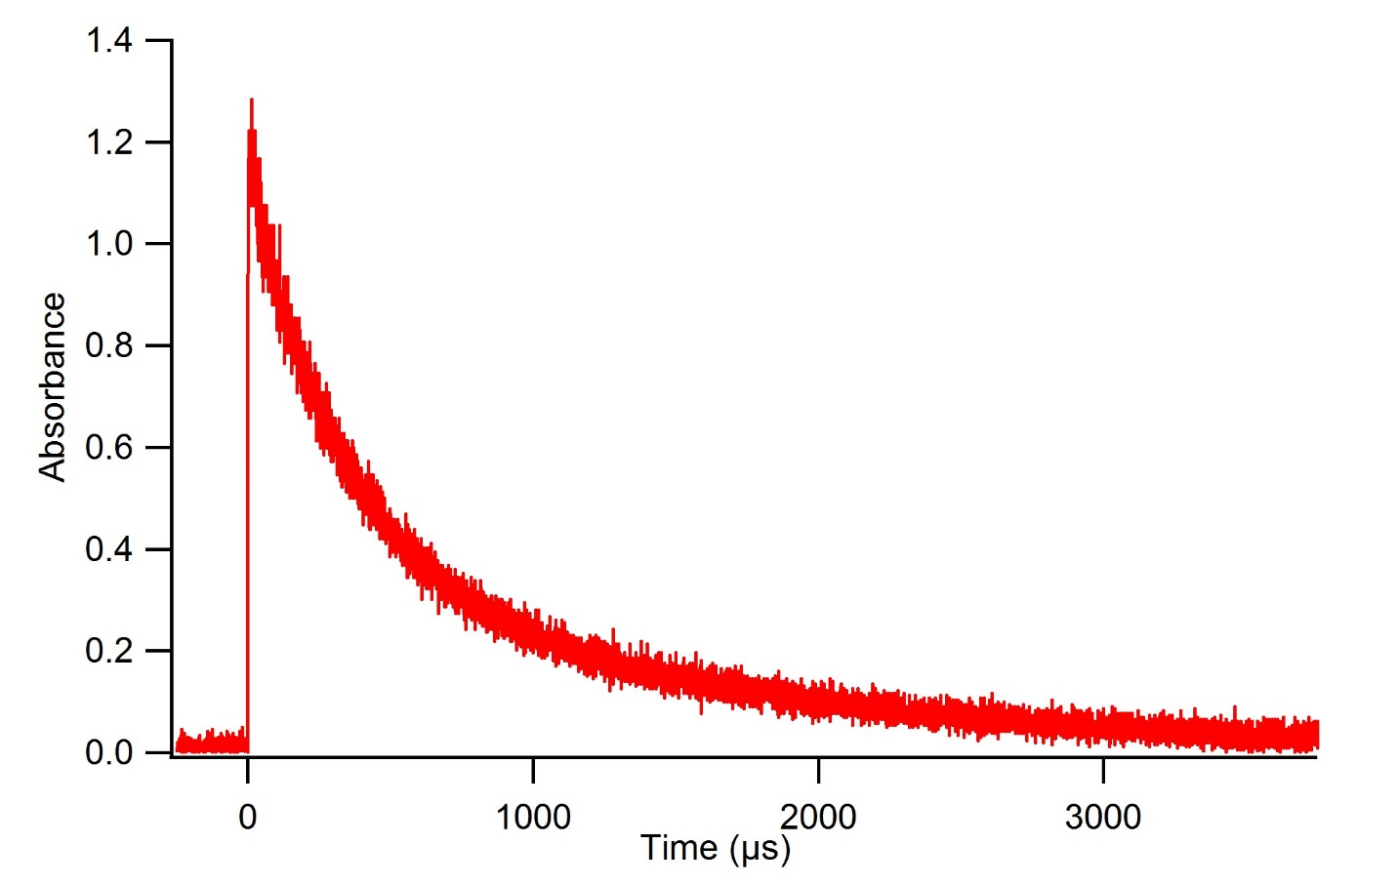
SOA formation
1,4-Naphtoquinone
C₁₀H₆O₂
Triplet state decay: 1,4-Naphtoquinone
Life time: 580 µs

Slide 12
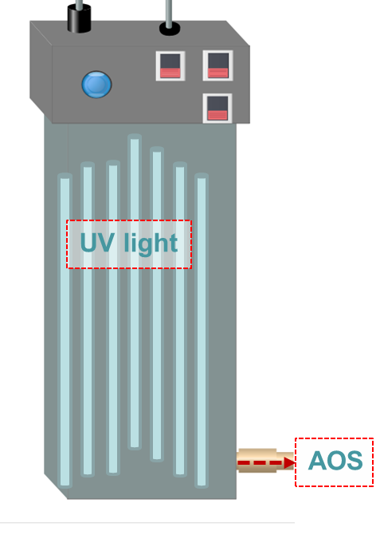

Experimental
PAH
VOC + RH
Aerosol flowtube
DMA
SOA monodispersed
SOA formation
Gas phase oxidation of the PAH
SOA growth
No gas phase chemistry
Only particle phase chemistry
Gothenburg Potential Aerosol Mass
(Go:PAM)
Chamber Mk II

Slide 13
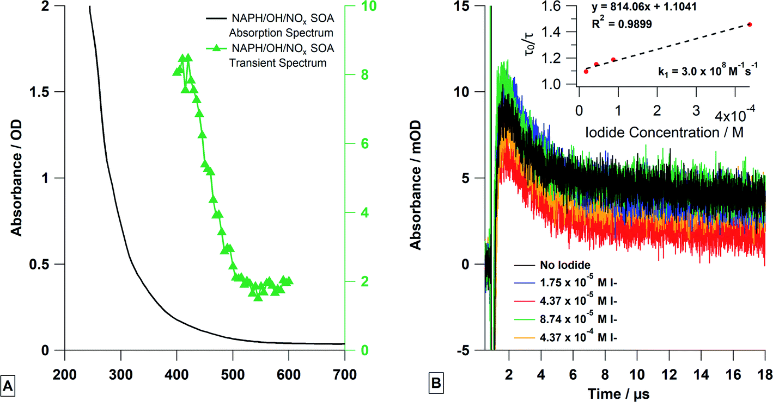

Fig. 7 (A) Steady state (black line) and transient absorption spectra (green triangles) of deoxygenated naphthalene SOA solution. The transient spectrum was the average signal from 1.2–2 μs. Please note the transient spectrum is measured in mOD. (B) The transient absorption decays at 420 nm were measured and fitted to produce a Stern–Volmer analysis at varying concentrations of KI. All solutions were deoxygenated.
Gemayel et al, Environ. Sci.: Atmos., 2021, 1, 31-44

Slide 14
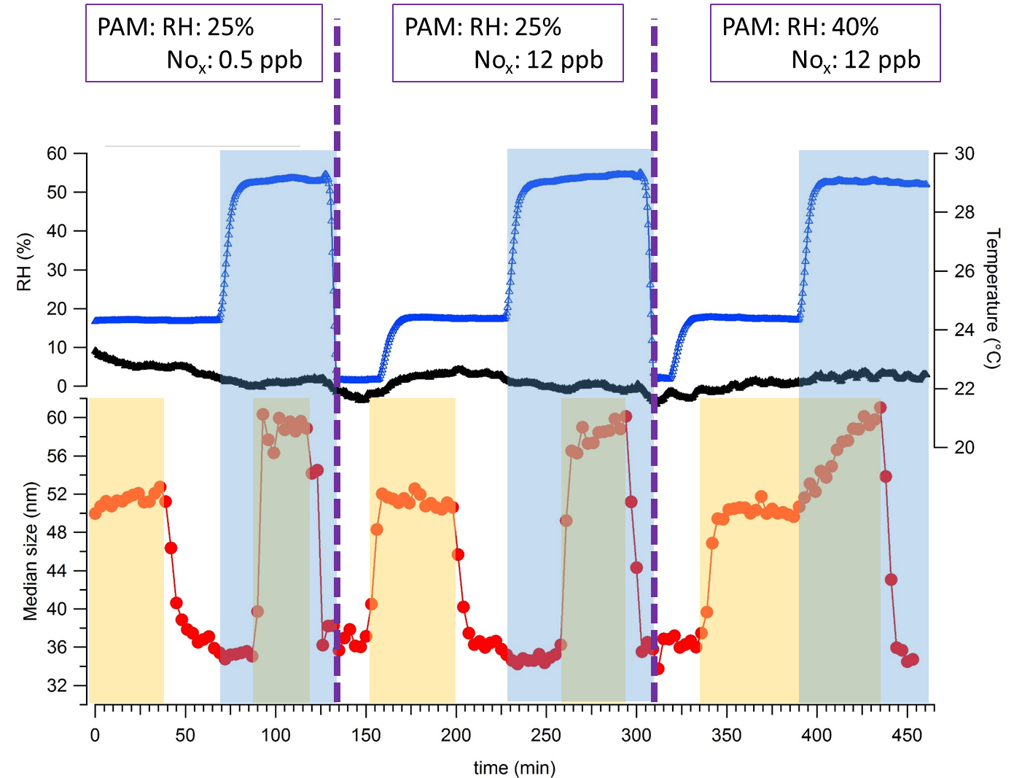
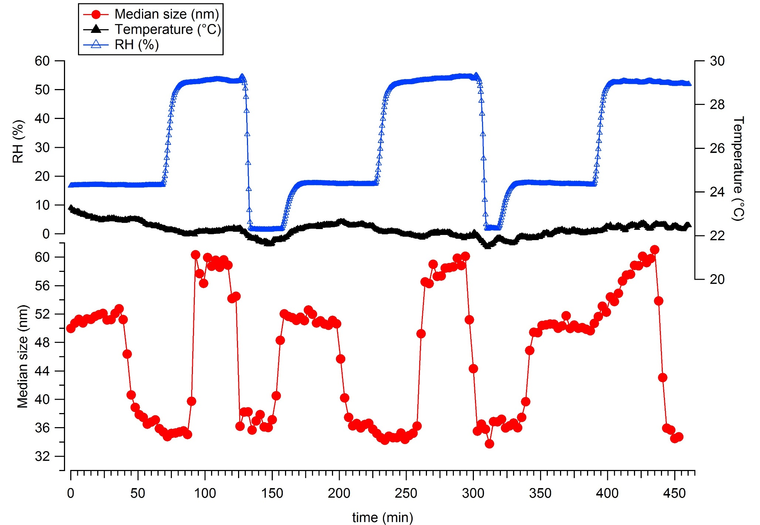
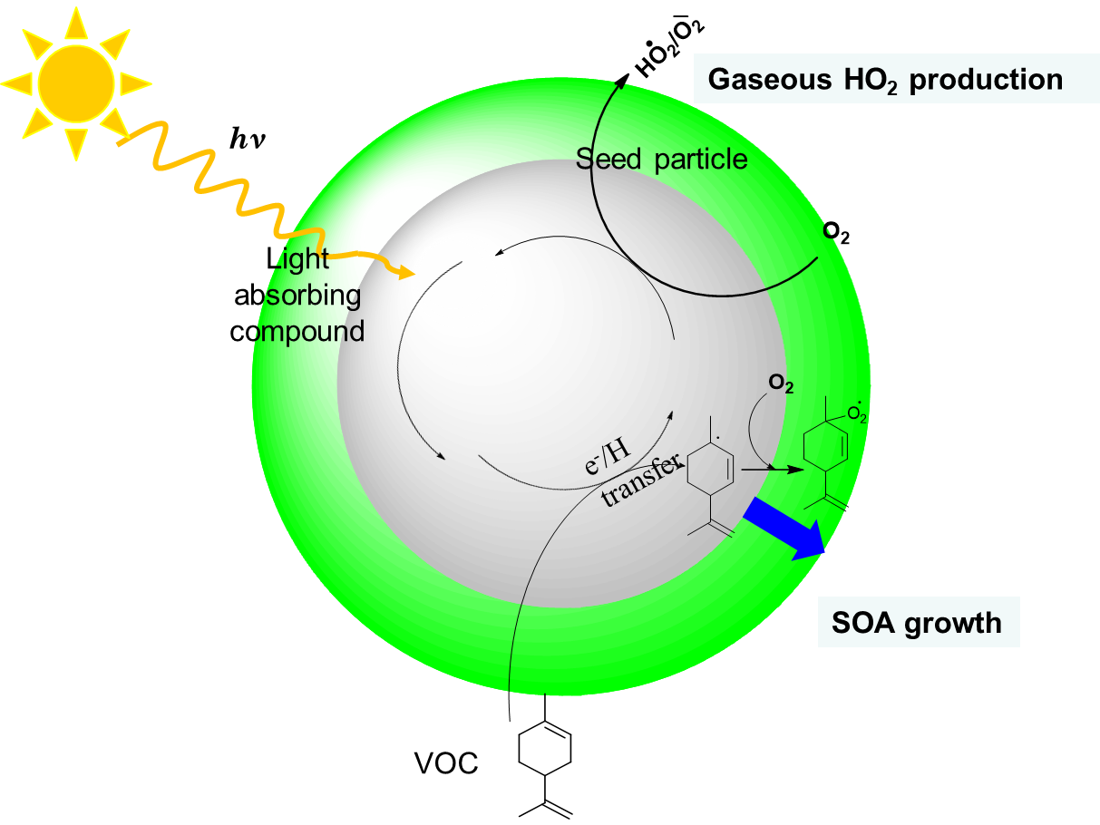
Particle growth
VOC: Limonene (100 ppb)
Residence time: 20 min
PAM: RH= 25 %
[NO₂]= 0.5 ppb
PAM: RH= 25 %
[NO₂]= 12 ppb
PAM: RH= 40 %
[NO₂]= 12 ppb
RH (%)
T (°C)
Naphtalene
SOA
Median size (nm)

Slide 15
Can SO2 undergo photosensitized oxidation?

Slide 16
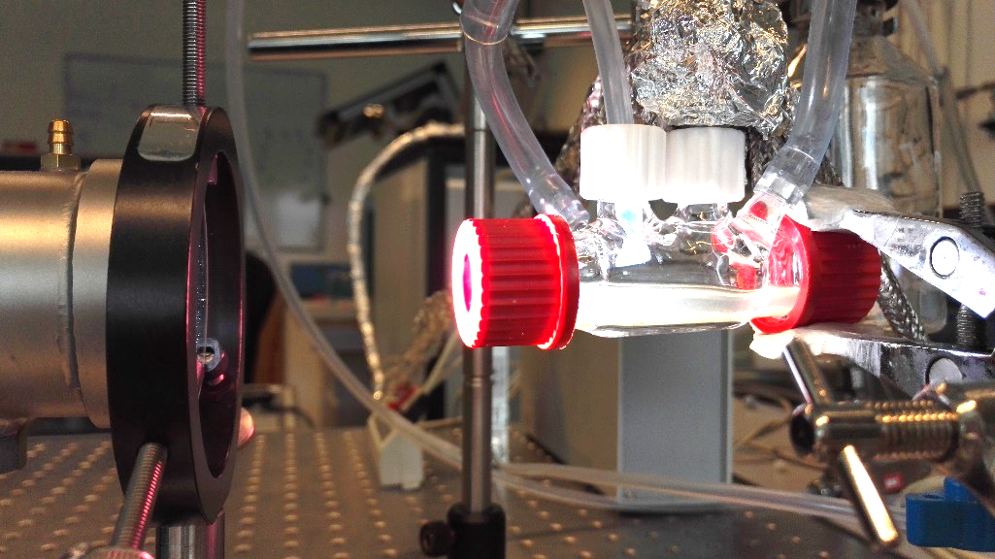
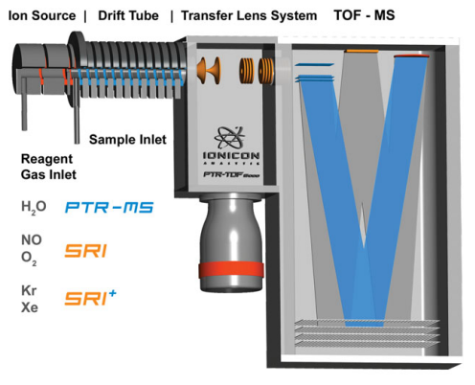

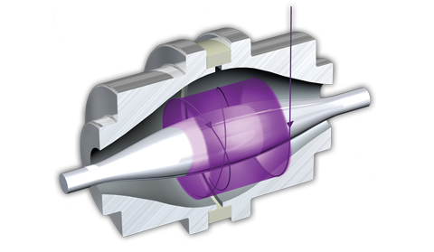
Experimental setup
exhaust
air
PTR-ToF-MS
Xenon lamp
Pyrex filter
(λ>290 nm)
Xe
hν
LC-HRMS
Quartz cell with
sample solution

Slide 17
Time trace of SO₂ in the gas phase above a 4-BBA aqueous solution
Model photosensitizer

Slide 18
Time trace of SO₂ in the gas phase above a 4-BBA aqueous solution
SO₂ (g) ⇌ SO₂ (aq)
SO₂·H₂O ⇌ H⁺ + HSO₃⁻
HSO₃⁻ ⇌H⁺ + SO₃²⁻

Slide 19
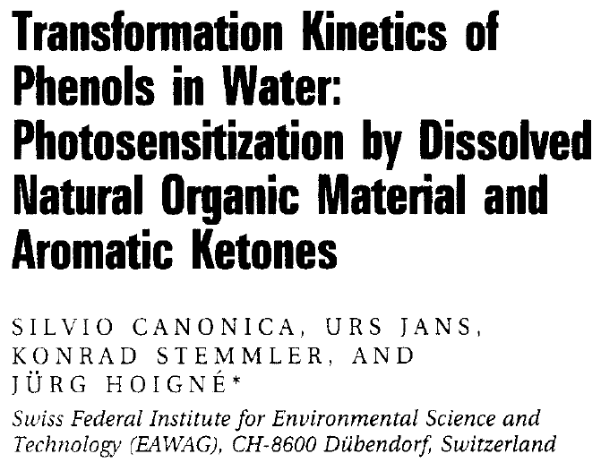
HOx as possible oxidant
Canonica et al

Slide 20
Time trace of SO₂ in the gas phase above a 4-BBA aqueous solution
Under air and nitrogen , the same loss is observed
= HOx is not triggering that loss
Do we observe a direct reaction between SO₂ and the excited state?

Slide 21
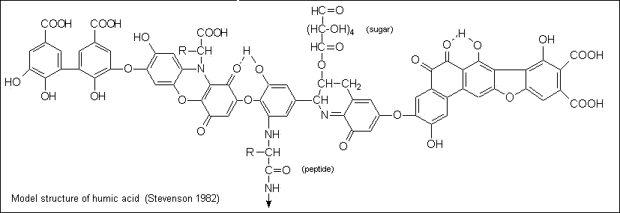
Time trace of SO₂ in the gas phase above the aqueous solutions of 4-BBA (75 µM), AA 1, AA 2, HA (70 mg/L), and HAS (70 mg/L).
HUMIC acids & salts
Model photosensitizer

Slide 22
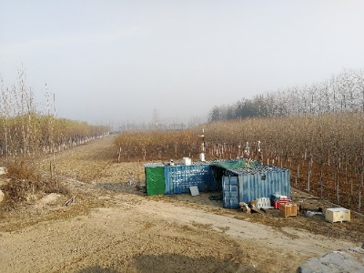
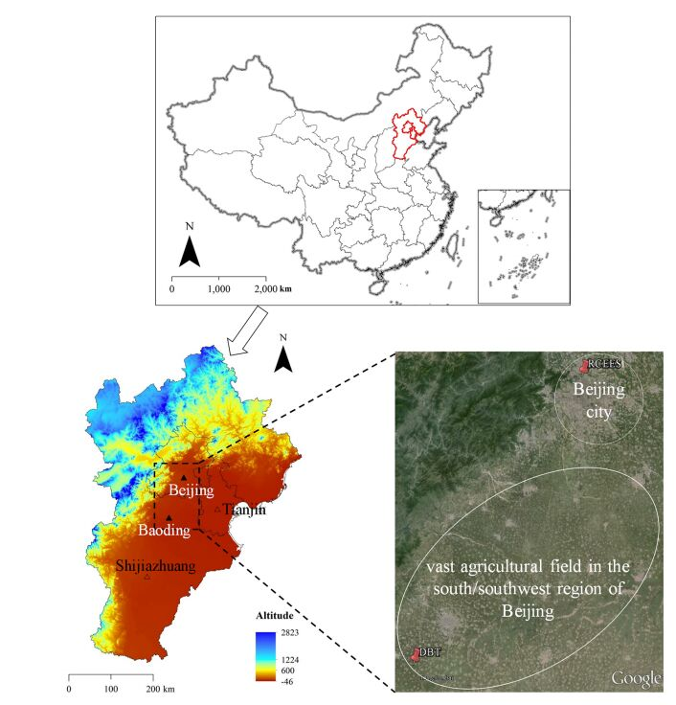
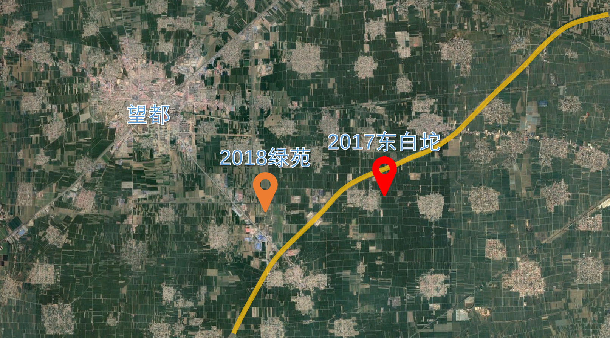
Wangdu Supersite
West-South to Beijing
Transport channel of Mt. Taihang

Slide 23
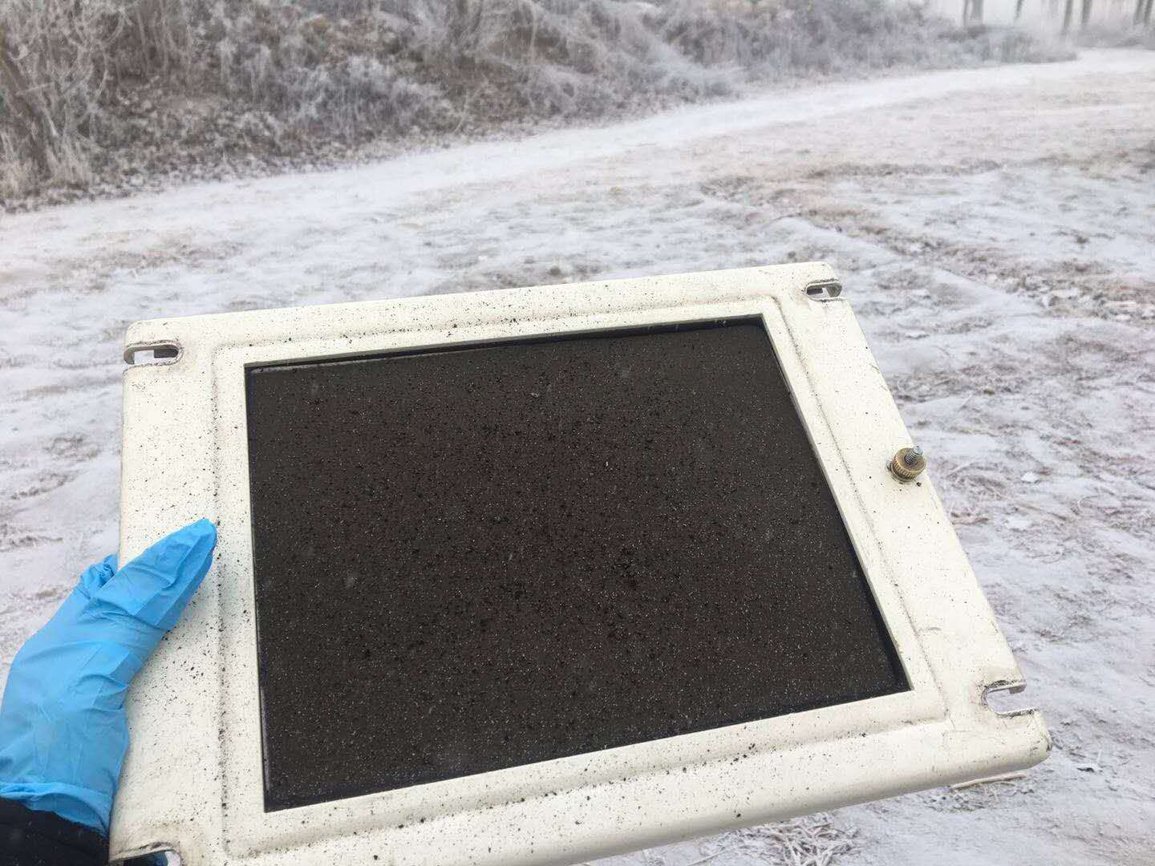

Slide 24
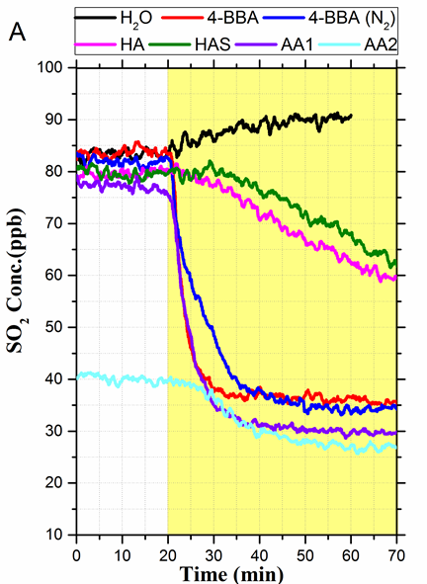
Time trace of SO₂ in the gas phase above the aqueous solutions of 4-BBA (75 µM), AA 1, AA 2, HA (70 mg/L), and HAS (70 mg/L).
HUMIC acids & salts
Model photosensitizer
Authentic samples

Slide 25
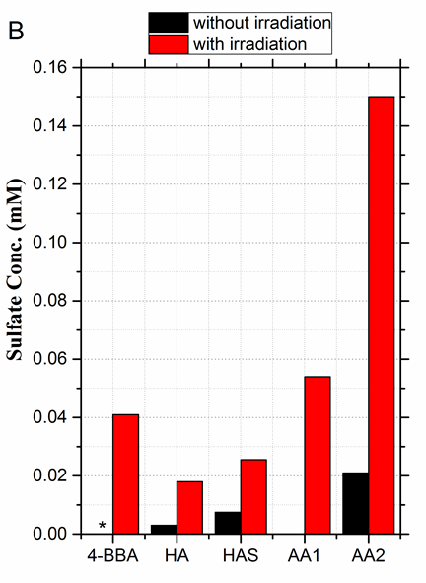
Sulfate production in the liquid phase (B). *Below the detection limit.

Slide 26

Aerosol flowtube experiment
CPC
Movable
injector
180 cm
Atomizer
SO₂
Air
Air
SMPS

Slide 27
Time trace of sulfate production in the aerosol phase. 4-BBA particules with diameter equal to 70 and 80 nm were selected to import to the AFT.
So what is the rate coefficient for the triplet state reacting with SO₂?

Slide 28
Sulfite quenching
Transient absorption decay of the acetophenone, flavone, 4-BBA, xanthone, and HULIS (ambient sample) triplet state in deoxygenated aqueous solutions with different concentrations of Na₂SO₃ at same pH.

Slide 29
Similar to … OH + EtOH →…
Diffusion limit ca. 10¹⁰ M⁻¹s⁻¹
Stern–Volmer plots of the observed quenching first-order rate coefficients k_{obs} as a function of aqueous S(IV) concentration. Red squares, acetophenone; black triangles, flavone; blue circles, xanthone; green diamonds, 4-BBA; pink stars, HULIS-AA. The pH of all acetophenone solutions is 2.6 and the pH of all flavone, xanthone, 4-BBA, and HULIS-AA solutions is 1.8.

Slide 30
Possible reactions…
→ SO₂* + T; energy transfer (a)
SO₂ (aq) + T* → SO₂^{·+} + T^{·-}; electron transfer to T* (b)
→ SO₂^{·-} + T^{·+}; electron transfer from T* (c)
HSO₃⁻ + T* → HSO₃· + T^{·-}; electron transfer to T* (d)
→ SO₃^{·-} + H·; hydrogen transfer to T* (e)

Slide 31
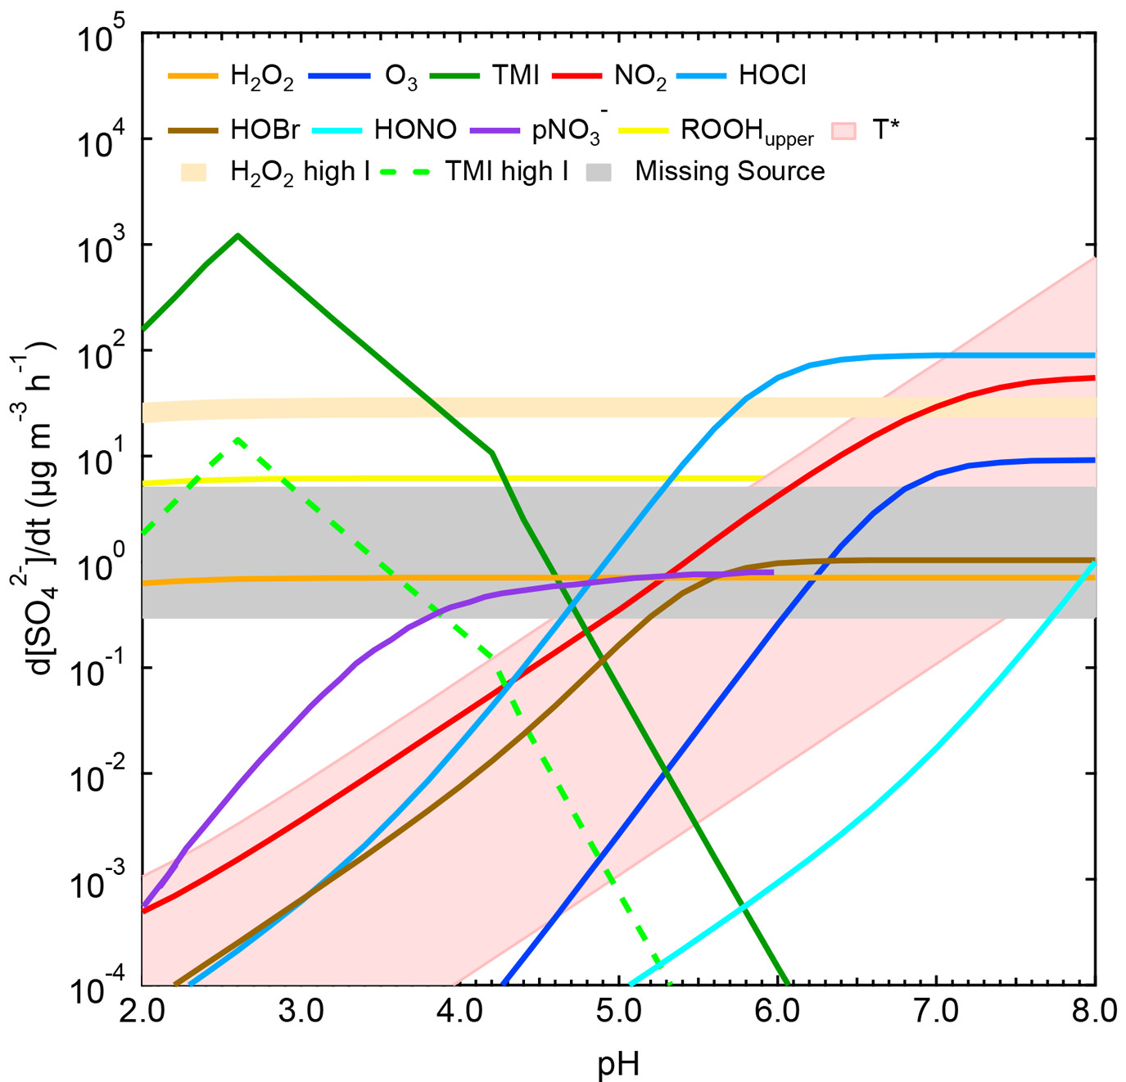
Liu et al. Environ. Sci. Technol. 2021, 55, 8, 4227-4242

Slide 32
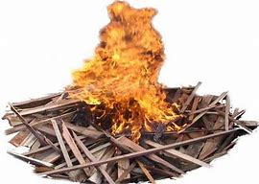
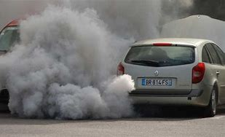
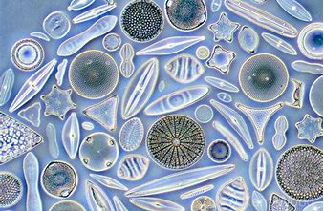
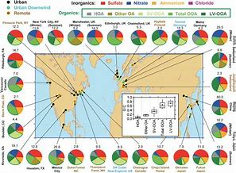
Possible sources of atmospheric photosensitizers
Primary sources
  HULIS
  Brown carbon (BrC)
  Transport (PAHs)
  Biological
Secondary sources
  Brown Carbon (BrC)
  SOA chemistry
  -…
Multiple sources- more « simple » molecules

Slide 33
We have to rethink the atmospheric oxidation capacity!!
There is more chemistrty taking place than we thought (and not just radicals)
My conclusion
Questions?

