Slide 1
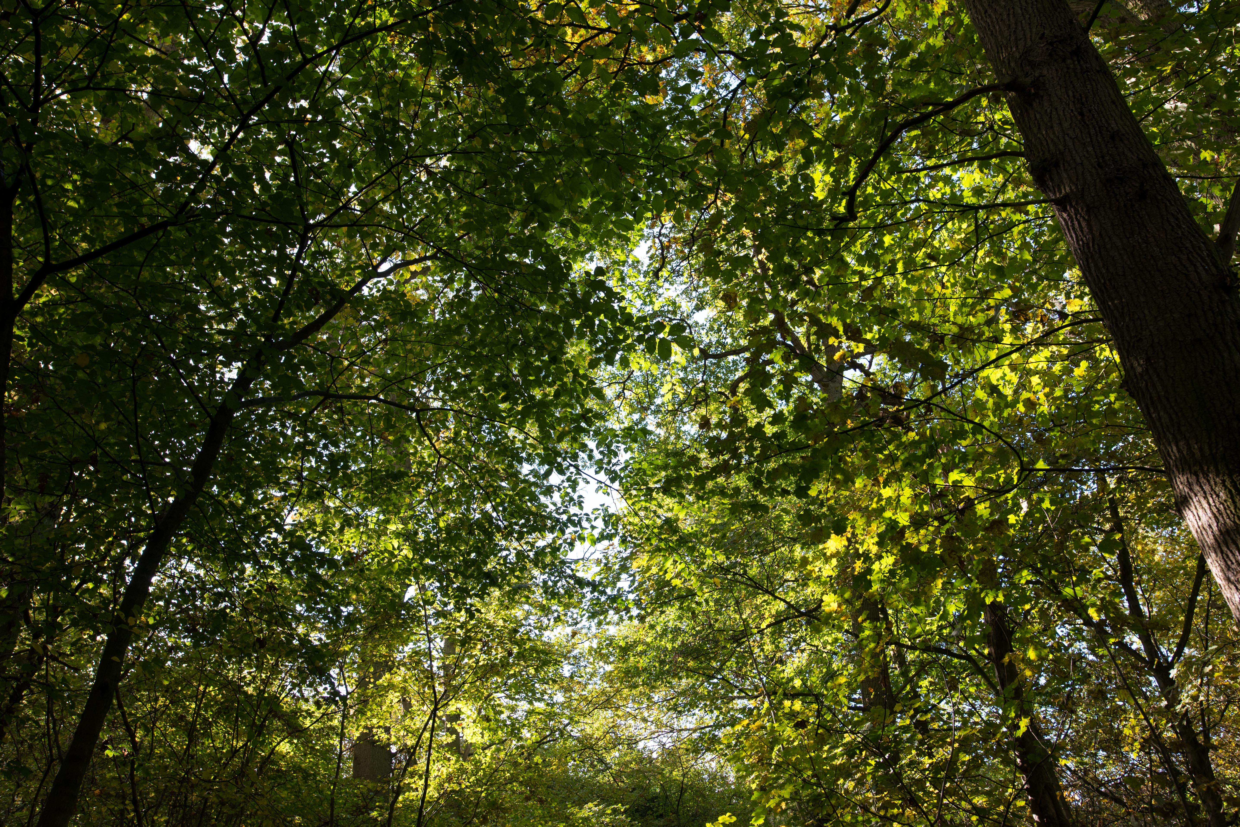




The effects of elevated CO₂ and canopy position on chlorophyll concentrations in mature Quercus robur
Anna Gardner^{1,2}, David Ellsworth³, Jeremy Pritchard^{1,2}, and Rob Mackenzie^{1,4}
Introduction
Study Objectives
Methods
Results
Early conclusions
Get in touch:
axg042@student.bham.ac.uk
@annagardnerr
www.annagardner.co.uk
anna-gardnerr
¹ Birmingham Institute of Forest Research, University of Birmingham.
² School of Biosciences, University of Birmingham.
₃ Hawkesbury Institute for the Environment, Western Sydney University.
⁴ School of Geography, Earth & Environmental Sciences, University of Birmingham.

Slide 2
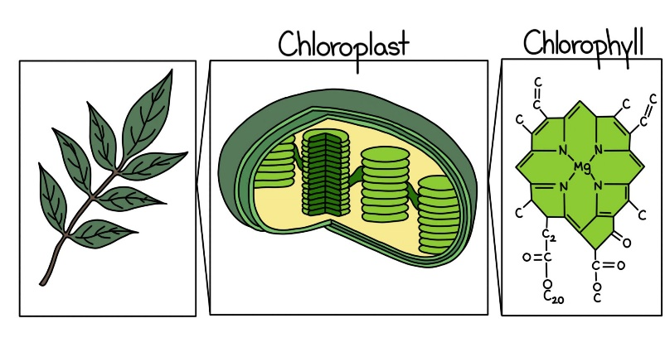
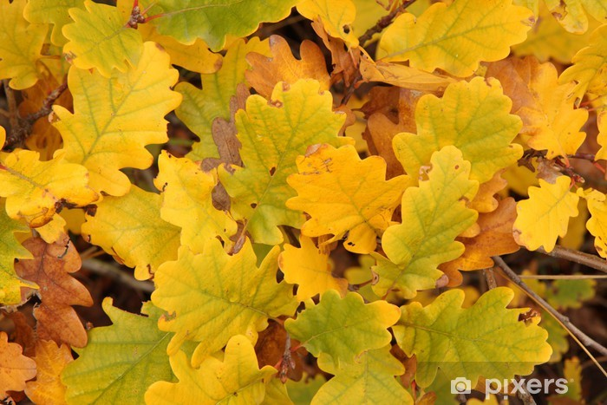
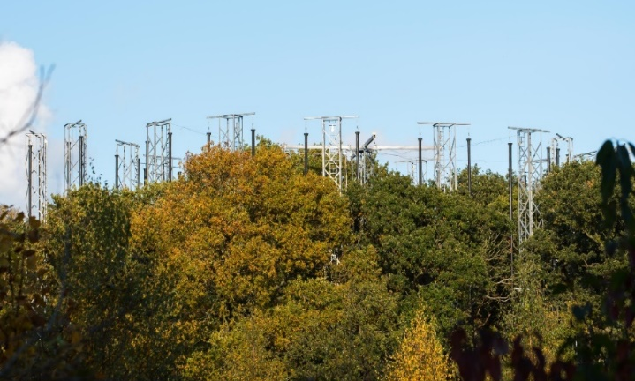
Introduction
Back to start
Elevated CO₂ affects plant function.
Many plants show reduced foliar N with eCO₂.
  Important component of proteins e.g. photosynthetic proteins
  Implications for plant processes.
Some studies show reduced chlorophyll concentrations in eCO₂, not always.
  Photosynthetic pigment located in chloroplasts.
  Chlorophyll is an N-rich compound.
  If N allocation to chlorophyll follow total N;
    Does chlorophyll respond similarly to eCO₂?
N reallocation? plants may be able to reallocate N with eCO₂.
Important to understand N allocation under eCO₂ - modelling.
Image source: Gabi Slizewska
Introduction pt.2

Slide 3
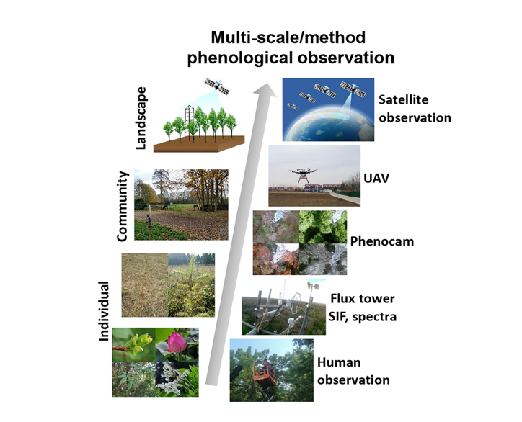
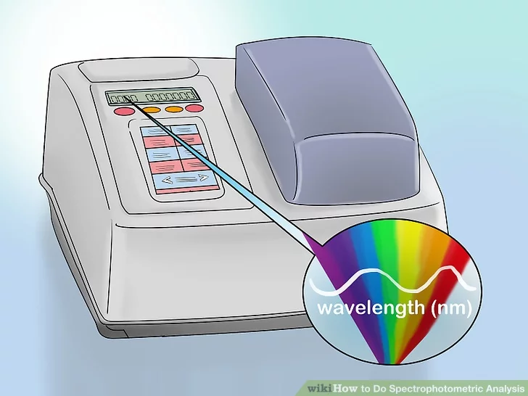
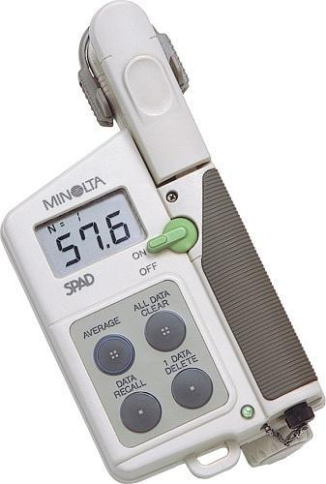
Introduction
Methods to quantify chlorophyll;
Traditional extraction:
  Accurate
  Destructive,
  Time consuming,
  Require laboratory conditions,
  and are therefore not always suitable.
Field diagnostic tools (e.g. SPAD meter):
  Objective,
  Minimal training,
  Instantaneous,
  In situ,
  Non-destructive
  Repeat sampling.
  Need to establish species-specific calibration equation.
Back to start
Image sources:
Above: Piao et al. 2019; Top left: Wikipedia; Bottom left: Konica Minolta

Slide 4
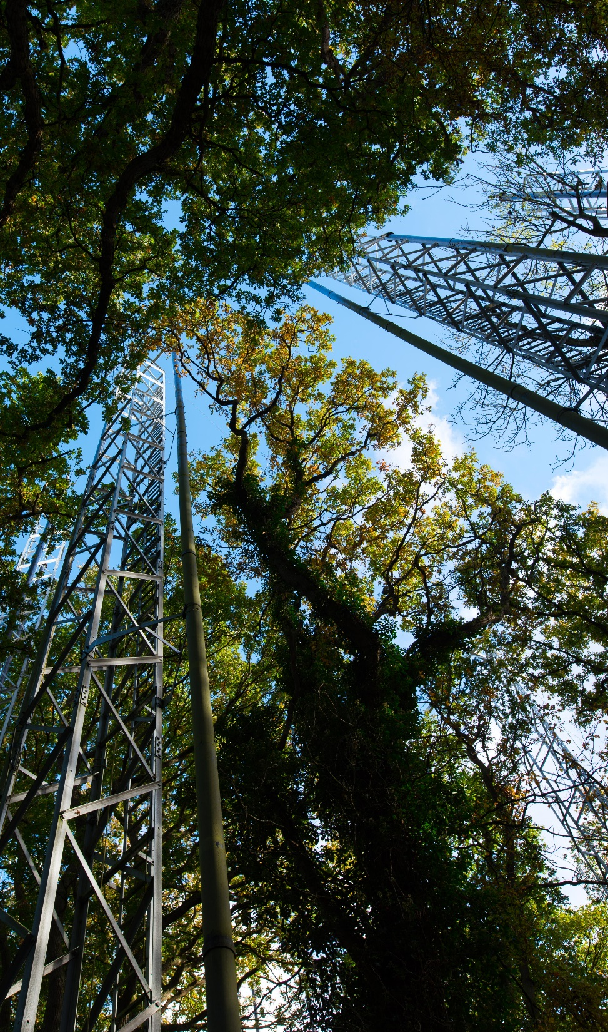
Study Objectives
Our objectives were;
To determine empirical relationship between foliar chlorophyll concentrations and SPAD-502 meter readings for forest-grown English oak (Quercus robur).
To quantify the effect of canopy position on foliar chlorophyll content.
To quantify the effect of elevated CO₂ treatment on foliar chlorophyll content and N allocation to light-harvesting.
This study was conducted at the Birmingham Institute of Forest Research Free Air Carbon dioxide enrichment (BIFoR FACE) facility located in Staffordshire, UK.
175 year old oak-dominant temperate forest.
Six plots of woodland with two CO2 treatments (n=3);
  Ambient CO₂ (~405 ppm) and
  Elevated CO₂ (~555ppm)
Back to start

Slide 5
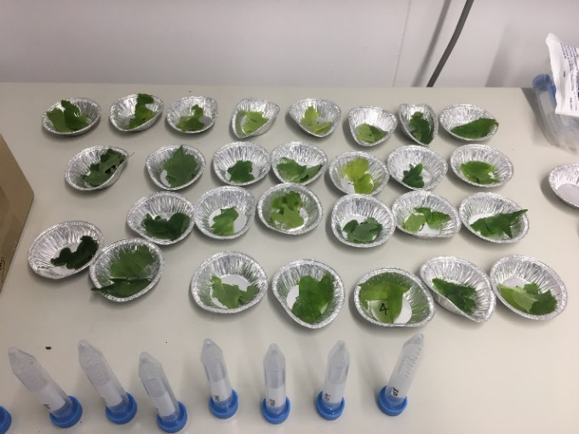

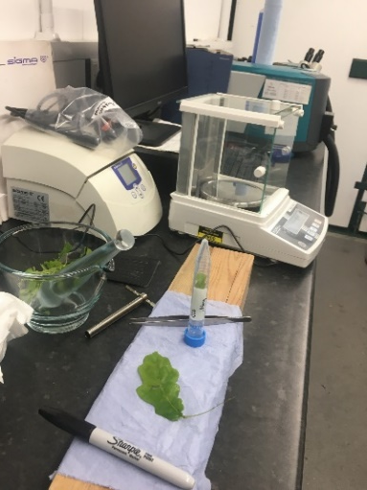
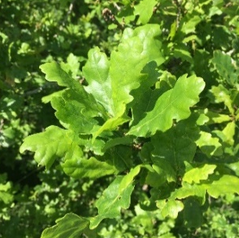
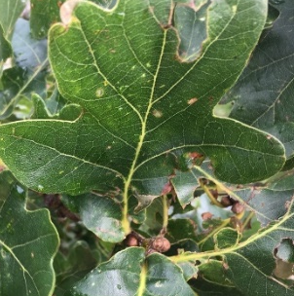
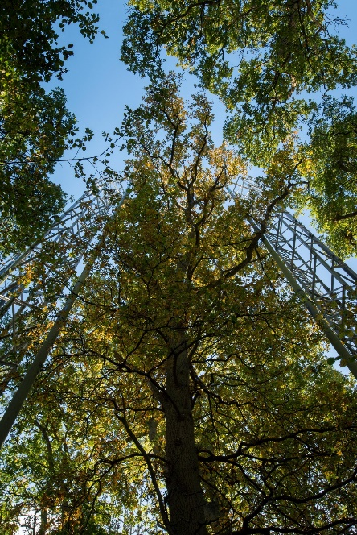

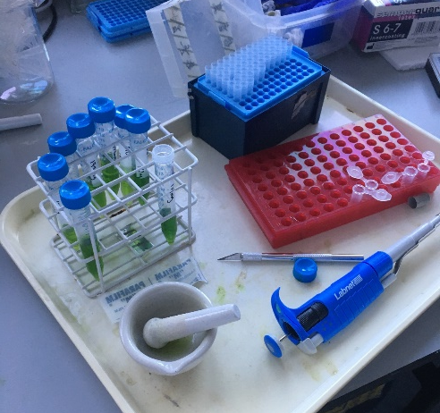
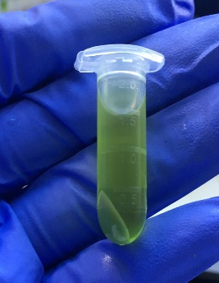
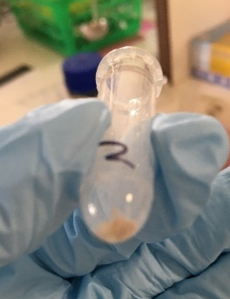
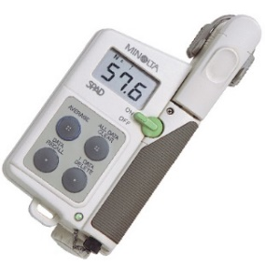
Methods
Back to start
In situ SPAD-502 measurements:
Monthly across growing season in 2019 and 2020.
Three defined canopy positions for Q. robur.
Elevated CO₂ and ambient CO₂ plots, n=3.
Traditional chlorophyll extractions;
At BIFoR; 75 leaves in 2020: -80 °C storage.
At UoB; 80% acetone extraction and spectrophotometer readings.
Obtain calibration equation.

Slide 6
Results: Species-specific calibration equation
Strong correlations between SPAD values and total chlorophyll and carotenoid concentrations.
All three functions performed well (R² values for all three models > 0.78 and low RMSE values).
Log function performed best.
Relationship slightly weaker at higher SPAD values.
→ Apply this calibration to the SPAD values taken over two growing seasons at BIFoR.
  = Interpret effects of canopy and elevated CO₂.
Figure 1. Leaf chlorophyll concentration, expressed per unit dry weight (mg g⁻¹), in relation to the SPAD-502 values of Q. robur. The linear, logarithmic and quadratic regression are presented with the equations and their coefficients of determination (R² values) given in Table 1.
Back to start
Results pt.2

Slide 7
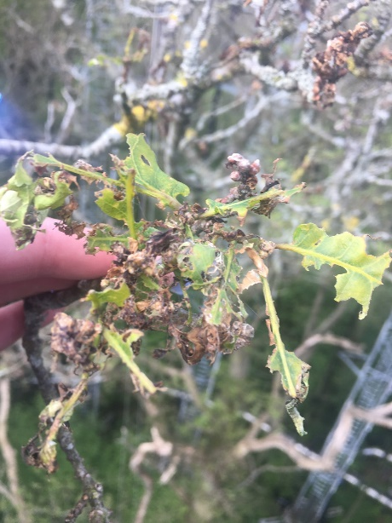
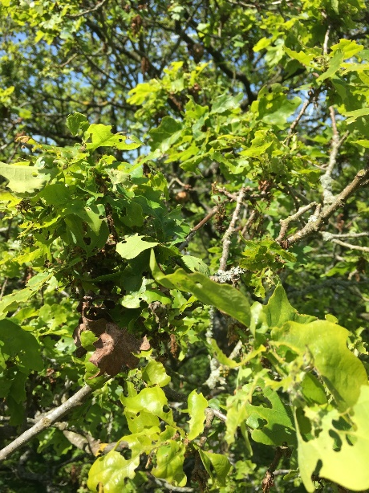
Results: Seasonal and interannual variability in Total Chl
Total Chl follows typical seasonal pattern.
  Broadly similar between years.
Significant ‘Year’ x ‘Month’ effect.
  Lower chlorophyll concentrations in May 2019.
      Herbivory?
      Frost events?
Back to start
Results pt.3

Slide 8

Results: The effect of canopy position on Total Chl
Total Chl significantly higher in lower canopy leaves, in both sampling years (P ≤ 0.05).
  ~10-15% higher in the lower canopy leaves.
    Largest differences in July 2019 (17%)
    Smallest differences in September.
Upper
Middle
Lower
Back to start
Results pt.4

Slide 9
Results: The effect of elevated CO₂ on Total Chl
1.
2.
Total Chl reduced with eCO₂ (-2 to -9%).
‘Canopy’ x ‘CO₂’ interaction.
  Significant effect confined to upper canopy (-8 to -9%) (P<0.05).
Further work to assess leaf nitrogen data.
  2018 data suggests no changes to Total N with eCO₂.
Back to start
Results pt.5

Slide 10
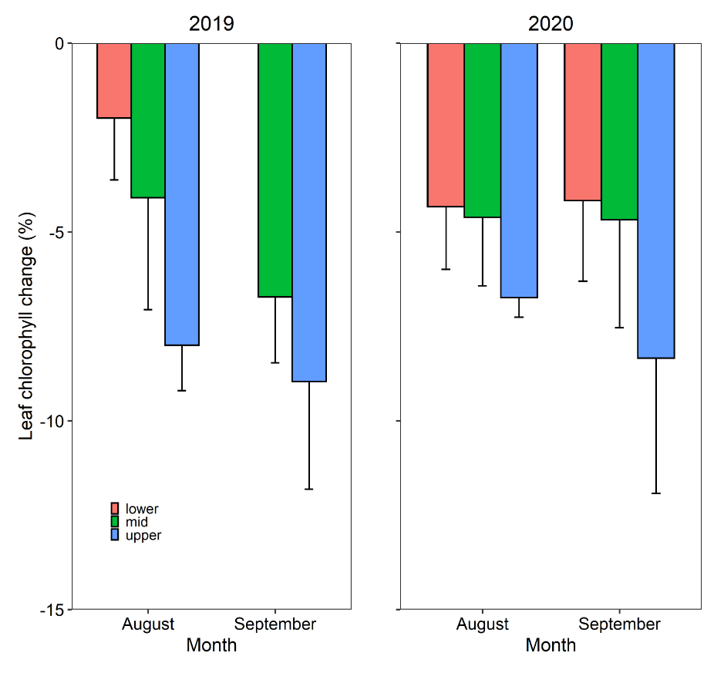
Results: The effect of elevated CO₂ on Total Chl – implications for autumnal phenology?
Slightly larger reductions in chlorophyll with exposure to eCO₂ as autumn begins.
- Still need to add on October data.
Larger eCO₂ reductions in upper canopy.
  More exposed leaves?
Suggests potential reduction in effective season length.
Early analysis and further work needed to confirm these suggestions.
  E.g. Corroborate results with leaf litter.
Back to start
Results summary

Slide 11



Summary of early results
Using the SPAD meter
SPAD-502 meter proved effective.
Calibration equations obtained in this study will be useful in future studies.
  remote or difficult research sites.
  avoid resource expenditure on traditional extractions.
Effects of eCO₂ and canopy on chlorophyll
Total Chl higher in the lower tree canopy.
Total Chl reduced under eCO₂, significance confined to the upper canopy.
Slightly larger eCO₂-driven reductions in Total Chl with progression of autumn.
  Potential impacts on autumnal phenology?
+ eCO₂
Back to start
Image sources: Wikipedia

Slide 12
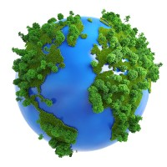


Early conclusions
The SPAD meter is a simple non-invasive method useful to monitor changes in chlorophyll of mature trees under eCO₂.
Research highlights the importance of canopy position.
Leaf-level responses: Reallocation of resources in response to eCO_{2.}
Also….
Potential direct consequences of rising atmospheric CO₂ to alterations of phenological events.
  Further work needed.
Next steps…
Back to start
Leaf area data.
Leaf N data.
  Quantify allocation of N to chlorophyll.
  Identify any changes to N allocation in chlorophyll with eCO₂
Image sources: Above: IIASA, Bottom: Janet Moore

Slide 13


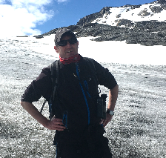
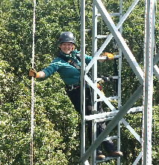
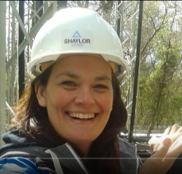

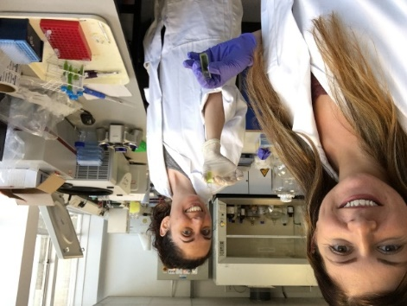
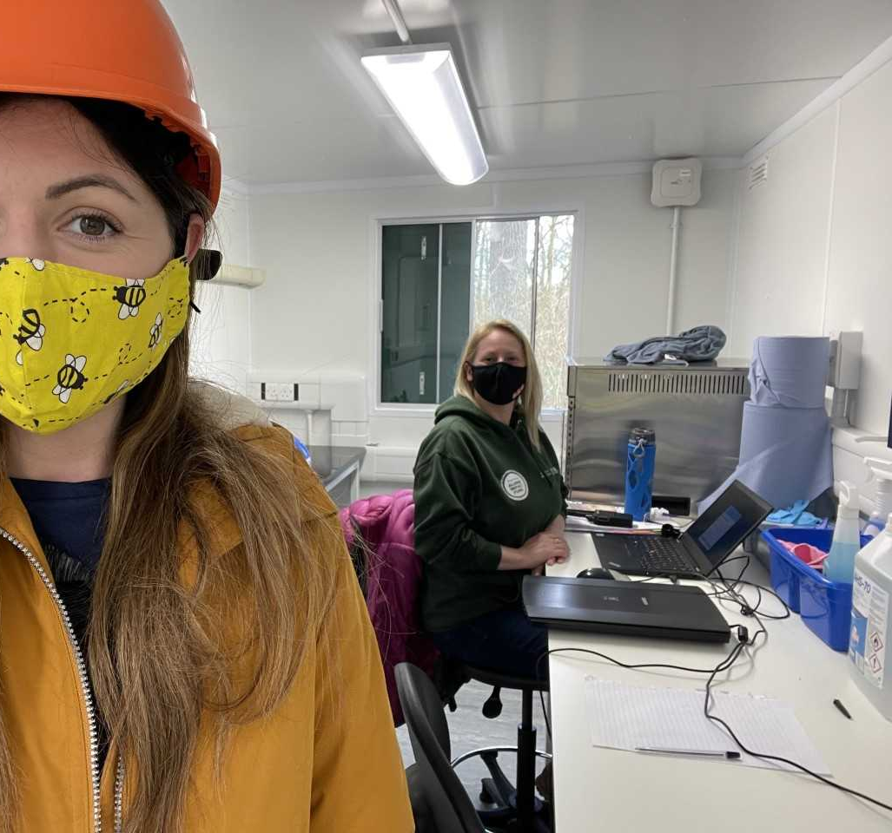
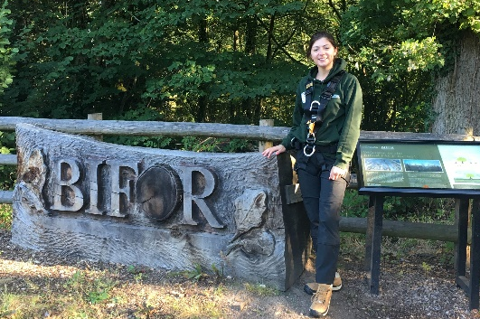
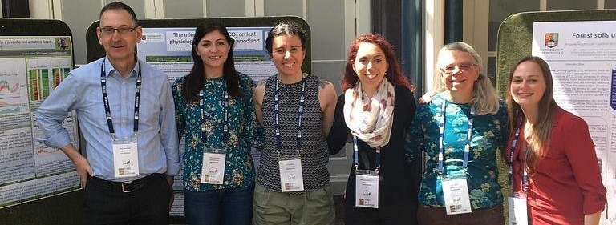
Acknowledgements
The BIFoR Tech Team.
Supervisors: Rob Mackenzie, Jerry Pritchard and David Ellsworth.
Funding: John and Moyra Horseman (The Horseman Trust) and Royal Forestry Society
Rob Keyzor and arborist team.
Christine Foyer and Barbara Karpinska for lab space and chlorophyll extractions.
Angeliki Kourmouli help with chlorophyll extractions.
Gael Denny and Deanne Brettle for the leaf area measurements.
Photos: Freddie Miller
Thank you for listening!
Please feel free to get in contact
Contact:
axg042@student.bham.ac.uk
www.annagardner.co.uk
@annagardnerr

