Slide 1
GRACE Follow-On Gravity Field Recovery from Combined Laser Ranging Interferometer and Microwave Ranging System Measurements
Saniya Behzadpour, Andreas Kvas, and Torsten Mayer-Gürr
EGU General Assembly 2021
2021-04-30
Go to the next page ►

Slide 2
Quick access links
1
GRACE-FO gravity recovery
3
Stochastic modeling
2
LRI data calibration
4
Postfit residual analysis
◄
►

Slide 3
GRACE-FO gravity recovery
▲ Back to the first page
◄
►

Slide 4
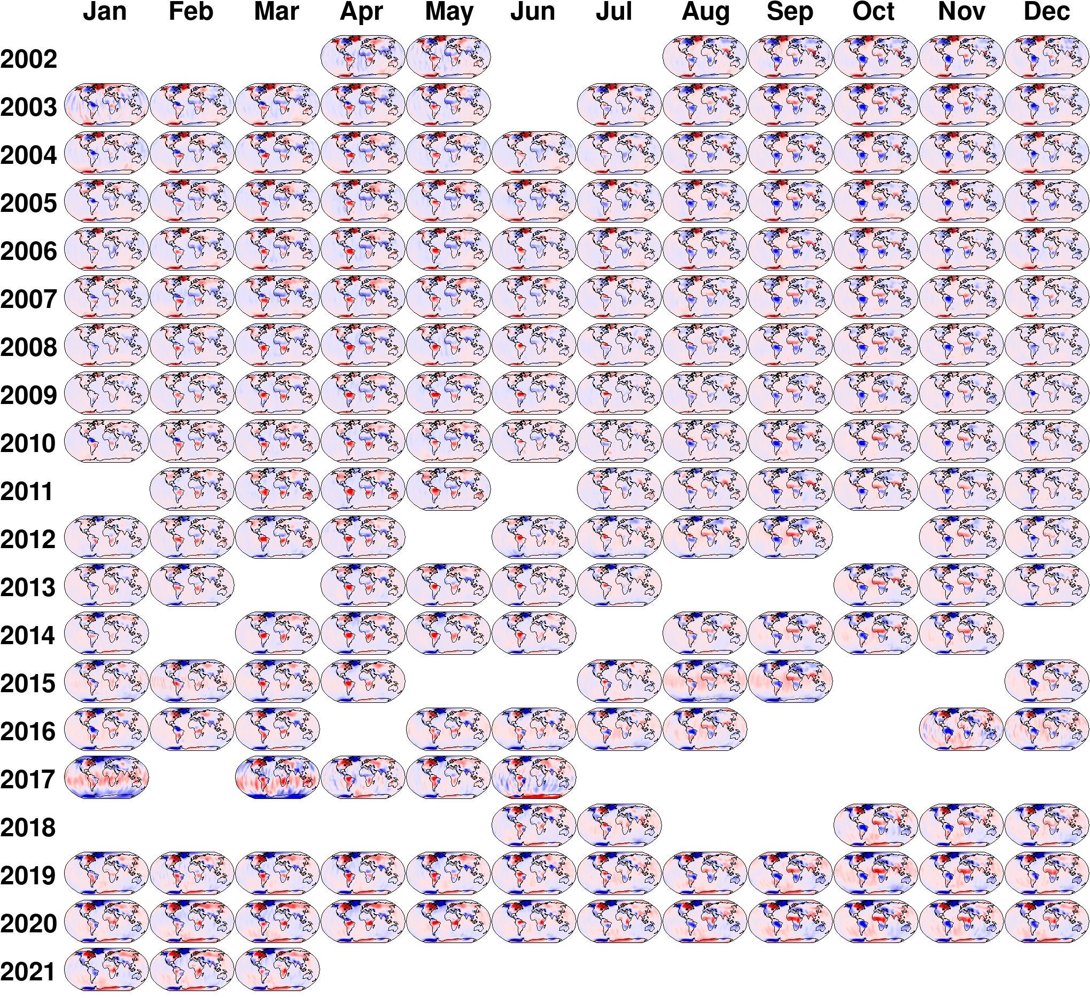
Operational ITSG-Grace2018
ITSG-Grace series of gravity field solutions are computed at Institute of Geodesy, Graz University of Technology.
ITSG-Grace2018
Complete GRACE time series
Evaluation published: Kvas et al. (2019)
ITSG-Grace_operational
Operational processing of GRACE-FO data
Continuation of ITSG-Grace2018
Updated background models
In-house ACT1B products: Behzadpour et al. (2021)
▲ Back to the first page
◄
►

Slide 5
Background models
Force models | ITSG-Grace2018 | ITSG-Grace_operational
Static field + annual + trend | Internal GRACE+GOCE 2017 | GOCO06s
Atmosphere + Ocean | AOD1B RL06 | AOD1B RL06
Hydrology | LSDM (submonthly part) | LSDM (submonthly part)
Astronomical tides | JPL DE421 | JPL DE432
Earth tides | IERS2010 | IERS2010
Ocean tides | FES2014b + GRACE estimates | FES2014b + new GRACE estimates
Atmospheric tides | AOD1B RL06 | AOD1B RL06
Pole tides | IERS2010 (linear mean pole) | IERS2010 (linear mean pole)
Ocean pole tides | Desai 2004 (linear mean pole) | Desai 2004 (linear mean pole)
Relativistic effects | IERS2010 | IERS2010
▲ Back to the first page
◄
►

Slide 6
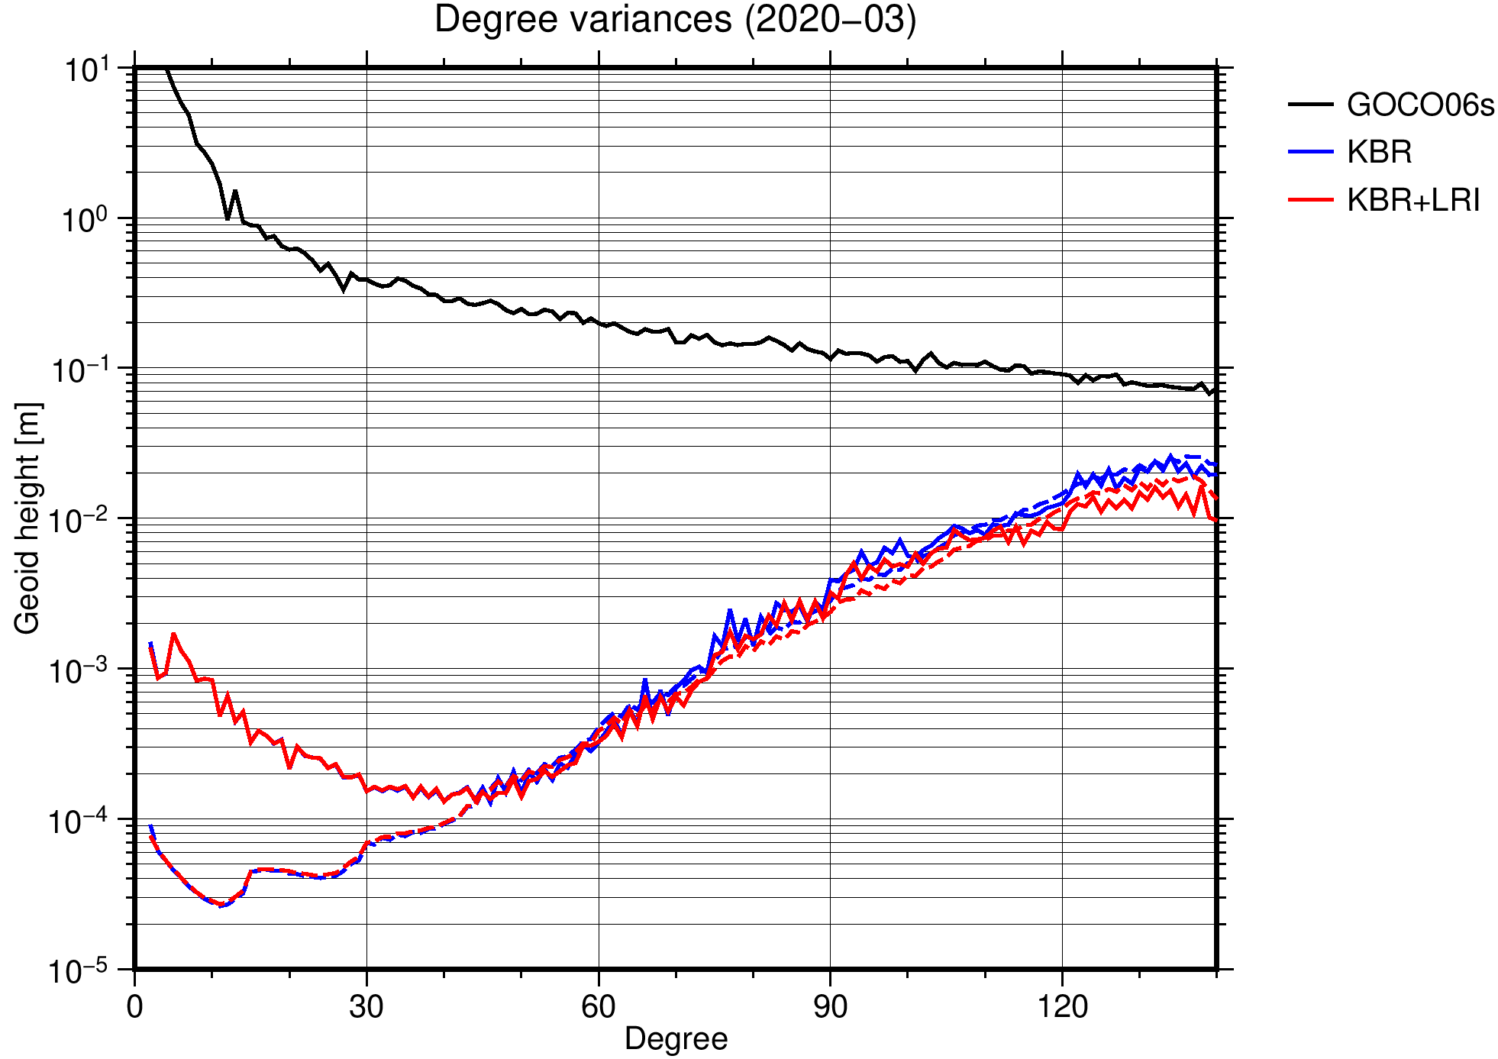
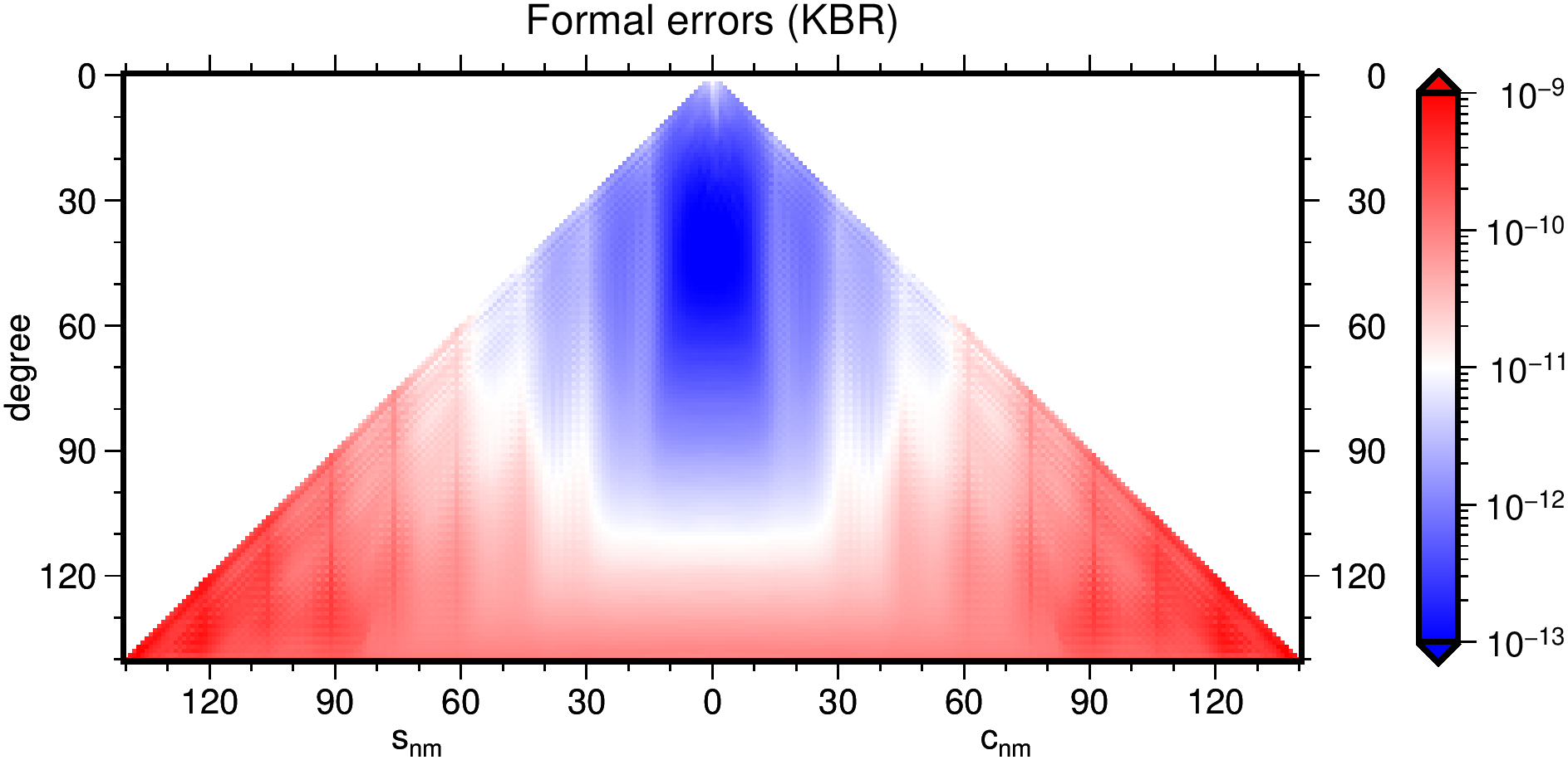
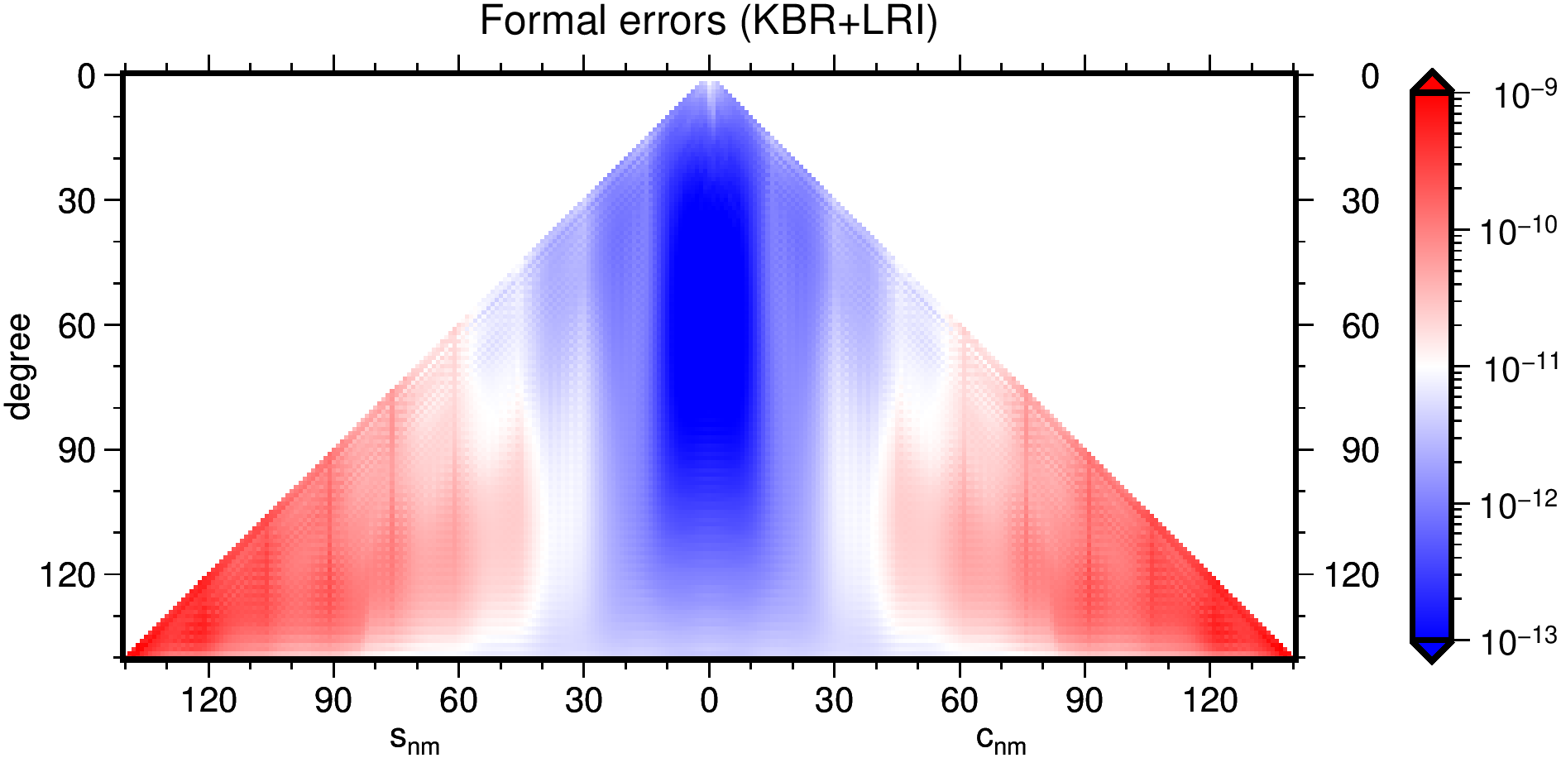
Dual SST gravity field recovery
GRACE-FO has 2 independent low-low satellite-to-satellite tracking (SST) measurements:
K-band Ranging Instrument (KBR),
Laser Ranging Interferometer (LRI).
Combining the two SST observation groups in gravity field modeling:
improves estimation of high-degree spherical harmonic coefficients,
near zonal coefficients for degrees above 60 are better determined.
In the next slides, we discuss the additional steps for dual SST gravity modeling, implemented in ITSG-Grace2018.
▲ Back to the first page
◄
►

Slide 7
LRI data calibration
▲ Back to the first page
◄
►

Slide 8
Calibration approach
LRI calibration: Developing a calibration approach that is compatible with different processing strategies throughout the mission and ensures high quality and consistent LRI1B data sets.
Calibration steps : (1) data screening and a-priori calibration
(2) co-estimation of calibration parameters in dual SST gravity field recovery
Calibration equation:
$${\dot{ρ}}_{cal}=S{\dot{ρ}}_{obs}+b$$
LRI Scale factor (1,2):
Estimation: once per day
Parameterization: uniform cubic B-splines (UCBS), with a 1.5h knot interval
LRI Time bias (1,2):
Estimation: once per day
Parameterization: uniform cubic B-splines (UCBS), with a 1.5h knot interval
▲ Back to the first page
◄
►

Slide 9
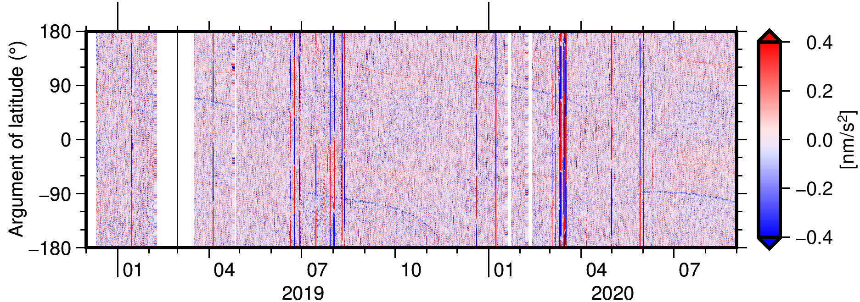
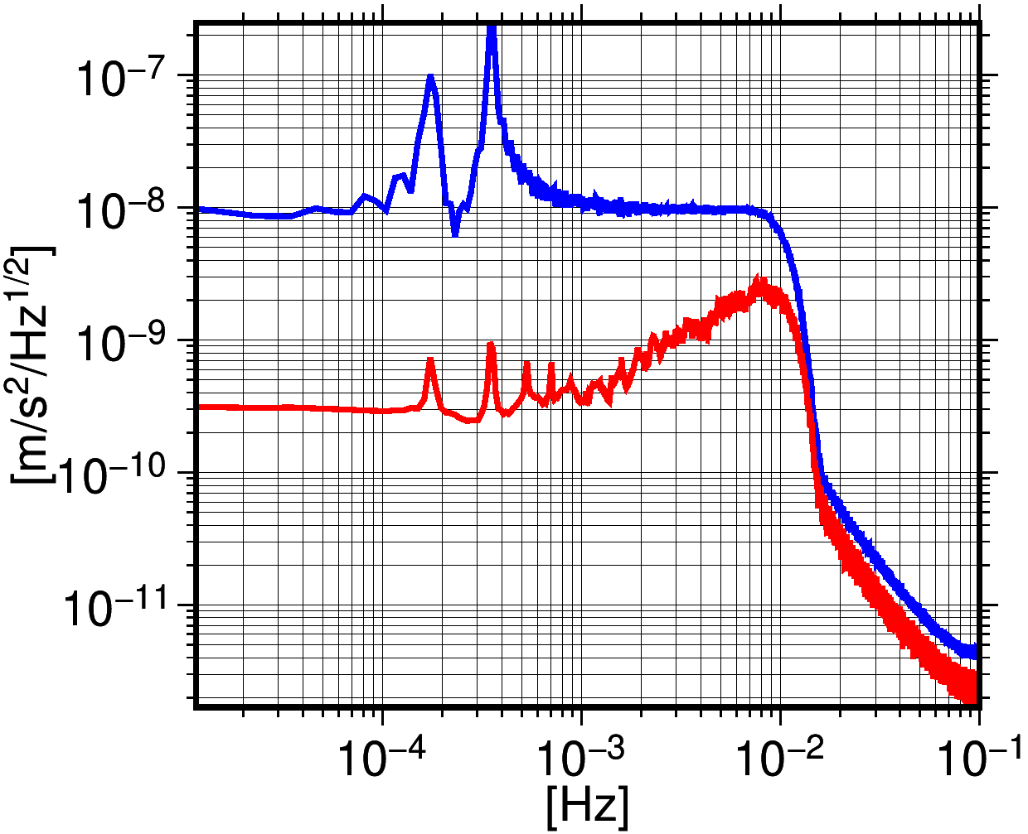
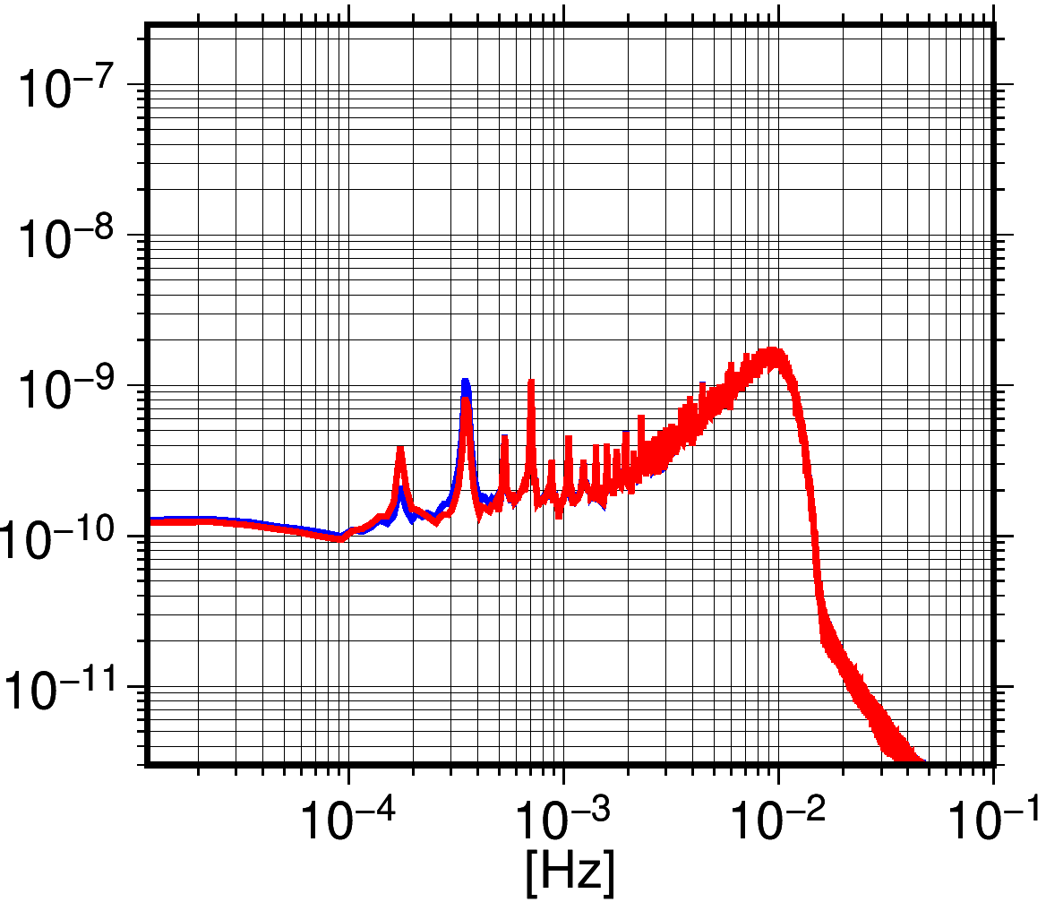
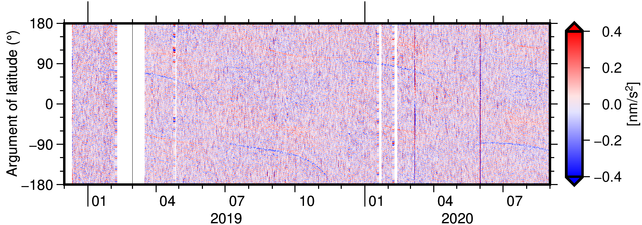
Calibration of LRI1B v04
LRI1B v04 a-priori calibration is based on KBR1B data.
The calibration mitigates the remaining systematics in the original LRI1B v04 (until June 2020, first processing update) due to the LRI time offset and scale factor.
Difference between LRI and KBR range accelerations before (top) and after (bottom) calibration in time domain (low-pass filter applied).
2019-06
2020-09
v04 – KBR
cal – KBR
Difference between LRI and KBR range accelerations before (blue) and after (red) calibration in spectral domain (low-pass filter applied).
▲ Back to the first page
◄
►

Slide 10
Stochastic modeling
▲ Back to the first page
◄
►

Slide 11
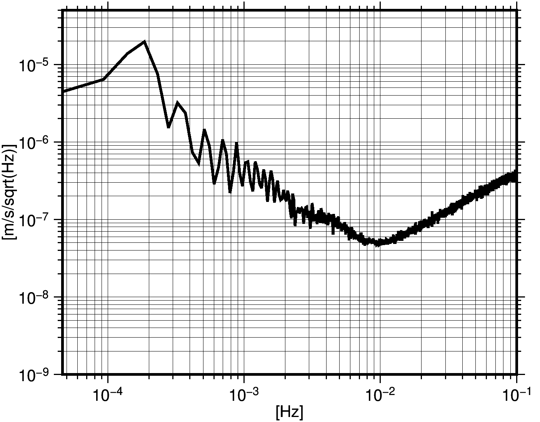
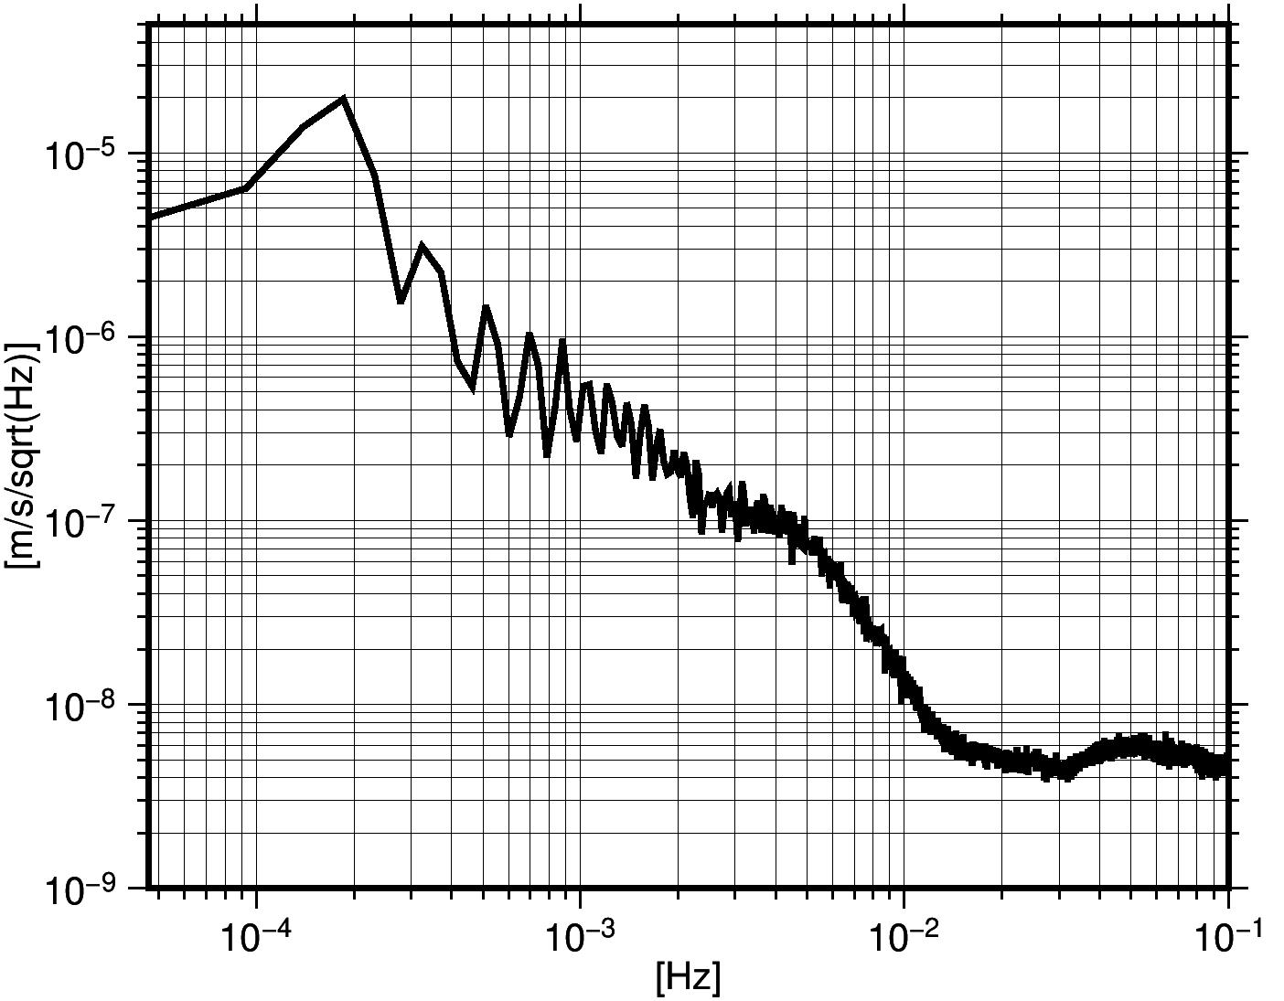
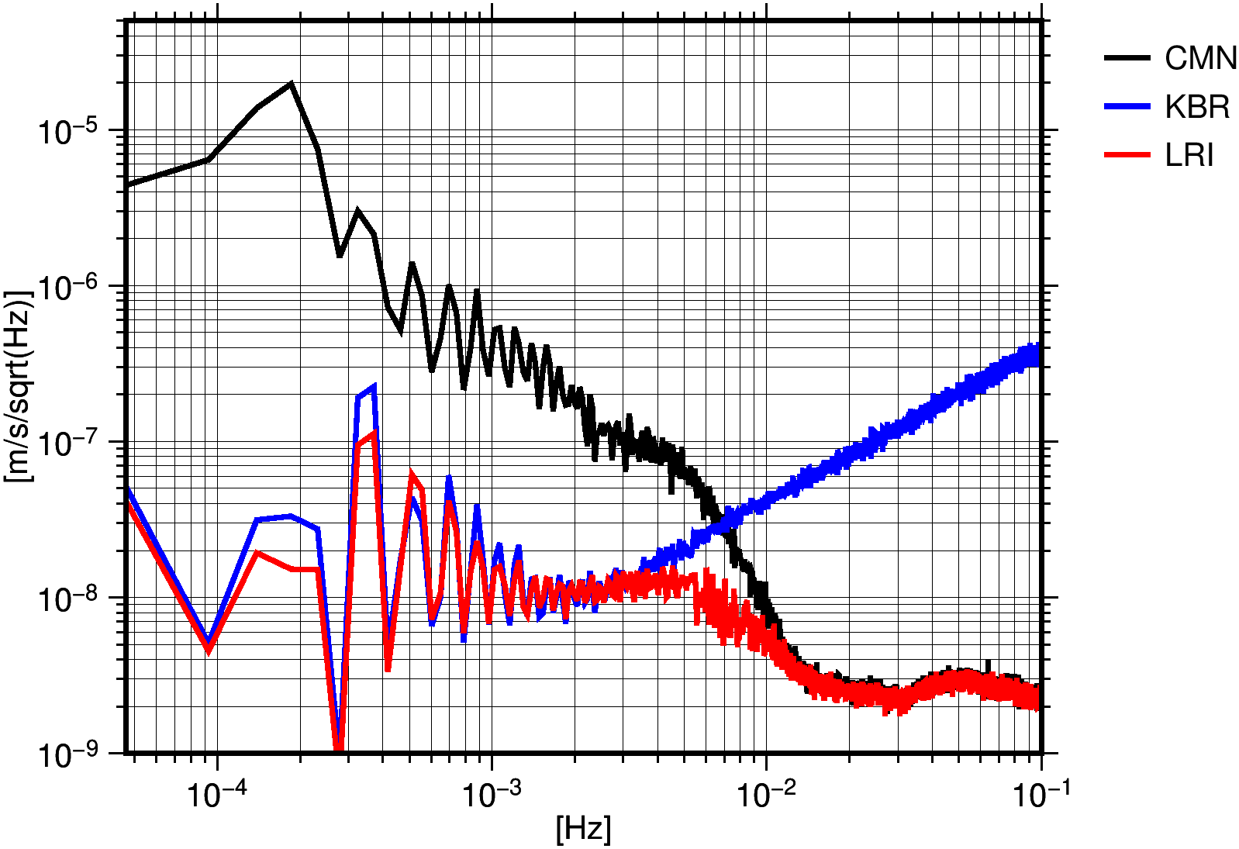
Stochastic observation model
The observation noise defines the weight matrix in the adjustment and is a superimposition of different sources.
Using KBR and LRI together allows to determine the properties of different noise sources (Kvas et al. 2020)
$∑\left(∆l\right)$ KBR-only
$∑\left(∆l\right)$ LRI-only
$∑\left(∆l\right)$ KBR+LRI
$l_{CMN}$ common signal in both: forward modelled observations which contain ACC/ACT and background model errors.
$$∆l= \left[\begin{matrix}l_{KBR}−l_{CMN} \\ l_{LRI}−l_{CMN}\end{matrix}\right]=\left[\begin{matrix}l_{KBR} \\ l_{LRI}\end{matrix}\right]−\left[\begin{matrix}l_{CMN} \\ l_{CMN}\end{matrix}\right]$$
$∑(∆l)= \left[\begin{matrix}∑_{KBR} & 0 \\ 0 & ∑_{LRI}\end{matrix}\right]$+$\left[\begin{matrix}∑_{CMN} & ∑_{CMN} \\ ∑_{CMN} & ∑_{CMN}\end{matrix}\right]$
Covariance models for 3 observation groups are determined with variance component estimation (VCE, e.g., Koch 1980, Ellmer 2018)
▲ Back to the first page
◄
►

Slide 12
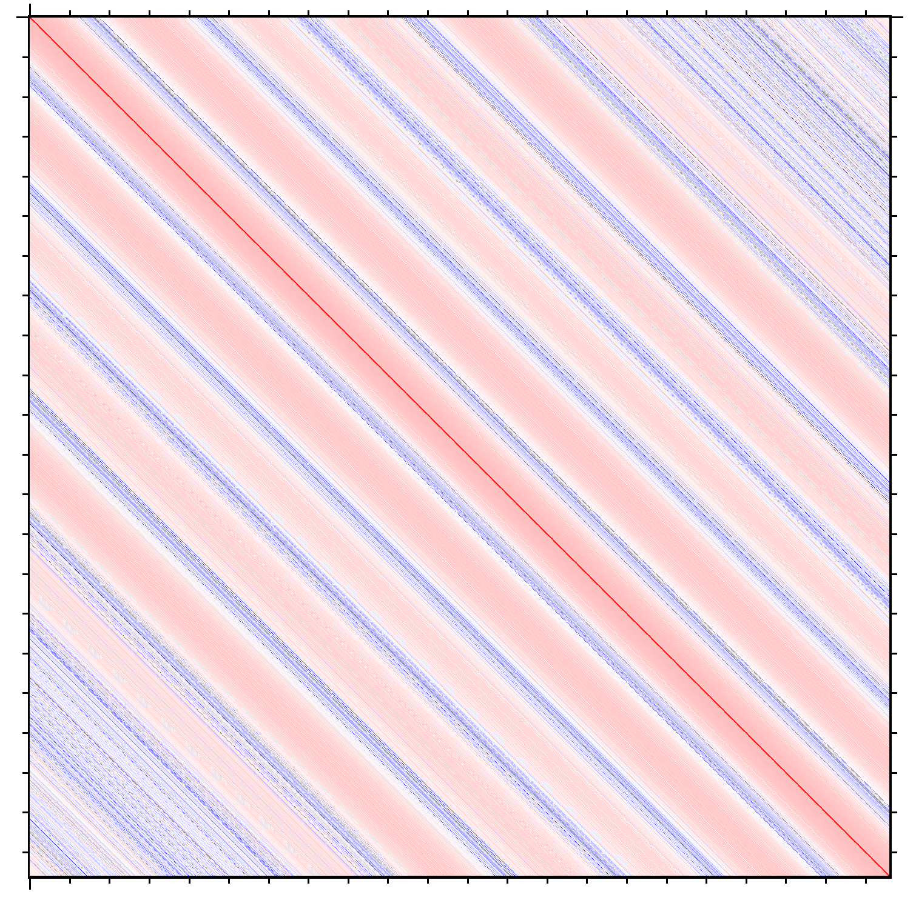
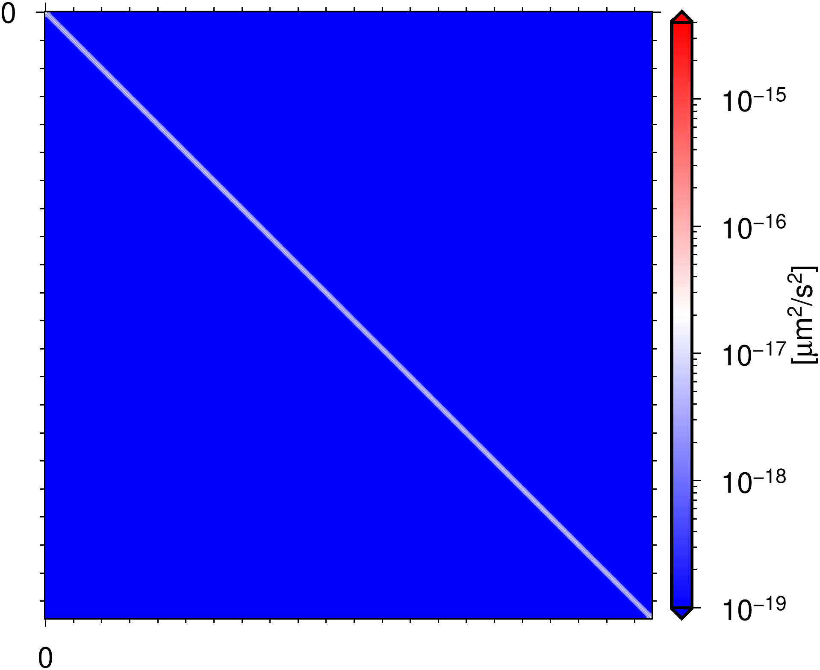
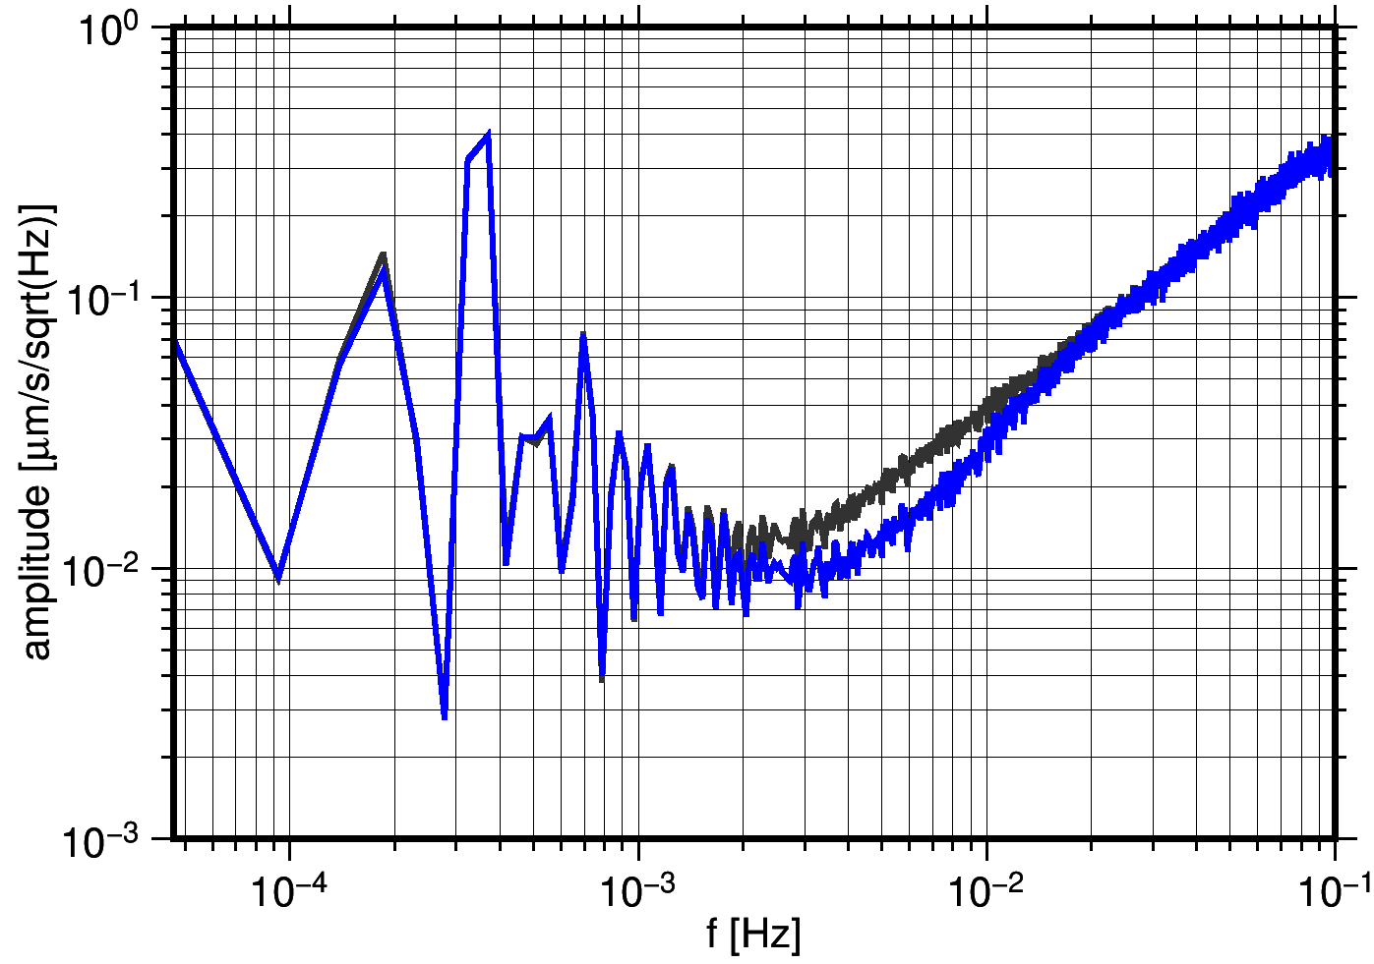
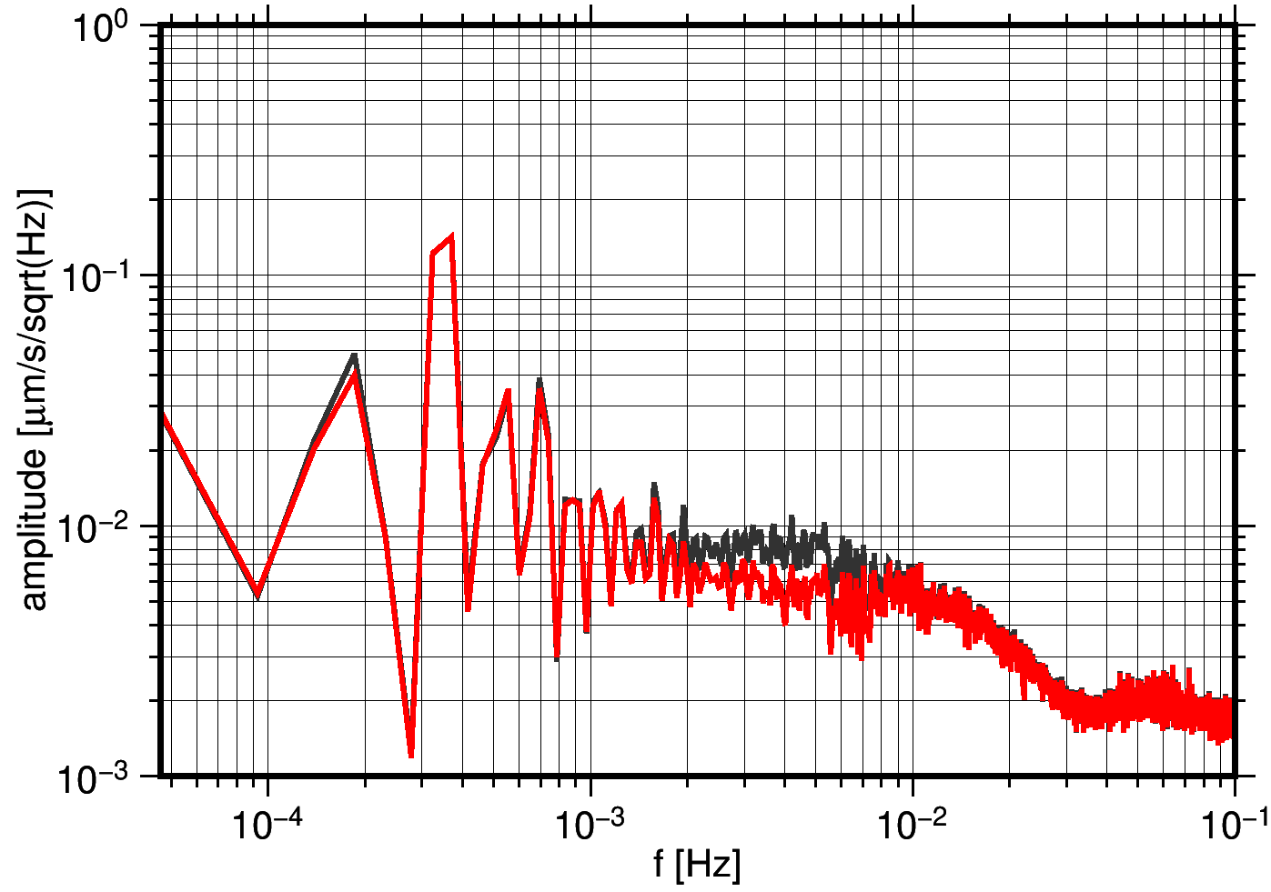
Stochastic observation model
CMN and LRI noise models are considered to be stationary.
KBR noise includes antenna offset correction (AOC) noise:
Attitude uncertainities propagation to AOC (Ellmer, 2018).
Considering AOC noise reduces KBR and LRI error ASDs in 2-10 mHz frequency band.
$$∑_{KBR}$$
$$∑_{AOC}$$
$$\text{KBR}$$
$$\text{LRI}$$
Include AOC covariance
Exclude AOC covariance
▲ Back to the first page
◄
►

Slide 13
Postfit residual analysis
▲ Back to the first page
◄
►

Slide 14
Separation of KBR, LRI, and CMN Residuals
We can use the determined KBR, LRI, and CMN covariance functions to split the postfit residuals into individual components through collocation (Kvas et al. 2020).
Individual components are linear transformations of post-fit residuals.
$$\left[\begin{matrix}r_{KBR} \\ r_{LRI}\end{matrix}\right]= \left[\begin{matrix}I & 0 & I \\ 0 & I & I\end{matrix}\right]\left[\begin{matrix}e_{KBR} \\ e_{LRI} \\ e_{CMN}\end{matrix}\right]$$
$$\left[\begin{matrix}e_{KBR} \\ e_{LRI} \\ e_{CMN}\end{matrix}\right]=\left[\begin{matrix}∑_{KBR} & 0 & 0 \\ 0 & ∑_{LRI} & 0 \\ 0 & 0 & ∑_{CMN}\end{matrix}\right]{\left[\begin{matrix}I & 0 \\ 0 & I \\ I & I\end{matrix}\right]\left[\begin{matrix}{∑_{KBR}+∑}_{CMN} & ∑_{CMN} \\ ∑_{CMN} & {∑_{LRI}+∑}_{CMN}\end{matrix}\right]}^{−1}\left[\begin{matrix}r_{KBR} \\ r_{LRI}\end{matrix}\right]$$
Individual residuals can be used to study instrument related effects. However, as the contrast is not perfect, there is leakage between the noise sources.
Multiresolution analysis (MRA) is applied to decompose each residual component into different frequency bands to study their temporal, spatial, and orbit-related features (Behzadpour et al. 2019).
▲ Back to the first page
◄
►

Slide 15
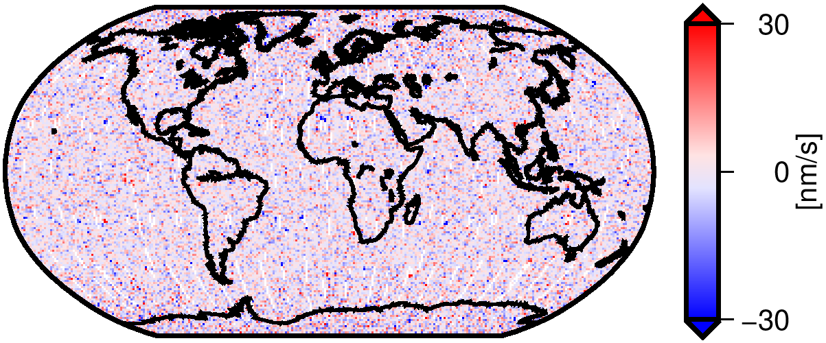
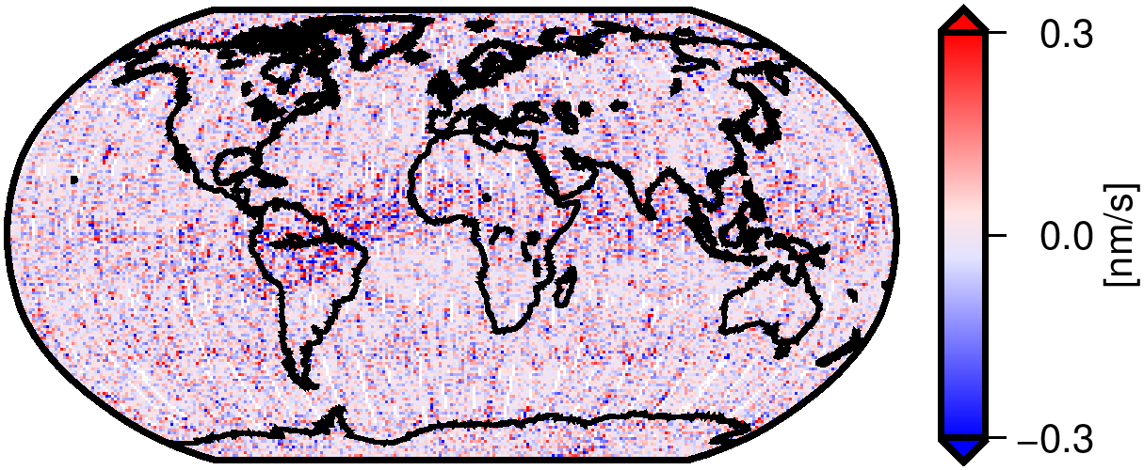
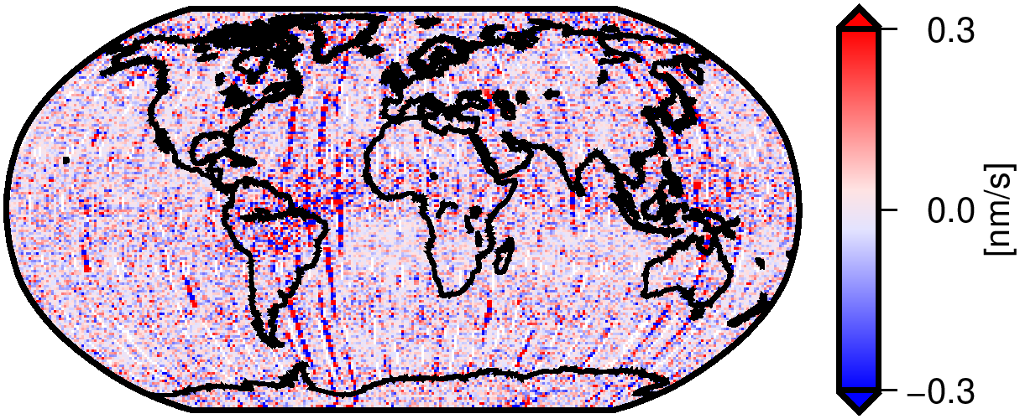
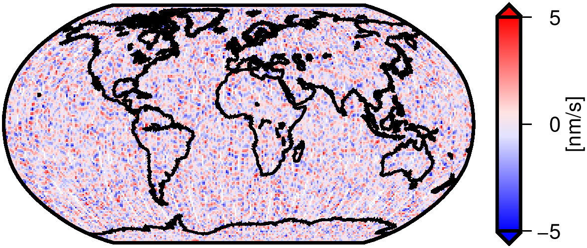
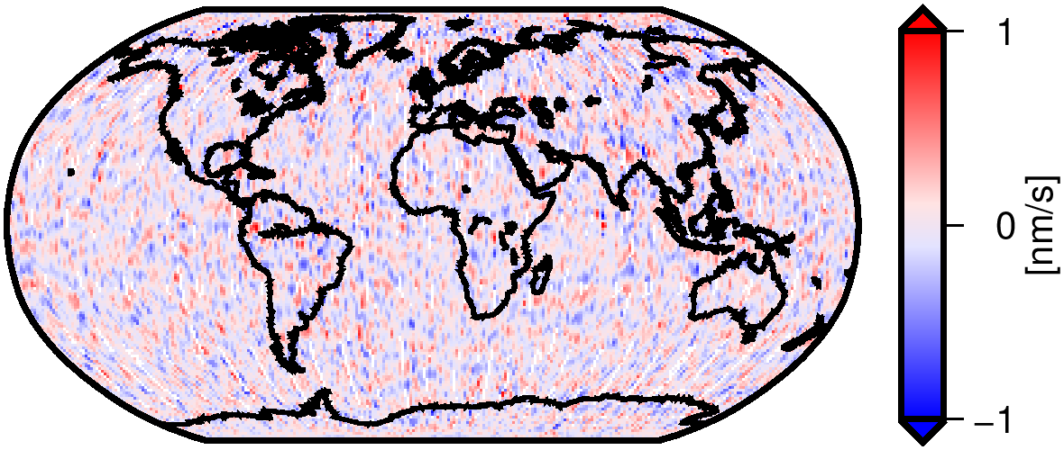
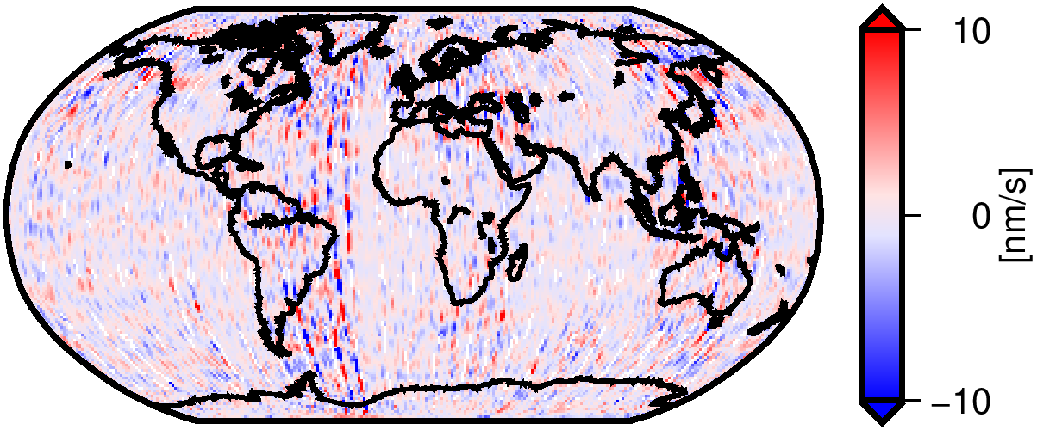
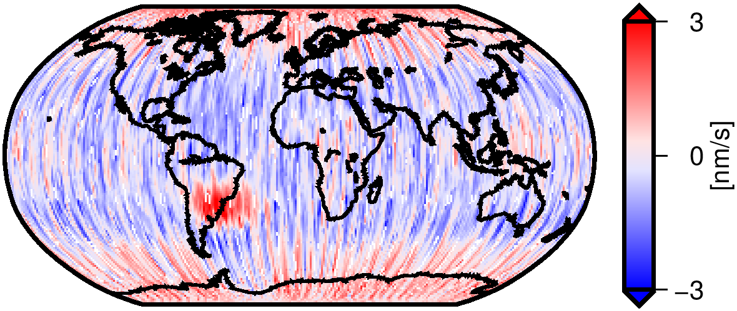
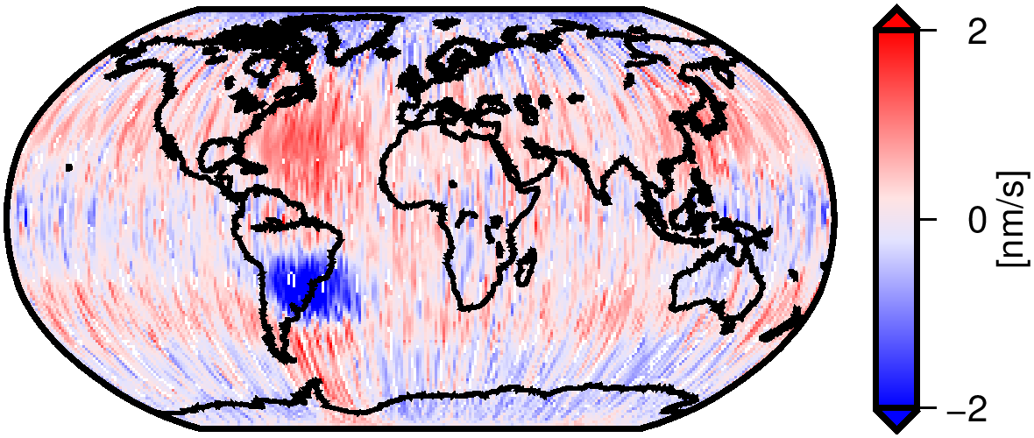
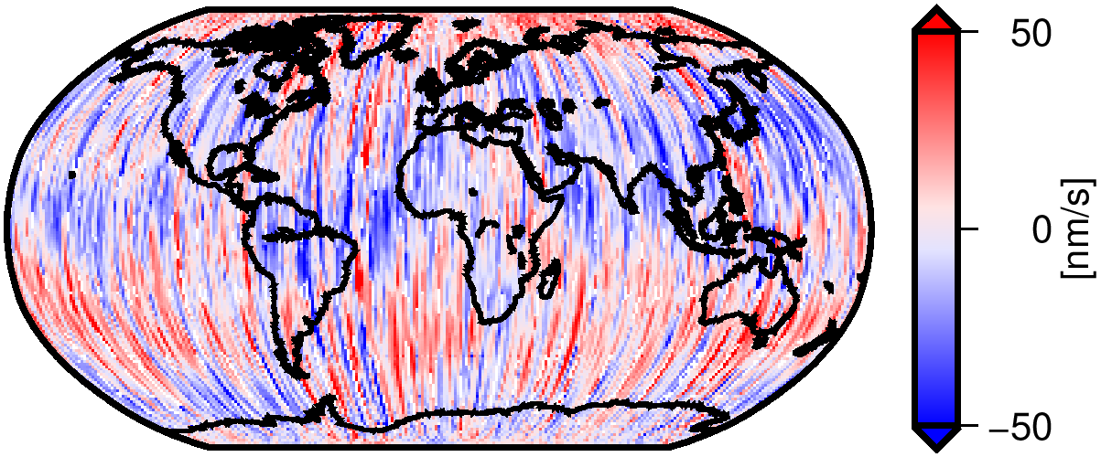
Residual decomposition (February 2021)
$$\text{KBR}$$
$$\text{LRI}$$
$$\text{CMN}$$
f > 12.5 mHz
3.1 < f <12.5 mHz
0.4 < f < 3.1 mHz
▲ Back to the first page
◄
►

Slide 16
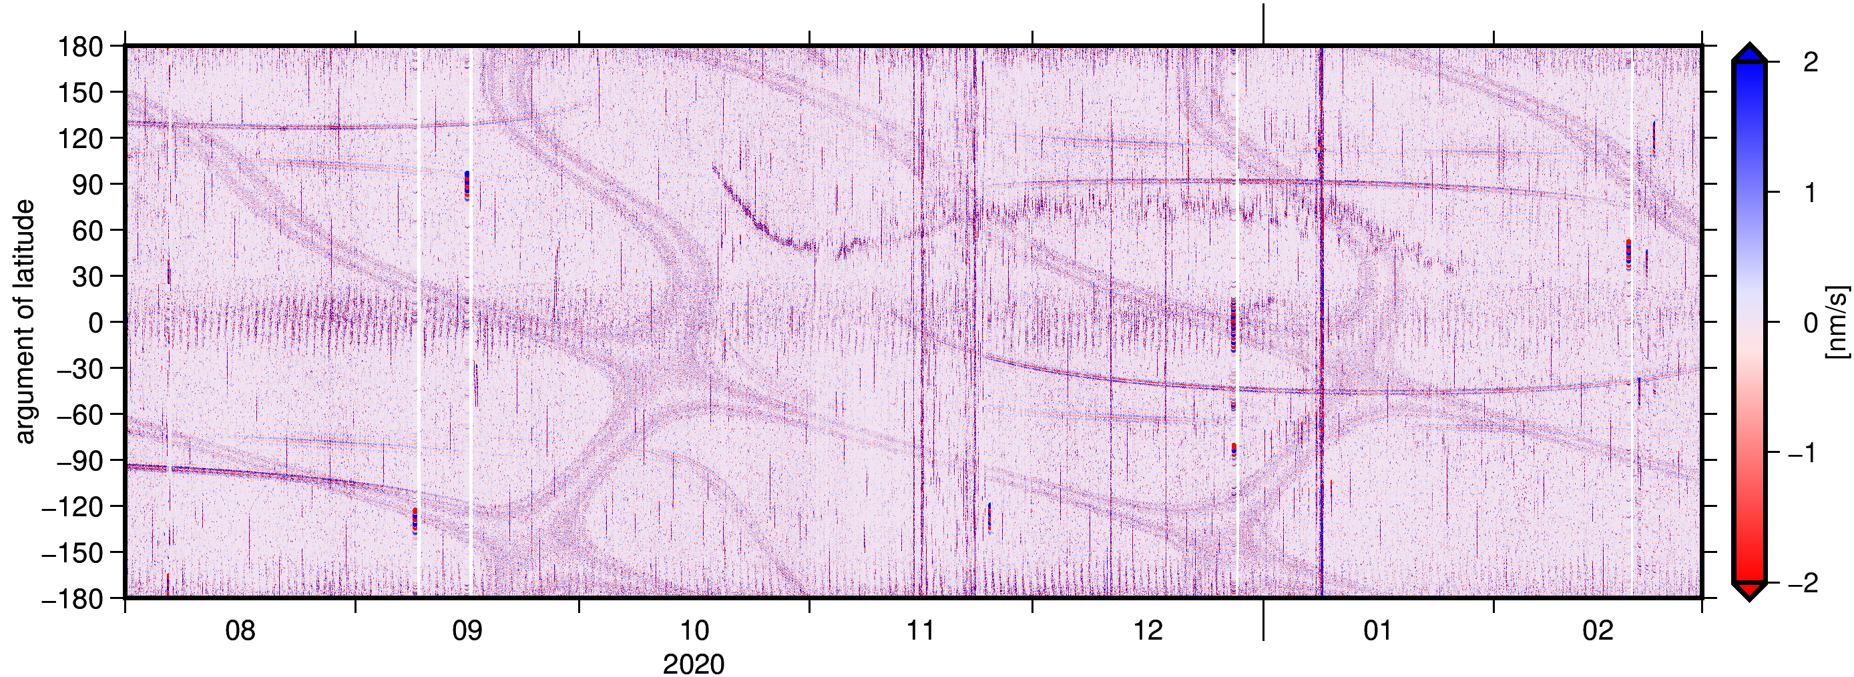
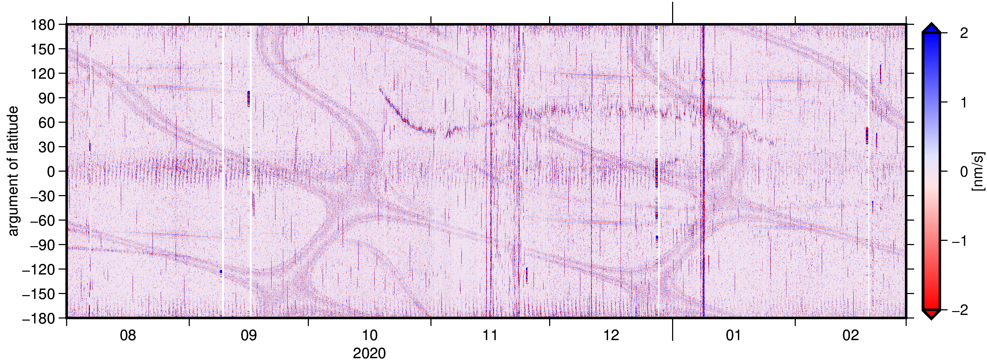
Residual analysis
Systematic errors are visible in CMN residuals due to eclipse transits.
These events are time-indexed beforehand. Their waveform is nearly constant within a month and can be approximated by a polynomial.
We set up and estimate the coefficients of this polynomial as additional instrument calibration parameters for CMN observations in the gravity field adjustment.
CMN residuals at frequencies above 12.5 mHz with (top) and without (bottom) parametrization of the eclipse transit events.
▲ Back to the first page
◄
►

Slide 17
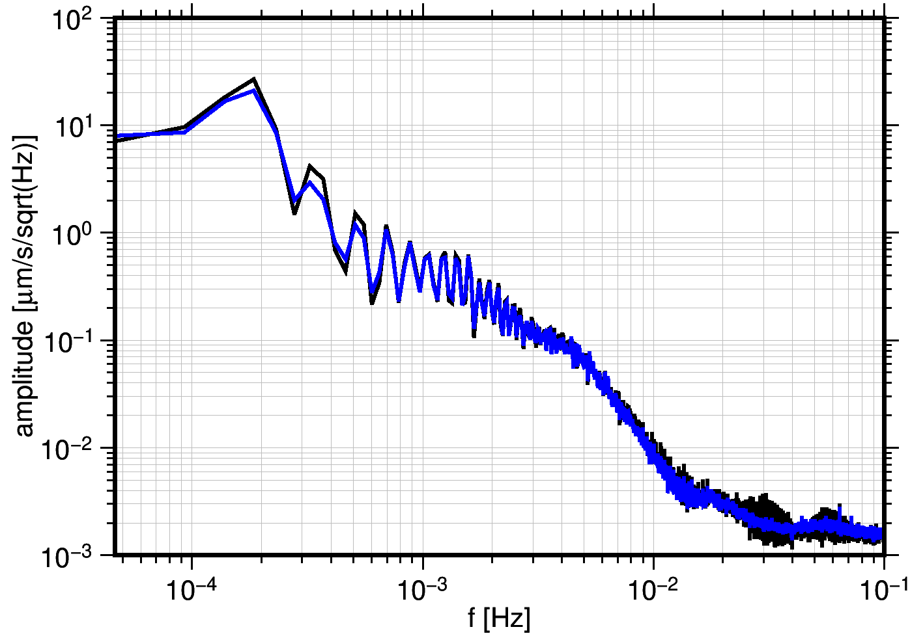
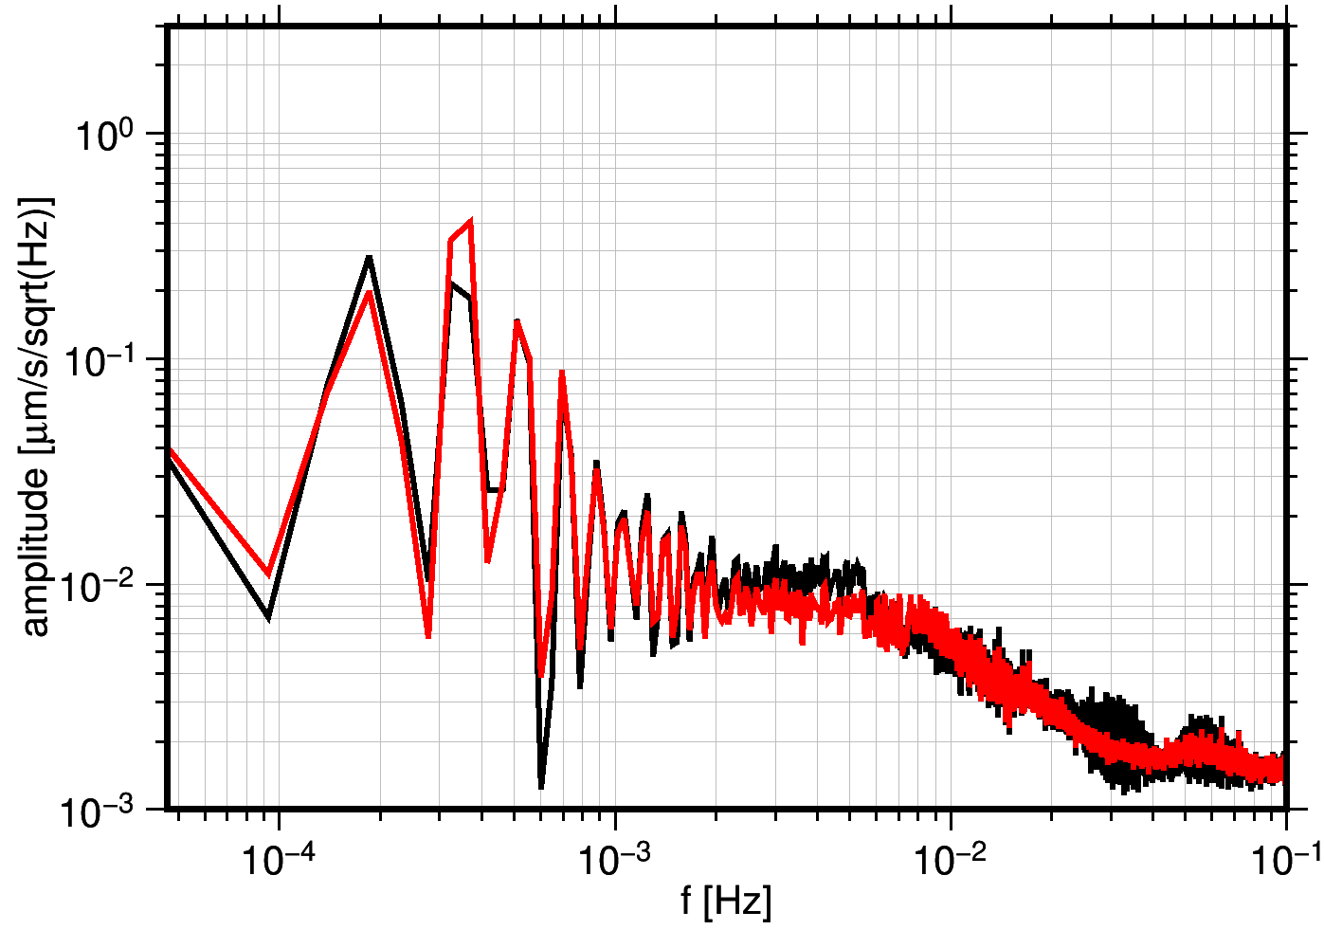
Residual analysis
Considering eclipse transit parametrization reduces CMN and LRI error ASDs in frequency band above 12.5 mHz.
$$\text{CMN}$$
$$\text{LRI}$$
Include parametrization
Exclude parametrization
▲ Back to the first page
◄
►

Slide 18
Summary
The aim of this study is to incorporate the two ranging systems (LRI and KBR) in the ITSG-Grace2018 gravity field model.
LRI1B data calibration mitigates the remaining systematics in the original LRI1B v04 due to the LRI time offset and scale factor.
Using KBR and LRI together allows to separate common noise sources from instrument specific ones. In other words, ACC/ACT and background model errors can be disentangled from ranging errors.
The separation of post fit residuals enables a closer inspection of the measurements.
Systematic errors in CMN components due to eclipse transits can be reduced by co-estimation of parametric models.
▲ Back to the first page
◄
►

Slide 19
References
Behzadpour, S., Mayer‐Gürr, T., & Krauss, S. (2021). GRACE Follow‐On accelerometer data recovery. Journal of Geophysical Research: Solid Earth, 126, e2020JB021297. https://doi.org/10.1029/2020JB021297
Behzadpour, S., Mayer-Gürr, T., Flury, J., Klinger, B., & Goswami, S. (2019). Multiresolution wavelet analysis applied to GRACE range-rate residuals. Geoscientific Instrumentation, Methods and Data Systems, 8(2), 197–207. https://doi.org/10.5194/gi-8-197-2019
Ellmer, M. (2018). Contributions to GRACE Gravity Field Recovery: Improvements in Dynamic Orbit Integration Stochastic Modelling of the Antenna Offset Correction, and Co-Estimation of Satellite Orientations. Graz: Verlag der Technischen Universität Graz. https://doi.org/10.3217/978-3-85125-646-8
Kvas, A., Behzadpour, S., and Mayer-Guerr, T. (2020): Gravity Field Recovery and Observation Noise Separation from Simultaneous Laser Ranging Interferometer and K-Band Ranging System Measurements, GRACE/GRACE-FO Science Team Meeting 2020, online, 27 October–29 Oct 2020, GSTM2020-14, https://doi.org/10.5194/gstm2020-14
Kvas, A., Brockmann, J., Krauss, S., Schubert, T., Gruber, T., Meyer, U., Mayer-Gürr, T., Schuh, W., Jäggi, A., & Pail, R. (2020). GOCO06s – A satellite-only global gravity field model. Earth System Science Data Discussions, 1-31. https://doi.org/10.5194/essd-2020-192
Kvas, A., Behzadpour, S., Ellmer, M., Klinger, B., Strasser, S., Zehentner, N., Mayer-Gürr, T. (2019). ITSG-grace2018: Overview and evaluation of a new GRACE-only gravity field time series. Journal of Geophysical Research: Solid Earth, 124 (8), 9332-9344.
Landerer, F. W., Flechtner, F. M., Save, H., Webb, F. H., Bandikova, T., Bertiger, W. I., . . . Yuan, D.-N. (2020). Extending the global mass change data record: GRACE follow-on instrument and science data performance. Geophysical Research Letters, 47 (12).
Wen, H. Y., Kruizinga, G., Paik, M., Landerer, F., Bertiger, W., Sakumura, C., McCullough, C. (2019). Gravity Recovery and Climate Experiment Follow-On (GRACE-FO) Level-1 Data Product User Handbook (Tech. Rep. No. JPL D-56935 (URS270772)). Jet Propulsion Laboratory, Pasadena, California.
▲ Back to the first page
◄
►

Slide 20
Thank you for your attention!
Funding provided by:
the Austrian Research Promotion Agency
the European Union’s
Horizon 2020 research and innovative programme
under grant agreement No. 870353
HORIZON 2020
▲ Back to the first page

