Slide 1
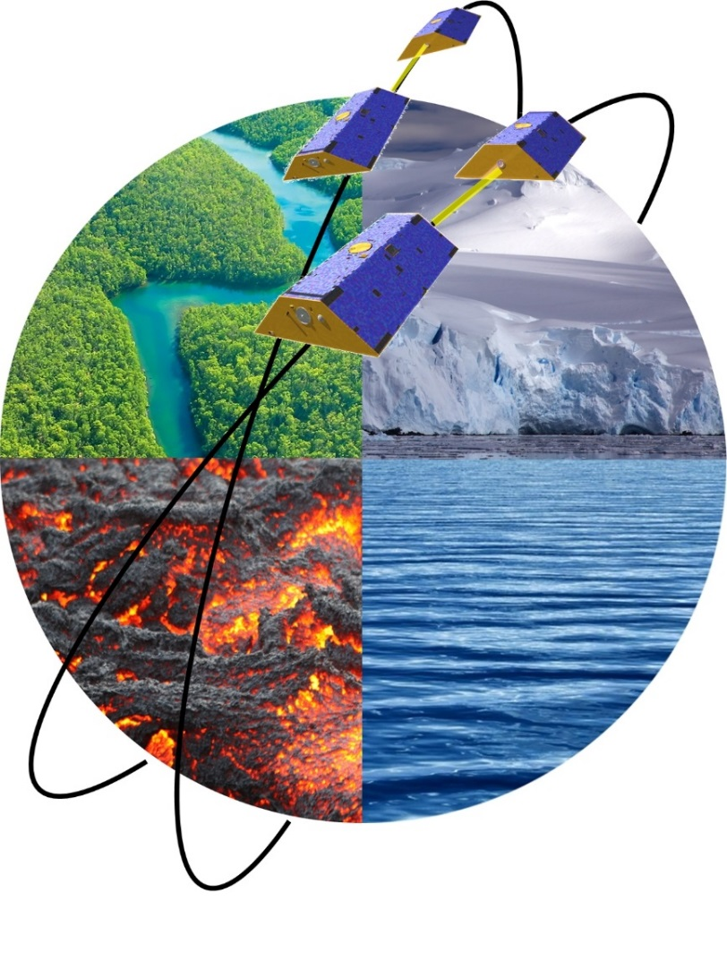

Future Gravity Mission Concepts for Sustained Observation of Mass Transport
in the Earth System
Roland Pail
Chair of Astronomical and Physical Geodesy
Technical University of Munich, Germany
vEGU 2021 G4.1| EGU-9447 | R. Pail | 30-04-2021

Slide 2
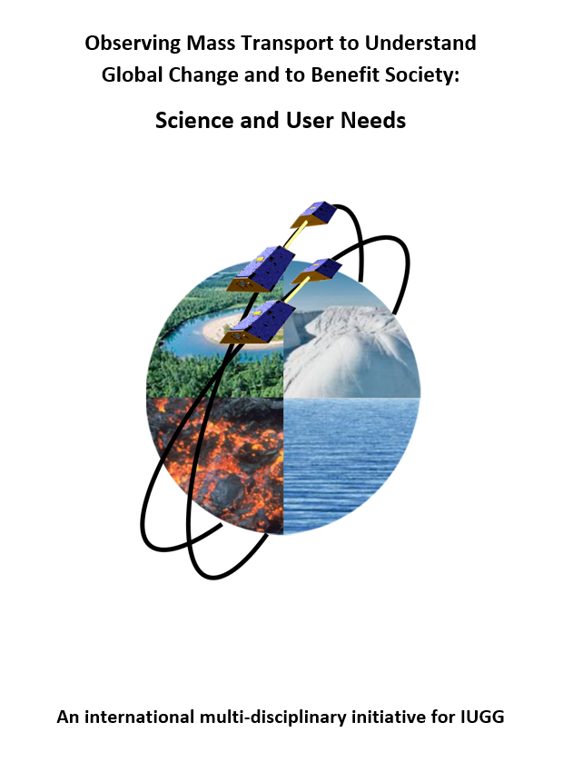
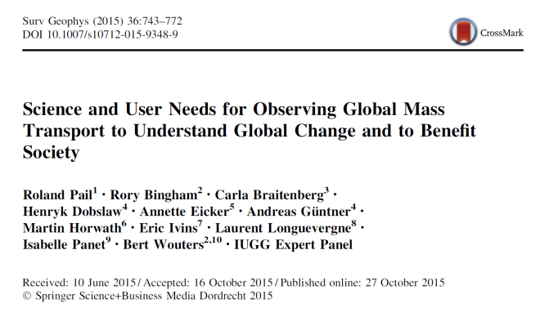
User Study by International Union of Geodesy and Geophysics (IUGG) 2015
1. Final Report: DGK Series B
2. Paper: Pail et al. 2015, Surveys in
Geophysics, 36(6):743-772
3. IUGG Resolution 2015
“The international science community, represented by IUGG, urges International and national institutions, agencies and governmental bodies in charge of supporting Earth science research to make all efforts to implement long-term satellite gravity and magnetic observation constellations with high accuracy that respond to the aforementioned need for sustained observation.”
→ User community letter to
NASA, ESA and EC in 2016
http://dgk.badw.de/

Slide 3
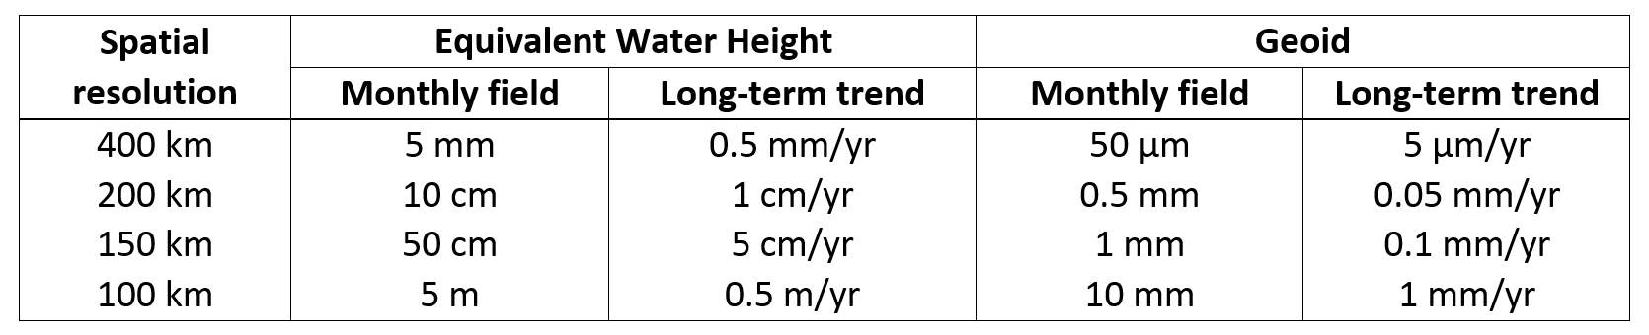

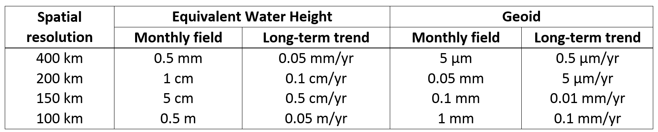
Consolidated Science and User Needs
… expressed in numbers
Threshold
In combination with GRACE & GRACE-FO more reliable estimates of trends
Improved spatial resolution
Improved temporal resolution: reduction of aliasing
Target
Significant leap forward
Significantly increased spatial and temporal resolution
New applications (science, societal benefit)

Slide 4



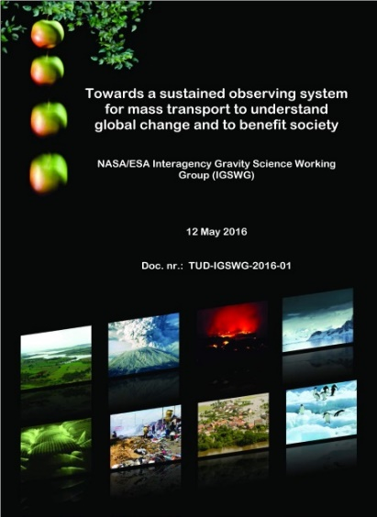
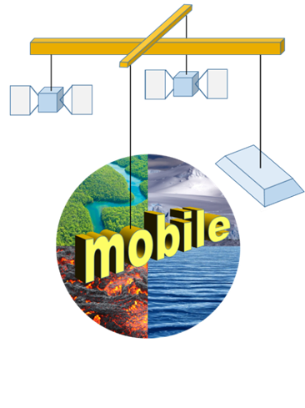
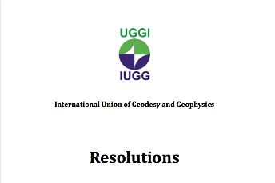
Future missions: cooperation ESA+NASA
Science and User Needs
NASA/ESA Interagency Gravity Science Working Group
Mission proposals
e-.motion² (ESA EE9; double pair)
MOBILE (ESA EE10; high-low tracking)
NASA/ESA joint activities
NASA Mass Change Designated Observable (MCDO) study
ESA Next-Generation Gravity Mission (NGGM) study, MAGIC Phase A

Slide 5
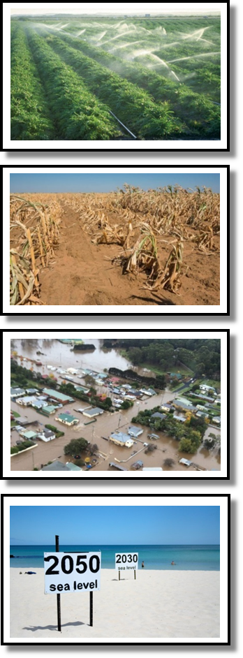
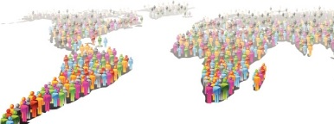
User needs vs. mission requirements & architectures
Target
Extension of time series
Higher spatial resolution
Higher temporal resolution
→ Only new mission concepts will meet these science and user needs

Slide 6
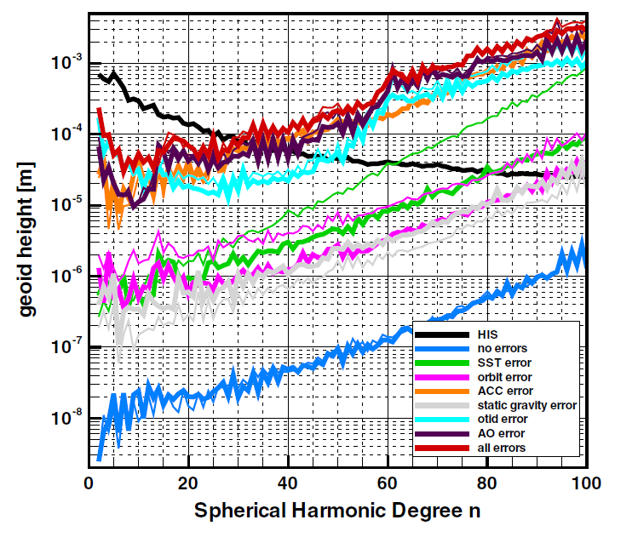
Main contributors to error budget
accelerometer error
ocean tide aliasing
atmosphere & ocean aliasing
Instrument errors are currently not the limiting factor of gravity field performance.
(Flechtner et al. 2016)

Slide 7
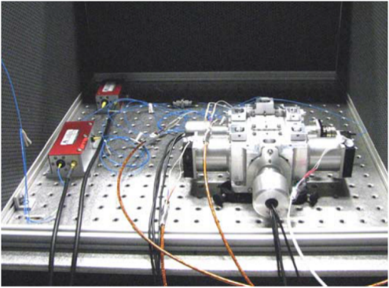
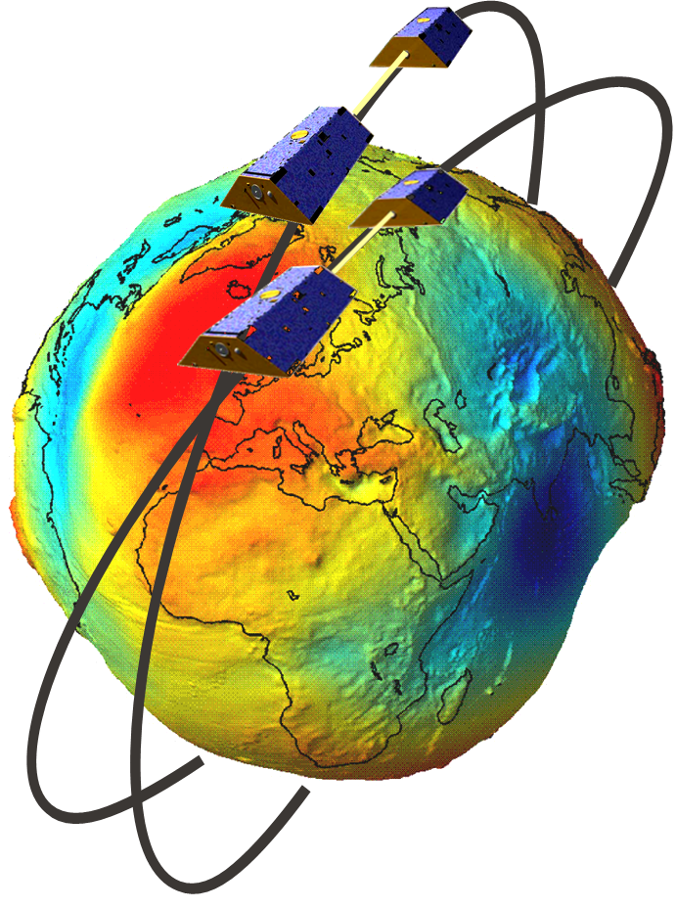
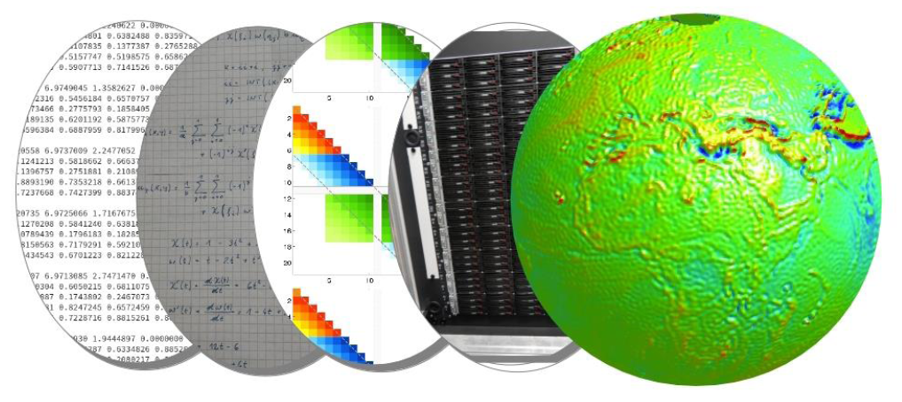
Future mission concepts: potential for improvements
New/improved measurement technologies
Improved inter-satellite ranging: KBR vs. LRI
Improved technologies of accelerometry/gradiometry
High-precision optical clocks
Improved thruster technologies; AOCS
Satellite formations
Improved spatial and temporal resolution due to
formation flights in a certain constellation
Reduction of temporal aliasing effects
Processing & combination with complementary geophysical models
De-aliasing by means of improved spatial-temporal parameterization
Improved separation of signals due to complementary information
Integrate models of the complex system Earth

Slide 8
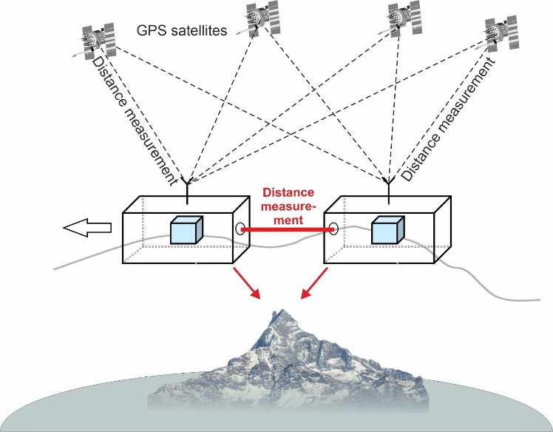
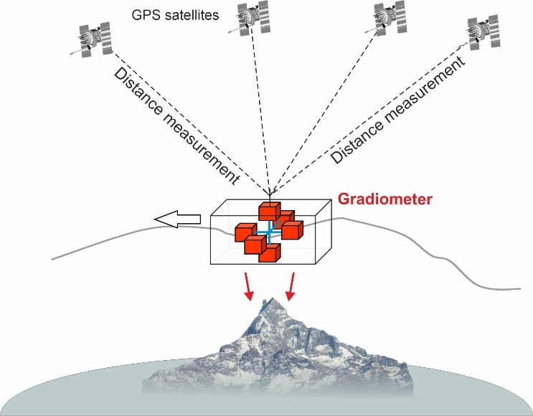
1. New sensors: the role of accelerometry (ACC)
Single or multi inline pair missions
Measuring the non-gravitational accelerations, to be reduced
from ranging measurements
Gradiometry missions
Measuring differences of gravitational accelerations (‘differential
mode’)
Plus measuring non-gravitational accelerations (‘common mode’)
→ drag-free control, [attitude determination]

Slide 9
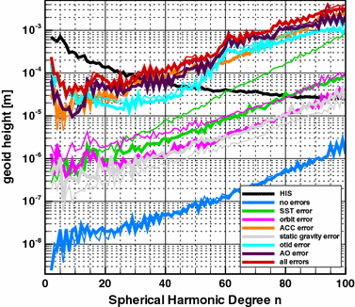
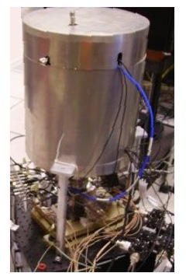
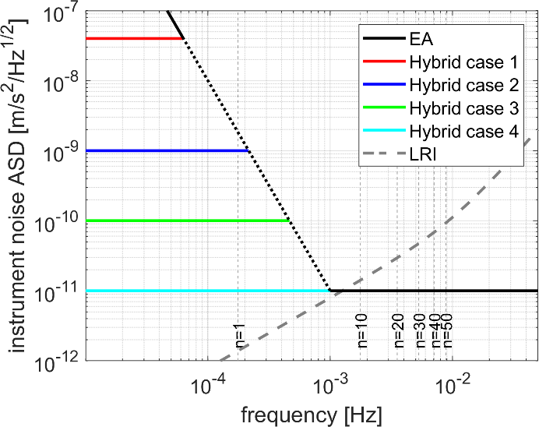
1. New measurement technologies / accelerometry
Main error contributors to temporal gravity fields
ONERA: Hybridization of electro-static (ES) accelerometer and cold atom interferometer (CAI)
Numerical simulation of gravity field retrieval
  Single-pair mission (350 km altitude)
  LRI ~ GRACE-FO (40 nm/√Hz)
(Flechtner et al. 2016)

Slide 10
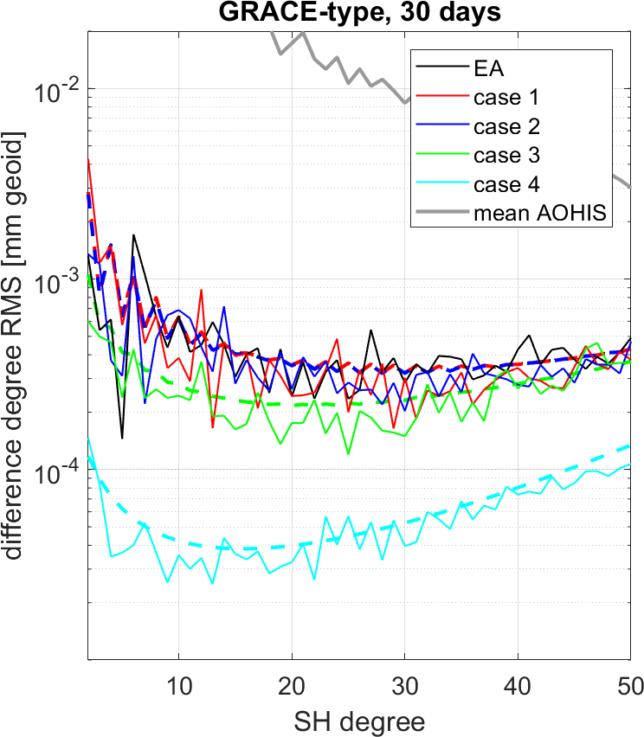
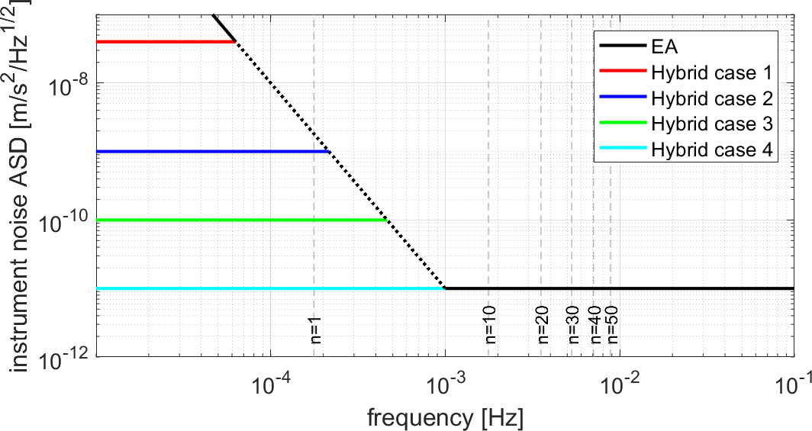
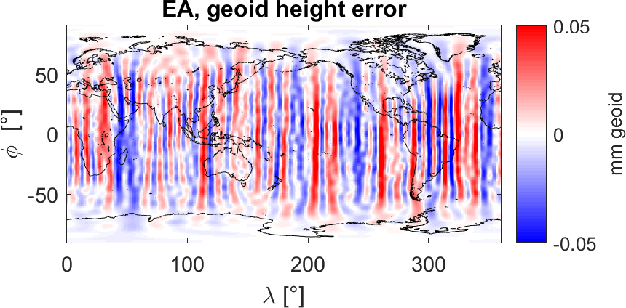
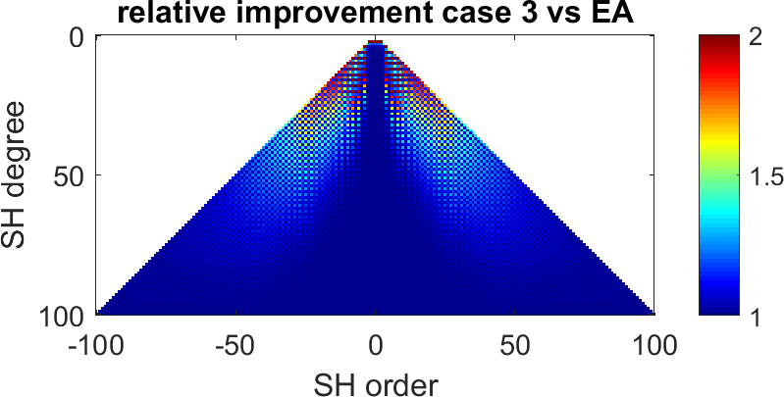
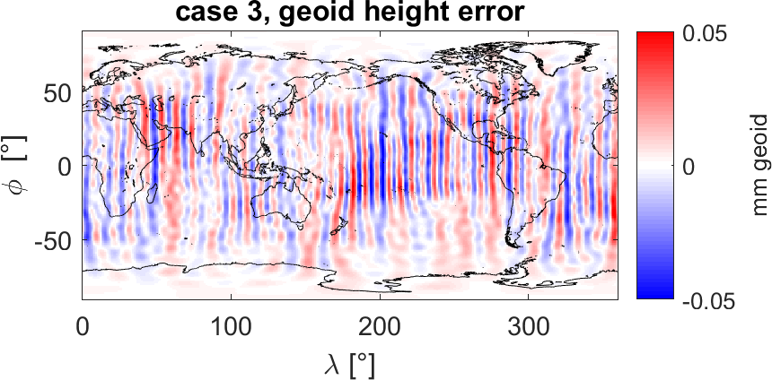
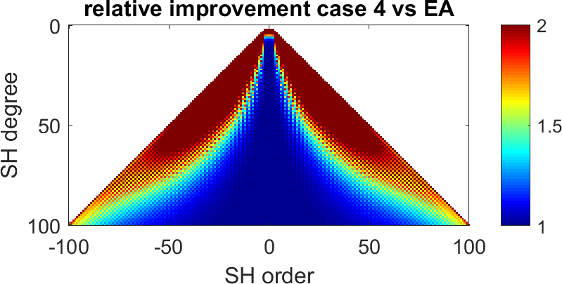
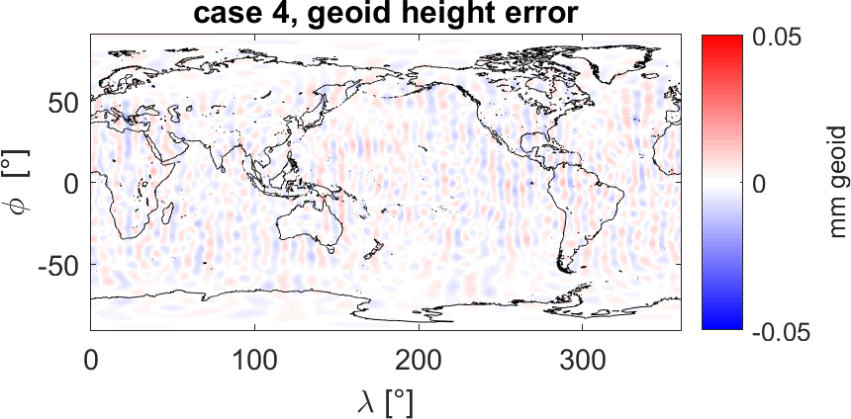
1. ACC: retrieval performance: instrument noise + static gravity field
Abrykosov P, Pail R., Gruber T. et al. (2019): Impact of a novel hybrid accelerometer on satellite gravimetry performance. Advances in Space Research 63 (10), 3235 - 3248

Slide 11
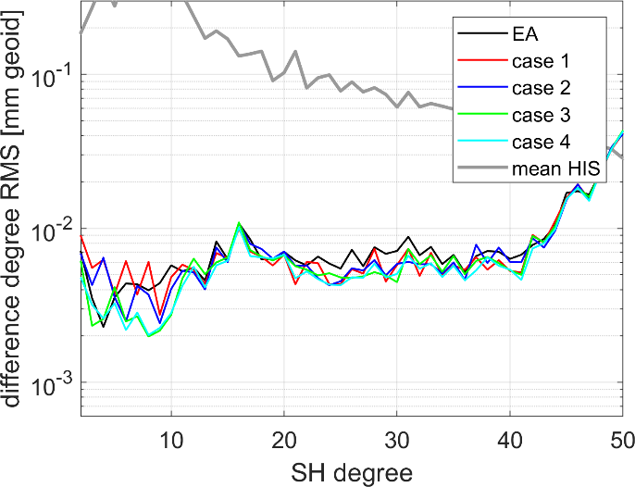
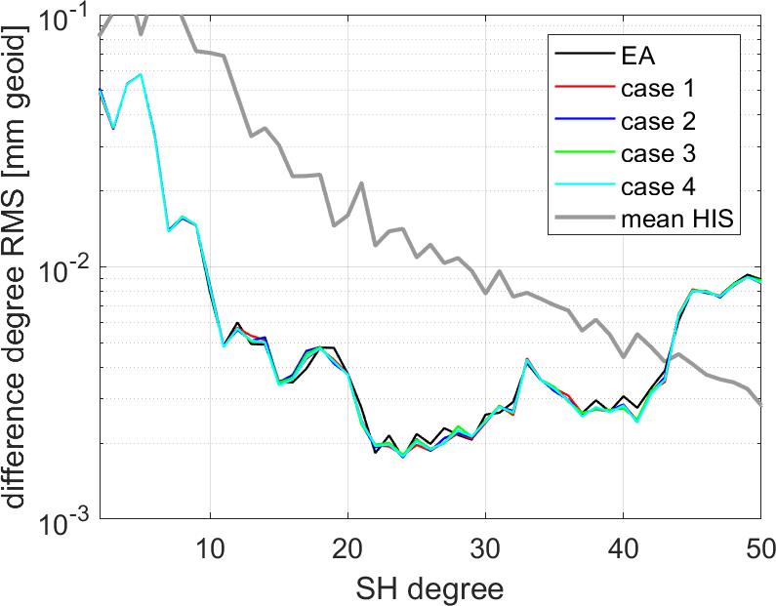
1. ACC: retrieval performance: temporal gravity field
HIS retrieval
HIS + ocean tide aliasing
Better performance of Cases 3 and 4 to some extent still visible
Performance superimposed by strong aliasing errors

Slide 12
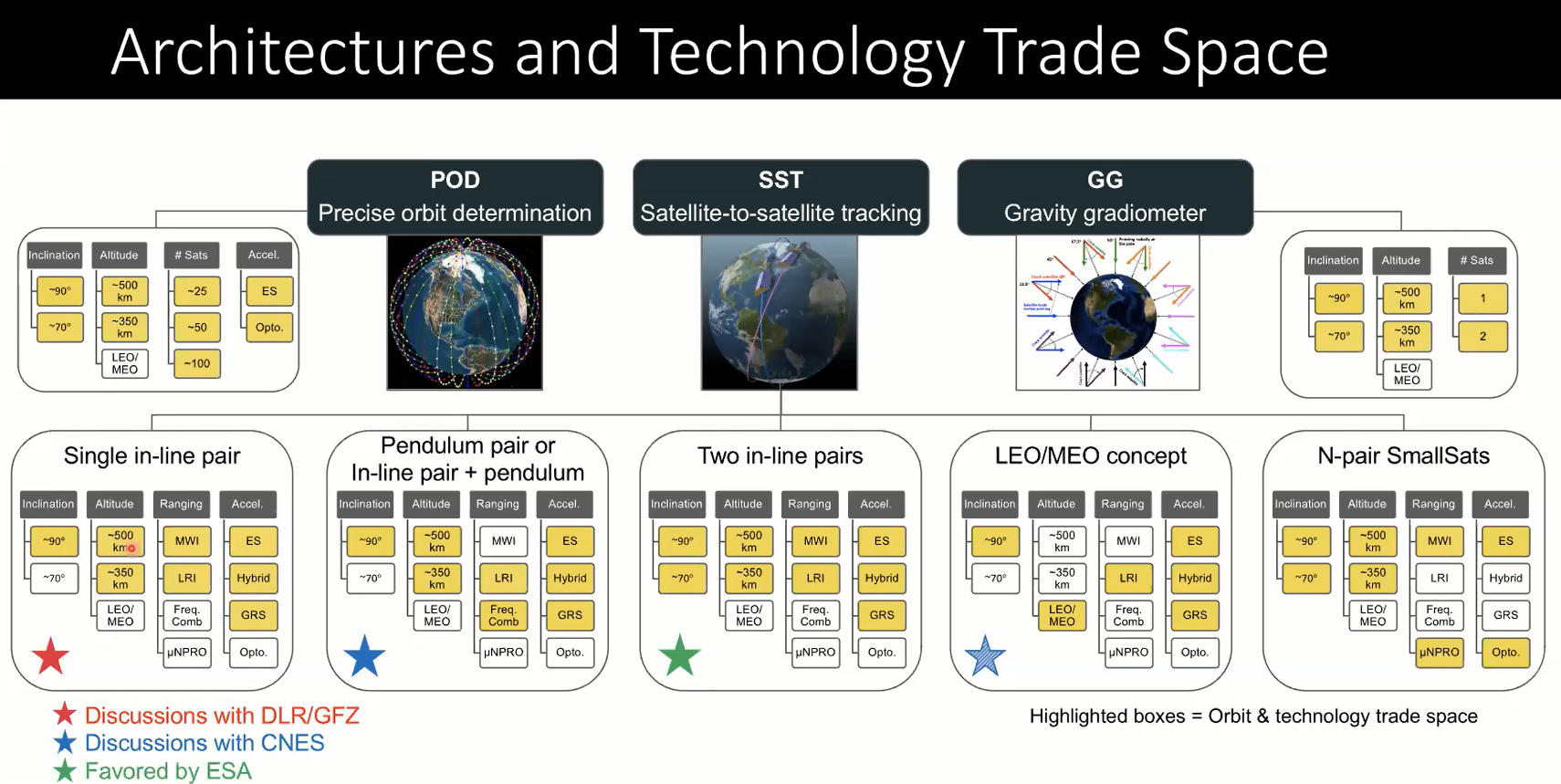


2. Mission architectures: NASA Mass Change Designated Observable (MCDO) study
DLR/GFZ: GRACE-I
EE8: e.motion
CNES: MARVEL
EE9: e.motion²
ESA ADDCON study
EE10: MOBILE
CNES: MARVEL
Courtesy: David Wiese (2020)

Slide 13
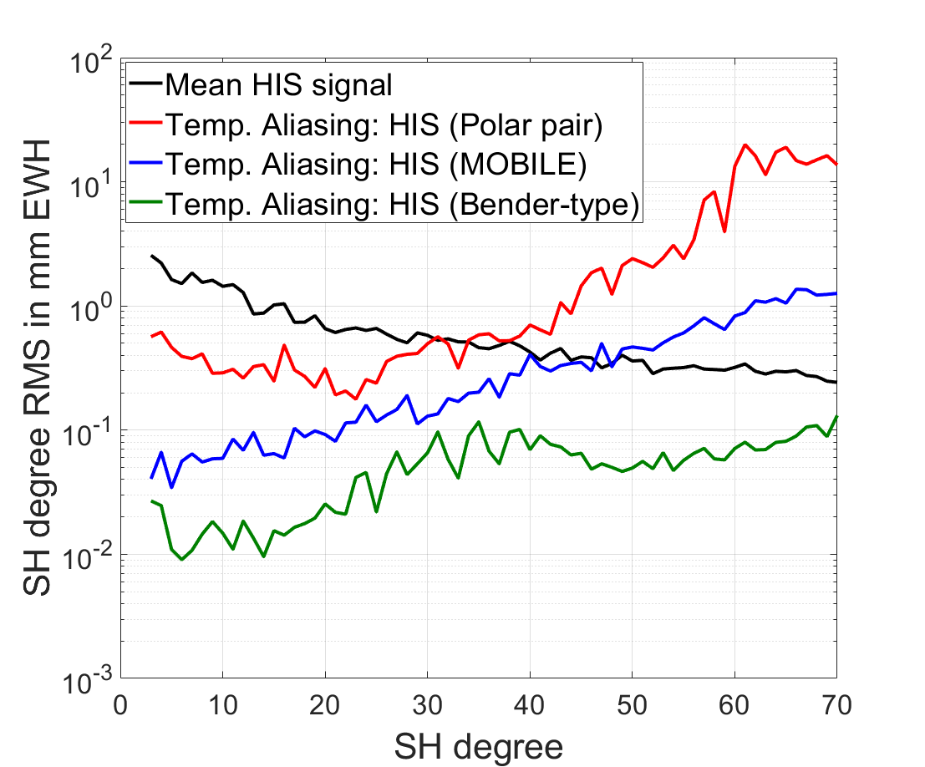
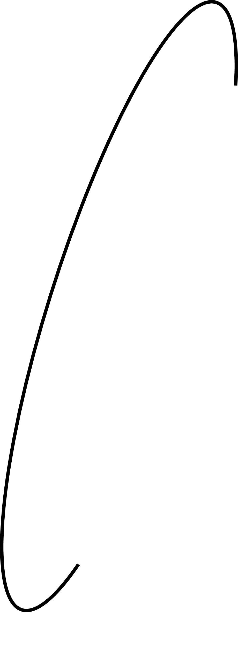

Assessment of different NGGM concepts: HIS retrieval errors
High-low
polar pair
MOBILE
Single pair
Bender double pair
Double pair
Bender double-pair concept outperforms MOBILE minimum configuration in terms of achievably gravity field accuracy.

Slide 14
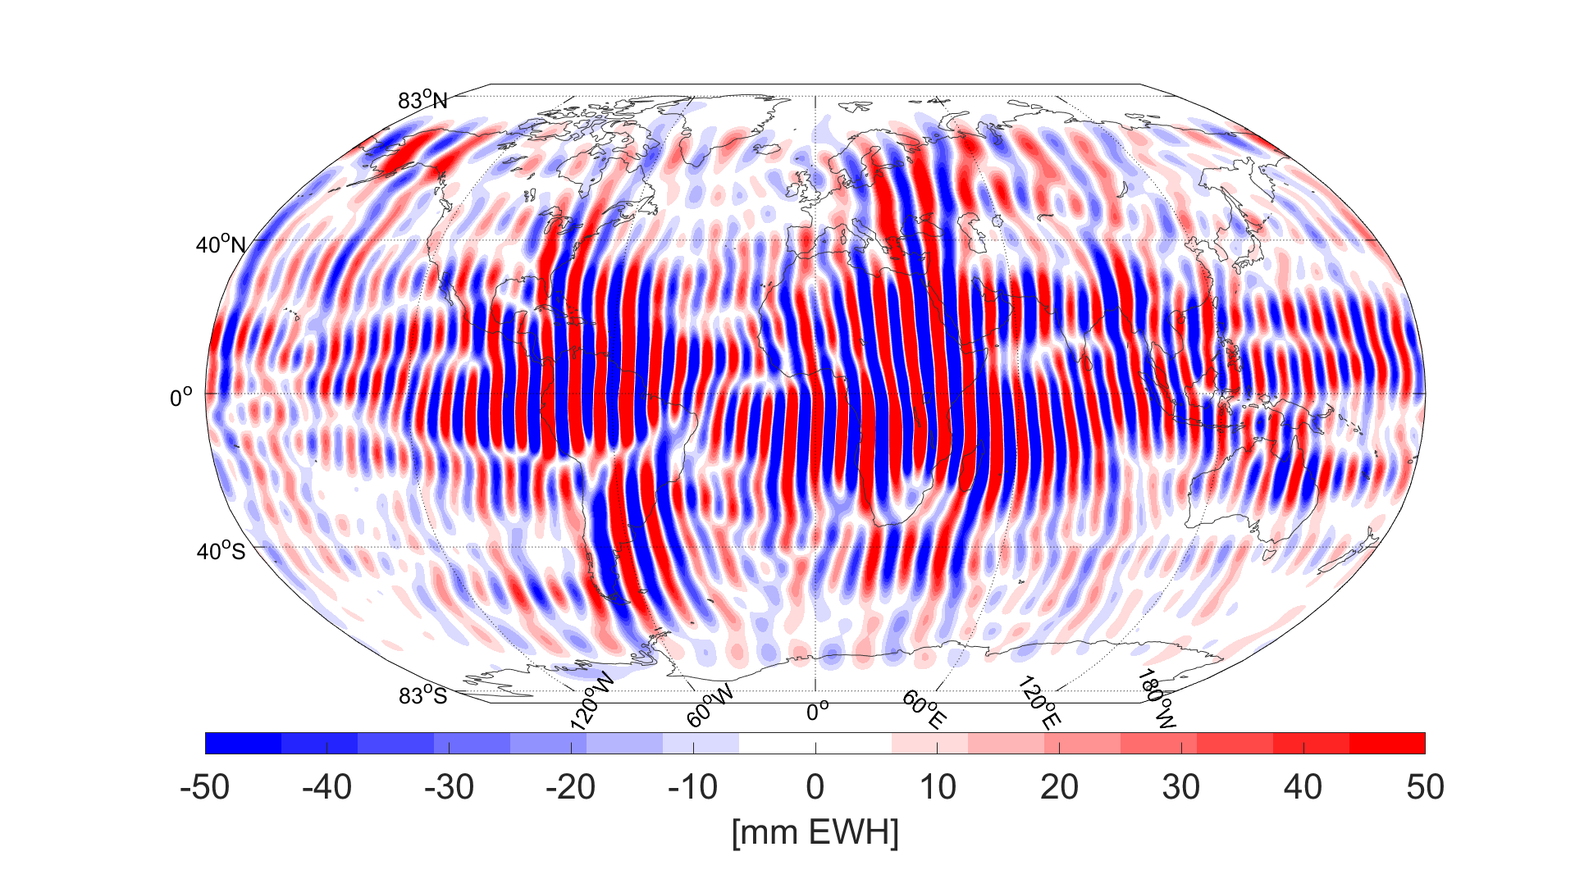
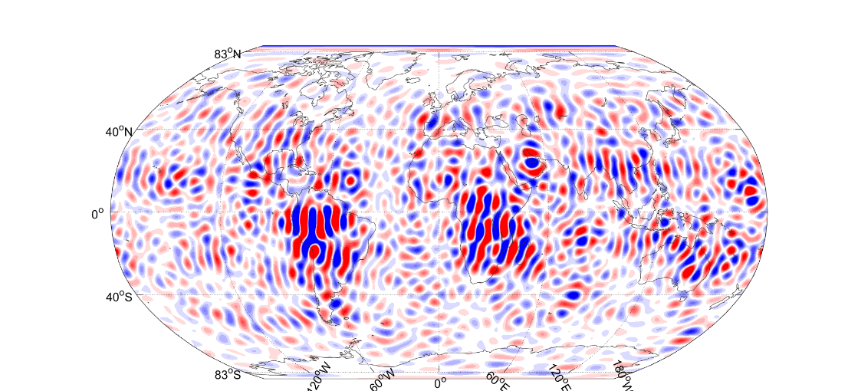
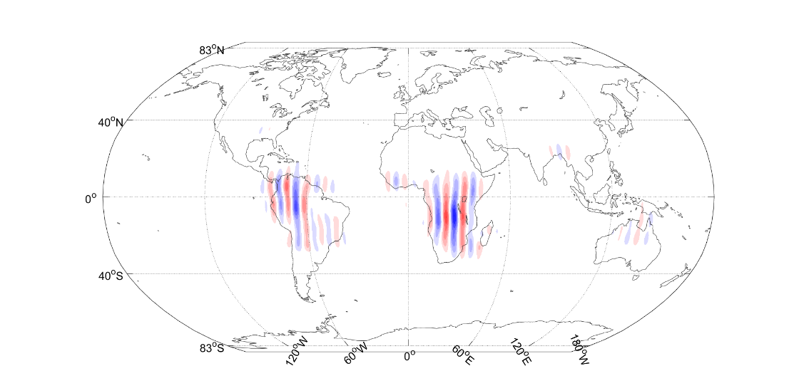
Assessment of different NGGM concepts: HIS retrieval errors
Polar pair
MOBILE
Bender double-pairs
HIS retrieval errors in [mm EWH]

Slide 15
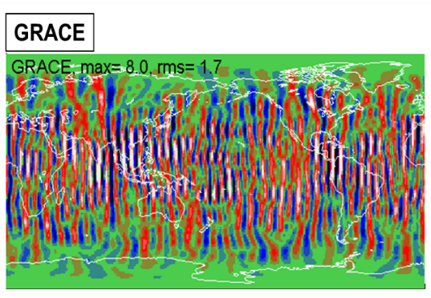
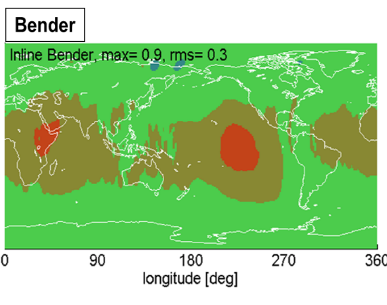
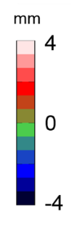
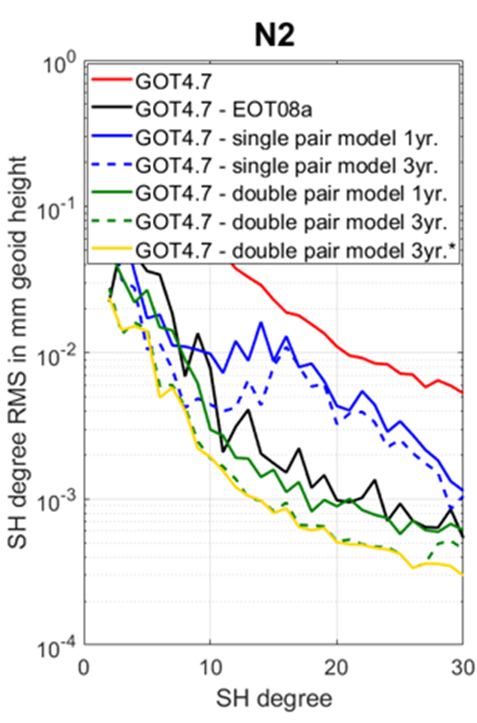
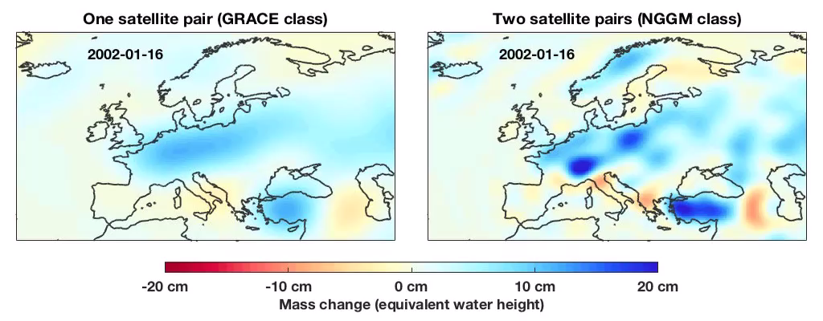
Satellite formations: potential advantages of double-pairs over single pairs
Improved de-aliasing capabilities
Direct estimation of short-periodic non-tidal signals and ocean tides
Higher spatial and temporal resolutions
30 day solutions
3 day solutions

Slide 16


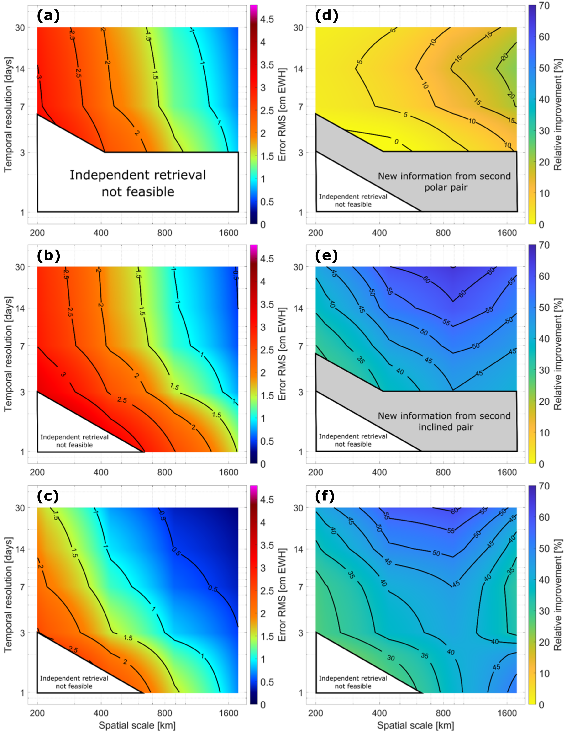
Single vs. double pairs: post-processing included
Joint science study of JPL/Caltech and TUM on quantification of added
value of double pair concepts
Post-processed gravity field retrieval errors in terms of [cm] EWH
GRACE-Follow On
Double polar
Double Bender
Hauk M., Wiese D.N. (2020) New methods for linking science objectives to remote sensing observations: a concept study using single and dual-pair satellite gravimetry architectures. Earth and Space Science, 7.

Slide 17
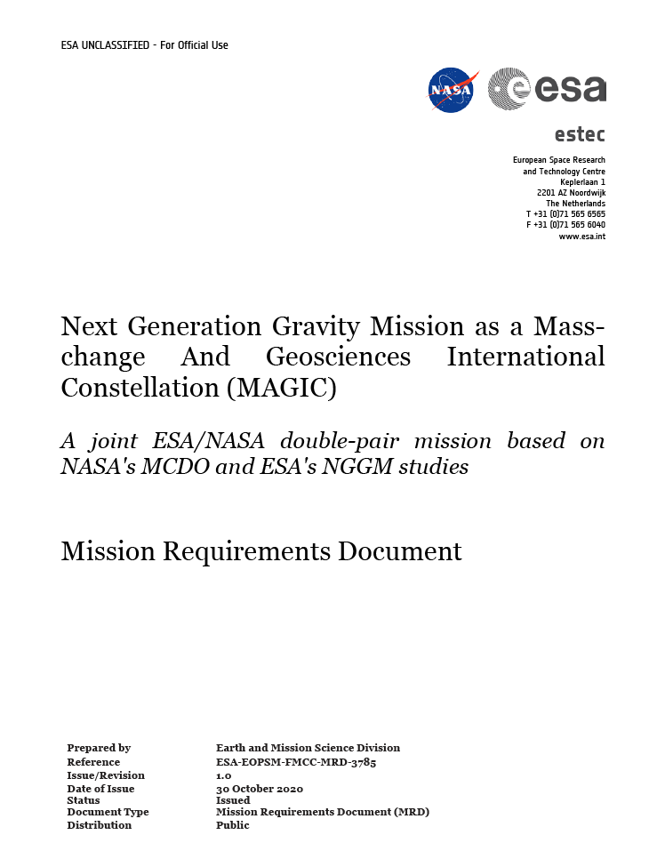
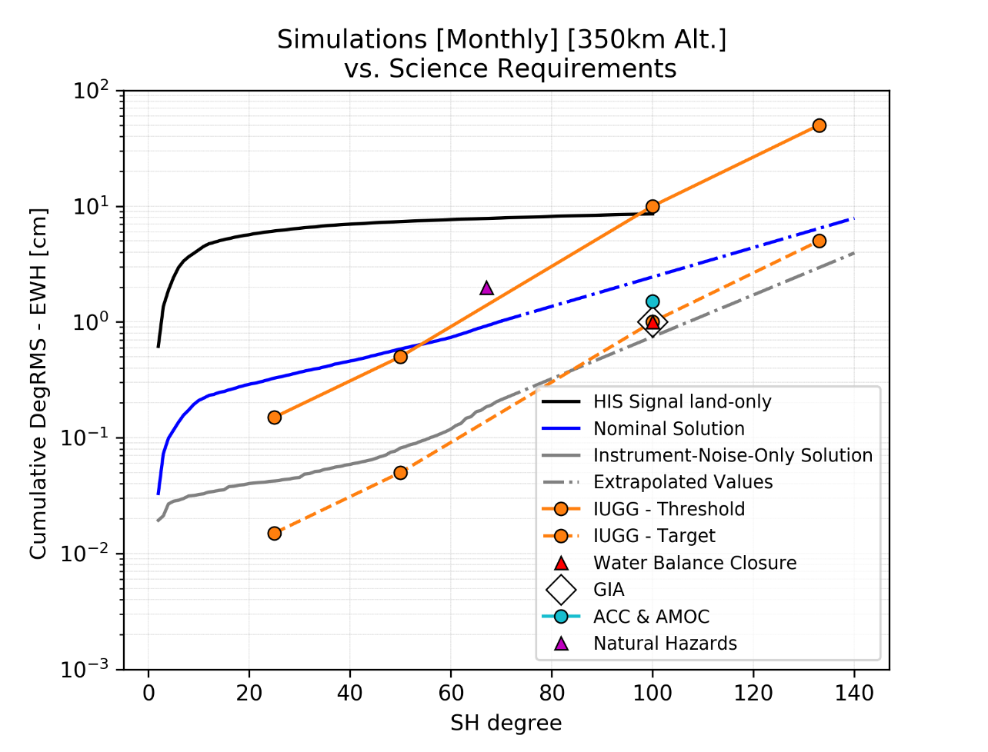
ESA/NASA Mission Requirement Document (MRD)
Basis doc. for current Phase A industry and science studies
IUGG threshold
Full errors simulation
IUGG target
Instrument-error only
Threshold requirements can be met even under
current worst-case assumptions (AO, OT errors).
With improved AO and OT models, target requirements can be approached.

Slide 18
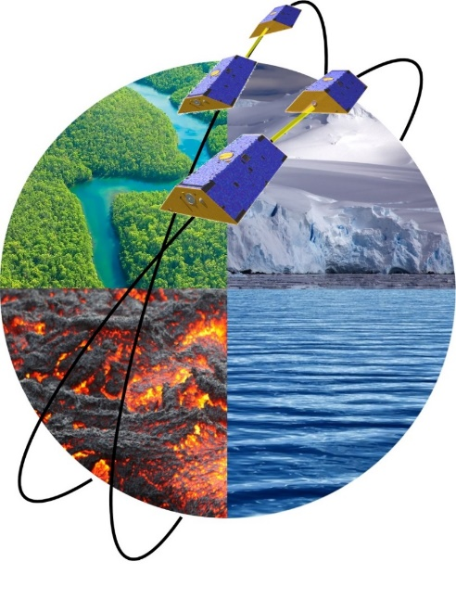
Conclusions
Requirements / mission architectures
  Consolidated user and mission requirements exist
  Joint ESA/NASA activities towards a double-pair mission (joint MRD, Phase A studies)
  Double-pair has the highest science return of all realistic observation concepts
Instrumentation / new sensors
  Instrument noise (ACC, ISL) is currently not the limiting factor of gravity field performance
  Among key payload, ACC is the largest error contributor by far
  Improved instrument performances (especially ACC) become important for
  satellite constellations (e.g. double pairs) , due to the reduction of the currently dominant error sources of tidal aliasing
  New sensors applied for gradiometry was not discussed in this talk, but is an interesting future option

