Slide 1

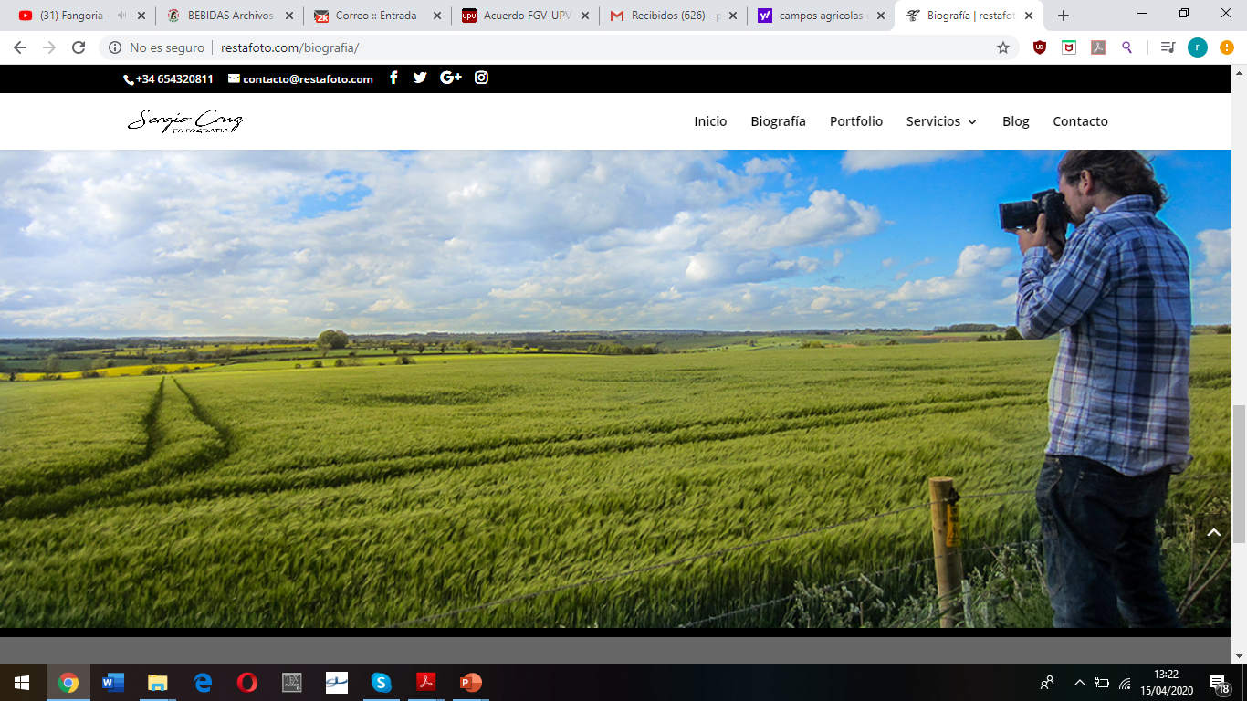


Assessment of groundwater contamination by chlorpyrifos using the PWC model in Valencia region (Spain)
Ricardo Pérez Indoval - Eduardo Cassiraga - Javier Rodrigo-Ilarri
Instituto de Ingeniería del Agua y Medio Ambiente (IIAMA)
Universitat Politècnica de València (UPV)

Slide 2
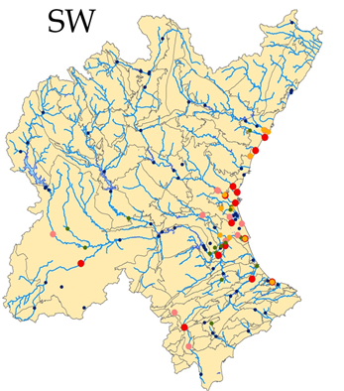
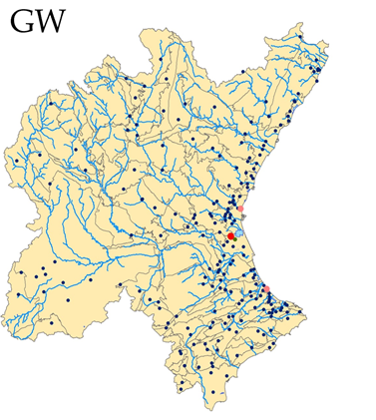
Current situation in Valencia Region (Spain)
The organophosphate insecticide chlorpyrifos is widely detected in the final stretches of the rivers (Mijares, Turia, Júcar) and in other areas of the Júcar Basin
Surface water quality control net
Groundwater quality control net
> 0.10
0.050-0.10
0.025-0.050

Slide 3
Hydrometeorological data
Mediterranean climate
Semi-arid climate
Increase of temperature
Decrease in rainfall
Climate change
Extreme periods

Slide 4
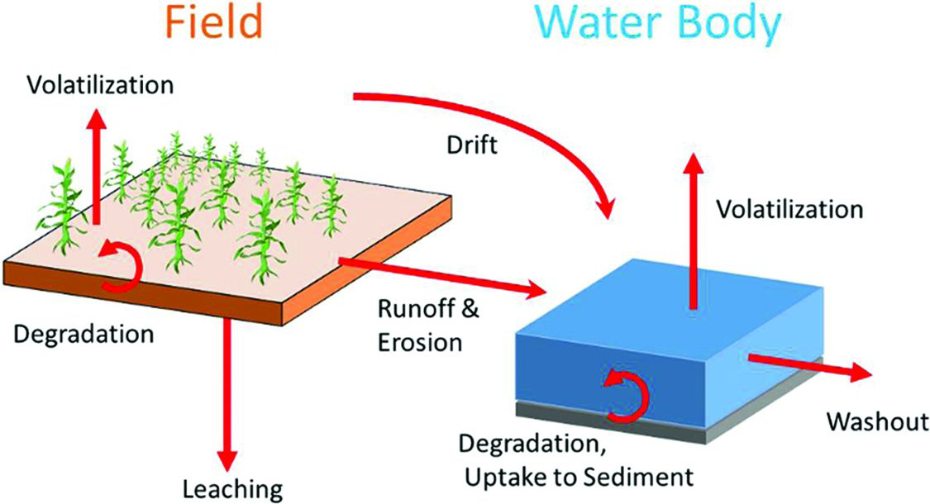
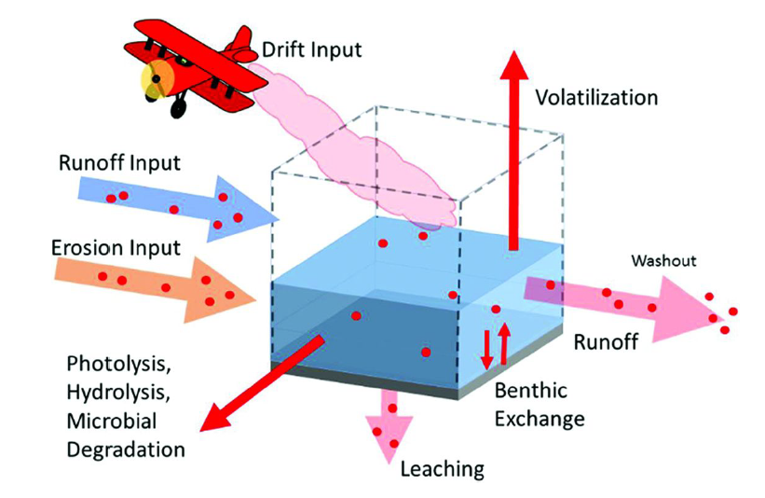
PWC: Groundwater conceptual model
A drinking water well beneath an agricultural field which draws water from a shallow unconfined, high water-table aquifer with a well screen.
Processes include water flow, chemical degradation and sorption, rain, irrigation and crop specific factors including transpiration, pesticide interception and management practices
Soil temperature
Slower aerobic soil degradation at depth up to 1m.
Young 2004

Slide 5
Case study 1
Single dose
5kg
3kg
2kg
1kg
 | Chlorpyrifos concentration
Case 1. Single dose | 1kg/ha | 2kg/ha | 3kg/ha | 5kg/ha
Peak concentration ppb | 0.1774 | 0.3548 | 0.5149 | 0.8005
Average concentration ppb | 0.0125 | 0.0249 | 0.0361 | 0.0562
Days > 0.10 ppb | 198 | 416 | 489 | 562
Disappear date | 08/12/2008 | 28/03/2009 | 21/05/2009 | 18/07/2009
Duration (days) | 982 | 1091 | 1144 | 1201

Slide 6
Case study 2
Annual application
5kg
3kg
2kg
1kg
2006
2007
2008
Case 2 | 1kg/ha | 2kg/ha | 3kg/ha | 5kg/ha
Peak concentration | 1.4617 | 2.9234 | 4.3851 | 7.3085
Average concentration | 0.1871 | 0.3742 | 0.5614 | 0.9356
Days > 0.10 | 2236 | 2745 | 2941 | 3145

Slide 7
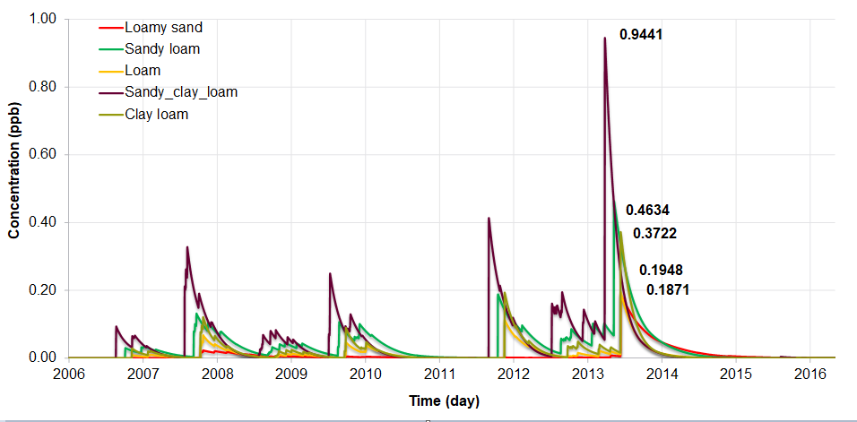
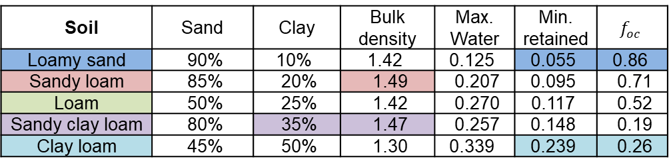
Case study 3
Simulation for different soil types
Soil | Sand | Clay | Bulk density | Max. Water | Min. retained | $$f_{oc}$$
Loamy sand | 90% | 10% | 1.42 | 0.125 | 0.055 | 0.86
Sandy loam | 85% | 20% | 1.49 | 0.207 | 0.095 | 0.71
Loam | 50% | 25% | 1.42 | 0.270 | 0.117 | 0.52
Sandy clay loam | 80% | 35% | 1.47 | 0.257 | 0.148 | 0.19
Clay loam | 45% | 50% | 1.30 | 0.339 | 0.239 | 0.26

Slide 8
Conclusions
The daily and maximum concentrations of the pesticide chlorpyrifos have been estimated in an groundwater mass of Valencia Region
The sensitivity analysis show a proportionality between the application dose and the concentrations.
Modelling application on heavy rainfall day on has a multi-fold impact on groundwater concentrations of low persistence compounds compared to persistent compounds.
These concentrations are highly dependent on the soil characteristics (being 4 times higher on sandy clay than in loamy sand).

