Slide 1
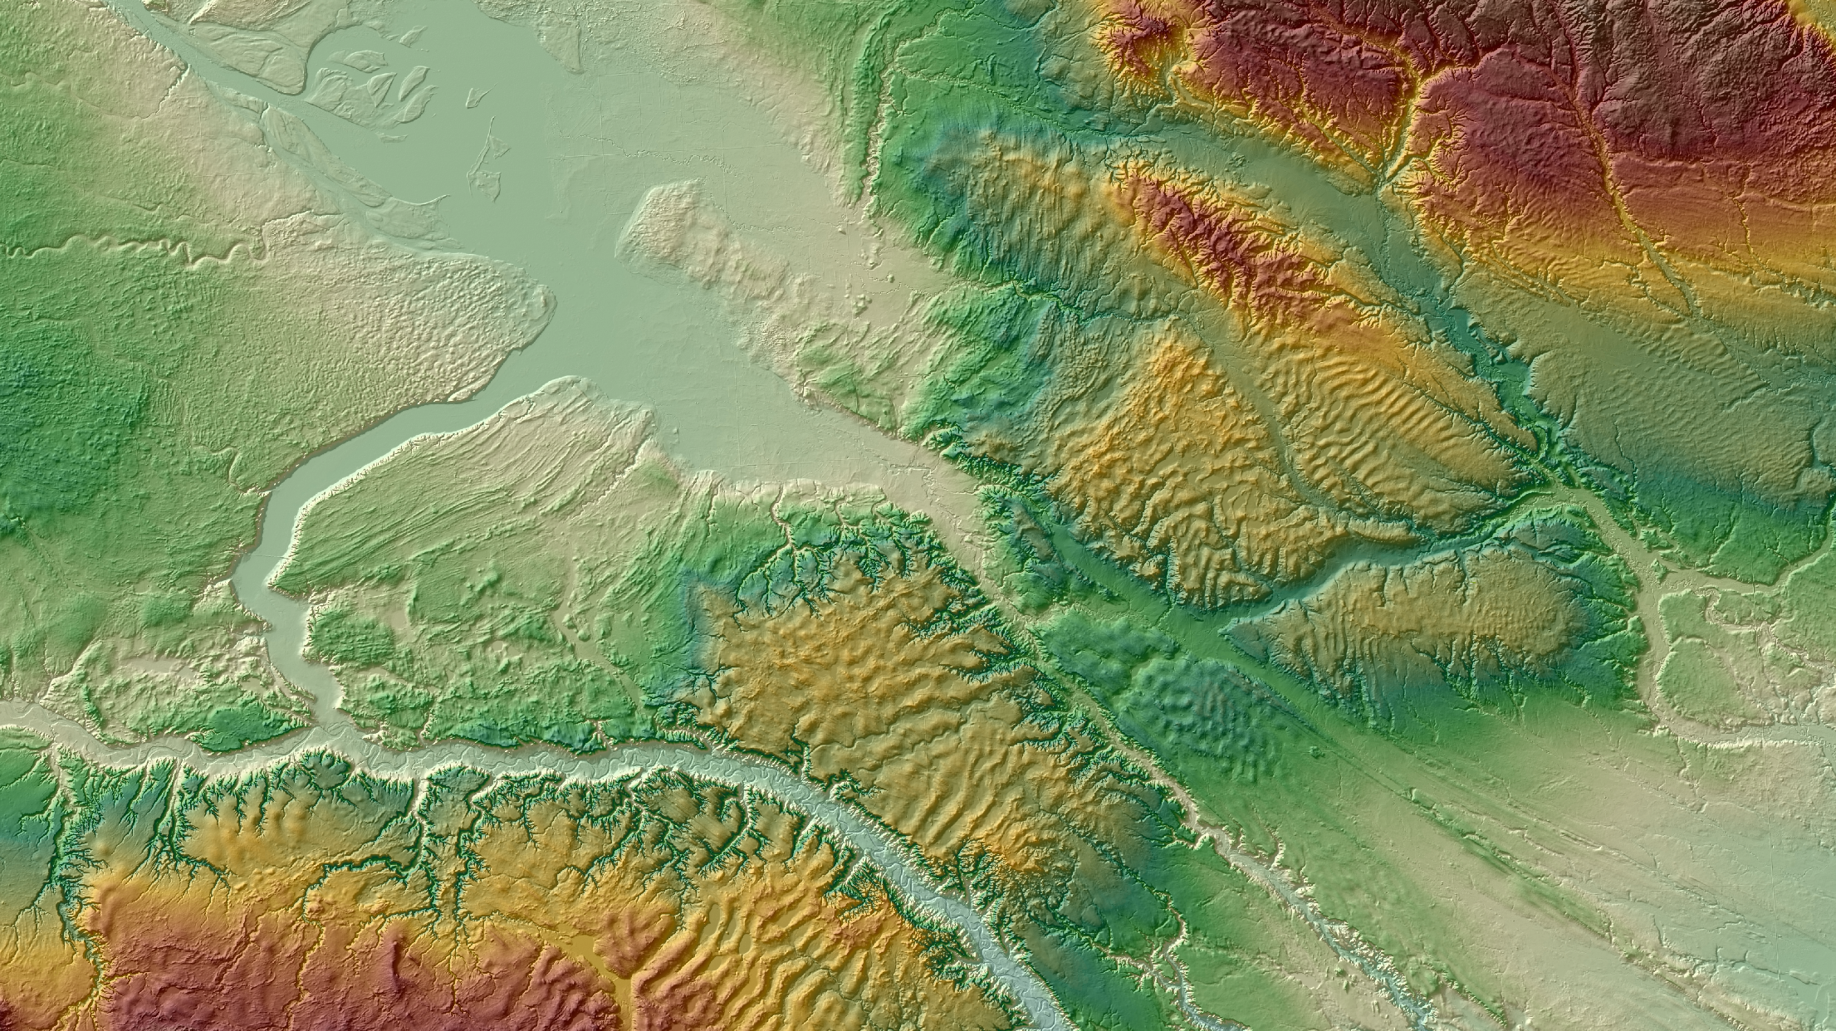




Powerpoint presentation with audio support
Ribbed bedforms: markers of palaeo-ice stream margins, basal meltwater drainage and ice flow dynamics
Vérité, J., Ravier, É., Bourgeois, O., Pochat, S., Lelandais, T., Clark, C. D., Bessin, P., Mourgues, R., Peigné, D., and Atkinson, N.
28.04.2021

Slide 2
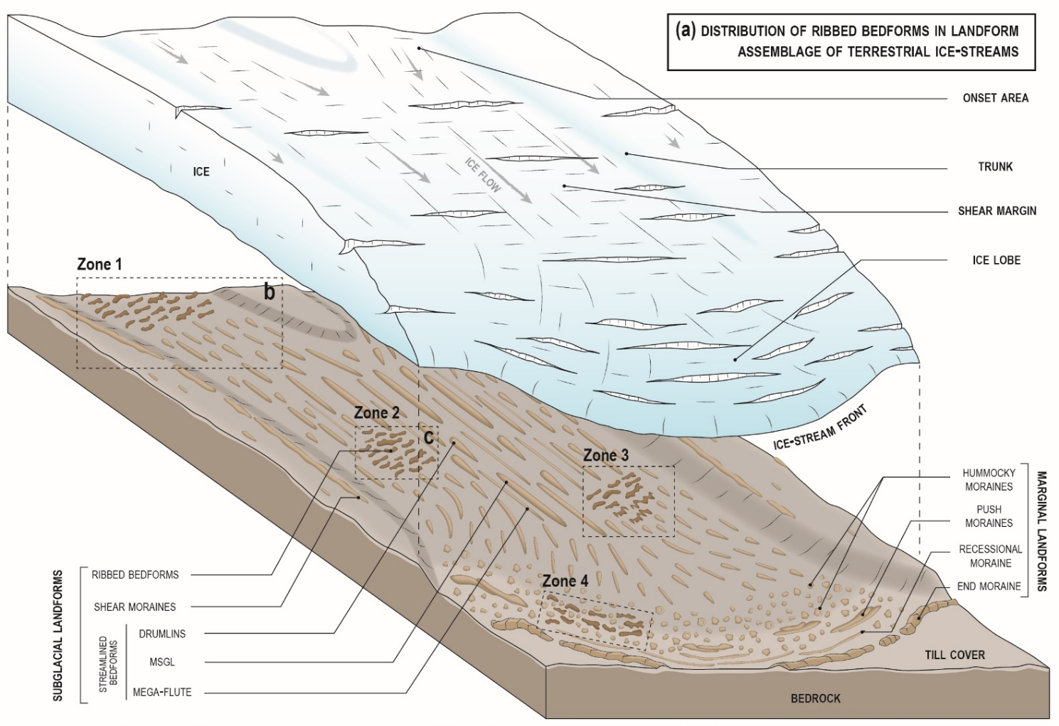
Ice streams and ribbed bedforms in literature
Ribbed bedforms:
- Ribbed moraines
- Rogen moraines
- “Traction ribs”
- Mega-scale transverse ridges (or mega-ribs)
Morphometry:
- Ratio L/W: 2.9 to 4.2
- Dimensions:
Length: 100s m to 40 km
Width: 100 m to 6 km
- Orientation: transverse to oblique
Distribution in IS landsystem:
- Onset area
- Isolated patches in IS trunk (associated to lineations)
- Marginal area (associated to hummocky moraines)
Formation:
- Reshaping of existing bedform
- Fracturing of frozen-bed
- Subglacial meltwater floods
- Till deformation
Exploration of ribbed bedforms formation below ice stream margins

Slide 3
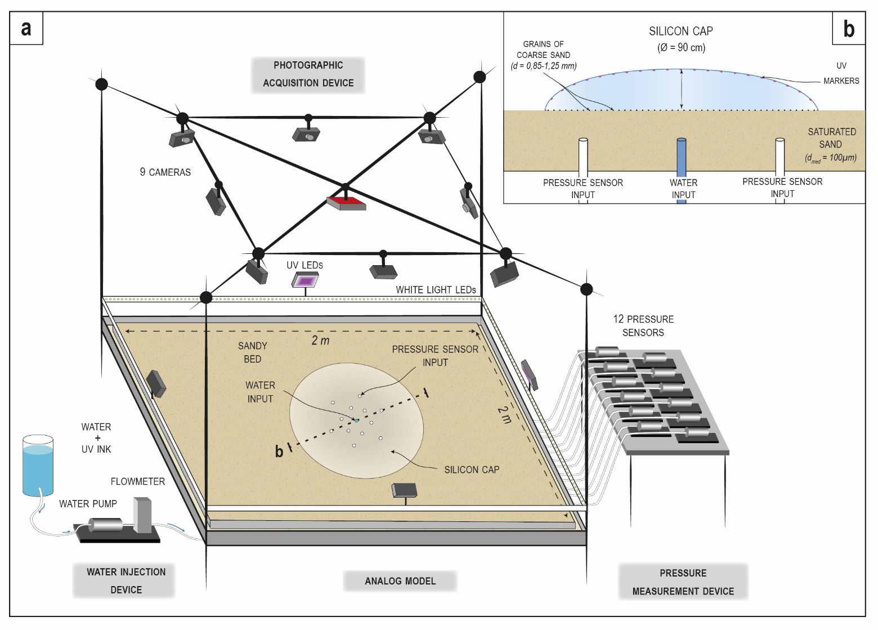
Analog modelling
Methods: analog experiments
Experimental ice streams
- ice: silicon putty
- sedimentary substratum: sand
- meltwater: water (+ UV ink)

Slide 4
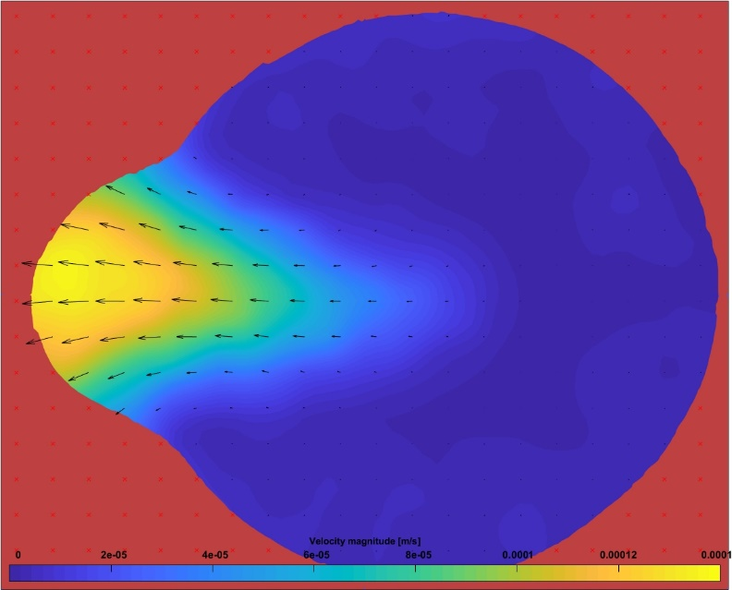
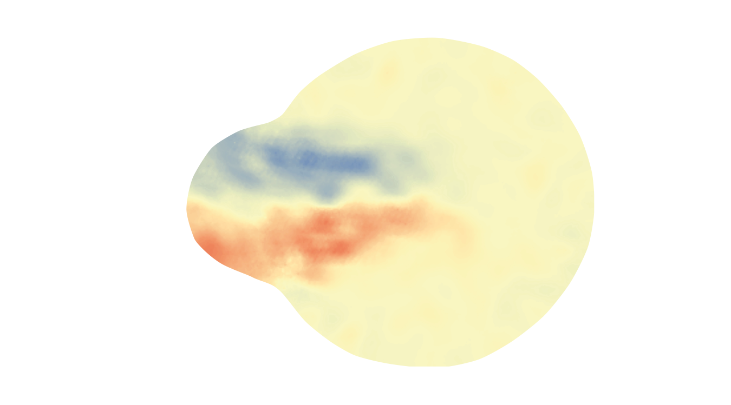
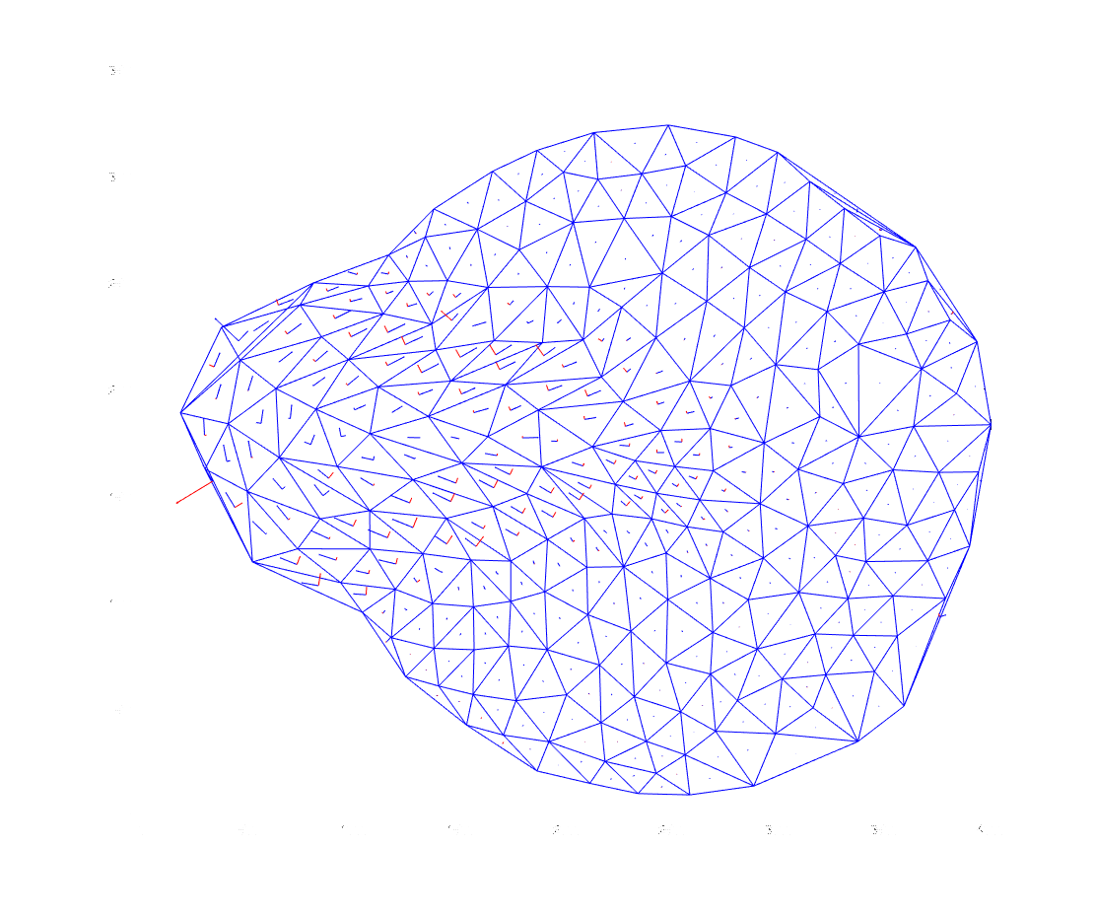
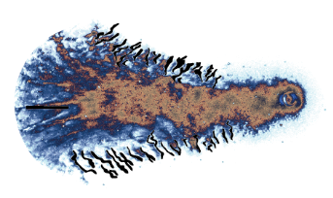
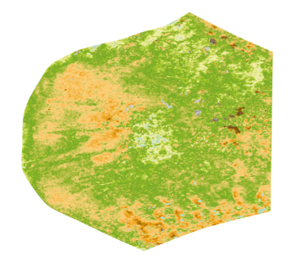
Analog modelling
Methods: analog experiments
Experimental ice streams
- ice: silicon putty
- sedimentary substratum: sand
- meltwater: water (+ UV ink)
Flow velocity of silicon cap surface (m.s⁻¹)
Shear strain rate and strain axis (s⁻¹)
Water distribution and bedforms
Snapshot in white light
Snapshot in UV light
Digital elevation model

Slide 5
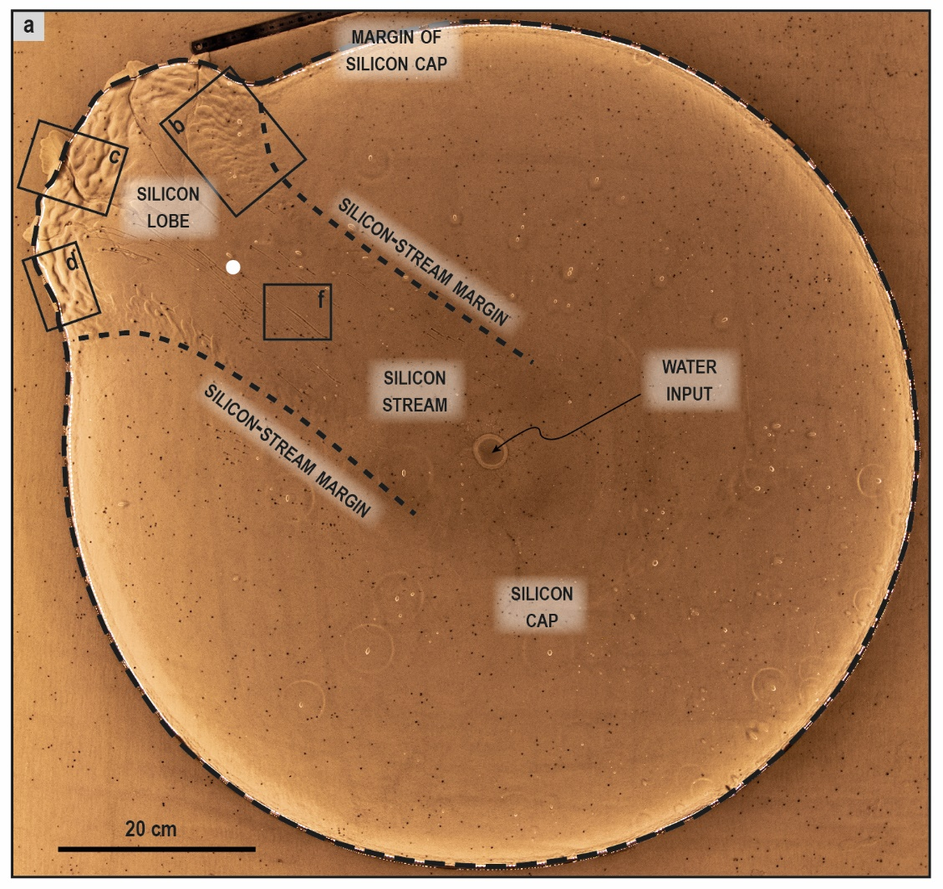
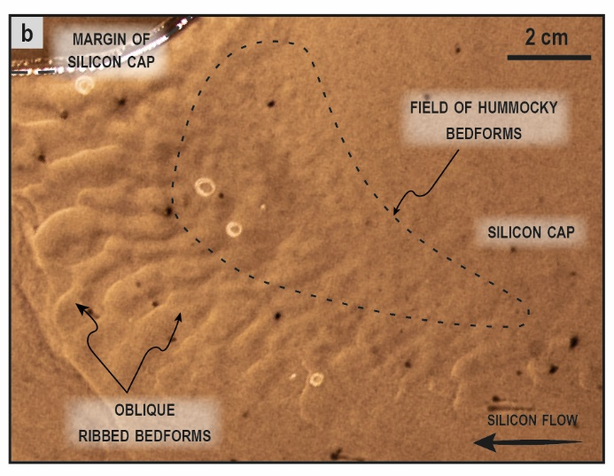
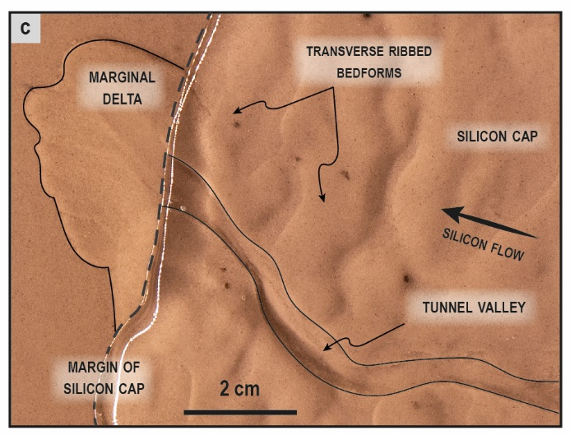
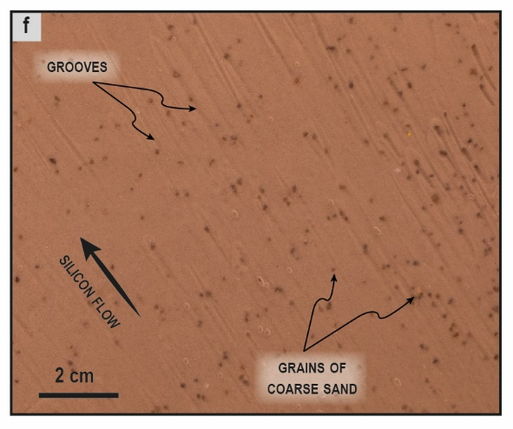
Analog modelling
Methods: inventory of analog subglacial bedforms and morphologies

Slide 6
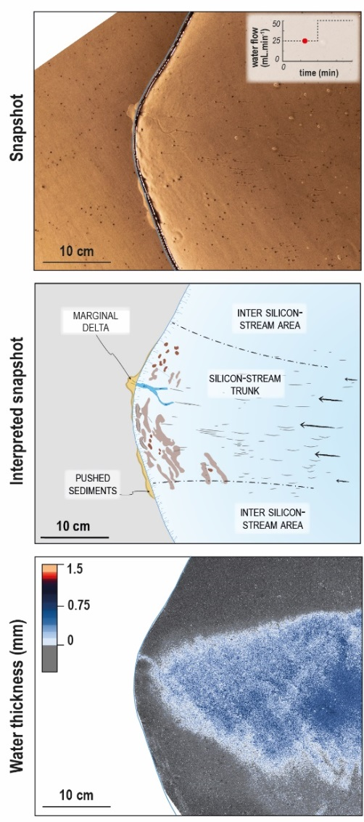
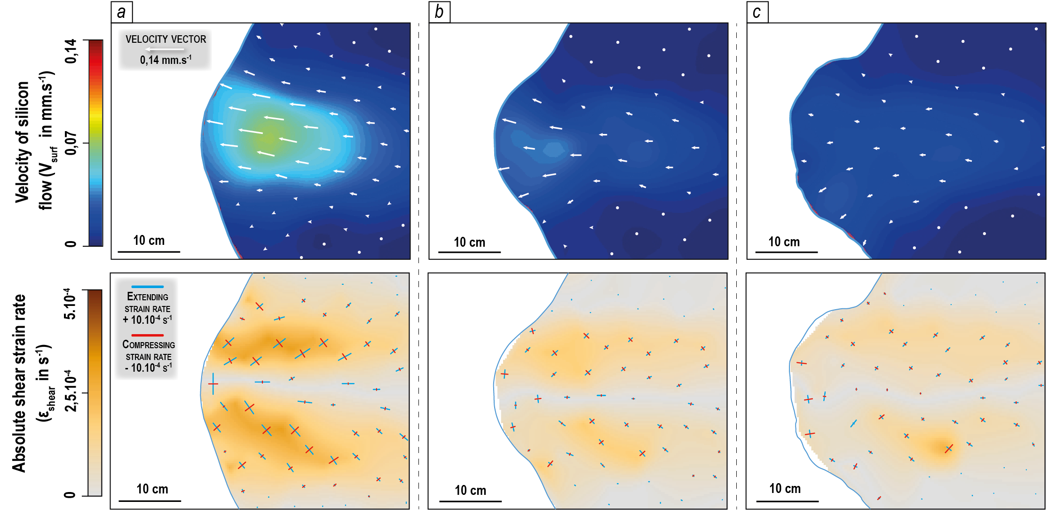
Analog modelling
Results: a well-developed channelized drainage below stagnant lobe
1) - Proto-ribbed bedforms
- Water film
- Fast-flowing stream
Time

Slide 7
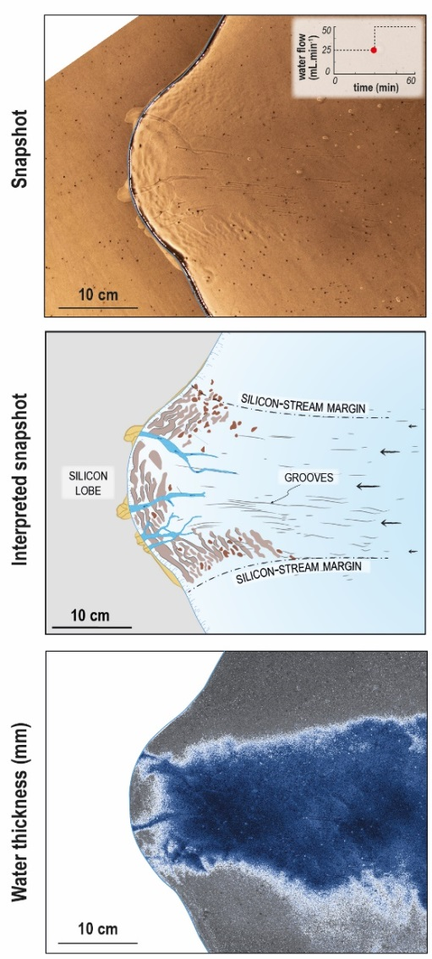
Analog modelling
Results: a well-developed channelized drainage below stagnant lobe
1) - Proto-ribbed bedforms
- Water film
- Fast-flowing stream
2) - Channelization below lobe
- Stream slow-down
- Ribbed bedforms differentiation (lobe and shear margins) and growth perpendicular to compressing axes
Time

Slide 8
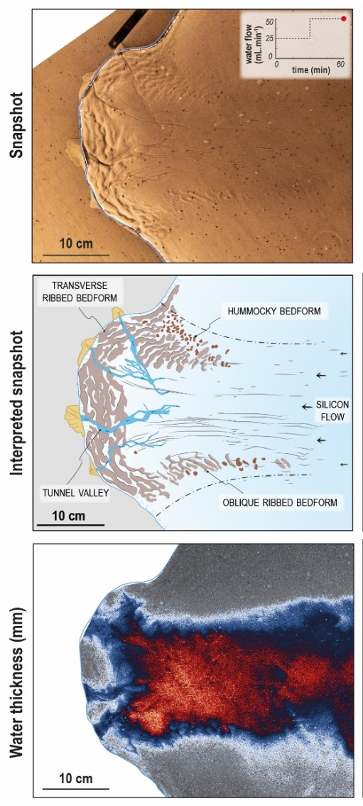
Analog modelling
Results: a well-developed channelized drainage below stagnant lobe
1) - Proto-ribbed bedforms
- Water film
- Fast-flowing stream
2) - Channelization below lobe
- Stream slow-down
- Ribbed bedforms differentiation (lobe and shear margins) and growth perpendicular to compressing axes
Time
Increase in meltwater flow
3) - Incision of tunnel valleys
- Lobe stagnation
- Ribbed bedforms growth

Slide 9
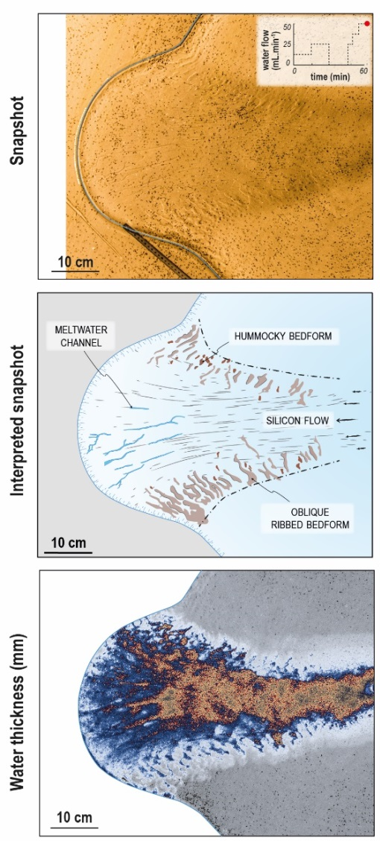
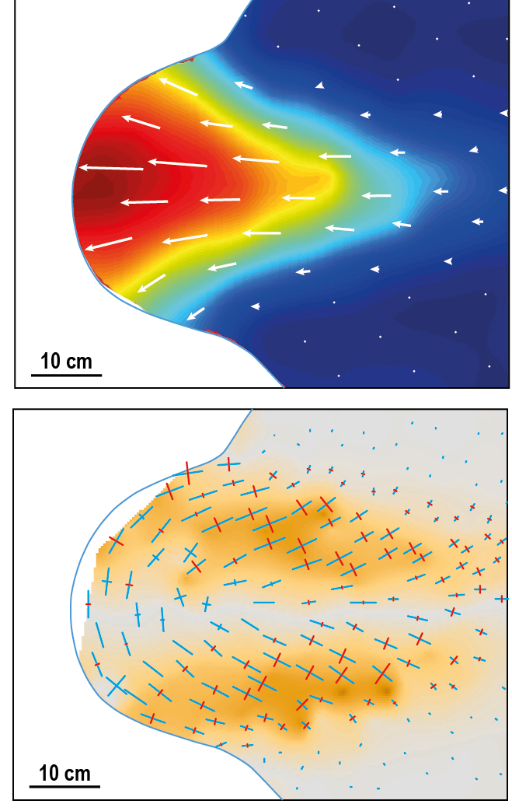
Analog modelling
Results: a poorly-developed channelized drainage below surging lobe
1) - Proto-ribbed bedforms
- Water film
- Fast-flowing stream
2) - Channelization below lobe
- Stream slow-down
- Ribbed bedforms differentiation (lobe and shear margins) and growth perpendicular to compressing axes
Time
Increase in meltwater flow
3) - Spreading of distributed water film
- Surging lobe
- Frontal ribbed bedforms overprinting

Slide 10

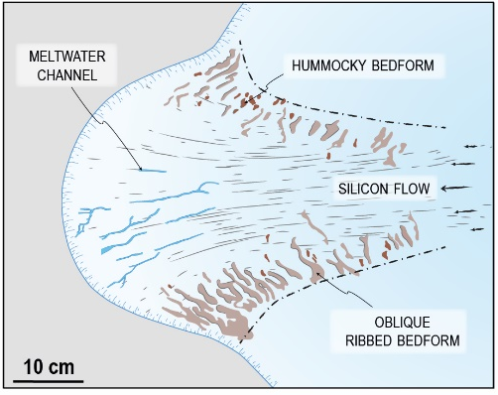
Analog modelling
Results: morphometric characteristics
well-developed channelized drainage below stagnant ice lobe
poorly-developed channelized drainage below surging ice lobe
Lateral ribbed bedforms
Orientation: oblique to shear margins (45 ± 5°) Dimension: l/w = 3.3 Shape: arcuate Wavelength: regular (λ_{mean} = 0.7 cm)
Channelized features
Channelized features
Deep, wide and efficient tunnel valleys
Shallow, narrow and inefficient meltwater channels
Frontal ribbed bedforms
Frontal ribbed bedforms
Orientation: parallel to lobe margin Dimension: l/w = 3.0
Shape: anastomosing Wavelength: regular (λ_{mean} = 1 cm)
Absent

Slide 11
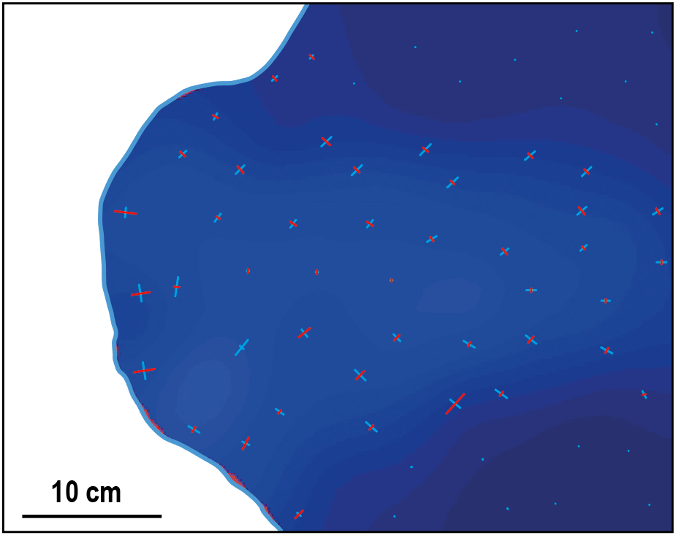
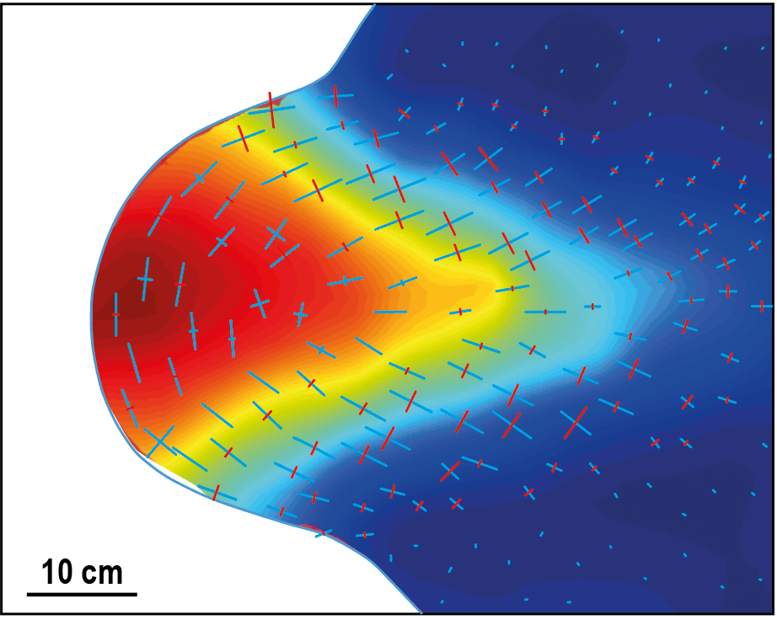
Analog modelling
Results: morphometric characteristics
well-developed channelized drainage below stagnant ice lobe
poorly-developed channelized drainage below surging ice lobe
Ribbed bedforms form and elongate perpendicular to compressing axes of
the silicon cap
Two distinct stream dynamics
Lateral ribbed bedforms
Orientation: oblique to shear margins (45 ± 5°) Dimension: l/w = 3.3 Shape: arcuate Wavelength: regular (λ_{mean} = 0.7 cm)
Channelized features
Channelized features
Deep, wide and efficient tunnel valleys
Shallow, narrow and inefficient meltwater channels
Frontal ribbed bedforms
Frontal ribbed bedforms
Orientation: parallel to lobe margin Dimension: l/w = 3.0
Shape: anastomosing Wavelength: regular (λ_{mean} = 1 cm)
Absent
Notes:
In any case, ribbed bedforms form and elongate perpendicular to compressing axes of the silicon cap (red lines), and their distribution below silicon lobes reflect two distinct stream dynamics: with a stagnant lobe in one hand and a surging lobe in the other hand.

Slide 12
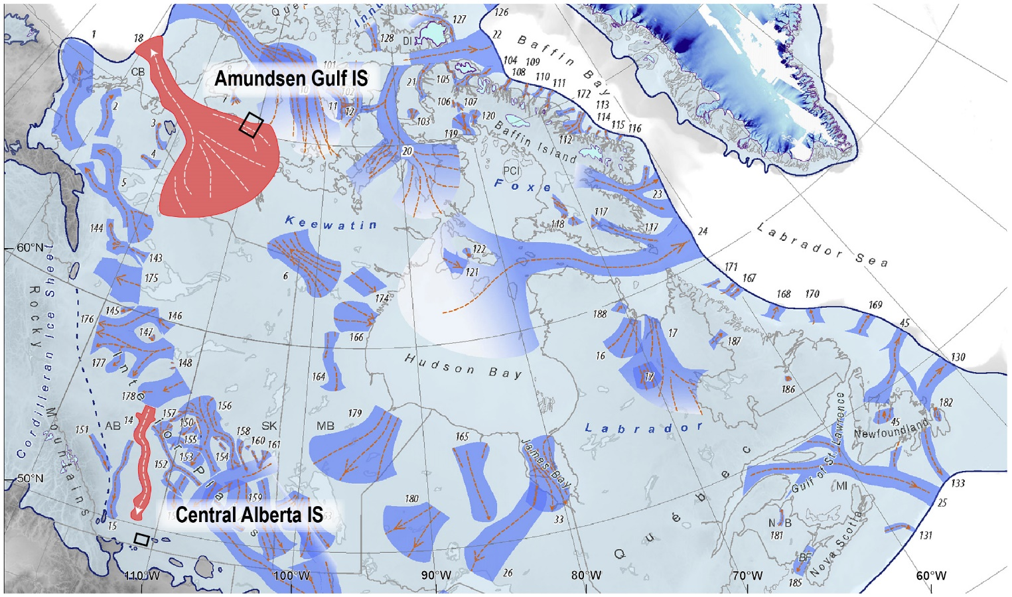
Palaeo-glaciological mapping
Method: ribbed bedforms below ice streams margins
Mapping of ribbed bedforms along margins of palaeo-ice stream beds
Ice streams of Laurentide Ice Sheet:
- Amundsen Gulf IS (trunk)
- Central Alberta IS (lobe)
Modified after Margold et al., 2018

Slide 13
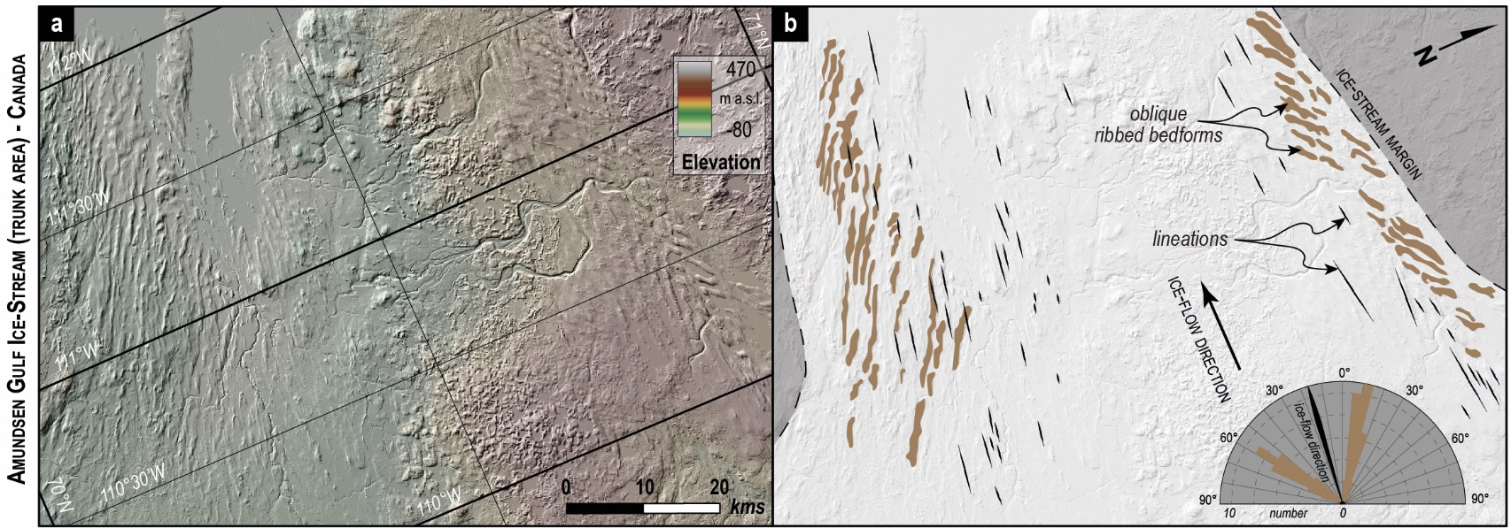
Palaeo-glaciological mapping
Results: ribbed bedforms below ice streams margins
➔ Amundsen Gulf IS – ribbed bedforms below shear margins
Orientation: oblique (25 – 45°) Dimension: l/w = 4.2 (l_{mean} = 4780 m; w_{mean} = 1110 m)
Shape: slightly arcuate Wavelength: regular (λ_{mean} = 1450m)
Former interpretations: ¤ distinct and oblique flow sets of lineations (Stokes et al., 2006)
¤ mega-scale transverse ridges (Greenwood and Kleman, 2010)

Slide 14
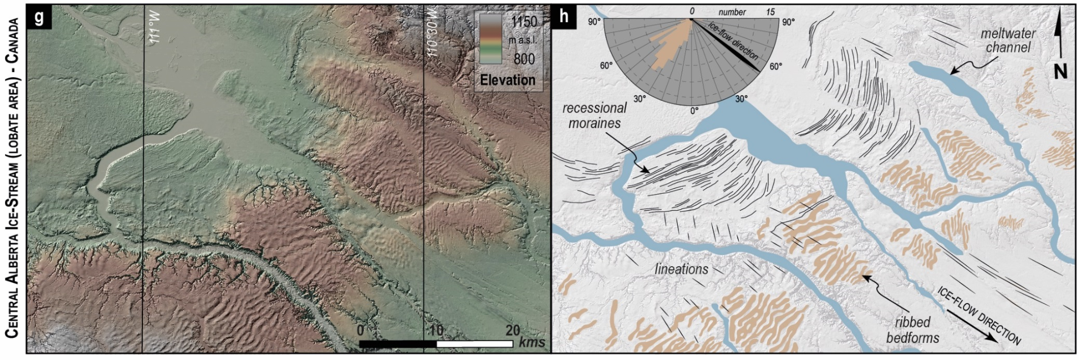
Palaeo-glaciological mapping
Results: ribbed bedforms below ice streams margins
➔ Central Alberta IS – ribbed bedforms below frontal lobe margin
Orientation: transverse (90 ± 5°) Dimension: l/w = 3.0 (l_{mean} = 4350 m; w_{mean} = 1350 m)
Shape: arcuate to anastomosing Wavelength: regular (λ_{mean} = 900m)
Characteristics: incised by and cross-cutting meltwater channels
Former interpretations: ¤ traction ribs (Sergienko et al., 2014; Stokes et al., 2016)
¤ overridden thrust masses (Evans et al., 2008, 2014; Atkinson et al., 2018)

Slide 15
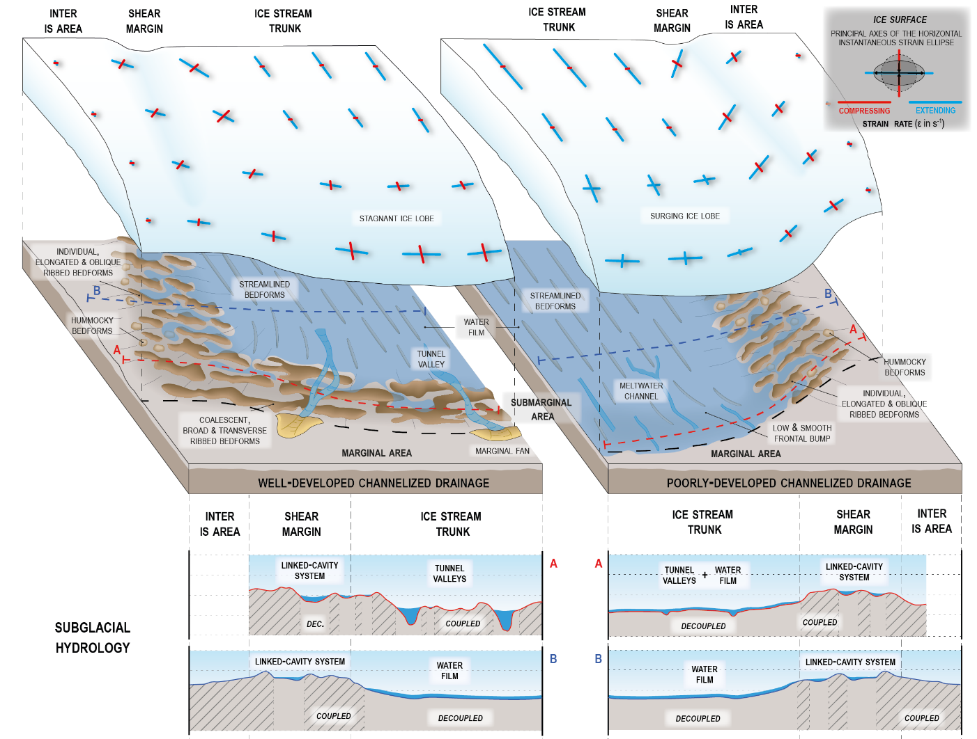
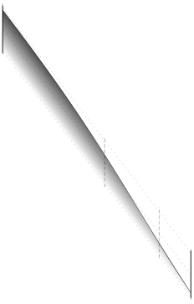
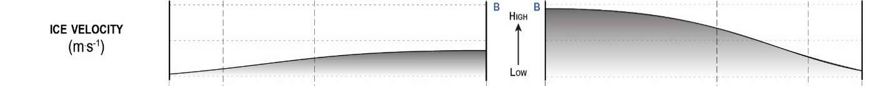


An integrative morphological-hydrological-glaciological model for the formation of ribbed bedforms beneath ice streams margins
Ice stream margins (shear & frontal lobe)
=
Formation of ribbed bedforms
Ribbed bedforms formation :
- transition coupling/decoupling below ice stream margins (controlled by hydrology)
Velocity gradient
- ice deformation (shear and compression)
- stress transfer (coupling) & bed deformation Ribbed bedforms
- spreading of water film in between ridges
Ribbed bedforms implications :
- location of ice stream margins
- distinct meltwater drainage systems
- controlled by ice lobe dynamics

