Slide 1
Potential hydro-climatic impacts from climate change over Burundi
M. Rocío Rivas López, Stefan Liersch, and Fred F. Hattermann

Slide 2
Outline
Introduction & motivation
Data and methods
    Climate data
    Hydrological modelling: eco-hydrological model SWIM
    Indicators
Results
    Performance of climate data
    Climate projections: long-term annual and seasonal mean
    Discharge projections: seasonal average and extreme discharges
Conclusions & discussion
<number>

Slide 3
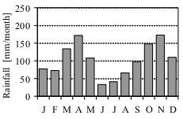
Introduction & motivation
Burundi is one of the poorest countries of the world and hence, very vulnerable to the impacts from climate change.
80% of the population relies on rain-fed agriculture, insufficient to cover household demand.
Poverty is widespread, with 90-95% of population living on less than $2 per day, particularly in rural areas. 56% of children suffer from chronic malnutrition (Baramburiye et al, 2013).
High population density: 11.17 million inhabitants
    Pop. Density: 289 inhab./km², 300-500 in rural areas, and 500-2000 in big cities
    Growth rate: 3.2% per year (World Bank, 2018).
Tropical wet climate, related to altitude
Major climate seasons:
    Dry season: June – September
    Short rainy season: October – December
    Long rainy season: March – May
There is not detailed information about the impacts of CC on water resources within Burundi
<number>

Slide 4
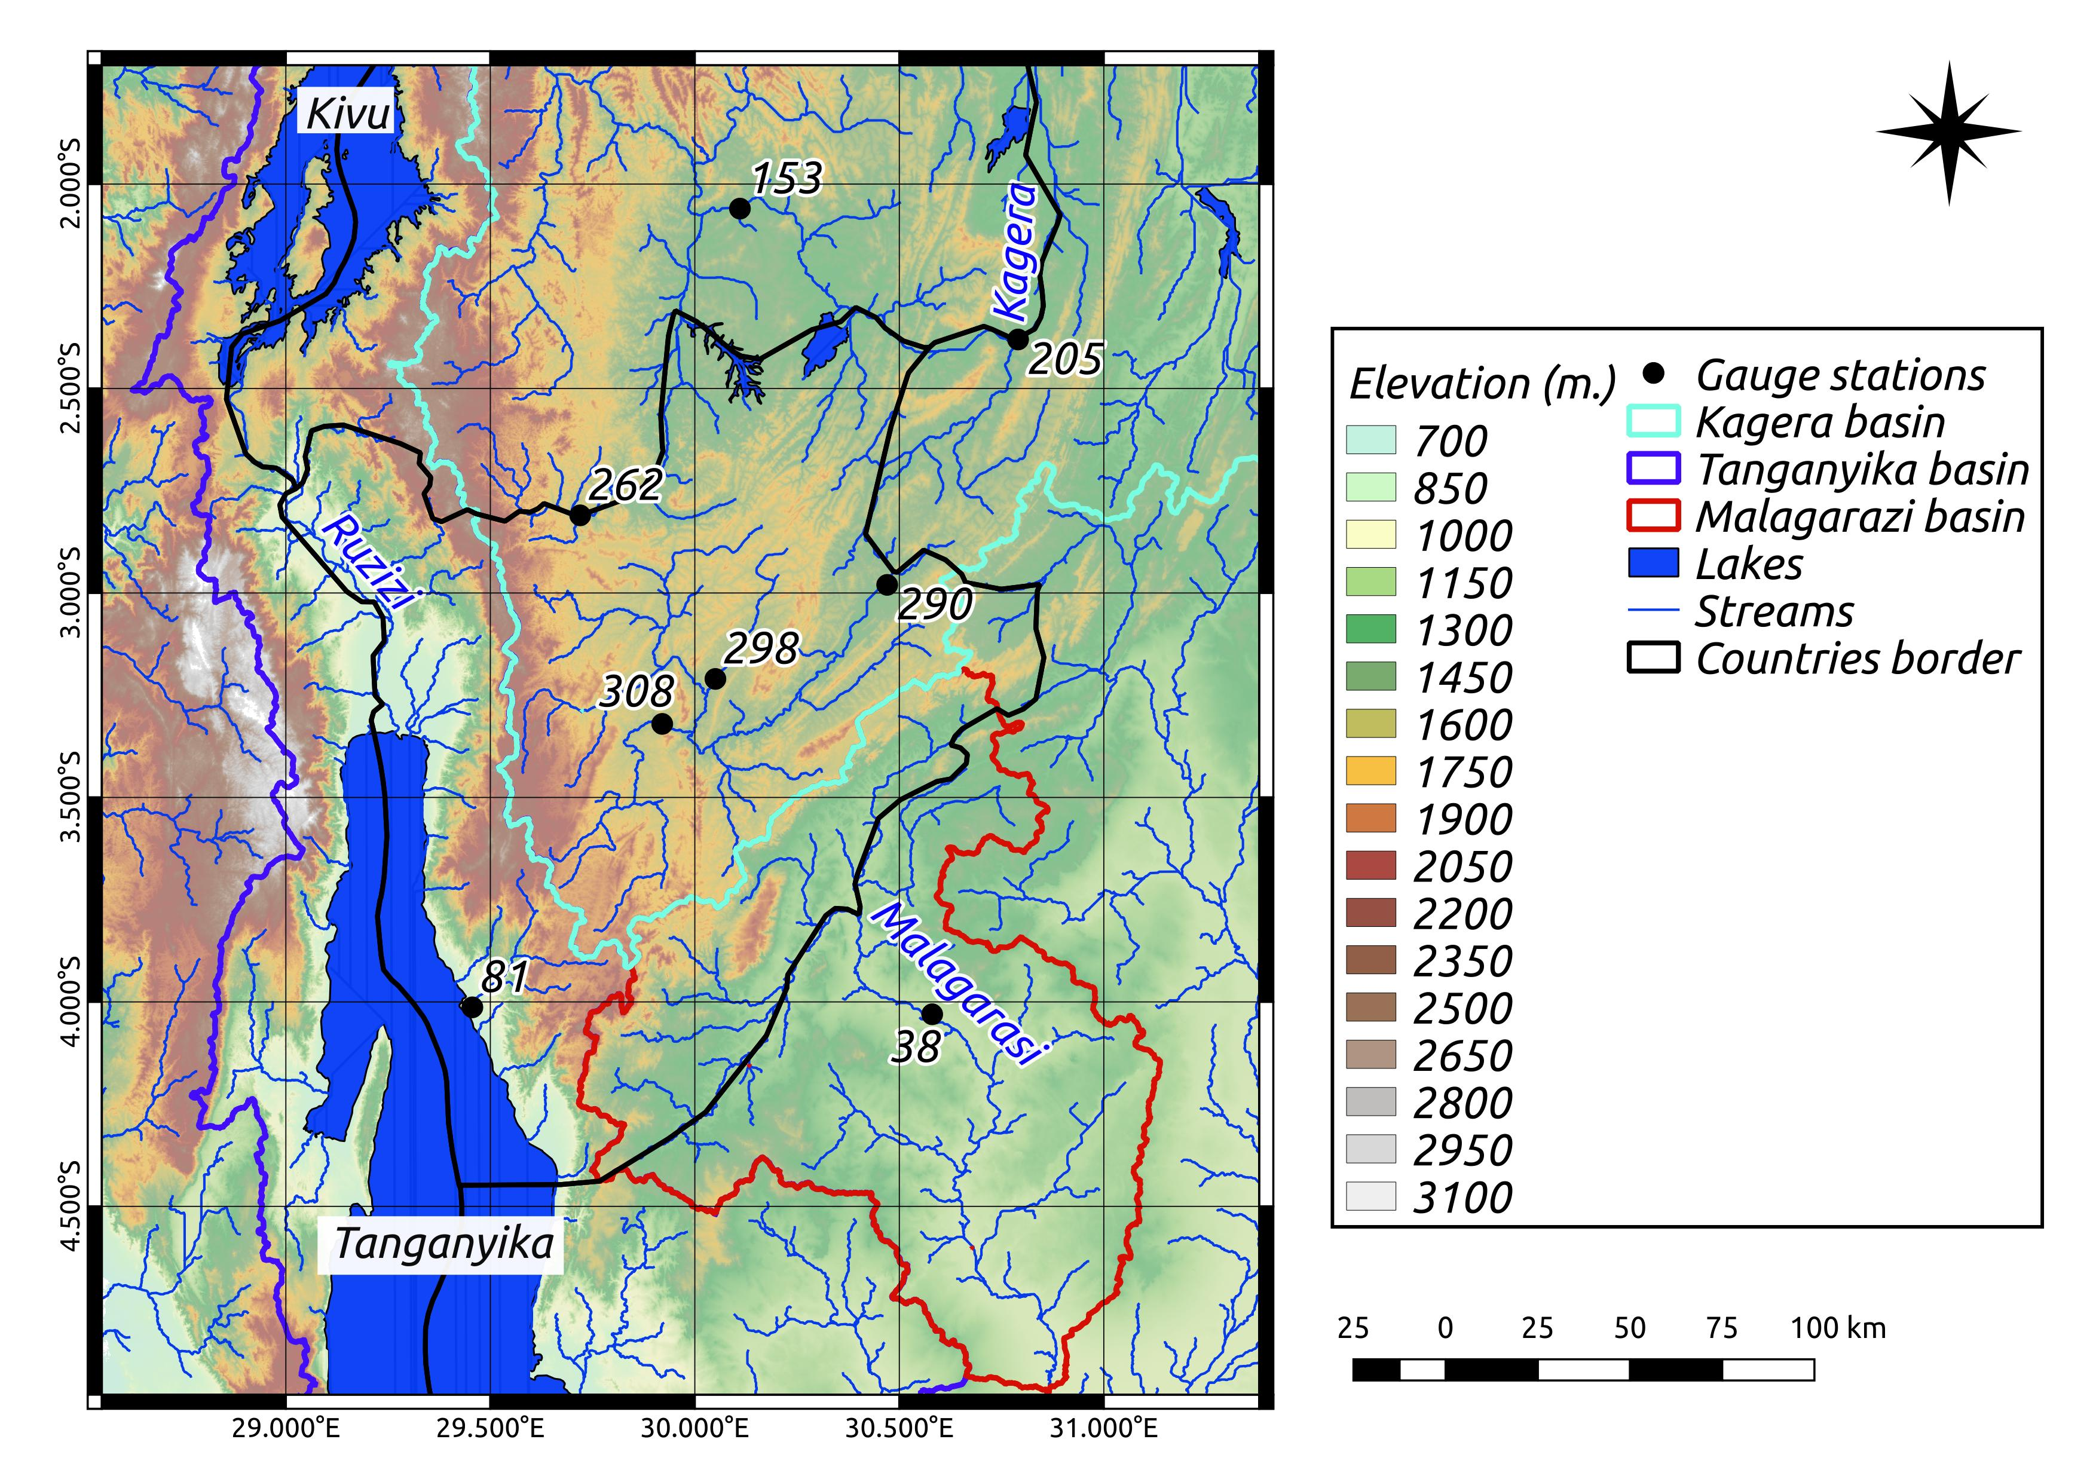
Data & Methods
Hydrological modelling:
  Elevation: SRTM90
  Land use map: GeoNetwork site of the FAO Africover Project (FAO-UN, 2009)
  Soil map: Harmonized Soil World Database v1.2 (HWSD) & Sotercaf project
  Calibration and validation:
    Climate data (WFD-ERA40)
    Observed Q:
      Global Runoff Data Centre (GRDC)
      Institute of Geography of Burundi (IGEBU, via GIZ)
Climate projections: CORDEX (13 RCMs)
  Climate scenarios: RCPs 4.5 and 8.5
  Periods: 1970-1999, 2030-2059, 2070-2099
<number>

Slide 5

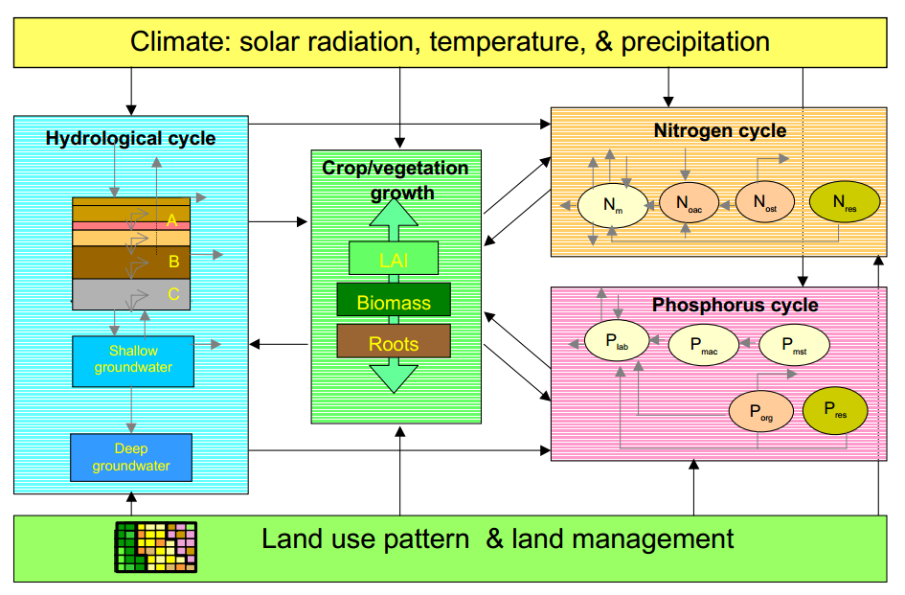
Data & Methods
SWIM: Soil and Water Integrated Model
  Semi-distributed eco-hydrological model
  Developed at PIK, based on SWAT & MATSALU
  Daily time step
  Three-level dis-aggregation scheme:
    Basin – subbasin – hydrotope or hydrological response unit (HRU)
    HRU= smallest unit that belong to the same subbasin, same soil and land use
River basins: Kagera, Malagarazi, and Tanganyika
Indicators:
  Long-term annual and monthly mean precipitation, temperature, and river discharge
  Extreme climate indicators (temp. and prec.)
  Extreme river discharge: Q5, Q10, Q90, Q95, HQ10, HQ25, AEP and T for HQx
Flow chart of the SWIM model, integrating hydrological processes, crop/vegetation growth, and nutrient dynamics
4

Slide 6
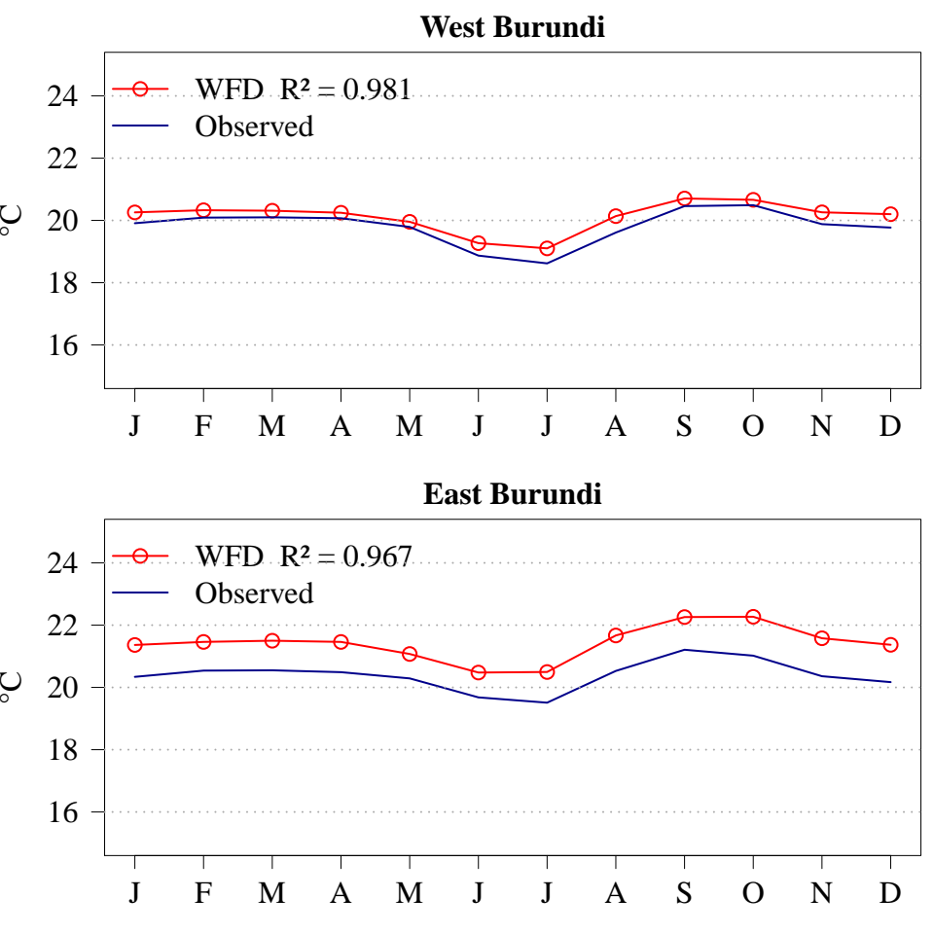
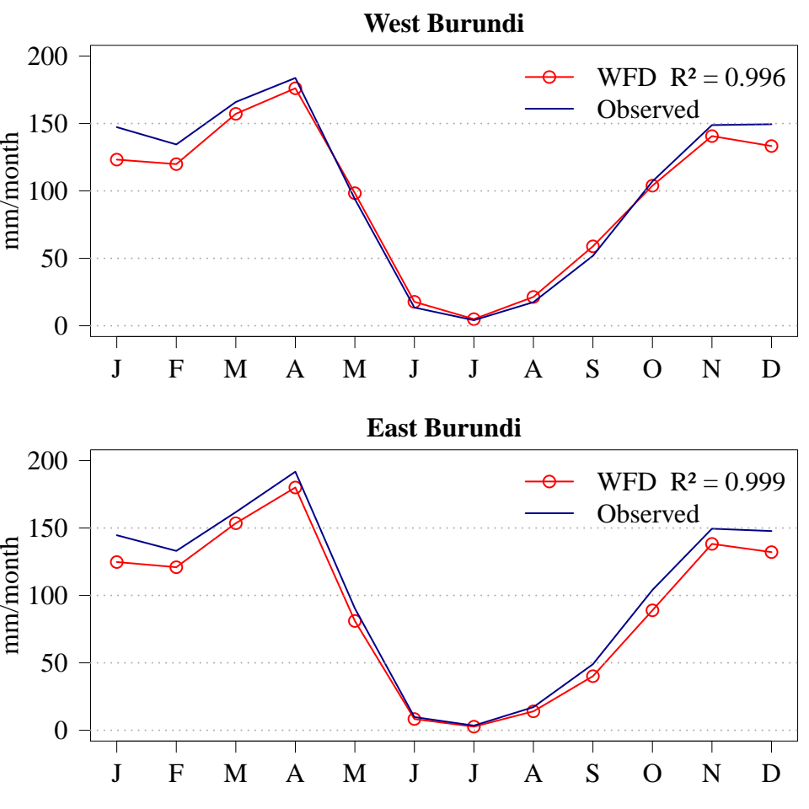
I. Results: Performance of WFD-ERA40 vs. observed climate
Temperature (1970-1999)
Precipitation (1970-1999)
5

Slide 7
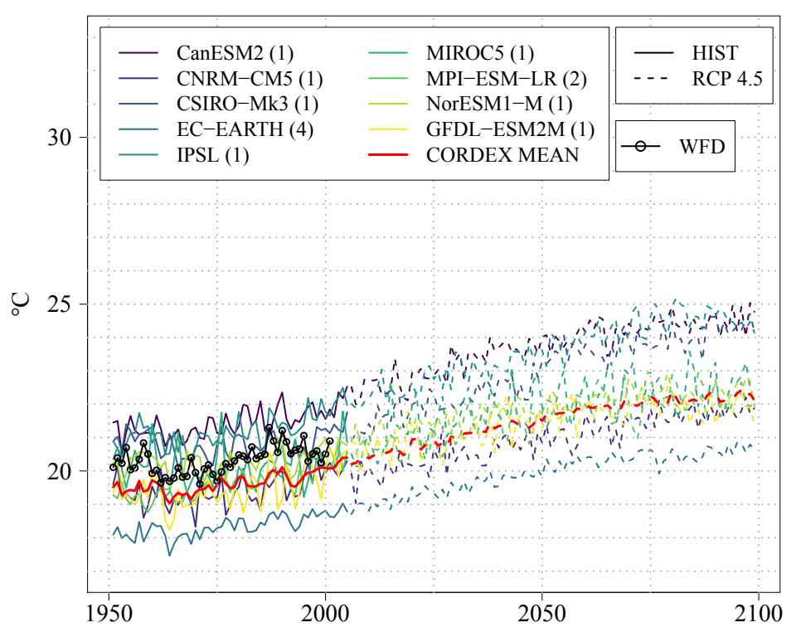
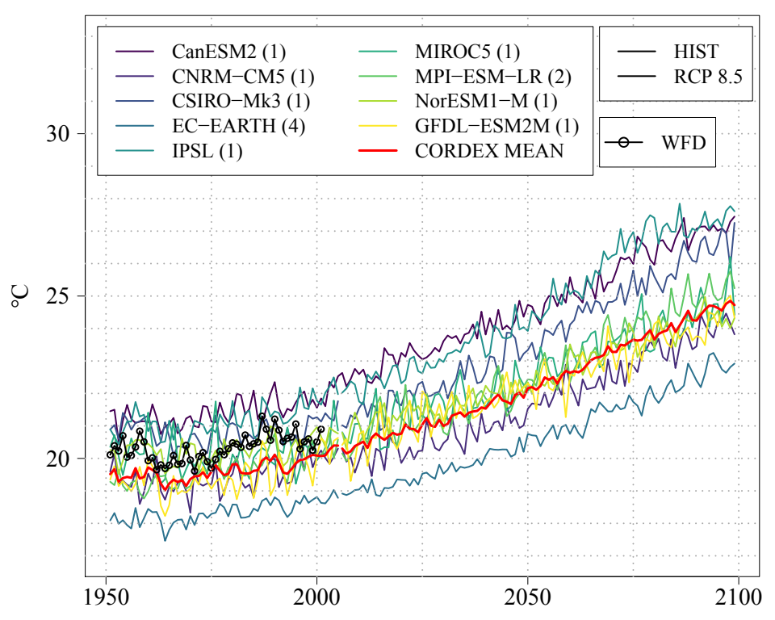
II. Results: Annual temperature projections from CORDEX
(vs. WFD-ERA40)
5

Slide 8
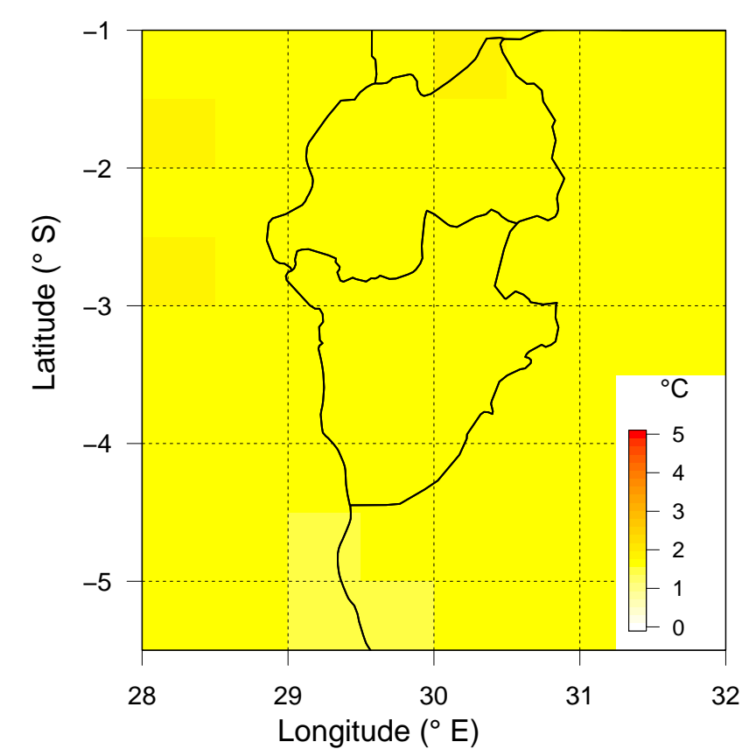
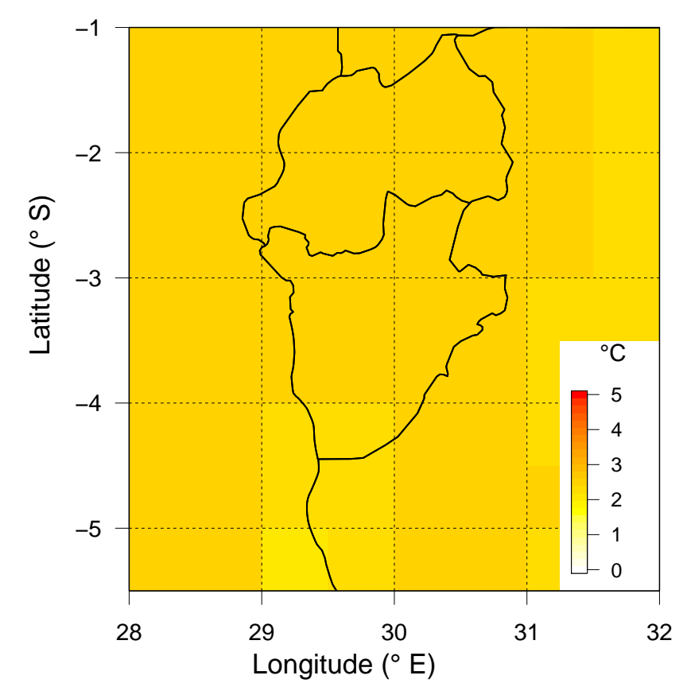
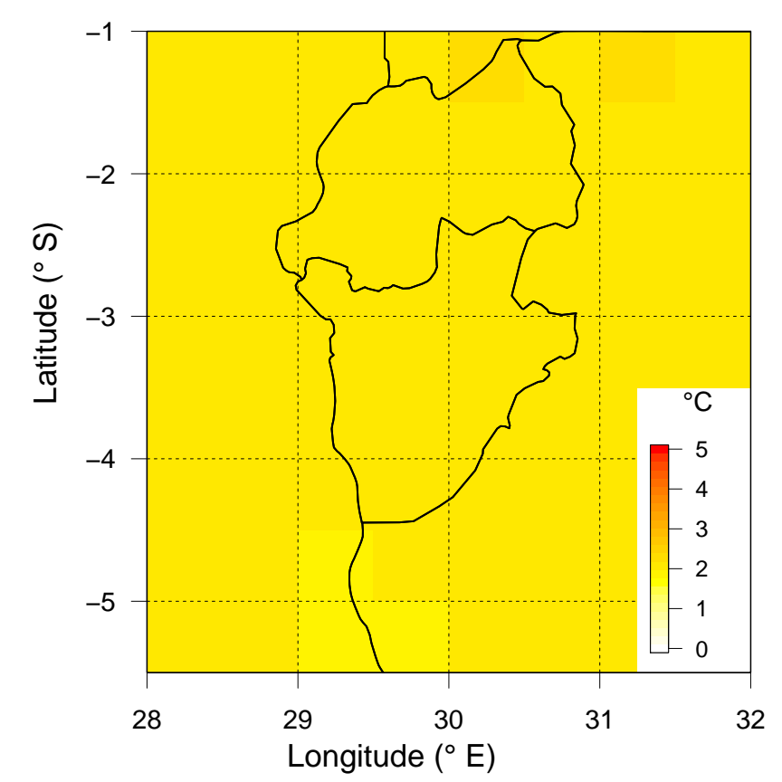
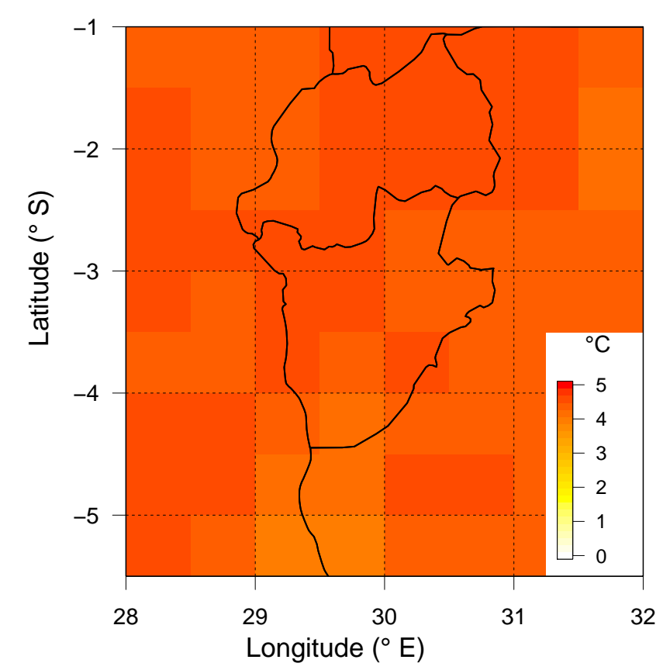
II. Results: Climate anomalies (long-term annual mean temp)
RCP4.5 -P1
RCP4.5-P2
RCP8.5-P1
RCP8.5-P2
+ 1.7°C
Models range: [1.3°C, 2.1°C]
+ 2.4°C
Models range:[1.9°C, 3.3°C]
+ 2.1°C
Models range:
[1.7°C, 2.7°C]
+ 4.4°C
Models range:
[3.6°C, 5.8°C]
5

Slide 9
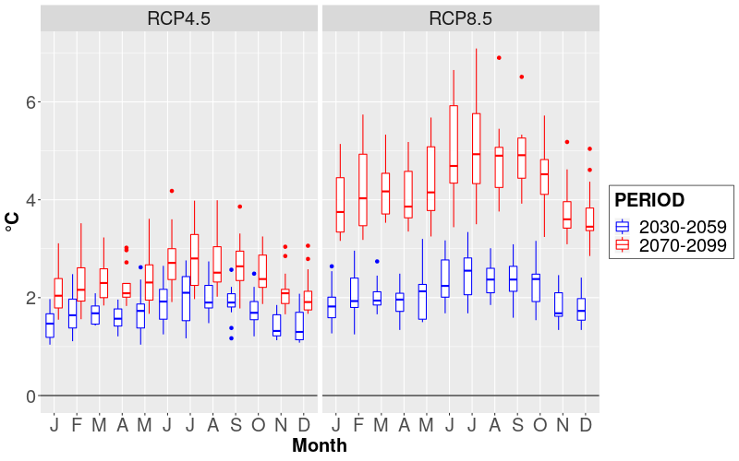
II. Results: Climate anomalies (seasonal temperature)
8

Slide 10
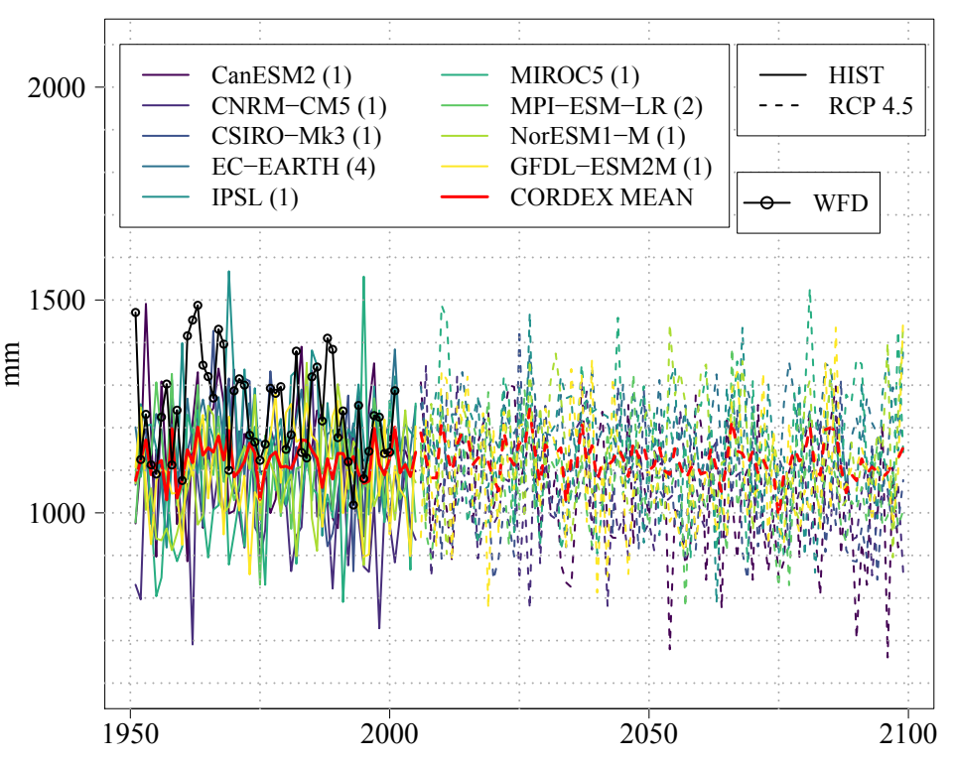
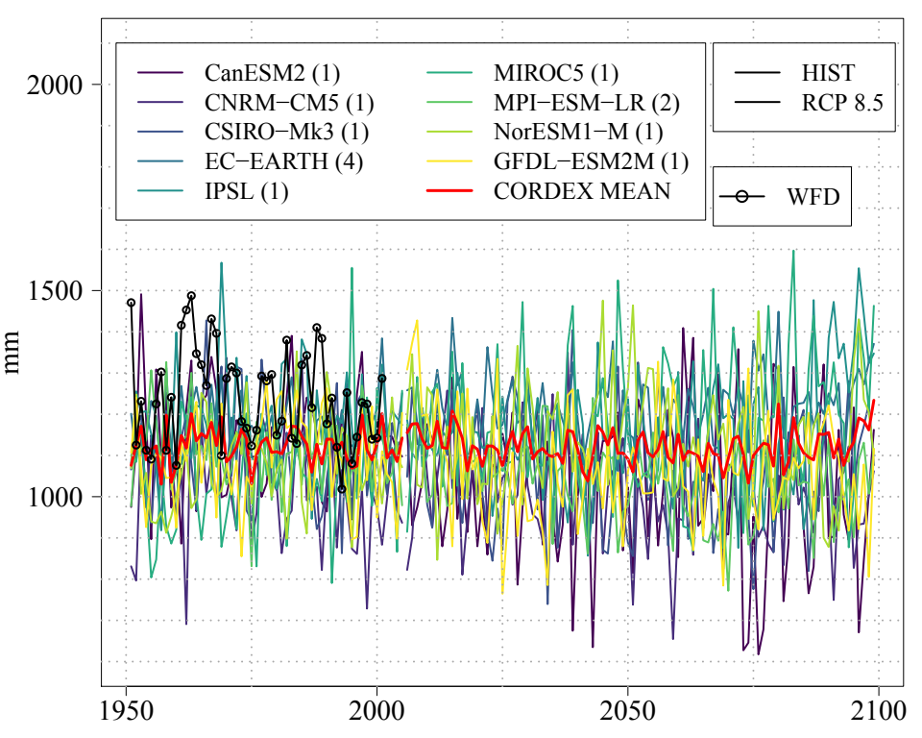
III. Results: Annual precipitation projections from CORDEX
(vs. WFD-ERA40)
8

Slide 11
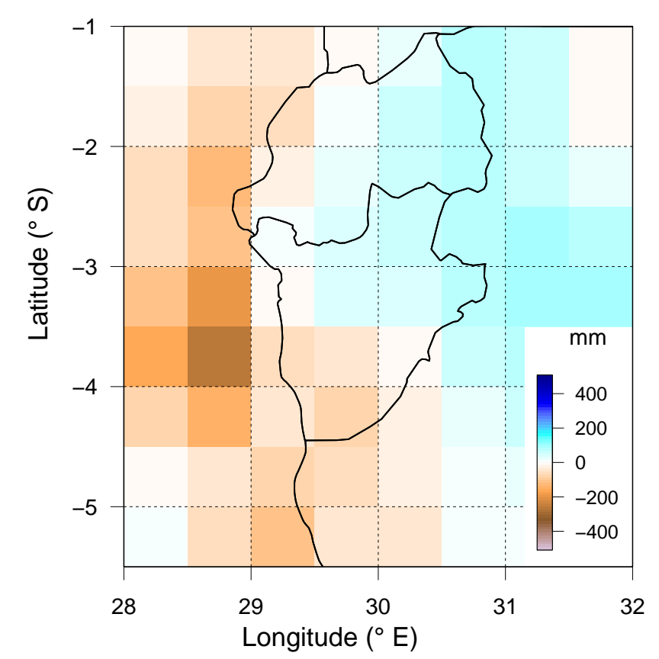
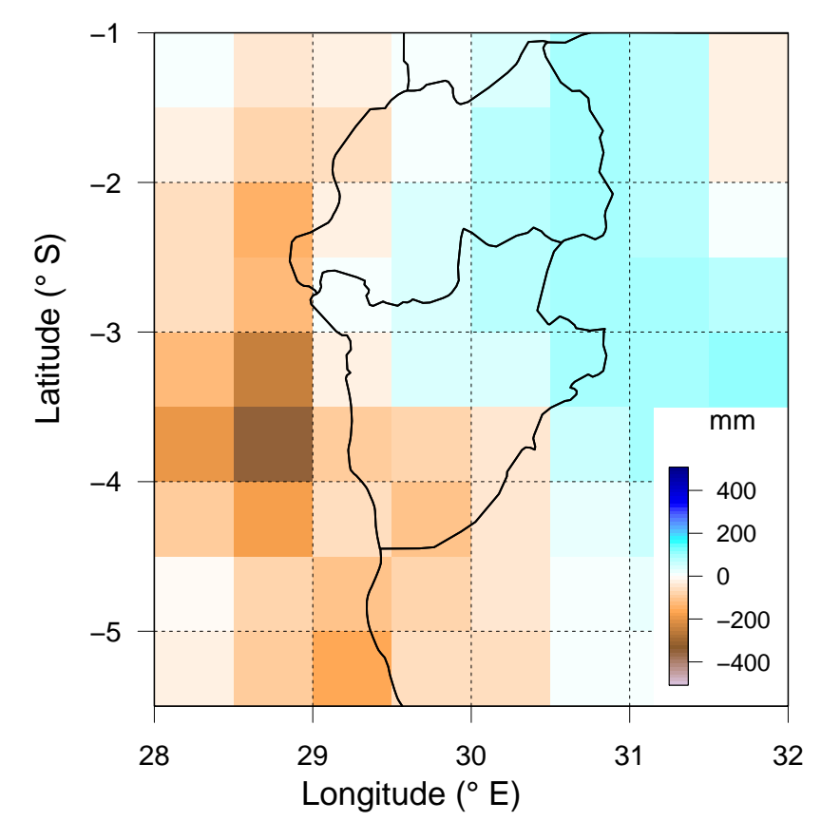
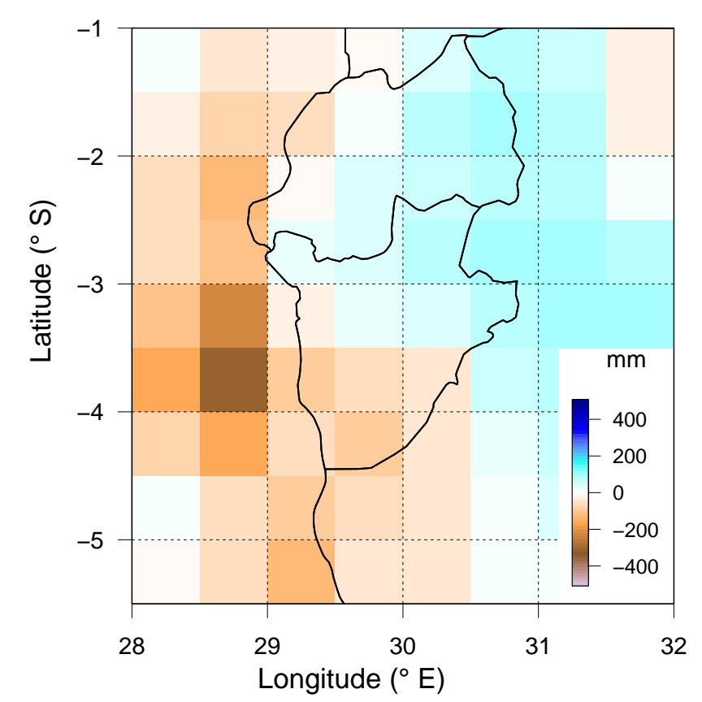
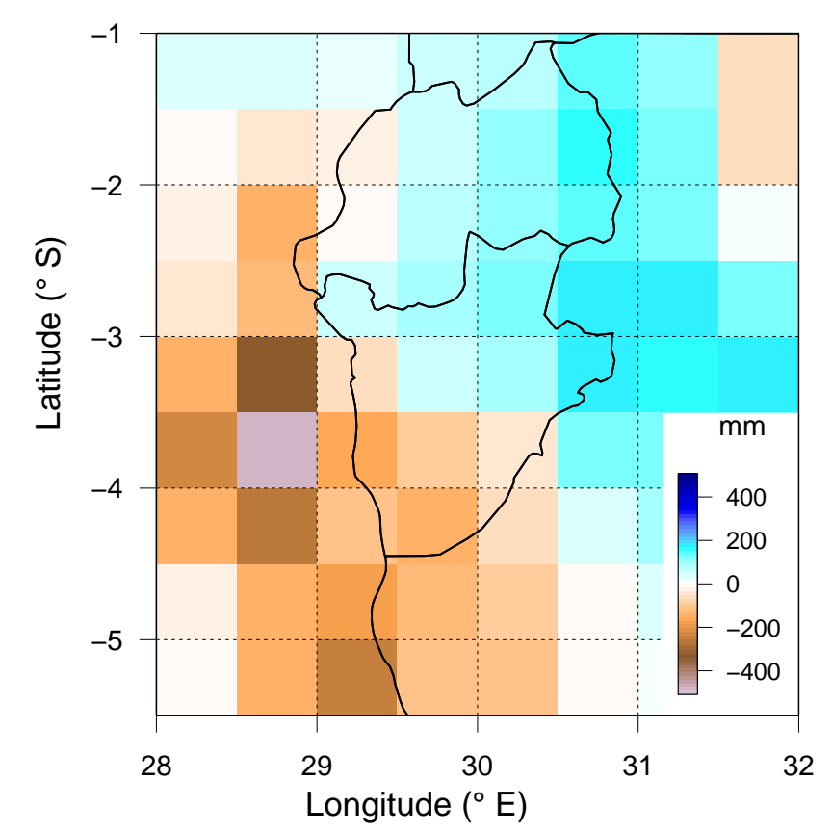
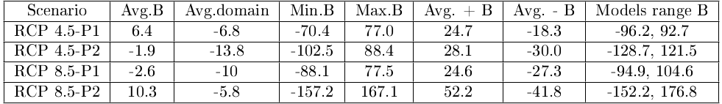
III. Results: Climate anomalies (long term annual mean prec)
RCP4.5 -P1
RCP4.5-P2
RCP8.5-P1
RCP8.5-P2
8

Slide 12
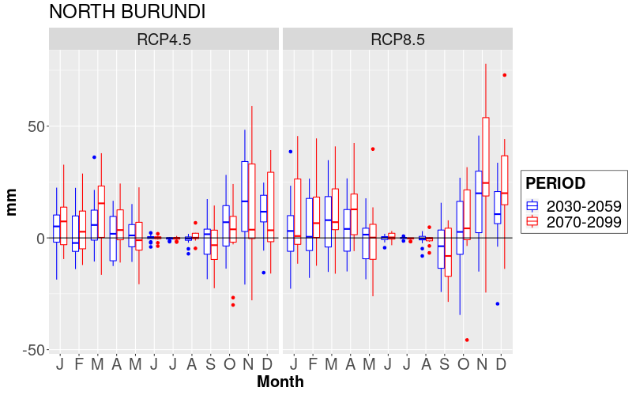
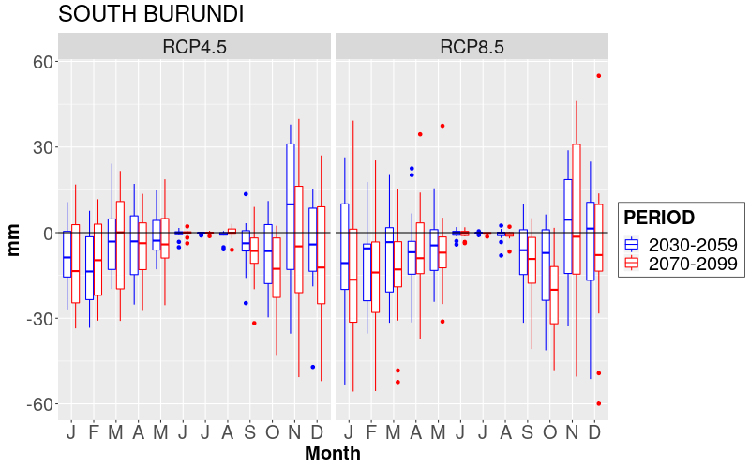
III. Results: Climate anomalies (seasonal prec. North/South)
11

Slide 13
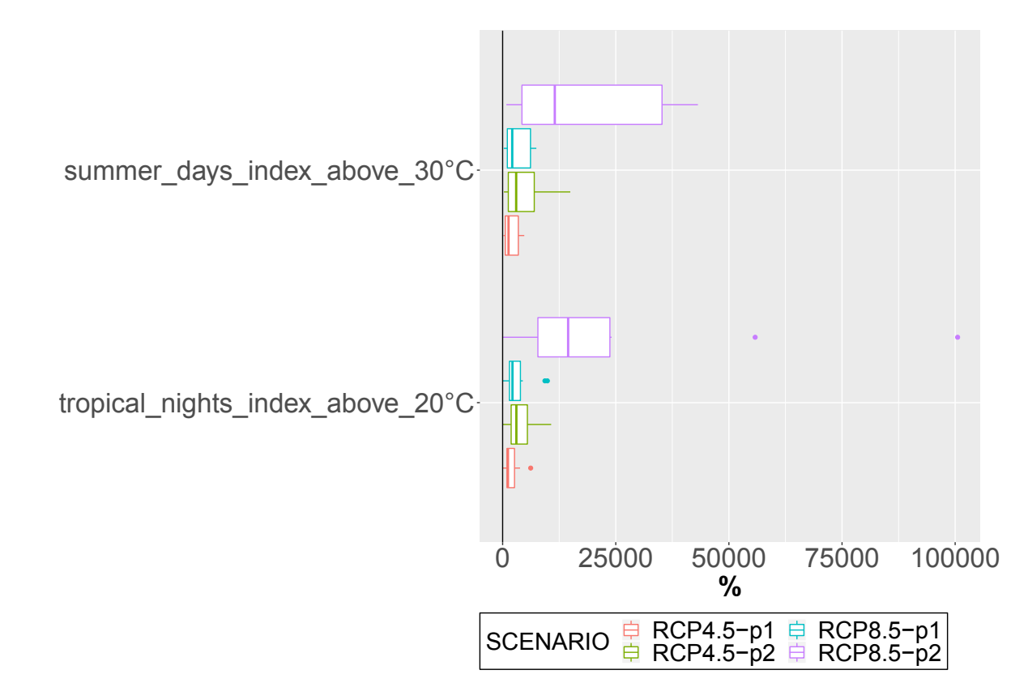
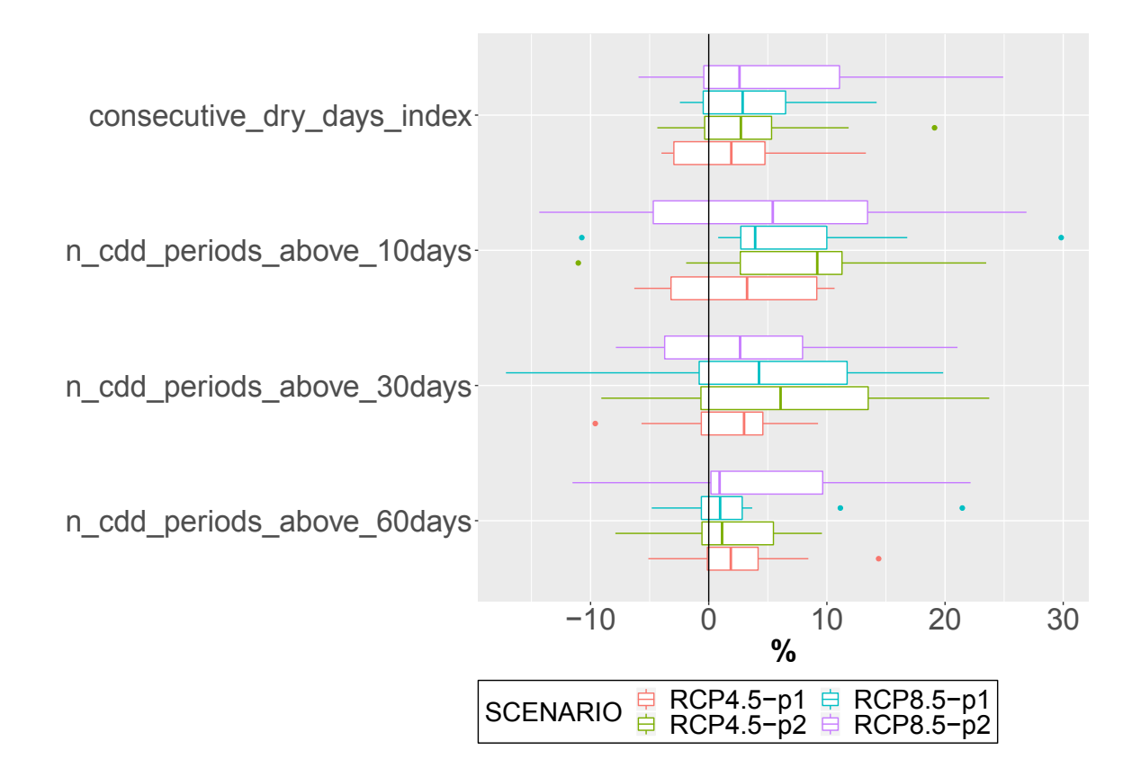
IV. Results: Climate extremes projected by CORDEX
Extreme temperature
Extreme low precipitation (frequency and duration)
11

Slide 14
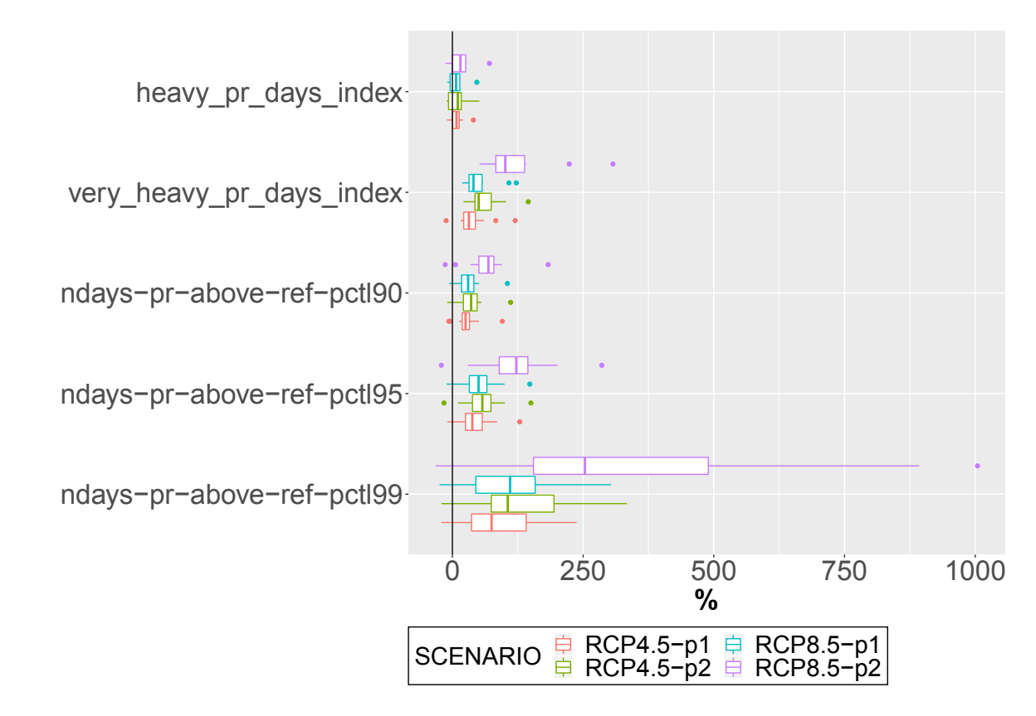
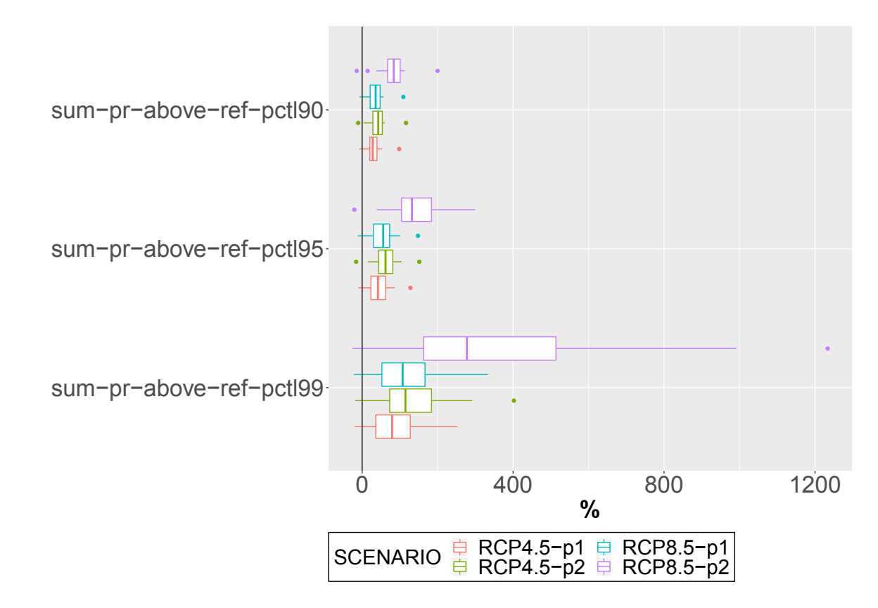
IV. Results: Climate extremes projected by CORDEX
Extreme high precipitation (frequency)
Extreme high precipitation (amount)
11

Slide 15
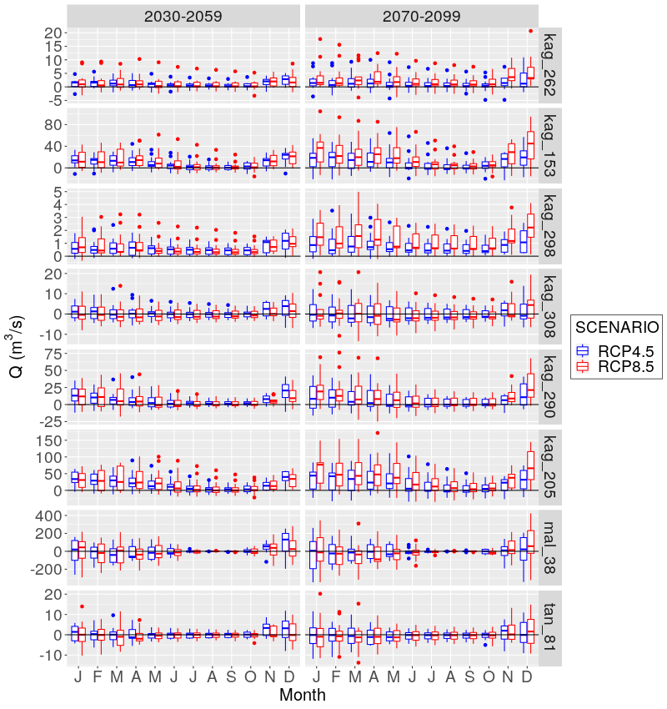
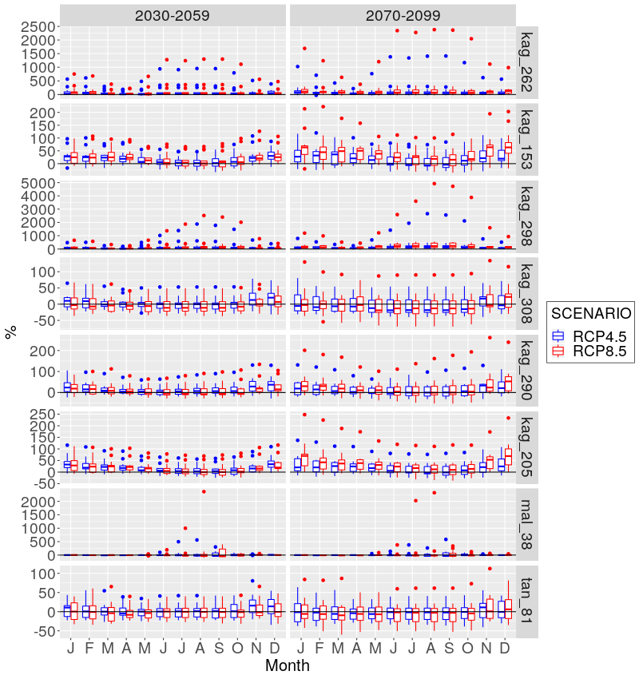
V. Results: Seasonal discharge
11

Slide 16
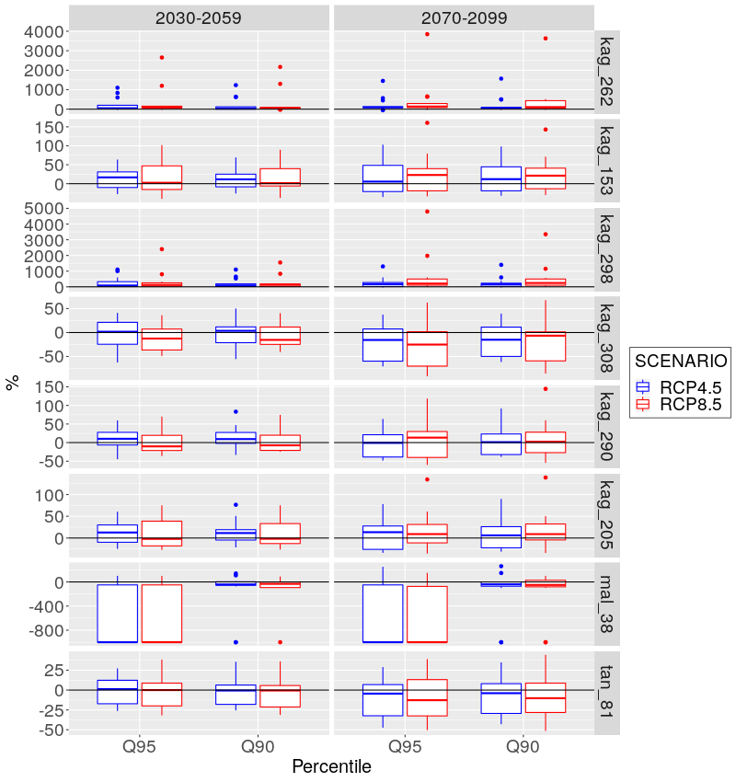
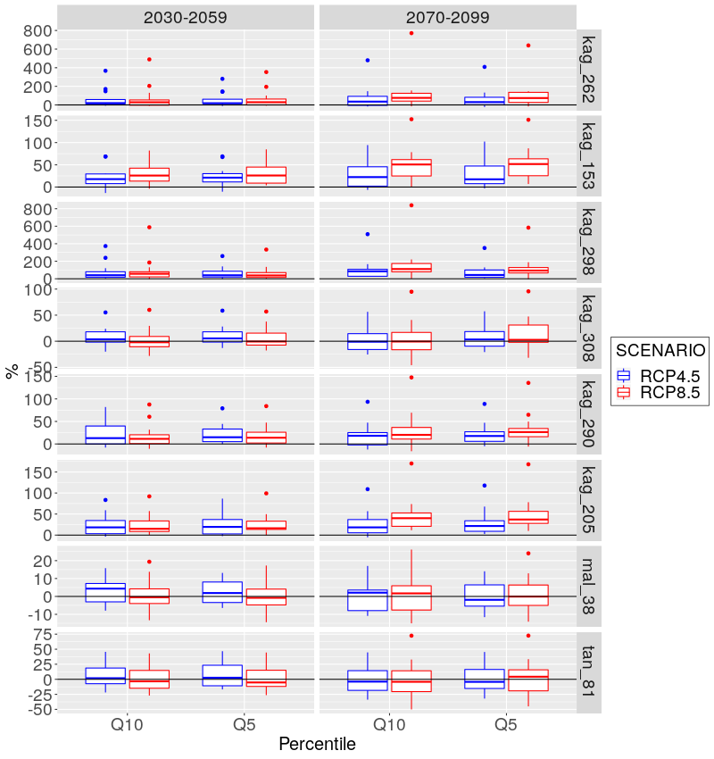
VI. Results: Extreme river discharge (low and high)
11

Slide 17
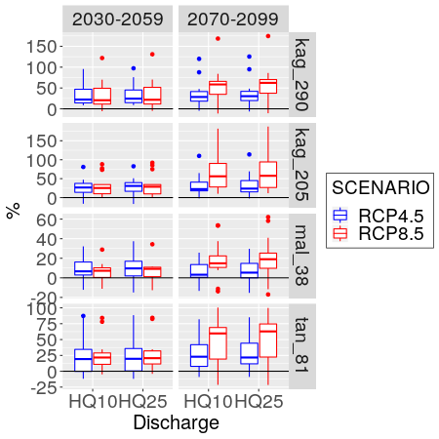
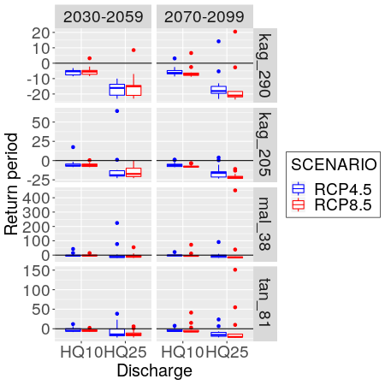
VII. Results: Changes in future for HQ10 and HQ25 (hist)
11

Slide 18
Conclusions
CORDEX RCMs projections over Burundi (BI) agree robustly on:
  A future warmer climate: increase in seasonal temperature in all scenarios, especially in the dry season.
  Precipitation will increase in the north, except during the dry season that may entail a prolongation due to decreases in September.
  Precipitation will decrease in the south (except November).
  Higher duration, frequency, magnitude, and intensity of extreme weather events (daily temperature, dry and wet events) over the region.
Changes in discharge:
  Increases of long-term annual mean discharge in North Burundi (up to 196% in small catchments and 40% in larger ones).
  The discharge in southern Burundi will decrease along the year (up to ~8%) with exceptions in the short rainy season (up to 17.7%) and RCP4.5.
  Higher daily and annual extreme river discharges, higher probabilities of exceedance, and lower associated recurrence intervals imply a higher risk of floods in magnitude and frequency in most of BI.
Adaptation is needed in the agriculture, water, and energy sectors!!!
<number>

