Slide 1




Three-dimensional numerical modelling of site effects in the Palatine Hill, Roman Forum, and Coliseum archaeological area
Razzano Roberto* (1,3), Moscatelli Massimiliano (1), Pagliaroli Alessandro (2), Giuseppe Lanzo (3), Mancini Marco (1), Stigliano Francesco (1).
1) Italian National Research Council – Institute of Environmental Geology and Geoengineering
2) University of Chieti-Pescara
3) Sapienza University of Rome
Notes:
In this study, we face the problem of local seismic response in historical center of Rome

Slide 2
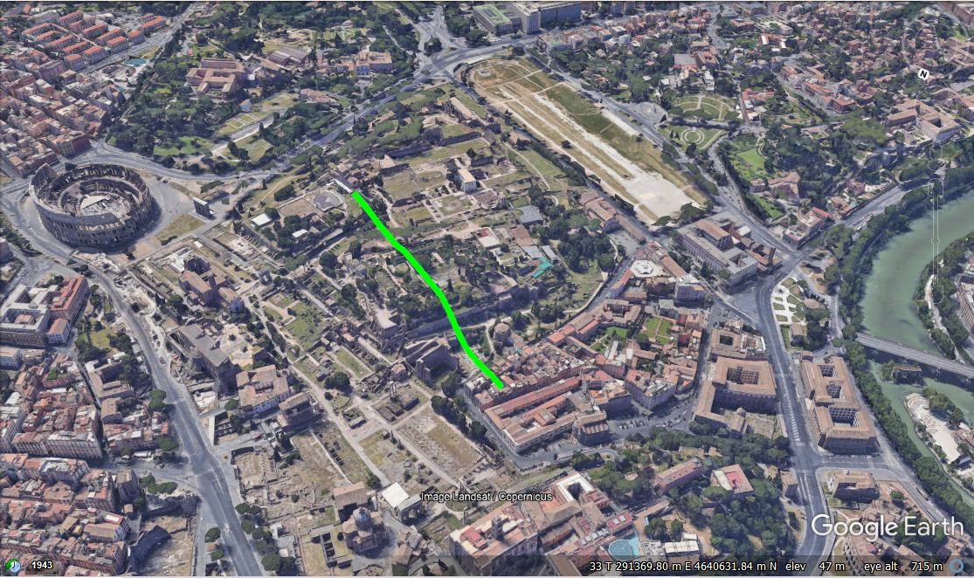
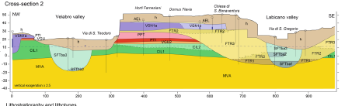
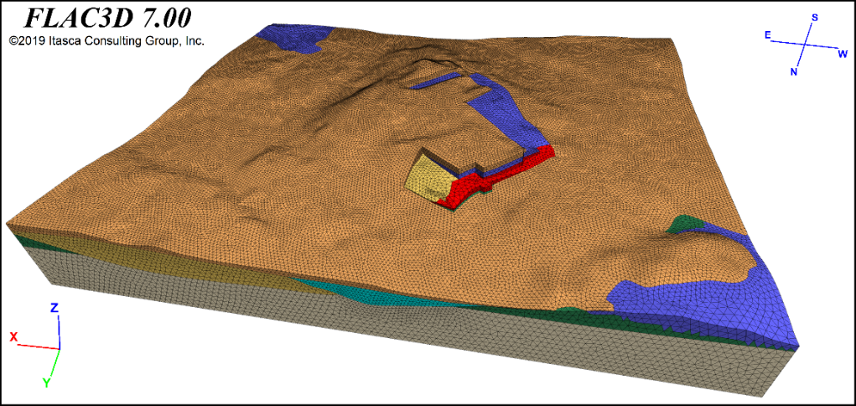
Introduction
The study area is characterized by complex site conditions (stratigraphy, dynamic properties, surficial and buried morphology, etc).
Circus Maximus
Colosseum area
Palatine Hill
Roman Forum
Linear properties of geotechnical units (Pagliaroli et al. 2013, Moscatelli et al. 2014)
Lithotype | Symbol | γ | VS | ν
[-] | [-] | (kN/m3) | (m/s) | (–)
Brick walls and conglomeratic | RPI_AEL | 18.0 | 350 | 0.42
Clayey-silty fluvial deposit | SFTba | 18.5 | 270 | 0.49
Massive lithoid tuff | VSN1a | 16.0 | 600 | 0.4
Pozzolanaceus tuff | VSN1b | 19.7 | 340 | 0.48
Tuff | PTI_PPT | 16.0 | 650 | 0.39
Silty, sandy silty | FRT | 20.1 | 510 | 0.465
Silty sand | CIL1_2 | 20.1 | 480 | 0.435
Sandy pebbly | CIL1 | 20.5 | 620 | 0.39
OC marine clay | MVA | 20.5 | 550 | 0.48
Notes:
with particular focus at Palatine Hill, Roman Forum, Circus Maximus, and Coliseum archaeological area, by using finite difference code FLAC3D.
The study area is characterized by complex site conditions in terms of stratigraphy, dynamic properties, surficial and buried morphology.

Slide 3
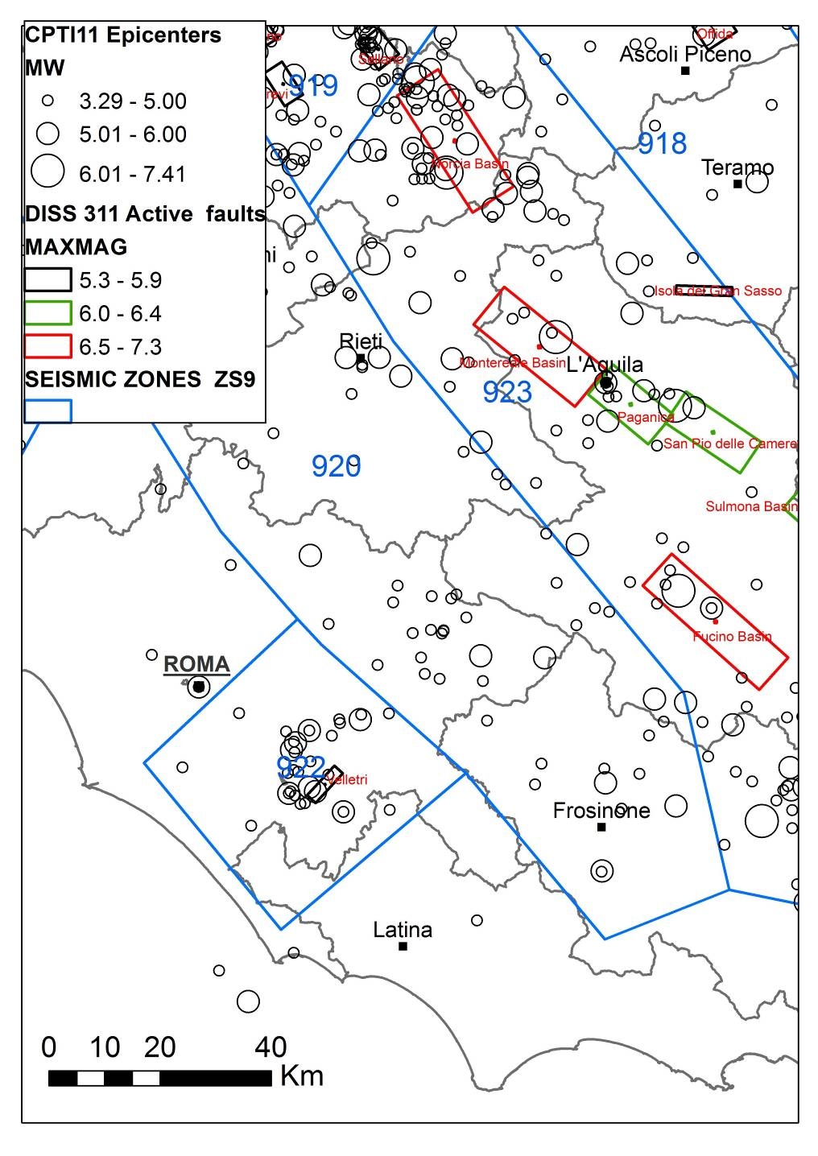
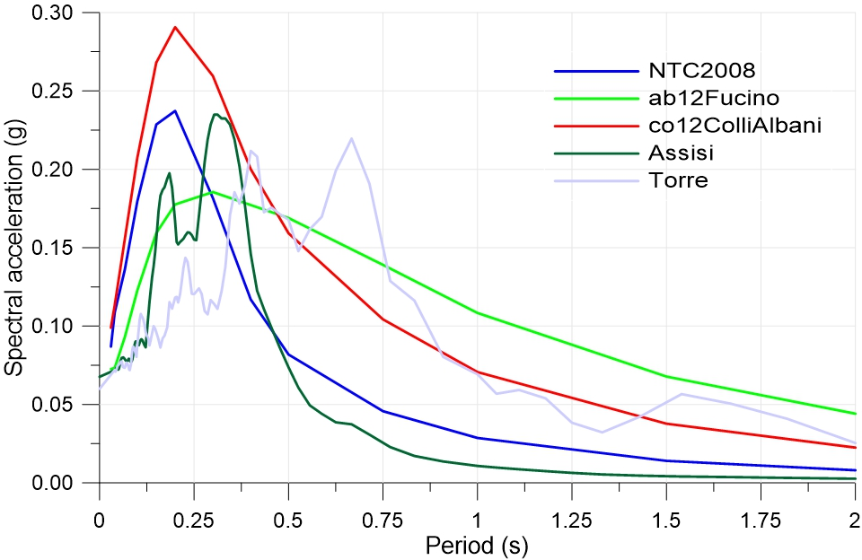
Input motion
The area of Rome is affected by earthquakes from different seismogenic districts: i) the central Apennine mountain chain (D = 90–130km and M = 6.7–7.0);
ii) the Colli Albani volcanic district area (D = 20km and M=5.5);
iii) Rome area itself characterized by rare, shallow, low-magnitude events (M < 5).
Both natural and artificial signals has been considered
Notes:
1) Probabilistic Seismic Hazard Assessment (PSHA):
Uniform hazard spectra from INGV 2004 map assuming a return period of 475 years (NTC-08 italian code); spectrum-compatible artificial recording was selected
2)Deterministic Seismic Hazard Assessment (DSHA):
two earthquake scenarios:1) Fucino basin source M=7, d=85 km 2) Colli Albani source M=5.5, d=20 km; natural and spectrum-compatible artificial recordings were selected

Slide 4
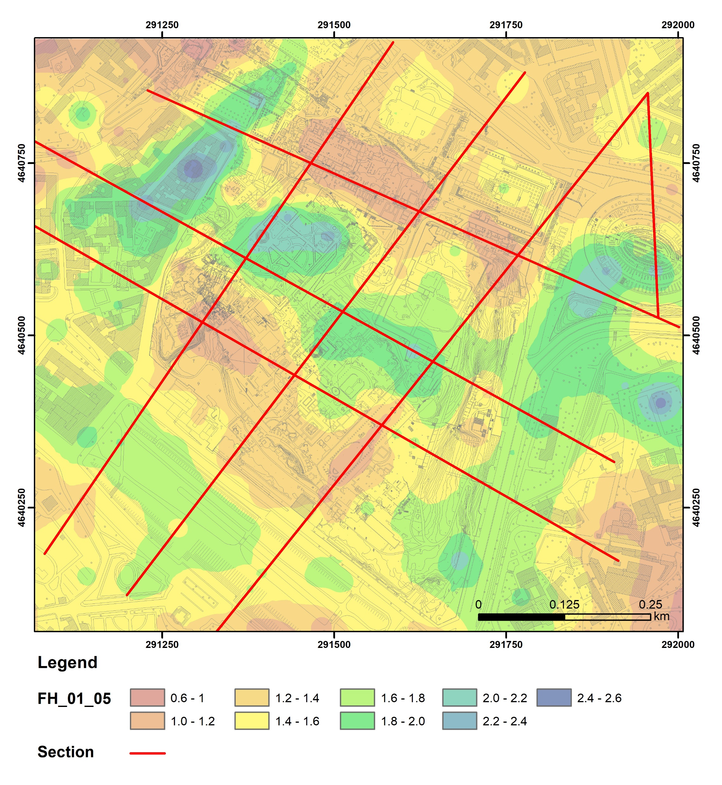
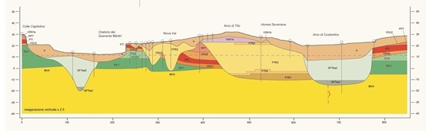
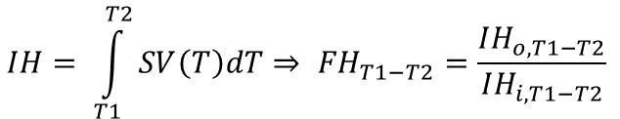
Numerical results
To evaluate the amplification of input motion, the amplification factor FH is defined as the ratio between Housner Intensity at ground surface (IH_{o}), and the corresponding input value (IH_{i}) applied at the base of model.
Section 3
a)
c)
$$IH= \int_{T1}^{T2}{SV\left(T\right)dT⇒ {FH}_{T1−T2}=\frac{{IH}_{o,T1−T2}}{{IH}_{i,T1−T2}} }$$
b)
d)
To considering the periods range T = 0.1 - 0.5 (which includes the natural periods of the structures in the study area) high values ​​of FH = 2.2-2.6 in correspondence narrow soft-filled valleys and top of Palatine hill
a)
b)
Section 3
Notes:
To evaluate the amplification of input motion, the amplification factor FH is defined as the ratio between Housner Intensity at ground surface (IHo), and the corresponding input value (IHi) applied at the base of model.
To considering the periods range T = 0.1 - 0.5, which includes the natural periods of the structures in the study area, high values ​​of FH = 2.2-2.6 in correspondence of Velabro Valley (a), the Colosseum area (b), the Horti Farnesiani (c) and Vigna Barberini (d) mainly due to the narrow valleys filled with soft material (SFT) and the thickness of the cover layer (RPI_AEL).

Slide 5
Conclusions/Remarks
the area of Rome is characterized by a low local seismicity, however, large amplifications are due to complex local conditions (stratigraphic and morphological-topographic);
numerical results confirmed that site conditions can have a significant influence in the historical urban center where the vulnerability is highest.

