Slide 1
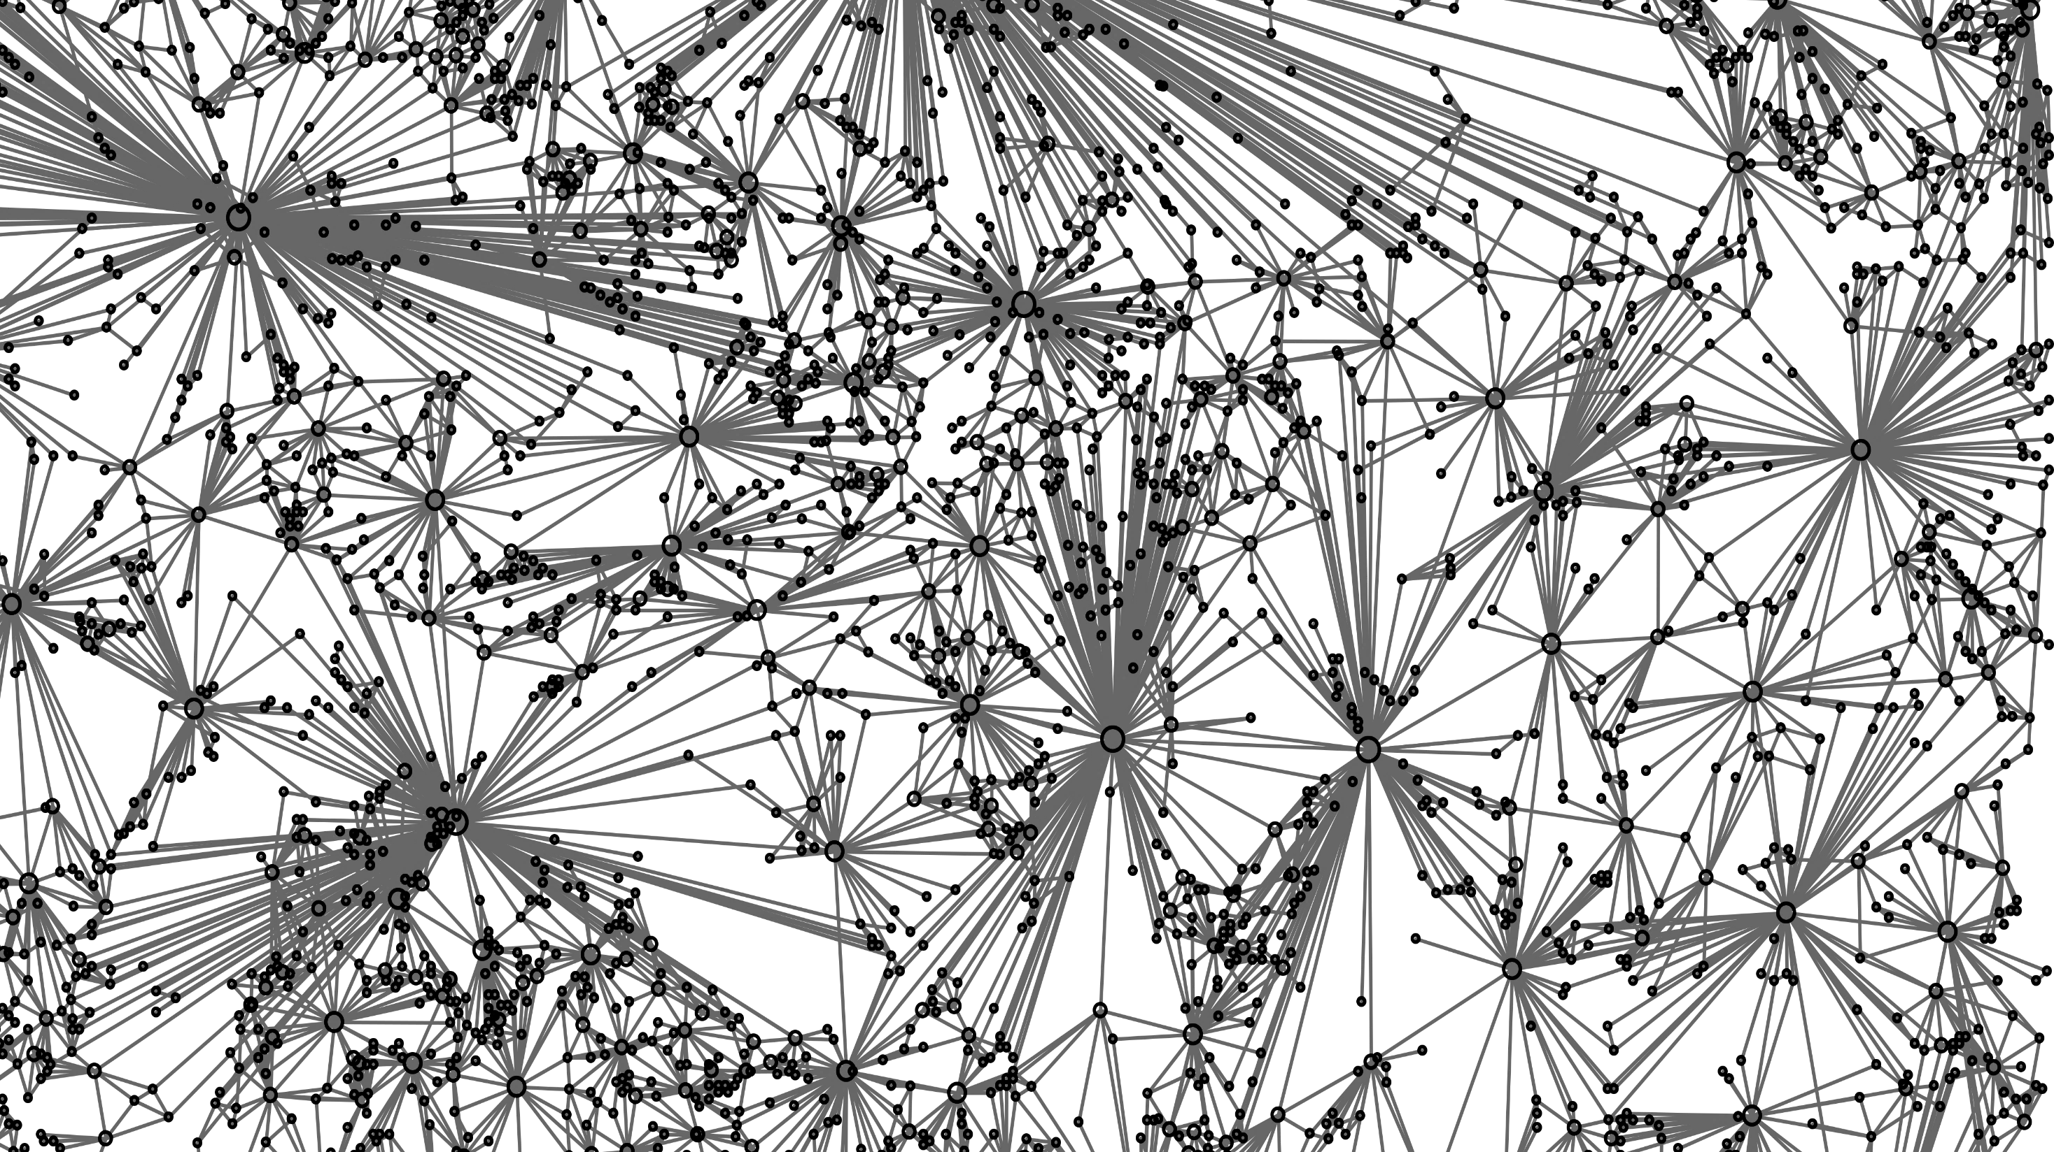








Combining wildfire behaviour simulations and complex network theory to support decision-making: A case-study in a Mediterranean region
Bruno A. Aparício¹, Ana C.L. Sá¹, Francisco C. Santos², Chiara Bruni¹, and José M.C. Pereira¹
¹University of Lisbon, School of Agriculture, Forest Research Centre, Lisbon, Portugal
²INESC-ID and Instituto Superior Técnico, Universidade de Lisboa, IST-Taguspark, 2744-016 Porto Salvo, Portugal
bruno.a.aparicio@gmail.com
@AparicioBruno

Slide 2
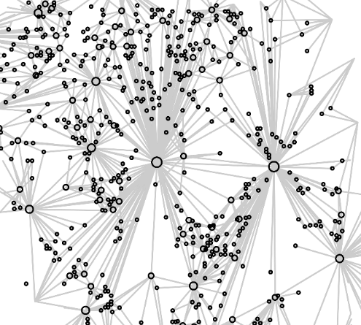





Our approach
  Currently, there are many models to simulate fire behaviour;
  The models’ outputs are very specific (e.g. fireline intensity, rate of spread, etc.), which are difficult to communication to decision-makers;
  We combined complex network theory to interpret the models’ outputs

Slide 3
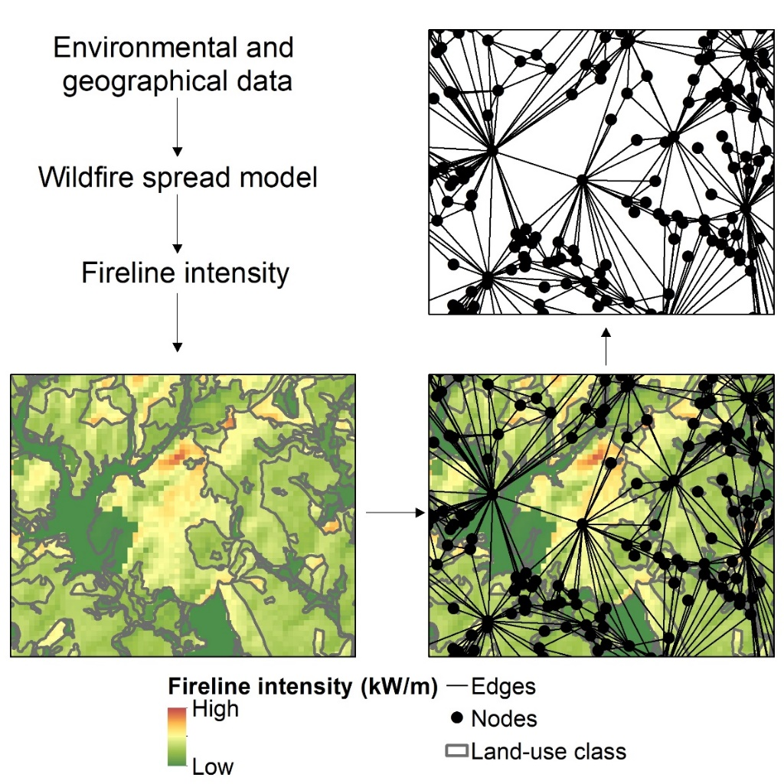
Our approach
  Currently, there are many models to simulate fire behaviour;
  The models’ outputs are very specific (e.g. fireline intensity, rate of spread, etc.), which are difficult to communication to decision-makers;
  We combined complex network theory to interpret the models’ outputs

Slide 4
Metrics
Betweenness centrality
  Which are the most important areas for wildfire transmission
Nodes with high intensity
Nodes with medium intensity
Nodes with low intensity

Slide 5
Metrics
Betweenness centrality
Giant Component
  Which are the most important areas for wildfire transmission
  Largest amount of area that have the potential to burn with little opportunities for ground-base suppression
Nodes with high intensity
Nodes where ground-base suppression has a low effectiveness
Nodes with medium intensity
Nodes with low intensity

Slide 6
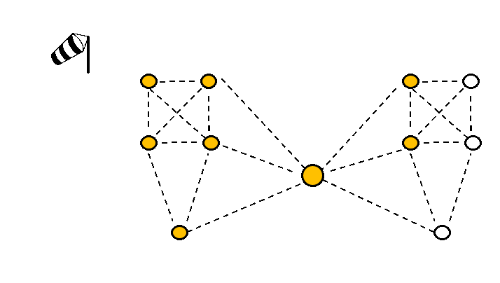
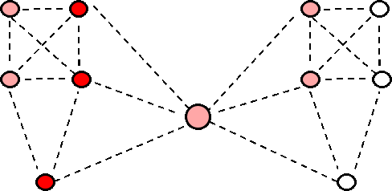
Metrics
Betweenness centrality
Giant Component
Directional Index of Wildfire Connectivity
  Which are the most important areas for wildfire transmission
  Largest amount of area that have the potential to burn with little opportunities for ground-base suppression
  Identify the most important areas for connectivity
Nodes with high intensity
Nodes where ground-base suppression has a low effectiveness
Nodes with high intensity
Nodes with medium intensity
Nodes with medium intensity
Nodes with low intensity
Nodes with low intensity

Slide 7
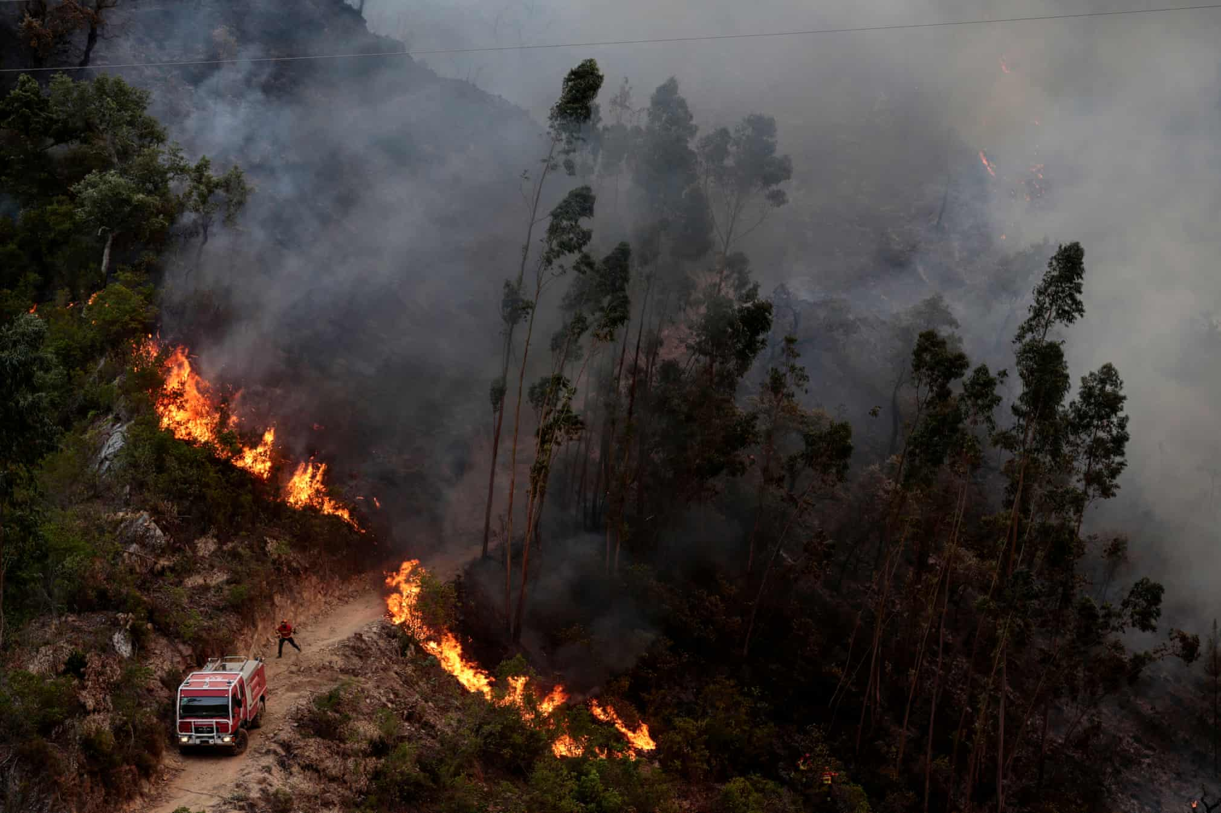
Case-study: Monchique Mountain, Portugal
Source: Filipe Farinha/EPA

Slide 8
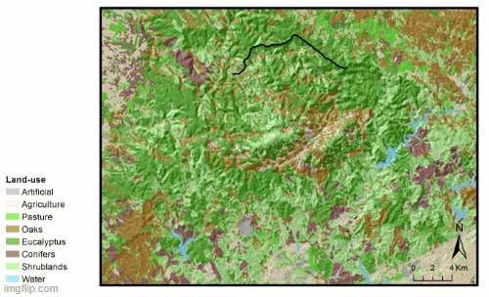


Identifying priority fuelbreaks
Randomly “implement” fuelbreaks, until the all fuelbreak network was “implemented”;
After the “implementation” of each fuelbreak, we ran a new simulation;
The graph-based metrics were calculated after each simulation
Quantify the effectiveness of each fuelbreak

Slide 9
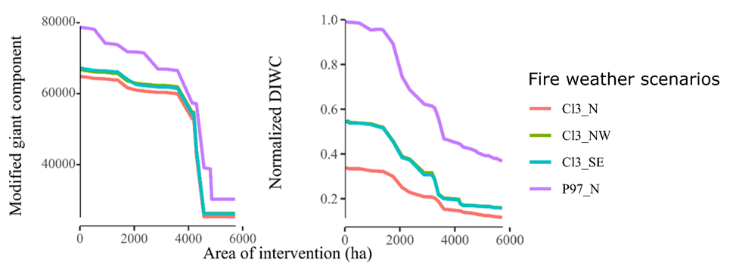
Identifying priority fuelbreaks
Randomly “implement” fuelbreaks, until the all fuelbreak network was “implemented”;
After the “implementation” of each fuelbreak, we ran a new simulation;
The graph-based metrics were calculated after each simulation
Which are the priority fuelbreaks?
Quantify the effectiveness of each fuelbreak

Slide 10
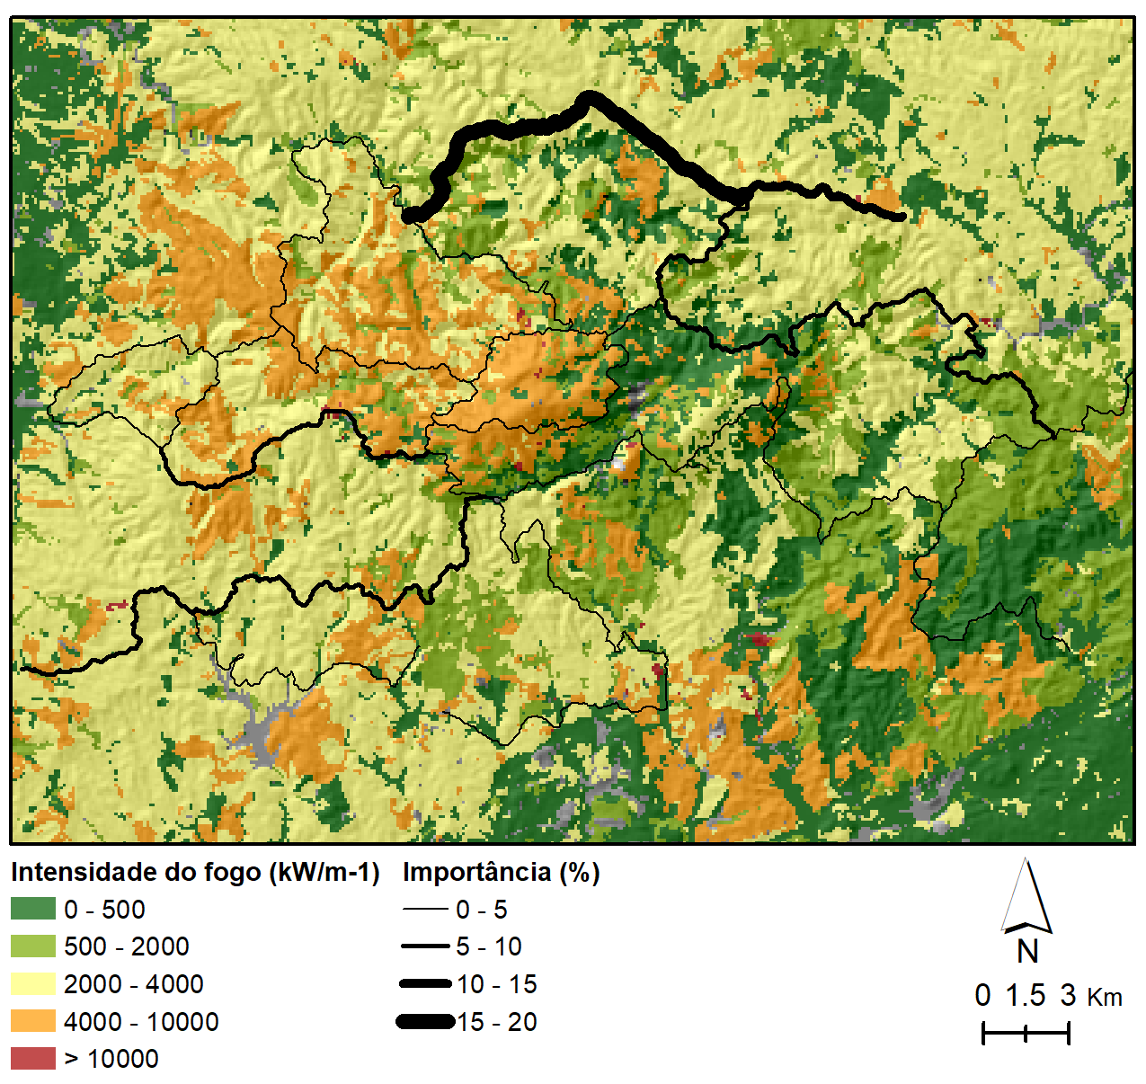
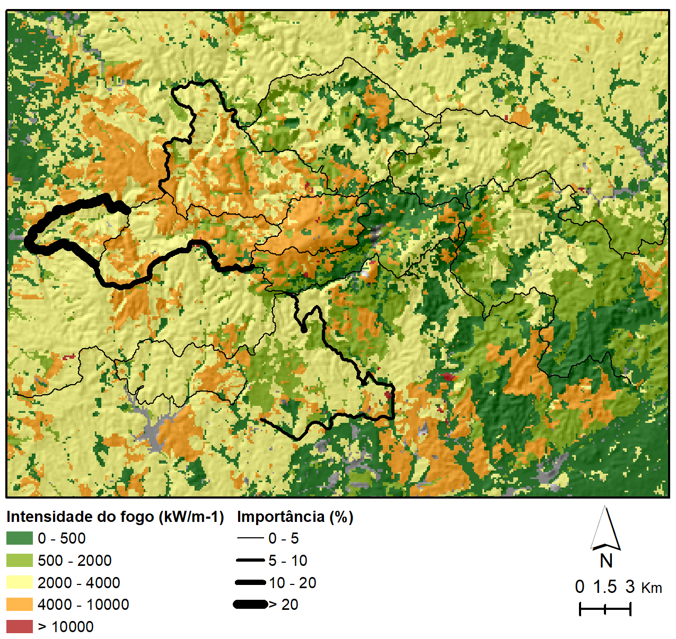



Identifying priority fuelbreaks
Directional Index of Wildfire Connectivity
Giant Component

Slide 11
Take-home messages
AND
Wildfire behaviour simulations
Complex Network Theory
1
Characterize the landscape using complementary metrics
2
Identify priority areas for fuel reduction
3
Support decision-making

Slide 12
Thank you!
bruno.a.aparicio@gmail.com
@AparicioBruno

