Slide 1
Fired clay from Neolithic houses – the role of past environment revealed in mineral magnetic properties
vEGU21: Gather Online
Neli Jordanova*, Diana Jordanova, Deyan Lesigyarski, Maria Kostadinova-Avramova
National Institute of Geophysics, Geodesy and Geography
Bulgarian Academy of Sciences

Slide 2
INTRODUCTION
 Burnt clay is the most abundant archaeological material from the Neolithic period, but it is still relatively under-explored. Decoding its signature can provide valuable information about different aspects of ancient societies and the level of technological development.
 Burnt Neolithic remains are often related to ancient houses which ended their existence as a result of extensive fire.
Thus, firing process during settlement burning developed in native atmosphere in the past environment.
General atmospheric conditions (oxygen content, moisture, air temperature, etc.) are specific for certain time period and territory
THE AIM OF THE STUDY WAS TO EXPLORE THE MAGNETIC SIGNATURE OF FIRED CLAY MATERIALS FROM NEOLITHIC HOUSES IN RELATION TO THE MOST IMPORTANT ENVIRONMENTAL FACTORS

Slide 3
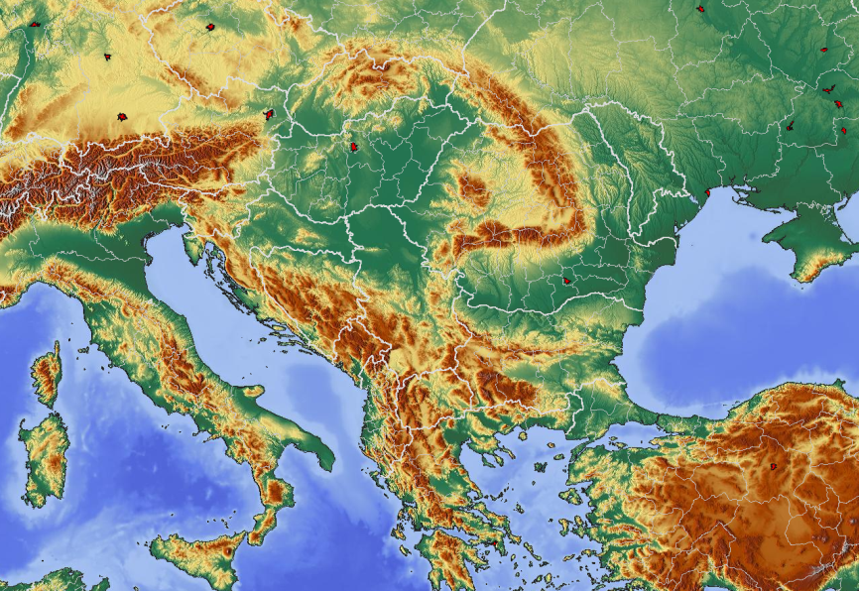
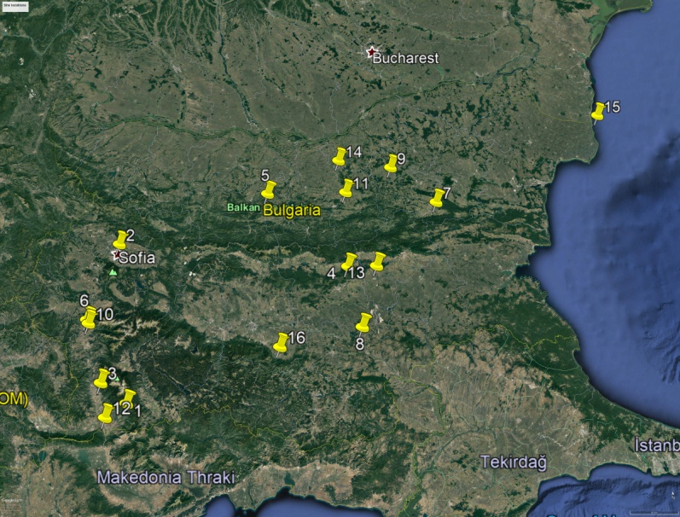
SITES
Abundant Neolithic sites are present on Bulgaria’s territory since its geographical location on the Balkan Peninsula provides a bridge between the Asia and Europe (Fig. 1). Burnt clay remains from 18 sites, dated from the local Early Neolithic to Eneolithic (~6000 B.C. - ~4000 B.C.,) were studied using mineral magnetic techniques.
Several sites (Kovachevo, Sofia and Durankulak) include two or three sets of samples depending on the archaeomagnetic dating of the sampled structures. After the chronological division the total number of archeological sites investigated amounts to 20.
 One sub-set of the sites is situated along the Struma (Strymon) river valley which is considered the major route for Neolithic expansion through the Balkan Peninsula
 Another sub-set is situated in the low-Danube Plain, north of the Balkan range
Figure 1. Study area and sites location:
Kovachevo (1); Slatina Sofia (2); Ilindentzi (3); Stara Zagora (4); Samovodene (5); Mursalevo No16 (6); Varbitza (7); Mursalevo No14 (6); Chavdarova cheshma (8); Popovo (9); Sharkov chiflik (10); Katchitza (11); Topolnitza (12); Nova Zagora (13); Petko Karavelovo (14); Durankulak (15); Dolnoslav (16).
Materials gathered from burnt clay materials. The whole collection studied consists of 117 samples.

Slide 4
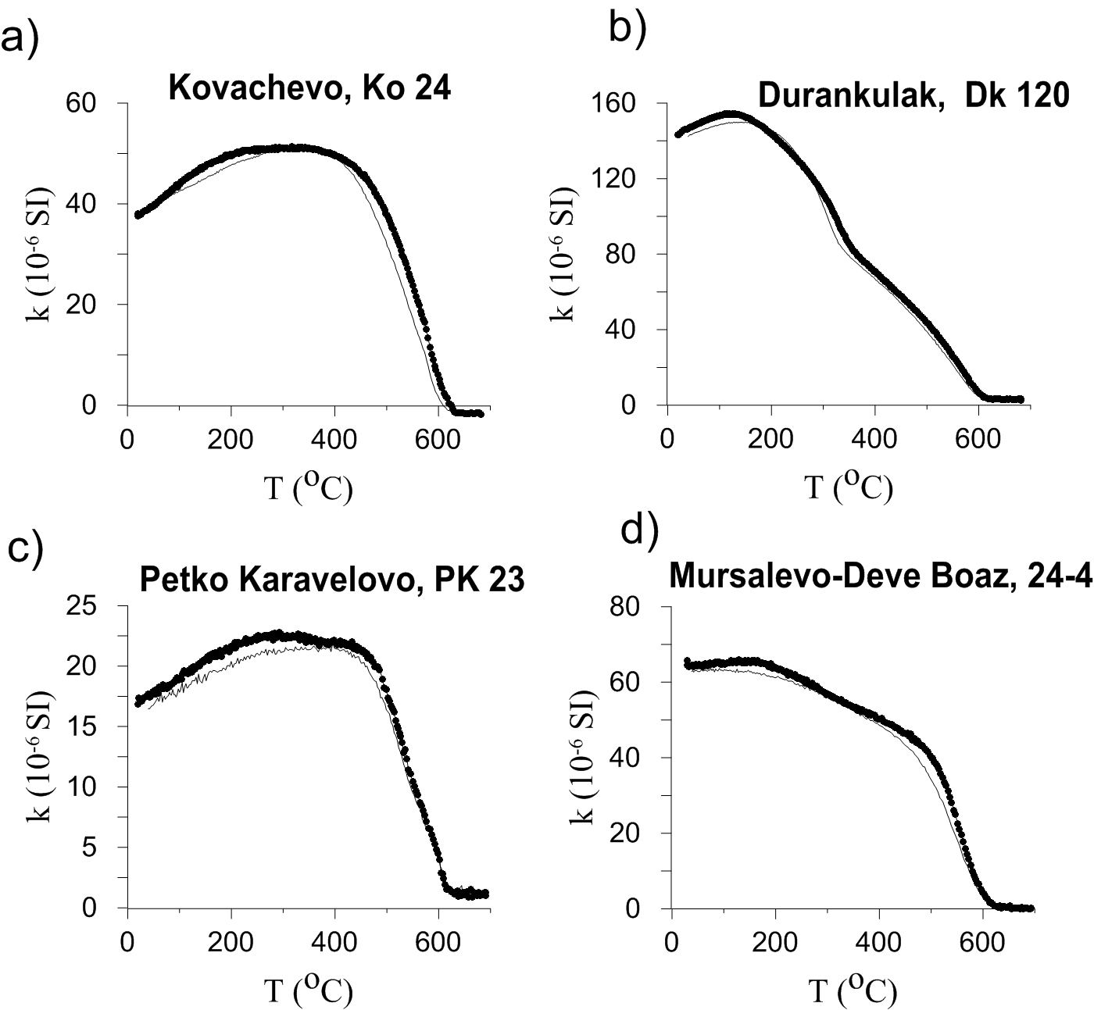
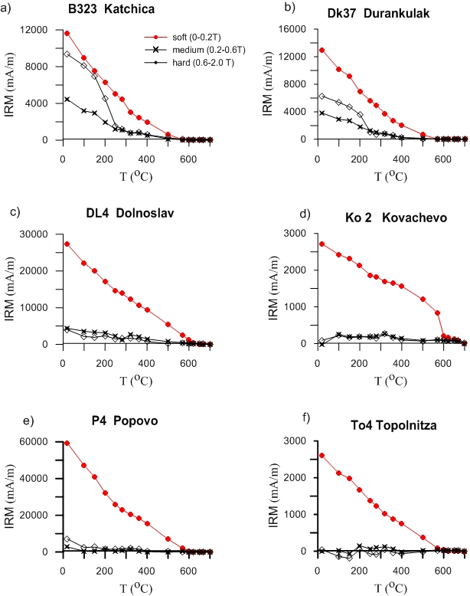
. Identification of magnetic minerals in burnt clay materials
Magnetic mineralogy in burnt clay materials is dominated by strongly magnetic low coercivity mineral, mostly magnetite with Tc~580°C.
Curie temperature Tc~270°C observed for sample DK120 and the thermal unblocking at ~250°C observed on the hard IRM component could be associated with a relatively rare Fe-oxide form - ε-Fe₂O₃ – which presence is increasingly reported in archaeological burnt materials
Figure 2. High-temperature behavior of magnetic susceptibility. Heating curve – thick line, cooling curve - thin line
In all samples the heating and cooling curves coincide. This fact suggests that no major mineral transformations leading to changes in magnetic mineralogy occur during heating
Figure 3. Step-wise thermal demagnetization of composite IRM

Slide 5
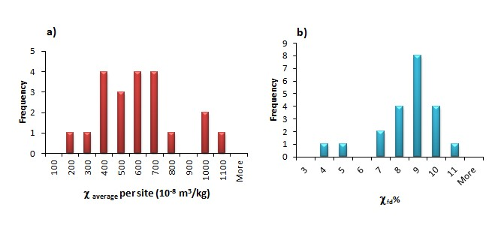
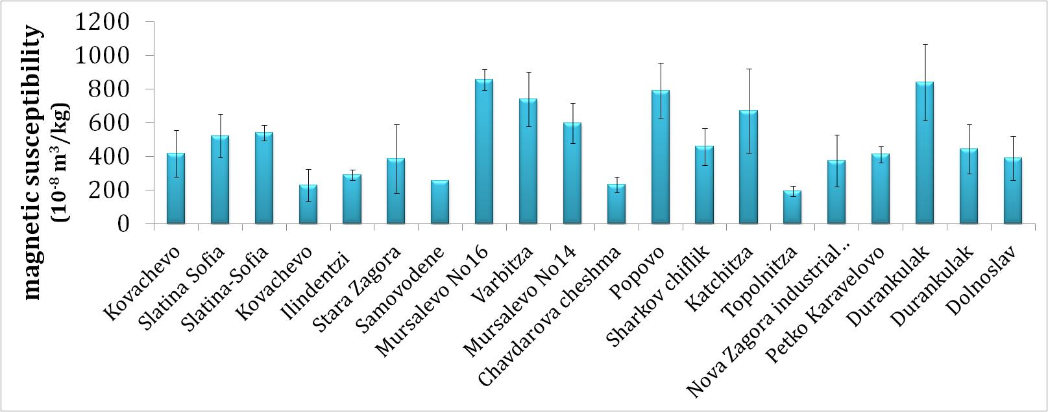
Magnetic susceptibility of fired clay from burnt Neolithic houses
Wide variations in the mean site-specific magnetic susceptibility values demonstrate big differences in the concentration of strongly magnetic fire-produced iron oxides.
For most of the sites χ _{average} falls within the range 400-700*10⁻⁸m³/kg, while single sites exhibit lower or exclusively high magnetic susceptibilities across the respective site.
Figure 5. Histograms of χ and χfd% at site level
χfd% values above ~8% suggest that the biggest part of the strongly magnetic iron oxides is in the SP grain-size range, according to the empirical model proposed by Dearing et al. (1996).
Figure 4. Magnetic susceptibility at site level. Standard deviation of the mean
is also shown.

Slide 6
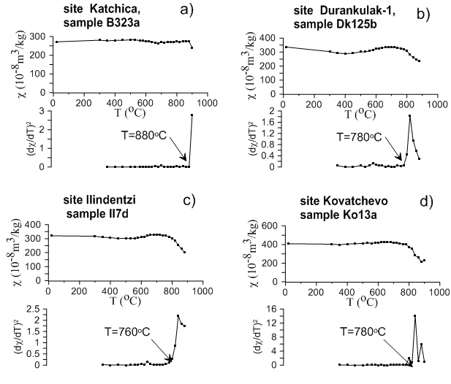
Determination of equivalent maximum firing temperature of burnt house destructions
Maximum firing temperature was evaluated according to the methodology proposed by Rasmussen et al. (2012), utilizing the magnetic susceptibility behavior upon laboratory step-wise reheating.
Table 1. Summary results for T_{fire}
bio-climatic zone : SM – sub-Mediterranean; SC – sub-continental; C – continental
N_{T} – number of T_{fire} determinations
Figure 5. Examples for determination of T_{fire}

Slide 7
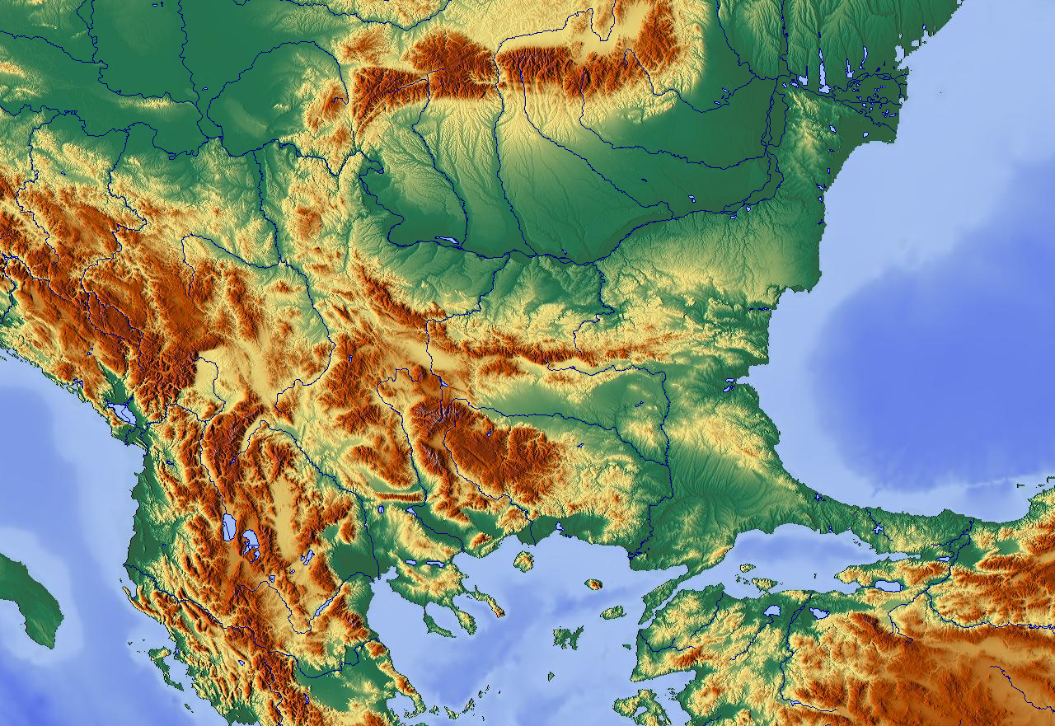
Magnetic susceptibility and frequency dependent magnetic susceptibility of burnt clays from different sites as related to the environmental conditions during the Neolithic era
Environmental settings across Bulgarian territory are generally controlled by:
1) the latitudinal climatic gradient
2) the increasing distance to the sea coast and the Balkans Mountain
The main climatic transition is underlined by significant change in the precipitation regime – from sub-Mediterranean (summer precipitation minimum) at the southernmost areas to continental (winter precipitation minimum) at the northern part.
Balkans
Black sea
MFF-maps
GEOLOGY FACTOR
Geology (surface deposits) - most probable source for the Neolithic house construction:
alluvial-proluvial deposits of sands, sandy-clays or aleurolitic –clays (lower- and middle Struma river valley )
lacustrine-marshy or fluvial deposits ; clayshales, siltshales, sands and sandstones (upper Struma valley; Sofia basin)
Low-Danube plain – loess deposits

Slide 8
Figure 6. Magnetic susceptibility and percent frequency dependent susceptibility for Neolithic sites, according to their dating and climate zone
Magnetic susceptibility data (Table 1, Fig. 6) show that sites from North Bulgaria (falling into the continental climate zone) generally have higher values compared to the other sites from South Bulgaria (sub-continental and sub-Mediterranean climate). χ_{fd}% for all sites varies mostly between 8-10% , independently of the raw material.
VEGETATION FACTOR
Vegetation is a key factor determining the wildfire’s parameters (e.g. Certini, 2014) and its spread. Thus, the wood used for the construction of Neolithic houses, as well as possible use of dung into daub preparation (Kruger, 2015; Forget et al., 2015), are the factors that determine the intensity of house firing.
According to the pollen- and charcoal data from the region (Marinova et al., 2012; Tonkov et al., 2014; Ivanova et al., 2018) the dominant vegetation during the late- to middle Holocene was oak woodland, while only for sites situated at high enough altitude the use of Pinus species by the ancient people, is considered possible.

Slide 9
FIRING TEMPERATURES ACHIEVED IN HOUSE BURNING DURING THE NEOLITHIC
The data demonstrate that the highest T_{fire} are obtained for the oldest sites from the Early Neolithic, although few sites show T_{fire} similar to the rest of the sites.
Burning of the Neolithic houses is an open-air firing process (e.g. in oxidizing environment) which is governed by the climate and weather conditions (Glasspool et al., 2015). The highest determinations of T_{fire} are related to sites located in the sub-Mediterranean and sub-continental climate, characterized by winter precipitation maxima (Ivanova et al., 2018). Thus, the hot and dry summers created fire-prone environment in which firing process is empowered.
Figure 7. Site-averaged Tfire for Neolithic sites according to their dating
and location in the climatic zones.

Slide 10
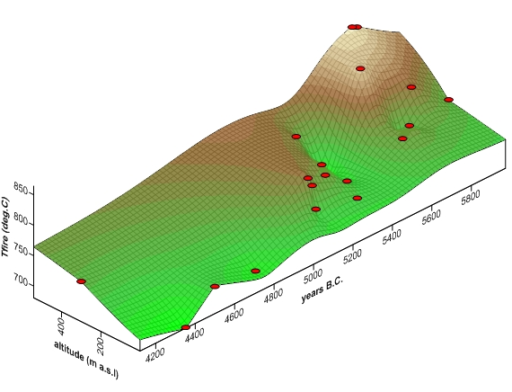
The oldest Early Neolithic sites which appeared at higher altitudes display the highest T_{fire}, while for Late Neolithic sites at lower altitudes T_{fire} are lower (Fig. 8).
HOW TO EXPLAIN THIS OBSERVATION?
Since maximum T_{fire} is mostly obtained for sites situated at higher altitude, it can be supposed that incorporation of pine wood into the house construction gives more energy of the fuel, as compared to oak wood (Bartlett et al., 2019);
It is possible to link the higher T_{fire} in Early Neolithic to the observed increase in global fire activity during the Middle Holocene (Brücher et al., 2014) which is considered as a result of variations in temperature (the occurrence of the Holocene climatic optimum);
The maximum in T_{fire} could also be a result of achieving extreme ignition during supposed ritual house-burning in Early Neolithic settlements in the SE Balkans (Chapmann, 1999).
Figure 8. Distribution of site-averaged Tfire in relation
to site’s altitude and dating interval.

Slide 11
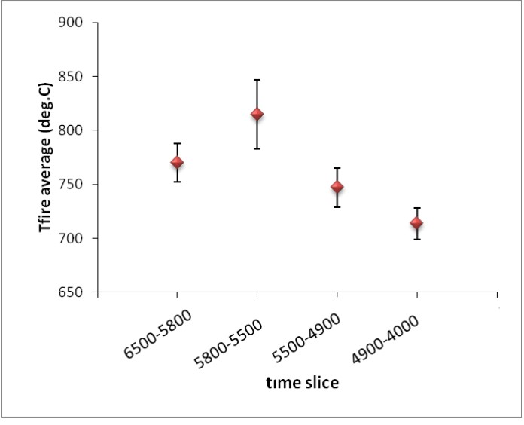
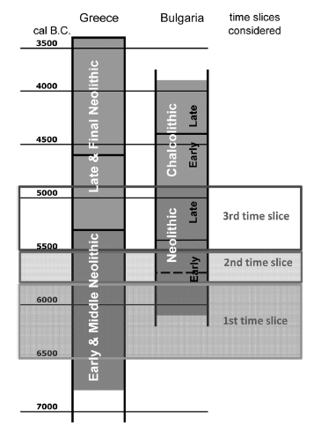
FIRING TEMPERATURES IN NEOLITHIC HOUSES IN TIME
Figure 9. Averaged Tfire for the time slices, adopted in Marinova and Ntinou (2018)
A well expressed trend in T_{fire} is observed, with maximum value of T_{fire}~815°C attained in the period 5800-5500 B.C., followed by systematically lower T_{fire} estimates in the succeeding periods (Fig.9) of the Neolithic. Considering the fact that the standard deviation intervals of the average T_{fire} for the four periods in general do not overlap (Figure 9), the trend observed could be regarded as significant, reflecting real phenomenon.
Neolithic periodization and “time slices” adopted
According to Mariniva and Ntinou, 2018.

Slide 12
CONCLUSIONS
The main magnetic minerals in fired Neolithic houses are magnetite, maghemite and in some cases ε-Fe₂O₃ ;
2) Firing temperatures were estimated using magnetic susceptibility method for 198 samples from all sites. T_{fire} varies generally between 760-880°C, but in some cases reaches 900-1050°C.
3) Magnetic susceptibility enhancement is dependent on the raw clay mineralogy and the firing intensity, being higher for sites developed on loess materials. Sites located in river valleys from South Bulgaria show lower susceptibility enhancement.
4) The highest firing temperatures among coeval sites are achieved in those located at the highest altitudes. This is probably related to the availability of pine wood, supplying higher fire energy in addition to commonly spread oak wood during this time of the Holocene era at the Balkans. Environment at sites of low altitudes favor oak wood as dominant construction material available for building houses, leading to lower fire intensity.
5) The highest T_{fire} is obtained in Early Neolithic sites dated between (5800-5500 BC) while in the time slices (5500-4900 BC) and (4900-4000 BC) T_{fire} estimates systematically decrease to 713°C. Possible hypotheses to explain this regularity include: climatic optimum at the timing of Early Neolithic favors higher fire occurrence; availability of pine wood which is able to produce higher firing temperatures than oak wood; intentional firing of Early Neolithic houses by additional supply of fuel causing extensive combustion.

Slide 13
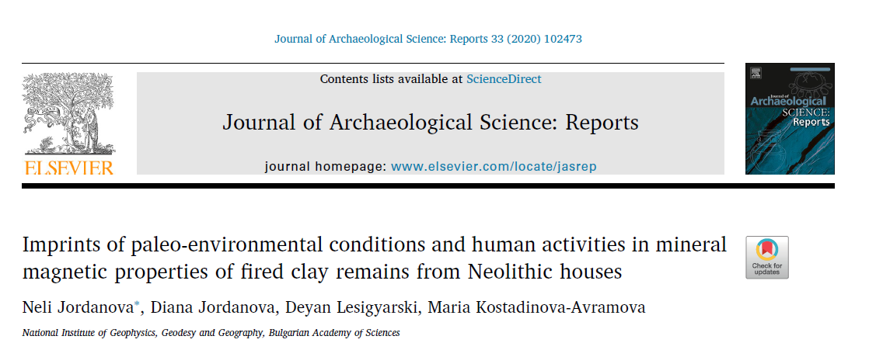
The results reported are published in:
This study is financially supported by the national co-financing for the Bulgarian team participating in COST Action CA17131 “The Soil Science & Archaeo-Geophysics Alliance: going beyond prospection (SAGA)”, grant No KP-06-COST/2, funded by the Bulgarian National Science Fund.

Slide 14
References
Bartlett A. I., Hadden R.M.,. Bisby L. A., 2019. A Review of Factors Affecting the Burning behaviour of Wood for Application to Tall Timber Construction. Fire Technology, 55, 1–49
Brücher, T., Brovkin, V., Kloster, S., Marlon, J. R., Power, M. J., 2014. Comparing modelled fire dynamics with charcoal records for the Holocene, Clim. Past, 10, 811–824.
Certini, G., 2014. Fire as a Soil-Forming Factor. AMBIO, 43,191–195, DOI 10.1007/s13280-013-0418-2.
Chapmann, J. 1999. Deliberate house-burning in the prehistory of central and eastern Europe. In A. Gustafsson & H. G. Karlsson (Eds.), Glyfer och arkeologiska rum: En vänbok till Jarl Nordbladh (pp. 113–116). Durham, UK: University of Gӧteborg Press.
Glasspool, J., Scott, A.,Waltham, D., Pronina, N., Shao, L., 2015. The impact of fire on the Late Paleozoic Earth system. Front. PlantSci.6:756; doi:10.3389/fpls.2015.00756
Dearing, J.A., Dann, R.J.L., Hay, K., Lees, J.A., Loveland, P.J., Maher, B.A., O’Grady, K., 1996. Frequency dependent susceptibility measurements of environmental materials. Geophys. J. Int. 127, 228-240.
Forget, M. C.L., Regev L., Friesemc D. E., Shahack-Gross R., 2015. Physical and mineralogical properties of experimentally heated chaff-tempered mud bricks: Implications for reconstruction of environmental factors influencing the appearance of mud bricks in archaeological conflagration events. Journal of Archaeological Science: Reports 2, 80–93
Ivanova, M., De Cupere, B., Ethier, J., Marinova, E., 2018. Pioneer farming in southeast Europe during the early sixth millennium BC: Climate-related adaptations in the exploitation of plants and animals. PLoS ONE 13(5): e0197225
Marinova, E. and Ntinou, M. , 2018. Neolithic woodland management and land-use in south-eastern Europe: The anthracological evidence from Northern Greece and Bulgaria. Quaternary International, 496, 51-67
Marinova, E., Tonkov, S., Bozilova, E., Vajsov, I., 2012. Holocene anthropogenic landscapes in the Balkans: the palaeobotanical evidence from southwestern Bulgaria. Veget Hist Archaeobot. 21, 413–427; DOI 10.1007/s00334-011-0345-8.
Tonkov, S., Marinova, E., Filipova-Marinova, M., Bozilova, E., 2014. Holocene palaeoecology and human–environmental interactions at the coastal Black Sea Lake Durankulak, northeastern Bulgaria. Quaternary International, 328–329, 277-286
Rasmussen, K. L., De La Fuente, G., Bond, A., Mathiesen, K., & Vera, S. 2012. Pottery firing temperatures: A new method for determining the firing temperature of ceramics and burnt clay. Journal of Archaeological Science, 39(6), 1705–1716

