Slide 1
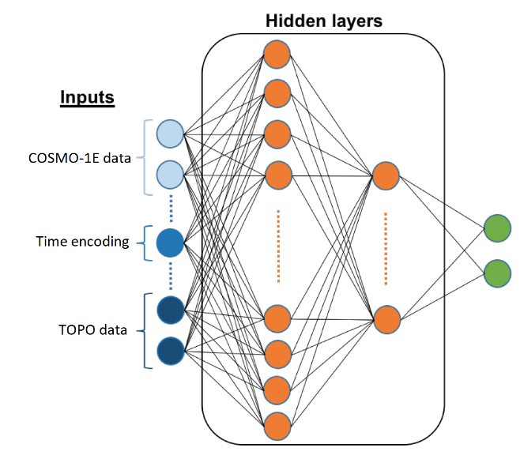
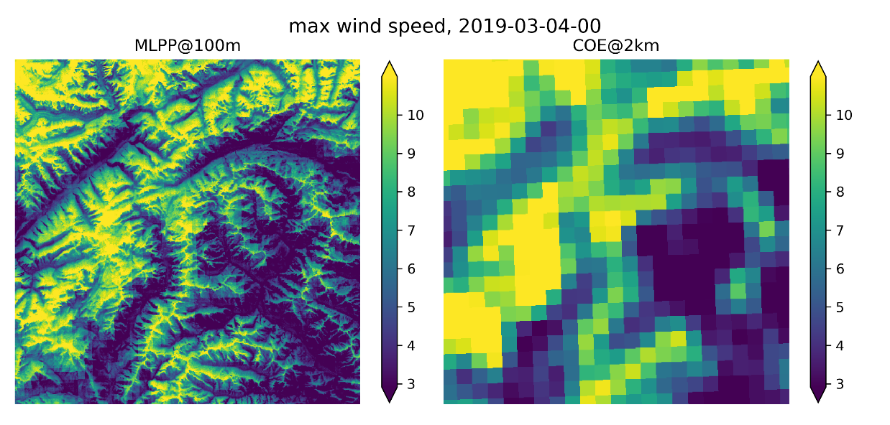
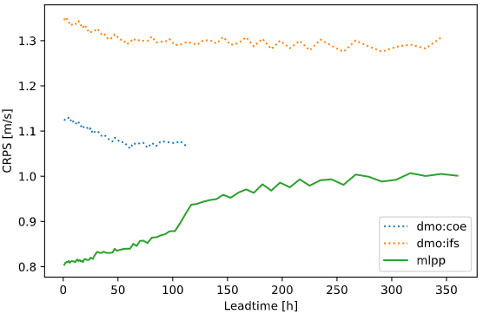
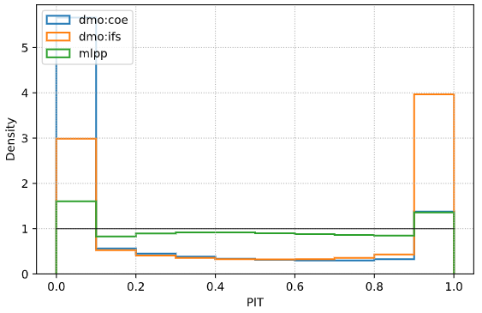
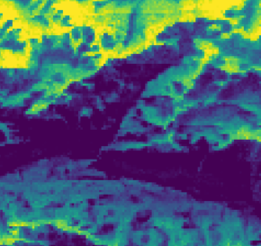
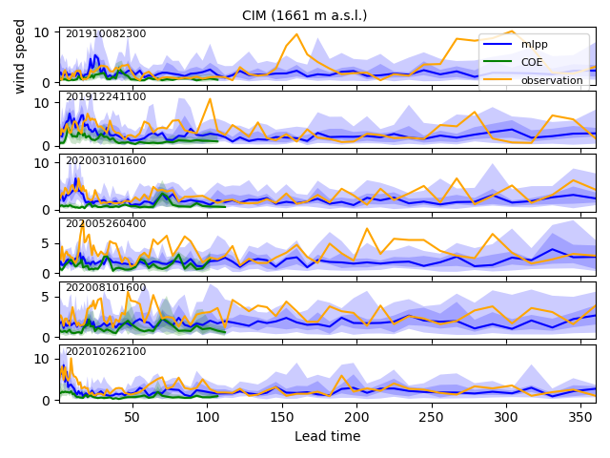
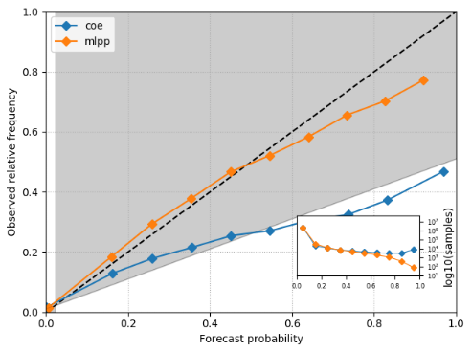
EGU21-9849
Postprocessing wind forecasts with deep learning in complex terrain
NWP
Time
encodings
α
Gamma(α, β)
β
DEM
descriptors
MC Dropout
(Bayesian approx.)
Aleatoric uncertainty
Epistemic uncertainty
NWP sources
COSMO-1 (1km, +33h, det)
COSMO-E (2 km, +120h, 21 memb.)
IFS-ENS (20 km, +360h, 51)
> 33 kt
Data split:
train (2016-2018, 300 stations)
val (2019, 100 stations)
test (2020, 100 stations)

Slide 2
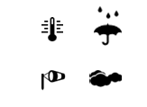





MeteoSwiss «PostprocVeri» project
Implement postprocessing for core parameters
of general weather forecasts (www, app)
  probabilistic
  spatial
  seamless in time
Verification: systematic verification along processing chain
Collaborations
+
+ …

Slide 3
Forecast postprocessing
Postprocessing brings NWP into the «real world».
  No more «grid-cell average value» but observable quantity.
Statistical procedure based on historical observations (measurements).
It includes both the calibration of model output statistics and statistical downscaling.
For the same reasons that data assimilation is required to feed observed information into numerical prediction models, an analogous process of forecast assimilation is required to convert model predictions into well-calibrated forecasts of observable variables.
Stephenson et al 2005
Notes:
Stephenson, D. B., C. A. S. Coelho, M. Balmaseda, and F. J. Doblas-Reyes, 2005: Forecast assimilation: A unified framework for the combination of multi-model weather and climate predictions. Tellus, 57A, 253–264.
«An elegant duality between statistical postprocessing and data assimilation has recently been discovered by Stephenson et al. (2005) in the context of their work on multimodel forecast combination (Coelho et al. 2004a,b). This has led Stephenson et al. (2005) to refer to forecast postprocessing by the more dignified and meaningful expression forecast assimilation—the process whereby model predictions are assimilated into existing knowledge to produce improved forecasts of real-world observable quantities.”

Slide 4
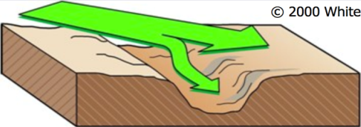
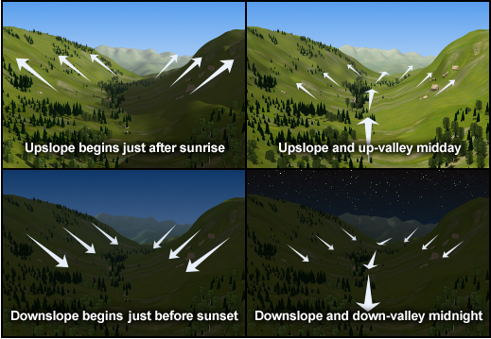
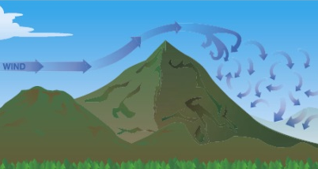
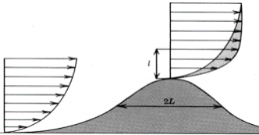
Challenges in forecasting wind
Thermal wind systems
Forced channeling
© David Whitemann
Sheltering
Speed-up
© The COMET Program
© weather.gov
© globalwindatlas.info
Many interactions between wind and topography occur at scales not resolved by NWP models.
Notes:
NWP predictions should not be taken on face value as forecasts of observable variables

Slide 5
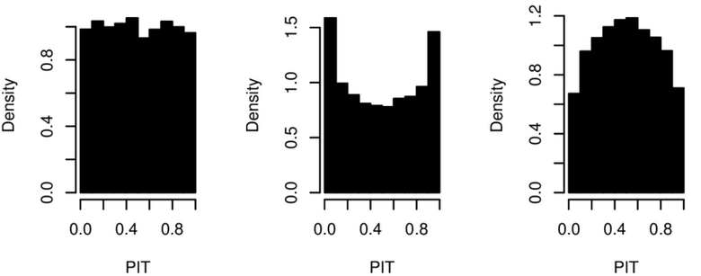
Goal
To provide subgrid-resolution (point), probabilistic wind speed forecasts.
Quality criteria:
accuracy
Continuous ranked probability score
CRPS = E(abs. error) – E(spread)
«ensemble MAE»
negative orientation (lower is better)
multivariate extension: Energy Score
calibration
Probability integral transform (PIT) histograms
flat histogram: predictive distribution equals observed distribution
© R. Ranjan
well calibrated
underdispersive
overdispersive
Notes:
Pit histograms
Predicted distribution good representation of observation variability (uncertainty) ?
where observations usually fall within the predicted distribution

Slide 6
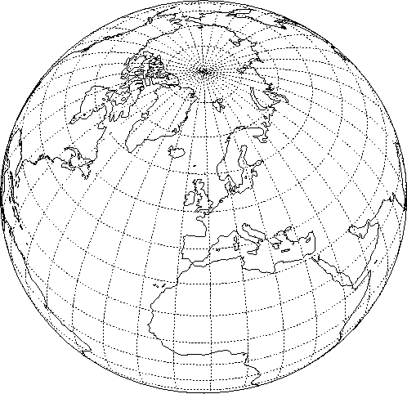



NWP data
ECMWF IFS-ENS
COSMO-E (COE)
  Alpine region
  2.2 km horiz. res.
  21 members
  2 runs a day (00UTC and 12UTC)
  5 day forecast horizon
  June 2016 – November 202
  Surface parameters as well as some upper levels
COSMO-E
© R. Keller

Slide 7
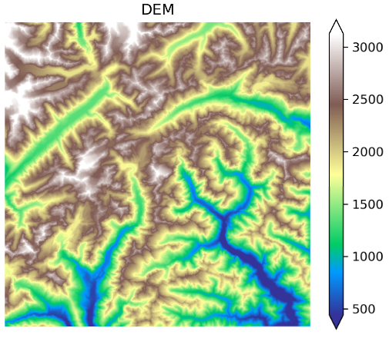
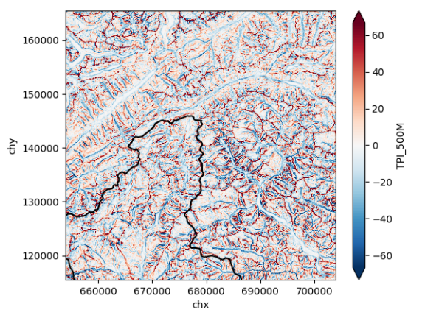
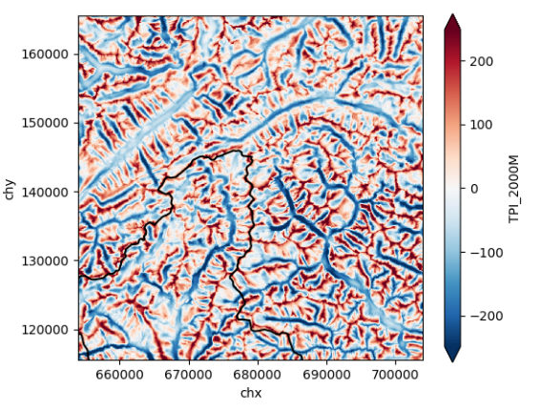
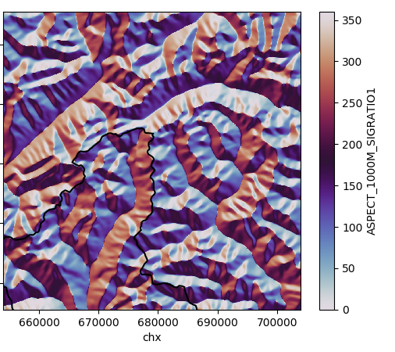
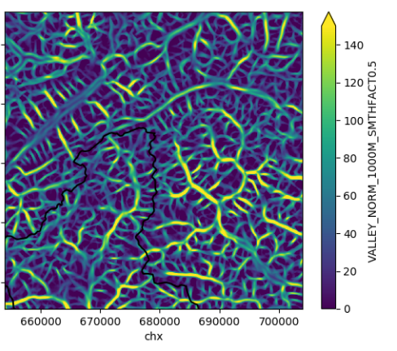
Topographical descriptors
Various topographic features are extracted from a 50 m DEM.
E.g., Topographic Position Index (TPI) provides the altitude difference w.r.t. to surrounding neighborhood.
Descriptors are computed at different spatial scales.
↔ 50 km
TPI
500m
TPI
2000m
aspect
1000m
Valley Index (Schaer 2019)
1000m

Slide 8
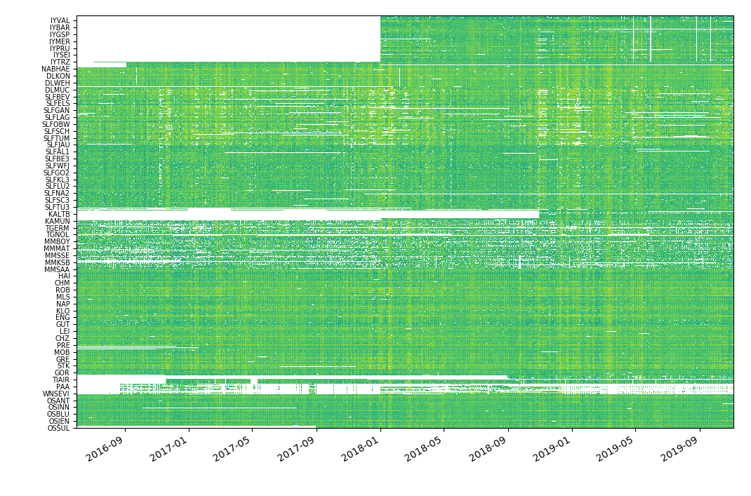
Reference observations
(sequential split)
train 50%
val 25%
test 25%
test 20%
100 stations
1 year
100 stations
1 year
val 20%
(randomized split)
300 stations
2 years
log hourly wind speed
train 60%
MeteoSwiss
stations →
time →

Slide 9
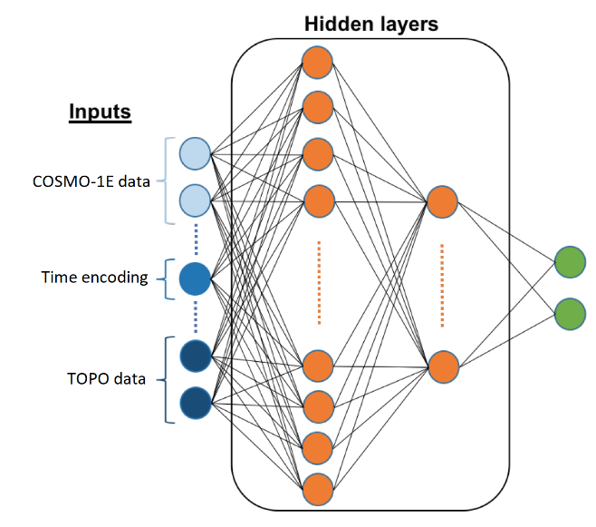
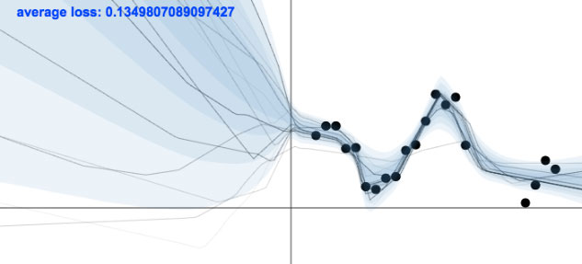
Probabilistic deep learning
Regular MLP with distribution parameters as outputs.
  Describe uncertainty in the data.
  Features cannot fully determine target values.
  Aleatoric uncertainty.
Prediction
μ
σ²
Schaer 2019 (adapted)
epistemic uncertainty
aleatoric uncertainty
Gal 2015

Slide 10
Probabilistic deep learning
Regular MLP with distribution parameters as outputs.
  Describe uncertainty in the data.
  Features cannot fully determine target values.
  Aleatoric uncertainty.
Dropout during inference to create an ensemble of models.
  Describe uncertainty in the ML model.
  Training data do not cover all possible situations (→ extrapolation)
  Epistemic uncertainty.
Prediction
μ
σ²
Schaer 2019 (adapted)
epistemic uncertainty
aleatoric uncertainty
Gal 2015

Slide 11
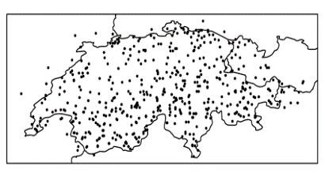
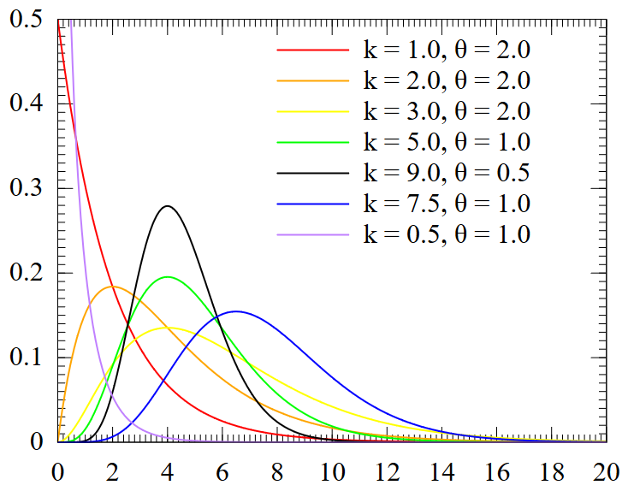
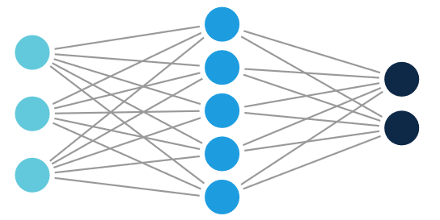
Probabilistic deep learning
Use a neural network to predict the parameters of the conditional probability distribution:
  Select target variable (wind speed)
  Select input features (predictors)
  Select parametric distribution (e.g., Gamma)
  Select neural network architecture
  Select loss function (CRPS)
© wikipedia
Model selection based on the validation set.

Slide 12
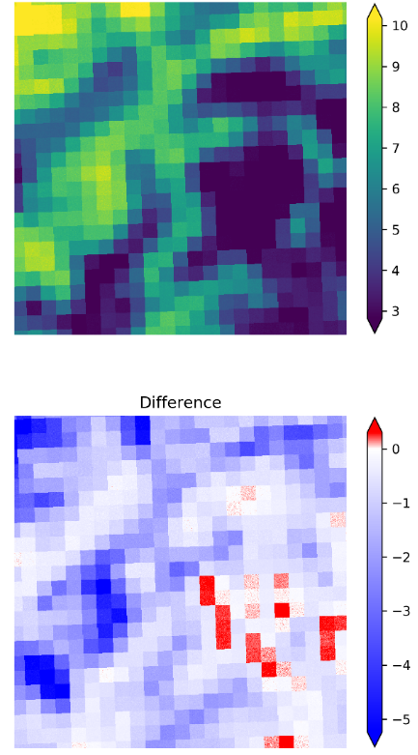
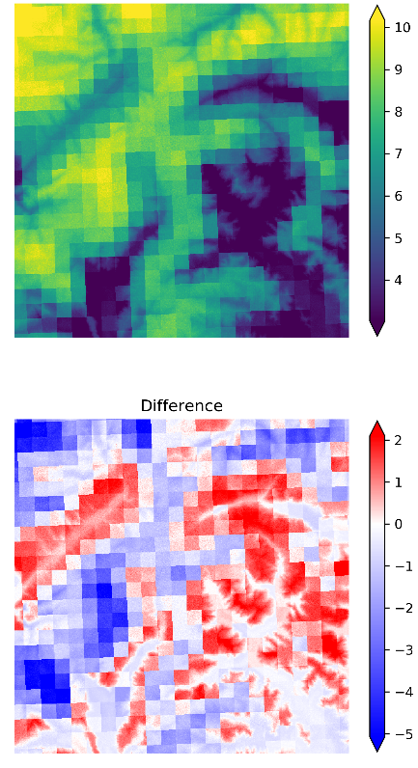
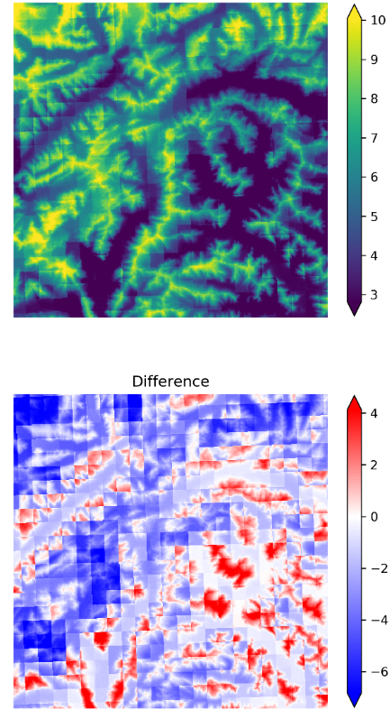
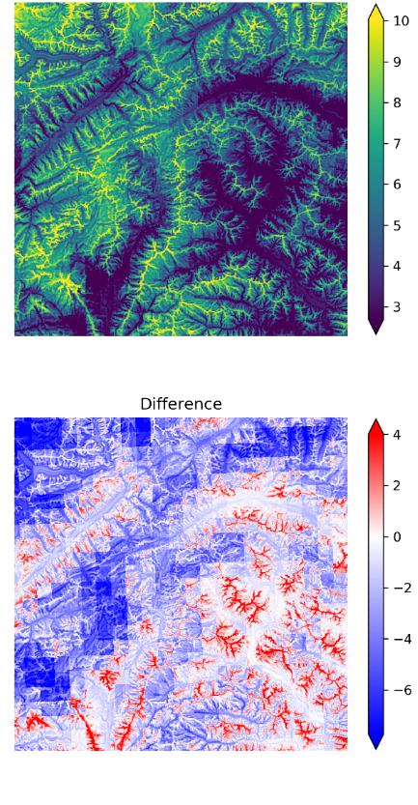
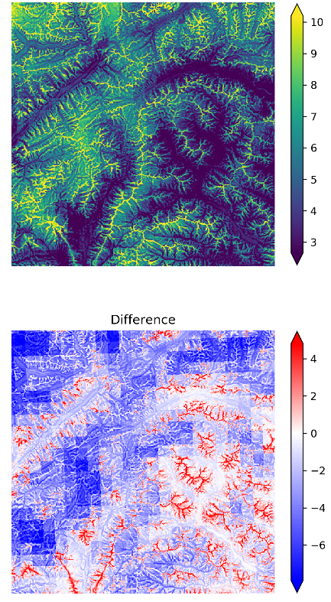
coe+dem+hdiff
+tpi500
coe+dem+hdiff
+tpi500+tpi2000
coe
coe+dem
coe+dem+hdiff
MLPP max wind speed
[m/s]
MLPP - DMO
[m/s]
↔ 50 km

Slide 13
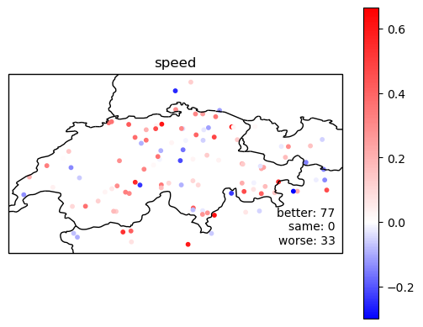
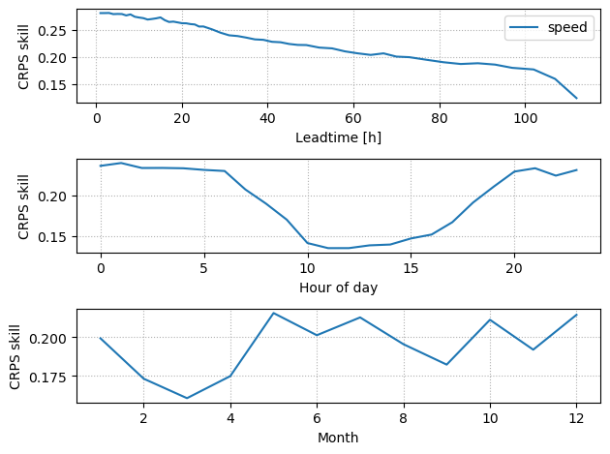
Accuracy on test/unseen set
wind speed
  CRPS skill = 1 – CRPS / CRPS_{NWP}

Slide 14
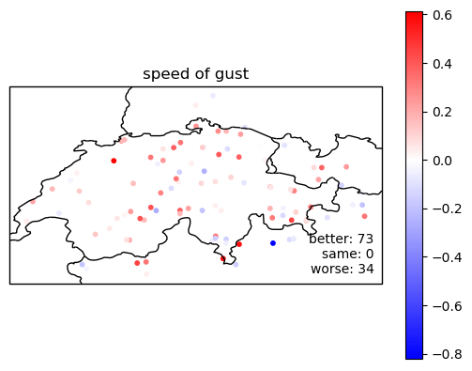
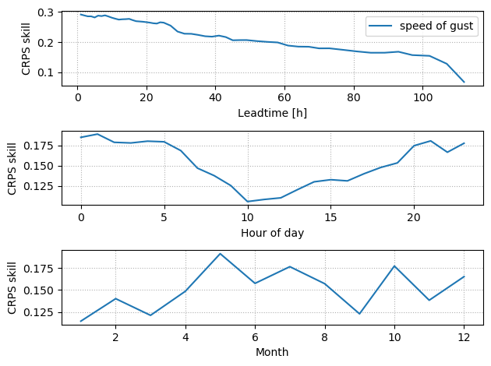
Accuracy on test/unseen set
wind gust
  CRPS skill = 1 – CRPS / CRPS_{NWP}

Slide 15
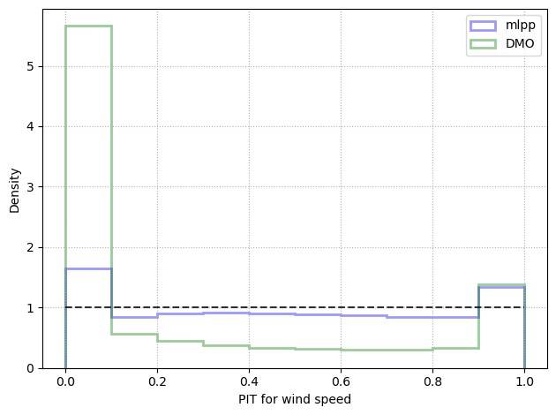
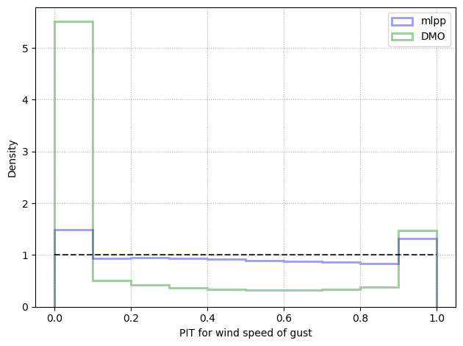
Calibration on test/unseen set
wind speed
wind gust

Slide 16
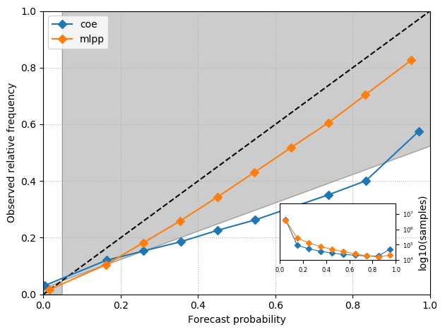
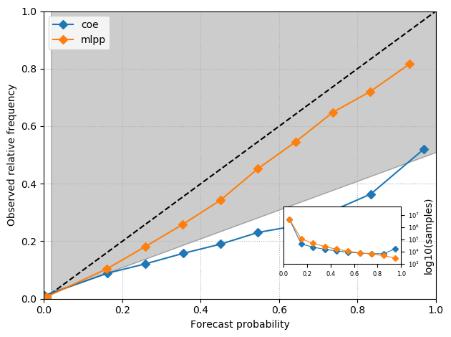
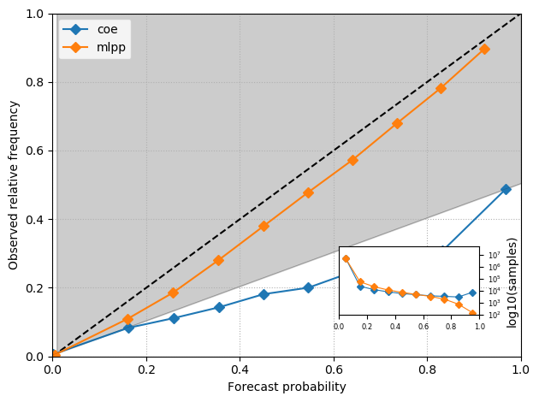
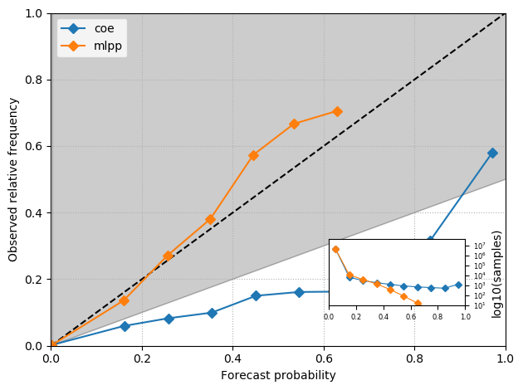
Reliability diagrams (wind gust)
47 km/h
60 km/h
72 km/h
94 km/h

Slide 17
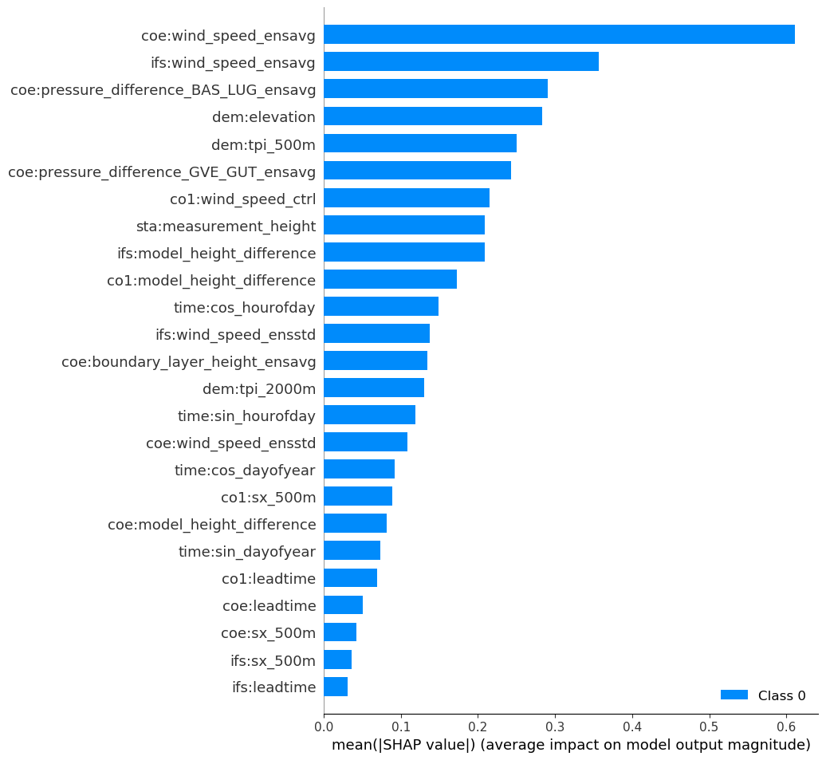
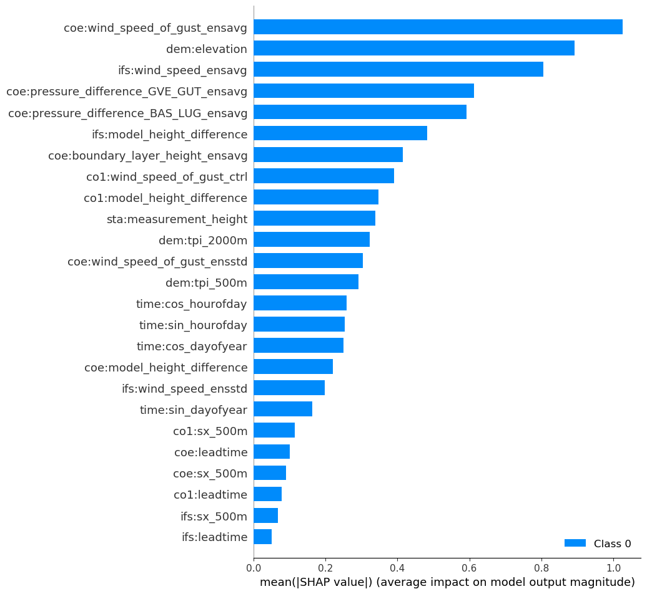
Feature importance
SHAP (SHapley Additive exPlanations):
https://github.com/slundberg/shap
wind speed
wind gust

Slide 18
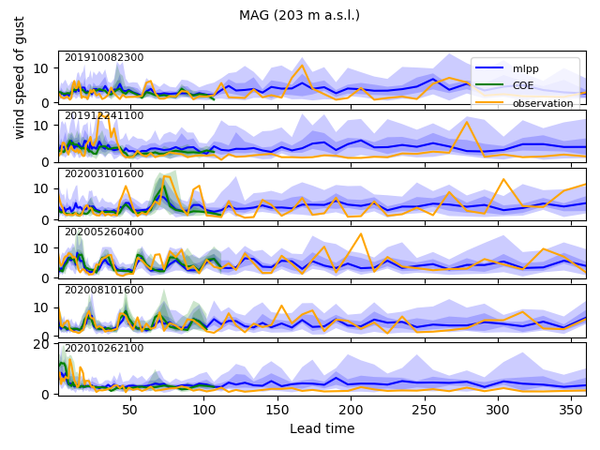
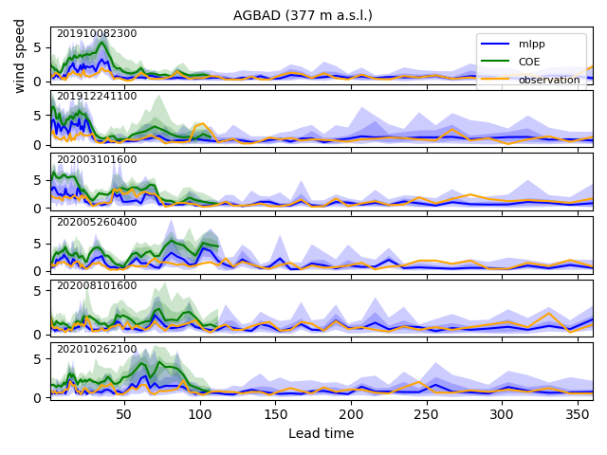
Meteograms

Slide 19
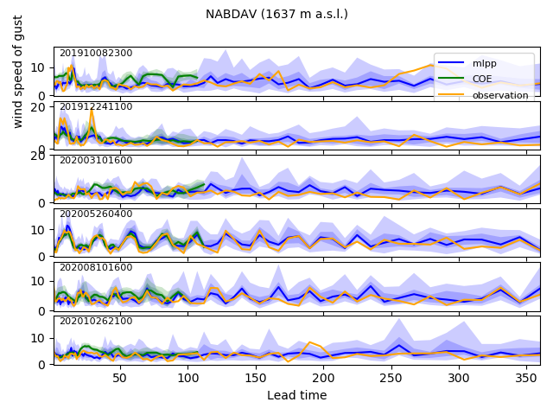
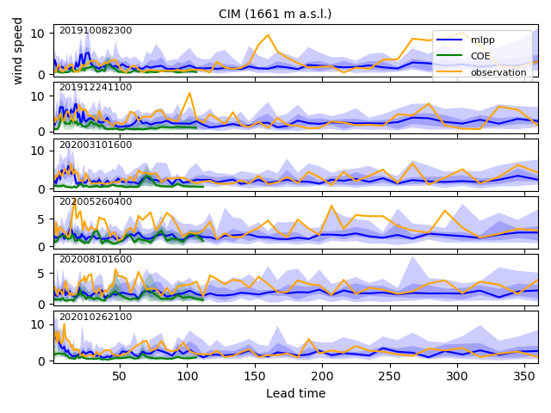
Meteograms

Slide 20
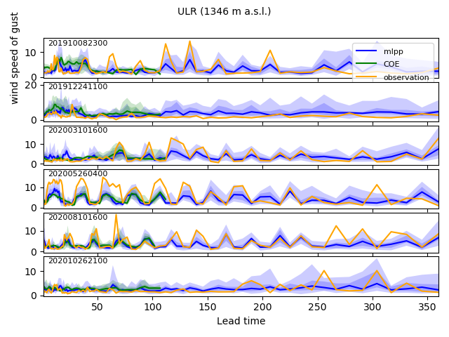
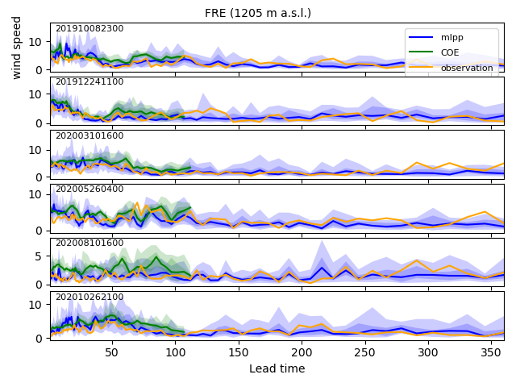
Meteograms

Slide 21
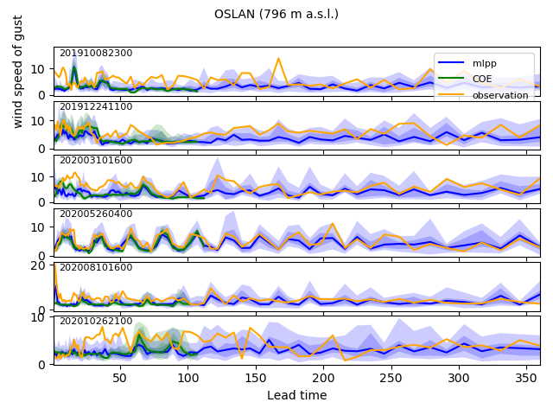
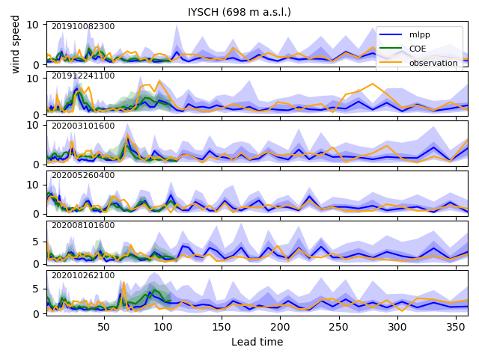
Meteograms

Slide 22

High-resolution wind map

Slide 23

High-resolution wind animation

