Slide 1





Modeling of Lagrangian particles in the turbulent boundary layer considering attached eddies: particle trajectories and concentration profiles
Yu-Ying Huang¹ and Christina W. Tsai²
¹ Graduate Student, Department of Civil Engineering, National Taiwan University, Taipei, Taiwan
² Professor, Department of Civil Engineering, National Taiwan University, Taipei, Taiwan

Slide 2




Stochastic particle trajectories in turbulent flows
flow direction
$$U_{m}$$
Type-B eddies
$$d_{p}$$
particles
$$h$$
Type-A eddies
y
x
z

Slide 3

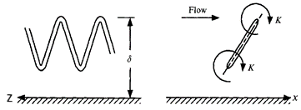
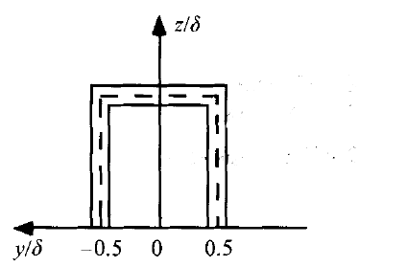
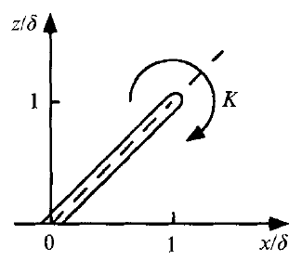

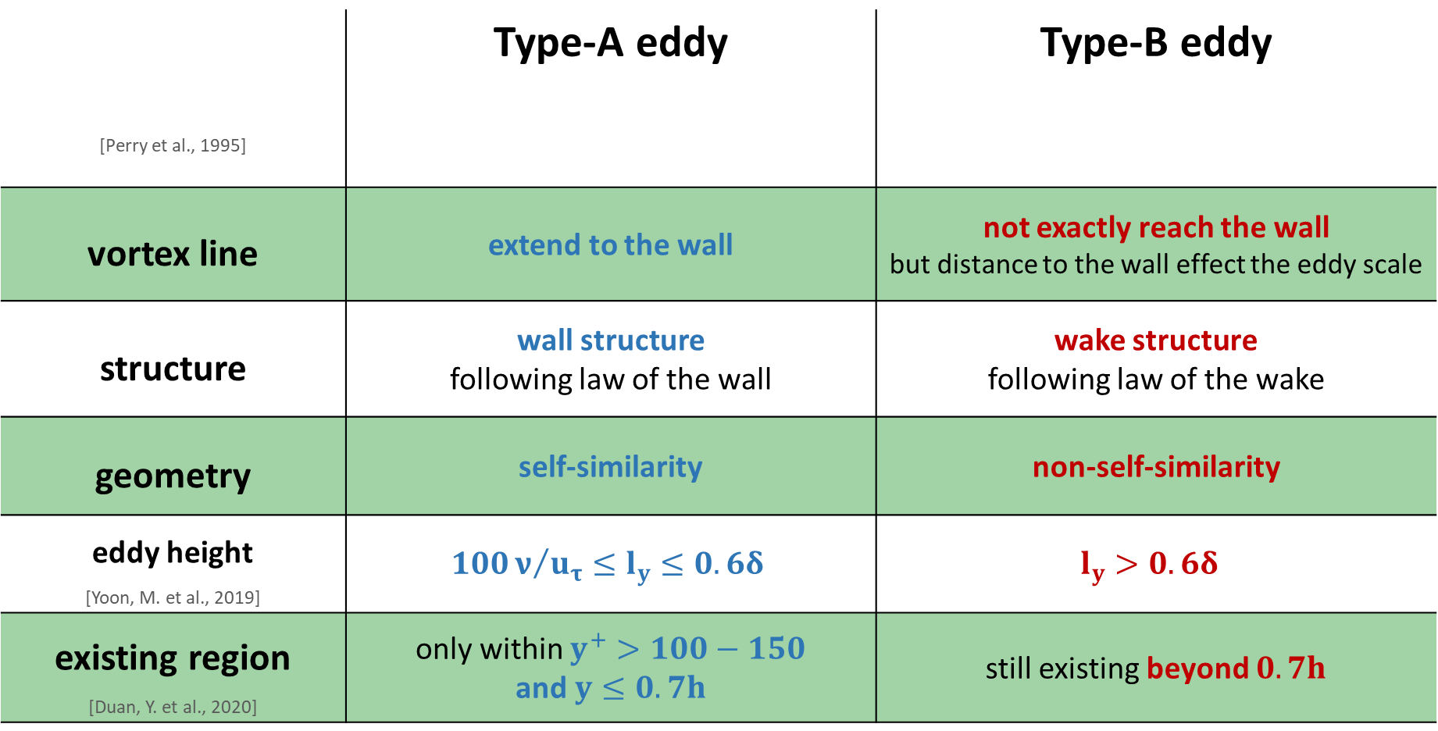
Attached eddy properties
[Perry et al., 1995] | Type-A eddy | Type-B eddy
vortex line | extend to the wall | not exactly reach the wall but distance to the wall effect the eddy scale
structure | wall structure following law of the wall | wake structure following law of the wake
geometry | self-similarity | non-self-similarity
eddy height [Yoon, M. et al., 2019] | $$100ν/{u_{τ}}≤l_{y}≤0.6δ$$ | $$l_{y}>0.6δ$$
existing region [Duan, Y. et al., 2020] | only within $y^{+}>100−150$ and$y≤0.7h$ | still existing beyond $0.7h$

Slide 4
Stochastic Lagrangian model

Slide 5
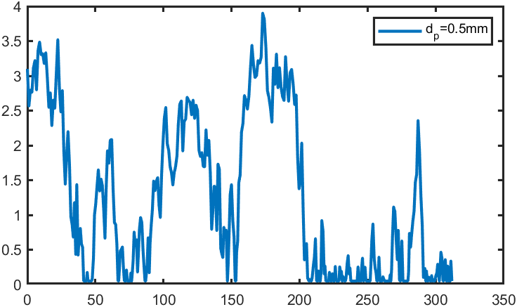
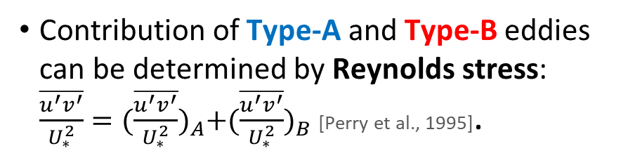
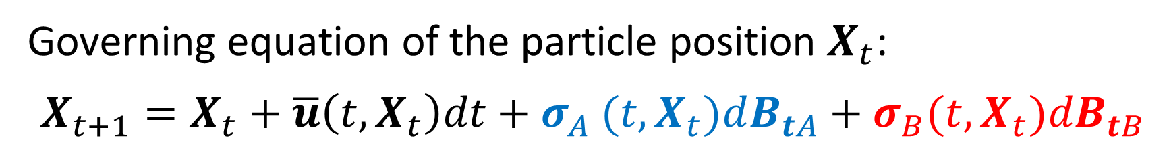
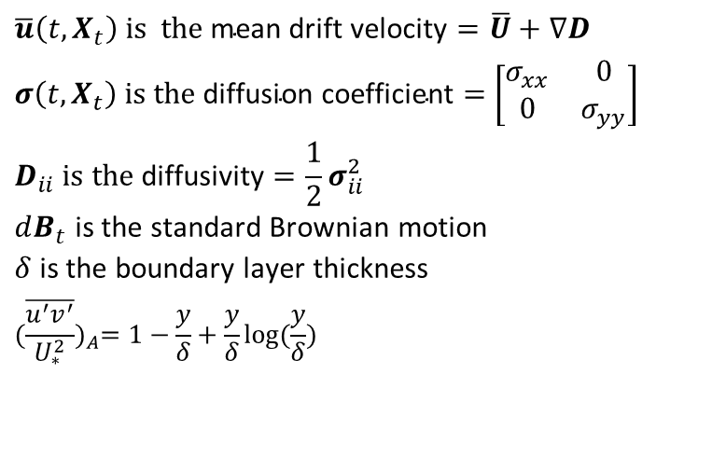
The proposed model
Governing equation of the particle position $X_{t}$:
$$X_{t+1}=X_{t}+\overline{u}\left(t,X_{t}\right)dt+σ_{A} (t,X_{t})dB_{tA}+σ_{B}(t,X_{t})dB_{tB}$$
mean drift term
effects by Type-A eddies
effects by Type-B eddies
turbulence term
Sample path
Contribution of Type-A and Type-B eddies can be determined by Reynolds stress: $\frac{\overline{u^{′}v^{′}}}{U_{∗}^{2}}={(\frac{\overline{u^{′}v^{′}}}{U_{∗}^{2}})}_{A}+{(\frac{\overline{u^{′}v^{′}}}{U_{∗}^{2}})}_{B}$ [Perry et al., 1995].
$$\overline{u}\left(t,X_{t}\right) \text{is} \text{the} \text{mean} \text{drift} \text{velocity}=\overline{U}+∇D$$
$σ\left(t,X_{t}\right) \text{is} \text{the} \text{diffusion} \text{coefficient}=$ $\left[\begin{matrix}σ_{xx} & 0 \\ 0 & σ_{yy}\end{matrix}\right]$
$$D_{ii} \text{is} \text{the} \text{diffusivity}=\frac{1}{2}σ_{ii}^{2}$$
$dB_{t}$ is the standard Brownian motion
$δ$ is the boundary layer thickness
$${(\frac{\overline{u^{′}v^{′}}}{U_{∗}^{2}})}_{A}=1−\frac{y}{δ}+\frac{y}{δ}log(\frac{y}{δ})$$
Y(cm)
X(cm)

Slide 6
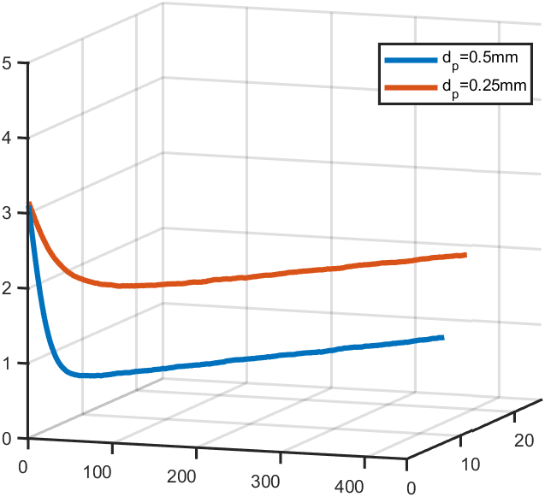
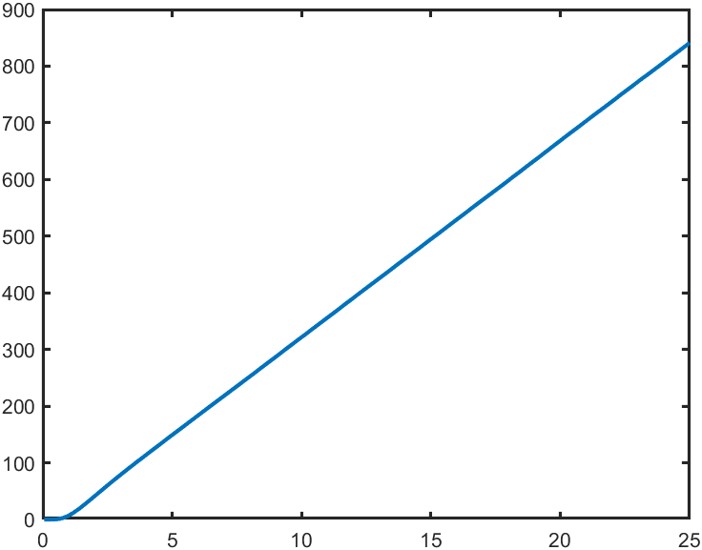
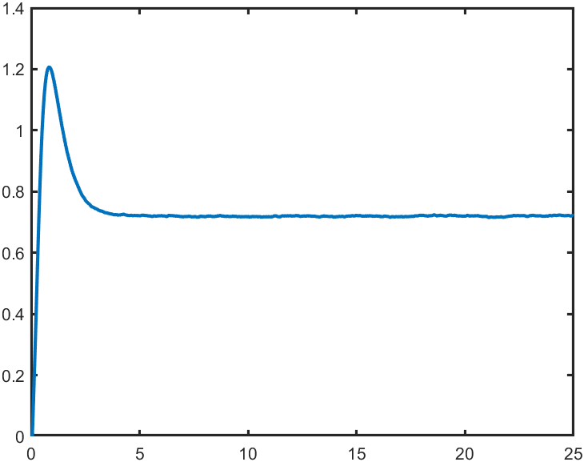

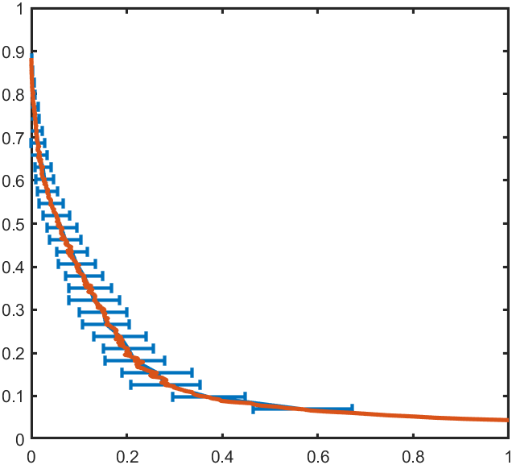



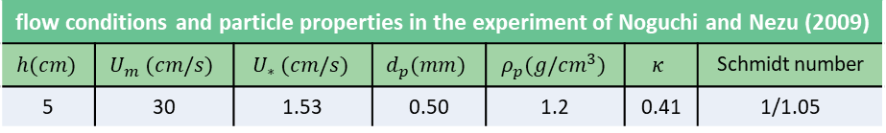

Simulation results
flow conditions and particle properties in the experiment of Noguchi and Nezu (2009)
$$h(cm)$$ | $$U_{m} (cm/s)$$ | $$U_{∗} (cm/s)$$ | $$d_{p}(mm)$$ | $$ρ_{p}(g/{cm}^{3})$$ | $$κ$$ | Schmidt number
5 | 30 | 1.53 | 0.50 | 1.2 | 0.41 | 1/1.05
Ensemble mean of particle position
Ensemble variance of particle positions (d=0.5mm)
*10,000 particles with 100 realizations
Variance of X
Variance of Y
Y(cm)
smaller particle
larger particle
time(s)
time(s)
X(cm)
time(s)
Distribution of Type-A and Type-B eddies for different sizes of particles
Concentration profile (d=0.5mm)
Type-A
Type-B
Type-A
Type-B
for $d_{p}$=0.25mm
for $d_{p}$=0.50mm
$$y^{+}$$
Type-A eddies have more contribution within the inner layer and effects on the bigger particle.
Type-B eddies play an important role in the outer layer and effects on the smaller particle.
Y/h
outer layer
Inner layer
C/C_{max}
%

Slide 7



Summary:
The proposed model can account for the effects of attached eddies, Type-A and Type-B eddies, respectively.
Due to the stochastic and Lagrangian methods, 1st, 2nd or higher moments at each simulation time can be obtained.
Influence on the different sizes of particles and height can be studied by the distribution of Type-A and Type-B eddies.
References:
Duan, Y., Zhang, P., Zhong, Q., Zhu, D., & Li, D. (2020). Characteristics of wall-attached motions in open channel flows. Physics of Fluids, 32(5), 055110.
Noguchi, K., & Nezu, I. (2009). Particle–turbulence interaction and local particle concentration in sediment-laden open-channel flows. Journal of Hydro-environment Research, 3(2), 54-68.
Perry, A. E., & Marusic, I. (1995). A wall-wake model for the turbulence structure of boundary layers. Part 1. Extension of the attached eddy hypothesis.
Yoon, M., Yang, J. M., Hwang, J., & Sung, H. J. (2019). Wall-attached and detached structures in a turbulent boundary layer subjected to adverse pressure gradient. In 15th Asian Symposium on Visualization. Asian Symposium on Visualization.
Ongoing works:
Studying the influence of attached eddies on sediment particle anomalous diffusions in the turbulent boundary layer
Improving the zero value of the particle diffusivity near the water surface when secondary flows occur
Discussing the correlation between Type-A and Type-B eddies
vEGU21
THANK YOU

