Slide 1


Input data automation to model evaporation loss
in an Argentinian vineyard
using a coupled water, vapor and heat flow model
Arij Chmeis, Johanna R. Blöcher, Michal Kuráž

Slide 2
Objectives
Problem Statement
Extremely low precipitation in semi-arid/arid regions makes irrigation necessary
Inefficient irrigation can lead to soil salinity or excessive water loss
Our case study:
  Vineyard in San Juan, Argentina
  Dry area with limited water supply
  Water is delivered by trucks and overland flooding is used as the irrigation scheme
  Considering evaporation losses in understanding of water flow is needed
Characterizing evaporation losses
Predicting soil water pressure head
Predicting soil temperature
Automating model configuration files input

Slide 3
The Coupled Model
Numerical coupled liquid water, water vapor, and heat transport model
DRUtES
Software Implementation
Boundary Conditions
Heat & Water Flow
Estimated Parameters
Improved method
Created by Kuráž, Mayer, and Blöcher (2020)¹ combining hydrodynamical and thermodynamical processes.
Solved the surface energy balance equation based on methods by Allen et al. (1998)² and Monteith and Unsworth (2013)³.
Atmospheric interface was assigned as the system’s top boundary condition.
Porous medium (soil interface) was assigned as the system’s bottom boundary condition.
Developed new estimation of actual incoming shortwave radiation R_{in} by reviewing FAO guidelines (Allen et al., 1998)².
Incorporated aspects from Saito et al. (2006)⁴ and Monteith and Unsworth (2013)³.

Slide 4
Modelling Evaporation
Model requirements
Surface Energy Balance
Soil Hydraulic & Thermodynamic Properties
Site-Specific Data
R_{n} − H − LE − G = 0
Solving the equation allows us to obtain the evaporation rate E (water flow’s top boundary condition), and the soil surface heat flux G (heat flow’s top boundary condition).
Such as shortwave and longwave radiation, wind speed, soil and crop specific resistances, and albedo.
Such as van Genuchten parameters, soil and water heat capacities, and hydraulic and thermal conductivities, and root water uptake.

Slide 5
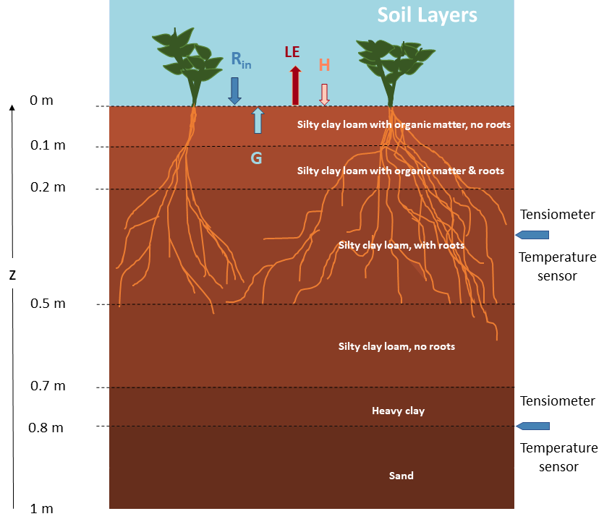
Model Domain Setup
Soil domain was setup to be 1 m deep.
Soil profile consists of the following textures: Silty clay loam with 2% organic matter in the first 2 layers, silty clay loam in layers 3 and 4, heavy clay in layer 5 and finally sand in the last layer.
Root densities can be found in layers 2 and 3.
Observation points in the form of soil sensors are installed at the depths of 0.35 and 0.8 m below surface.

Slide 6



Data and Issues
In-situ Measurements
Solution: Automation Tools
Meteorological Data
Access to backdated records was unavailable therefore combining daily meteorological data files was needed.
Data is taken from a nearby airport, which made it difficult to relate to our case study (relating wind measured at 2 m to a crop height of 2 m).
Lack of measurement data on the study site meant that estimation of soil hydraulic and thermal properties was required.
Lack of soil hydraulic and thermodynamic properties along with site- specific information meant validation and calibration period is essential.
Python scripts were developed to solve data issues. This included: eliminating missing records, flagging incorrect values, estimating R_{in} and extracting initial and boundary conditions.

Slide 7
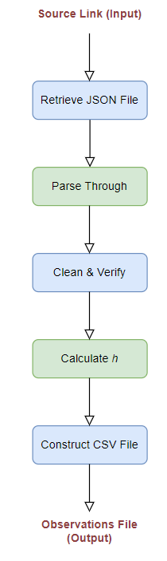
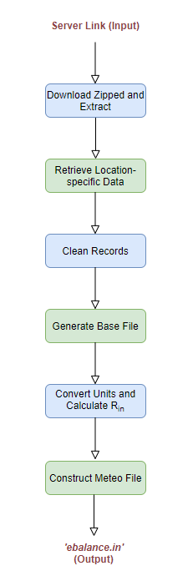
Observations:
Flowchart of generating the observations file in the CSV format using Python script.
Model Input:
Flowchart of constructing the ebalance.in configuration file using Python script.

Slide 8
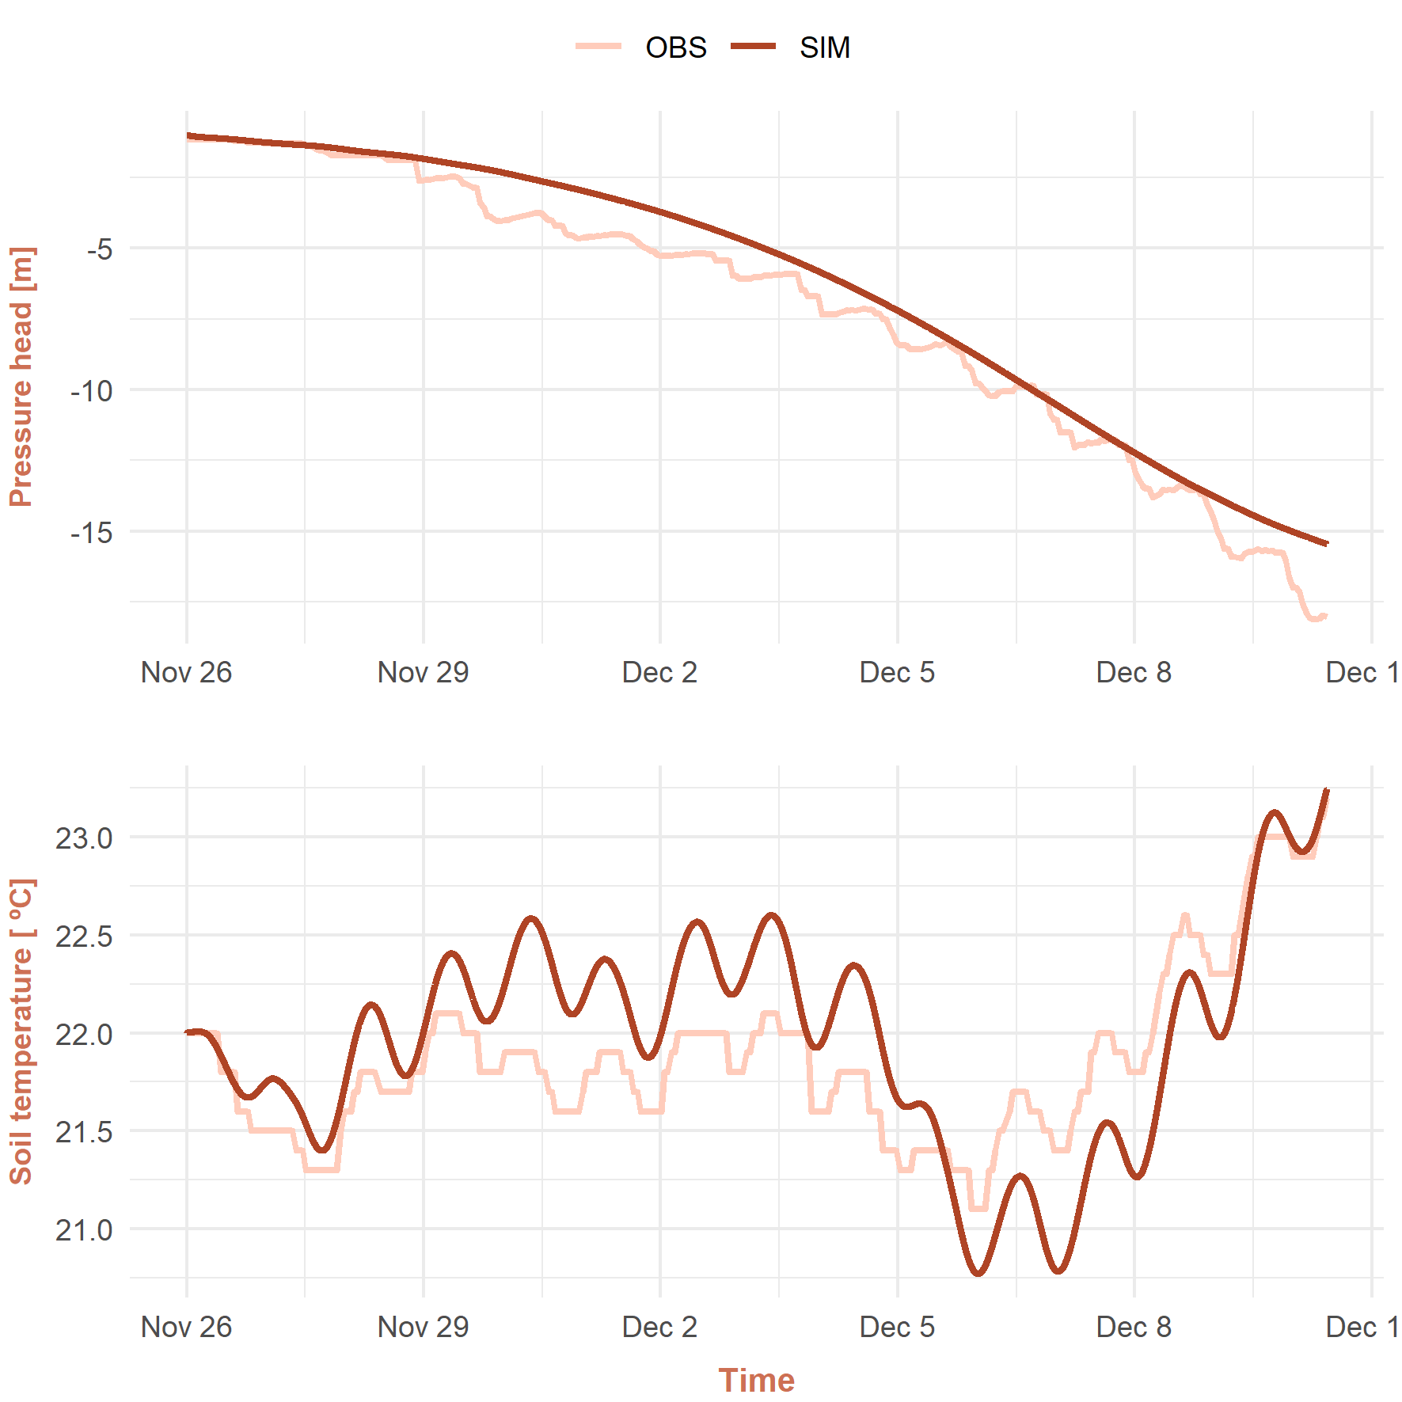
Model Calibration
The calibration period was chosen to start immediately before an evaporation event and to end right before an irrigation event.
Simulated versus observed pressure head were plotted at 0.35 m depth during the calibration scenario (26 Nov. 2020 - 10 Dec. 2020).
Model-generated soil temperature at the same depth followed real-life observations with great precision.
Lack of diurnal patter in the simulated pressure head can be observed from the graph.
The calibration period parameter configuration was applied on a second phase (16 Feb. 2021 - 22 Feb. 2021) to perform model validation.
8

Slide 9
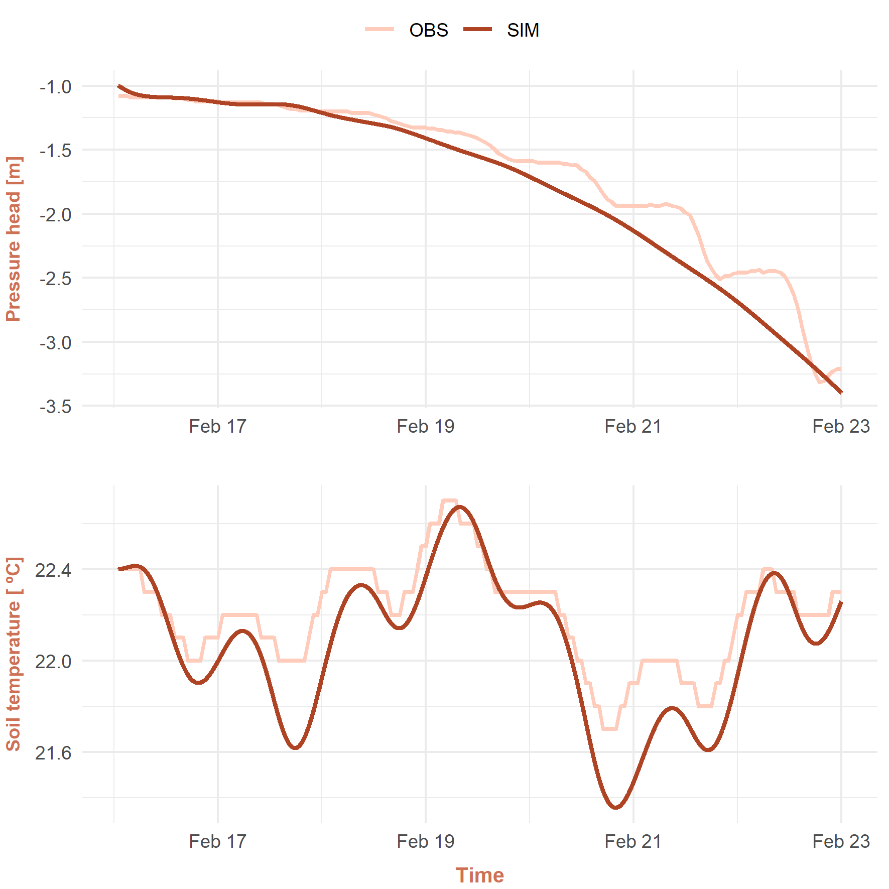
Model Validation
The system produced an output record that predicts temperature and pressure head distribution across the study site over the simulated period.
The model’s estimation of pressure head and soil temperature compares well with the values measured by in-situ soil sensors.
Surface energy balance equation was solved in the process of determining heat and water flows top boundary conditions.
The model validation successfully confirmed estimated soil and boundary properties.
System dependent evaporation rates were successfully calculated, and the state variables that could be described reproduced accurately.

Slide 10

Conclusion
The results of simulations measured well against the observed values obtained from the soil sensors.
The model succeeded in characterizing the non-isothermal evaporation rate and produced accurate description of the pressure head and soil temperature.
Model combinations were chosen to compensate for the lack of detailed information on soil properties which leads to varying accuracies in results.
Dynamical implementation of the root water uptake term as a time-varying value would reflect diurnal changes in the soil water content.
Knowledge of measurable quantities (e.g., root water uptake or water content) can increase confidence in the different aspects of the model.
Simulating longer runs that include both irrigation and evaporation phases requires an enhanced boundary description.
The system can be used as a helpful decision-making tool for farmers, in order to facilitate efficient water-usage and optimize the irrigation process according to the soil and plant needs.
And further recommendations

Slide 11
References
Kuráž, Michal, Petr Mayer, and Johanna Ruth Blöcher (2020). DRUtES – an opensource library for solving coupled nonlinear convection-diffusion-reaction equations. url: http://www.drutes.org
Allen, Richard G et al. (1998). “FAO Irrigation and drainage paper No. 56”. In: Rome: Food and Agriculture Organization of the United Nations 56.97, e156.
Monteith, John and Mike Unsworth (2013). Principles of environmental physics: plants, animals, and the atmosphere. Academic Press.
Saito, Hirotaka, Jiri Sim˚unek, and Binayak P Mohanty (2006). “Numerical analysis of coupled water, vapor, and heat transport in the vadose zone”. In: Vadose Zone Journal 5.2, pp. 784–800.

Slide 12
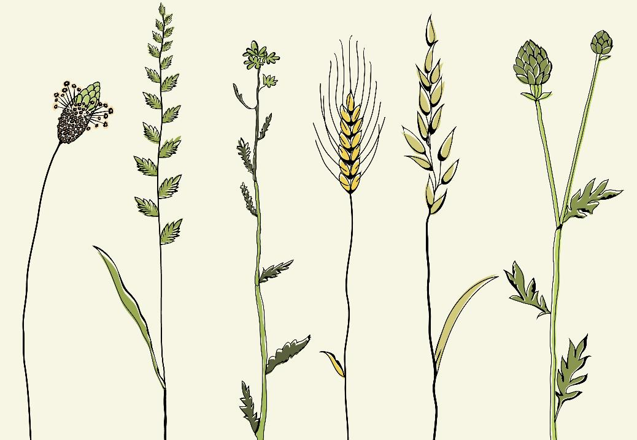
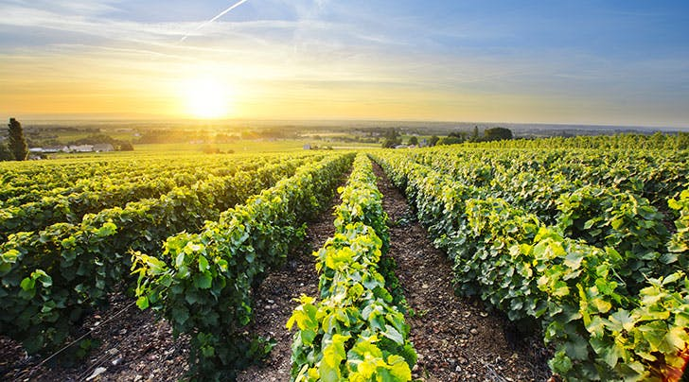
Thank You!

