Slide 1


Analysis of ionospheric compressional waves and electron density oscillation during storm periods using Swarm observations
EGU 2022
ST 3.5
Yangfan He (Yangfan.He@whu.edu.cn)
Luyuan Sun
2022 05.23-05.27

Slide 2
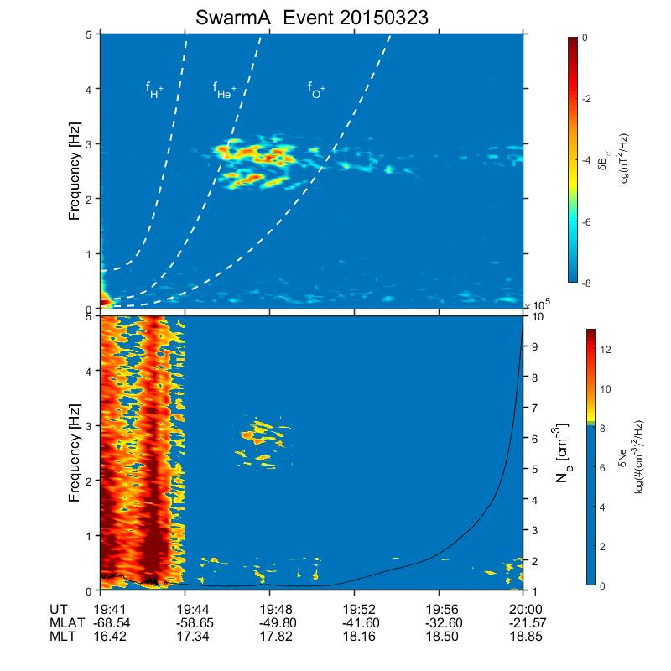
1. Research object
2014-2018 Storm Periods
（Dstmin ≤ -50nT）
299 EMIC Compressional Waves:
criteria:
16 Hz electron density data available
frequency > 0.15 Hz
Power > 10⁻⁷nT²/Hz
102 Plasma Density Oscillation Events induced by compressional EMIC wave:
time within the range of EMIC wave
frequency of peak power nearly equal to EMIC wave
frequency range difference is lower than 0.5 Hz

Slide 3
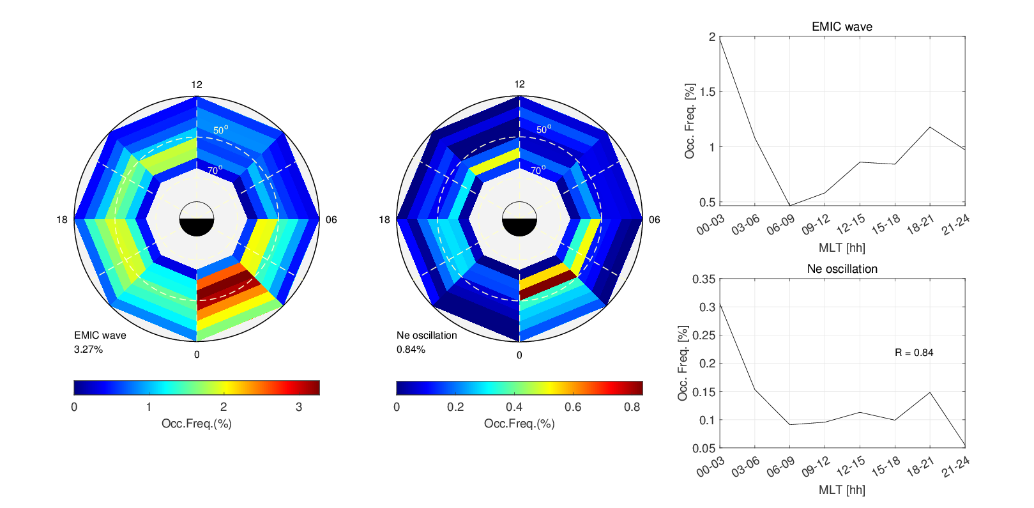
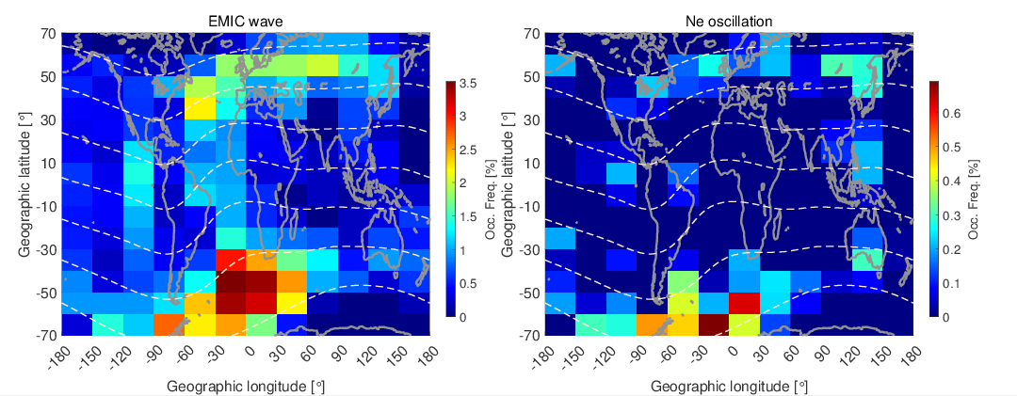
2. Results
Spatial and temporal distribution
high similarity in MLT distribution
peak occurrence:
00-03 MLT and 18-21 MLT
consistent high occurrence region
South Atlantic Anomaly Region (SAA)

Slide 4
2. Results
Enhanced proton flux and background electron density
0°MLAT = Latitude of EMIC’s maximim power density occurred
the proton flux at the location of EMIC wave is strong
EMIC wave induce a localized Ne density enhancement in the F layer

Slide 5
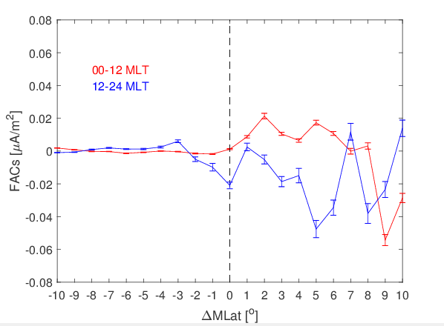
2. Results
Relative location to FACs
dawn:
lower latitude area outiside the R2 field-aligned currents
dusk:
the equatorial boundary area of the R2 field-aligned currents

Slide 6
3. Conclusion
Local time and longitudinal variations of plasma density oscillations related to compressional waves are releaved.
Energetic proton precipitation and enhanced F-layer electron density emerge around the compressional wave region.
Waves locate outside the dawn R2 field-aligned currents (FACs) and at the equatorial boundary of dusk R2 FACs.

