Slide 1
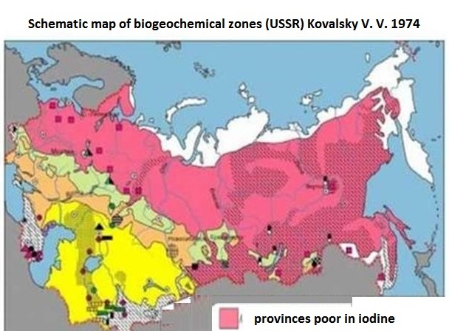
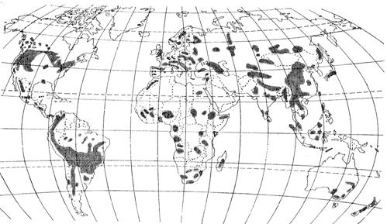
A study of iodine concentration in soils and drinking waters
of the Mountainous Crimea
Korobova E.M., Berezkin V.Yu., Kaukova E.P., Glebov V.V.
Vernadsky Institute of Geochemistry and Analytical Chemistry, RAS Sankt Petersburg State University Russian State Agrarian University
The aim of the research was to identify variation of iodine content in different soils and natural drinking waters hosted by different aquifers in the Mountainous Crimea. Soil and water samples were collected in several regions of the Mountainous Crimea (mostly in Bakhchisarai) and tested for iodine content.
Areas of endemic goiter (WHO)
Crimean peninsula
Iodine-deficiency diseases are among the most common non-communicable human diseases

Slide 2
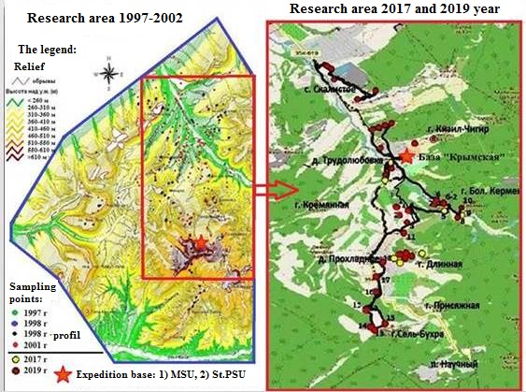
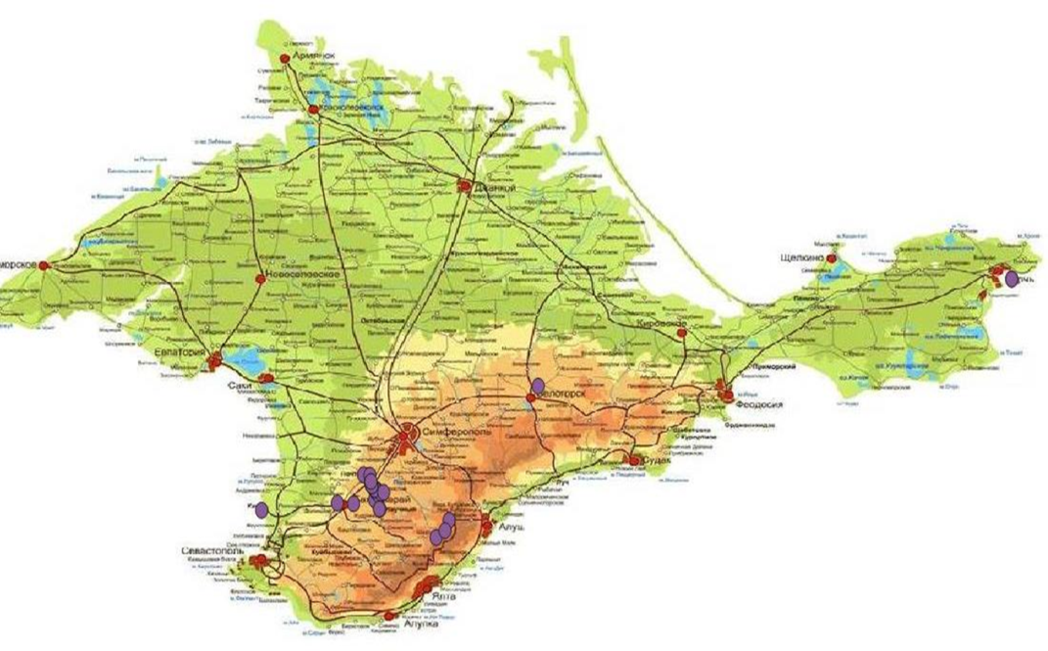
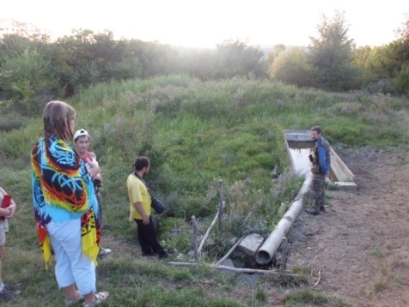
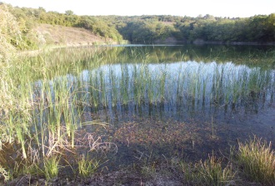
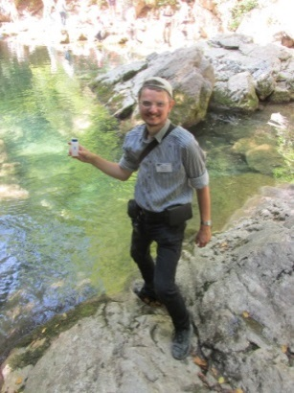
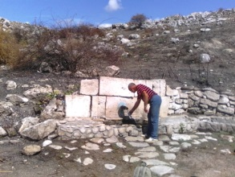
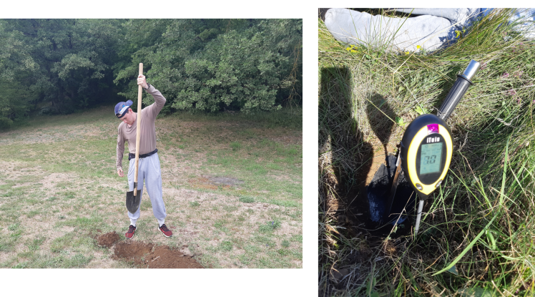
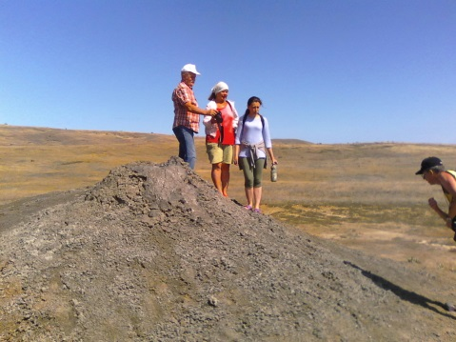
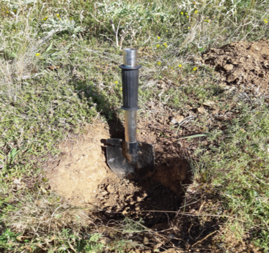
A study of iodine concentration in soils and drinking waters
of the Mountainous Crimea
Samples of natural drinking water (n=37) were taken in three districts of the Mountainous Crimea (Bakhchisarai, Alushta and Simferopol) from various sources (rivers, wells, ponds, tapwater) in 2017.
Soil samples (n=23) were taken in the Bodrak River valley (Bakhchisarai district) from the upper horizons (sampling depth down to 20 cm) in 2019.
Iodine was determined in the laboratory of the Institute of Geochemistry of the RAS (2017-2019).

Slide 3
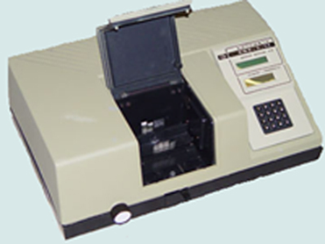
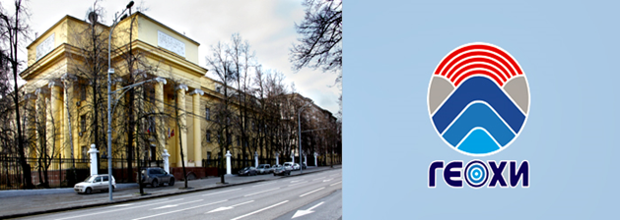
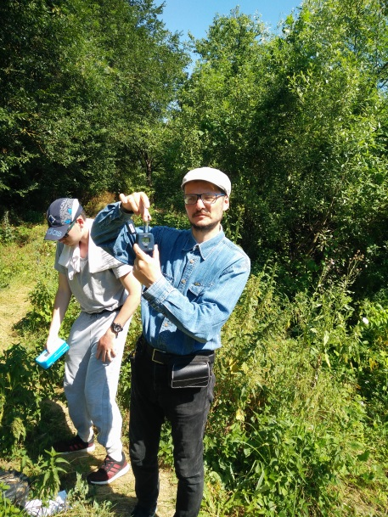
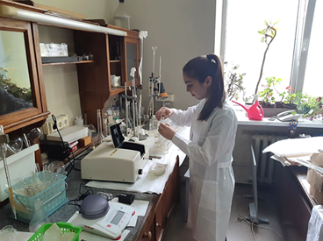
A study of iodine concentration in soils and drinking waters
of the Mountainous Crimea
Statistical characteristics of iodine content in waters of Mountain Crimea (µg/l)
Type of water source | N | Minimum | Median | Average | Maximum
Sources of drinking water
Water pipe-line and private pumps | 11 | 0,99 | 4,33 | 5,46 | 16,24
Rill (streamlet) | 7 | 1,74 | 6,06 | 6,04 | 11,21
Public wells | 5 | 0,89 | 4,47 | 6,22 | 17,54
Rivers | 7 | 2,33 | 4,44 | 9,26 | 24,38
Other water sources
Salse (mud volcano) | 2 | 139,8 - 139,9
Precipitation | 4 | 0,31 | 2,22 | 1,90 | 2,88
Pond | 2 | 1,04 - 2,24
Iodine was determined by kinetic rhodanide-nitrite
method (Proskuryakova, Nikitina, 1976)
in the laboratory of environmental biogeochemistry at the Vernadsky institute of GEOKHI of the Russian Academy of Sciences
Statistical characteristics of pH, humus and
iodine content in soils of Mountain Crimea
Type of soils | Parameter | Minimum | Average | Median | Maximum | N
Mountain regosols | Iodine (mg/kg) | 1,3 | 5,6 | 5,1 | 16,5 | 13
 | Humus (%) | 4,1 | 6,2 | 5,9 | 8,8 | 8
 | рН | 7,5 | 8 | 7,9 | 8,5 | 13
Mountain cambisols | Iodine (mg/kg) | 0,35 | 1,69 | 1,6 | 3,5 | 6
 | Humus (%) | 1,7 | 5,1 | 5,1 | 8,6 | 6
 | рН | 6,6 | 6,9 | 6,8 | 7,9 | 6
Fluvisols | Iodine (mg/kg) | 0,4 | 1,1 | 1,2 | 1,6 | 4
 | Humus (%) | 2,6 | 3,2 | 3,1 | 3,9 | 4
 | рН | 7,2 | 7,6 | 7,7 | 7,8 | 4

Slide 4
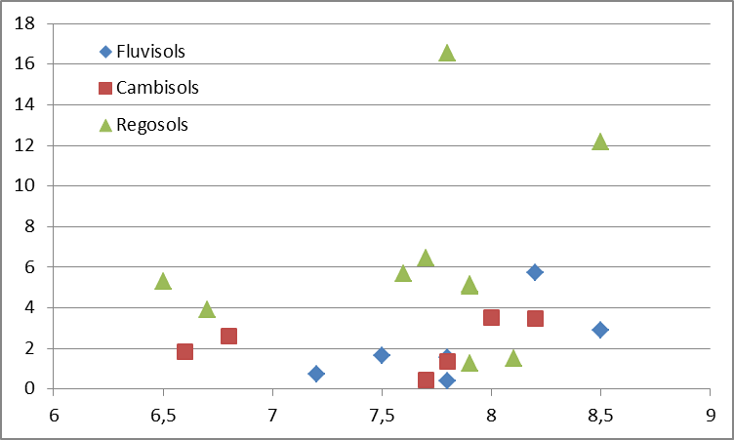
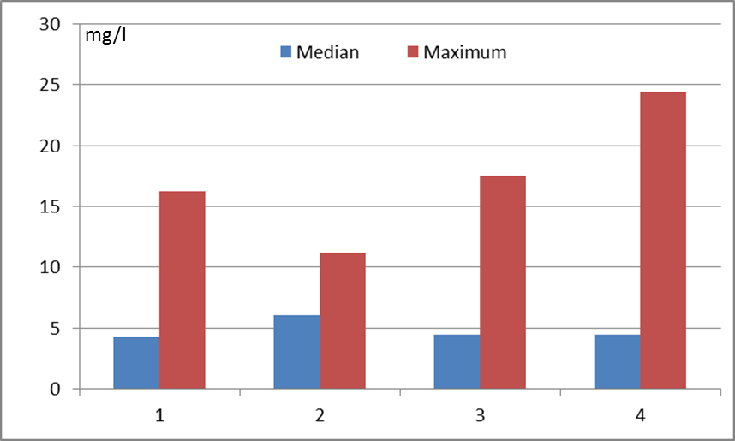
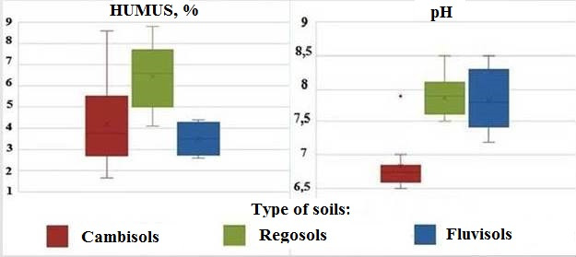
A study of iodine concentration in soils and drinking waters
of the Mountainous Crimea
Statistical characteristics of iodine in water
Statistical characteristics of iodine in soils
I, μg/kg
I, mg/kg
μg/l
pH
Tap water and private wells
Rill (streamlet)
Public wells
Rivers
The content of humus in the upper horizon (A1 / A1C) and pH of the main types of soils in the valley of the r. Bodrak Mountainous Crimea (n=17)

Slide 5
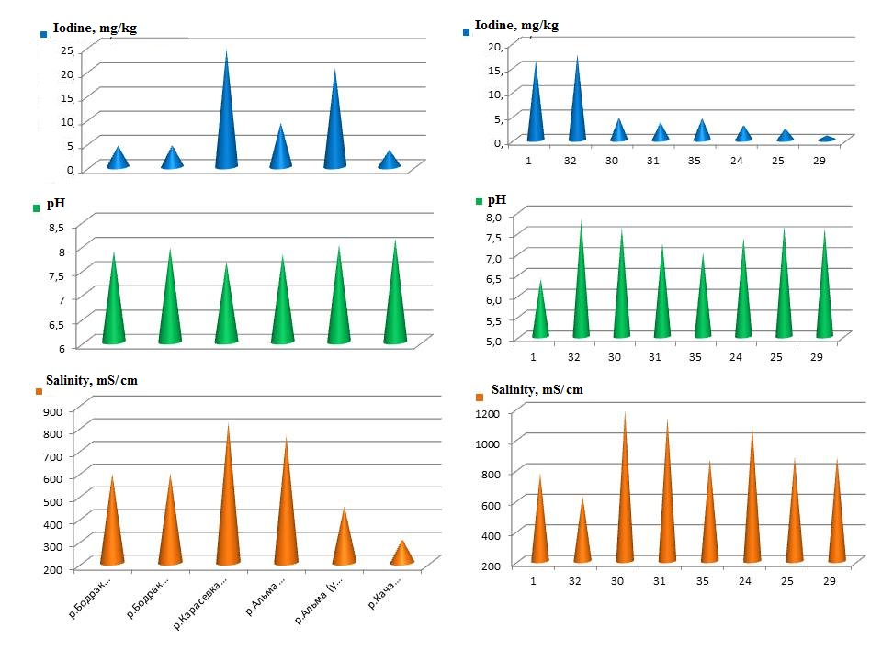
A study of iodine concentration in soils and drinking waters
of the Mountainous Crimea
The first experimental obtained data characterized the iodine content in natural waters and soil cover of the geochemically contrasting landscapes of the second ridge of the Crimean Mountains (Bakhchisaray district).
It was revealed that iodine amount in the centralized sources of drinking water is within the range of the standards (2-10 µg/l). However, the iodine concentration in decentralized sources appeared to be low (0.89 µg/l - private wells; 1.75 µg/l - drilled wells) which is apparently explained by the aquifers’ types. The low content of iodine (1.04 - 2.24 µg/kg) in ponds requires further experimental studies and verification.
A high variability of iodine in the soils of automorphic landscapes of the Crimean Mountains (from 0.43 mg/kg (mountain Cambisols) to 15.4 mg/kg (Regosols)) was established. The maximum content of iodine was found in Regosols, and the minimum in Cambisols (0.43 mg/kg) and Fluvisols (0.41 mg/kg).
For natural soils (not affected by agricultural activities), the highest iodine values ​​correspond to soils with the highest humus content and pH value in the topsoil.
It has been confirmed that in a limited area (3*5 km) with approximately the same iodine supply with precipitation, the iodine content in different topsoils can variate several times depending upon humus and carbonates amounts.
Iodine concentration, pH, and water salinity
1) Rivers 2) Public wells
The study was carried out with partial support of
the Vernadsky Institute of Geochemistry and Analytical Chemistry, RAS
which provided equipment for measuring iodine.
Thanks for your attention!

