Slide 1
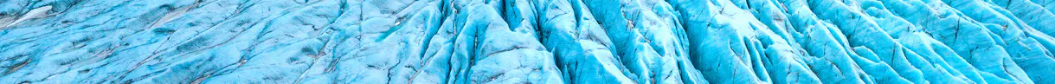




Fusion of multi-sensor, multi-temporal velocity observations to study intra-annual glacier dynamics
Laurane Charrier, Yajing Yan, Emmanuel Trouvé, Elise Colin Koeniguer, Silvan Leinss, Jeremie Mouginot, and Romain Millan
Contact: laurane.charrier@univ-smb.fr

Slide 2
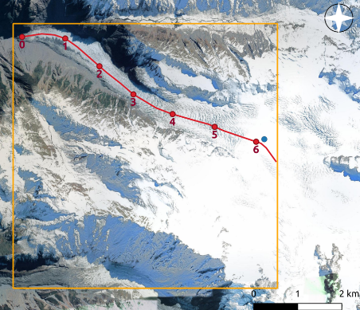
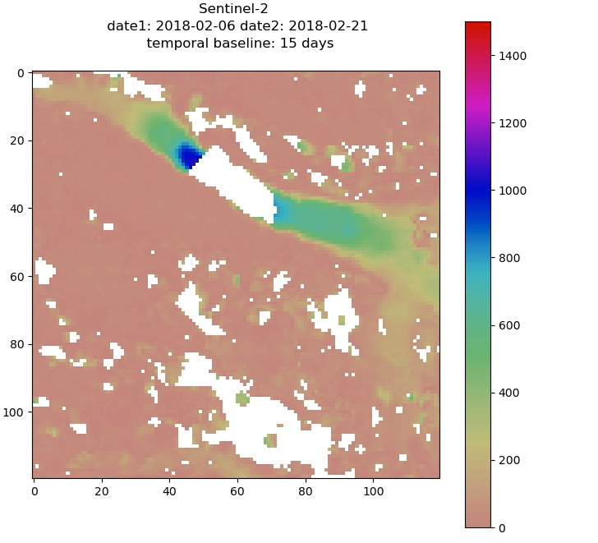
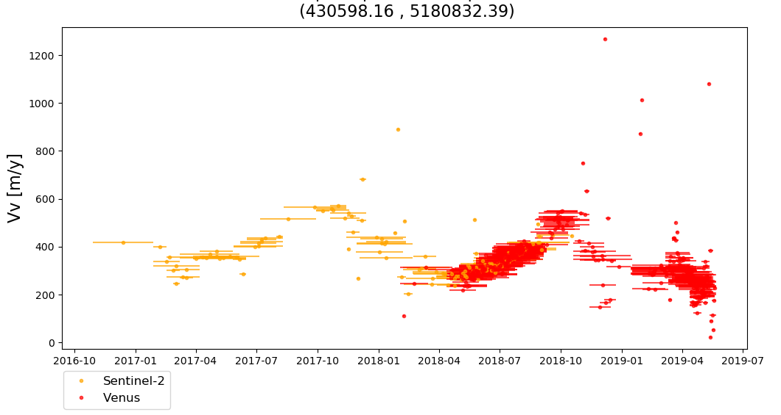
Available ice velocity maps
Data from Millan et al., 2019 (IGE)
Sentinel-2 (5 days) and Venµs (2 days)
Fox glacier, NZ
Velocity magnitude [m/y]
Velocity magnitude [m/y]
Sentinel-2
Venµs
How to deal with this amount of data ?
Multi-temporal, multi-sensor
Uncertainty, gaps
2

Slide 3
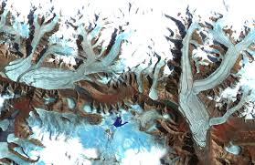
Temporal closure
Missing data
Charrier et al., 2022a,b
t_{k-1}
t_{k}
t₀
t₂
t₄
t₆
t₇
t_{k+1}
t₁
t₃
t₅
…
Input: Displacements Y
Y
Ouput: Displacements X
Inversion
…
X
t_{k} to t_{k+μ}

Slide 4
Temporal closure
Missing data
Charrier et al., 2022a,b
Questions:
-which temporal sampling ?
t_{k-1}
t_{k}
t₀
t₂
t₄
t₆
t₇
t_{k+1}
t₁
t₃
t₅
…
Input: Displacements Y
Y
Ouput: Displacements X
Inversion BY = AX
…
X
spaning an optimal temporal sampling
t_{k} to t_{k+μ}

Slide 5
Temporal closure
Missing data
Charrier et al., 2022a,b
Questions:
-which temporal sampling ?
-how to deal with uncertainty ?
t_{k-1}
t_{k}
t₀
t₂
t₄
t₆
t₇
t_{k+1}
t₁
t₃
t₅
…
Input: Displacements Y
Y
Ouput: Displacements X
Inversion BY = AX
Iterative Reweighted Least Square
…
X
spaning an optimal temporal sampling
t_{k} to t_{k+μ}

Slide 6
Temporal closure
Missing data
Charrier et al., 2022a,b
Questions:
-which temporal sampling ?
-how to deal with uncertainty ?
-how to deal with multi-sensor and gaps ?
t_{k-1}
t_{k}
t₀
t₂
t₄
t₆
t₇
t_{k+1}
t₁
t₃
t₅
…
Input: Displacements Y
Y
Ouput: Displacements X
Inversion BY = AX
temporal interpolation
…
X
spaning an optimal temporal sampling
t_{k} to t_{k+μ}

Slide 7
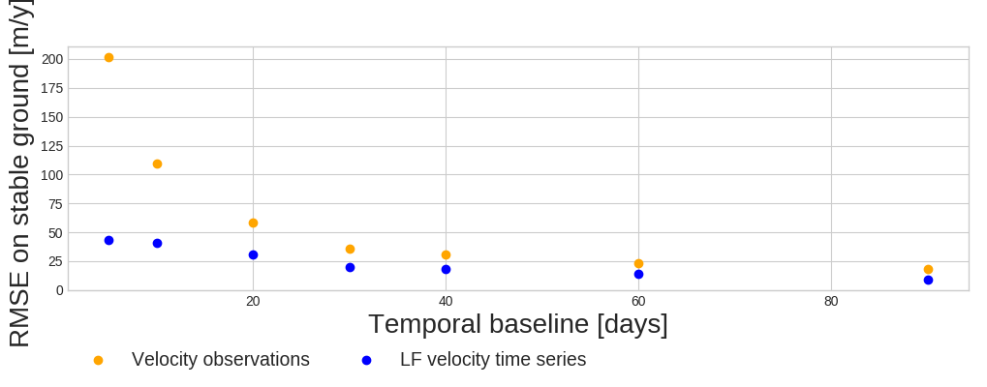
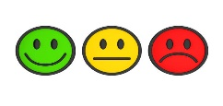
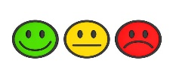
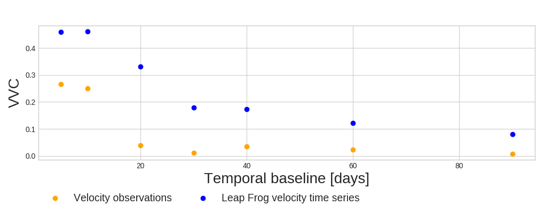


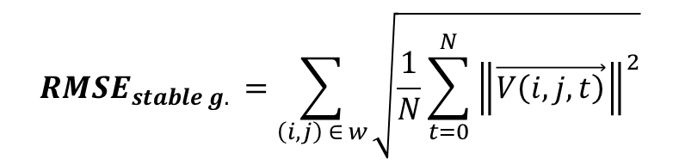

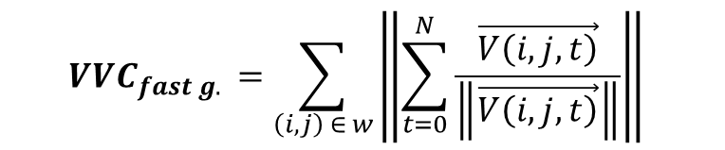

Regular Leap Frog time series - optimal temporal sampling
$${RMSE}_{stable g. }=\sum_{\left(i,j\right) ∈ w}{\sqrt{\frac{1}{N}\sum_{t=0}^{N}{{\left\|\vec{V\left(i,j,t\right)}\right\|}^{2}}}}$$
$$RMSE$$
$$RMSE$$
Velocity observations
Inverted velocity time series
$${VVC}_{fast g. }=\sum_{\left(i,j\right) ∈ w}{\left\|\sum_{t=0}^{N}{\frac{\vec{V\left(i,j,t\right)}}{\left\|\vec{V\left(i,j,t\right)}\right\|}}\right\| }$$
$$VVC$$
$$VVC$$
Velocity observations
Inverted velocity time series
Notes:
the RMSE over stable areas is always lower for the RLF time
series than for the velocity observations: from 78% lower for
a temporal baseline of 5 days to 40% lower for a temporal
baseline of 60 days. In

Slide 8
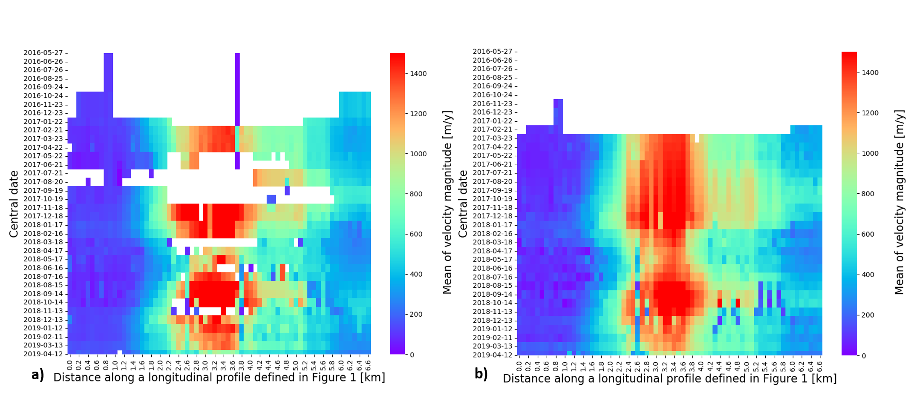
Velocity magnitude along a longitudinal profile
30-day moving average on velocity observations
30-day inverted velocity time series
Distance along a longitudinal profile over the Fox glacier [km]
Distance along a longitudinal profile over the Fox glacier [km]

Slide 9
Conclusion
Velocity time series with:
a reduced uncertainty
a regular and optimal temporal sampling
no redundancy
a better spatial and temporal coverage
Using multi-sensor and multi-temporal observations
Work in progress: fuse velocity maps from different methods
Toward a better understanding of intra-annual glacier dynamics ?

Slide 10
Thanks for your attention !
Contact: laurane.charrier@univ-smb.fr
Charrier, L., Yan, Y., Koeniguer, E. C., Leinss, S., & Trouve, E. (2022a). Extraction of velocity time series with an optimal temporal sampling from displacement observation networks. IEEE Transactions on Geoscience and Remote Sensing, 60, 1‑10. https://doi.org/10.1109/TGRS.2021.3128289
Charrier, L., Yan, Y., Koeniguer, E. C., Mouginot, J., Millan, R., & Trouve, E. (2022b). Fusion of multi-temporal and multi-sensor ice velocity observations. International Annals of the Photogrammetry, Remote Sensing and Spatial Information Sciences. https://hal.archives-ouvertes.fr/hal-03602685

