Slide 1
Constraining the production rate of reactive oxygen species from air pollution in the human lung with mechanisms in cloud chemistry models
Ashmi Mishra, Eleni Dovrou, Steven Lelieveld, Ulrich Pöschl, Thomas Berkemeier
Department of Multiphase Chemistry, Max Planck Institute for Chemistry
24.05.2022

Slide 2
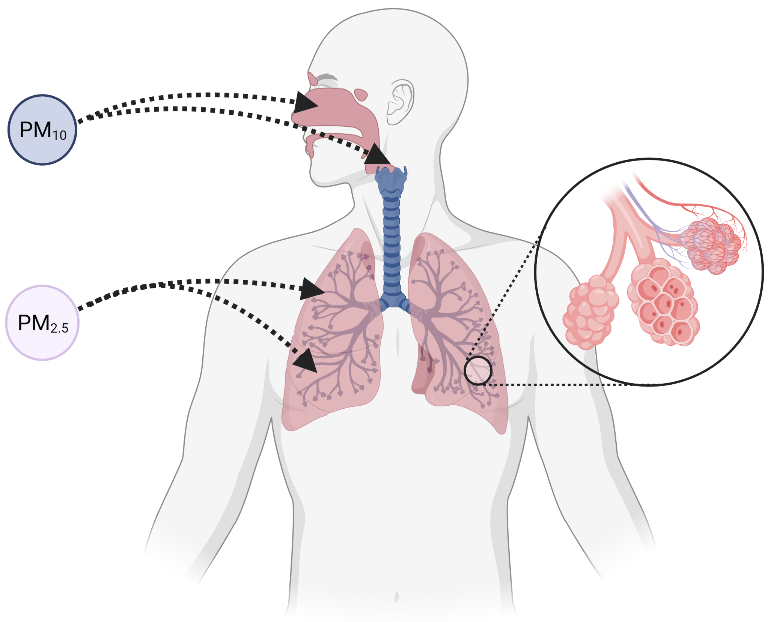
Introduction and motivation
Epithelial lining fluid (ELF):
Mucus layer covering the respiratory tract
First contact point for air pollutants
Air pollutants can cause diseases:
Respiratory disease
Cardiovascular disease
PM: Particulate Matter

Slide 3
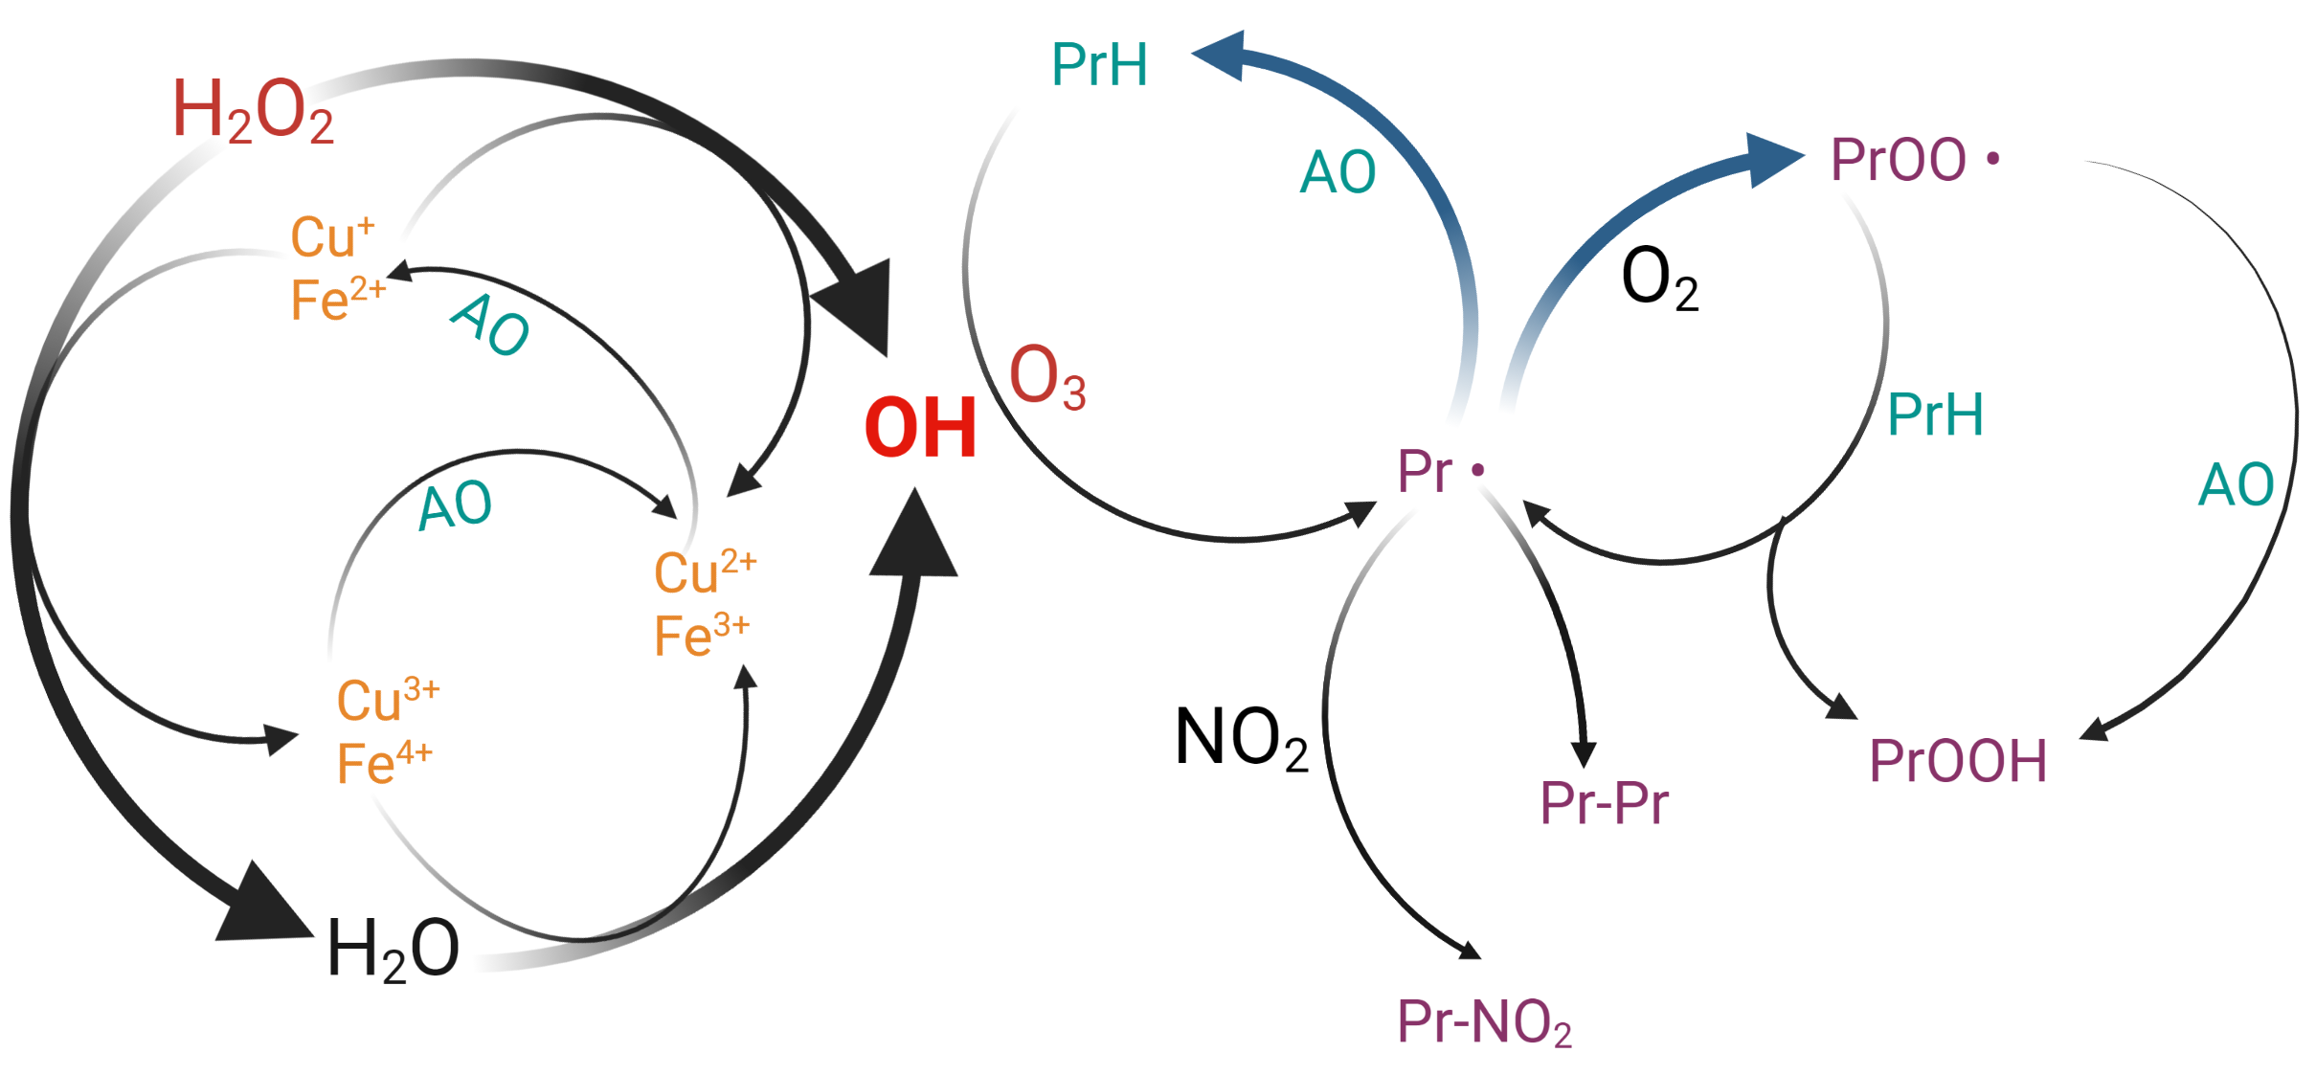
Interaction of Transition Metals, Reactive Oxygen Species, Biological Molecules
Fenton chemistry: Interaction of pollutants and ROS
Protein chemistry: Interaction of biomolecules and ROS
PrH: Protein, AO: Antioxidants, ROS: Reactive oxygen species

Slide 4
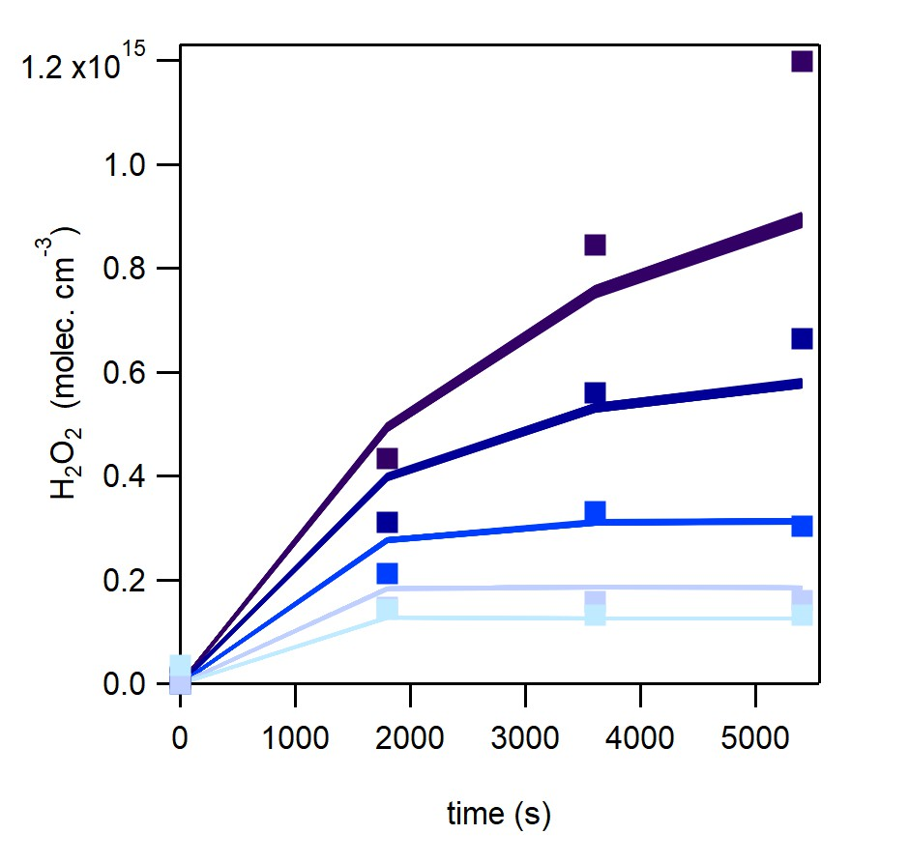
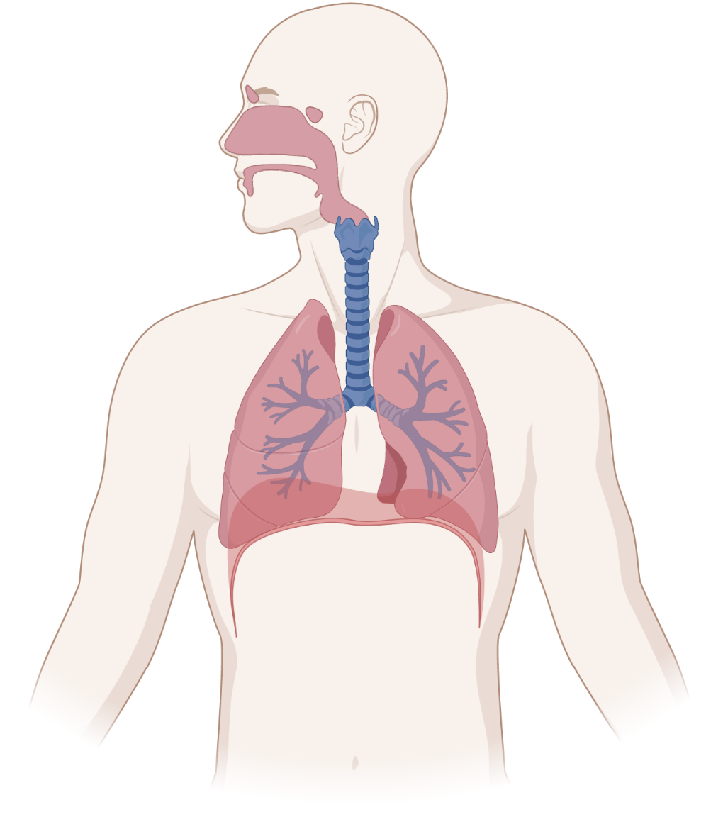
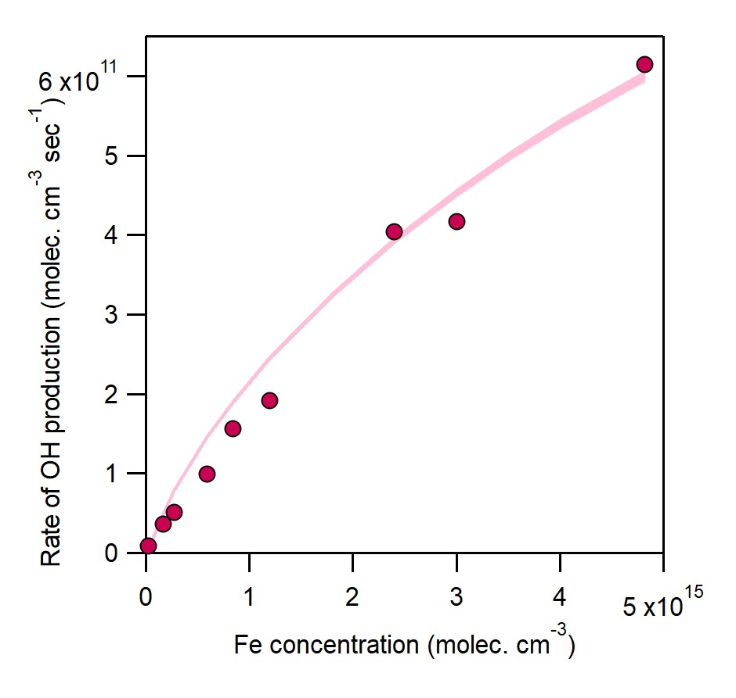
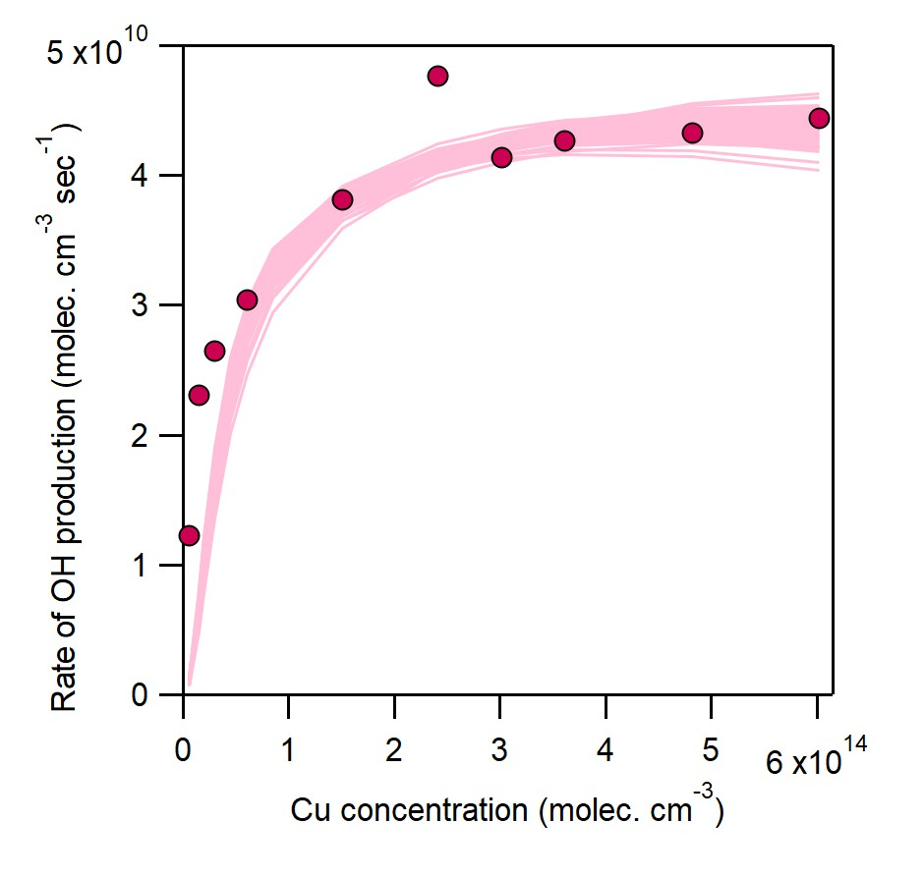

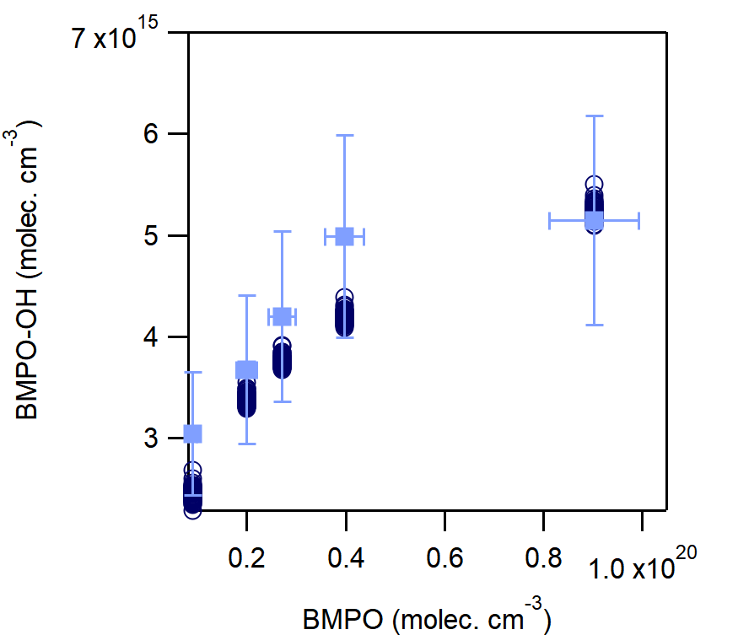
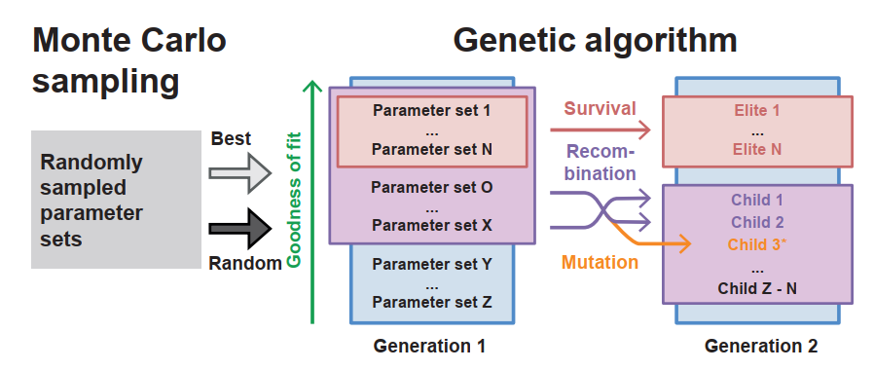
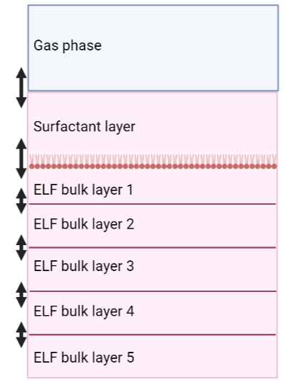



Methods: Inverse modelling
Oxidative stress:
Imbalance between natural defense of antioxidants
and ROS production
Experimental data from the lab
CAPRAM
CLEPS
Quantifying oxidative stress from redox active species
KM-SUB-ELF
Kinetic Model
Rate coefficients
ELF: epithelial lining fluid

Slide 5
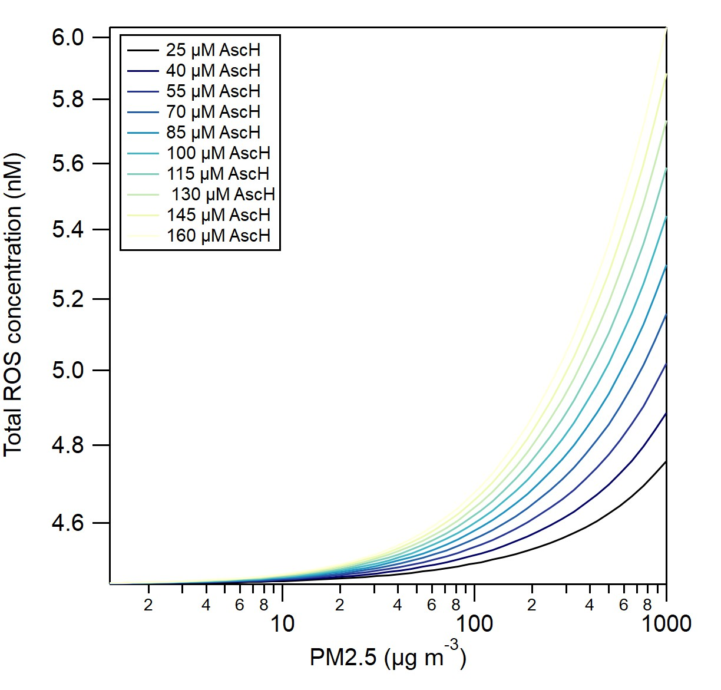
Ascorbic acid: Pro-oxidant behavior
Total reactive oxygen species (ROS) concentration increases as ascorbic acid (AscH) concentration is increased

Slide 6
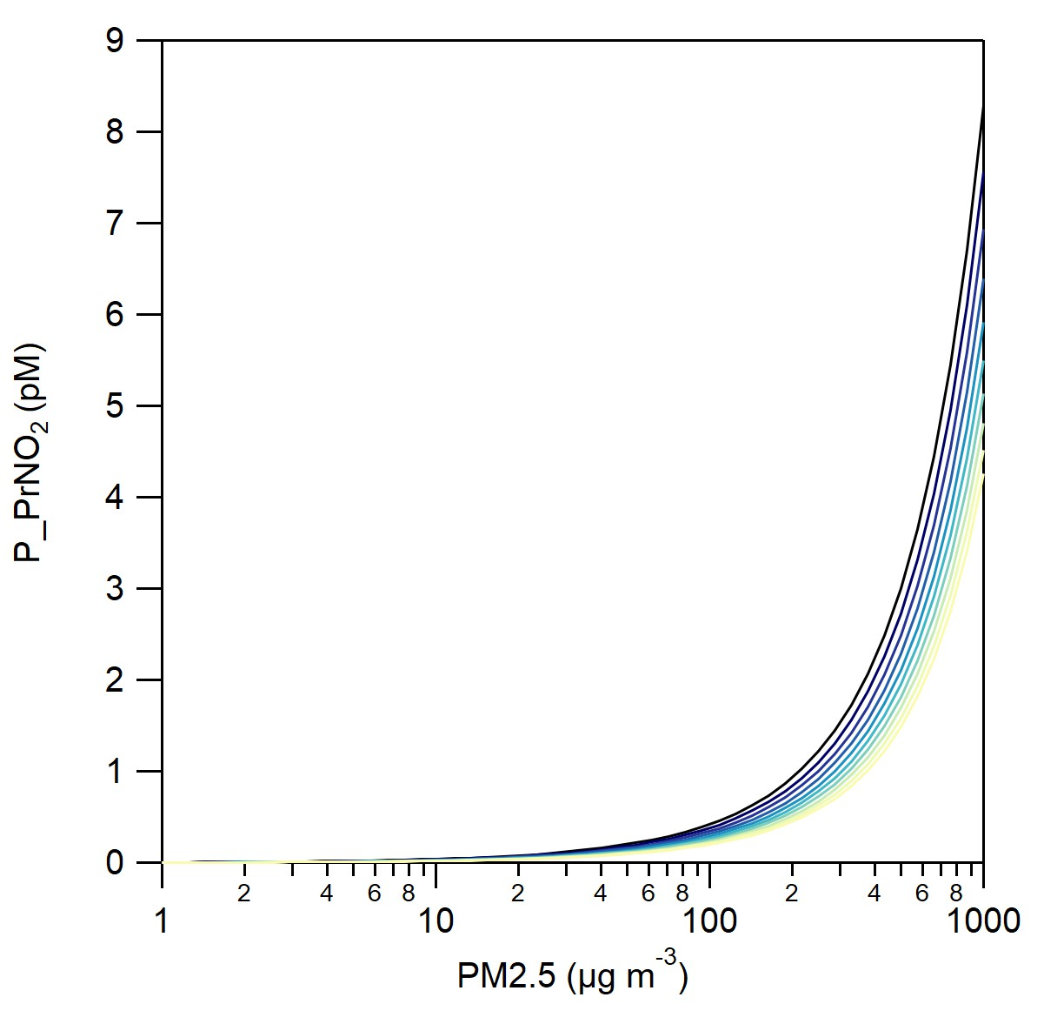
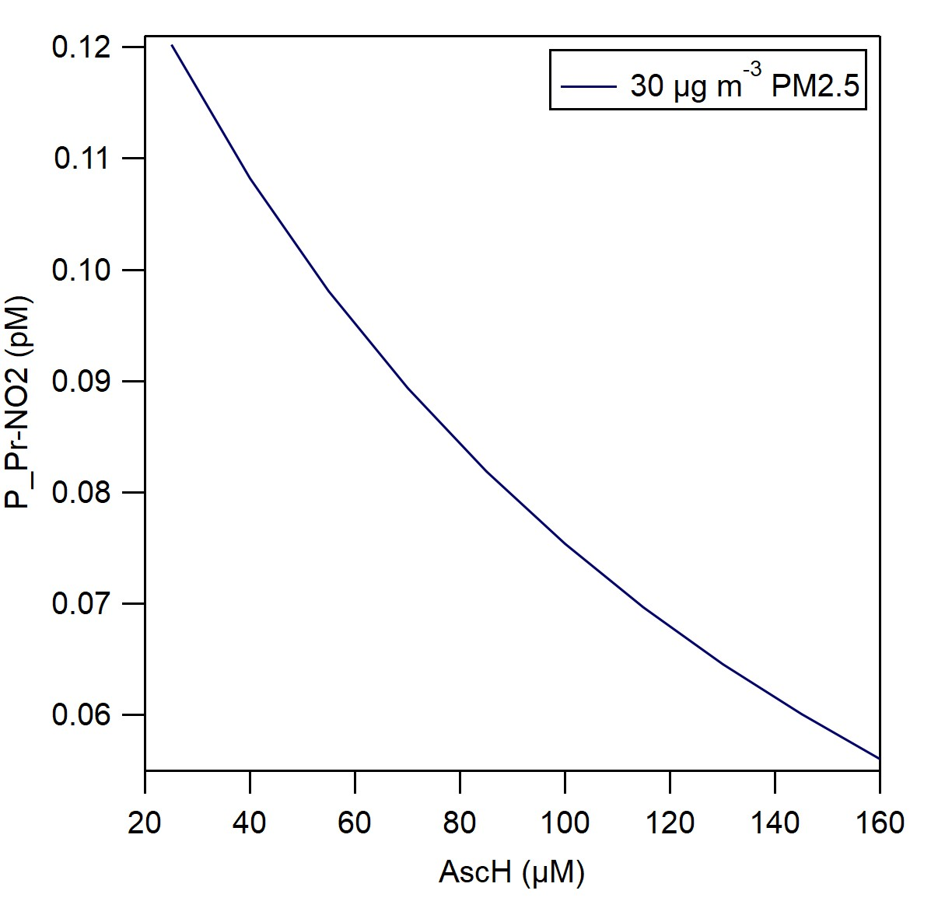
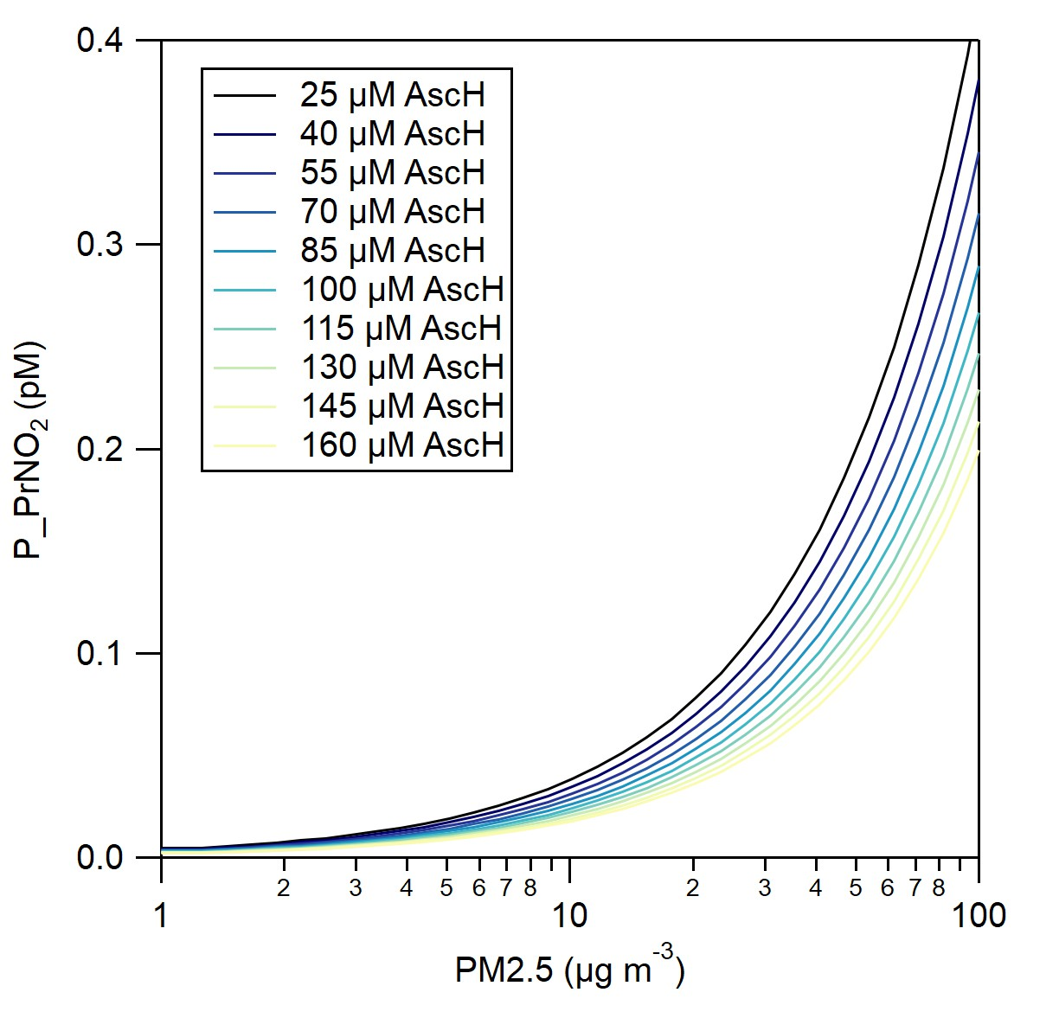
Ascorbic acid: Anti-oxidant
Biomolecular damage decreases as ascorbic acid (AscH) concentration is increased

Slide 7
Thank you!
Berkemeier Group

Slide 8
Ascorbic acid: Anti-oxidant
Biomolecular damage decreases as ascorbic acid (AscH) concentration is increased

Slide 9
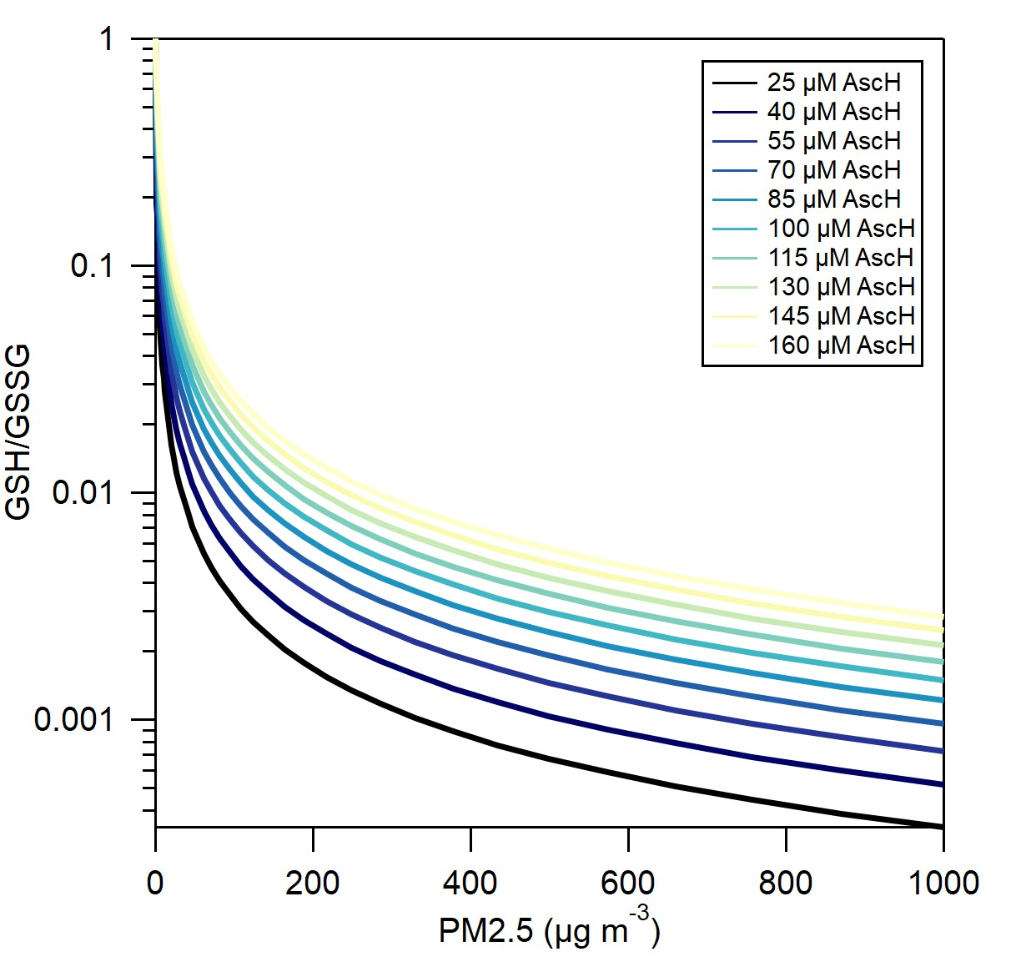
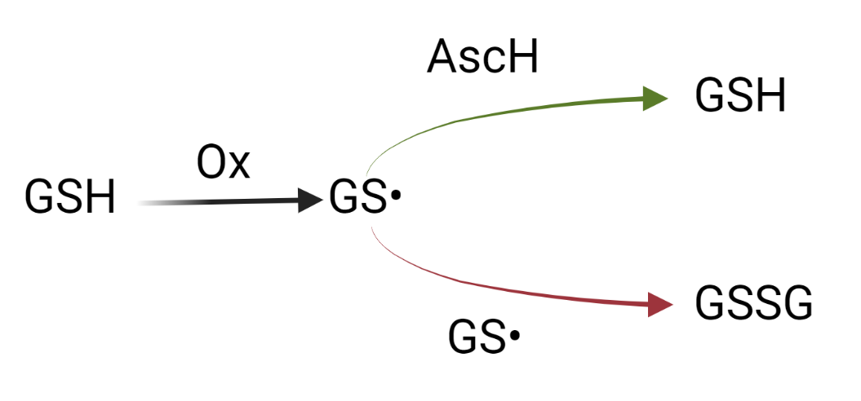
Ascorbic acid: Anti-oxidant
GSH: Glutathione (a common biomolecule/antioxidant)
GSSG: oxidized form of GSH
Biomolecular damage decreases as ascorbic acid (AscH) concentration is increased

