Slide 1







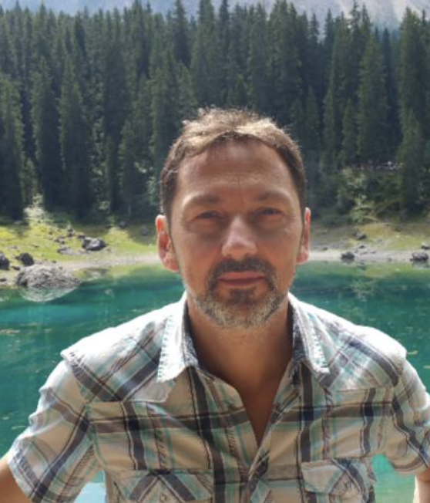
Assessment of deep learning based landslide detection and mapping performances with backscatter SAR data
Lorenzo Nava¹, Kushanav Bhuyan¹, Sansar Raj Meena¹, Oriol Monserrat², Filippo Catani¹
¹ Machine Intelligence and Slope Stability Laboratory (MISSlab), Department of Geosciences, University of Padova, Italy
² Department of Remote Sensing, Geomatic Research Unit, Centre Tecnològic Telecomunicacions Catalunya, Spain
EGU General Assembly 2022 - Session NH3.8 - Thursday, 26 May, 13:42–13:49

Slide 2
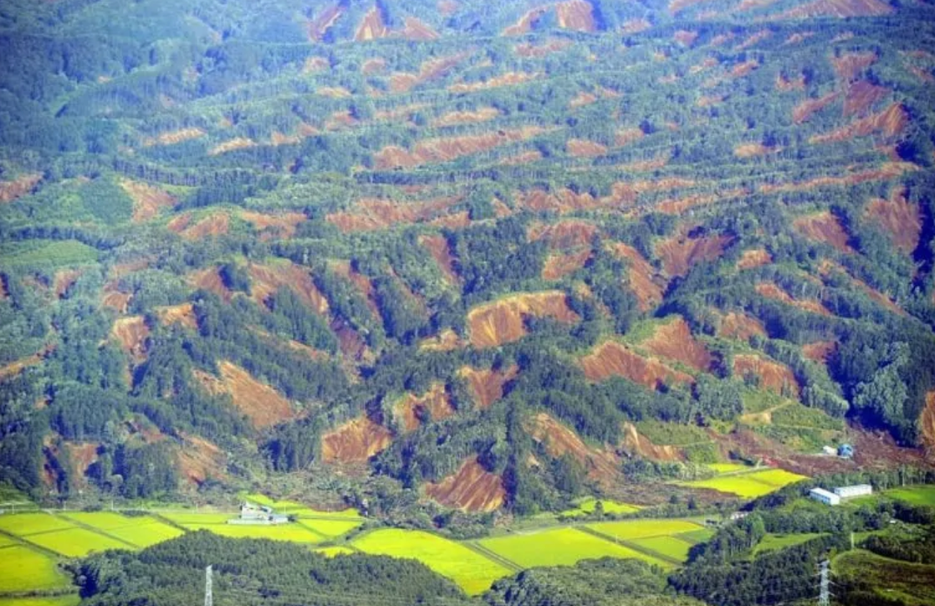
EGU General Assembly 2022
Introduction:
Cause severe damages to communities as well as to human infrastructures.
Earthquake- and rainfall-triggered multiple landslides events damage wide areas in a short time span.
We must be able to intervene promptly right after the event.
Source: http://meteoweb.eu

Slide 3
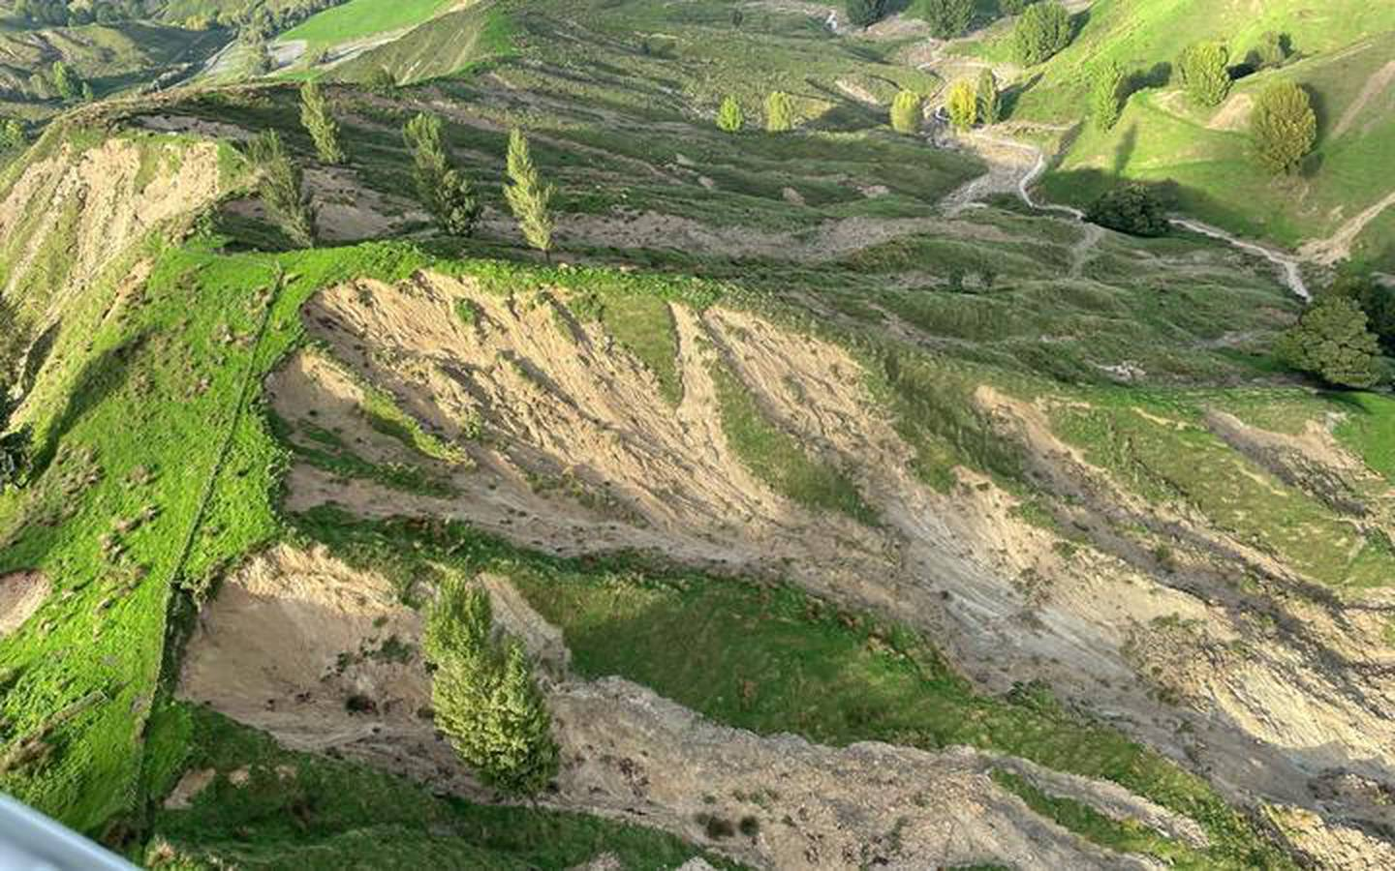
EGU General Assembly 2022
Research problem:
Optical data has limitations in presence of thick cloud cover.
Lack of research on SAR data in combination with Deep Learning to map landslides.
Source: https://blogs.agu.org/

Slide 4
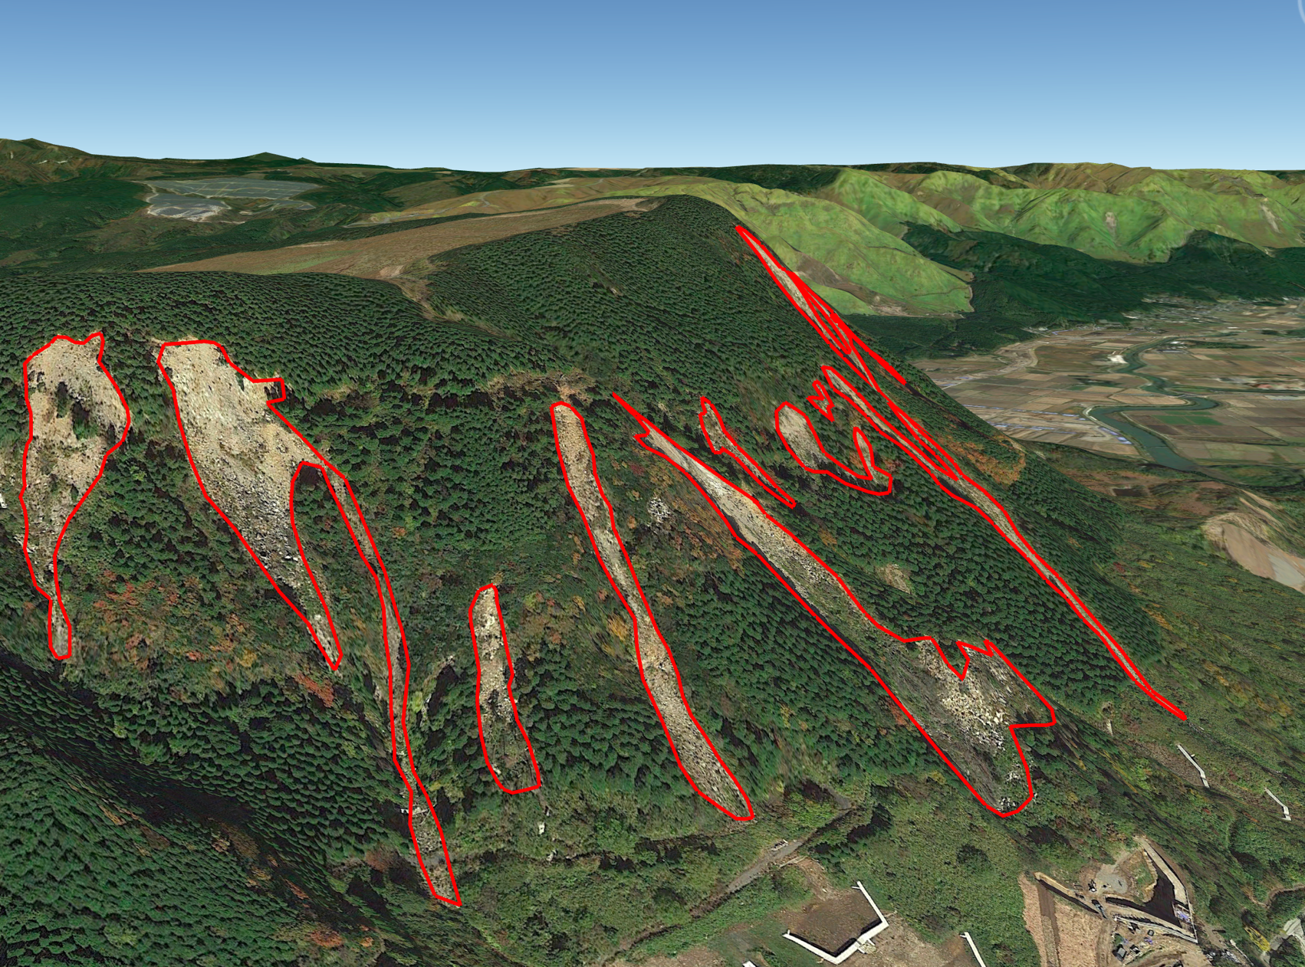
EGU General Assembly 2022
Purpose of the study:
Overcome whether-related limitations of optical data for rapid landslide mapping.
Evaluating performances of DL models on composites of different polarizations and orbits of Sentinel-1 SAR amplitude data.

Slide 5
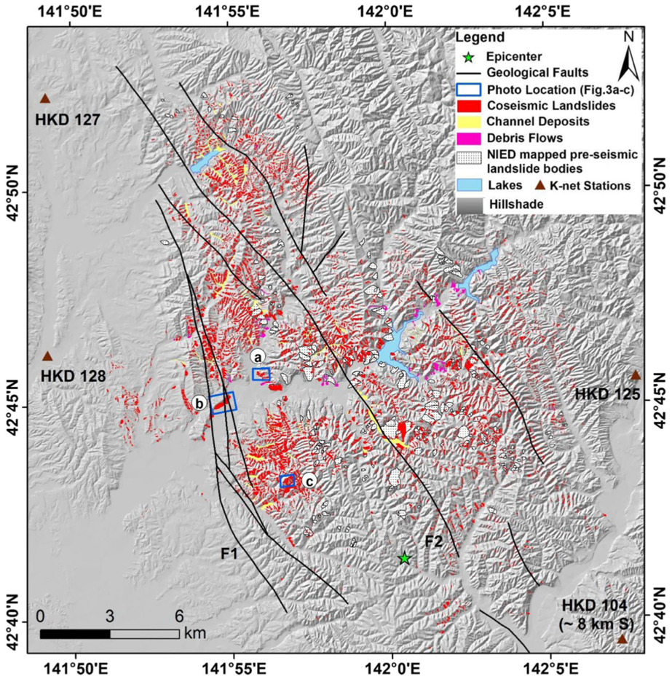
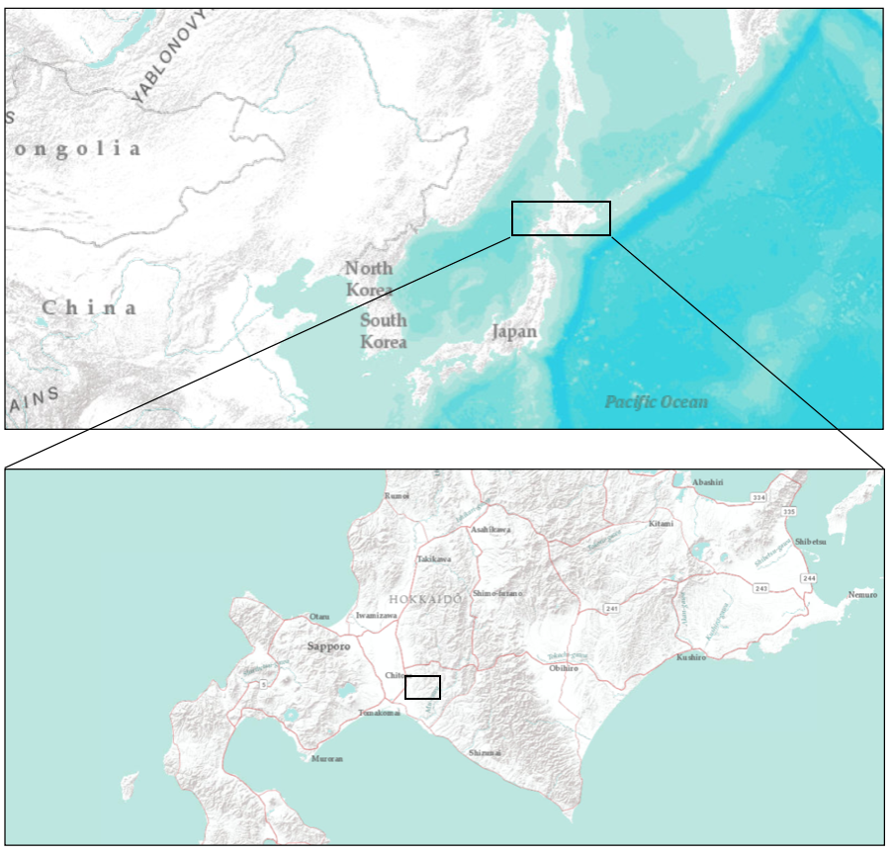
EGU General Assembly 2022
Study area:
Event considered:
Iburi sub-prefecture, Hokkaido, Japan.
A 6.6 Mw earthquake triggered about 7837 coseismic landslides on September 6, 2018.
Fig. 1: Localization of the study area.
Fig. 2: Coseismic landslides in the study area. (Source: Wang et al. 2019).

Slide 6
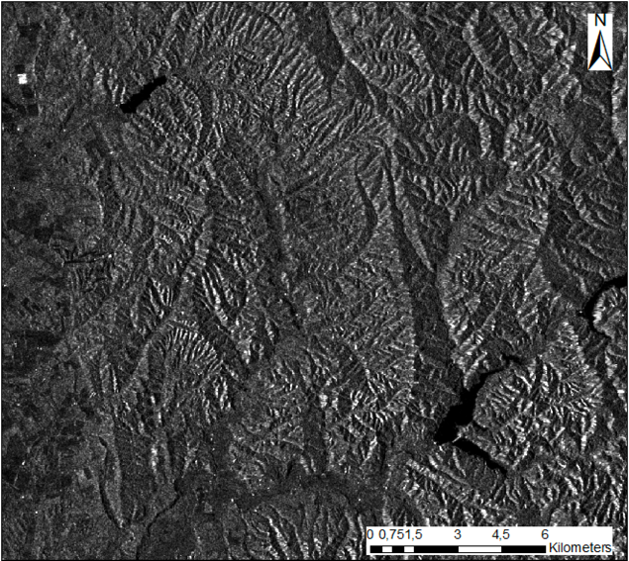
EGU General Assembly 2021
Materials:
Sentinel-1 SAR GRD products (VV and VH polarizations).
Sentinel-2 VHR RGB image (10 m x 10 m).
Digital Elevation Model (DEM) (30 m x 30 m) and Slope obtained from the same.

Slide 7
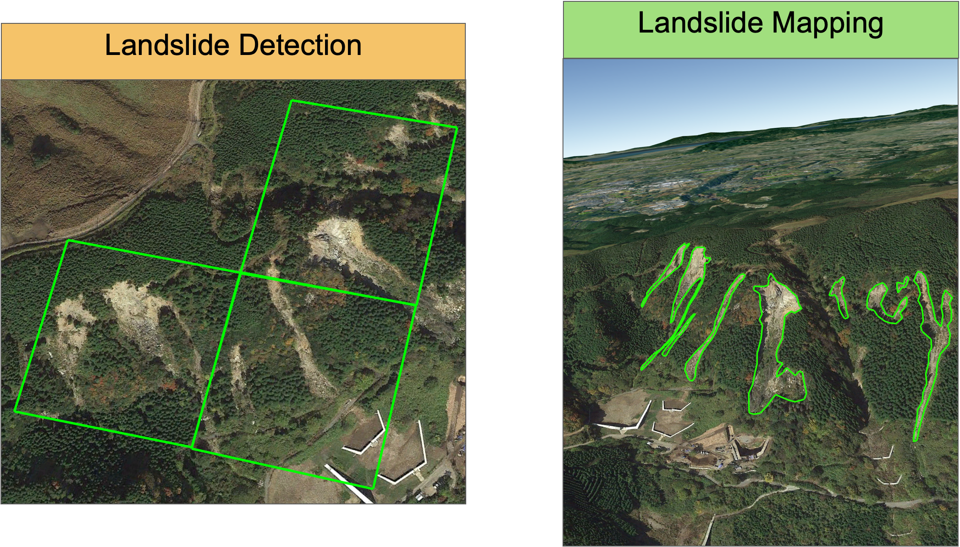
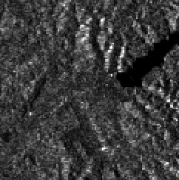
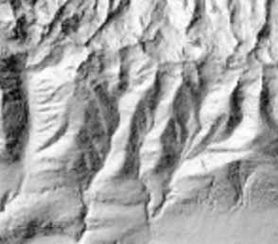
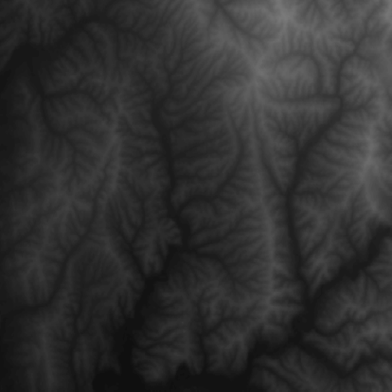
EGU General Assembly 2022
Object detection:
Rete Neurale
CNN
Input
Input
Sentinel-1 SAR Layers
Conv2D, 3x3
ReLU
MaxPool2D, 2x2
Sliding Window
Conv2D, 3X3
ReLU
MaxPool2D, 2x2
Topographic Layers
+

Slide 8
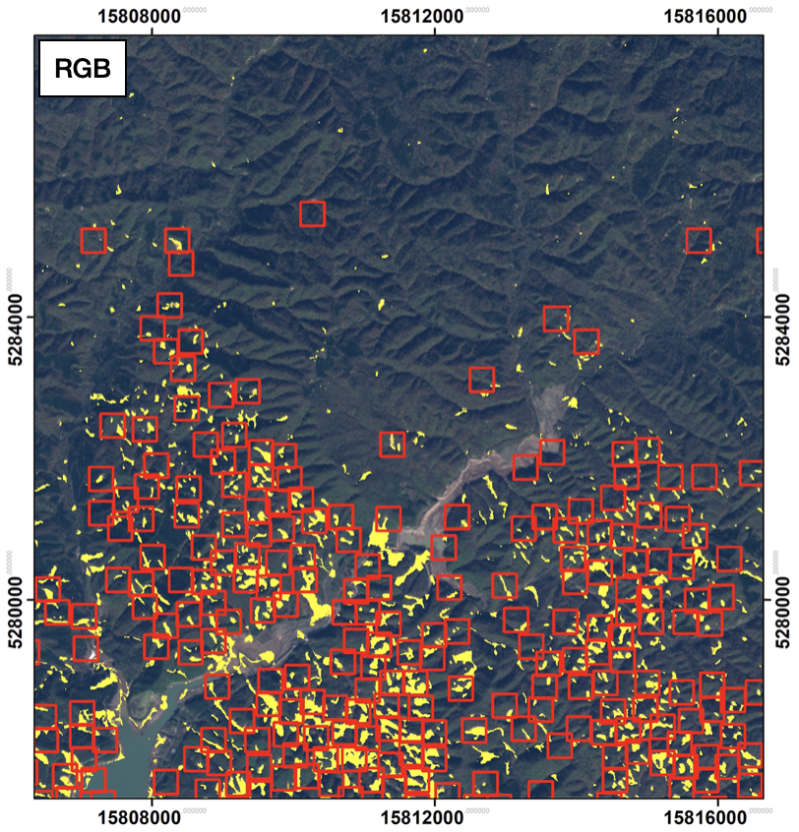
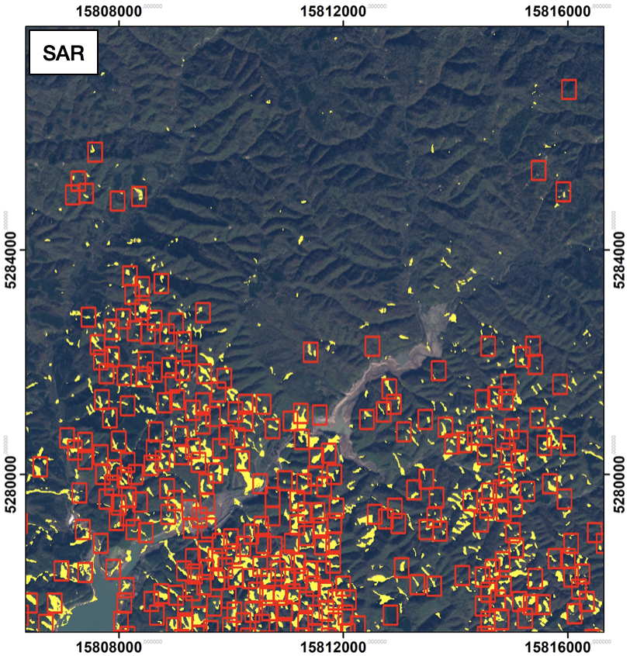
EGU General Assembly 2022
Object detection:
Nava et al., 2021

Slide 9
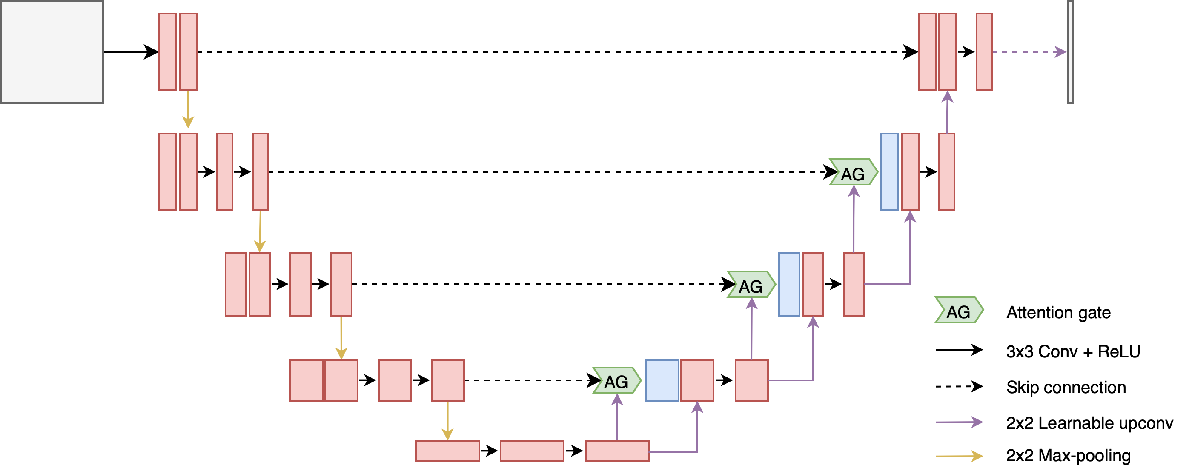
EGU General Assembly 2022
Image segmentation:
Sentinel-1 SAR Layers
Topographic Layers

Slide 10
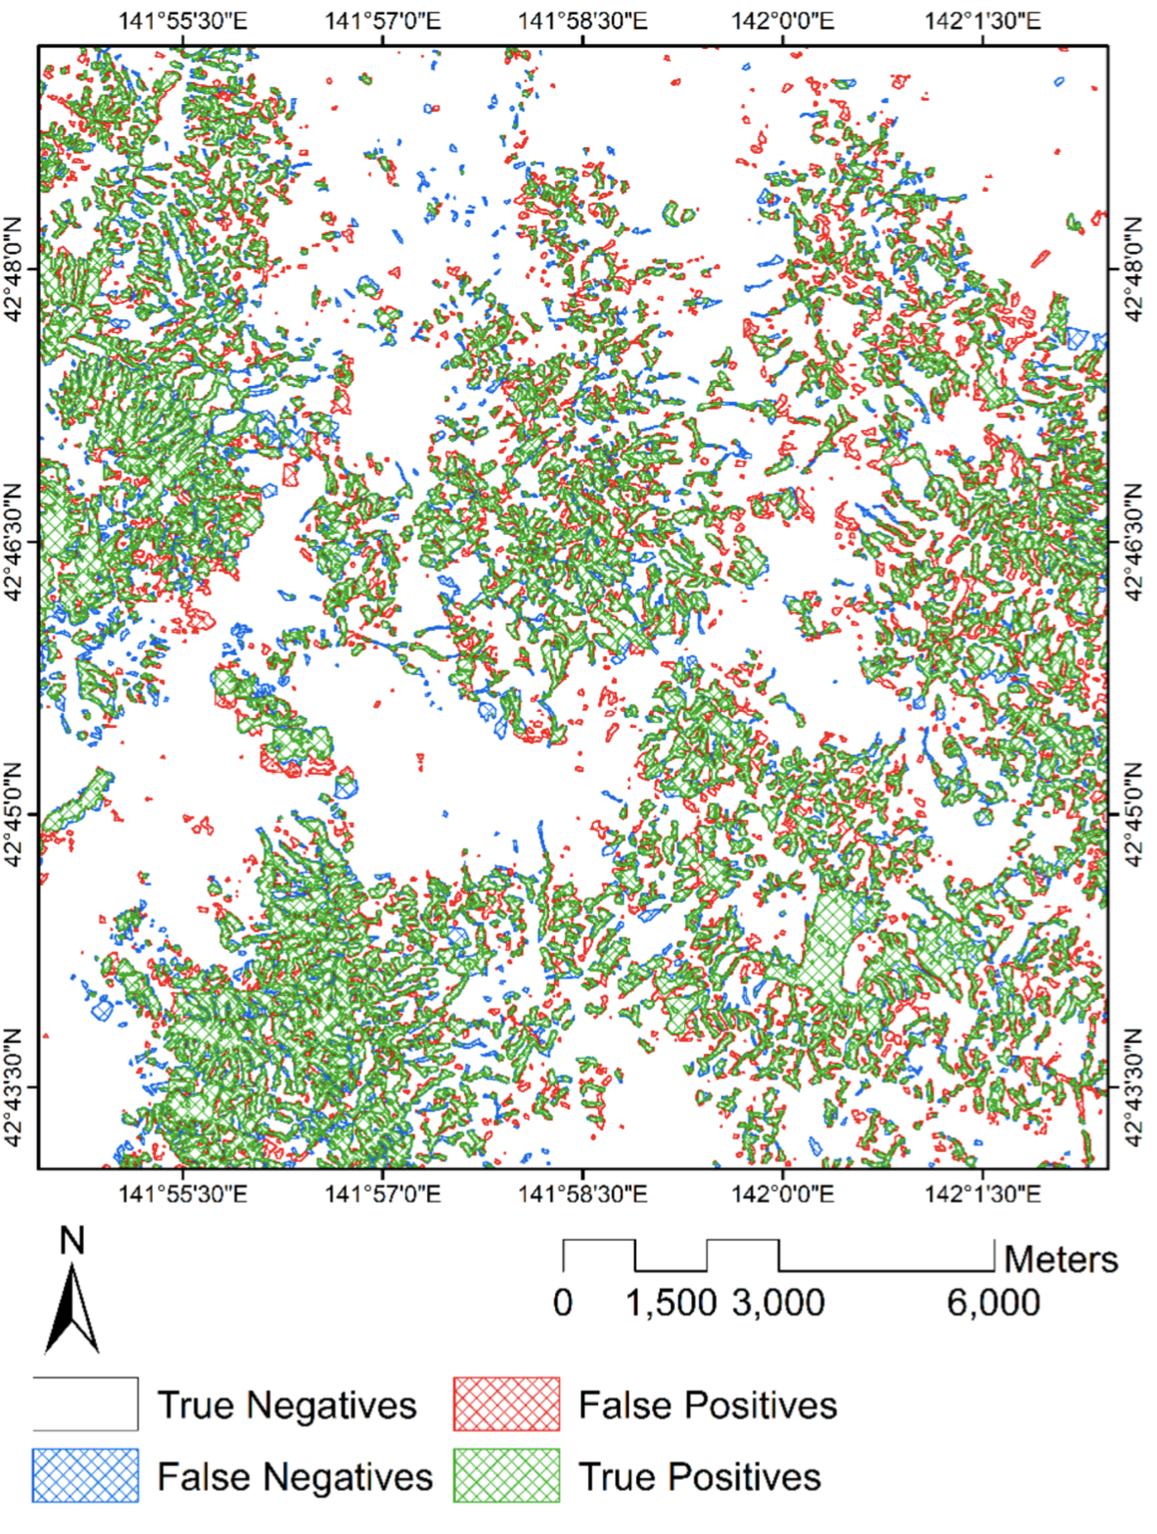
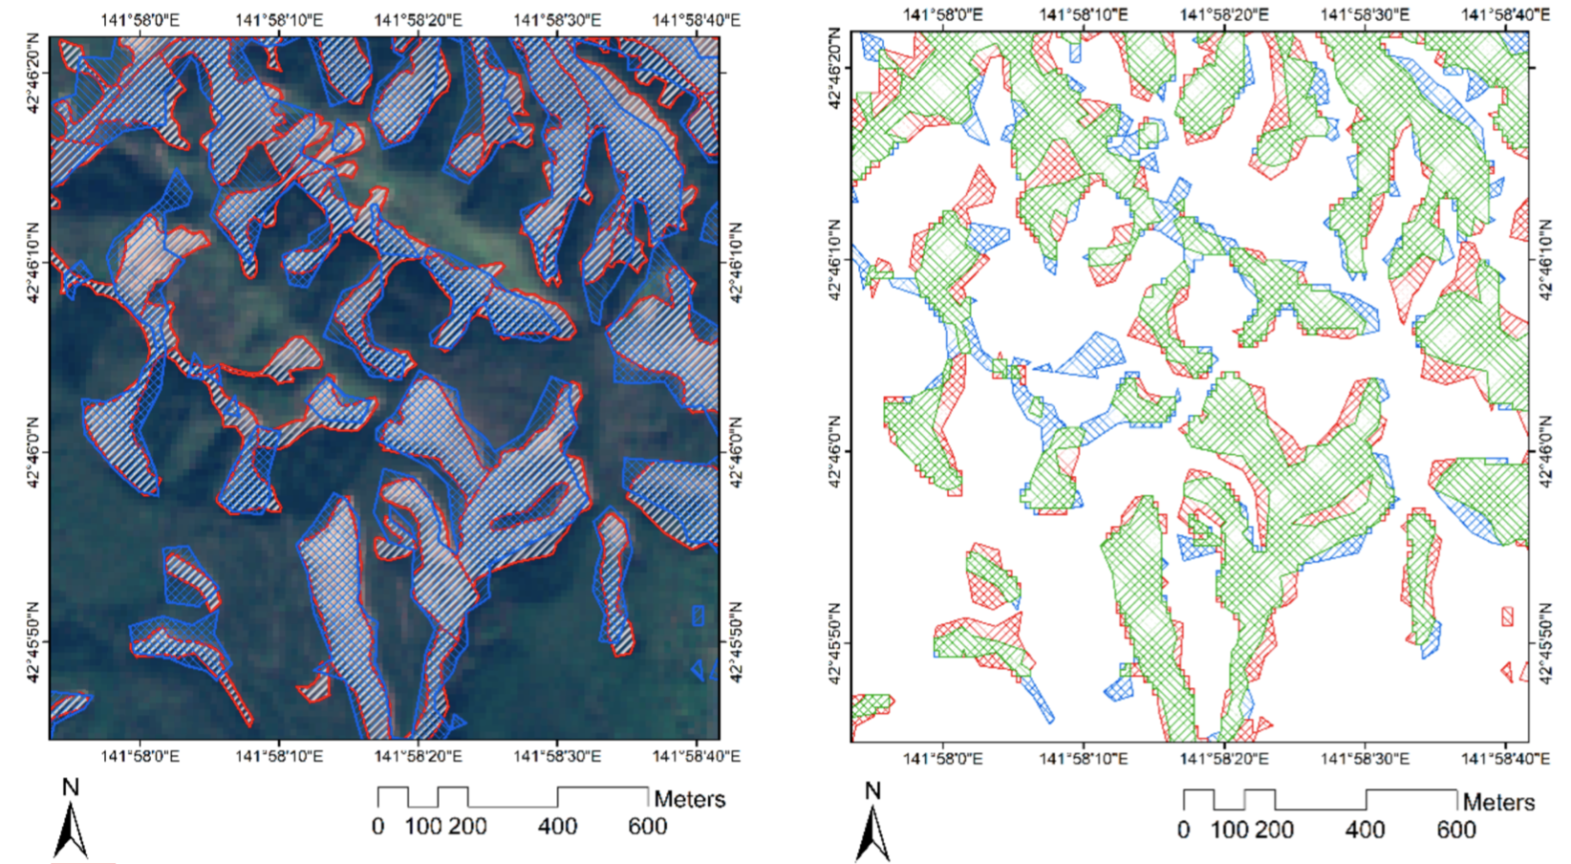
EGU General Assembly 2022
Image segmentation:
Nava et al., 2022

Slide 11
EGU General Assembly 2022
Conclusions:
It is possible to detect and map landslides also in presence of cloud cover (DL and SAR data).
Limitations due to geometric distortions.
Relevant benefits in terms of emergency management and civil protection operations, such as significantly decreasing the time delay in the emergency response in various scenarios.

Slide 12
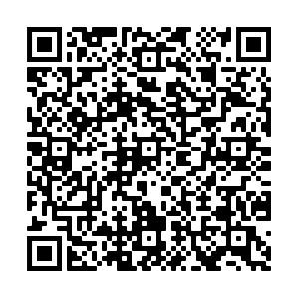

EGU General Assembly 2022
References:
Nava, L., Monserrat, O., & Catani, F. (2021). Improving landslide detection on SAR data through deep learning. IEEE Geoscience and Remote Sensing Letters, 19, 1-5.
Nava, L., Bhuyan, K., Meena, S. R., Monserrat, O., & Catani, F. (2022). Rapid Mapping of Landslides on SAR Data by Attention U-Net. Remote Sensing, 14(6), 1449.

Slide 13
THANK YOU
FOR YOUR ATTENTION
lorenzo.nava@phd.unipd.it

