Slide 1




27 May 2022
Rapid, reproducible, and wrong? Exploring sequential data assimilation as a coping mechanism for model structural error in groundwater decision support modeling
Katherine H. Markovich¹, Jeremy T. White², and Matthew J. Knowling³
¹INTERA Incorporated, Albuquerque, NM, USA
²INTERA Incorporated, Boulder, CO, USA
³School of Civil, Environmental and Mining Engineering,
Faculty of Engineering, Computer and Mathematical Sciences,
The University of Adelaide, Australia

Slide 2
Motivation
Model structural error arises from the fact that models are never perfect simulators of the real-world system.

Slide 3
Motivation
This error can lead to parameter compensation during data assimilation, where missing signal components in observations are incorporated into the adjustment of the wrong parameters.
The ultimate consequence of this is compromised, or ”wrong” predictions given by the decision support model.

Slide 4
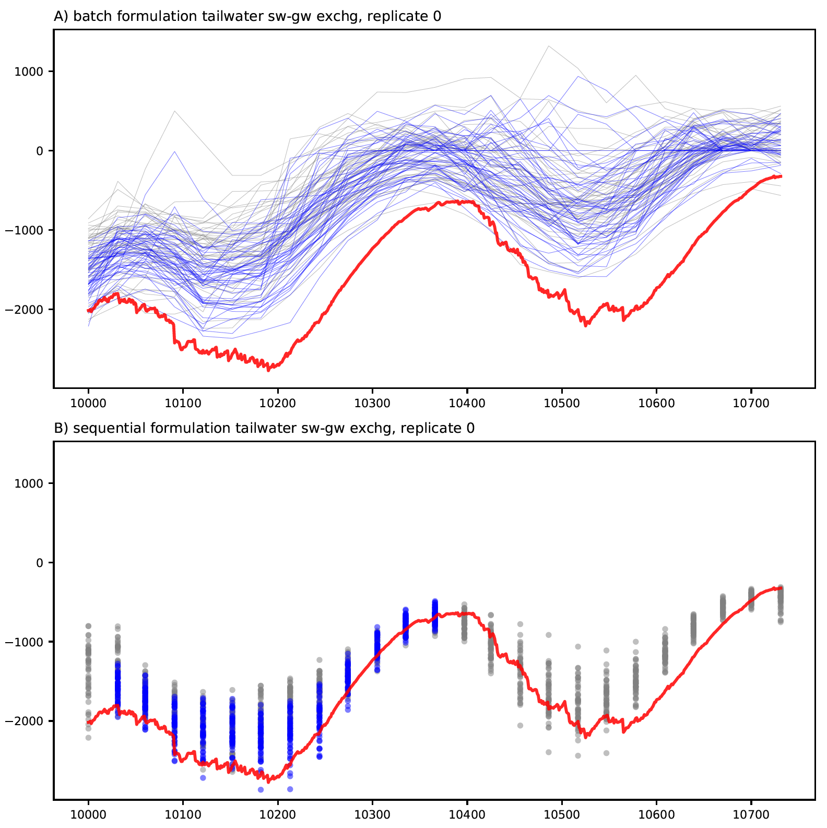
Data Assimilation Approaches
Batch data assimilation:
run model to completion and assimilate all observations post hoc to estimate parameters
Sequential data assimilation: break up model into assimilation cycles and estimate model state along with parameters

Slide 5
Data Assimilation Approaches
Batch data assimilation:
run model to completion and assimilate all observations post hoc to estimate parameters
Sequential data assimilation: break up model into assimilation cycles and estimate model state along with parameters

Slide 6
Research Questions
How does batch and sequential data assimilation compare when model error is limited to resolution error?

Slide 7
Research Questions
How does batch and sequential data assimilation compare when model error is limited to resolution error?
How does batch and sequential data assimilation compare when model error includes process error?

Slide 8
Research Questions
How does batch and sequential data assimilation compare when model error is limited to resolution error?
How does batch and sequential data assimilation compare when model error includes process error?
What is the relative performance during the assimilation period, near-term forecast period, and long-term forecast period?

Slide 9
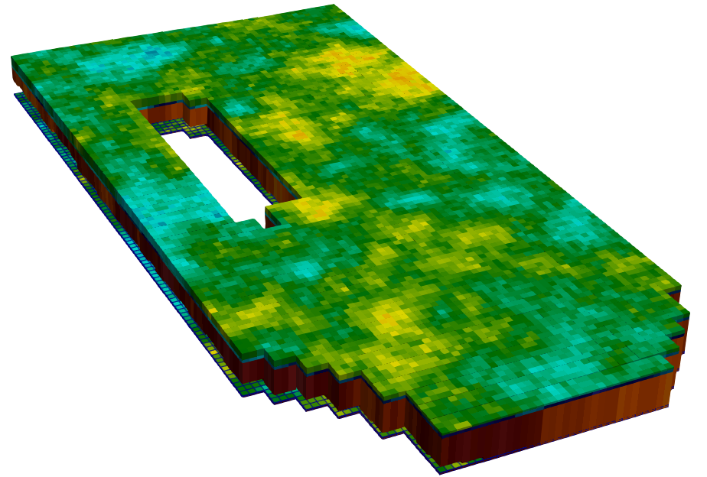
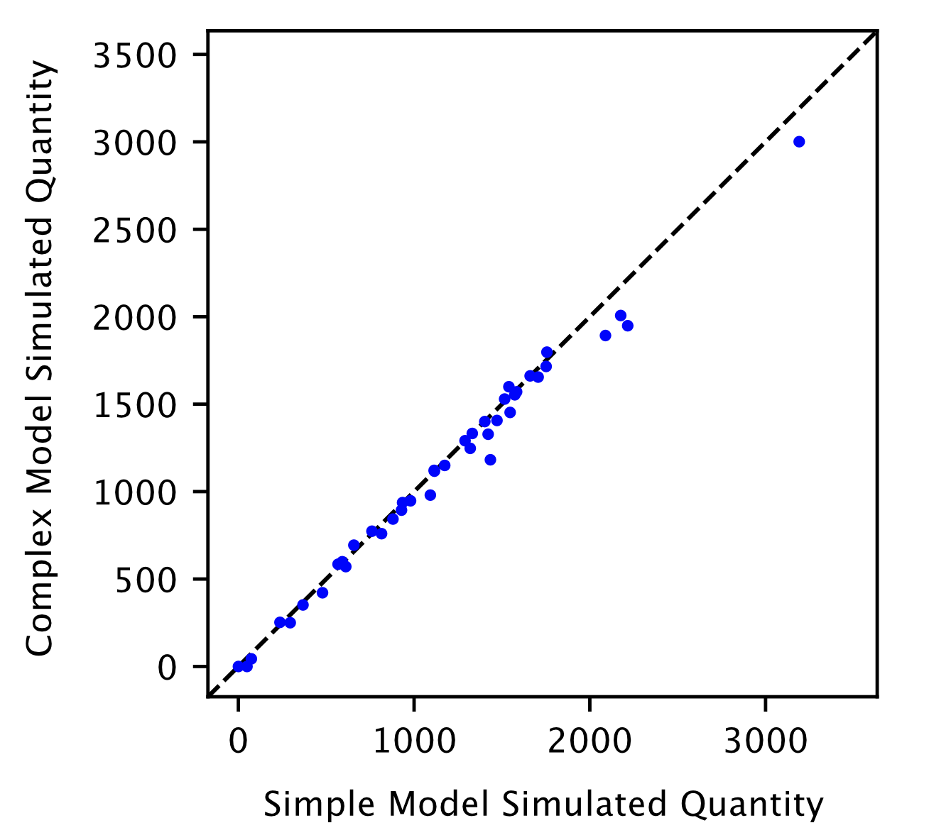
Paired Complex-Simple Analysis
Structurally complex truth models

Slide 10
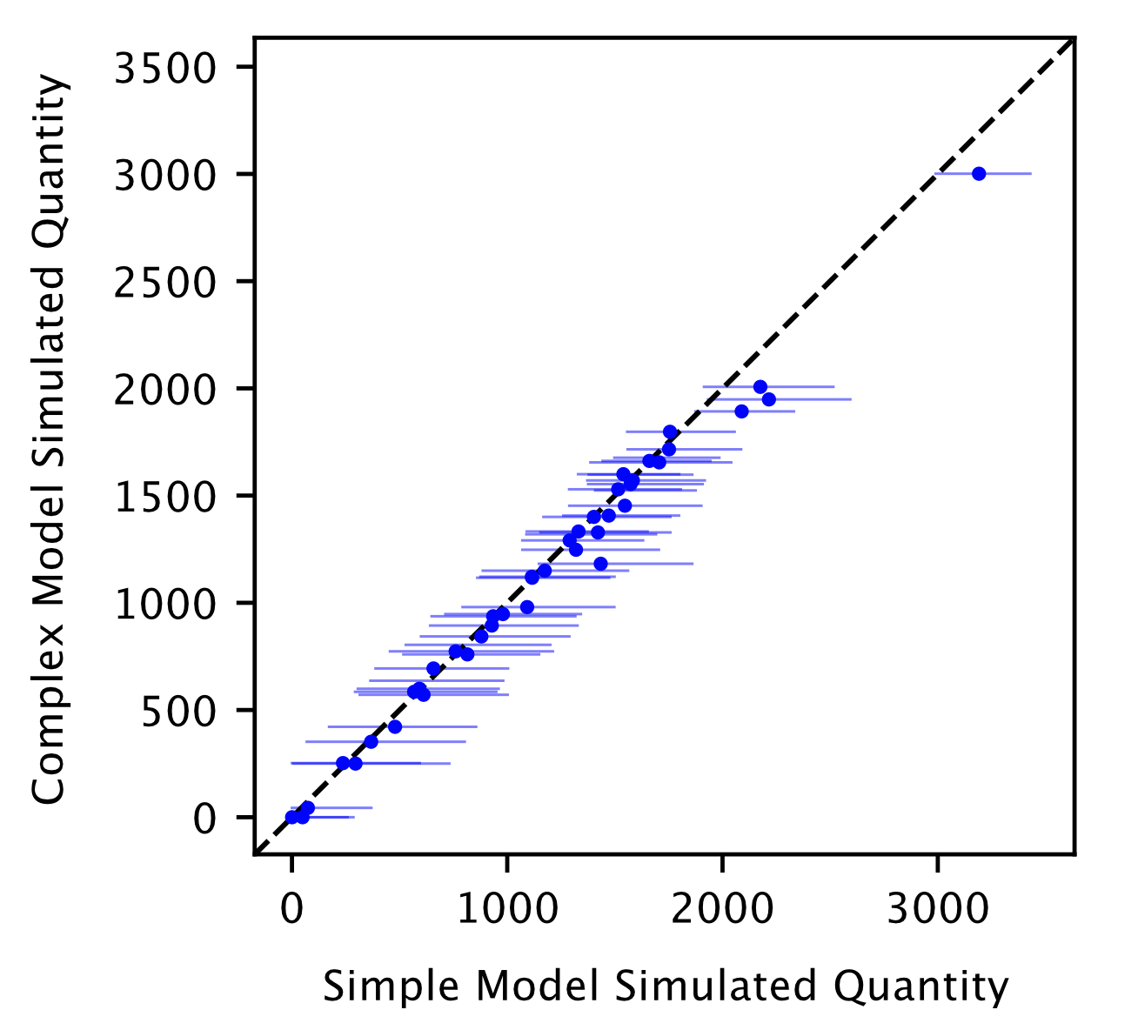
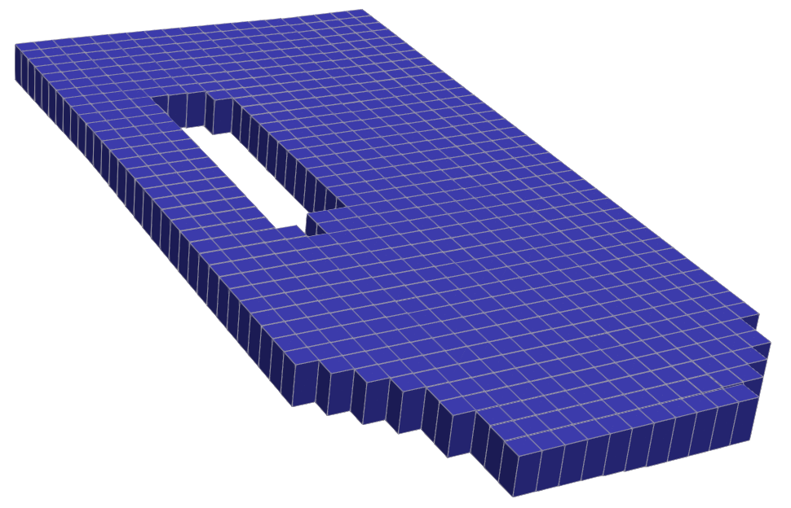
Paired Complex-Simple Analysis
Structurally complex truth models
Structurally simple decision support models

Slide 11
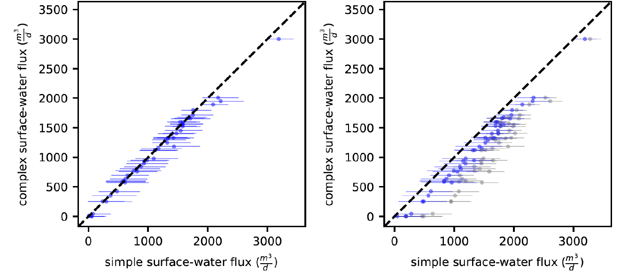
Coarse Scenario: Model error arises only from coarser resolution in simple model
Batch
Sequential
Assimilation Period

Slide 12
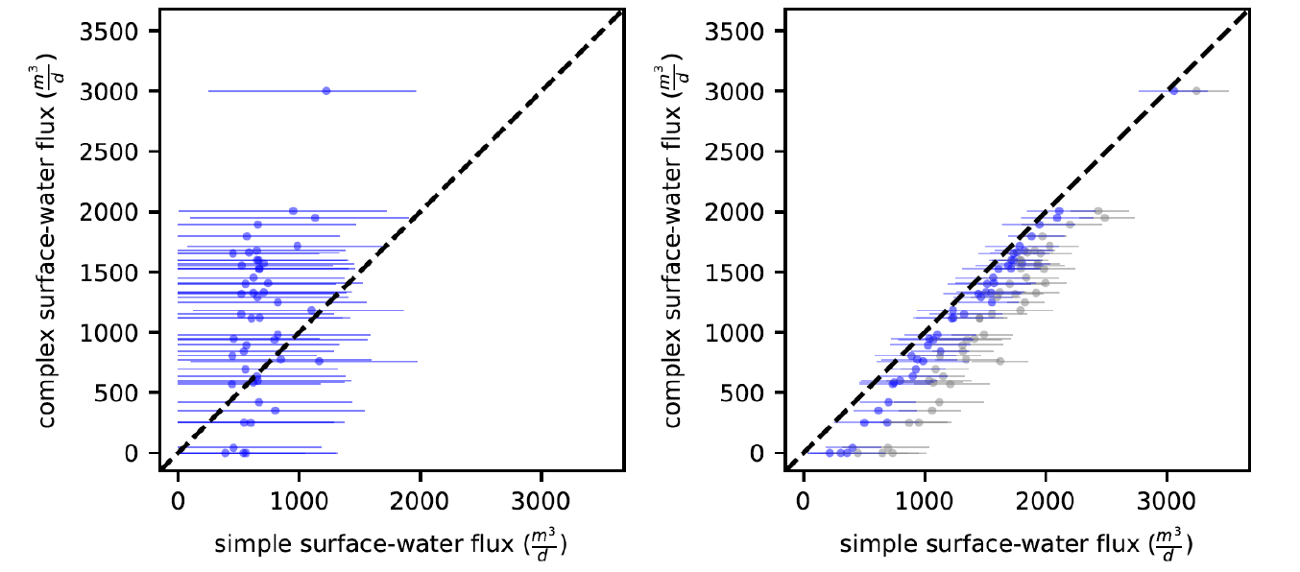
Fixed Pumping Scenario: Model error arises from coarser resolution and ‘known’ (i.e., not uncertain) pumping rates in simple model
Batch
Sequential
Assimilation Period

Slide 13
Conclusions
Both approaches perform well when:
Model error is limited to resolution mismatch
All parameters are considered uncertain (and thus adjustable)
The forecast of interest is near-term

Slide 14
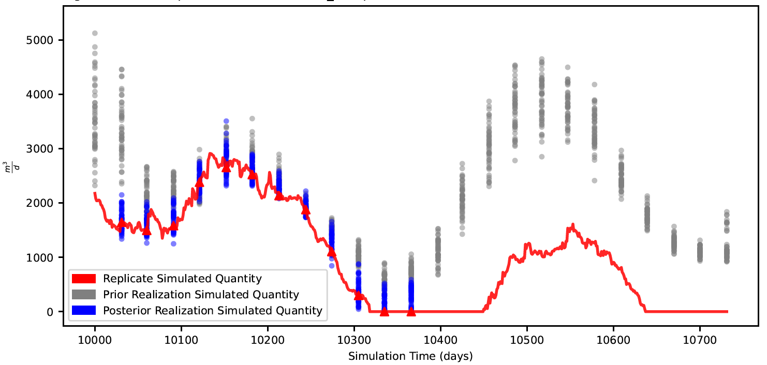
Conclusions
Sequential data assimilation does show promise in coping with model process error during assimilation.

Slide 15
Conclusions
The cycle approach of sequential data assimilation limits its ability to ‘see’ long-term trends in the data, leading to poor performance in long-term prediction.

Slide 16
Thanks for listening, and please look out for our preprint (HESS-2022-170) which will be available soon in HESS Discussions:
“Sequential and batch data assimilation approaches to cope with groundwater model error: An empirical evaluation”

